Slide 1
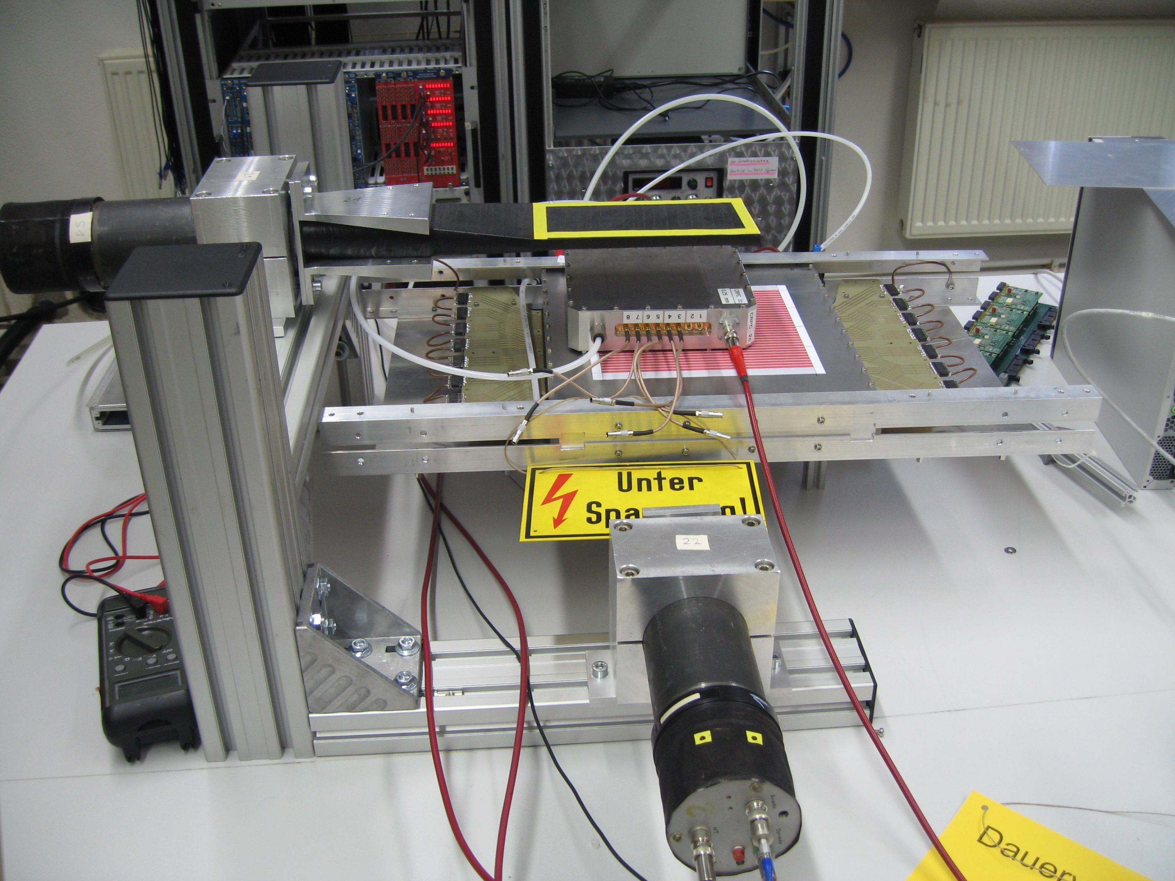
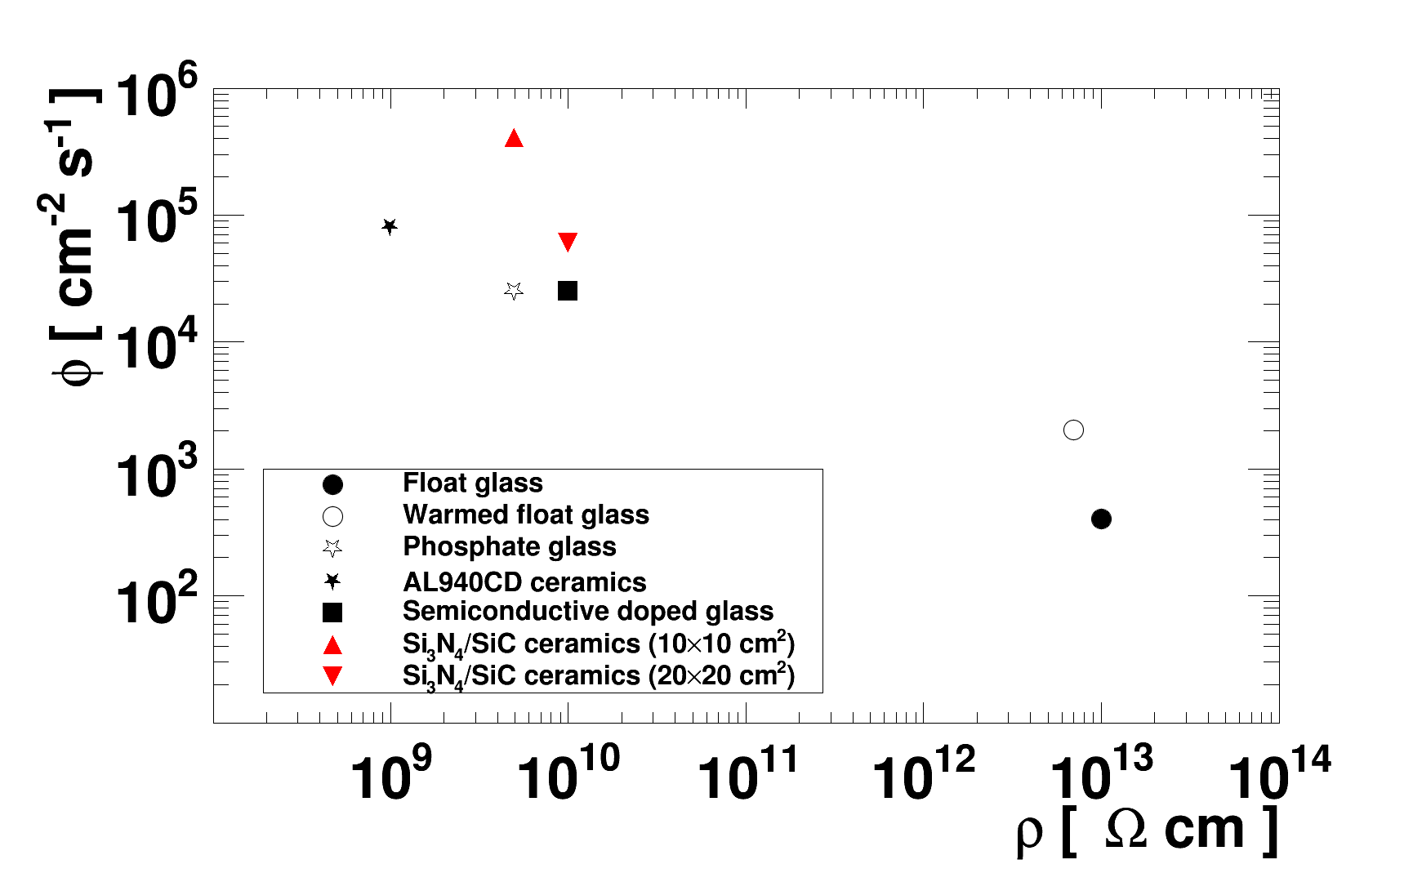
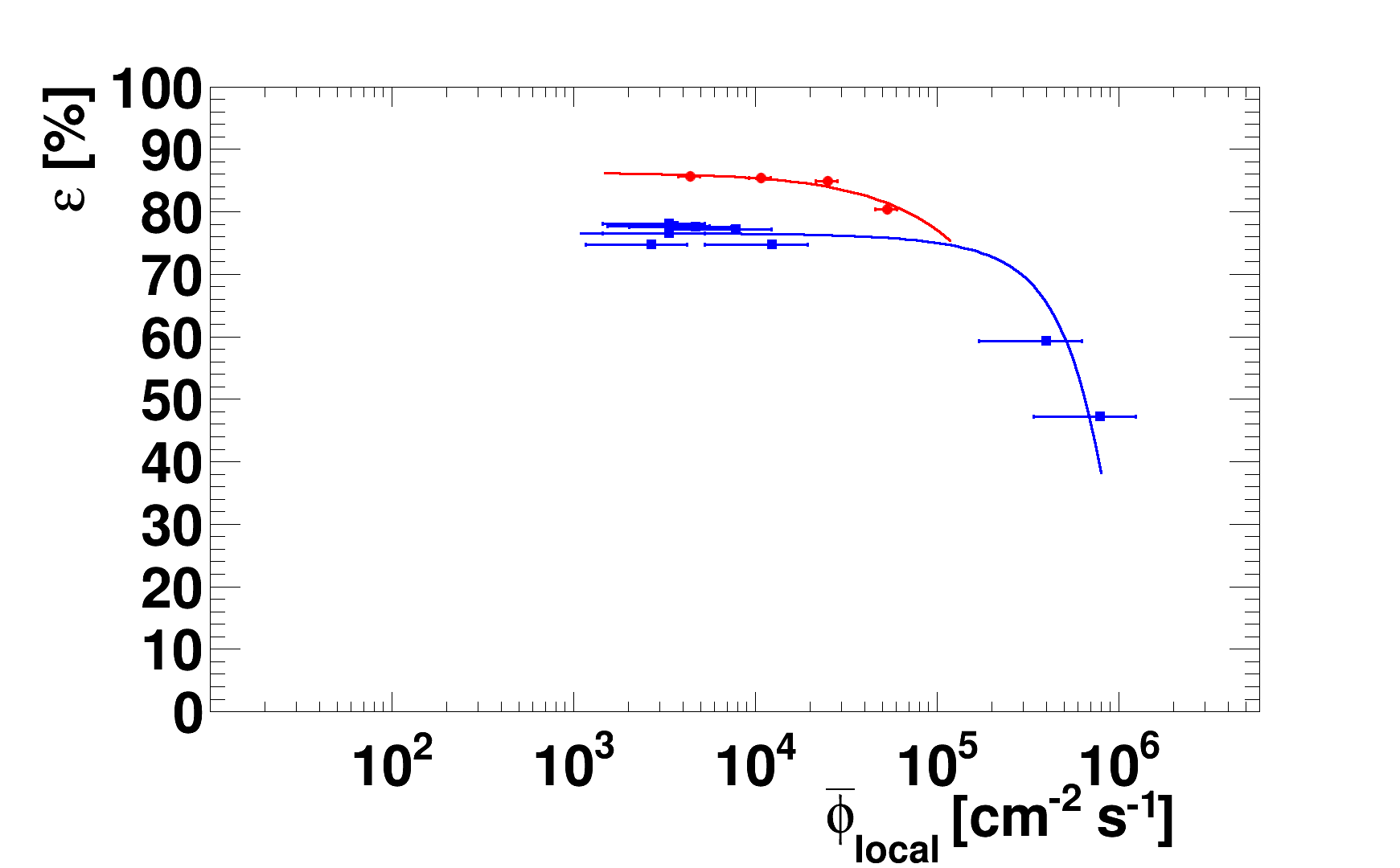
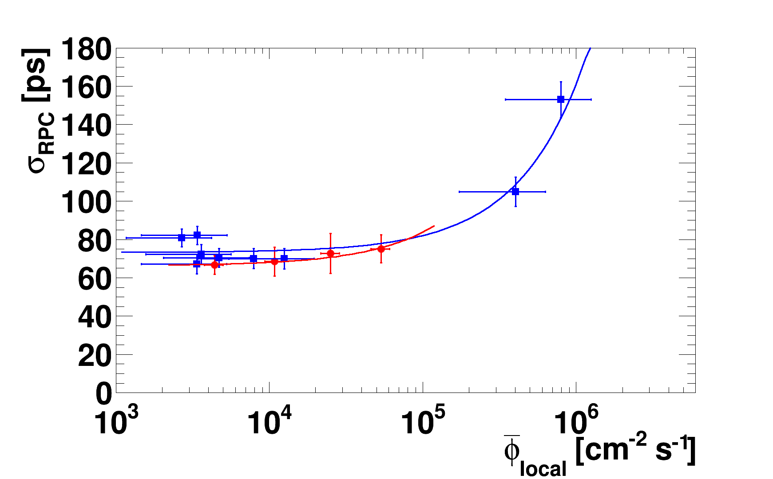
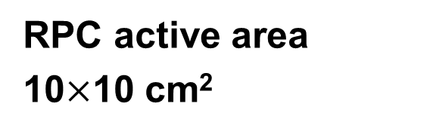
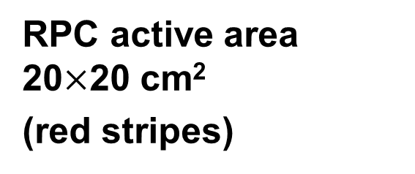
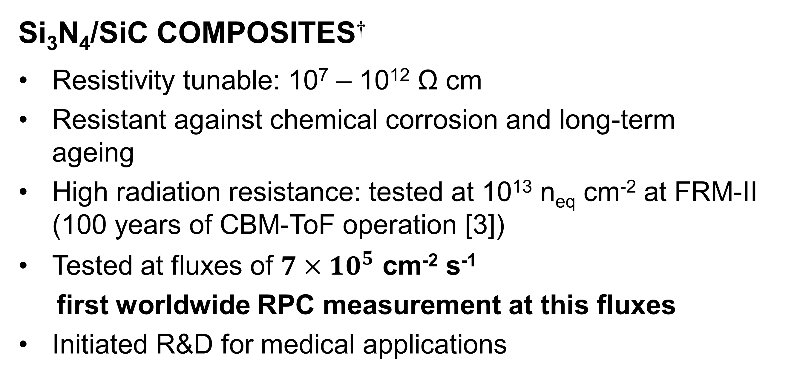
TIMING RESISTIVE PLATE CHAMBERS
WITH CERAMIC ELECTRODES
NEXT-GENERATION HIGH-RADIATION-TOLERANT
PARTICLE DETECTORS
A. LASO GARCIA
MOTIVATION
Time-of-Flight measurement in
high-energy physics experiments
Very high fluxes (Φ ~ 10⁵ cm⁻² s⁻¹)
High efficiency (ε > 90%) and
time resolution (σ < 100 ps)
STATE-OF-THE-ART
Soda-lime glass,
Semiconductive glass,
Si₃N₄/SiC ceramics [1,2],
Φ_{max} ~ 1000 cm⁻² s⁻¹
Φ_{max} ~ 30000 cm⁻² s⁻¹
Φ_{max} > 60000 cm⁻² s⁻¹
RPC active area 20$×$20 cm²
(red stripes)
RPC active area
10$×$10 cm²
Test facility for RPC calibration with cosmic radiation
Si₃N₄/SiC COMPOSITES†
Resistivity tunable: 10⁷ – 10¹² Ω cm
Resistant against chemical corrosion and long-term ageing
High radiation resistance: tested at 10¹³ n_{eq} cm⁻² at FRM-II (100 years of CBM-ToF operation [3])
Tested at fluxes of $7×{10}^{5}$ cm⁻² s⁻¹
first worldwide RPC measurement at this fluxes
Initiated R&D for medical applications
Performance of RPCs with Si₃N₄/SiC electrodes tested in electron beams (•) and proton beams (■)
MAXIMUM FLUX FOR SODA-LIME GLASS [4]
MAXIMUM FLUX FOR SEMICONDUCTOR DOPED GLASS [5]
Si₃N₄/SiC CERAMICS REGION
† Developed in collaboration with Fraunhofer-Institut für Keramische Technologien und Systeme IKTS, Dresden.
[1] L. Naumann et al., Nucl. Instr. Meth. A 635 (2011) S113.
[2] A. Laso Garcia et al., JINST 7 (2012) P10012.
[3] V. Friese, C. Sturm (Eds.) and the CBM Collaboration,
CBM Progress Report 2011. Darmstadt 2012. ISBN 978-3-9811298-9-2.
[4] I. Deppner et al., JINST 7 (2012) P10008.
[5] M. Petrovici et al., JINST 7 (2012) P11003.

