Slide 1
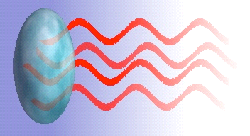
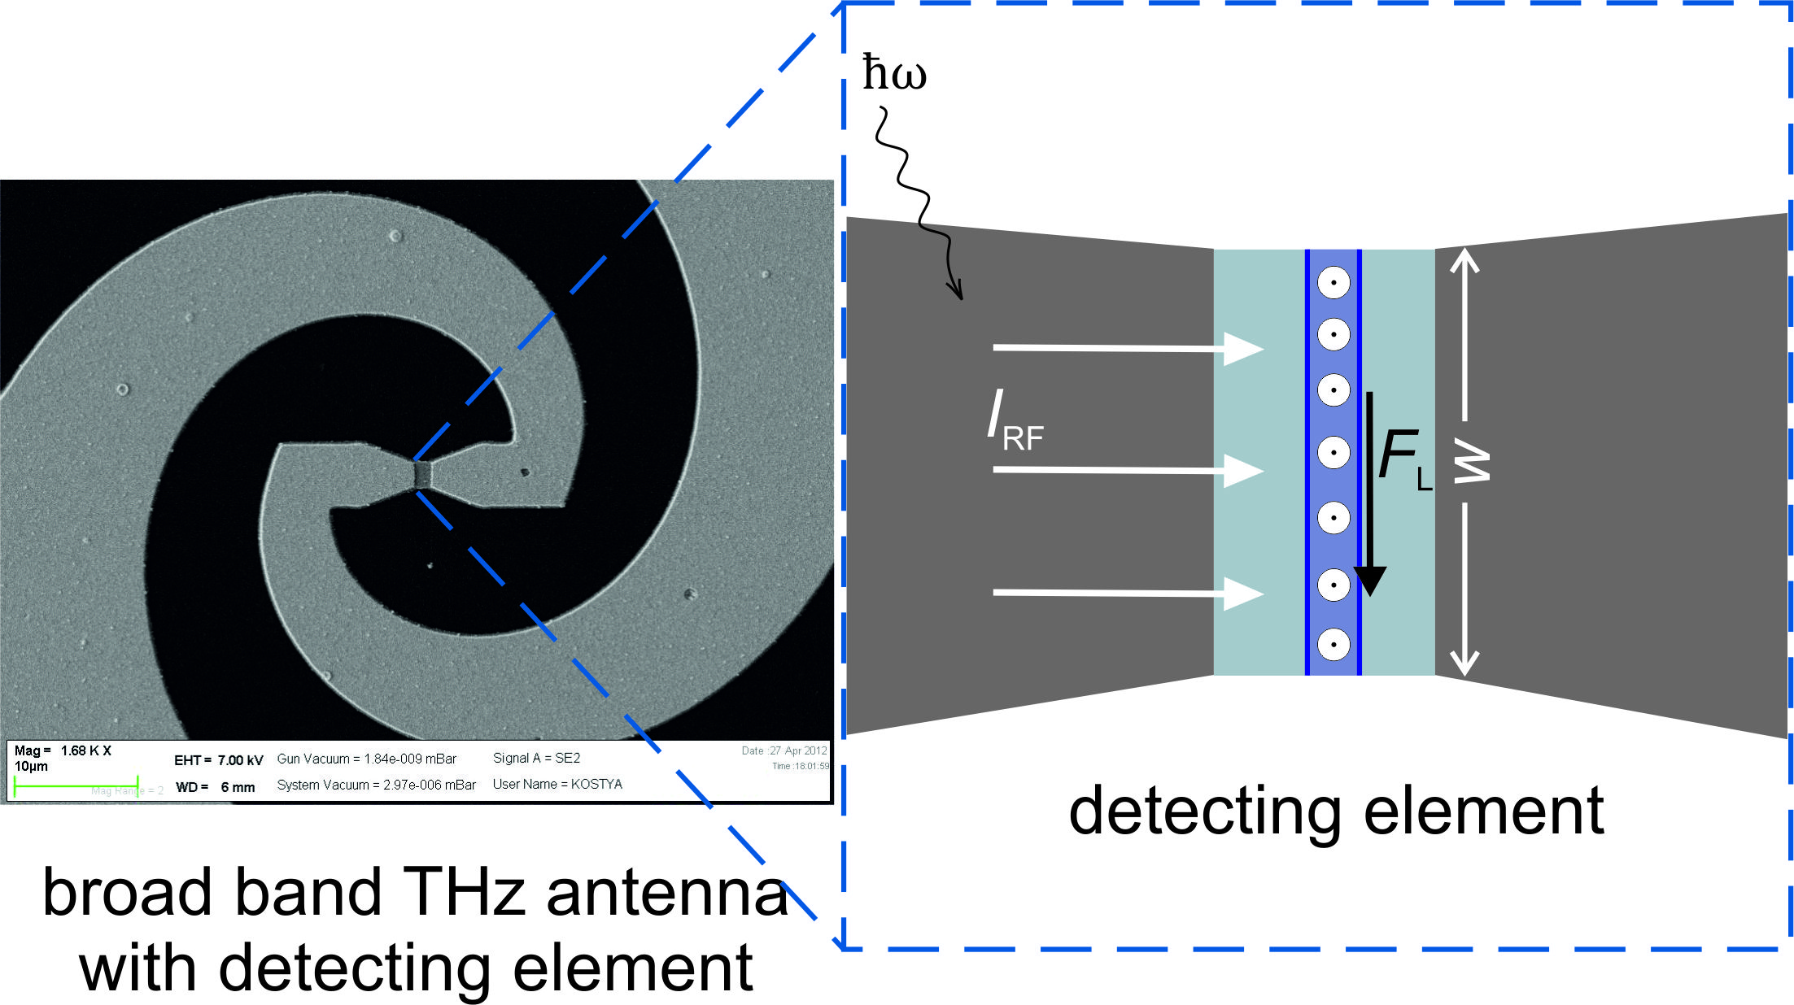
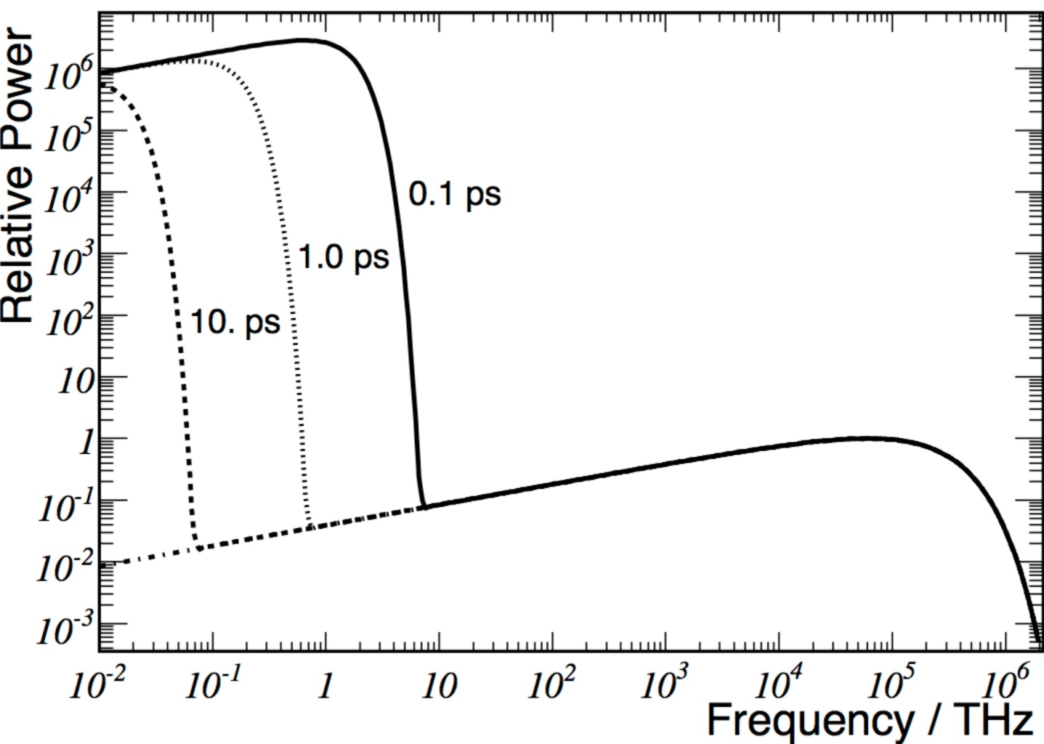

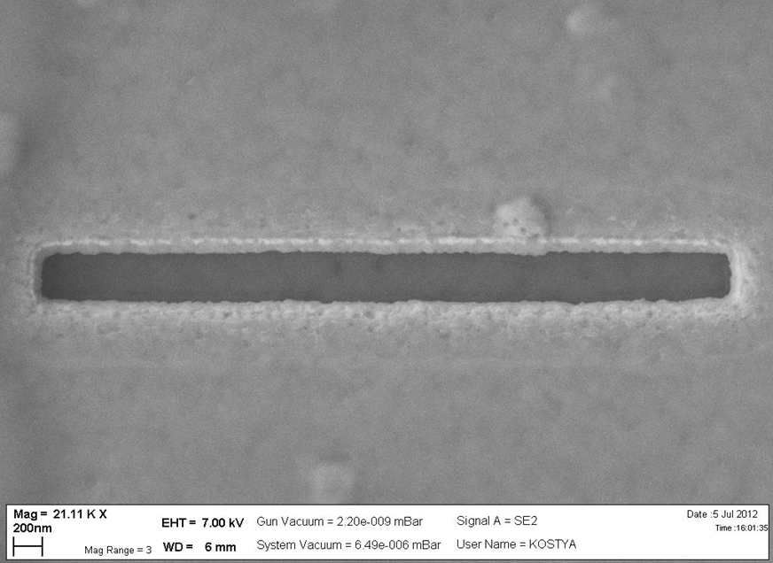
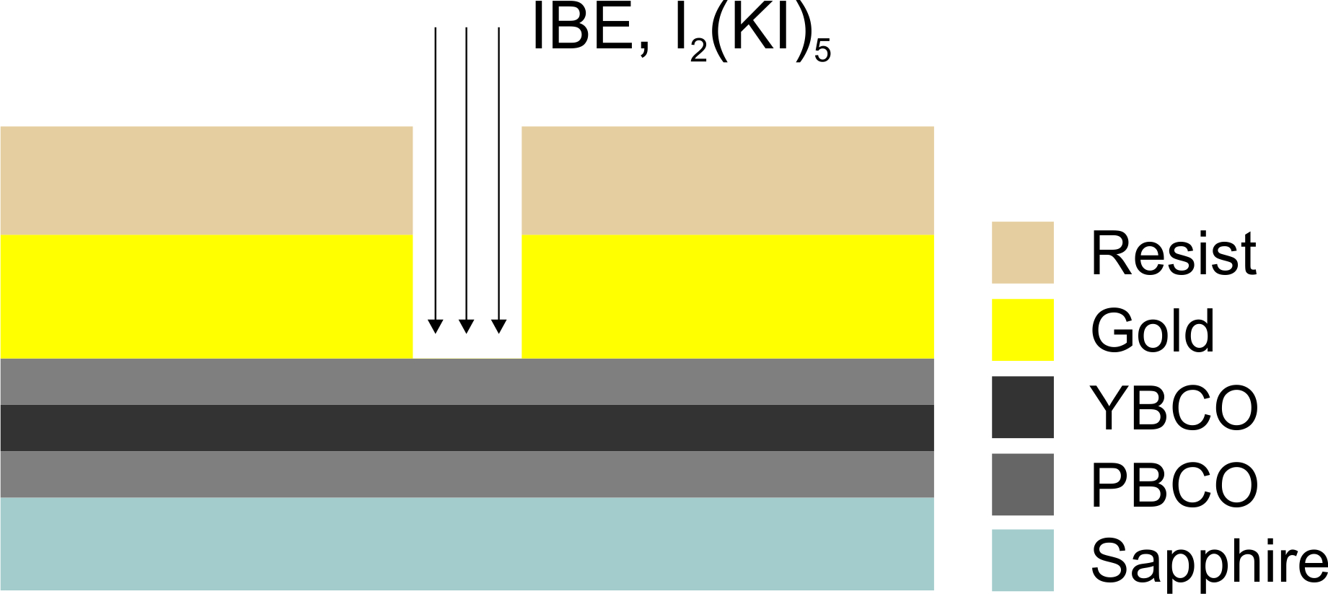
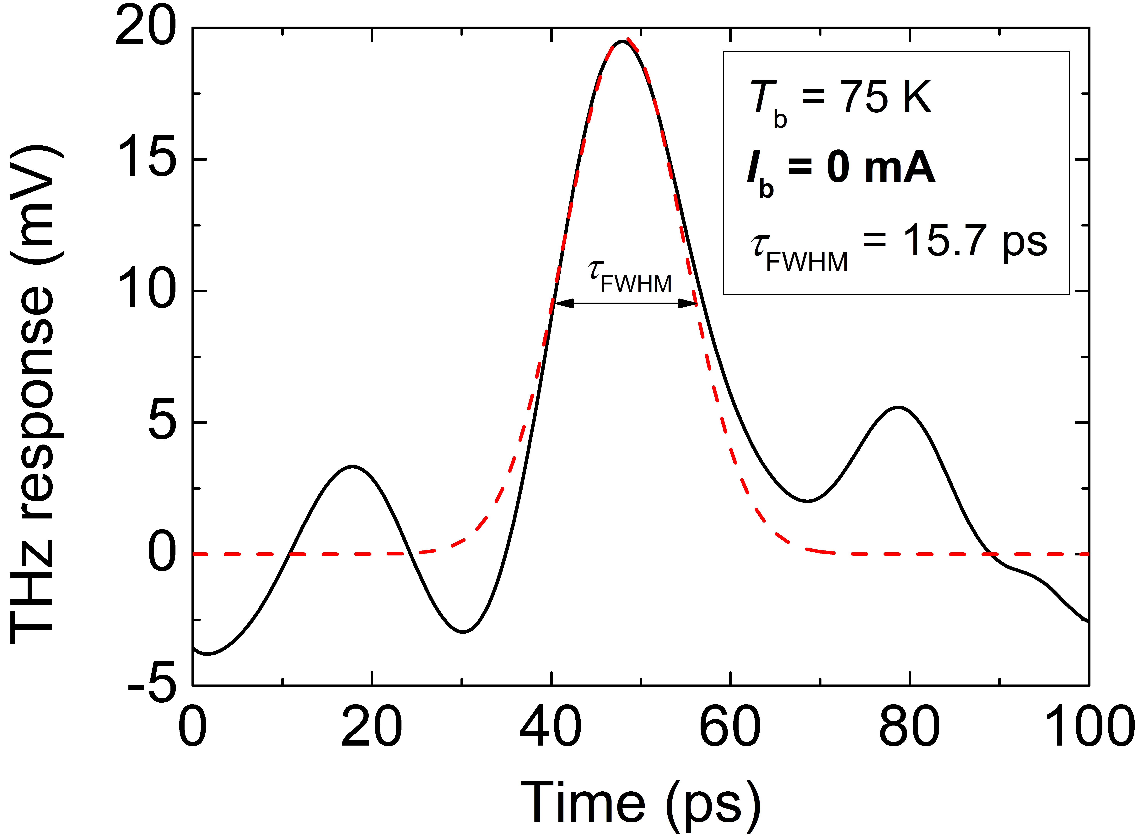

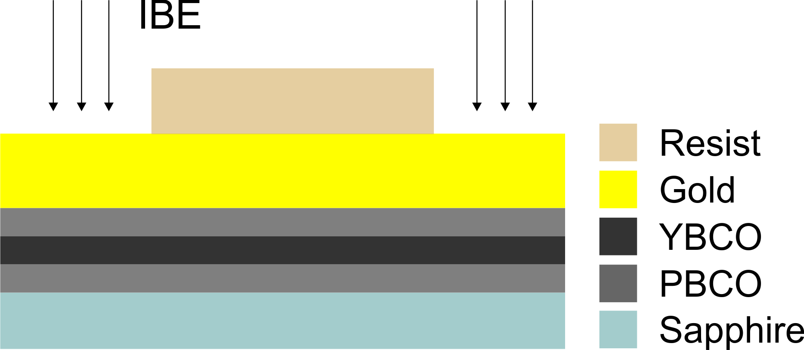
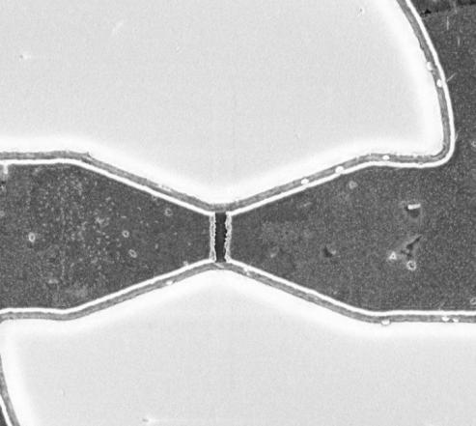
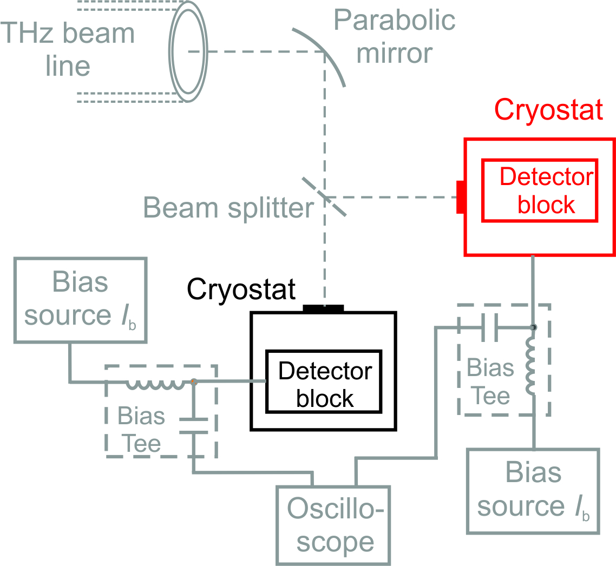
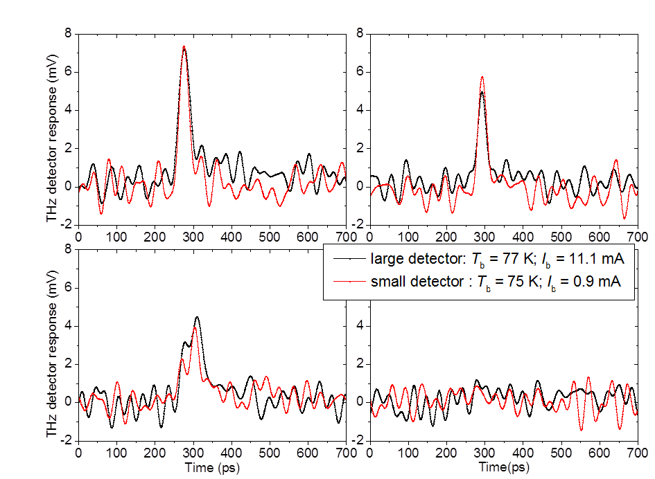
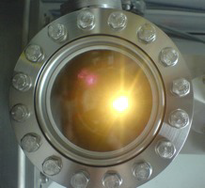
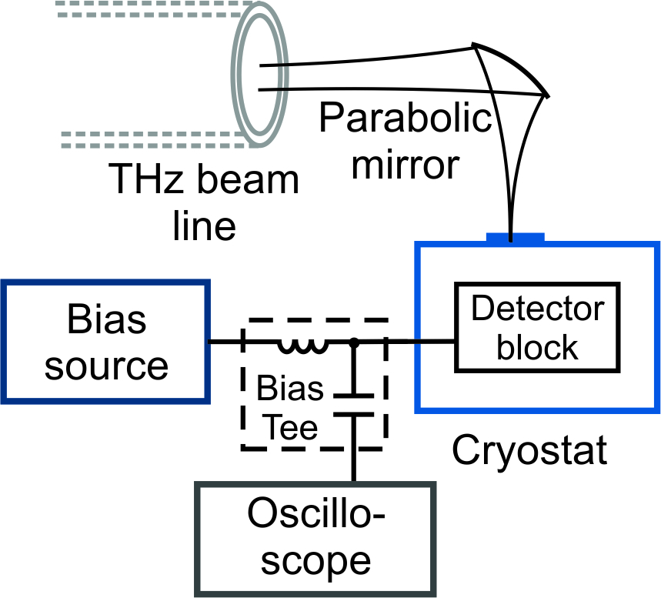
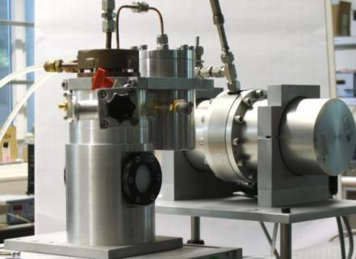
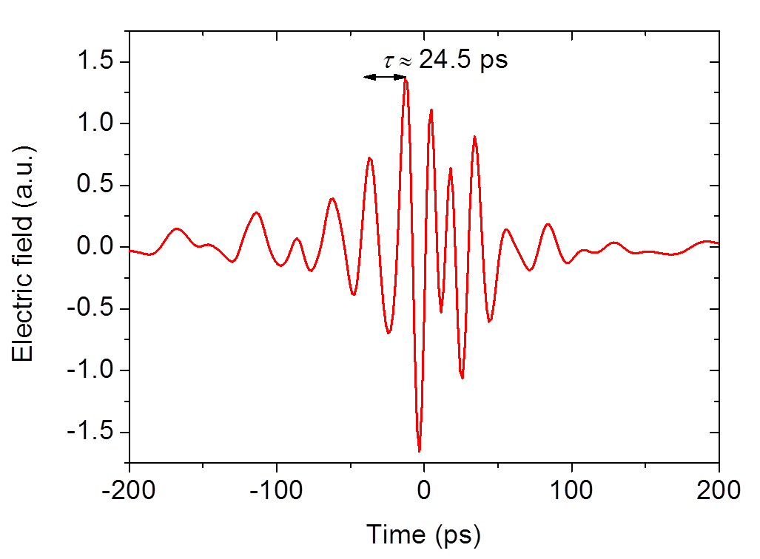
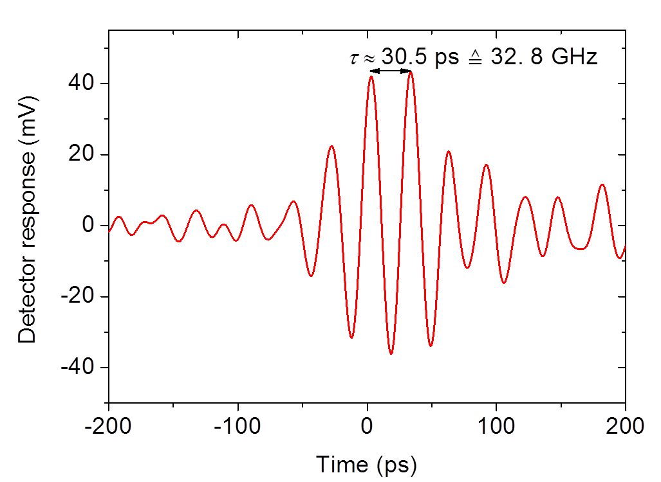
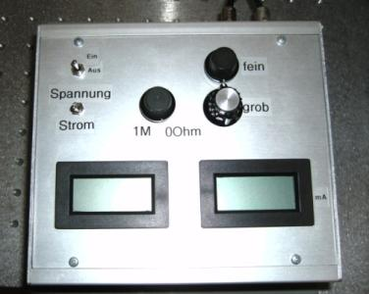
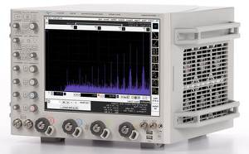

Ultra-fast YBCO THz detectors
DTS - Monitoring of the electrical field of Coherent Synchrotron Radiation
Juliane Raasch (KIT)
Fast and sensitive direct THz detectors for CSR
Principle of detector operation
Study of Coherent Synchrotron Radiation (CSR) requires ultra-fast THz direct detection system
Absorbed photon induces rf current
Generation of magnetic flux quanta (vortices)
High-temperature superconductor YBa₂Cu₃O_{7-x} (YBCO):
Intrinsic response time < 2ps
Broad dynamic range > 30 dB
Broad band THz antenna: 30 GHz – 2.5 THz
Lorentz force
→ Displacement of vortex lattice
Measurable voltage transient
Detector technology
→ Picosecond response time
→ Zero-bias current operation
→ Electrical field sensitivity
Pulsed Laser Deposition
Detector operation: Experimental results
Length of detecting element (EBL, IBE & wet etching)
Filling pattern in low-alpha operation at ANKA
Antenna & coplanar design (EBL & IBE)
Monitoring of the pulse shape of single CSR THz pulses
EBL – Electron Beam Lithography
IBE – Ion Beam Etching
Ultra-fast THz detection: Experimental setup
Zero bias operation: detection of the electrical field
$$τ≈15 ps$$
Simulation
E. Roussel, PhLAM,
Université de Lille
Experiment

