Slide 1
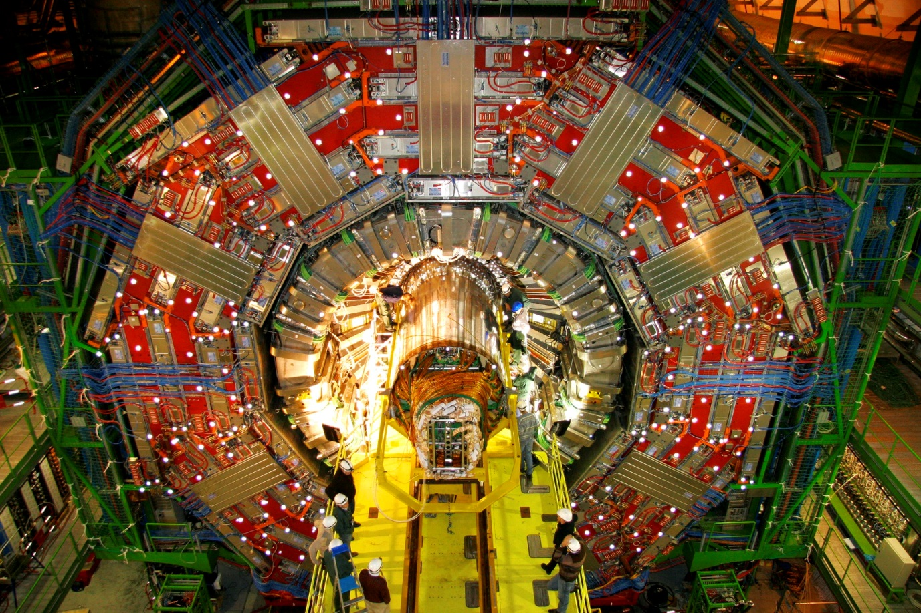
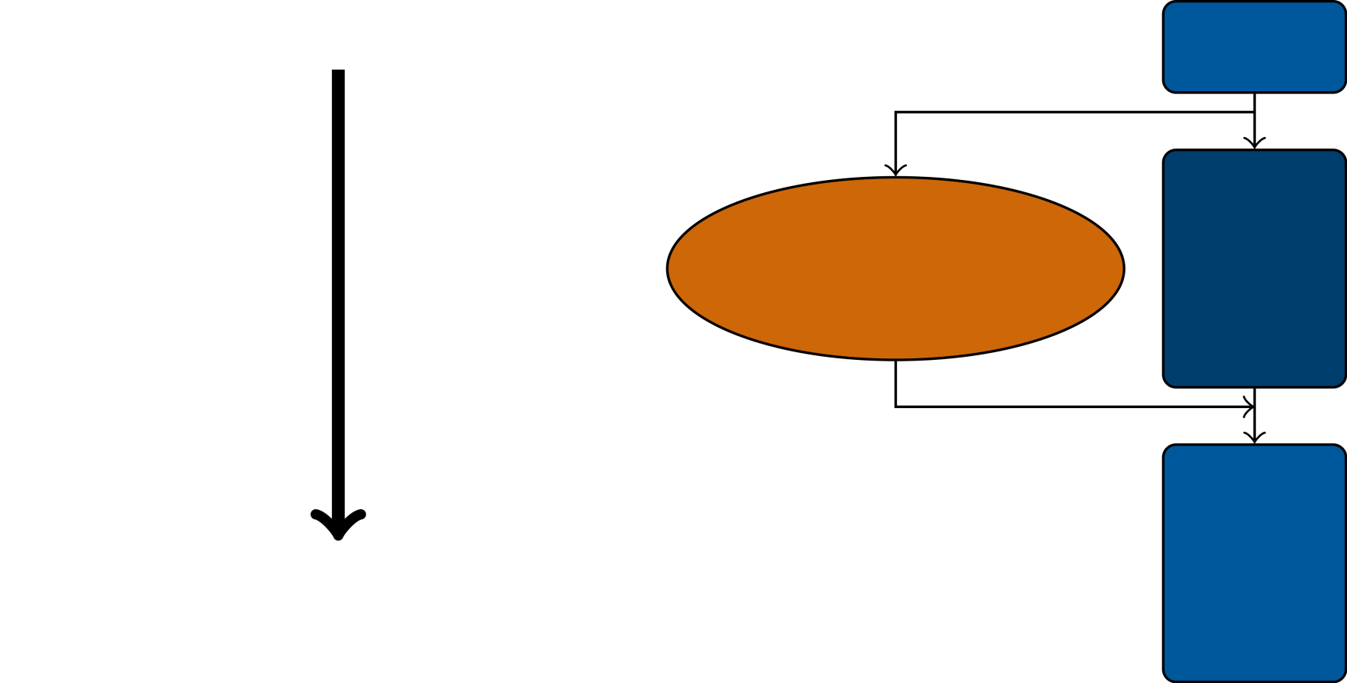
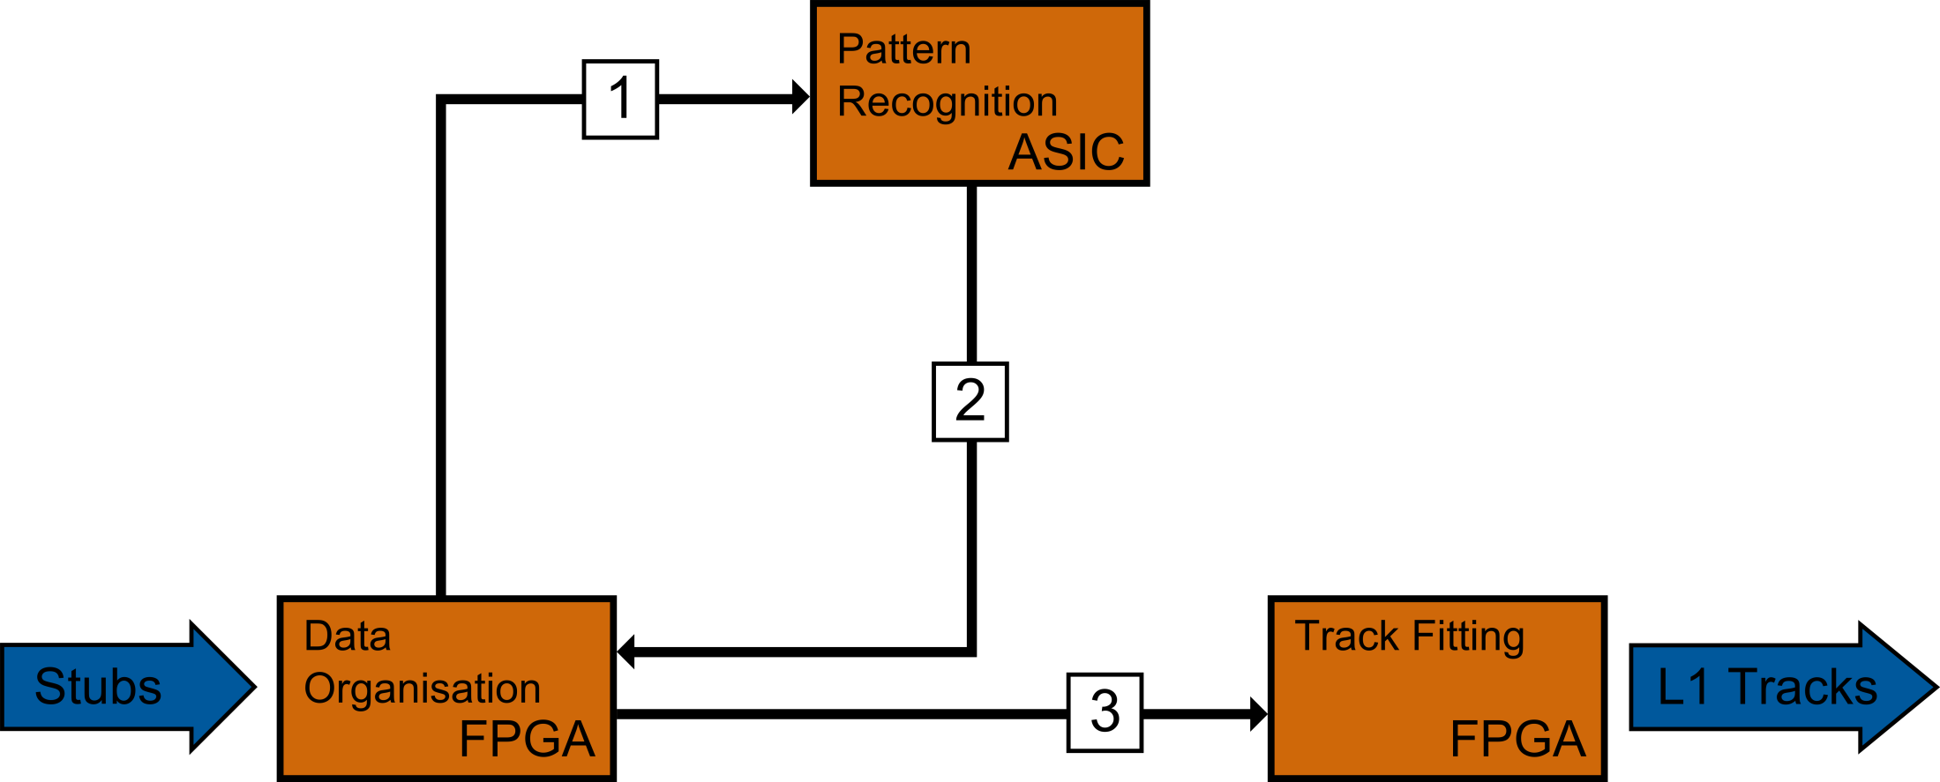
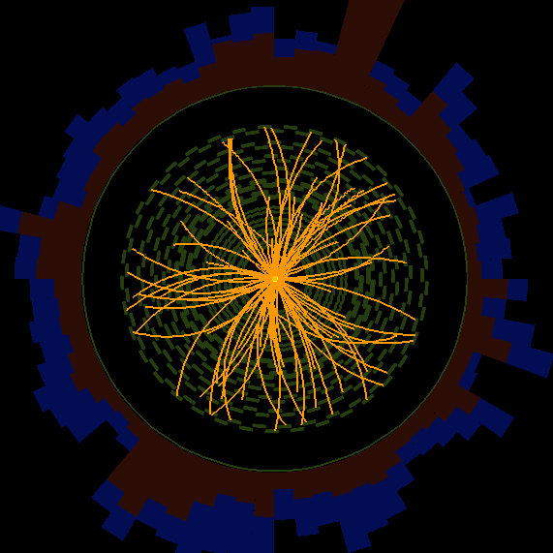
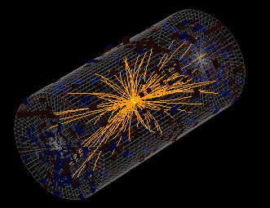
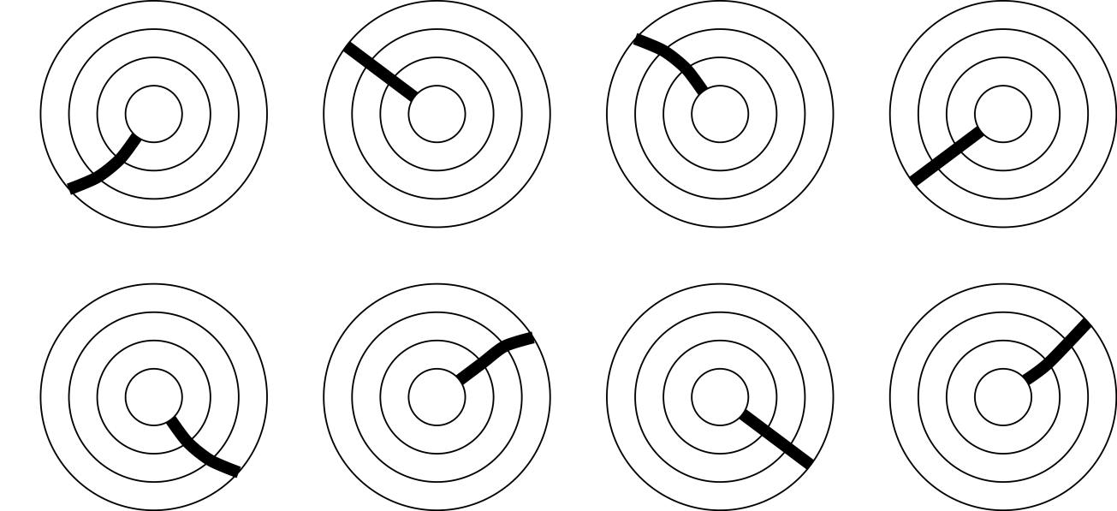
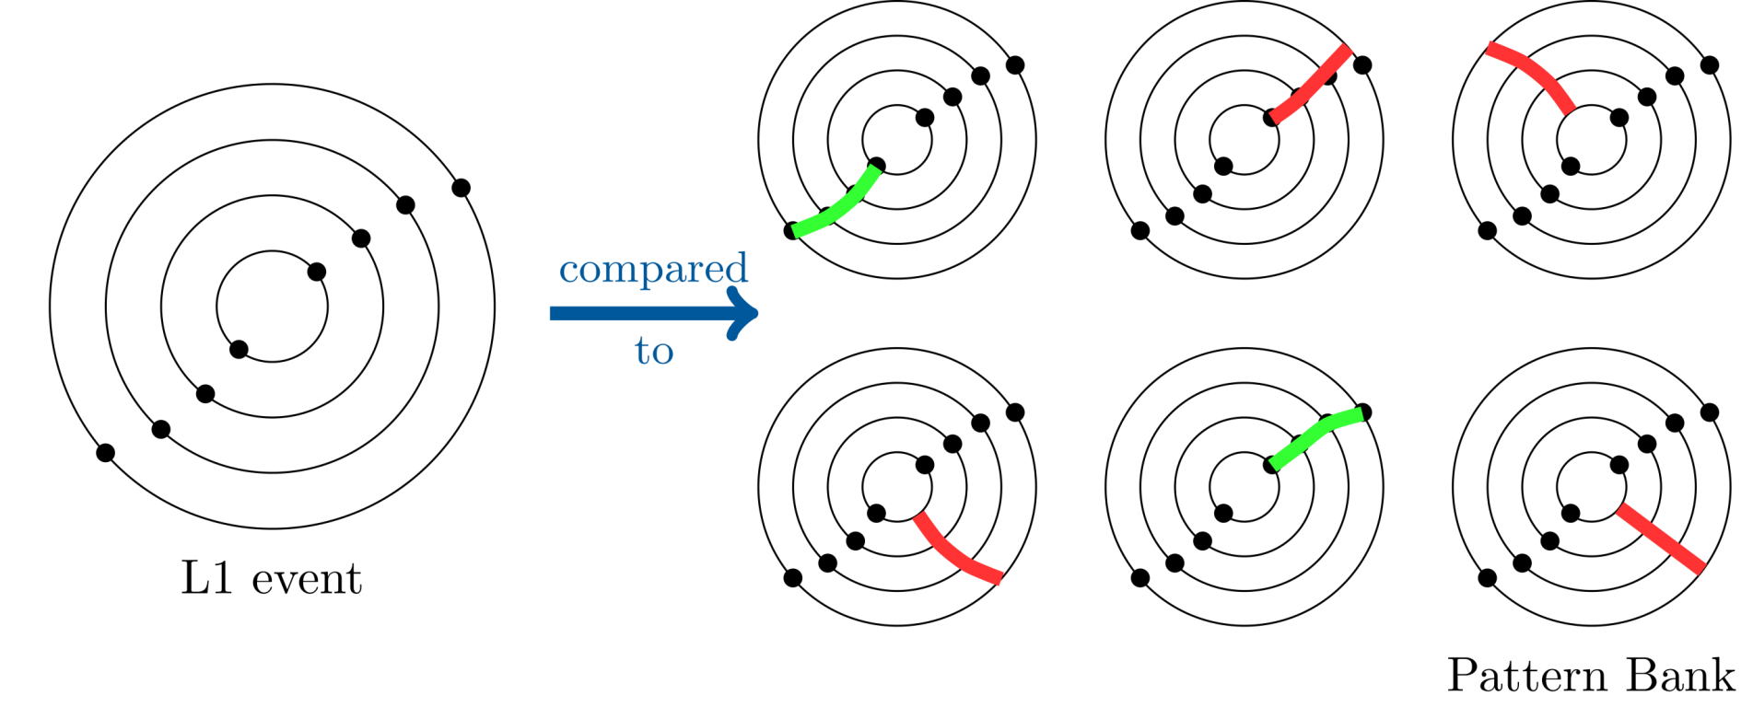
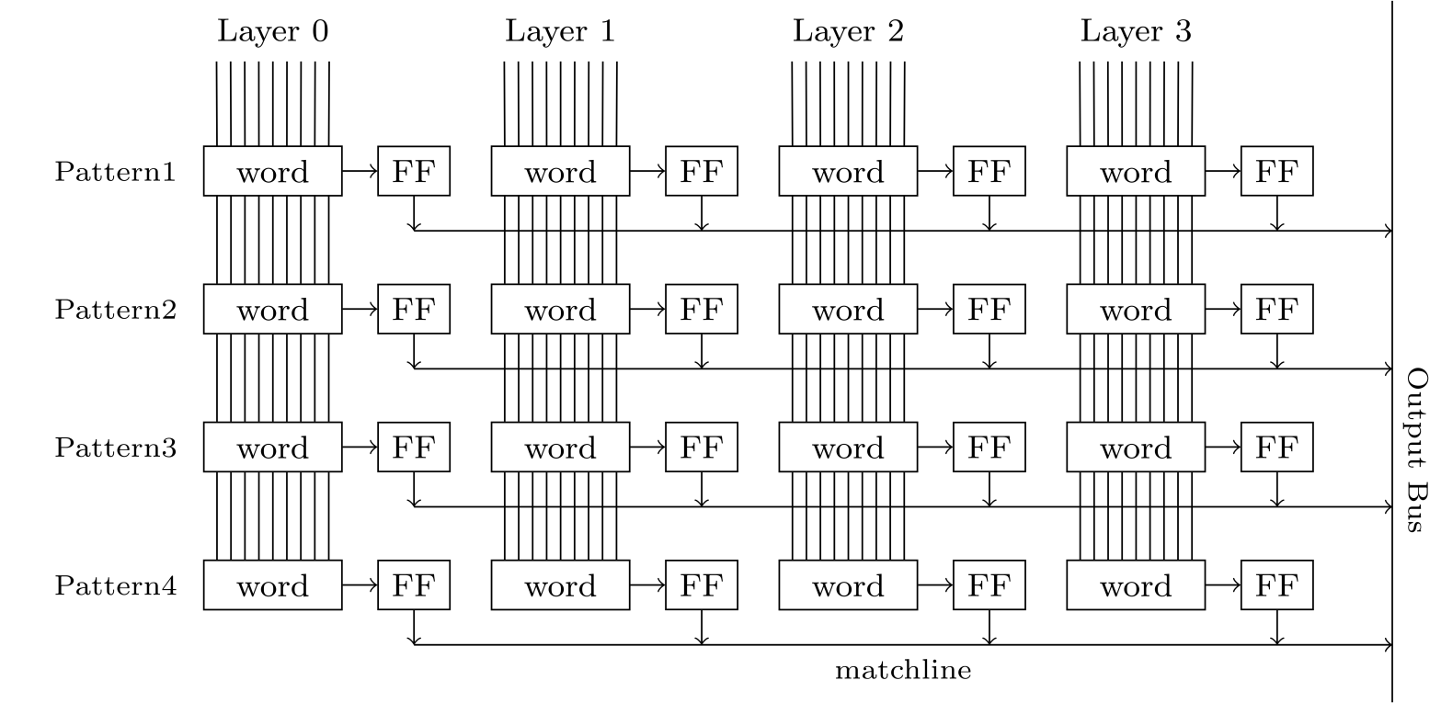
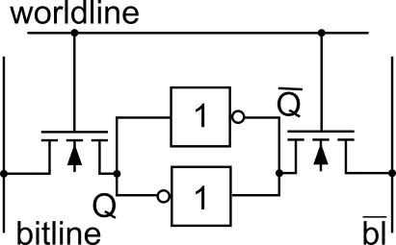
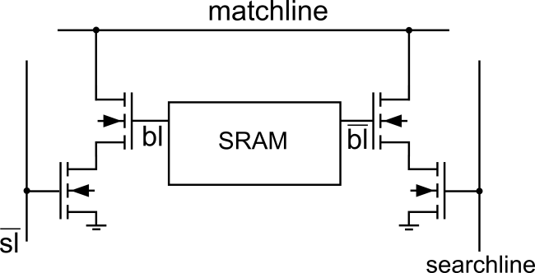
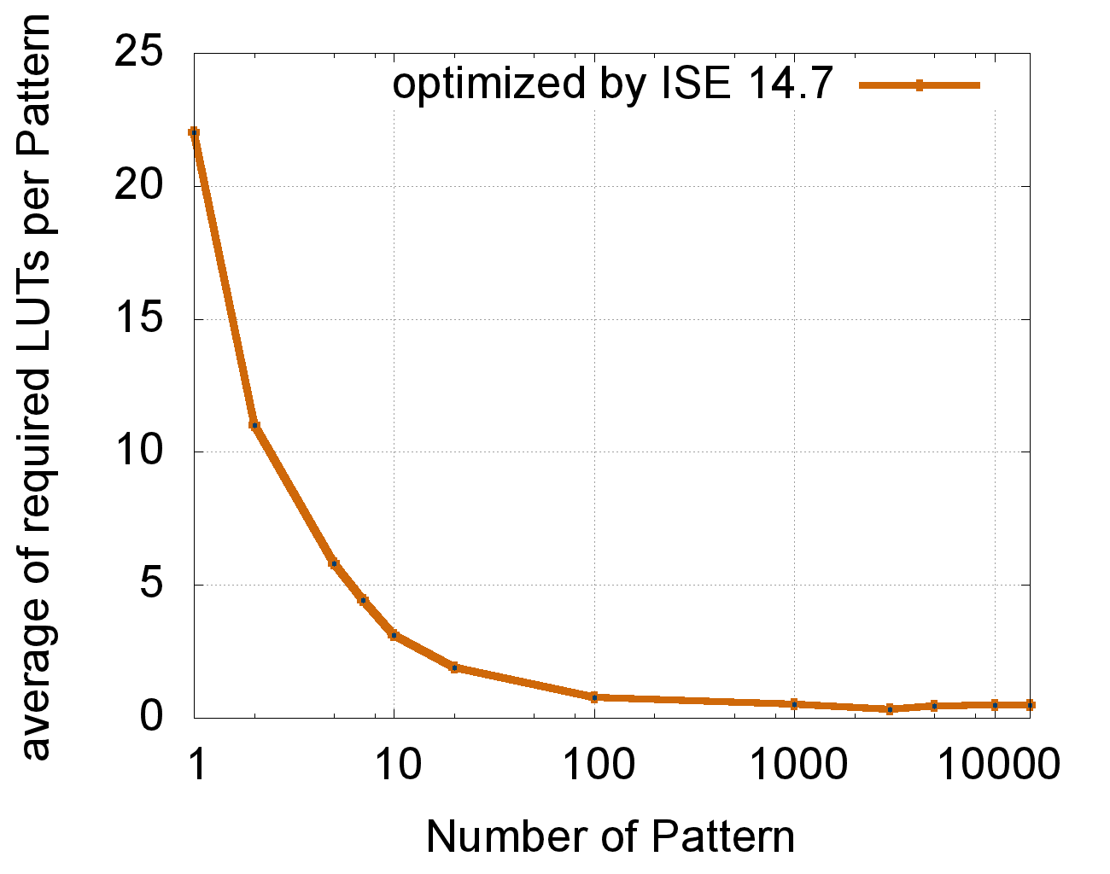
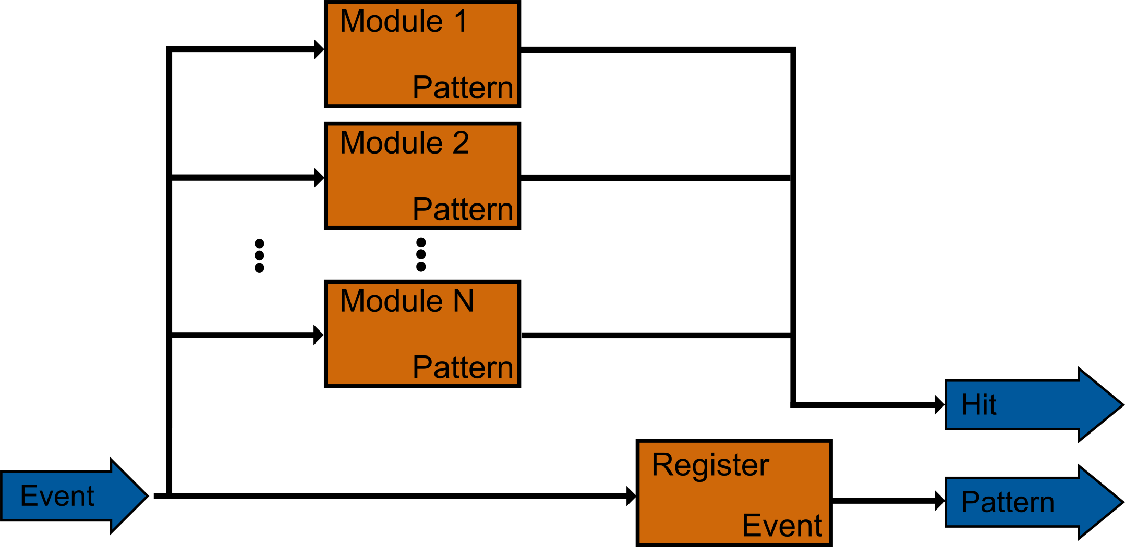
CMS Level 1 Track Trigger for HL-LHC
DTS - An AM-based Trigger Approach
Tanja Harbaum (KIT)
System Overview
10000 tracks per collision
400 billion tracks per second
L1 Track Trigger Board
Actions
Data Transfer
Trigger Tower Formation
Pattern Recognition
Track Fitting
Vertexing
40 MHz
Detector
Latency $\sim 10 μs$
Level 1
Frontend Pipelines
100 kHz
Readout Buffers
Pattern Recognition - Approach
We know how interesting particles look like:
Let‘s make some pictures of them
Pattern Recognition
Generated Pattern Bank of interesting tracks
One pattern defines a road into the tracker
Compare the incoming data to the Pattern Bank
!
How can we find a needle
in this haystack within 10 $μs$
track
?
One pattern
Pattern Bank
Implementation
Content Addressable Memory (CAM)
Provide hit result within one clock cycle
128 Bits per Pattern
Set of 8 layers
16 Bits per superstrip address
Specify a low granularity tracker strip
~100 M Patterns overall
> 1 Gbyte data has to be loaded and compared within microseconds
DDR3-SDRAM: bit rate 34 Gbyte/s is not enough
SRAM cell
CAM cell
FPGA based Approach
Efficient utilization of FPGA structure
Port Associative Read only Memory features
FPGA CAM Board Architecture
Minimization by logic
Decrease number of LUTs per Pattern
Depends on the composition of the Pattern Bank
Utilise FGPA vendor tools
Extensive minimization accessible
15000 pattern -> 7300 LUTs
3.5% of xc7v330t

