Slide 1
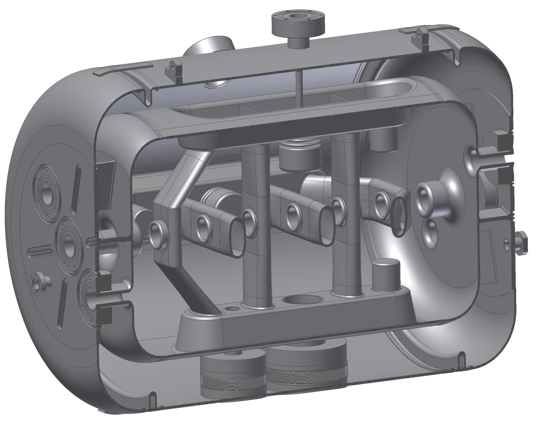
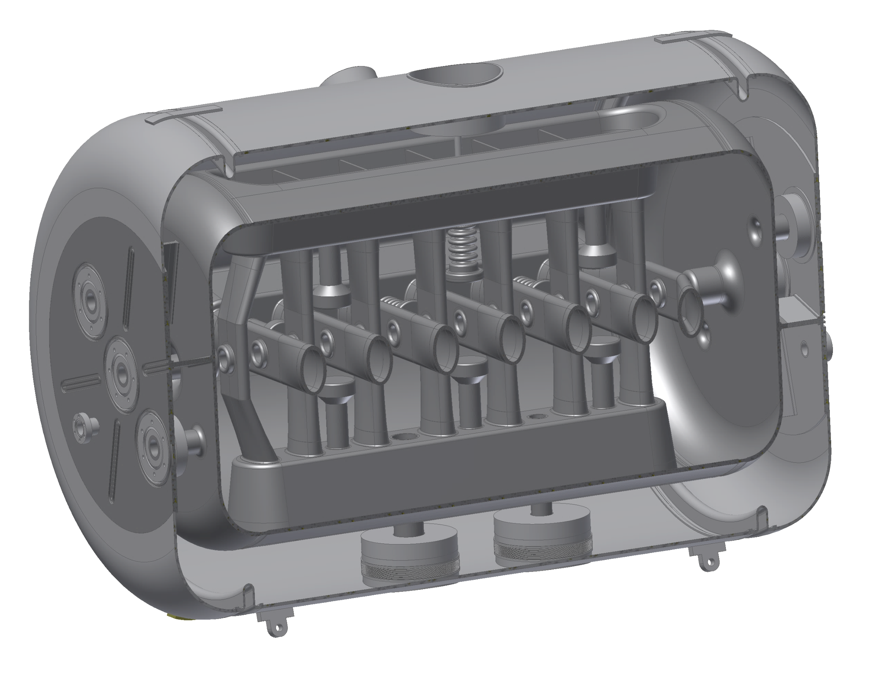
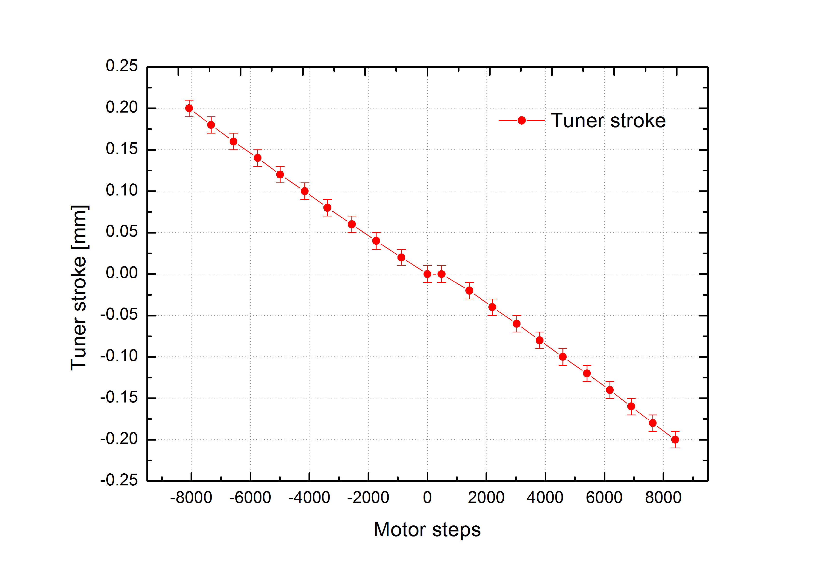
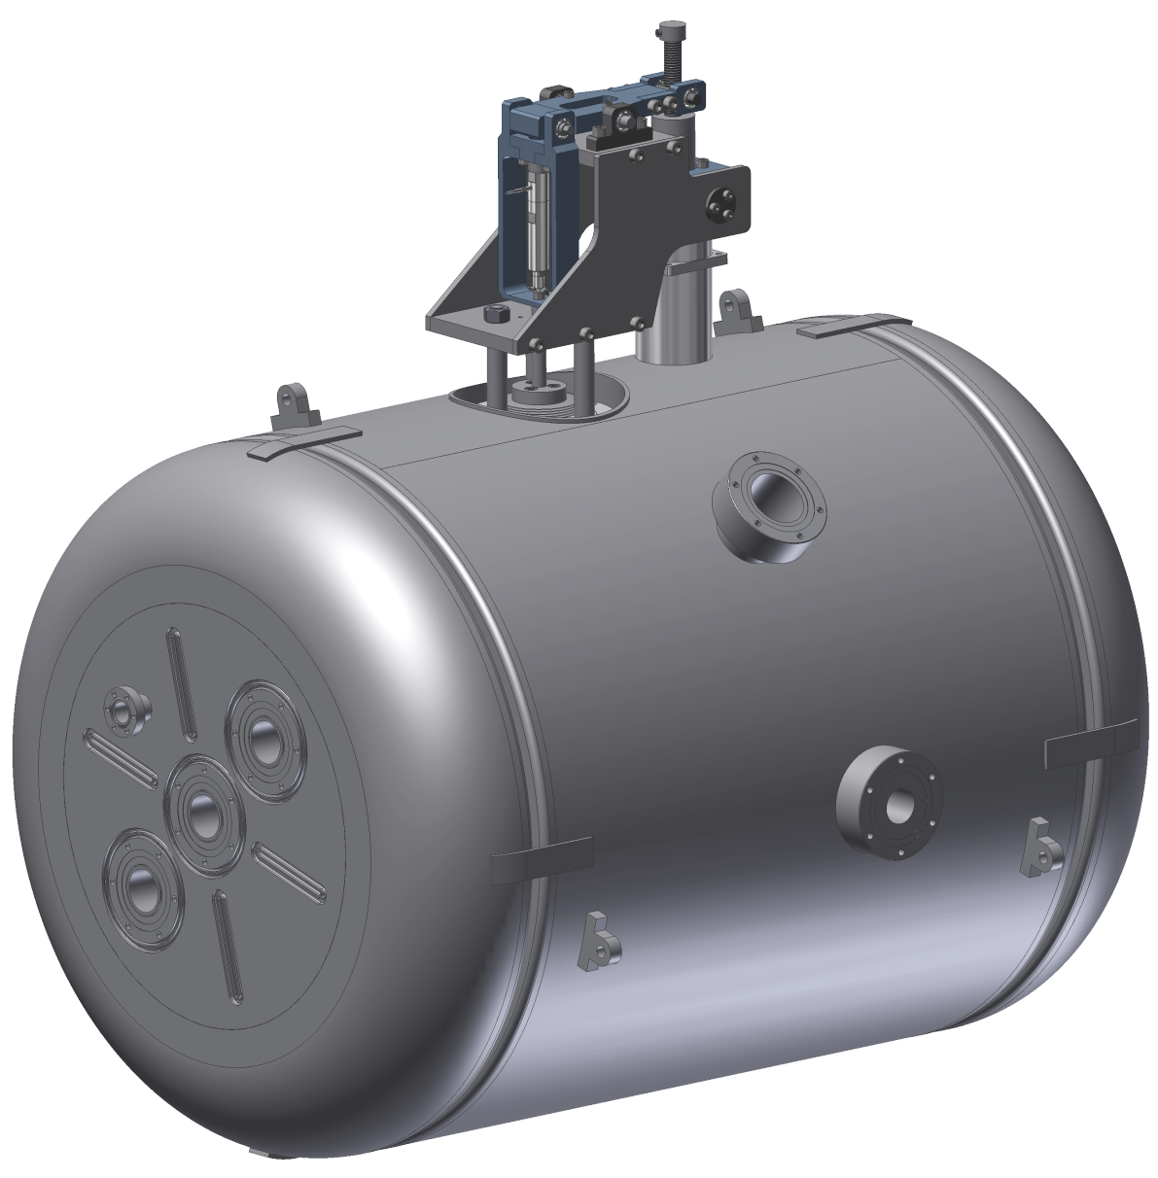
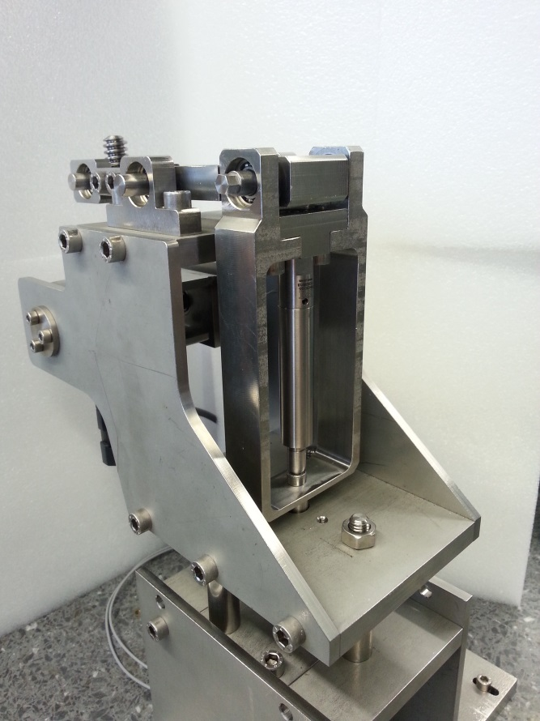
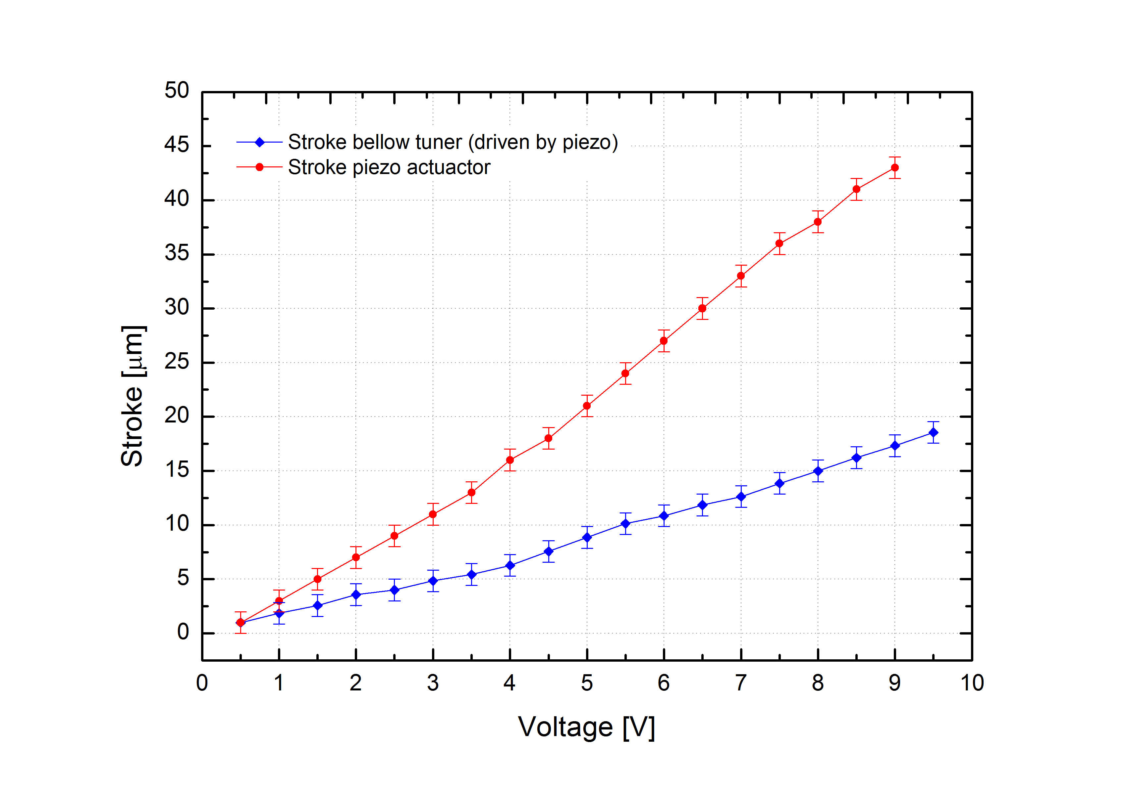
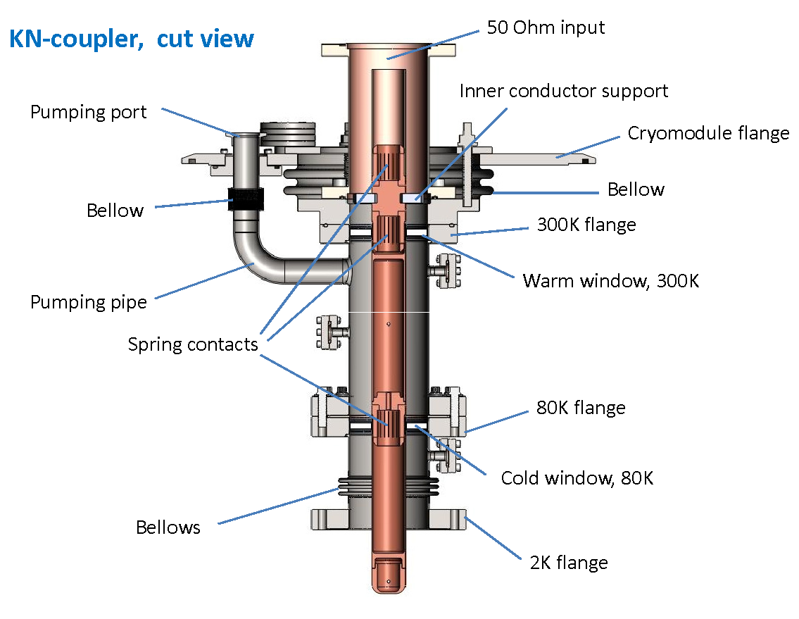
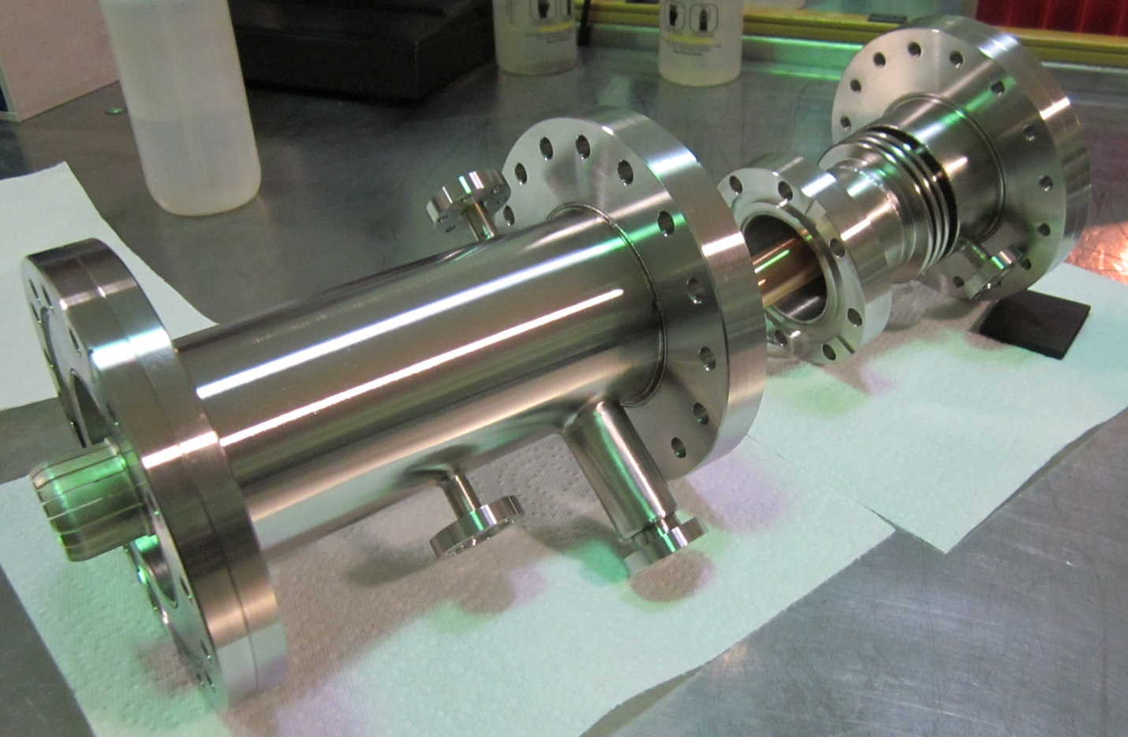
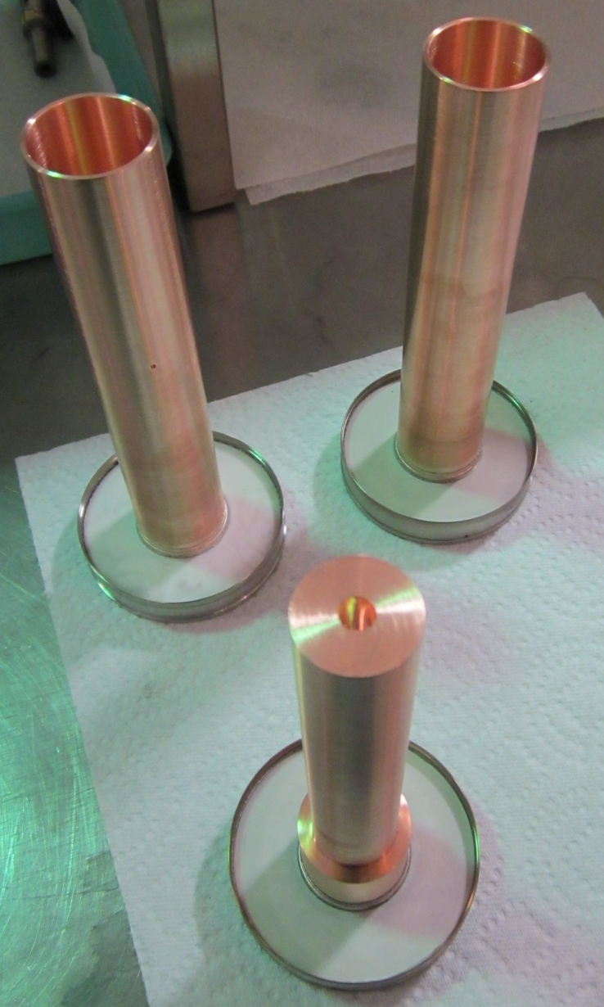
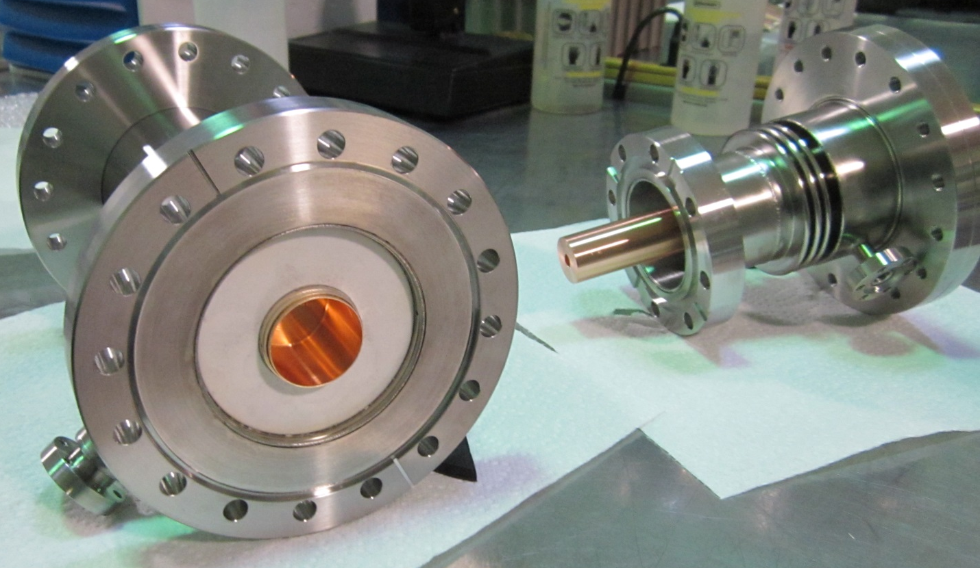
RF Coupler and Tuner Development of Superconducting CH-Cavities
Michael Amberg
HIM, Goethe-Universität Frankfurt,
Johannes Gutenberg-Universität Mainz
ARD ST1&2: Superconducting RF Science and Technology / Hadron Accelerators
The superconducting CH-structure (Crossbar-H-mode) is a multi-cell drift tube cavity for the low and medium energy range operated in the H₂₁-mode, which has been developed at the Institute for Applied Physics (IAP) of Frankfurt University. With respect to different high power applications two types of superconducting CH-structures (f = 325 MHz, β = 0.16, 7 cells and f = 217 MHz, β = 0.059, 15 cells) are presently under construction and accordingly under first measurements.
Tuner flanges
Tuner flanges
Dynamic tuner
(3 in total)
Dynamic tuner
(3 in total)
Static tuner
(4 in total)
Static tuner
(9 in total)
Coupler flanges
Coupler flanges
Figure 1: 3D section view of the sc 325 MHz CH Booster Cavity for the GSI-UNILAC
Figure 2: 3D sketch of the sc 217MHz CH for the sc cw LINAC Demonstrator project.
The Fast Piezo-Based Frequency Tuner for Superconducting CH-Cavities
Slow tuner arm
(mechanical advantage ≈ 2:1)
Fast tuner
(piezo actuator)
Slow tuner
(stepper motor)
Dynamic bellow plunger
Figure 3: Complete piezo-based frequency tuner including the 3-cell dynamic bellow plunger mounted on top of the helium vessel (left) and first measurement results at room temperature (right).
RF Power Coupler for the sc 325 MHz CH-Cavity
The scheduled beam tests of the sc 325 MHz CH-cavity at GSI Unilac require a dedicated 60 kW pulsed power coupler. Fermilab’s power coupler for Project X , which has already been tested successfully up to 750 kW pulsed power (4 kW average), has very similar specifications.
Requirements:
325 MHz
60 kW pulsed power
1% duty cycle
10 mA beam current
1 ms pulses
The design will also be adapted for the sc 217 MHz CH-Cavity for first pulsed tests
Figure 4: Power coupler design for Project-X cavity SSR1 by Fermilab.
Figure 5: Components of the Power coupler for the sc 325 MHz Cavity.

