Slide 1
Accelerator Research and Development
Reinhard Brinkmann, DESY
ARD Topic Speaker
Updated version Feb 20

Slide 2
Implementation of ARD in Helmholtz
Long history of Acc. R&D as mission critical for other programmes – as an own topic ARD will maintain a strong link to programmes MU and MML
  As enabling technology for large research infrastructures
  Generating improvements and novel concepts for existing facilities and new projects (e.g. ANKA, BESSY-II, ELBE, FAIR, EU-XFEL)
  Link to other research fields like Health and to technology transfer and industrial applications
Generic, future oriented research is strengthened
  Exploitation of synergies
  Foster high-risk/high-impact activities with ambitious goals

Slide 3
Implementation of ARD in Helmholtz
Fostering networking and cooperation
  Joint projects between Helmholtz centers, transfer of knowledge and technologies, joint usage of infrastructure
  Collaboration with universities and international partners at top level of science and technology
Improving visibility of accelerator physics and technology
  Attract young talents to our field
  Strengthen accelerator physics education & research at universities

Slide 4
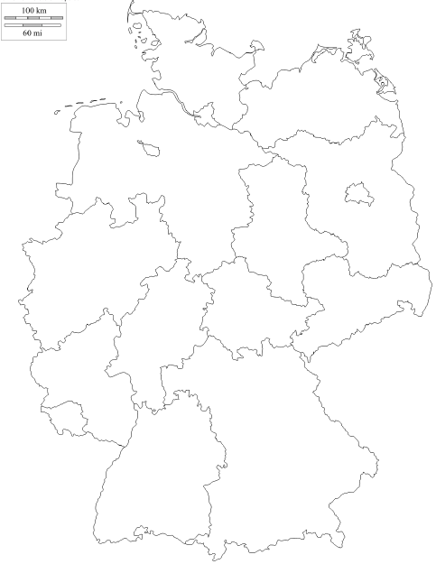


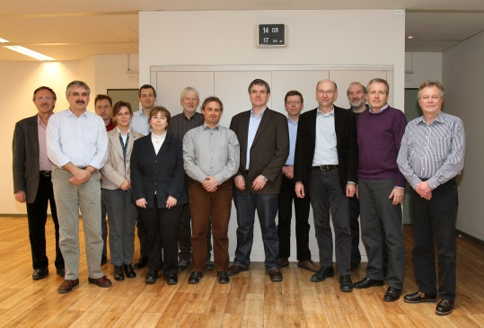






ARD and German Universities
Partner universities
U-Rostock
U-Hamburg
HU-Berlin
TU-Dresden
U-Jena
TU-Dortmund
U-Wuppertal
RWTH Aachen
U-Bonn
U-Siegen
U-Giessen
U-Mainz
U-Frankfurt
TU-Darmstadt
HI-Jena
(committee for accelerator physics) 1st meeting 17 Jan 2011
PAGE 4

Slide 5












… + 30 further cooperation partners
MBI
PTB
U-hospital Dresden - OncoRay
PSI
CERN
IBS-RISP
STFC-Daresbury Lab
J. Adams Inst.
KVI
TRIUMF
NCBJ
TU-Lodz
TU-Warsaw
BNL
Cornell U.
FNAL
JLAB
LBNL
MI State U.
SLAC
UCLA
IMP-CAS
ASG S.p.A.
INFN
BINP
INR
Moscow State U.
St. Petersb. State U.
KEK
RIKEN

Slide 6
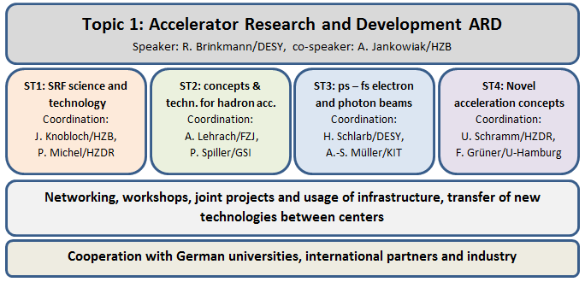
ARD structure and management
www.helmholtz-ard.de

Slide 7
Resources per sub-topic
Total 161 FTE incl. 30 PhD
GSI-Da. contributions to ARD not in PoF-III evaluation (for information: 1.5M€ or 5% of ARD resources)

Slide 8
Synergy and coherence
Sub-topics are not disjunct/orthogonal – research activities benefit from overlap and synergies
  Example 1: SRF technology has strong impact on hadron accelerators (link ST1-ST2) and photon beam sources (link ST1-ST3)
  Example 2: strong link between ST3 and ST4 for dynamics, diagnostics and synchronisation of short electron bunches
Exploitation of synergies and common interests enhances the efficiency, coherence and excellence of our research programme

Slide 9
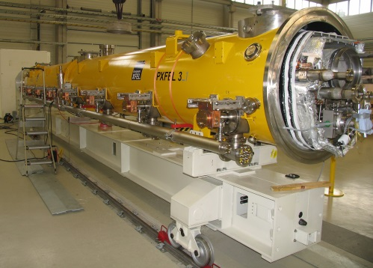
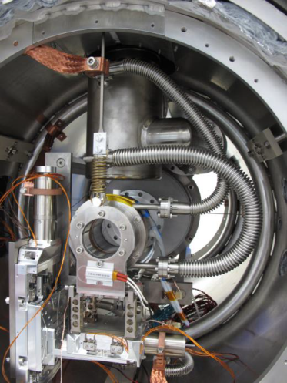

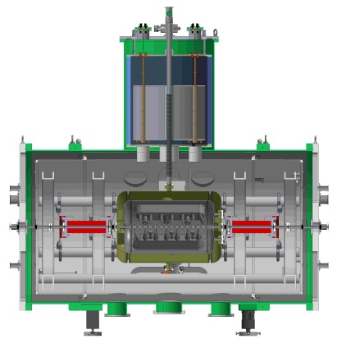
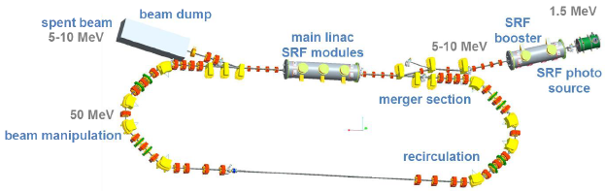
ST 1 : SRF science and technology
ST2,3
Focus on development of high duty cycle/CW superconducting accelerators for electron and hadron beams
  Pushing the limit of beam sources/injectors
  Pushing the limit of CW acceleration

Slide 10
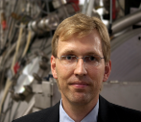
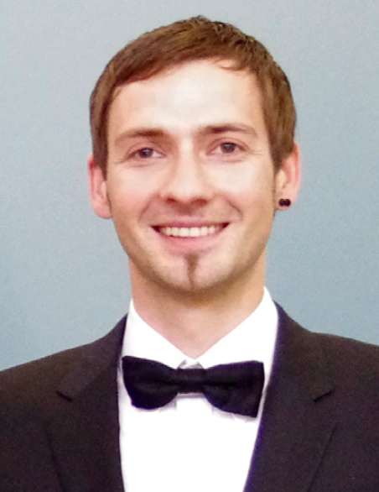
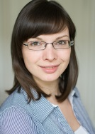
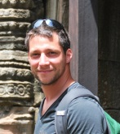
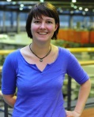
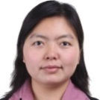
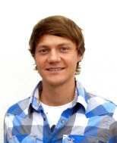
Further presentations ST 1
Talks:
  J. Knobloch, CW-SRF – enabling technology for next generation accelerators
  A. Arnold, High brilliance electron beams from SRF guns
Posters:
  J. Vogt, Reducing power dissipation in s.c. cavities by thermal cycling
  J. Branlard, European XFEL goes cw – challenges and opportunities
  S. Schubert, From alchemy to understanding – photocathodes for high brightness electron sources
  R. Xiang, Nanocoulomb bunch charges from s.c. photo injectors
  M. Amberg, RF coupler and tuner development for s.c. CH cavities

Slide 11
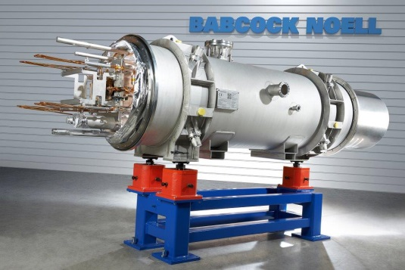
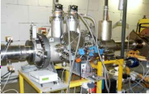
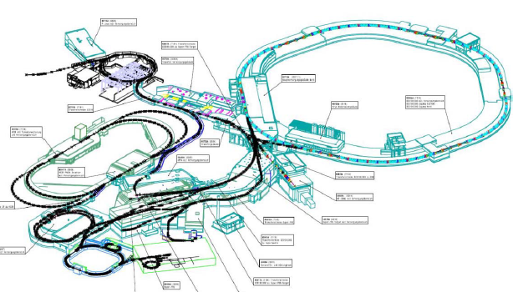

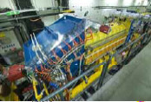

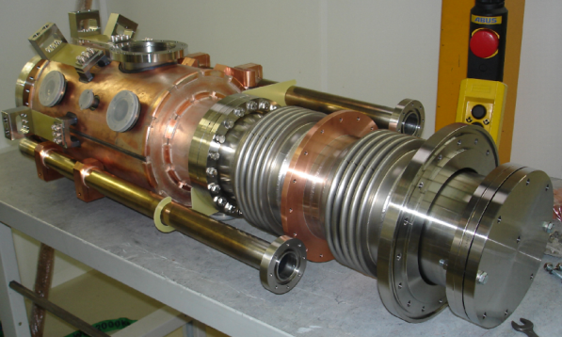
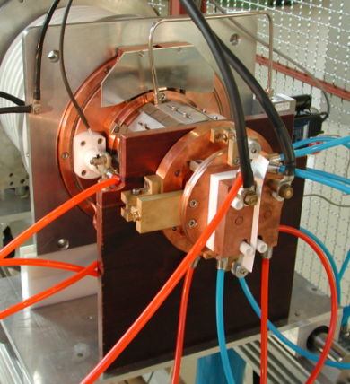
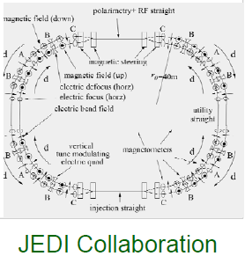
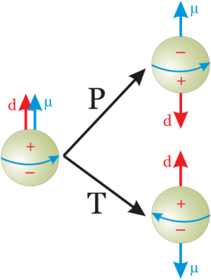
ST 2: Concepts & techn. for hadron accelerators
Towards ultimate heavy ion intensities
EDM search:

Slide 12
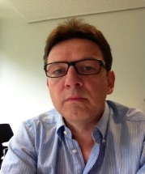
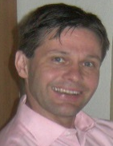
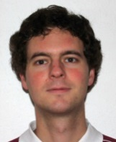
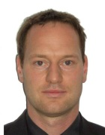
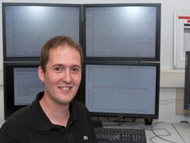
Further presentations ST 2
Talks:
  W. Barth, Heavy ion high intensity linac developments
  A. Lehrach, Dedicated hadron accelerators
Posters:
  L. Bozyk, Ultimate heavy ion intensities
  D. Winters, Laser cooling
  M. Rosenthal, Spin dynamics towards EDM measurements

Slide 13
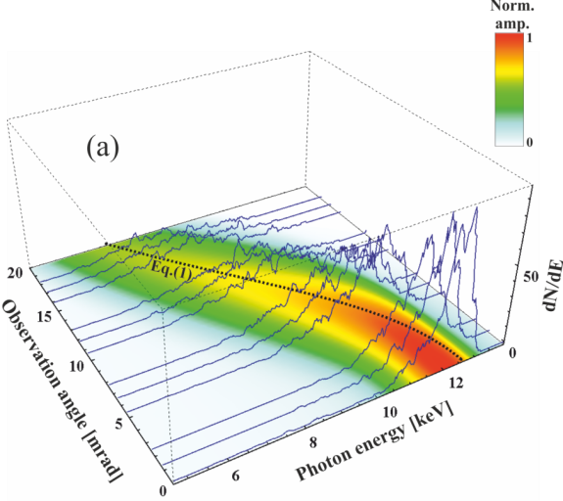

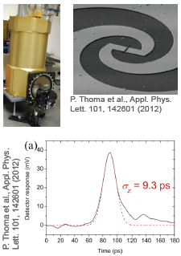
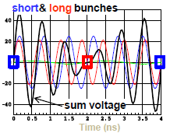




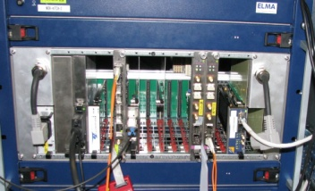

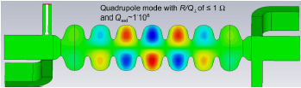






ST 3: ps and fs electron and photon beams
ST4
Beam dynamics & photon sources
Ps-fs beam diagnostics
Stability, controls & synchronisation
Terahertz cylindrical waveguide
X-rays
Inverse Compton scattering

Slide 14
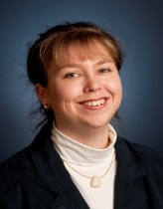
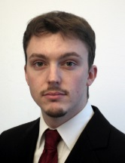
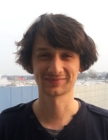
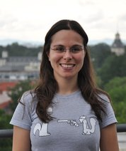
Further presentations ST 3
Talks:
  A.-S. Mueller, Concepts and technologies for ultra-short beams
Posters:
  M. Hoffmann, Towards attosecond RF controls for accelerators
  M. Ruprecht, Beam dynamics of short pulse operation of BESSY^{VSR} with sc RF system
  N. Hiller, Observation of the micro-bunching instability in the ANKA storage ring with single shot electro-optical detection
PAGE 14

Slide 15
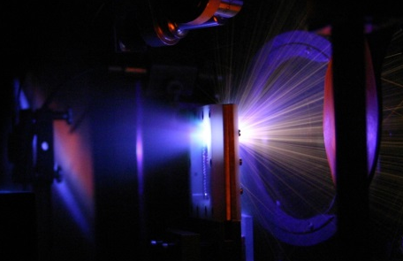
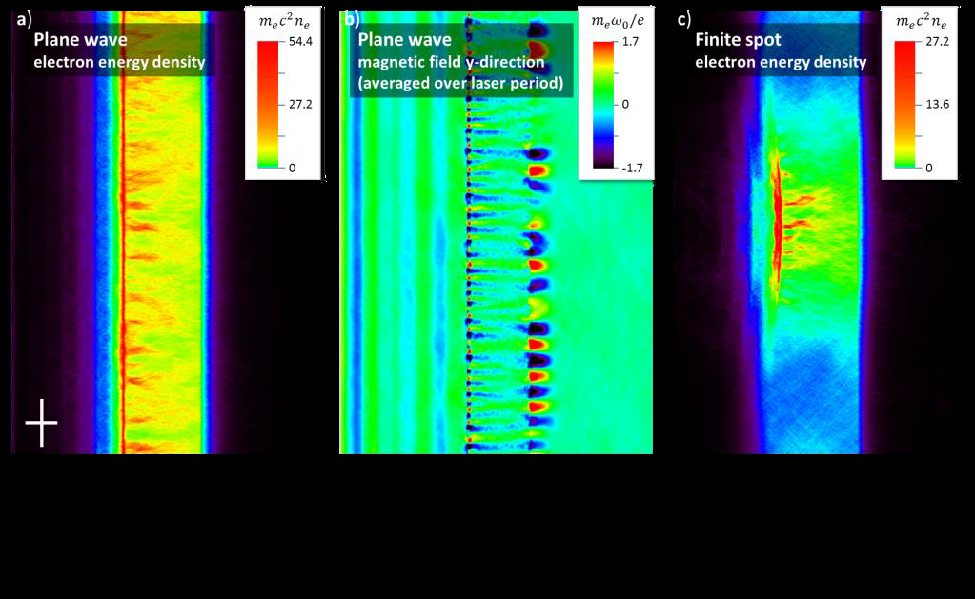
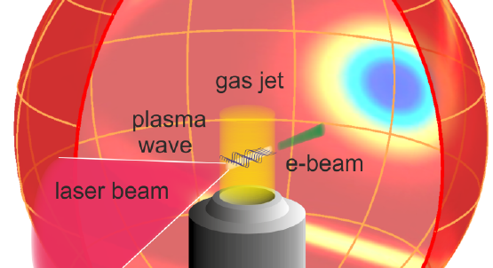
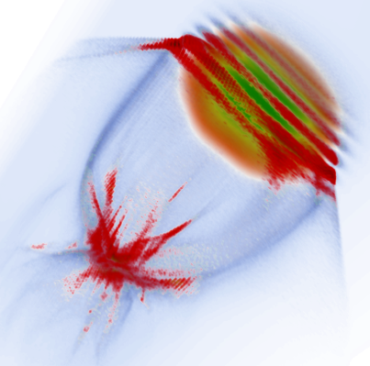
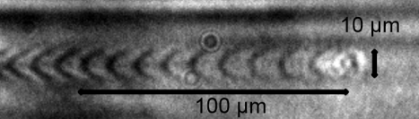
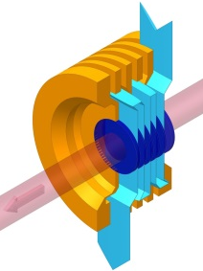
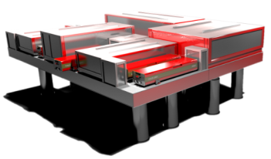
ST 4: Novel acceleration concepts
Plasma based - ultimate field gradients - high peak currents - fs bunches - improved
average power and control suitable for user oriented operation
Laser ion acceleration
Laser- and beam-driven plasma wakefield electron acceleration
Advanced simulation capability and feedback
Next generation laser development
PAGE 15

Slide 16
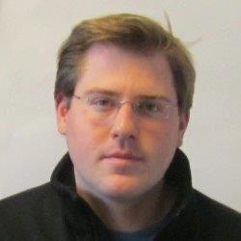
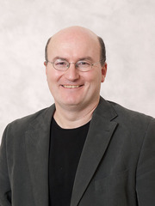
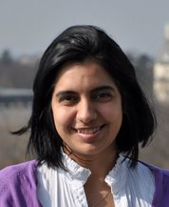
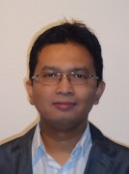
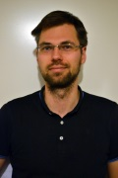
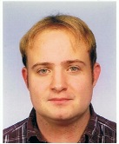
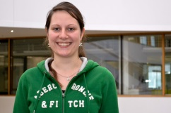

Further presentations ST 4
Talks:
  A. Maier, Perspectives of plasma-wakefield acceleration for compact light sources
  M. Zepf, Laser-plasma acceleration of ions
Posters:
  V. Alfonso Rodriguez, A s.c. transverse gradient undulator for LPWFAs
  A. Irmann/A. Saevert, Laser wakefield acc. and ultrafast diagnostics
  A. Klenke, Laser development for laser particle acceleration
  Th. Bruemmer and A. Jochmann, Advancing Thomson sources to optical undulators and medical applications
PAGE 16
PAGE 16

Slide 17
Infrastructures for accelerator research
Facilities for user experiments, part-time usage for ARD
Facility | Center | Sub-topics
FLASH | DESY | ST3, ST4
REGAE | DESY | ST4
UNILAC/SIS18/ESR | GSI | ST2
MAMI | HIM/JGU | ST2
CRYRING | HIJ | ST2
BESSY-II | HZB | ST3
MLS | HZB/PTB | ST3
ELBE | HZDR | ST3, ST4
ANKA | KIT | ST3

Slide 18
Infrastructures cont’d
Dedicated ARD infrastructures (existing, under construction or planned)
Facility | Center | Sub-topics
PITZ | DESY | ST3, ST4
TTF/CMTB | DESY | ST1
SINBAD (planned) | DESY | ST3, ST4
HLI (constr.) | GSI | ST2
PHELIX,POLARIS,JETI200 | HIJ | ST4
HoBiCaT | HZB | ST1
GunLab (constr.) | HZB | ST1
BERLinPro (constr.) | HZB | ST1, ST3
FLUTE, PICCOLO (planned) | KIT | ST3
PW lasers at ELBE center | HZDR | ST3, ST4

Slide 19

Distributed test facility
ST1 - ST3 - ST4
Collaboration
  Networking of research infrastructures
Synergy
  Extension of facilities for common usage
Leadership
  International leading flagship projects towards ultra-compact accelerators and radiation sources
Proposal for strategic investment funds → 2016 – 2020
Preparation team:
R. Assmann (DESY), V. Bagnoud (GSI),
M. Büscher (FZJ), A. Jankowiak (HZB),
M. Kaluza (HIJ), A.-S. Müller (KIT),
U. Schramm (HZDR)

Slide 20




SINBAD: example for new ARD infrastructure
50as pulses
1st phase towards Distributed ARD Test Facility
Usability & scalability of plasma acceleration
Electron pulse <1fs conv. acc.
14M€ ERC synergy grant Dec 2013
DESY-CFEL-UHH-U/Arizona Coop.
Utilise existing, unused infrastructure at DESY

Slide 21
Concluding remarks
Implementation phase of ARD as a new topic in the Helmholtz portfolio since 2011 has already proven extremely valuable
  Realisation of synergies and new joint activities
  Attracting students and young scientists to our field
  Strengthening and launching new international cooperations
We are looking forward to a rich and top-class research programme in PoF-III which is mission-critical to the area Matter and to Helmholtz in general and defines leadership in the world-wide effort of further enhancing accelerator physics and technology

Slide 22
Thank you very much for your kind attention!

Slide 23
Backup slides

Slide 24
University partners – scientists and PhDs

Slide 25
ST1 resources vs activities

Slide 26
ST2 resources vs activities
Including GSI-Da contribution!

Slide 27
ST3 resources vs activities
DESY fehlt noch!

Slide 28
ST4 resources vs activities

