Slide 1
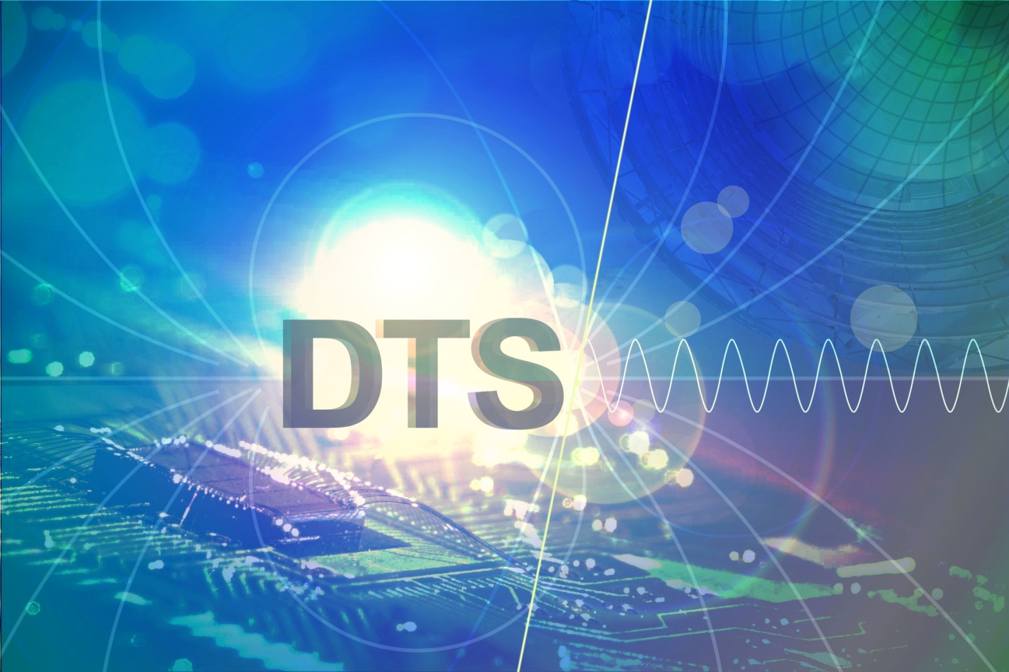

Detector technology and systems
Marc Weber

Slide 2
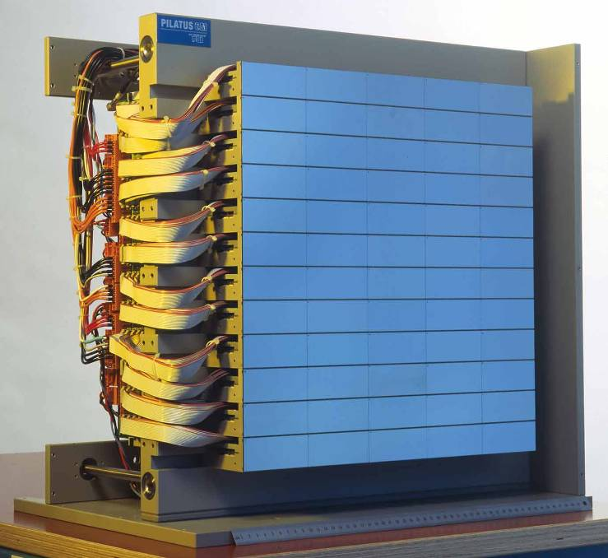

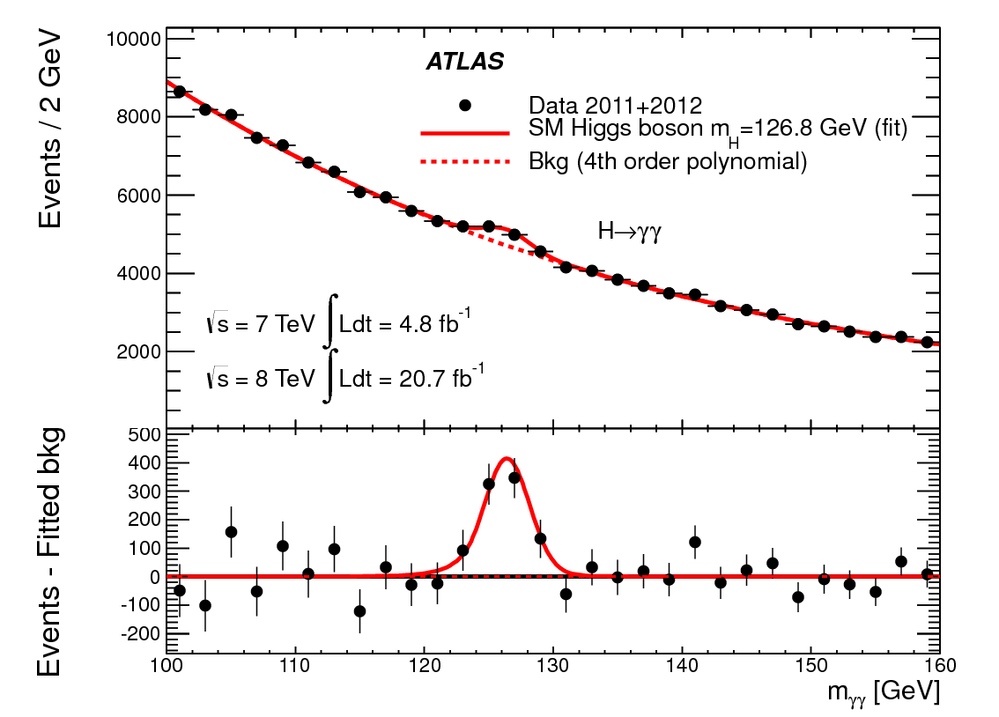
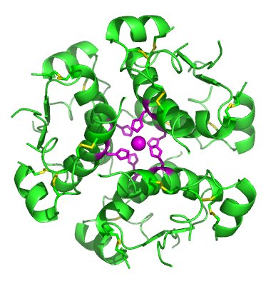
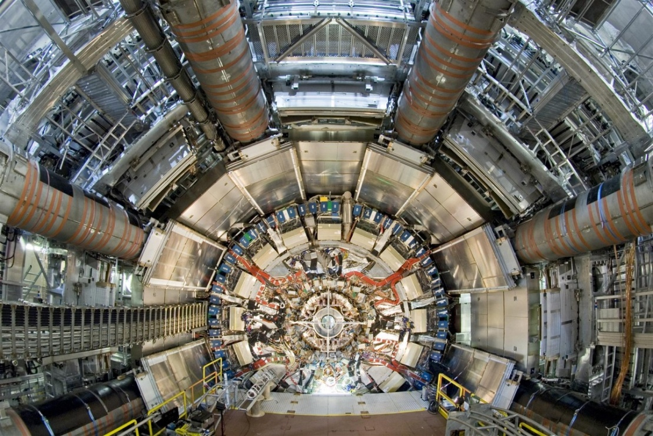
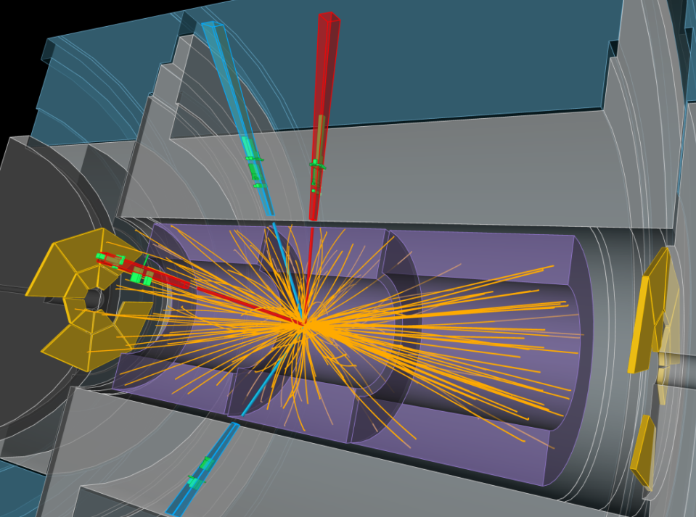
Detectors driven by science
Photon science Particle physics
Science enabled by technology

Slide 3
Focus and challenges
Challenges
Billion-channel detectors
High resolution
Edge-less detectors
Low mass
Detector Technologies
& Systems
High quantum
efficiency
Low power
Highly integrated,
pixelated
detector systems
High bandwidth
Low noise
Real-time data processing
Radiation
hardness
Integration of
complex
systems
Dark matter searches
Science at
photon sources
Astroparticle physics
Neutrino physics
Science at neutron sources
Nuclear and hadron physics
Particle physics
Scientific applications
Notes:
Environmental conditions
Radiation environment
Magnetic fields
Temperatures
Cryogenic
Extreme data rates
Millions to billions of channels
Low mass, innovative materials
Real-time reconstructions
High Z sensors
High quantum efficiency
High spatial, energy and time resolution
Edge-less sensors
VLSI
Massively parallel computing
Heterogeneous digital hardware
3D integration
Optical data communication
packaging
Low noise
Low power

Slide 4
Anticipated large-scale facilities
Matter and the Universe
LHC, HL-LHC (ATLAS, CMS, ALICE)
FAIR (APPA, CBM/HADES, NUSTAR, PANDA)
Pierre Auger Observatory
IceCube, PINGU
KATRIN
Edelweiss, EURECA/SuperCDMS
H.E.S.S., MAGIC, VERITAS, CTA
From Matter to Materials and Life
European XFEL
PETRA III, FLASH
BESSY, BESSY^{VSR}
ANKA
ESS
2010
2020
Construction
Operation
Cutting-edge detectors are needed for all facilities and for
all science fields in “Matter”

Slide 5
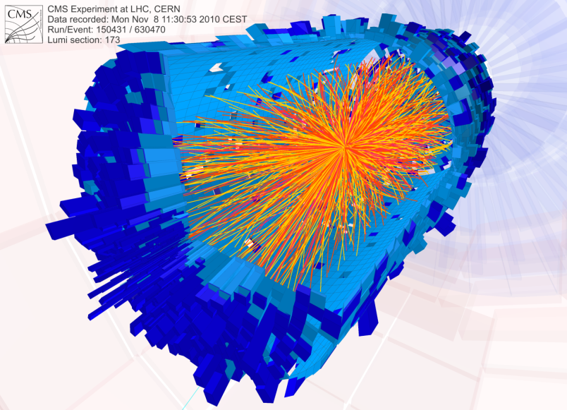
Example: LHC tracker upgrades
How to deal with ~400 billion tracks/second ?
five- to tenfold increase in track density and thus channels number
massive power distribution and cooling challenge
tenfold increase in radiation levels
Need a first level trigger decision within ~6 μs to do the science.
We are close to the experiments and the science.
Detectors and technologies are not available
off-the-shelf.

Slide 6
How to cope with these challenges?
Successful detector instrumentation demands:
Deep understanding of underlying physics principles
Broad technological expertise and multidisciplinary approaches
Access to sophisticated and expensive technological processes
Experience to combine technological building blocks into complex systems
Understanding of the science detectors will deliver
Creativity and originality

Slide 7



Detector technology and systems (DTS)
5 Helmholtz centers/institutes
Demonstrated history in detector conception, design and delivery
Multi-disciplinary teams of scientists, engineers and technicians
Access to major technical facilities and infrastructures
Well-embedded in international instrumentation community and experimental collaborations
Numerous national and international leadership positions
DTS is an ambitious attempt to exploit synergies
between centers and disciplines.

Slide 8
Philosophy and choices
For “best value for money”, we were guided by:
Which are the key technologies to enable the science?
Which detector types offers the highest science return?
Where are synergies largest and where is collaboration most rewarding?
Where is DTS world-leading and where should its technical portfolio be enhanced?

Slide 9

Topic structure
Sensors, ASICs and Interconnects
Data Transmission and Processing
Detector Systems
Sensors
Terabit/s Optical Data Transmission
HGF-Cube
Compact Gaseous Detectors
Readout Electronics
Intelligent
Programmable
Electronics
Fast Photon and X-ray Detectors
Fast Timing Detector Systems
Interconnect, Packaging and Innovative
Materials
Parallel Processing
CMOS Sensor Systems
Networking, Outreach and Applications beyond “Matter”

Slide 10
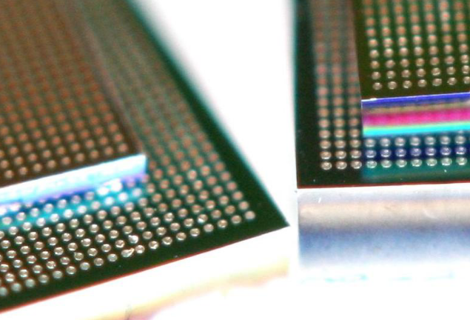
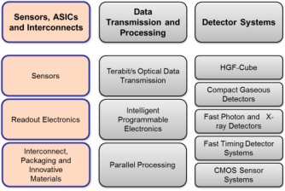
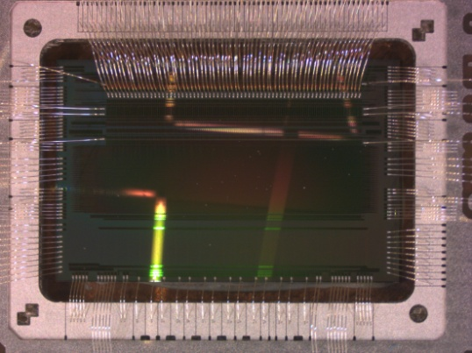
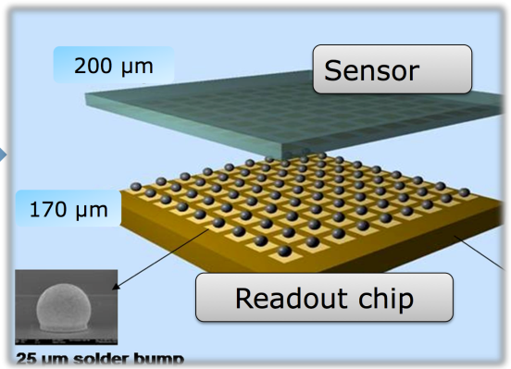
Sensors, ASICs and Interconnects
  Objectives:
  technologies for unprecedented
  efficiency, resolution and fluences
  mass- and edge-less detectors
  transition from millions to billions of pixels
  Challenges:
  extreme environmental requirements
  extreme integration density and functionality
  analog design for shrinking transistor size
  transition from hybrid pixels to 3D and monolithic technologies

Slide 11
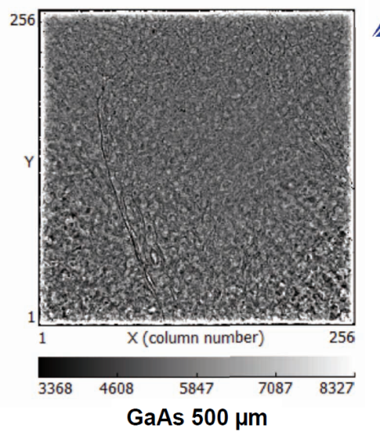
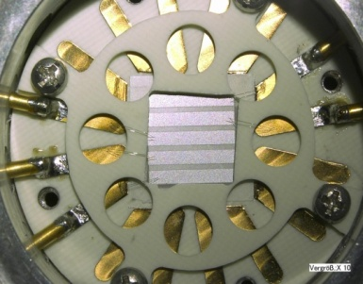
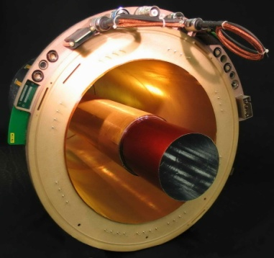
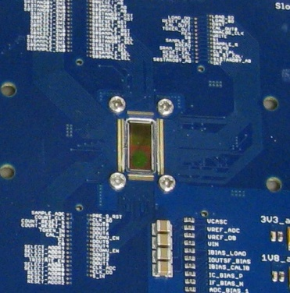
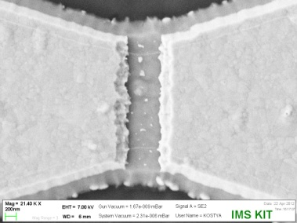
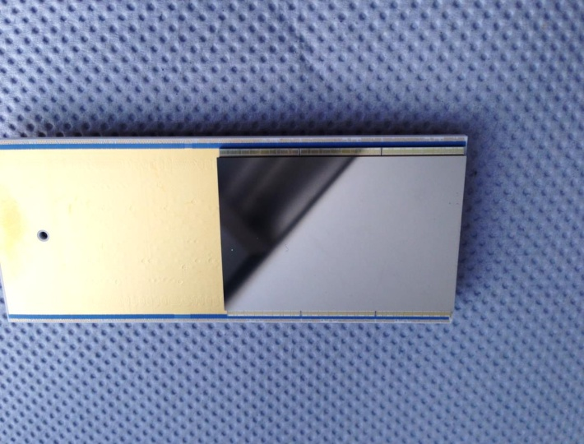
Competence and breadth in sensors
Our sensor portfolio ranges from CdZnTe, diamond, GaAs, Ge, Si to cryogenic YBCO sensors.
We host and have access to unique irradiation facilities at DESY, GSI, KIT.
Our sensor specialists are driving the field and hold key positions in various experiments.
Diamond on Iridium 962
GEM-TPC
Percival CMOS
Cryogenic YBCO
Helmholtz cube with CdTe and GaAs

Slide 12
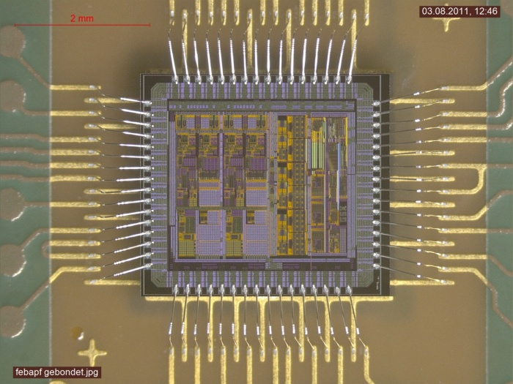
Sharing of expensive technologies
Advances in microelectronics will enable
detectors of unprecedented functionality.
Custom microchips (ASICs) are a must.
However costs for modern IC technology
(< 65 nm CMOS, 3D, etc.) become prohibitive.
Design process is getting involved and lengthy.
=> We combine forces, share designs and submissions, develop common building blocks between DESY, FZJ, GSI and KIT.
=> We strengthen overall expertise by creating a new ASIC design group at FZJ and a new ASIC professorship at KIT.

Slide 13
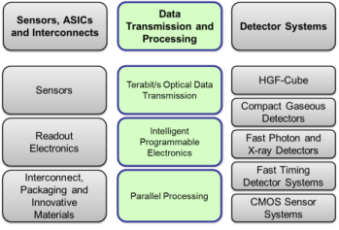
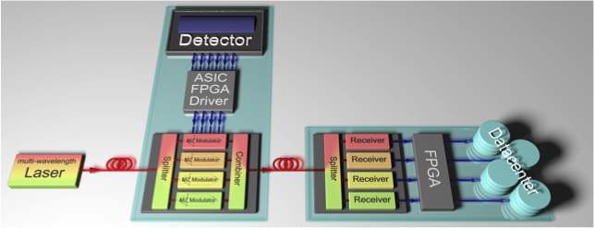
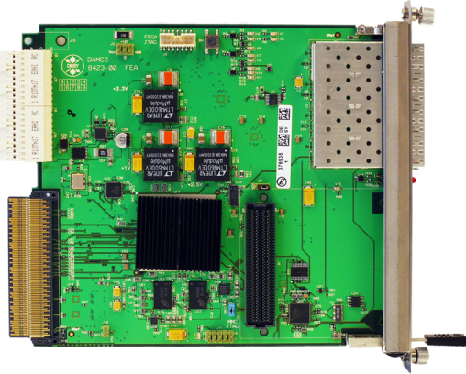
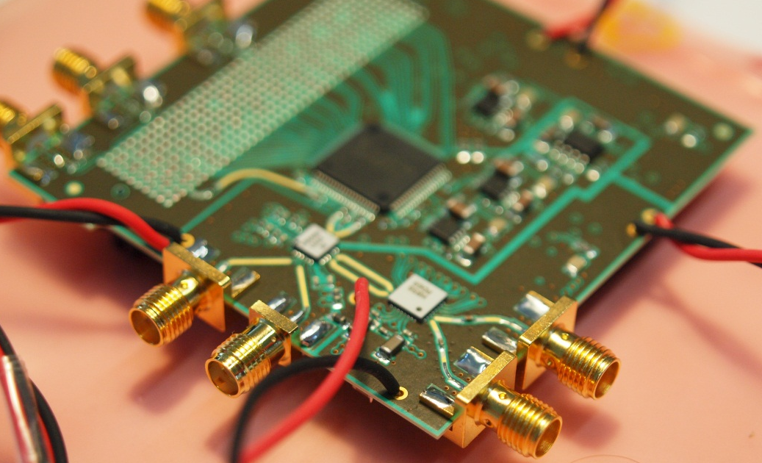
Data Transmission and Processing
  Objectives:
  Coping with unprecedented detector data rates and volumes
  Challenges:
  Moving electronic intelligence (FPGAs) closer to detector despite radiation and power constraints
  Tb/s optical links for data transmission out of detector volume
  Innovative DAQ and trigger architectures.
  Detector-related advanced algorithms and computing.
Optical data transmission for detectors
Picosecond sampling
Helmholtz MTCA.4 AMC

Slide 14
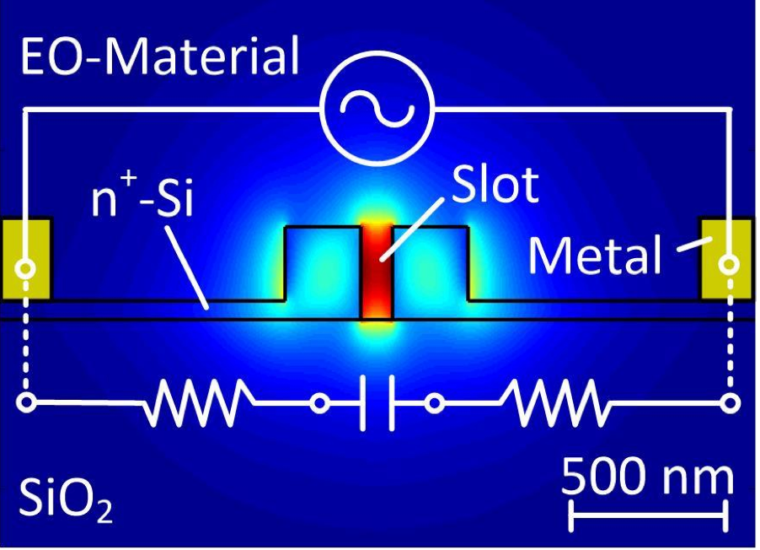
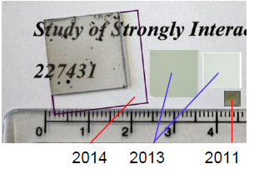
Original and high-gain research
Our portfolio includes selected high-risk/high
gain elements
We adapt technologies from elsewhere
(e.g. telecommunication) to detectors
We support others moving from
prove-of-concept to production systems
Example 1: Electro-Optical-Modulation
(see talk of C. Koos)
Example 2: Large-area diamond detectors
(University Augsburg: Diamond-on-Irridium)
Principle: Electro-Optical-Modulation
DOI samples produced in Augsburg

Slide 15
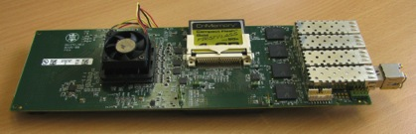
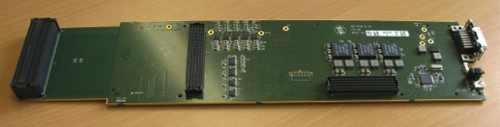
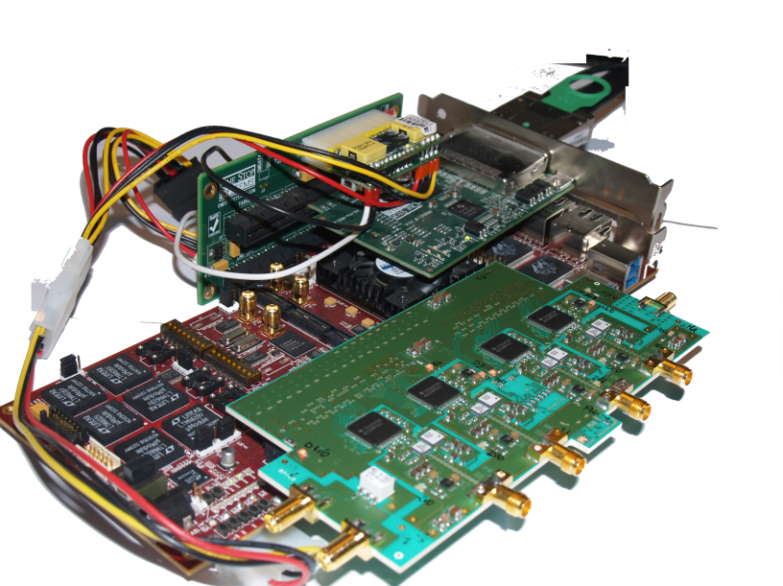
High-tech systems at fast R&D cycles
Long lead times are a nuisance and costly
Our approach is: modular frameworks, common platforms and synergetic collaboration
Example 1: Readout for HGF cube
  Readout, ADC, 10GbE links
Example 2: UFO High-throughput
DAQ framework
  High speed detectors, FPGA, PCIe links,
  GPUs

Slide 16
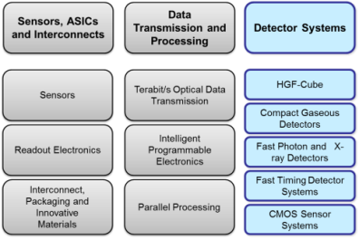
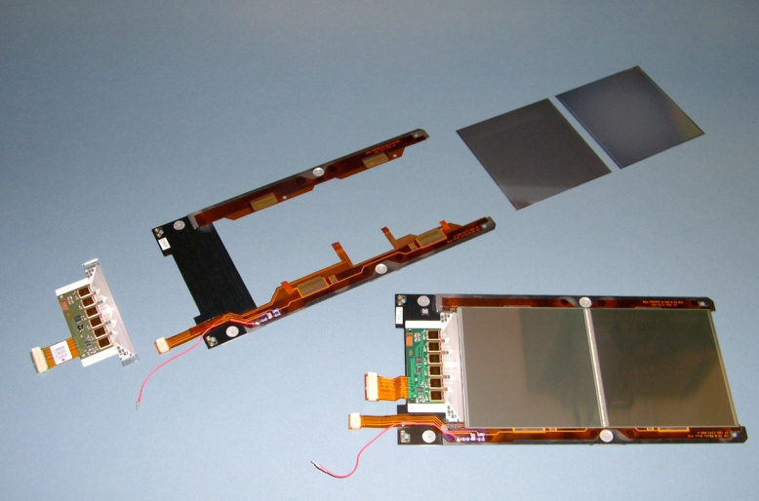
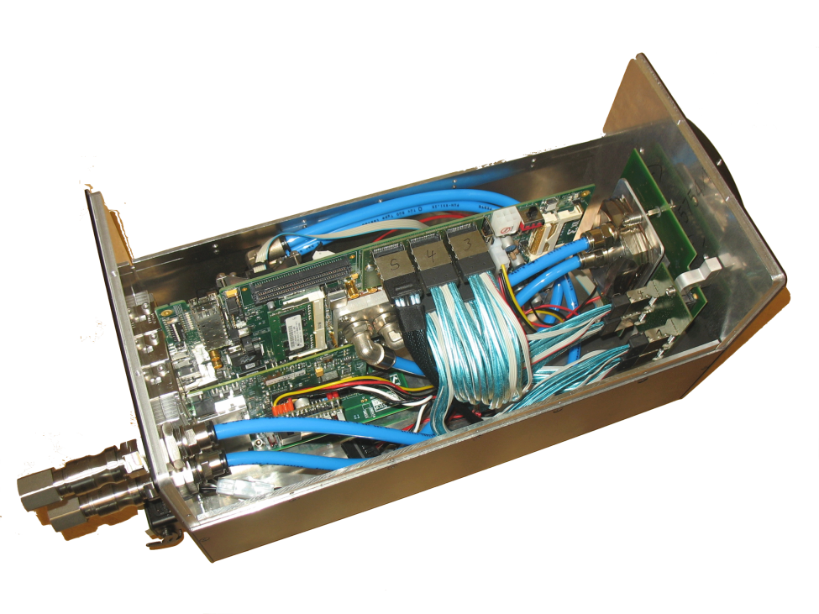
Detector Systems
  Objectives:
  Demonstrate cutting-edge technologies in complex, functional and scalable systems
  Challenges:
  Need to be selective
  Find balance between systems ready for use and prototypes
  Be ambitious while avoiding blue sky research
CMS Tracker Inner Barrel
Smart tomography camera

Slide 17
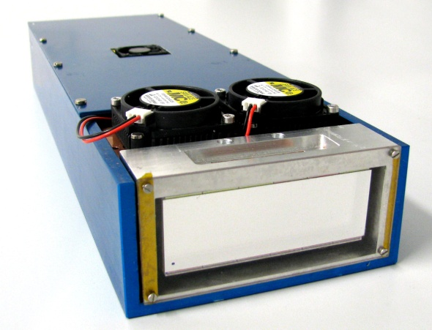

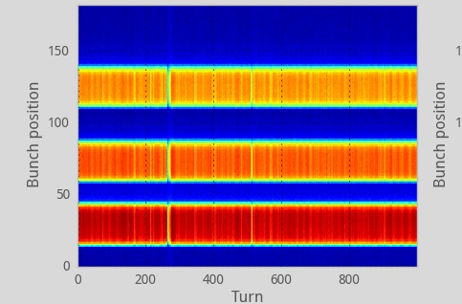
Demonstrators for science
We aim to develop modular demonstrator systems ready for use at beam line or test beam.
Example 1:
Helmholtz cube
Image with CdTe sensor
Example 2:
Beam diagnostics with superconducting THz sensor

Slide 18
Organisation
Precursor of DTS was established in 2012.
Since then, we have a lean but proven organisational structure.
Experienced subtopic
coordinators are assigned
and have been active since 2012.
Goals, milestones and
responsibilities are well-defined.
We are, however, prepared to
accommodate the unexpected and to react to opportunities not obvious today.
Collaboration board
Advisory board
Executive board
M Weber (KIT), subtopic coordinators
Technologies for integrated detectors
H Graafsma (DESY)
Ultrafast communication and analysis
J Ritman (FZJ)
Detector prototypes
CJ Schmidt (GSI)
Cross-disciplinary applications
F Fiedler (HZDR)

Slide 19


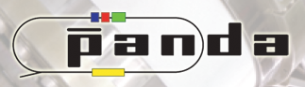

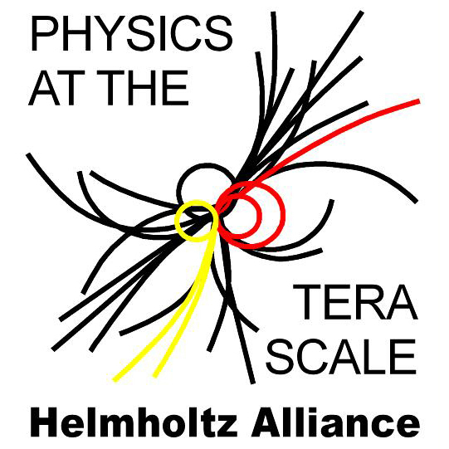
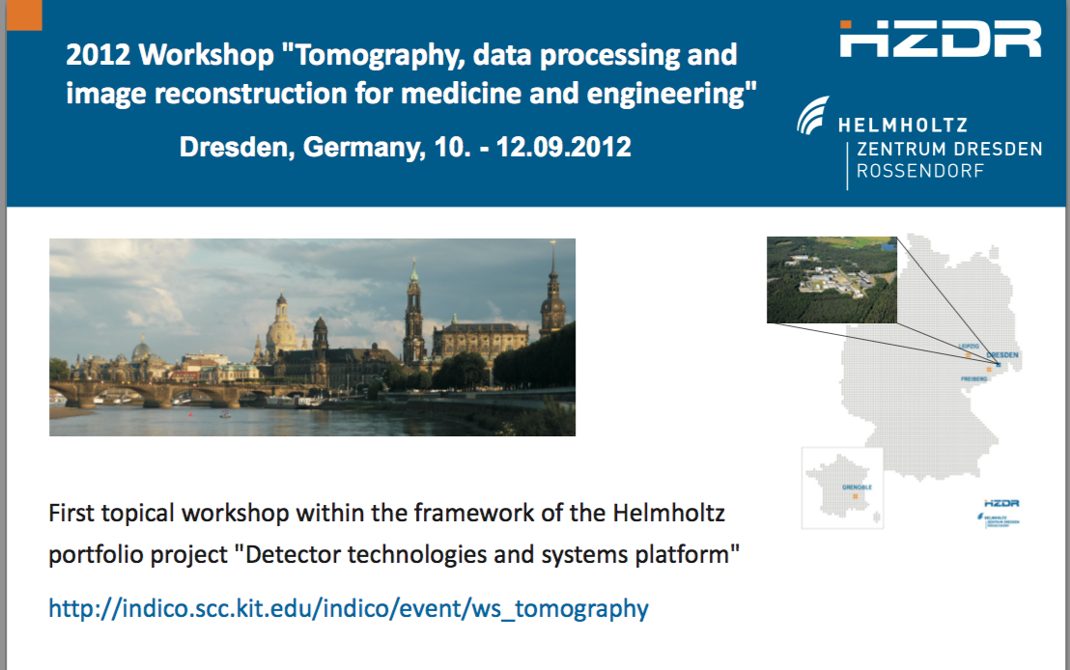
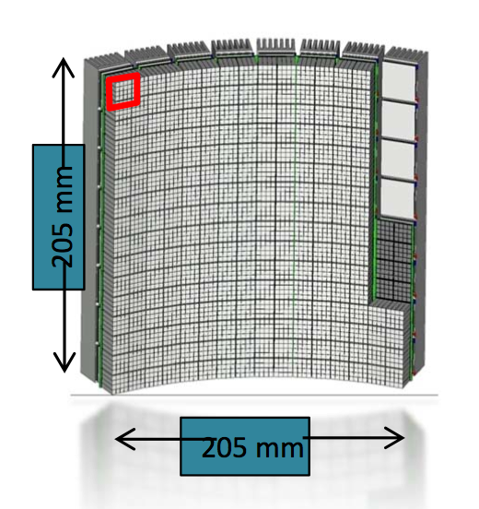
From Helmholtz to Universities and Society
Close collaboration with many major research centers and universities
  within experiments
  through Helmholtz Alliances
  (HAP, Terascale) and “MUTLink”
Topical workshops
WE Heraeus seminar
Applications in other field
Support of spin-offs / industry

Slide 20
Summary
“Detector technology and systems” is fully aligned with the strategy of “Matter”
DTS raises the level of cooperation between the HGF center and partners to a new level
We believe:
to have compiled a coherent research portfolio that fits our competences and scientific needs
that DTS will be a major player in the international community
that DTS will be a leader in shaping detector systems of unprecedented performance and complexity for the large-scale facilities of tomorrow.

Slide 21
Appendix

Slide 22
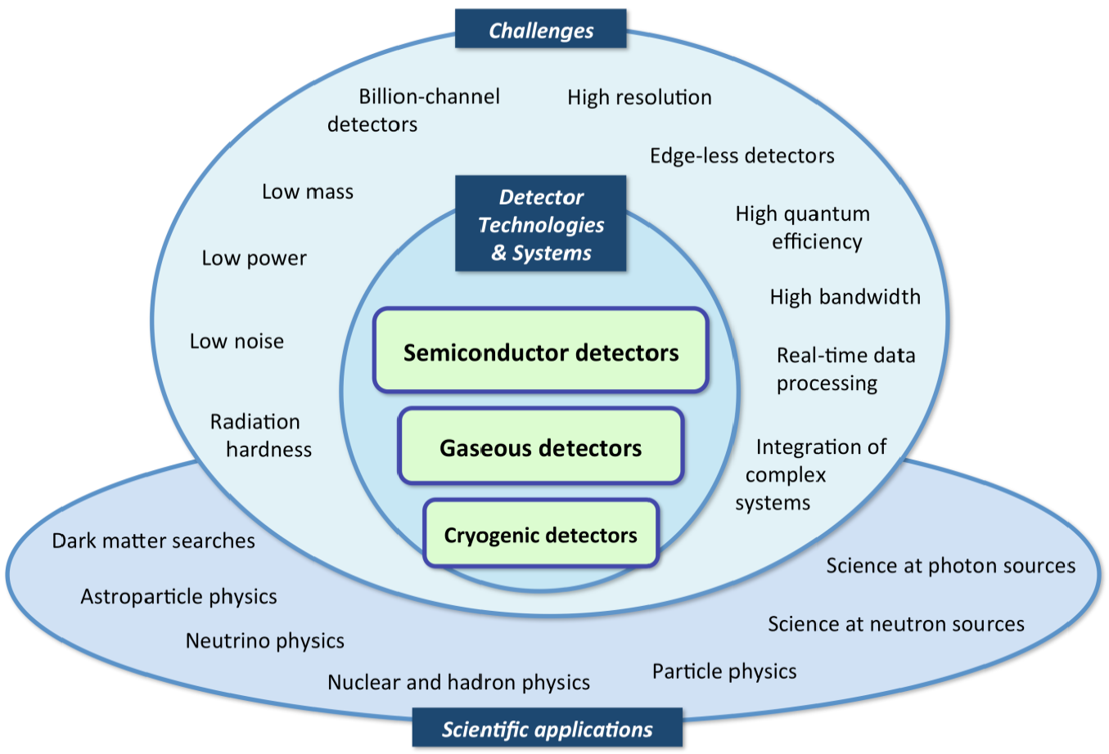
Detector challenges in “Matter” are extreme
Our detectors and technologies are not available off-the-shelf.

Slide 23

Vom LHC zum High-Luminosity-LHC
p-p-Kollisionen: ~ 1000 Spuren/Ereignis
Pb-Pb –Kollisionen: ~ 10000 Spuren/Ereignis
≙ HL-LHC
LHC sollte > 20 Jahre Daten liefern
statistische Messfehler sinkt nur mit 1/√N
daher Umbau des LHC in verschiedenen Phasen

