Slide 1

_
CMS Track Trigger and
PANDA Event Filter

Slide 2
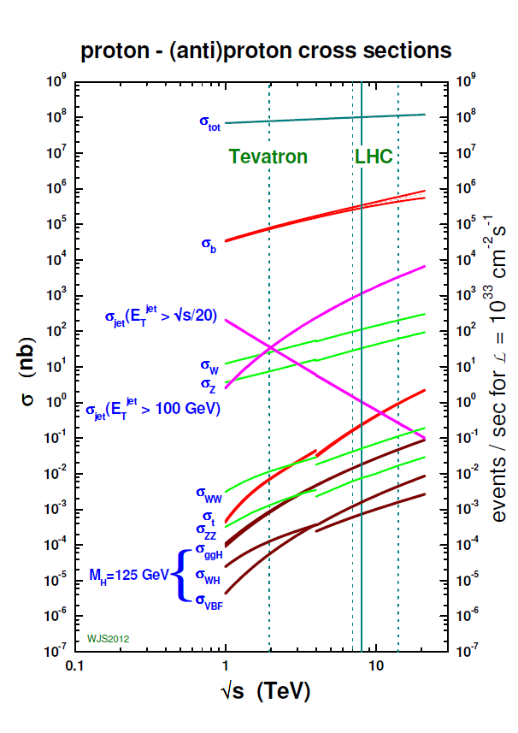
Needle in the haystack
_
PANDA
CMS
100 mb
total
10 mb
elastic
10⁻¹
1
10
100
1 mb
Antiproton momentum
[GeV/c]
100 μb
Background 10⁴ to 10¹¹ times larger than signal
Cross section
10 μb
Glueballs
1 μb
η_{c}
100 nb
χ_{c2}
X(3872)
10 nb
η_{c}π⁰
χ_{c0}
Hybrids
1 nb
PAGE 2

Slide 3
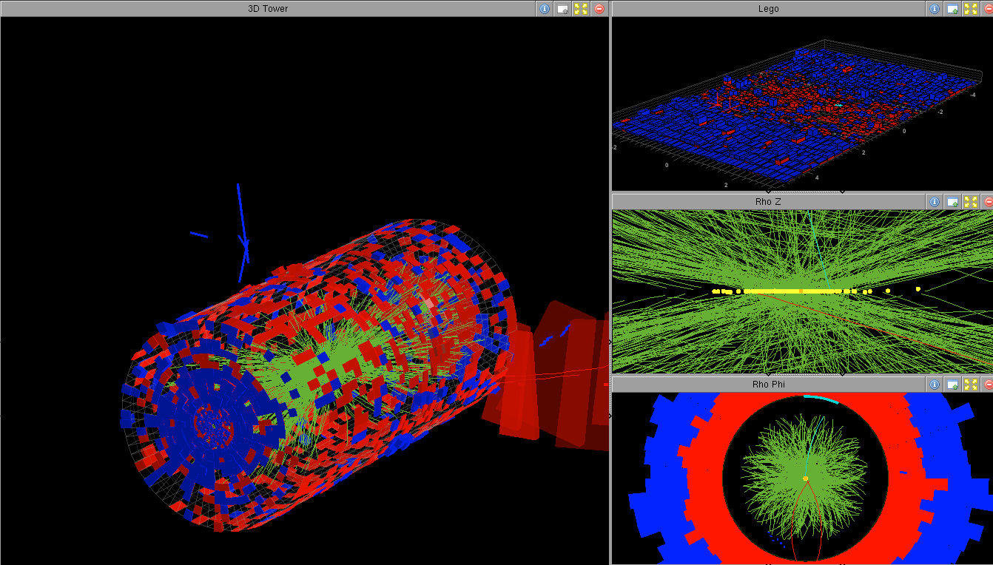
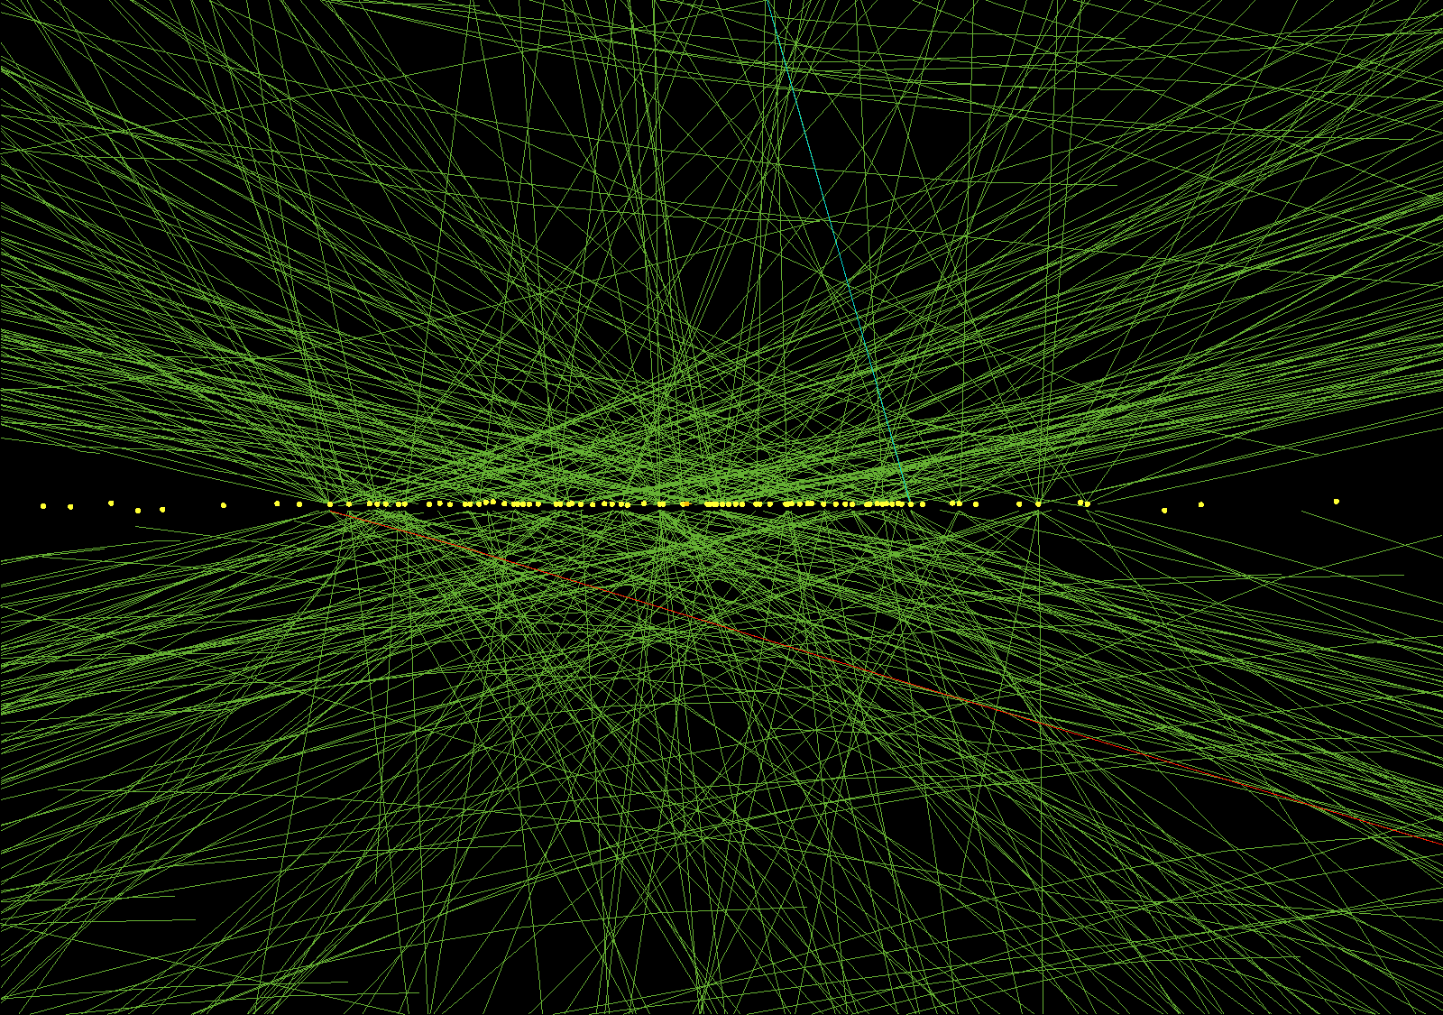
High Luminosity - LHC
CMS - 78 pileup events from high pile-up run
Luminosity: 10³⁴ cm⁻²s⁻¹ → 5⋅10³⁴ cm⁻²s⁻¹
Pileup per BX: 20 → 140
Charged tracks per BX: 1,000 → 5,000 - 10,000

Slide 4
Modern Large Scale DAQ – Example CMS
CMS
Calo/Muon
Detectors
40 MHz event rate
L1
Front end pipelines
100 kHz trigger rate
Readout buffers
Processor farms
1000 PCs
100 Hz output
100 MByte/s
HLT
Storage

Slide 5
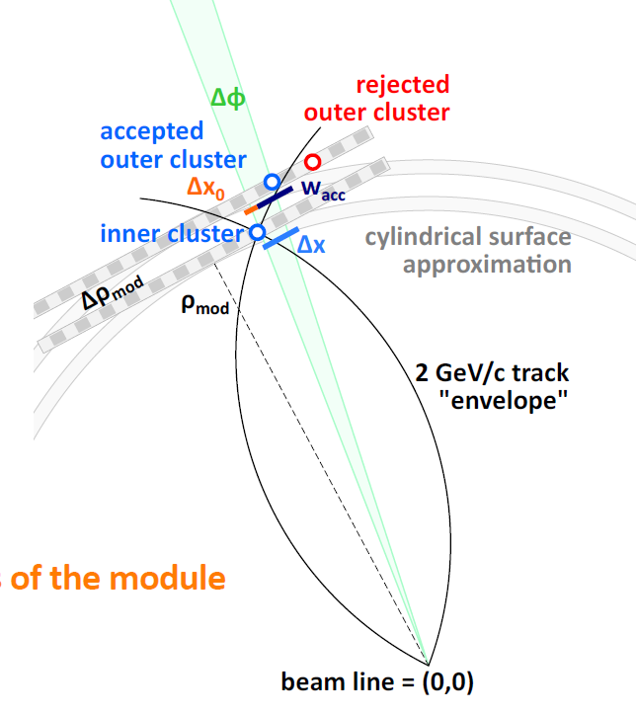
Future DAQ – CMS
Calo/Muon
Tracker
CMS
Tracker information
Detectors
40 MHz event rate
L1
Front end pipelines
100 kHz – 1 MHz trigger rate
Readout buffers
Processor farms
1 kHz output
HLT
Storage

Slide 6
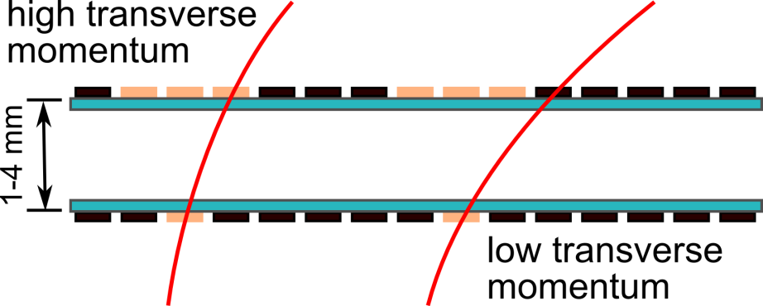
Future DAQ – CMS
Calo/Muon
Tracker
CMS
Tracker information
Detectors
40 MHz event rate
New FEE
Readout bandwidth largely increased
Correlation of tracks
Select tracks > 2 GeV/c for L1
Continous readout of stubs
L1
Front end pipelines
100 kHz – 1 MHz trigger rate
stub
Readout buffers
Processor farms
1 kHz output
HLT
Storage

Slide 7
Future DAQ – CMS
Calo/Muon
Tracker
CMS
Tracker information
Detectors
40 MHz event rate
New FEE
Readout bandwidth largely increased
Correlation of tracks
Select tracks > 2 GeV/c for L1
Continous readout of stubs
L1
Front end pipelines
100 kHz – 1 MHz trigger rate
Track trigger
Online track reconstruction
Combined with
Calo /Muon data
Largely increased bandwidth and compute power
Readout buffers
Processor farms
1 kHz output
HLT
Poster: CMS Level 1 Track Trigger for HL-LHC
Storage

Slide 8
PANDA a Step Further - Trigger-less DAQ
_
One of many experiments e.g. ALICE, LHCb, CBM
No hardware trigger to initiate readout
Continuous sampling readout
Event filtering by online data processors
Advantages:
  All data available for selection
  Flexible
  Upgradeable
Challenges:
  No event definition at readout stage
  No event time
  Much higher data rate

Slide 9
Data Rate and Event Size

Slide 10
Comparison
_
Calo/Muon
Tracker
CMS
PANDA
Detectors
40 MHz event rate
Detectors
20 MHz event rate
Triggerless FEE
Time stamp
20 MHz readout rate
200 GByte/s output
L1
Front end pipelines
100 kHz – 1 MHz trigger rate
Readout buffers
Readout buffers
Feature extraction
µTCA.4
Processor farms
1 kHz output
Event
Filter
Compute farms
ATCA system
FPGA, CPU, GPU, …
200 MByte/s output
HLT
Storage
Storage

Slide 11
Common Developments
Front-end electronics:
  Continuous readout
  High bandwidth outputs
  On-chip pre-processing
Optical data transmission:
  Radiation tolerance
  High bandwidth
  Low power
  Packaging
ASICs development (3.2.1)
Poster: Detector module development for the
CBM Silicon Tracking System
Poster: Free-Running Readout ASIC for Microstrip Sensors
Tbit/s Optical Data Transmission (3.2.2)
Presentation: Tbit/s Optical Data Transmission

Slide 12
Common Developments
High processing speed for complex algorithms
  High frequency board design
  Lossless data buffering
  Buffer synchronization
  Fast communication
  Heterogeneous processing networks
  (FPGA, CPU, GPU, …)
  Optimization of algorithms for used
  hardware
Huge data storage requirements of
~ 10 Pbyte/year
Intelligent Programmable Electronics (3.2.2)
Parallel Processing (3.2.2)
Poster: GPU-accelerated algorithms for data analysis

Slide 13
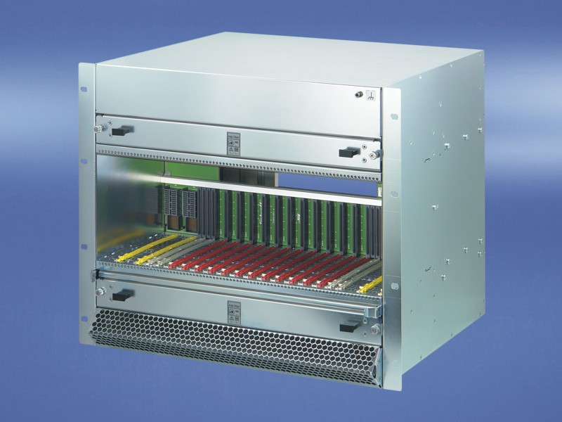
µTCA for physics (MTCA.4)
Industry standard specifically for physics:
  Enhanced connectivity on backside
  More and better clock lines
  Enhanced monitoring capabilities
Coordinated by DESY
Supported by „Helmholtz Validation Fund“
Widely used for accelerators (FLASH, XFEL, …), photon science and future particle physics experiments

Slide 14
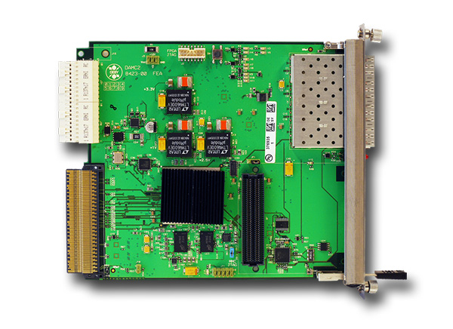
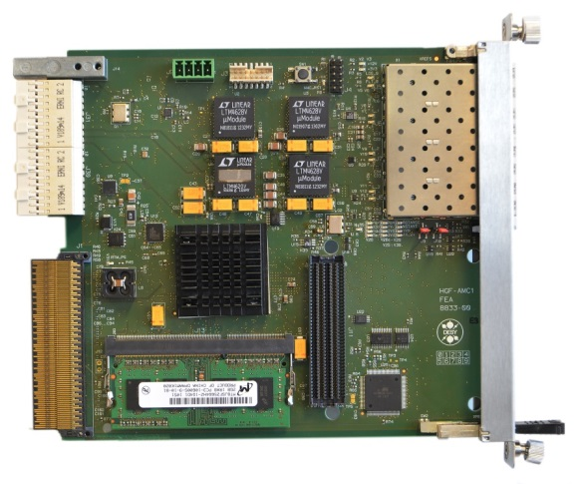
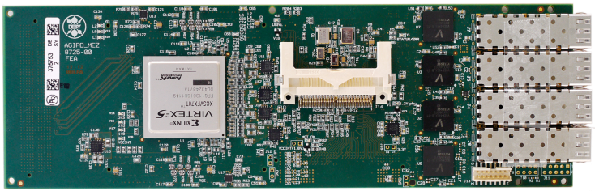
HGF AMC Board
DAMC2
HGF AMC
Virtex-5
µTCA.4
Accelerator control
Kintex-7
µTCA.4
4 x 10 Gbit/s SFP+
Accelerator control,
photon detectors,
PANDA, CMS
Mezzanine
Board
Build up on each other
Modular designs
Applications in different fields and centers
Virtex-5
4 x 10 Gbit/s SFP+
Readout AGIPD, PERCIVAL
Helmholtz Cube
Poster: The Adaptive Gain Integrating Pixel Detector (AGIPD)

Slide 15


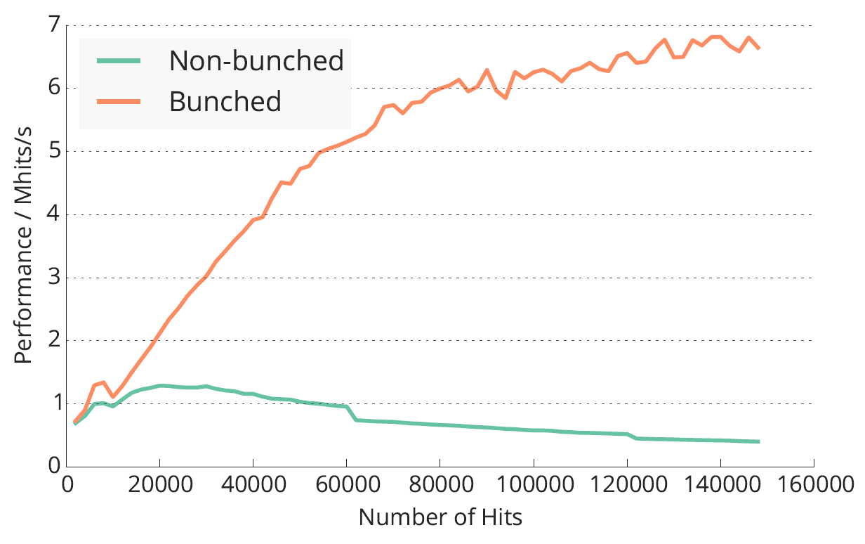


GPU Tracking
Tremendous performance increase by using GPUs vs. CPUs
Know-how essential ➔ close collaboration with NVIDIA
Track propagation inside PANDA
(RK 4th order)
Optimized vs. non-optimized track finding
optimized
Speedup
non-optimized
M.Al-Turany
Hits

Slide 16
Conclusions
High-speed DAQ systems are a key component for future experiments
Technological challenges require strong collaboration between different experiments and research fields
Common hardware structures, interfaces and firmwares save money and development time
Novel approaches require common developments to make them useful for a wide variety of experiments
Close collaboration with industry

