Slide 1
Detector Technologies and Systems
Science driven developments
The Helmholtz-Cube as an example

Slide 2
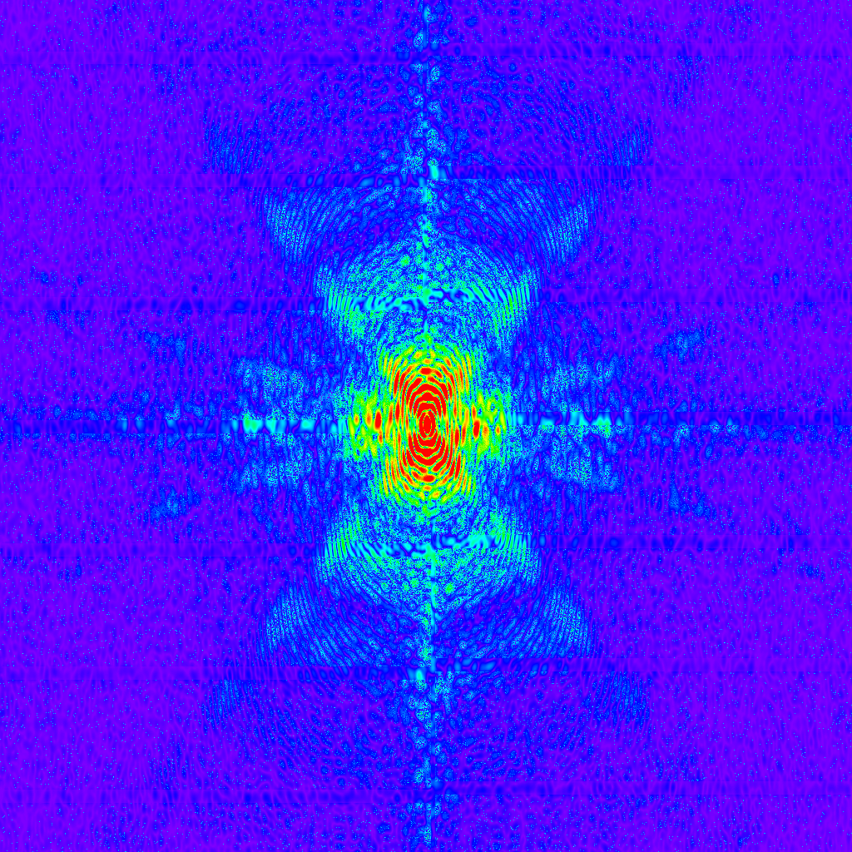
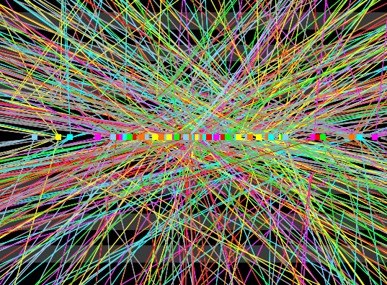
Science driven developments
High Luminosity LHC
European XFEL
Increased number of interactions
  ➔higher granularity
  ➔higher trigger rates
  ➔higher radiation tolerance
Increased peak brilliance @ 4.5 MHz
  ➔higher dynamic range
  ➔higher frame rates
  ➔higher radiation tolerance

Slide 3
A systems approach
DTS Structure
Sensors, ASICs and Interconnects
Data Transmission and Processing
Detector Systems
Sensors
Terabit/s Optical Data Transmission
HGF-Cube
Compact Gaseous Detectors
Readout Electronics
Intelligent Programmable
Electronics
Fast Photon and X-ray Detectors
Fast Timing Detector Systems
Interconnect, Packaging and Innovative Materials
Parallel Processing
CMOS Sensor Systems
Networking, Outreach and Applications beyond “Matter”

Slide 4
A systems approach
DTS Structure
Sensors, ASICs and Interconnects
Data Transmission and Processing
Detector Systems
Sensors
Terabit/s Optical Data Transmission
HGF-Cube
Compact Gaseous Detectors
Readout Electronics
Intelligent Programmable
Electronics
Fast Photon and X-ray Detectors
Fast Timing Detector Systems
Interconnect, Packaging and Innovative Materials
Parallel Processing
CMOS Sensor Systems
Networking, Outreach and Applications beyond “Matter”

Slide 5
A systems approach: The Helmholtz-Cube
Development of the components of solid state Hybrid Pixel Array Detectors:
Sensors
ASICs
Interconnect
Construction materials
High-speed I/O
Lower the barrier to develop and test new components by leaving rest of system unchanged
Develop components with system integration and testability in mind

Slide 6
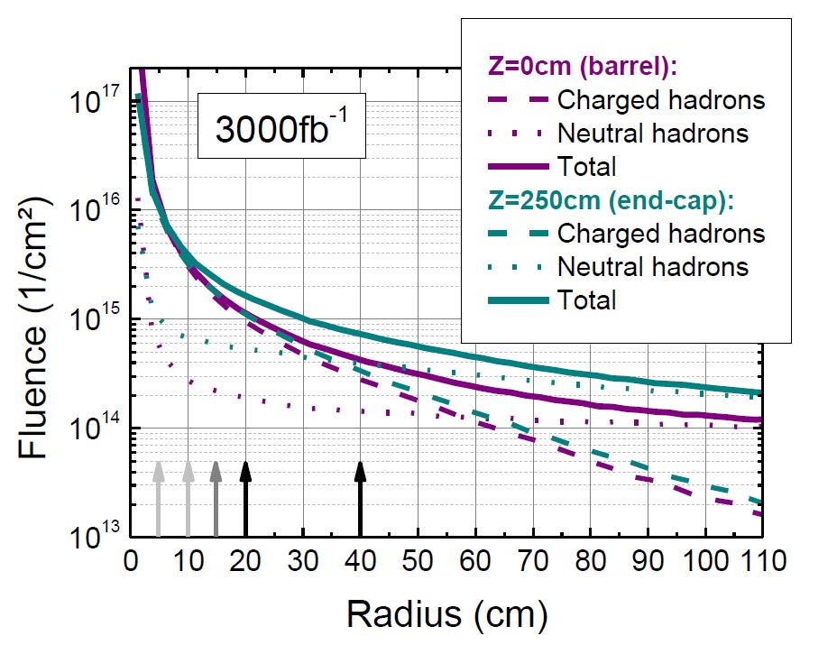

Radiation hard sensors
Challenging environment at high-luminosity LHC:
  Increased average number of interactions per bunch-crossing
    → need to increase granularity
  Increased luminosity by factor of five, thus even harsher radiation environment
    → Radiation hard sensor technologies and design
HL-LHC radiation field
outer tracker
$t\overline{t}$ event with 140 pile-up events

Slide 7
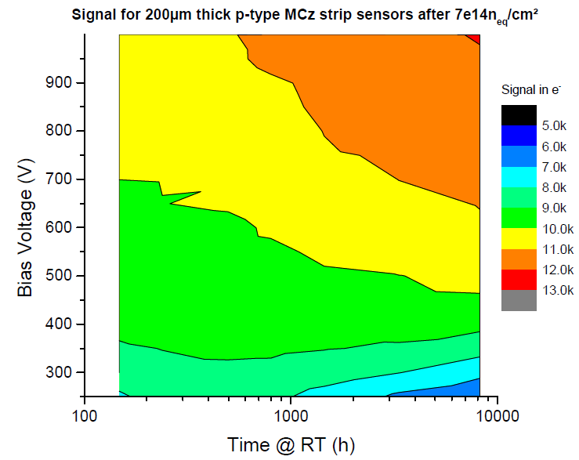
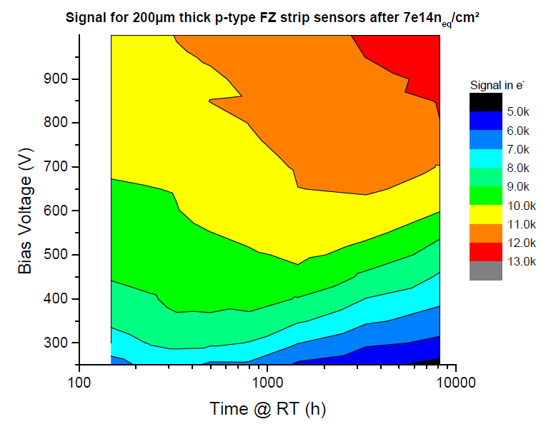
Radiation hard sensors
Investigation of behavior of differently grown materials
  ➔ Different growth methods result in different behavior

Slide 8
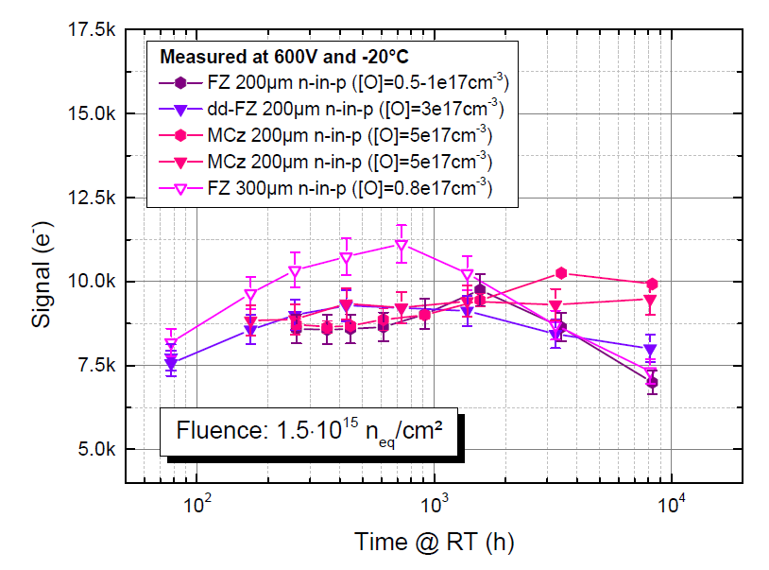
Radiation hard sensors
Materials:
  Epitaxially grown silicon, magnetic Czochralski, oxygen-enriched Floatzone
  all with thickness ≤200µm
Technologies:
  Planar strip and pixel sensors
  3d sensors
  CMOS
Running scenarios:
  Run cold at -20°C
  Keep at room temperature during
  maintenance period ~2 weeks/year

Slide 9
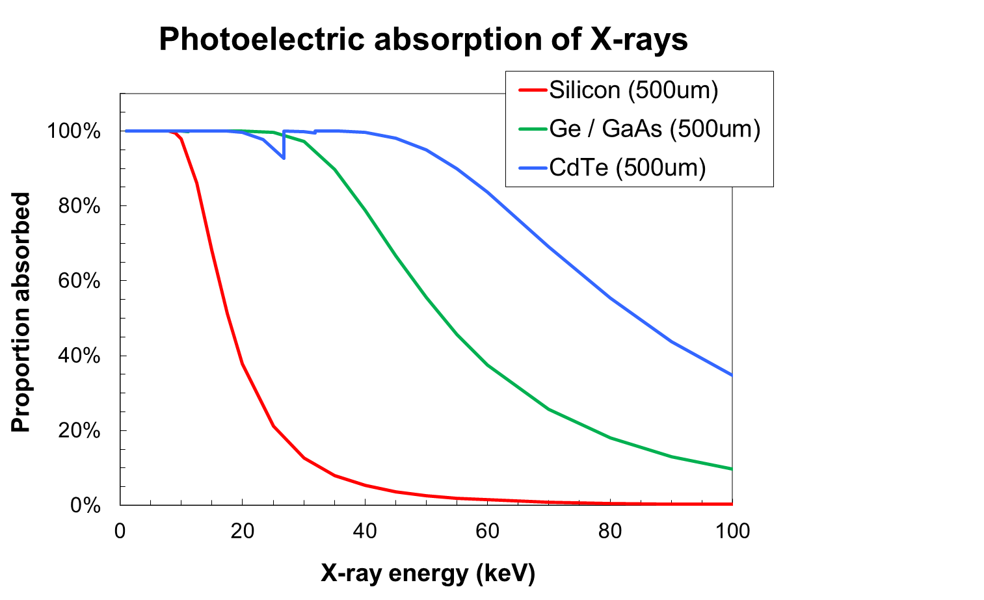
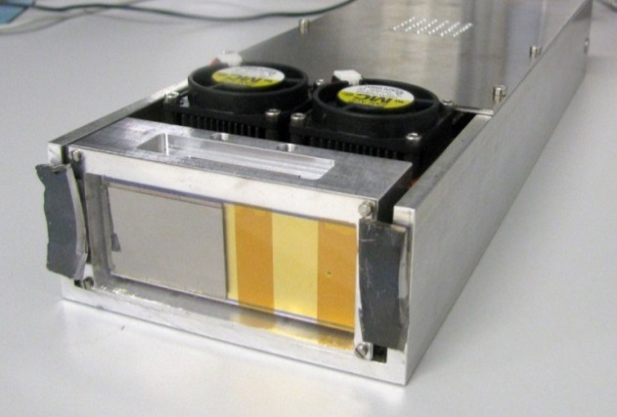
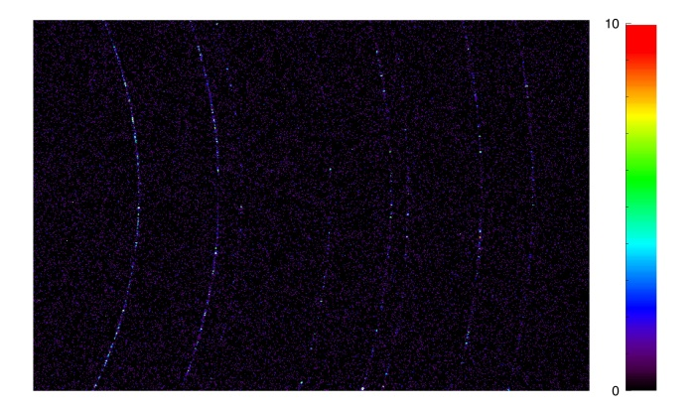
High-Z sensors
Aim: replace silicon sensor in Helmholtz-Cube with high-Z semiconductor
  Combine high QE with hard X-rays, high frame rate, high signal-to-noise
  Investigating different materials in collaboration with other institutes and industry: CdTe; GaAs; Ge
HGF-Cube + GaAs
Diffraction from CeO₂
42 keV; 2 ms

Slide 10
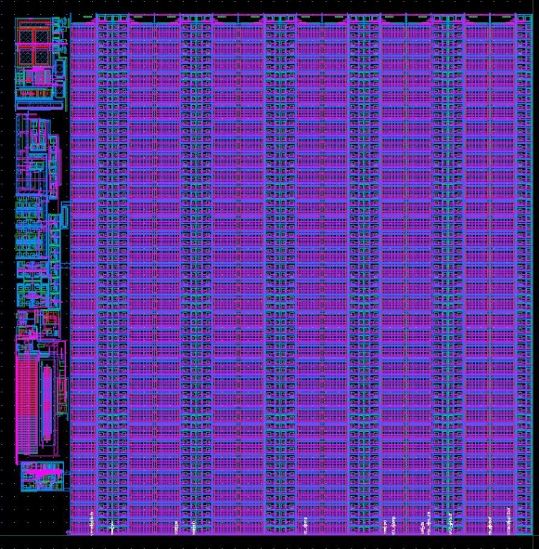
ASICs
Profit from Moore’s law: increased functionality per unit area
  ➔ smaller pixels or smarter pixels or both.
Profit from increased radiation hardness for deep sub-micron CMOS
Example: Detectors for the European XFEL: 4.5 MHz; 2700 images; 10s of MGy
Sensor
Electronics per pixel
Pixel matrix
…
HV
Analog Mem
CDS
RO bus (per column)
+
SW
DAC
Analog Mem
RO Amp
…
-
CTRL
THR
Calibration circuitry
ASIC periphery
Chip output driver
Mux
Adaptive gain amplifier
352 analog memory cells

Slide 11
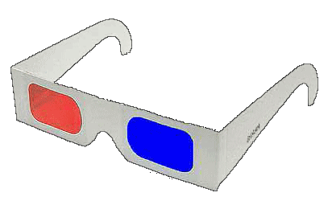

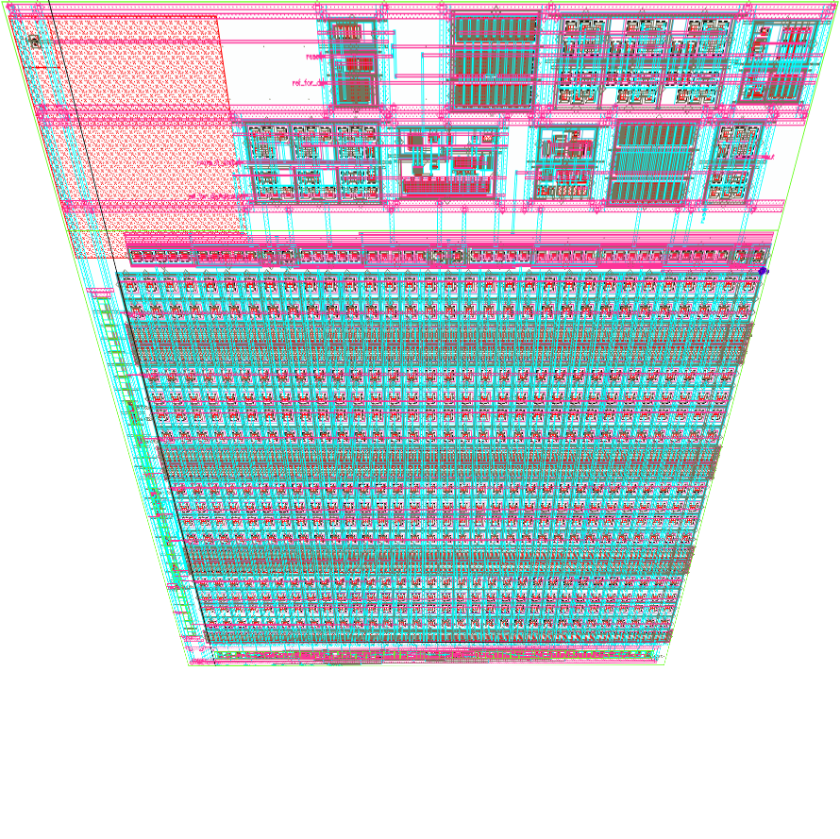
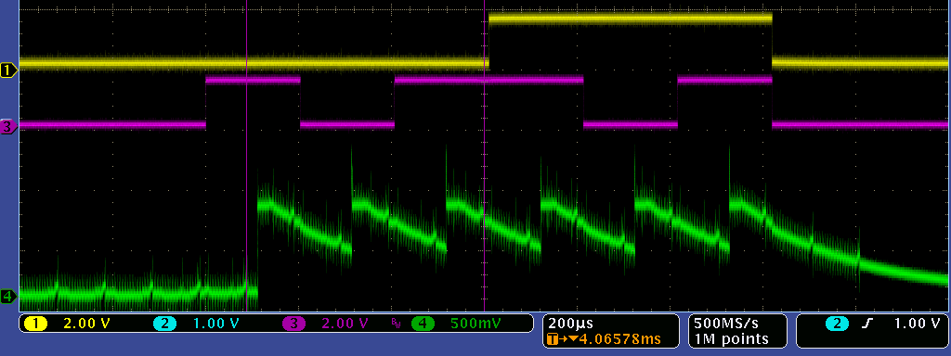
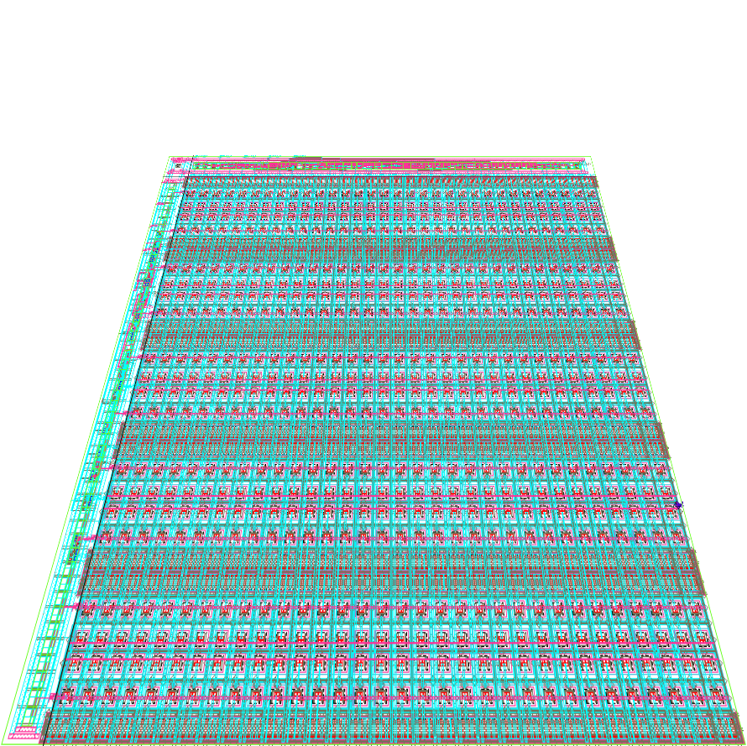
3D Evolution of the AGIPD detector
Scientific goal: most efficient Serial Femto-second Crystallography (SFX), Single Particle Imaging, etc
Technical goal: record as many images as possible during bunch train.
➔ Design a two-layer ASIC with more storage cells in second layer
bump bond pad
to sensor
First results: achieved connectivity between two layers!!
amplification &
double sampling
out
bottom tier
top tier
digital circ
storage on 2 tiers
(544 images)
test in progress ...
analog circ

Slide 12
Common actions on ASICs
The Helmholtz centers in MaT decided to:
Use a common next node: TSMC 65 nm CMOS
Create a design repository to share designs and design blocks
Design a common “multi-purpose” readout ASIC
Organize regular “designer meetings” for information exchange
Do mutual design reviews

Slide 13
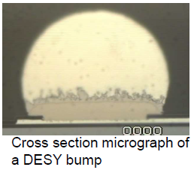
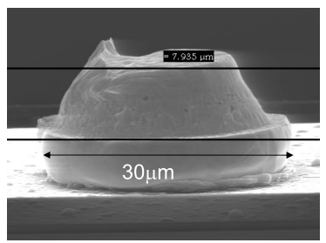
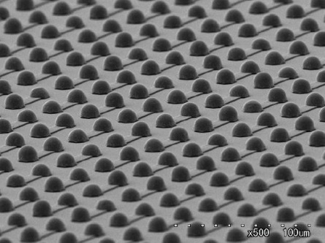
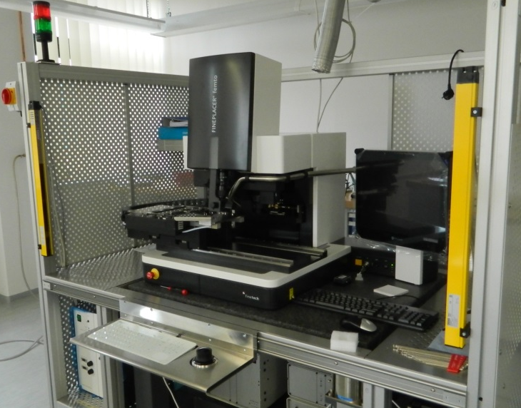
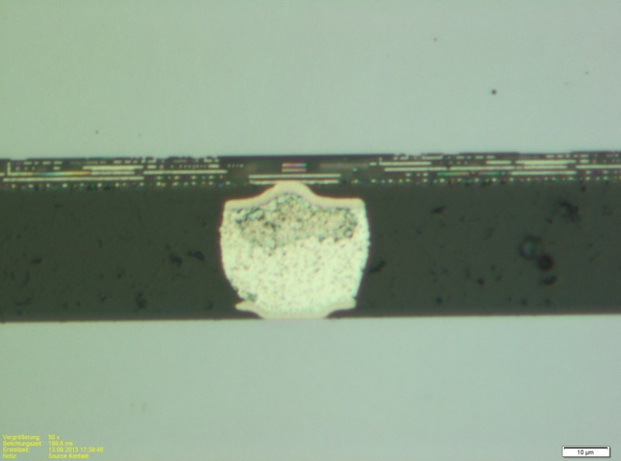
Interconnect & Assembly
Goals
Stimulate smaller pitch hybridization
Flexible small scale prototyping utilizing series like processes
New processes for innovative materials
Cost & time reduction from lab to detector
high yield & reliability
Micro-Studbump KIT
Sensor
PPS-Process (Senju-Metal)
ROC
High precision Flip-Chip bonder
High placement
accuracy (<2µm)

Slide 14
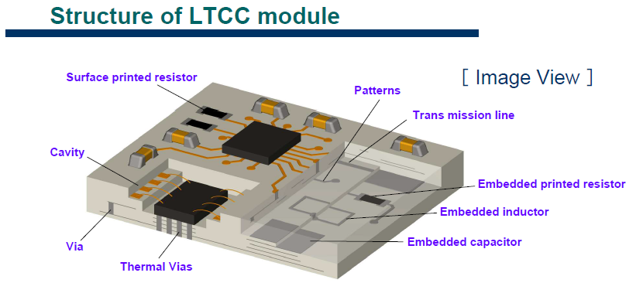
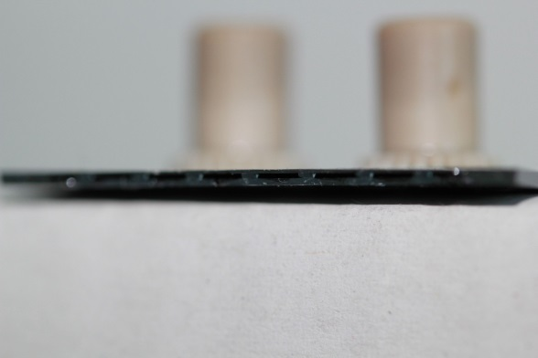
Innovative assembly structures
Goal: use innovative multi purpose materials for improved performance:
  Reduced mass
  Increased mechanical strength
  Increased cooling
Multi-functional PCBs
Micro-channel cooling
➔ See talk by Andreas Mussgiller

Slide 15
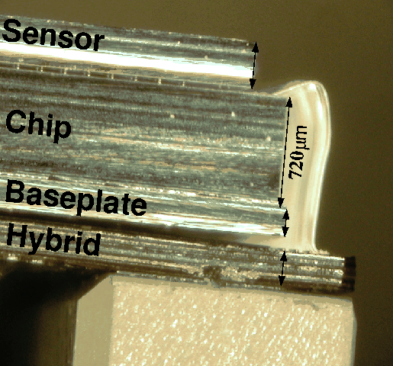
A common goal: Edgeless Helmholtz-Cubes
Current Helmholtz-Cube:
Edgeless Helmholtz-Cubes:
Technology involved is useful for many applications

Slide 16
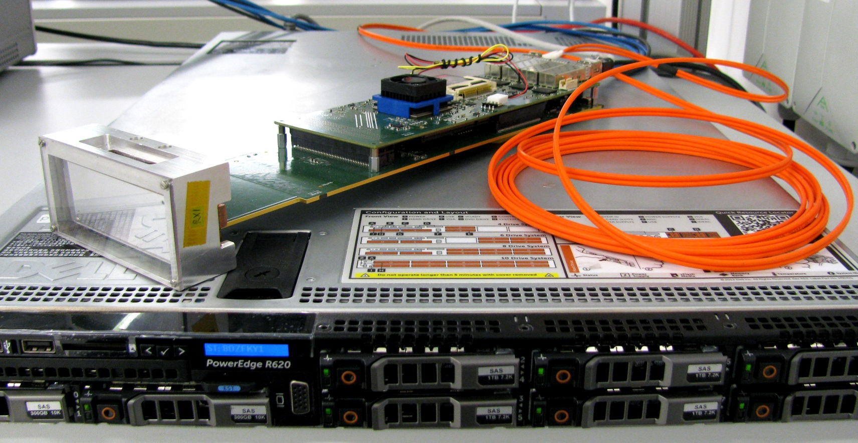
System integration of the Helmholtz-Cube
Intelligent Programmable H/W
High-speed optical I/O
Helmholtz-Cube
Data handling and processing

Slide 17
There is much more than shown here:
Si-PMs (see talk J. Ninkovic)
Fast radiation-hard diamond-based detectors
Gas based detectors, now combined with pixellated readout (e.g. Timepix3) (see talk Please fill in name)
CMOS imagers: low mass and low noise
Intelligent programmable hardware (e.g. FPGA based systems)
High-speed optical transmissions (see talk Chr. Koos)
On-the-fly data reduction and processing
➔ See posters for many more details.

