Slide 1
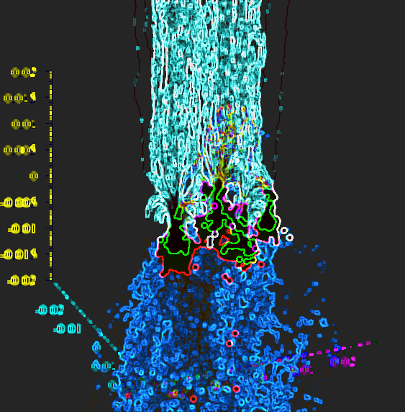
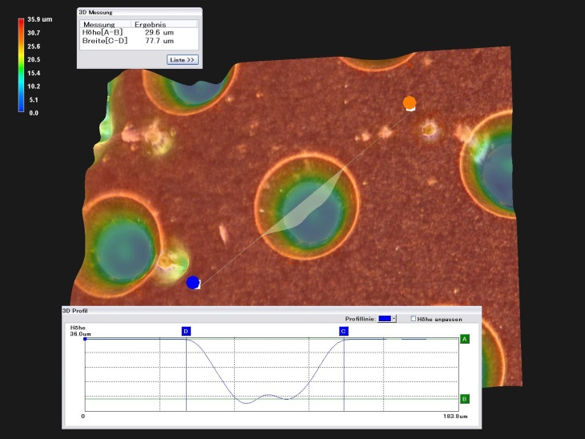
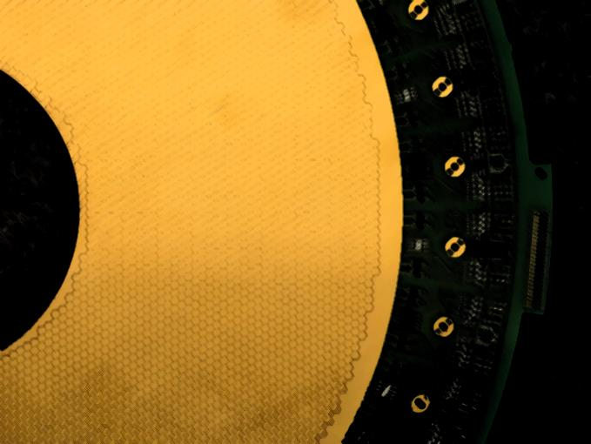
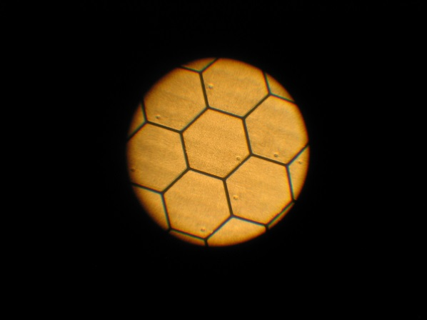
Gaseous Detectors
Nami Saito (GSI/HIM)
Notes:
( women issue.. )
I am working in a group in the detector lab in GSI developing gaseous detectors. and acturely 40 % are women in the group.

Slide 2
R&D in Broad Range
Detection
Multi-observables
dE, (x,y,z), t, flux, v,..
Detectors
Developments
Idea ➢ Design ➢ Fabrication
➢ Application ➢ Spin-off
Scope
Photon, MIP, Heavy ions
Gaseous
ionization
detectors
Physics
Material science
Electronics
Chemistry
Scale
Single channel ⇔ High-complex
millimeter ⇔ meter
Notes:
“Gaseous ionization detectors utilize state of the art technologies from many scientific fields,
Material science and electronics researches we do collaborate
and we have collaborations among institutions and we are interacting each other for research and developments.
For R&D, we consider things in a broad range. For example, for development process is starting from idea and we do design,.. application and spin-off like medical application, We have also strong cross-links to the accelerators
..from single channel to pixelated in High-complex, kubic meter scale that would be difficult for semi-conductor detectors as active media” complementary link to solid state detectors.
We take decisions on the technologies to develop according to the needs of the experiments to build (looking for ‘new physics’) and the facilities (e.g. accelerators) to operate. And we aim to maximize synergies between program fields and look for applications with an added value for the society (cancer treatment, medical imaging etc.).

Slide 3
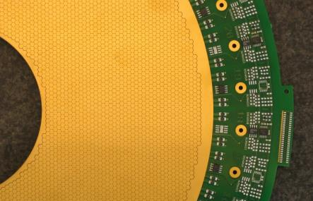
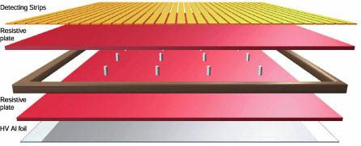
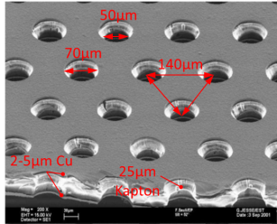
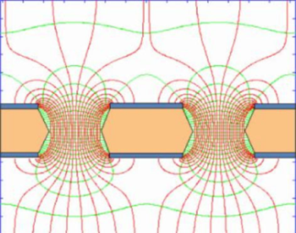
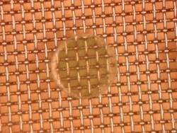
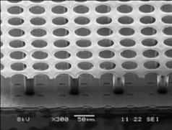
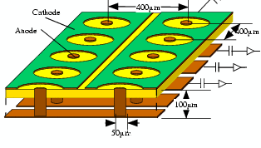
Applications from basic physics to applied research
Figures of merit
Size 100 m³, 10m²
Materials 0.1 % of X₀
Rate 10 MHz
Dynamic range fA ÷ mA
Resolution 1 %(E), 30µm(x)
100 ps(t)
Efficiency 100 %
Stability decade
Durability against radiation
R&D key components
Interaction in gas
Amplification (e⁻ avalanche)
Readout electronics
Readout pad plane
Key technologies
Resistive Plate Chamber
Gas Electron Multiplier
Micro-Mesh Gaseous Structure
Integrated Grid on Si
Micro Pixel Chamber
RPC
GEM
Electric fields of GEM foil
MicroMegas
Ingrid
µ-PIC
Notes:
This is just an example…: Needs are: larger, finer, thinner,
Its applied in Matter (MaT) but also in other fields BUT
Make such cutting edge detectors reality and affordable & exploit synergies Networking activities within and across the HGF program (Material, Life) but also with national and international universities (TUM,HIM,UAN) and industrial partners (CERN, TECHTRA) are essential to get the job done
relevant for industry → talk & teach industry, BUT of course we do not realize CMS
RPC (Resistive Plate. Chamber):
GEM (Gas Electron Multiplier): micro scale holes
MicroMegas (Micro-Mesh Gaseous Structure): micro-mesh
Ingrid (Integrated Grid on Si): thin metal grid on Si chip
µ-PIC (Micro Pixel Chamber): avalanche at readout pixel

Slide 4
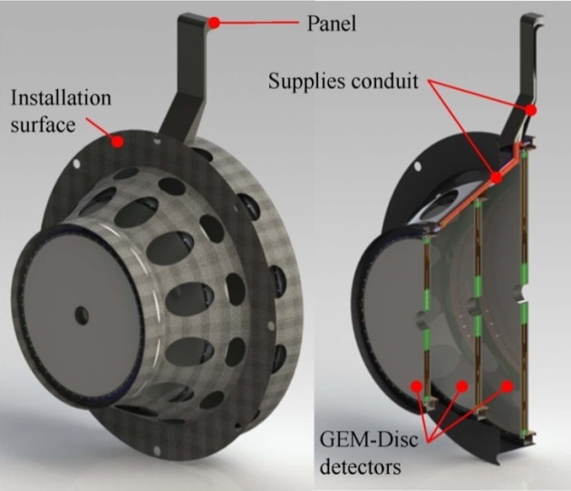
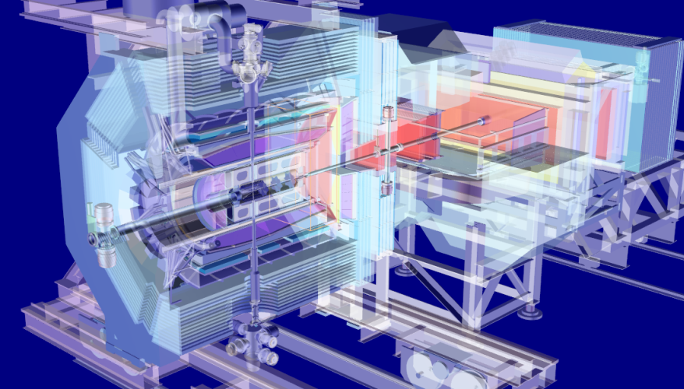
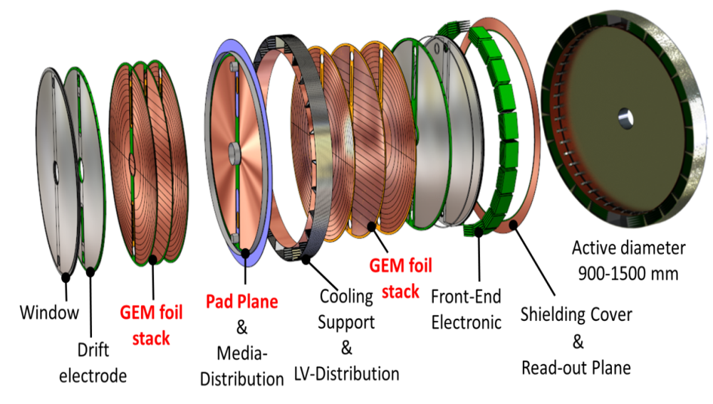
GEM-Tracker
A charged-particle track detection-system in the PANDA target spectrometer
Compact
Modular
Minimized material
Innovative
cutting-edge
Large scale ∅1.5 m
Thin materials ~0.5 % of X₀
High rates ~100 kHz/cm²
Track resolution ~100 µm
Double drift volumes 1 cm gap
Sectored GEM foils 1000 sect./disc
Continuous readout 32 MHz
Micro-patterned pad-plane ~40 kch
Notes:
This is just an example….for a high energy physics application aiming for new physics, driving developments applied in accelerator applications and medical imaging for cancer treatment
lossless, high aperture, high det. eff., large acceptance 100% 5-25°
Opens new horizons

Slide 5
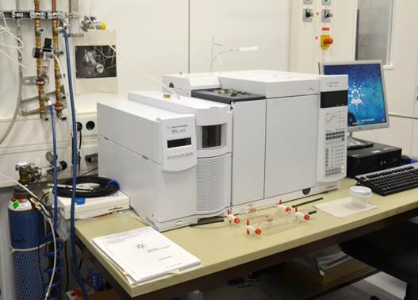
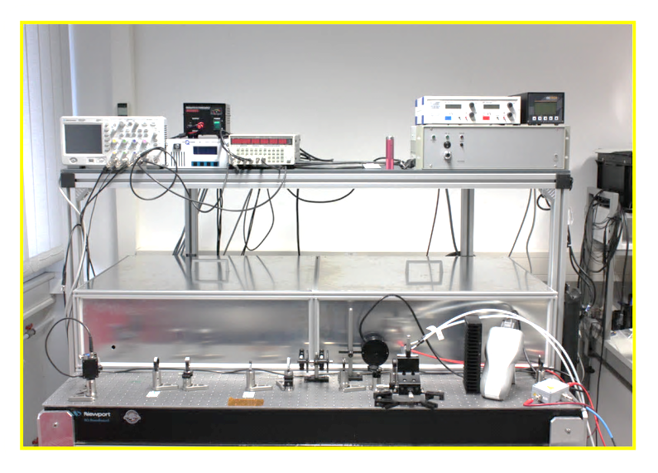
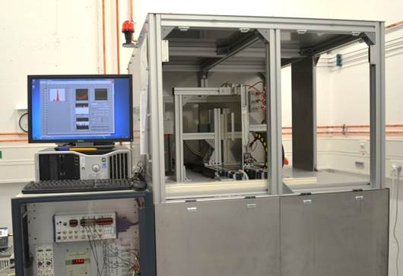
Common infrastructure Joint ventures
Gas chromatography
Test bench with laser
Aging test with a X-ray source
2D-scan system (microscope, X-ray, laser, scintillator)
Notes:
We offer service to the community within HGF and collaborators to be effective and gain synergies.
We have a center where gas chromatography, .
(We have strategic collaborations with universities and other institutes, eg. in PANDA with UAN, HIP, TUM, LMU also within the EU-funded topics and even some projects which profit synergeticall from DFG funds. )
(iso-class 3: 0.29p/m3 for >5micron)

Slide 6
Perspective & Vision
Complexity
Refinement
Miniaturization
Split & superimpose
Integration
Optimization
Solid state + Optical
Simple
Notes:
Gas are unbeaten when it comes to size (m2) and cost effectively to extract information from huge detection/interaction volumes (of 100m3) in one single installation
Challenges are within increasingly large information (TB/s) to be distilled within a short and eventually continuous in time (e.g. in PANDA) , requiring high channel numbers (reaching Mio) and novel read-out systems

Slide 7
End

Slide 8
Gaseous Detectors - Summery
Gaseous detectors have extensive use in scientific researches offering a large area coverage with low material budget
Unprecedented granularity of readout compete with Si-based device.
Cutting edge RPC system and robust and scalable micro-patterned gaseous detectors drive state-of-the-art technologies forward exploiting excellent timing, trigger and tracking applications.
Common infrastructure and joint venture accelerate R&D processes and enhance know-how on system engineering, quality assurance, and aging control.
Gaseous detectors are currently at optimization and integration phases, and possible scenario is to have a simple structure as micro-PIC has with technology from solid-state and optics
Notes:
Gaseous detectors are cross links among scientific fields and R&D make gain of many applications (accelerator control, low-to-high-energy physics experiments, medical imaging system)
Advanced gaseous detectors have sophisticated micro structures. Challenges are within large scale and large information handling though readout system.
State of the art technologies need to be pushed to enlarge application fields (boundaries – larger readout plane at higher density, slim down, lighter and stronger structural materials).

