Slide 1
SRF Science & Technology
Enabling technology for future accelerators
J. Knobloch (HZB) for the Sub-Topic 1 participants
DESY, HZB, HZDR, GSI, HIM

Slide 2
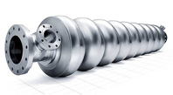
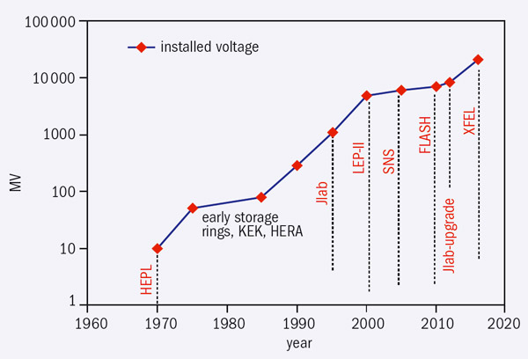

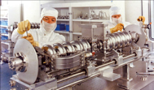
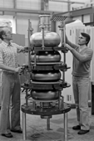
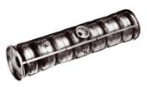
SRF – A success story
H. Padamsee, “Advances in Acceleration: The superconducting way”,
CERN Courier, Oct. 25, 2011
ILC?
for high beta structures (MV)
Shown here: only high beta LINACs.
Similar development for low beta LINACs
Why has SRF been so successful despite its cost & complexity?
… because SRF is frequently the enabling technology required for novel accelerator applications which otherwise would not be possible (or only with great difficulty).
Past: CW operation Present: High-field Future?: CW operation
but at moderate field ops. but (long) pulses and at high field
In general

Slide 3
What makes SRF unique?
SRF = enables CW and high field and high current and low impedance operation simultaneously
➔Better beam properties
  E.g., pulse length, brightness, average current …
➔Better stability
  E.g., equilibrium systems, implementation of beam-based feedback …
➔Better experimental conditions
  E.g., simpler signal recording & detection techniques
➔ Flexibility to tailor layout & operating parameters to application needs!
  E.g., Pulse structure/length, repetition rate, bunch length …
“Armed” with these advantages, where are the dreams taking us?

Slide 4
Where are the dreams taking us?
Many accelerator applications, both small and large … too many to discuss in detail
  CW LINAC-based light sources … FELs, THz
  Storage-ring based light sources
  Accelerators for high-energy physics (ILC, LHeC)
  ERL light sources ... combining advantages of LINACs and rings
  ERLs for nuclear/high energy physics
  Compact Compton sources for medical and industrial applications
  CW SRF LINACs/ERLs for Lithography
  High-power spallation sources
  High-power rare isotope beams
  High-power proton accelerators, nuclear waste transmutation
(CW) SRF is the enabling technology for many of these projects
Some examples on the following slides

Slide 5
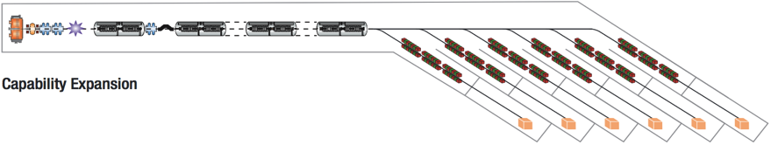
FEL light sources
LCLS-II
High rep. rate → multiple users possible
4 GeV
US BESAC Subcommittee on X-ray light sources report, (July 2013):
“(To address the Grand Challenges) … this new light source should provide high repetition rate, ultra-bright, … femtosecond x-ray pulses .... Stability and precision timing will be critical …”
High repetition rate, soft x-ray laser array
  Multiple FELs for multiple users with 10⁶ very stable pulses per second
Spatially and temporally coherent X rays
  Ultrashort pulses: 250 as – 250 fs
Tunable X-rays
  Adjustible photon energy & Polarization Control
  Moderate peak flux in pulses avoids damage or space charge problems
Superconducting accelerator
Original concept: NGLS
C. Mayes, SLAC
Based on slides from J. Corlett, LBNL, 2012
 | Rep. rate [Hz] | Time to do experiment | Resolution
Storage Ring | 10⁷ | 10 days | 100 ps
Pulsed FEL | 10² | 100 days | Few fs
NGLS | 10⁶ | 3 hours | Few fs
“Time required for time-resolved
reaction microscope experiments”
Comparison taken from NGLS CD0
proposal

Slide 6
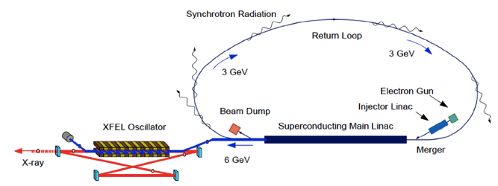
ERL-based light sources
ERLs: Efficiency of storage rings + beam properties as in LINACs
  Flux and multiuser operation as in 3rd generation light sources.
  Greater brilliance and brightness, … yet peak power below the destruction limit.
Proposal KEK
Superconducting LINAC
Tunable x-ray
FEL oscillator
ERL light source @ KEK
K.-J. Kim and Y. Shvyd‘ko
“Tunable optical cavity for an x-ray free-electron-laser oscillator”, Phys. Rev. ST-AB 12, 030703 (2009)
R. Hajima et al., “Simulations of XFELO for the
KEK ERL”, Proc. FEL2012 (2012)

Slide 7
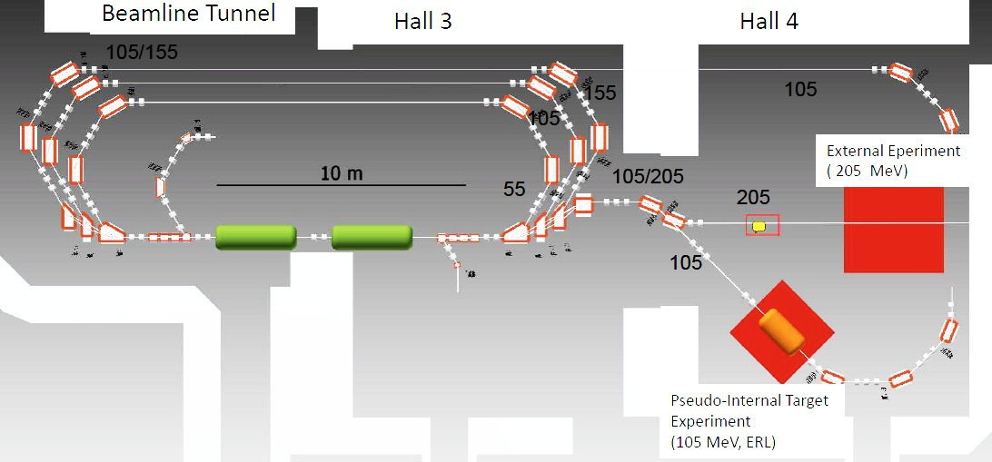
Nuclear physics with ERLs
MESA (Universität Mainz, funding approved)
Experiments
  Dark matter search
  Nuclear-stellar-astrophysics
  Polarized positrons for materials research
  Fluorescent nanodiamonds for medical applications
Beam parameters
  E = 100 MeV
  I = 10 mA
  Low-emittance beam
  CW operation
SRF Accelerator
K. Aulenbacher, et al., “Status of the MESA accelerator”, Proc. ERL 2013 (2013)

Slide 8
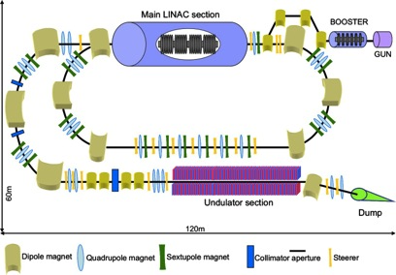
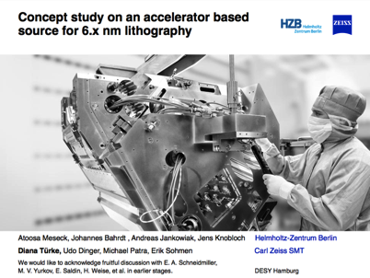
SRF for industrial applications
UV light source for Next-Generation Lithography (beyond 193 nm)
  100’s W @ 13.5 & 6.5 nm. Plasma sources are insufficient.
  CW LINAC driven light source to provide high average power with low peak power for precise control of illumination.
SRF LINAC
Industrialization
“Several facilities per year”

Slide 9
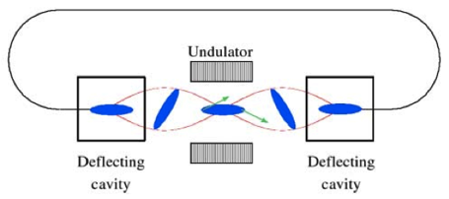
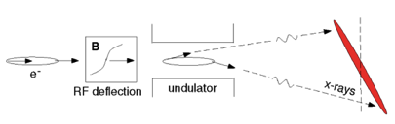


New SRF storage-ring applications
Photon-pulse-length manipulation via crab cavities (SPX @ APS)
Flexible bunch-lengths via large overvoltage (BESSY-VSR)
  Long and short bunches possible simultaneously in a storage ring!
  Requires high-voltage CW cavities operating at several frequencies
A. Zholents et al., Generation of subpicosecond x-ray pulses using RF orbit deflection NIM A 425, 385 (1999)
Deflecting
SRF Cavity
APS, Argonne
Deflecting
SRF Cavity
ST3
BESSY-VSR concept for BESSY II
17 ps
2 ps
17 ps
2 ps
17 ps
MML
1.5 GHz 1.75 GHz
G. Wüstefeld et al., “Simultenous long and short electron bunches in the BESSY II storage ring”, Proc. IPAC 2011 (2011)

Slide 10
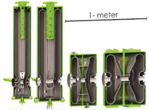
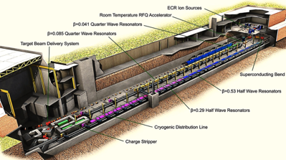
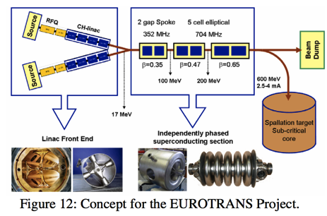
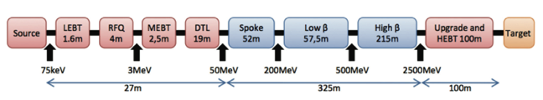
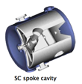

High-power ion accelerators
Courtesy M. Leitner, MSU
Rare Isotope Beams
J. Delayen, Proc. LINAC 2010
Nucl. Waste Transmutation
2.4 MW
FRIB
Michigan St. Univ.
> 200 MeV/u, 400 kW
Require high-power
CW or long-pulse
LINACs
ESS-S
2.5 GeV, 50 mA, 5 MW
MML
Spallation Neutrons
M. Eshraqi et al., Proc. IPAC 2010

Slide 11
Identifying common challenges
1. How far can we push existing systems?
  Existing technology can go a long way (e.g., CW TESLA operation)
2. Develop new CW SRF capable designs & treatments for:
  E.g., Highest currents with minimal beam disruption
  Reduced power dissipation
3. A LINAC is never better than its source → develop CW sources
  E.g., To provide average and peak high currents
  To tailor beams to the user needs
4. Nb is good … but can we do better? Develop new superconductors:
  E.g., Lower the power dissipation ×1/10
  Operation at higher temperature
  → less expensive and complex cryoplants
See talk by
A. Arnold

Slide 12
Impact of SRF R&D in ARD
R&D addresses Helmholtz facilities within the upcoming POF period
  ELBE, XFEL, BERLinPro, BESSY-VSR, CW Ion LINAC
  Directly addresses the MML and M&U programs
SRF R&D addresses large-scale facilities in the longer term future
  E.g., ESS, LCLS-II, EUROTrans, MESA, LHeC, HIAF, RISP
Know-How from SRF R&D can be transferred to industry
  E.g., Compton sources, lithography, medical imaging, turn-key
➔SRF R&D: addresses Helmholtz-Association facilities ... but many aspects are “generic” that benefit a wide spectrum of other projects
ST2
ST3

Slide 13
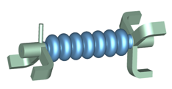
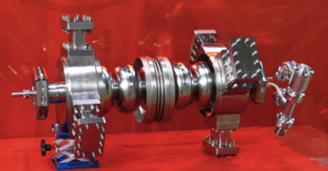
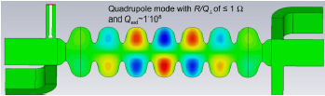
Impact of ARD R&D: Example 1
Development of next-generation, high-current SRF structures
  E.g., high-current cavity module with
    Low power dissipation for CW operation
    Heavy HOM damping for high current operation
Cavity development for BERLinPro:
Univ. Rostock, T. Univ Dortmund, HZB
Original JLAB 1.5 GHz development serves
as baseline

Slide 14
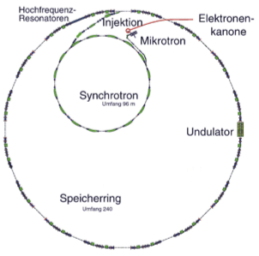
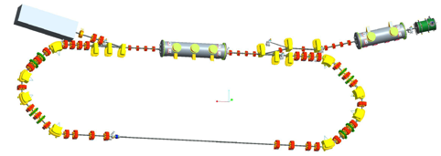
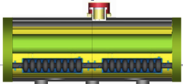

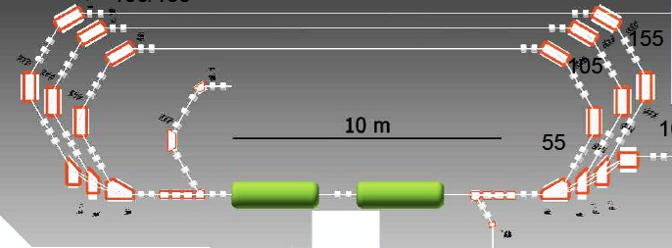
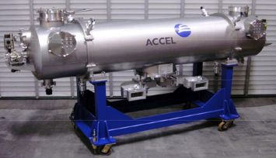
Impact of ARD R&D: Example 1
Short pulses in storage rings
BERLinPro & ERLs in general
ST3
ST3
High brilliance ERL
Short-pulse generation
MML
BESSY II
Technology transfer & industrialization
MESA (nucl. physics)
Industrialization
E.g., Past: Res. Instrum. production for ALICE (GB), TARLA (Turkey)→ New modules for new applications

Slide 15
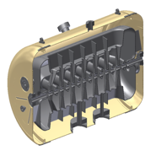
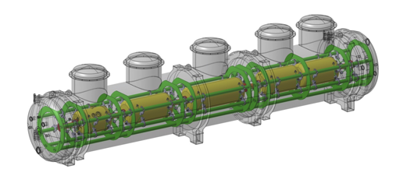
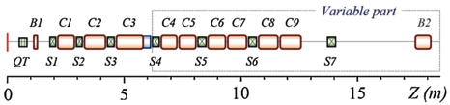
Impact of ARD R&D: Example 2
Development of new low-beta structure for ions
  High-acceptance, high-gradient CH-structures (GSI, U. Frankfurt)
Application: super-heavy-element program at GSI/HIM
  CW Ion LINAC for high-flux operation
Tuner flange
Helium vessel
Preparation
flange
Inclined
end stem
Coupler flange
Pickup flange
Development Universität Frankfurt & GSI
ST1
ST2
Super-heavy
element prodcution
M&U
See talk by W. Barth on ST2
Notes:
Crossbar H-mode cavities

Slide 16


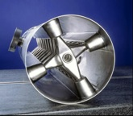
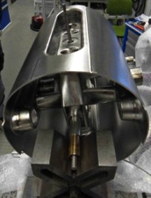
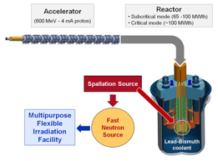
Impact of ARD R&D: Example 2
F. Dziuba et al., “Development of sc crossbar-H-mode cavities for proton and ion accelerators”, Phys. Rev. ST-AB 13 041302 (2010)
EuroTRANS
(Radioactive waste
transmutation)
EU
CH Structures
ST2
CW Ion LINAC
Super-heavy element
Science
HIM, GSI
Universität Frankfurt
Development Universität Frankfurt & GSI
ST2
EU
MYRRHA
(Radioactive waste
transmutation,
energy production)
UNILAC
(FAIR)
M&U

Slide 17
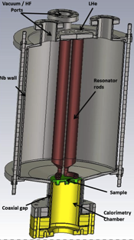
Impact of ARD R&D: Example 3
Cooldown conditions modify the losses in superconducting Nb
Basic R&D to better understand RF losses in various superconductors!
Fine grain cavity results (single cavity)
1.8 K
Trapped flux studies in Nb
J. Vogt et al.,
Phys. Rev ST-AB
Surface resistance
studies with samples
?!
Large-grain cavities (complete module)
Sample
Cooling procedure | Q₀ at 1.8K
Standard “DESY” | 4.7 × 10¹⁰
“HZB” + slow transition | 3.3 × 10¹⁰
“HZB” + fast transition | 4.6 × 10¹⁰
Study new superconductors
J. Sekutowicz, DESY

Slide 18
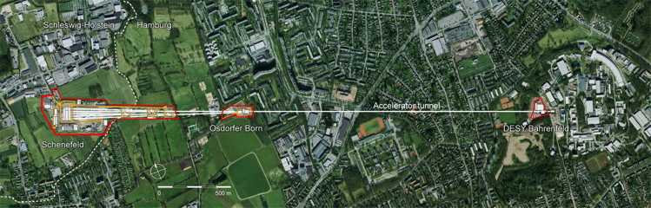
Impact of ARD R&D: Example 3
“Upgrade” existing facilities: e.g. Upgrade of XFEL to CW operation
MML
+ST3
ARD
Present
Future?
Better understanding
of losses in niobium
  Planned cryobudget
  TDR: Q = 10¹⁰
  New cryobudget (?)
  Q = 3 ×10¹⁰, CW
→ Max. CW beam
energy: 5.5 GeV
→ Max. CW beam
energy: 8 GeV

Slide 19

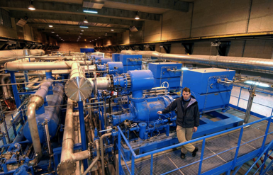
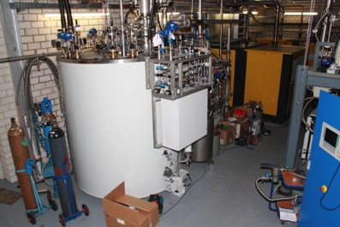
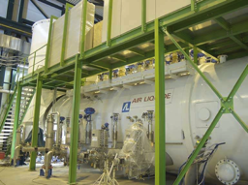
Impact of ARD R&D: Example 3
New GeV-class CW LINAC facilities can benefit from new SRF materials (& the CW-SRF expetise in the Helmholtz Association).
  Lower invest & operating cost for cryoplant, less complexity
Current reality Future with new materials?
High rep. rate → multiple users possible
4 GeV
C. Mayes, SLAC
ST1
Q = 1.5×10¹⁰, dissipation ≈20 W/m
Q = 1.5×10¹¹, dissipation ≈2 W/m
“around 65” MEUR
“around 10” MEUR

Slide 20
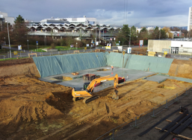
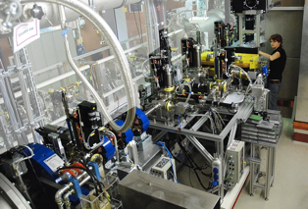
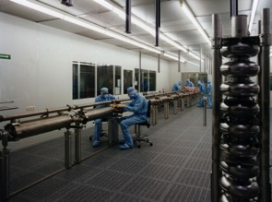
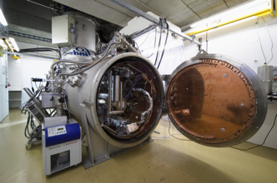
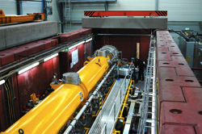
Helmholtz infrastructure for SRF R&D
Necessary infrastructure for the CW SRF program exists
or is under construction within Helmholtz → joint use
  Extensive cavity preparation
  Extensive cavity testing (low and high beta)
  SC sample testing
  Module testing
  Ion beam test facility
  Photoinjector test stand & beam characterization
  Offline cathode production & characterization
  High-current
  testing
Low-beta cavity process-
ing & testing @ HIM
Photoinjector
characterization @ HZDR
Module testing @ DESY
Cavity preparation @ DESY
SRF systems tests @ HZB

Slide 21
Backup
Folgende Folien nur als Backup für Fragen …

Slide 22

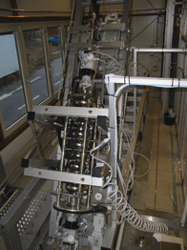
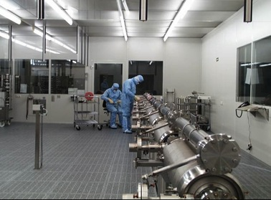
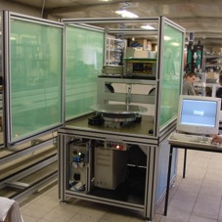
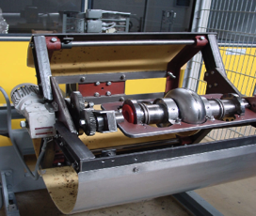
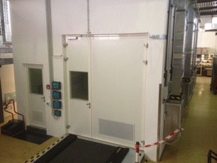
Cavity processing & assembly
DESY (extensive!)
Assembly and processing infrastructure
at HIM for ion accelerators under con-
struction.
Electropolishing
Clean-room assembly @ DESY
Eddy-current scanning
Barrel polishing
Clean-room assembly @ HZB

Slide 23
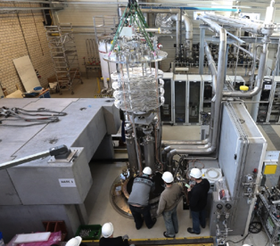
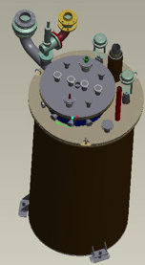




SRF Cavity testing
Sample testing (HZB)
- under construction
“Naked” cavity tests (DESY)
Low beta cavity tests (HIM)
- Under construction
“Fully equipped” cavities (HZB)
Complete modules (DESY)

Slide 24
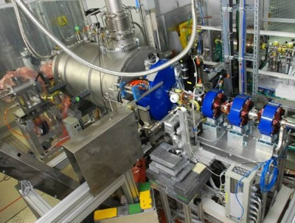
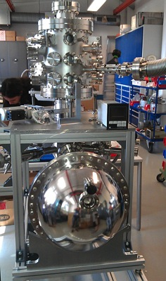

Photoinjector characterisation
SRF Photoinjector & diagnostics @ ELBE
Cathode development (HZB)
(+ cathode characterization
at Helmholtz Association
light sources)
Injector tests @ HZB’s
injector test facility
Test of DESY gun @HZB

Slide 25



Accelerator tests of SRF systems
Beam tests with ions at GSI with HLI injector
Dedicated high-current beam tests
at BERLinPro (under construction)
ELBE Accelerator (limited test opportunities)

Slide 26
CW XFEL Operation
Assumptions for CW XFEL operation
  Helium bath at 1.8 K rather than the present 2 K in pulsed mode
  Capacity of cryoplant increased to 5 kW@1.8 K (from 2.5 kW@2 K).
  The first 2 GeV of the LINAC replaced by high performance CW (high-field) cavities that achieve a Q factor of 2.5×10¹⁰
    Higher field (→ cryogenic load) ensures the excellent beam properties.
  Remaining “main” LINAC operates with “standard” (as-is) modules.
  12 additional modules are installed in the “main” LINAC
“Injector” LINAC |  |  |  |  | “Main” LINAC
E_{acc} | Modules | Q₀ | Dynamic & Static Load | Energy | E_{acc} | Modules | Q₀ | Dynamic & Static Load | Energy | Total energy
14.2 MV/m | 17 | 2.5 × 10¹⁰ | 1156 W | 2 GeV | 4.4 MV/m | 96 | 1 × 10¹⁰ | 1536 W | 3.5 GeV | 5.5 GeV
 |  |  | 68 W |  |  |  |  | 384 W
14.2 MV/m | 17 | 2.5 × 10¹⁰ | 1156 W | 2 GeV | 7.5 MV/m | 96 | 3 × 10¹⁰ | 1536 W | 6.0 GeV | 8 GeV
 |  |  | 68 W |  |  |  |  | 384 W
Red: Planned CW upgrade Green: “Improved” upgrade if Q-factor is improved

Slide 27






Impact of SRF R&D: Example 3
New SRF materials
operating at higher temp.
Designs for low frequencies
(learn from ion accelerators)
CW SRF Photoinjector
= all “ingredients” for turn key, compact accelerators → industrialization
(see talk by A. Arnold)
352 MHz
+
+
BNL
Linear Collider Newsline, Jan. 9, 2014
ICS is widely recognised as a promising approach to achieve high-intensity high-quality X-rays, … unique capabilities ... will lead to various applications in the industrial, medical, and security-related fields. The ... implementation of ICS sources, ... depends on the ability to achieve high peak brightness of the X-rays. The key technology required to realise this brightness is superconducting RF (SCRF) accelerating technology.
→ 1 W/m losses @ 4.2 K!
E.g.: Inverse Compton
sources (ICS)
“Cryoplant” for one cavity
KEK Quantum beam program
J. Urakawa et. al, KEK
MIT CUBIX Proposal

Slide 28
SRF Development in ARD
ELBE
CW FLASH/XFEL
BERLinPro
BESSY^{VSR}
CW Ion LINAC
2. CW-SRF High brilliance electron sources
3. New SRF technology for CW ops.
4. New supercon-ductors for CW ops.
1. Pushing existing technology for CW ops.
ST2
ST3
ST2
Address facilities within ARD/Helmholtz
Compact sources:
Compton sources
Lithography
Imaging, tech. transfer
“turn-key” units
New ideas
Large scale facilities
LCLS-II, ESS,
EUROTrans, MESA
LHeC, HIAF, RILAC2,
FRIB, RISP, CW-SRF-
based light sources
New ideas
MML, M&U
Industrialization
Generic results applicable
to other projects

Slide 29

X-ray FEL oscillators
High-brightness, high rep-rate electron beam for tunable X-ray FEL oscillator
  Order 5 GeV electron beam
  Multi-MHz rep rate
  Bunch length = 0.1 ps, emittance = 0.3 mm mrad
  Tunable, multi-keV X-rays out
  Full trans/long. coherence
  Bandwidth in meV range
Few MHz rep. rate
from 5-GeV SRF LINAC
K.-J. Kim and Y. Shvyd‘ko
“Tunable optical cavity for an x-ray free-electron-laser oscillator”
Phys. Rev. ST-AB 12, 030703 (2009)

Slide 30



Diversity of ERL applications
E.g., for particle physics (hadron-electron colliders), LHeC, eRHIC
E.g., for compact gamma-ray Compton Sources
  Require ultra-low emittance (0.1 mm mrad) for narrow energy spread
  High average current
LHeC LINAC-Ring
SRF LINAC
SRF Linac
SRF Linac
eRHIC Collider
M&U
SRF LINAC
R. Calaga et. al, CERN
V. Litvinenko et al., “High-energy high-luminosity electron-
Ion collider eRHIC”, Proc. DPF Conference, 2011
T. Hyakwawa et al., “Nondestructive assay pf plutonium and minor actinide in spent fuel nuclear resonance fluorescence with laser Compton scattering gamma rays”
NIM Physics Research A, 621 (2010)

Slide 31




ERL applications
E.g., for compact gamma-ray Compton Sources
  Require ultra-low emittance (0.1 mm mrad) for narrow energy spread
  High average current
E.g., for nuclear physics (hadron-electron colliders), LHeC, eRHIC
SRF Linac
SRF Linac
SRF Linac
© A.Hutton, V. Derbenev
V. Litvinenko
BNL

