Slide 1
Dedicated Hadron Accelerators
Andreas Lehrach
FZ Jülich & RWTH Aachen
ST2 coordinator
Draft, February 23
Notes:
Strong connection between primary and secondary beams
Condensation point for key technology development

Slide 2





Overview
Matter and The Universe
Cosmic Matter in the Laboratory
Projects
Physics
MU
Cooperation
SIS100/300
$$\text{p}\text{, }\text{HI}$$
Natl.Labs
HGF, MPI
Matter and Technology
ARD – ST2
Dedicated Hadron
Accelerators
FAIR
Int.Natl.Labs
BNL, BINP,
CERN, FNAL, IHEP, NFN,
JINR
HESR
$$\overline{p}\text{, }\text{p}\text{, }\text{HI}\text{,} \vec{p}$$
Universities
AC, BN, F,
HD, GI, J, DA,
MZ, W
EDM
$$\vec{p},\vec{d}, {}_{}^{3}{\vec{He}}$$
Objectives
COSY
Test bench
Industry
ASG, BNG,
Cryogenic,
SigmaPhi
DTS
Diagnostics
Beam and
Polarization
Beam quality
Intensity,
Phase Space
Simulation
Beam, Spin and
Dynamic Vacuum
Injector
Ion sources,
Linacs
Technology
Magnet,
RF systems
Notes:
Strong connection between primary and secondary beams
Condensation point for key technology development
Ion sources for future Hadron Accelerators
Ultimate heavy ion intensities
Superconducting magnet technology
Development of high-field E/B deflectors and high-precision spin dynamics for dedicated EDM storage rings

Slide 3
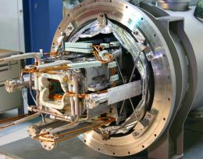
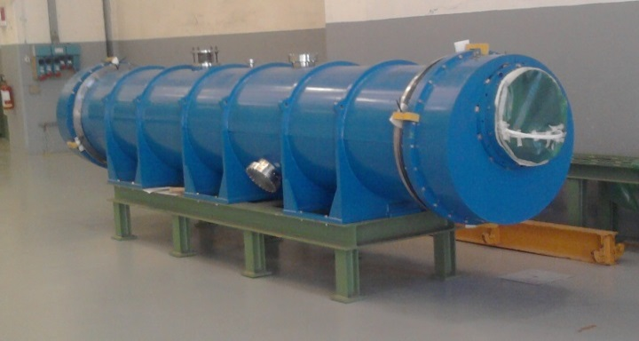
Ultimate Primary Beam Intensities:
Fast Ramped SC Magnets
Challenges:
High field, minimization of dynamic loss, mechanical stress and fatigue
Stabilizing dynamic vacuum
Achievements:
Development of low-loss superconducting wires (CuMg matrice, Nuclotron and Rutherford cable
Optimization of mechanical structure
Successful commissioning of SIS100/300 dipoles and quadrupoles
Testing of first, fast ramped s.c. dipole magnet with small radius of curvature
Goals:
Further improvement and optimization of fast ramped cos(θ) magnets (e.g. field quality)
Design, manufacturing, and testing of large aperture s.c. quadrupole magnets for final focusing systems
Development of superconducting septum magnet
→ Poster by L. Bozyk
SIS100 prototype superferic dipole ©Babcock Noell
SIS300 “cos(θ)” dipole in Cryostat
Cooperation partners: BNG, INFN Genova, Milano and Salerno, ASG Genova,
IHEP-Protvino and BINP-Novosibirsk
Notes:
Motivation ist Erzeugung von Schwerionenstrahlen höchster Intensität durch Absenkung der Ionenladung U73+ > U28+ Zur Unterdrückung der Umladungsverluste sind beim Betrieb mit niedrig geladenen Schwerionen kurze Zykluszeiten notwendig (s.c. Magnete für hohe Rampraten und Mittelfrequenzkavitäten mit hohen Gradienten) und eine gigantische UHV Saugleistung zur Stabilisierung des dynamischen Vakuums (daher kryogene Vakuumkammern).
Fast ramping
Dynamic vacuum due to cooled surfaces
3) SIS 100/300 Magnets commission
4) Higher field quality, larger aperture, curvatur

Slide 4
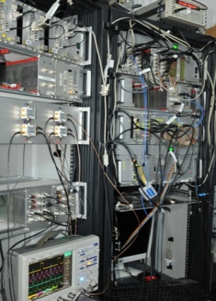
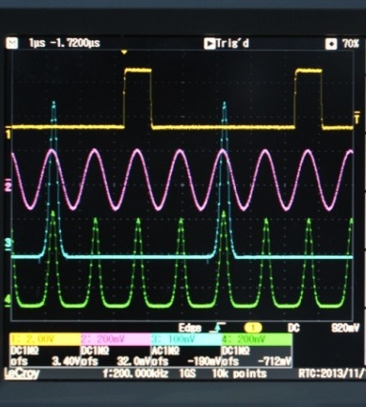
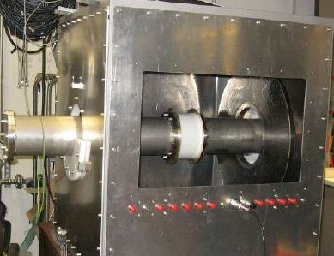
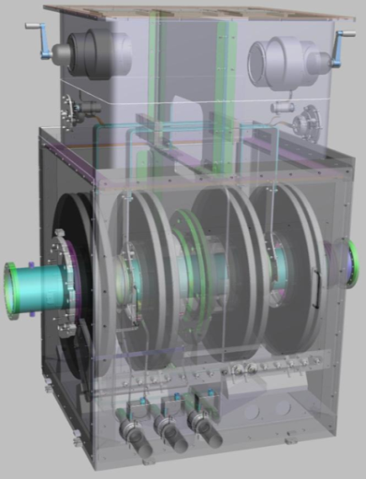
Ultimate Primary Beam Intensities:
Broadband Cavities and Signal Processing
Advantages of Magnetic Alloy (MA) loaded cavities:
C.W. operation
Short pulse and broadband operation
GSI- Hardware
First
results
Achievements:
Component studies almost completed
R&D for LLRF system ongoing:
multiplexing /de-multiplexing of gap-/ bunch- signals
Delivery of last parts for broadband test cavity modification
RF cavities for manipulations
and methods for stabilization of ion beams
Next steps:
Completion of test cavity modification
Measurements concerning different low-frequency, broadband cavity configurations
Signal processing prototype for longitudinal feedback
modification
Cooperation partners: IAT and TEMF, TU-Darmstadt
Notes:
RF cavities for manipulations and methods for stabilization of ion beam
Short pulses with broadband operation for secondary beams
First results have been achieved
3) Test system completed
4) Signal processing for longitudinal feedback

Slide 5
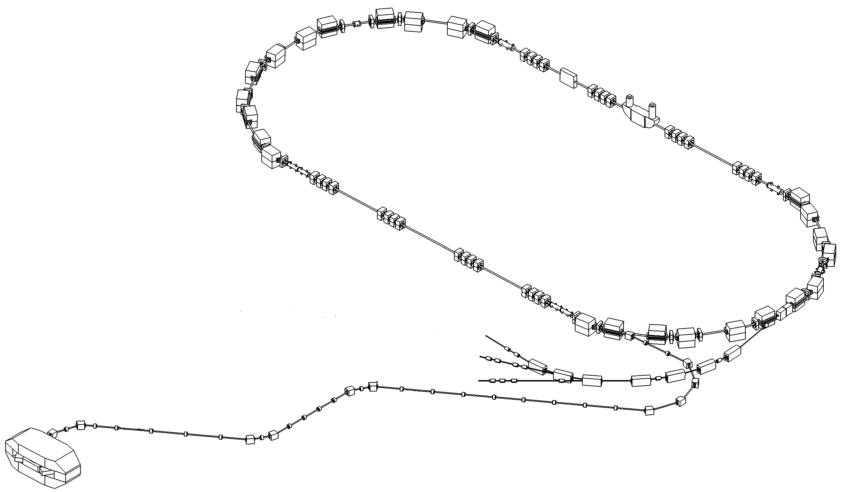
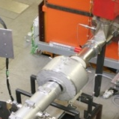
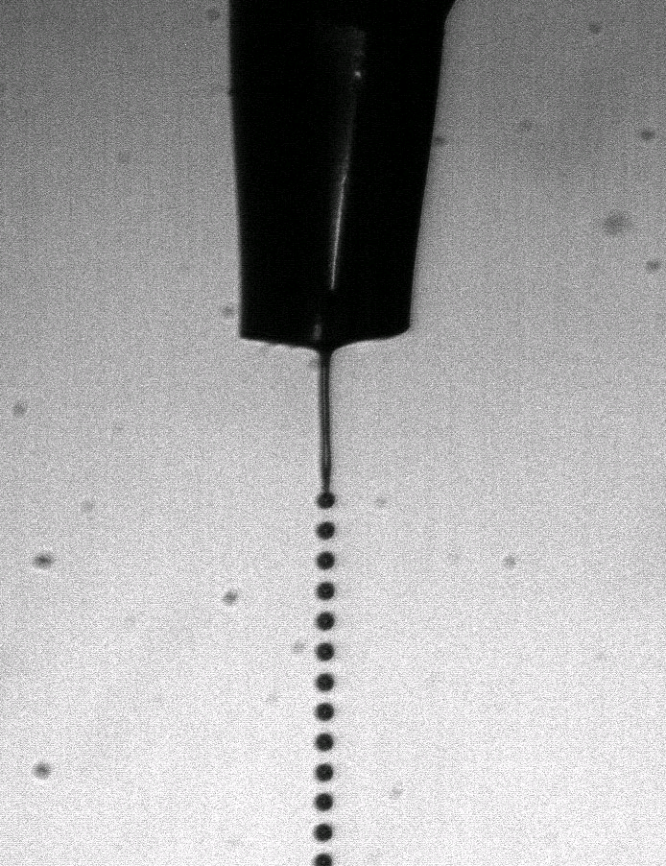
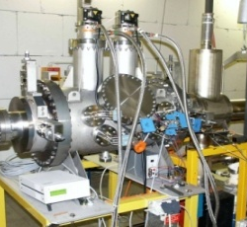
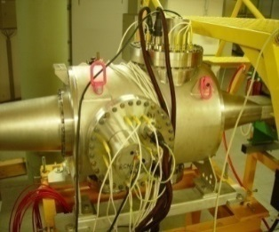
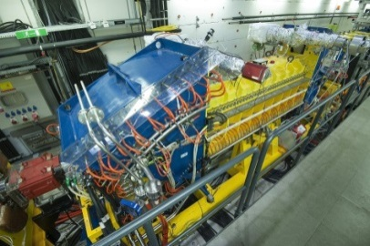
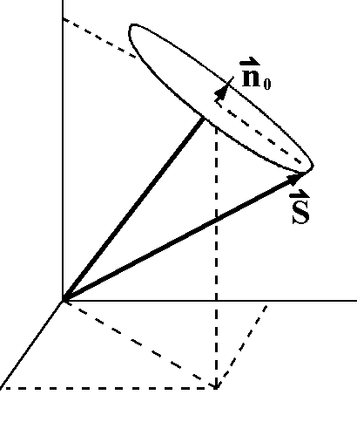
COSY Facility: Developments for HESR
Electron Cooler
100 kV
Barrier Bucket Cavity
mean energy loss compensation
Pellet Target beam-target interaction
COSY: 0.3 -3.7 GeV/c
Pol. protons and deuterons
HESR: 1.5 – 15 GeV/c
Antiprotons and HI
Stochastic Cooling
Residual Gas
Profile Monitor
Beam and Spin
Dynamics
→ Poster by M. Rosenthal
Electron Cooler
2 MV; 2013
DTS
Test bench for HESR components and FAIR detectors
Notes:
Couple of instruments…
Stochastiv cooling: prototyp pickup tank 1.5 –15 GeV/c
E-cooler:
100kV == 180 MeV protons
2MV == 4GeV protons

Slide 6
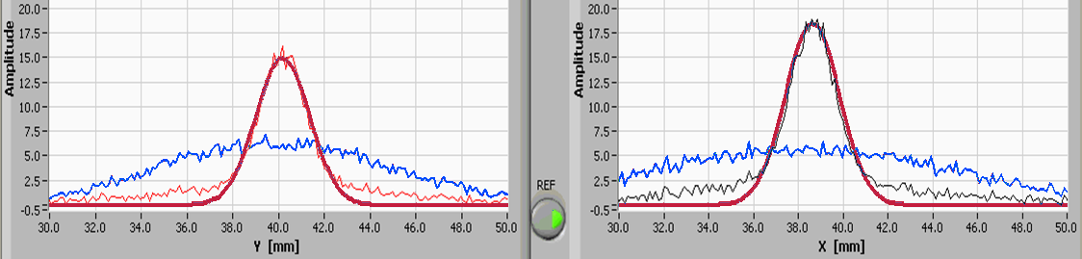
2 MV Electron Cooler
Joint development with Budker Institute (BINP, Russia),
commissioned at COSY, injection cooler for HESR
  Parameters demonstrated so far:
      Voltage up to 1.5 MV (5 bar SF6)
      Cooling at 900 kV / 300 mA (1.8 GeV p)
vertical
radial
200 MeV p
After
After
Before
Before
Amplitude
y (mm)
x (mm)
Electron cooling achieved for 1.8 GeV protons
Ongoing: commissioning for full COSY energy range (3 GeV)
Intermediate step to 4.5 / 8 MeV electron for HESR
Cooperation partners: BINP, JINR, FZJ, HIM
Notes:
Transversal (vertical & radial)
Evtl + BB
Electron cooling achieved:
for 200MeV Protons with
e-beam up to 200mA @ 109kV

Slide 7
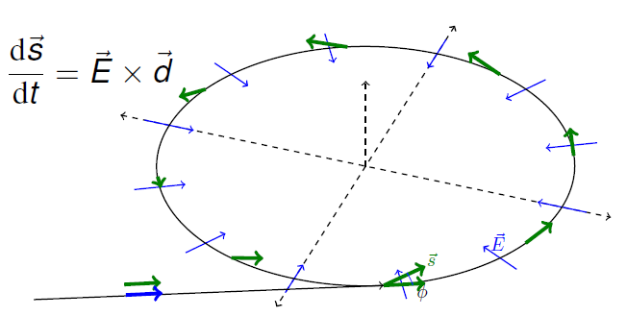

Storage Ring EDM Project
… measure for development of vertical polarization
⬄
EDM
Challenges:
Huge E-fields
Shielding B-fields
Spin coherence
Beam position
Polarimetry
(...)
Step wise:
COSY (PoF-III)
R&D and Precursor Expt.
Goal: 10⁻²⁴ e∙cm
Dedicated SR (after PoF III)
Goal: 10⁻²⁹ e∙cm
JEDI
Jülich Electric Dipole Moment Investigations
~ 100 members
(Aachen, Bonn, Dubna, Ferrara, Cornell, Jülich, Krakow, Michigan,
St. Petersburg, Minsk, Novosibirsk, Stockholm, Tbilisi, . . . )
10 PhD students from JARA-FAME (Forces and Matter Experiments)

Slide 8
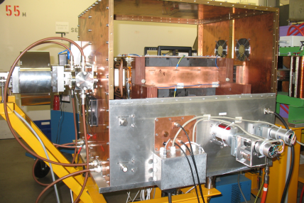
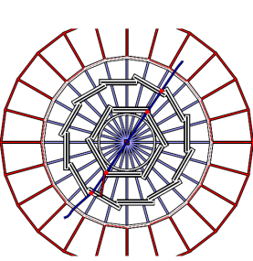
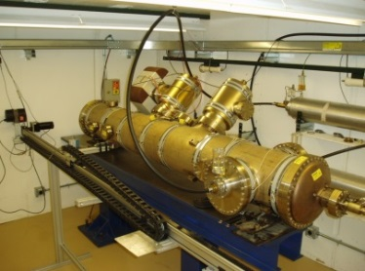
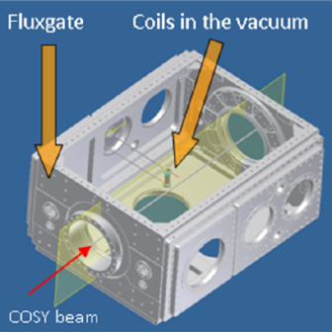
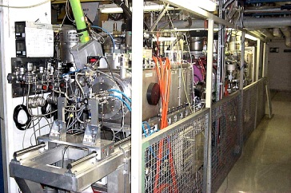
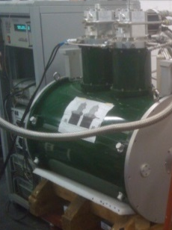

EDM: Prototyping and Spin Physics
RF ExB Spin Flipper
2014
Prototype Polarimeter
≥2015
Electrostatic
Deflector
2017
SQUID and Cavity BPMs
≥ 2014
Polarized
Ion source
Beam and Spin
Dynamics
→ Poster by M. Rosenthal
Siberian Snake
2014
DTS
EDM accelerator and detector component tests
Notes:
8

Slide 9
Zusammenfassung
Summary and Outlook
FAIR: Secondary radioactive ion or antiproton beams utilizing high-intensity primary beams
Contribution of FZJ and GSI to FAIR has been evaluated in PoF-II
Development of advanced and new key technologies
FZJ and GSI with HI-Mainz and HI-Jena cooperate with German universities, national and international collaboration partners
Charged-particle EDMs and high precision measurements
R&D work, first direct measurement and dedicated storage ring at COSY
Notes:
9

Slide 10


