Slide 1
Laser-Plasma Acceleration of Ions
Matt Zepf
Helmholtz Institut Jena

Slide 2



Towards ultra-compact, ultrafast proton and ion accelerators
MeV/u protons and ions
I>10¹⁹Wcm²
a₀>3
Space charge field:
E~T_{hot}/λ_{Debye}~MeV/µm=10¹³V/m
Target
Relatvistic electron production

Slide 3
Sheath Acceleration
(TNSA)
MeV/u protons and ions
I>10¹⁹Wcm²
a₀>3
Space charge field:
E~T_{hot}/λ_{Debye}~MeV/µm=10¹³V/m
Target
Relatvistic electron production
- Low emittance beams with µm-scale source size
Ultrashort burst duration (<ps)
Broad Spectra
Energy scales as I^{1/2}

Slide 4
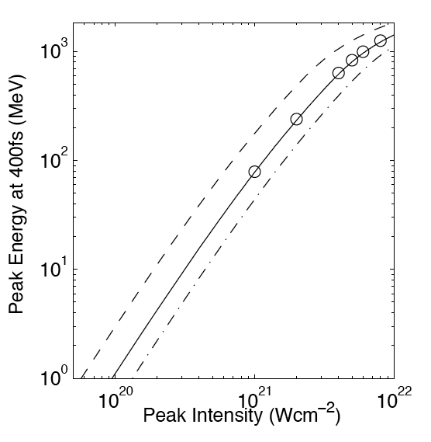
Radiation Pressure Acceleration (RPA)
I>10²⁰Wcm²
A₀>10
Foil thickness:100nm
150nm
250nm
350nm
Ponderomotive Push
Target
Advantages
Rapid Scaling with Intensity predicted
More controlled spectral shape
Challenges
Suppression of hot electrons
  Circular Polarisation, Top-hat focus
  Extreme Intensities
  Extreme Contrast

Slide 5
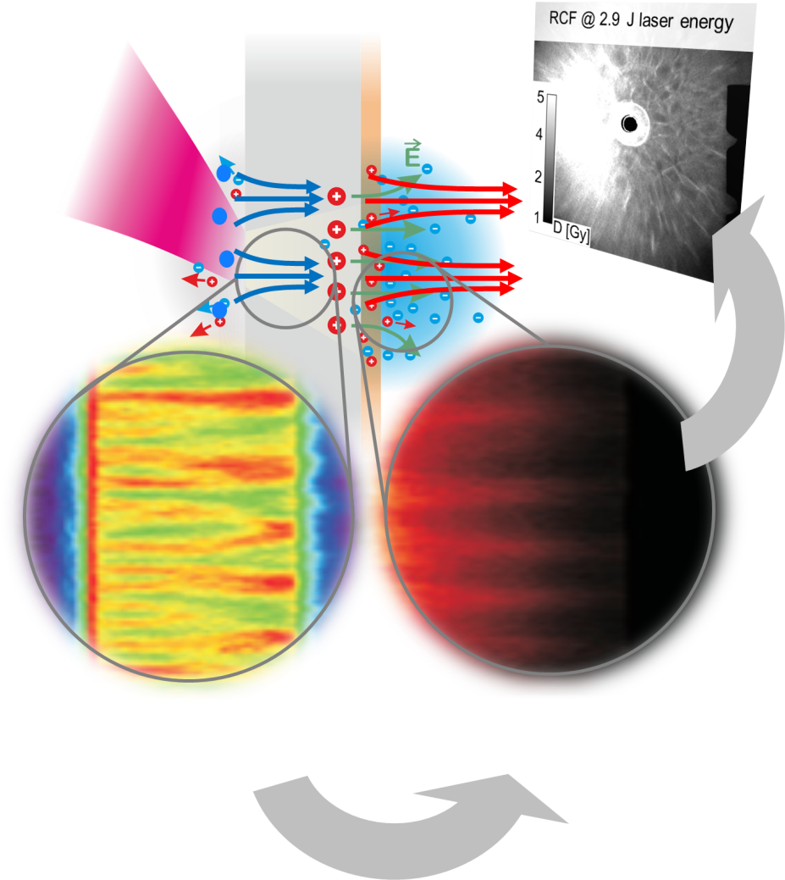
Advanced Diagnostics and
State of the Art computing
laser intensity
~ 10²¹ W/cm²
diagnostics
plasma instabilities trigger electron filamentation
modulated ion density at the target rear
PIC simulations

Slide 6
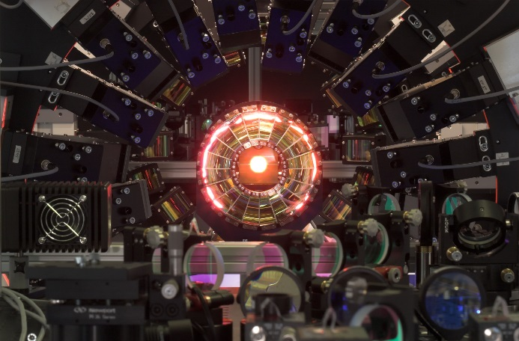
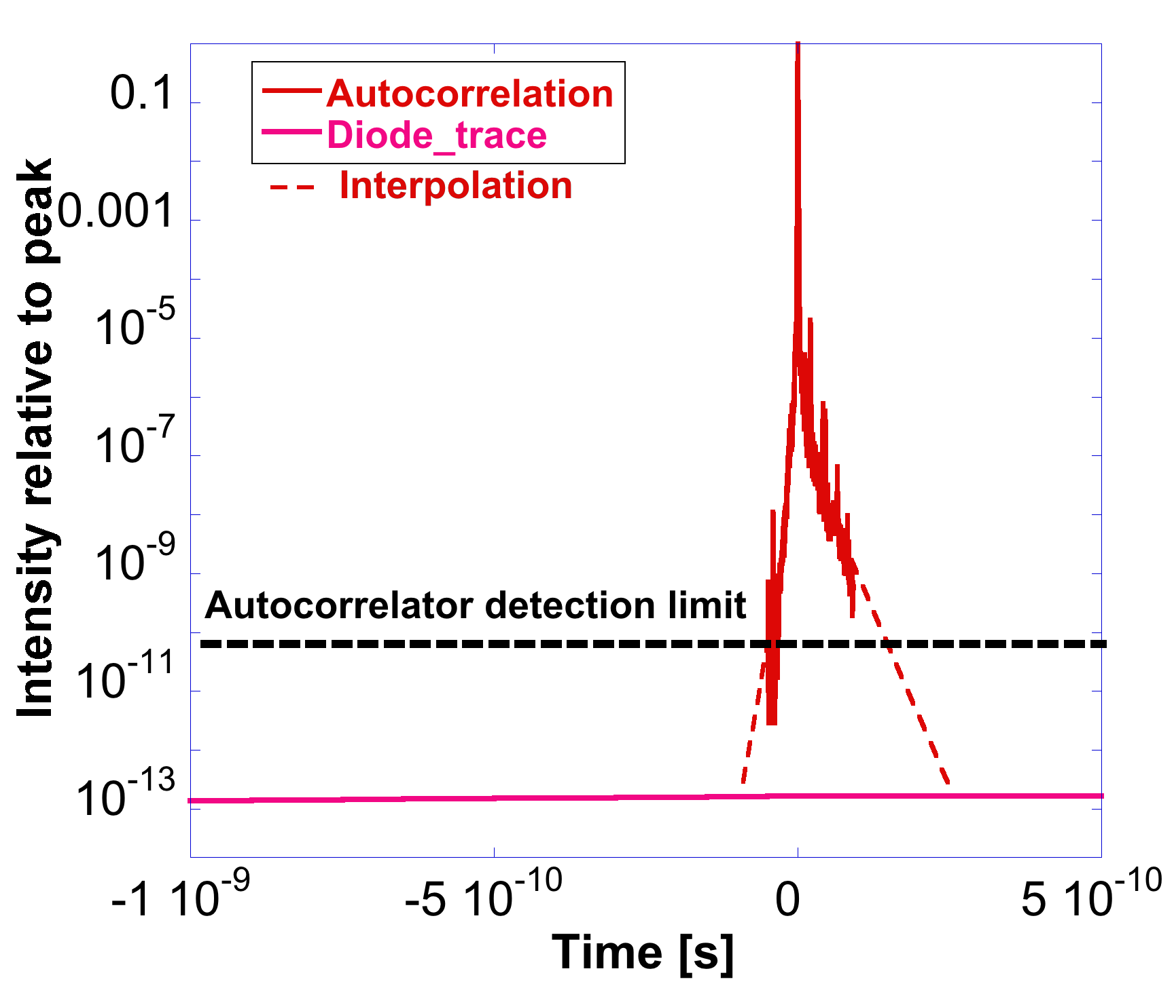
Laser Development
Diode-pumped ultra-intense lasers – high average power PW lasers
Optimally suited for ion acceleration due to
- High pulse energy (10… 50 J)
- High repetition rate (0.025 Hz…1Hz)
- High peak powers (250 TW…1 PW)
Collaboration:
HI Jena, HZDR, GSI
Polaris@HI Jena
Focal Spot Shaping
Extreme Pulse Contrast >10¹²

Slide 7
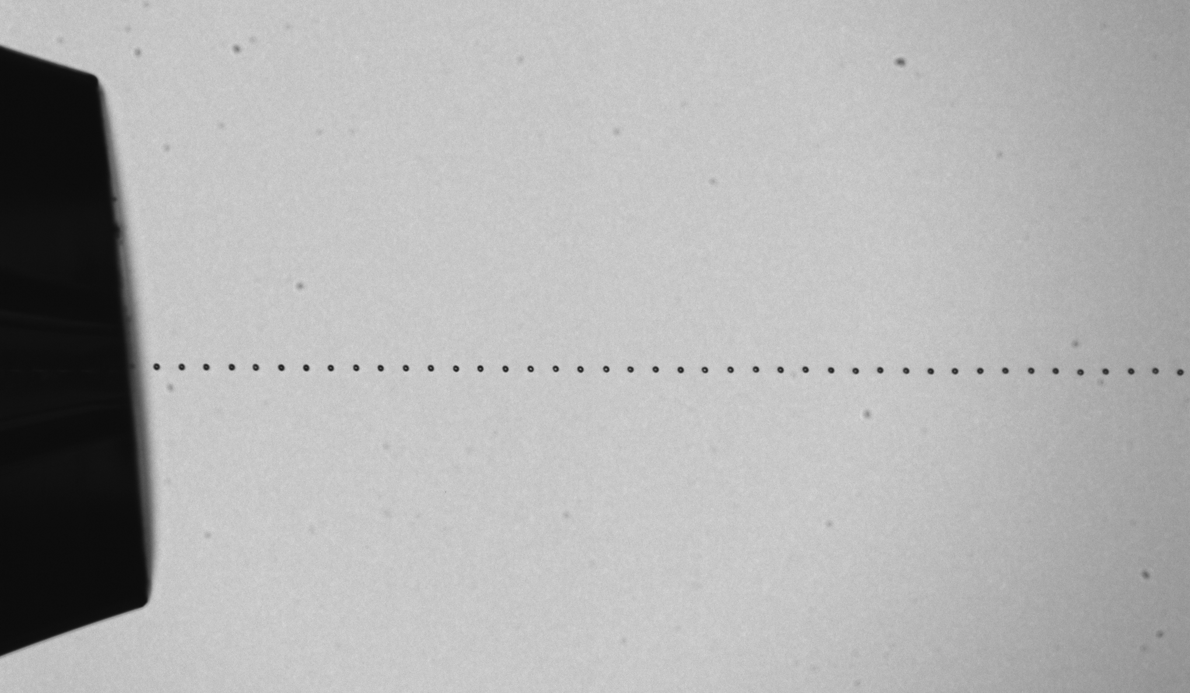
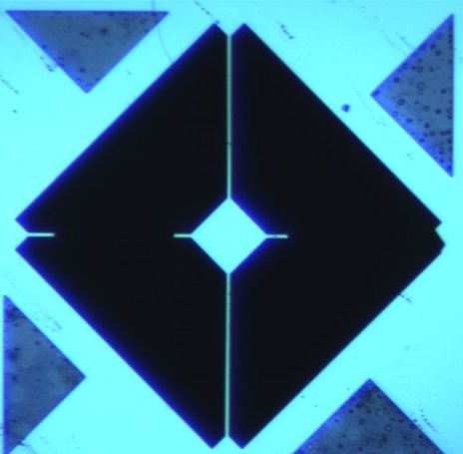
Advanced Targetry
Advanced Cryo-targetry
Laser Synchronised H₂
droplet stream
Carbon-Nanotube Foam
1µm
optimized target designs …
ultrathin
microstructured and wafer-based serial production
near-critical density
tailoring …
absorption
transport
accelerating gradients
100µm
Si-wafer based reduced-mass target

Slide 8
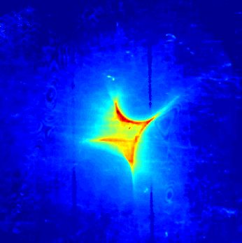


LIGHT
- coupling laser-accelerated ions into conventional accelerator structures
Bending Magnet
The LIGHT test-stand at GSI
Current achievements:
  initial experimental proof of principle done
    > 10⁹ particle per bunch, < ns duration (high peak current)
    ΔE/E< 3% after phase rotation at 10 MeV energy
  development of specific diagnostics done
Program for POF III
Target area and applications
  Relevant laser developments (repetition rate and temporal contrast)
  Extension of the concept towards 100 MeV
Quadrupole
Z4
Buncher Cavity
Solenoid
Target Chamber
laser diagnostics
ion beam profile
ion beam spectrum
20
9.4MeV@2.12m
1.5
source
10
solenoid focusing
1
energy compression
mm
0
relative dN/dE
-10
0.5
-20
-20
-10
0
10
20
0
mm
7
8
9
10
11
12
proton energy [MeV]
Notes:
Coupling advantages of Laser driven acc and RF technology

Slide 9
Ultrafast Ionpulses
Chirped Probe
1.053nm, 350fs
Ultrafast response of Matter to ion irradiation
Relaxation time of 35ps in SiO₂ measured
(10² slower than response to keV X-rays)
ns relaxation time scale for intense irradiation (lattice heating)
Glass substrate
Laser
>10¹⁹Wcm⁻²
Slit
10 μm Al foil
To detector
Notes:
Evaluated under programme MML

Slide 10
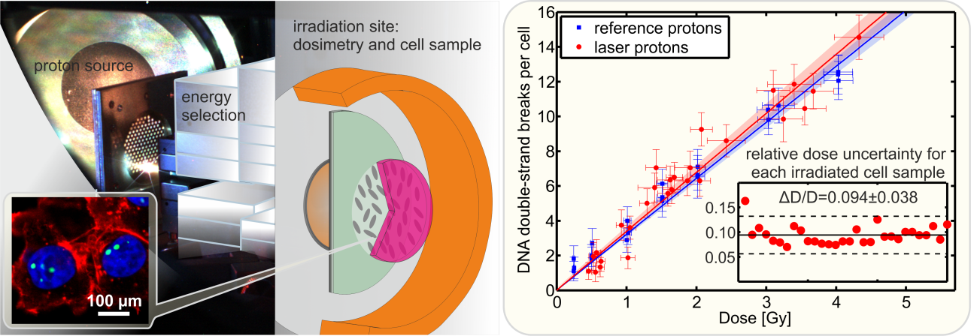
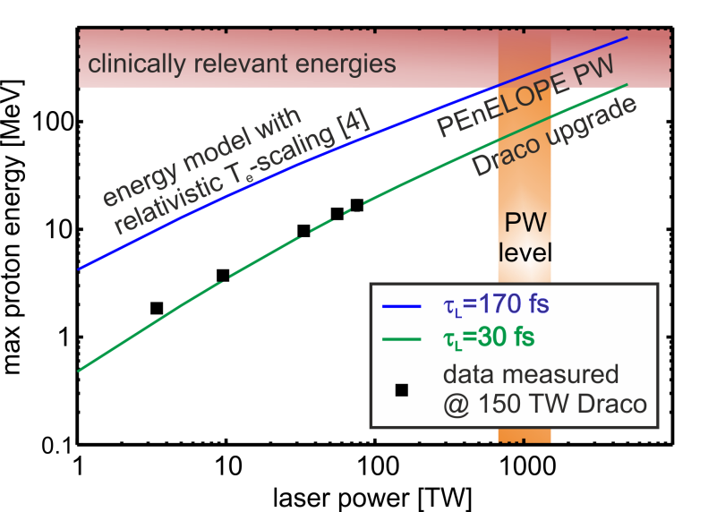
Compact laser proton delivery for medical applications
Radiobiological (translational) studies as
first step to laser proton oncology
Requires repetition rate, online diagnostics and beam control
Scaling to 200 MeV regime
(here based on T. Kluge PRL)
Notes:
Medical apps – evaluated under the programme health

Slide 11
Summary
Synergetic program within Helmholtz driving source development and application on key fronts in parallel
Ultracompact hadron accelerators
  scaleable to 100’s of MeV
  Extremely short pulse duration
Development paths
  Laser Development (repetition rate, contrast, spatial)
  Advanced targetry (Cryo-targets, Carbon Nanotube)
Applications
  Injection into RF structures
  Compact sources for medical applications
  Ultrafast hadron sources for novel time resolved studies

