Slide 1
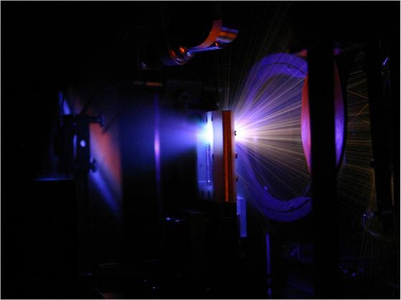
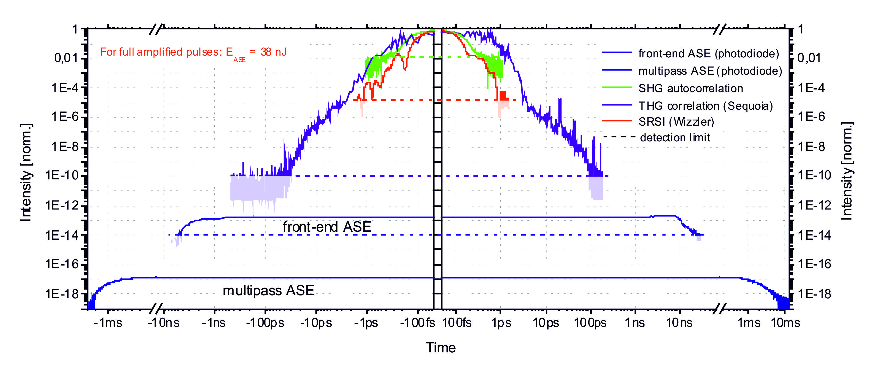
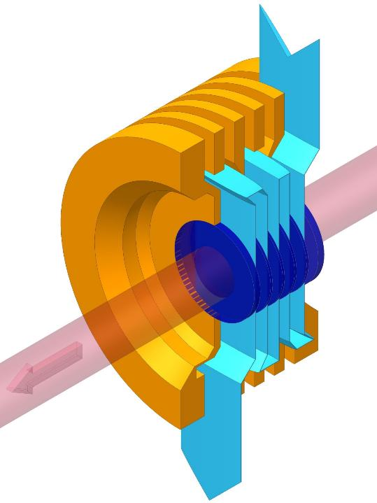
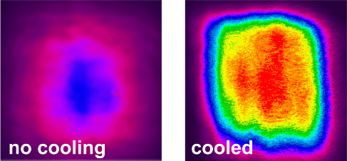
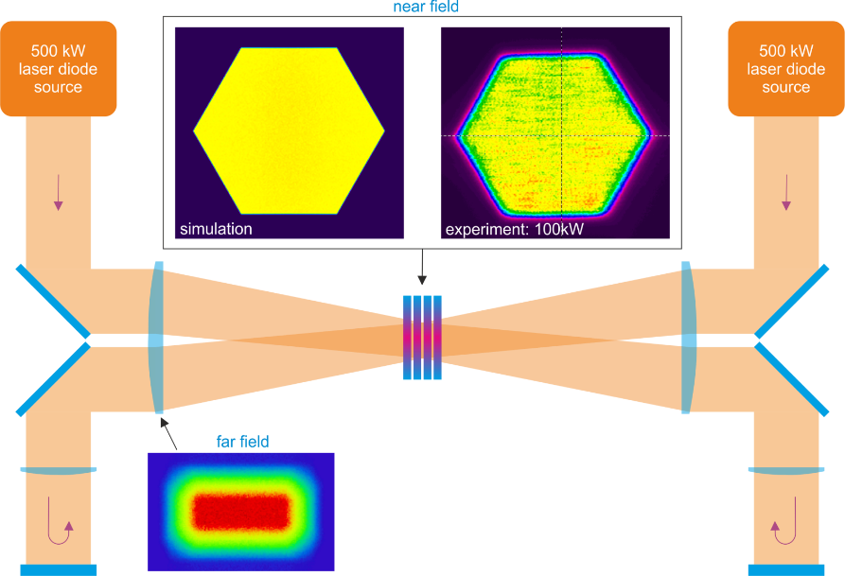
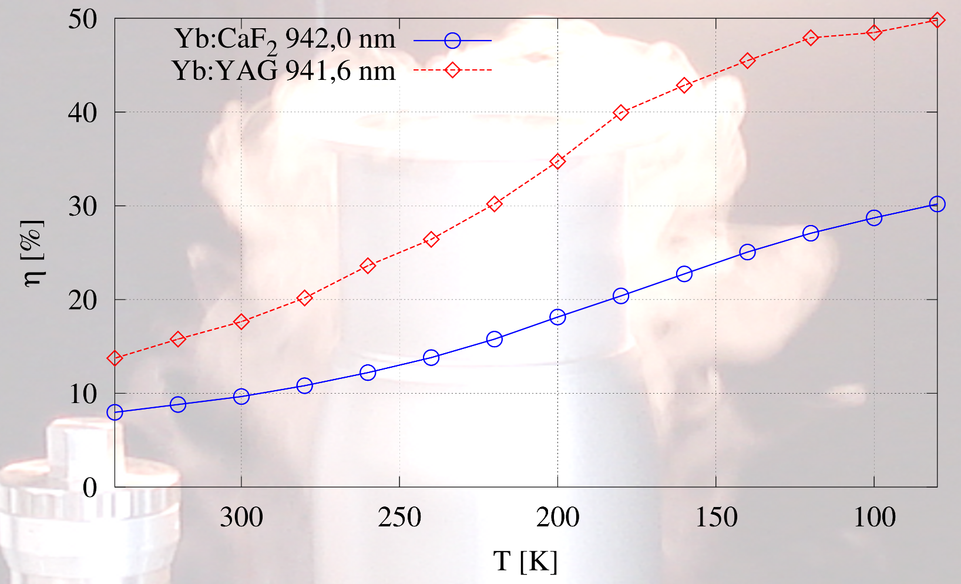
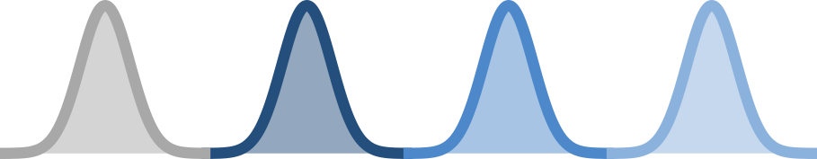
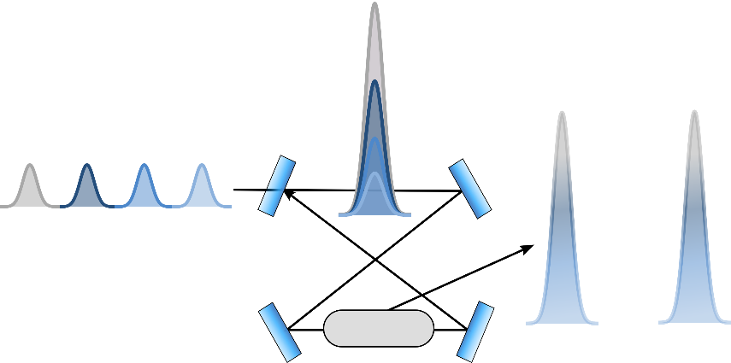
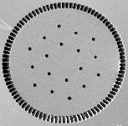
Advanced laser concepts for laser particle acceleration
ARD – ST 4: Novel acceleration concepts
Arno Klenke – HI Jena
Motivation
State of the art lasers for particle acceleration
Multi J pulse energies
Sub-100fs pulse durations
Repetition rates of ≤ 1Hz
Desired parameters for future applications
Multi kHz repetition rates
High average powers
High pulse contrast
Efficient operation
High repetition rate PW solid-state lasers
Pulse contrast enhancement
Pulse repetition rate enhancement
Combination of double-CPA technique with non-linear filtering (OPA, XPW etc.): improvement of ASE contrast by 4 orders of magnitude and shortening of main pulse
Suppression of fs-prepulses
Novel method to measure ASE intensity contrast spanning several milliseconds and more than 16 orders of magnitude
Future project: generation of 2nd harmonic of compressed pulses
Gas or liquid facet cooling of multi-slab gain media
Liquid coolant: 1J, 10Hz operation achieved
Efficiency enhancement
High brightness pump engines
Cryogenically cooled amplifiers
Development of burst-mode laser systems
Improvement of thermo-mechanical properties of laser materials (e.g. Yb:CaF₂ or YAG) @ 100 K (LN₂)
…
τ_{pre}
pump
High brightness (3MW/cm²/sr) laser diodes and brightness conservative imaging and homogenization for compact high-energy amplifiers
Efficiency enhancement due to multi-pass pumping
Reduced LIDT due to distribution of extraction fluence over many pulses
10 Hz bursts with individual 1-TW pulses (100’s fs and 100’s mJ) @ up to 1 MHz possible
Efficiency for Yb:YAG and Yb:CaF₂ as a function of temperature. Values are simulation results for a 1J amplifier extracting with 5J/cm² and a fixed gain of 100. 4 extraction passes in case of Yb:YAG and 24 in case of Yb:CaF₂.
Towards TW lasers with very high repetition rates
Advanced fiber designs for mode-area scaling
Coherent combination of multiple parallel amplifiers
Enhancement in a passive cavity
stretched fs-pulses
f_{switch} = 15 kHz
Standard
fiber
f_{rep} = 10 MHz
Large-pitch fiber
Switch
More than 100µm mode-field diameter with diffraction-limited beam quality
Combination of 4 amplifiers with mJ pulse energies at 530W average power demonstrated
fs pulses stretched to the ns-regime are stacked to one oscillating pulse before it is switched out
Scaling from mJ-level pulse energies to the J-level

