Slide 1
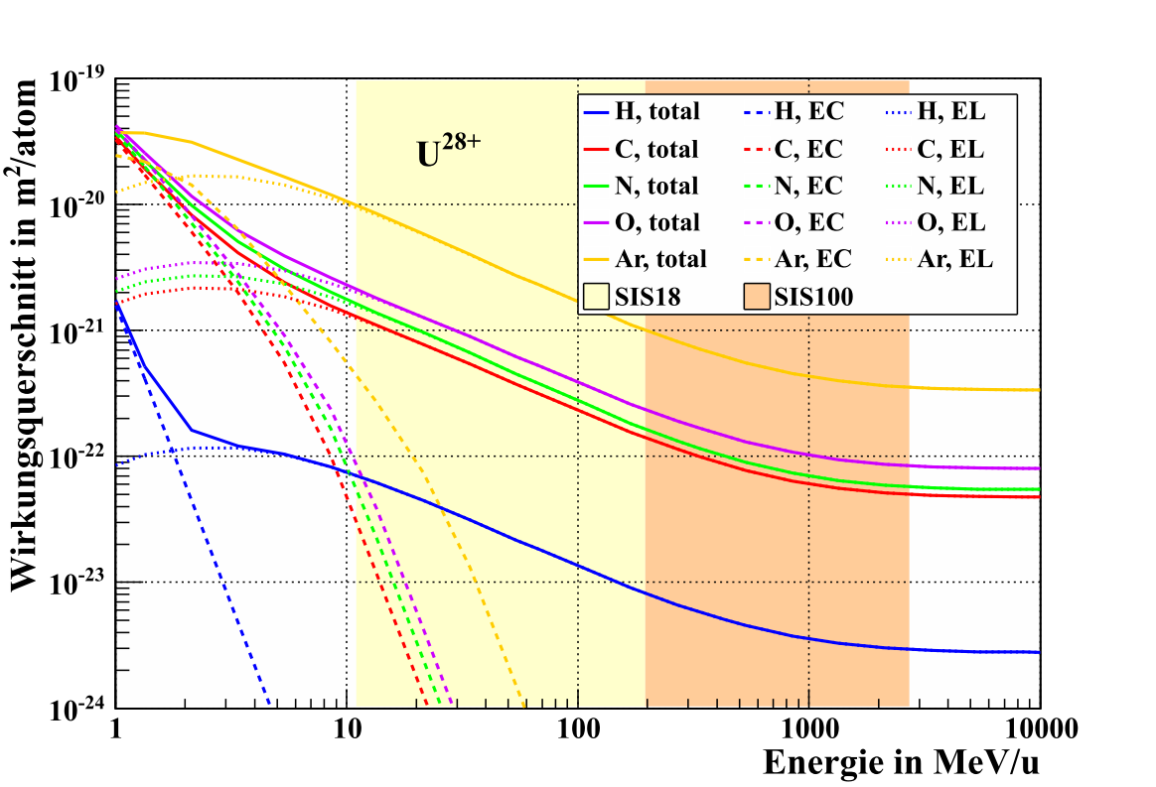
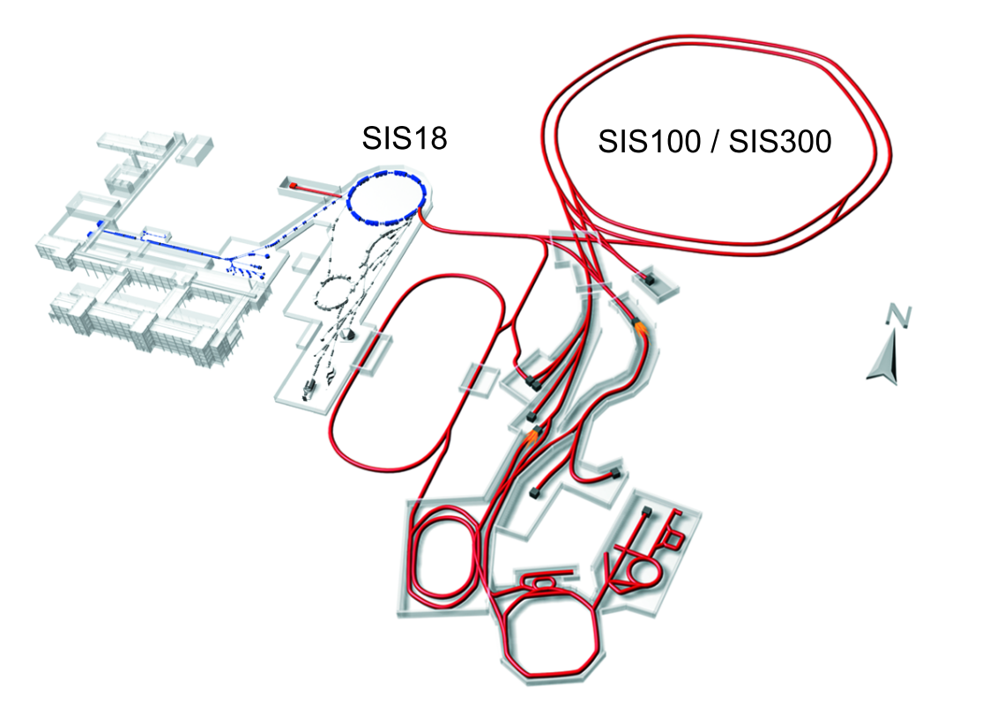
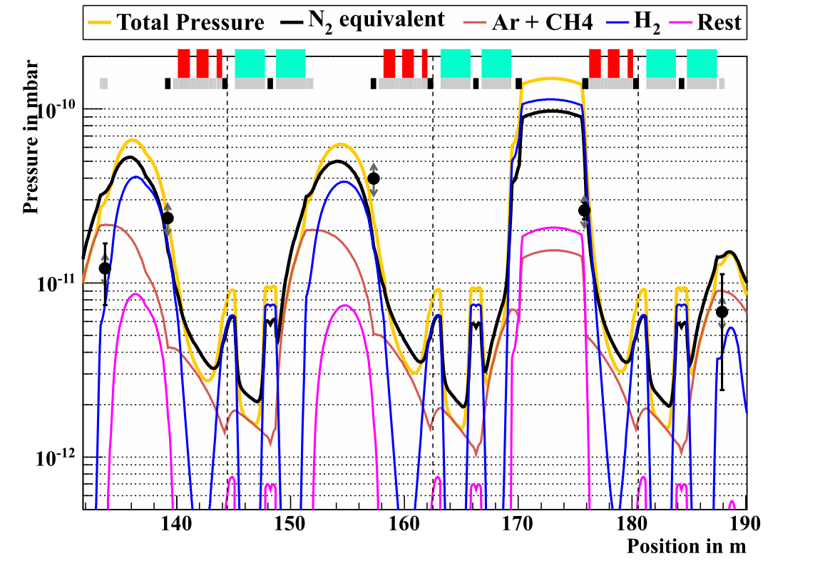
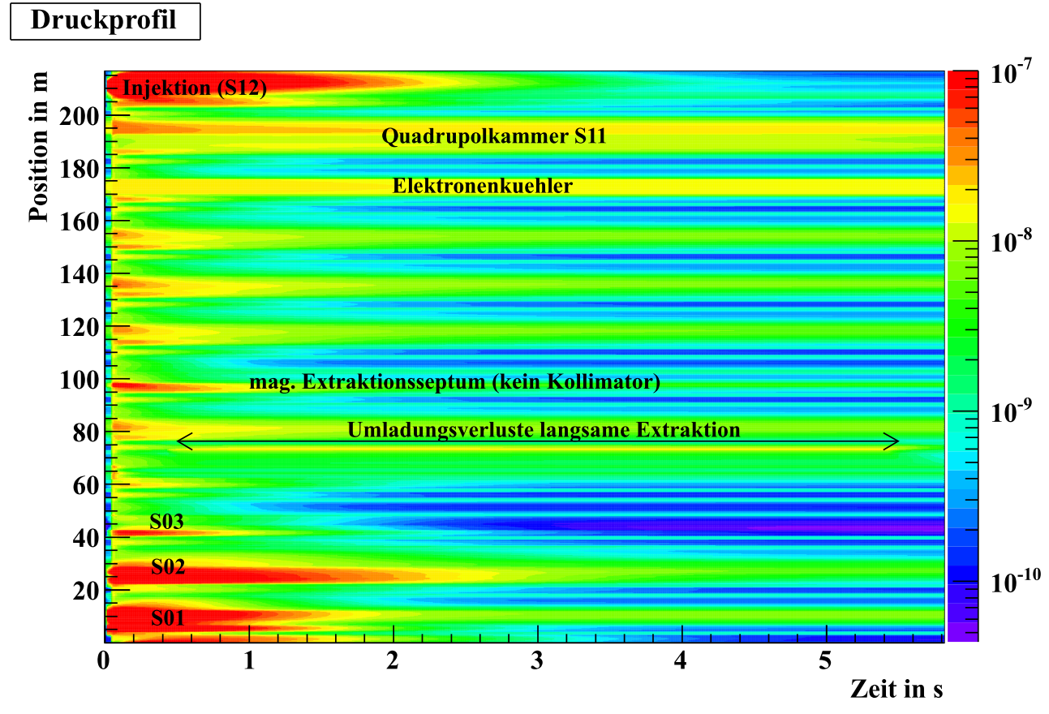
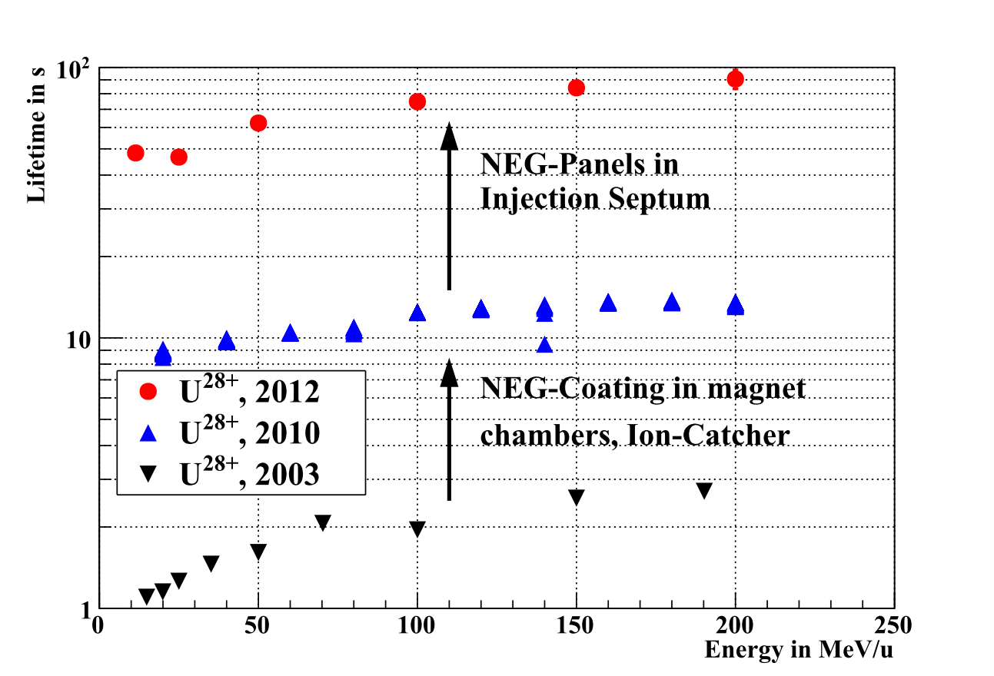
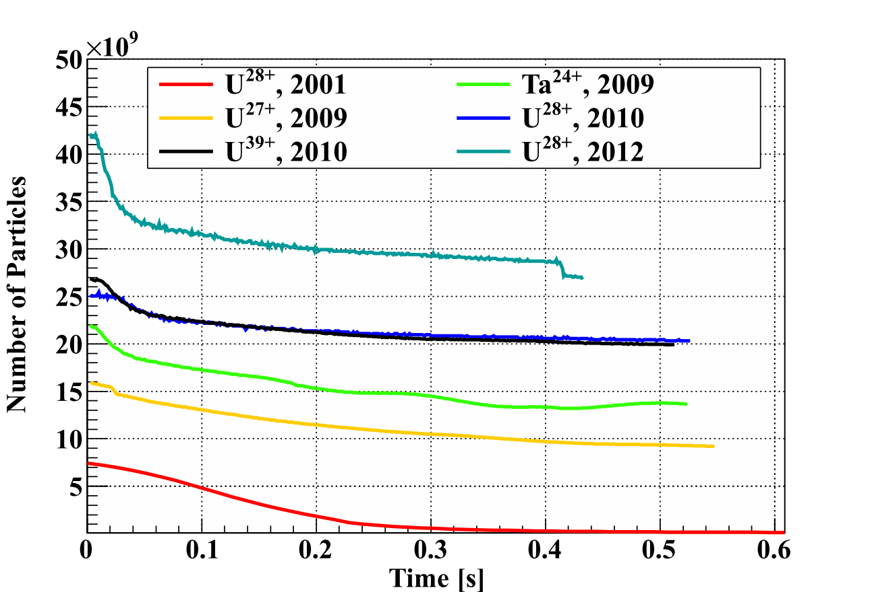
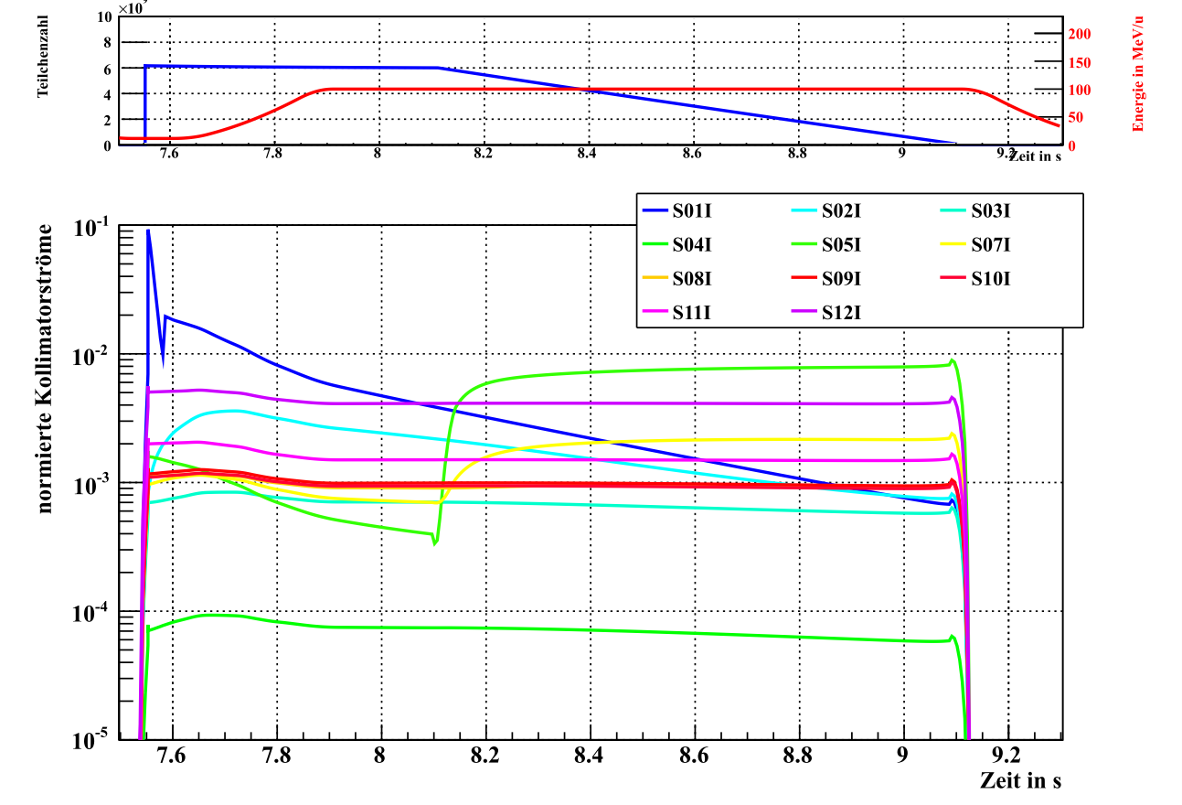
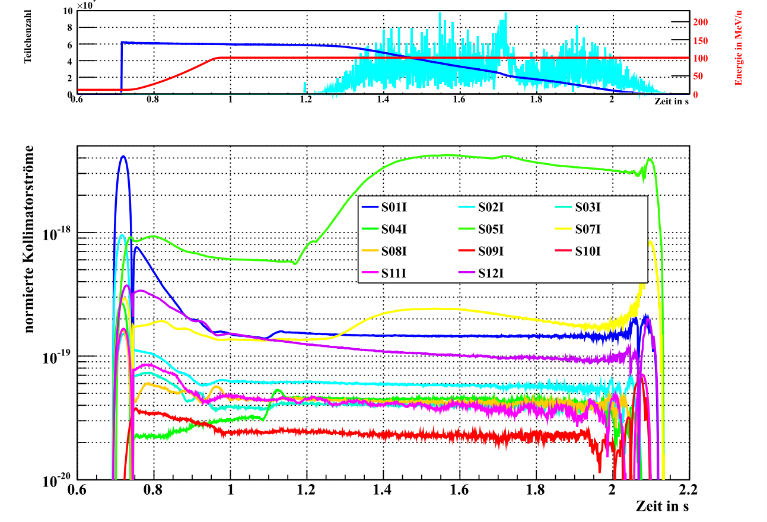
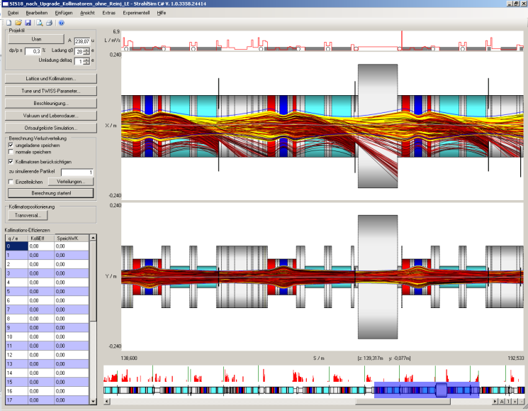
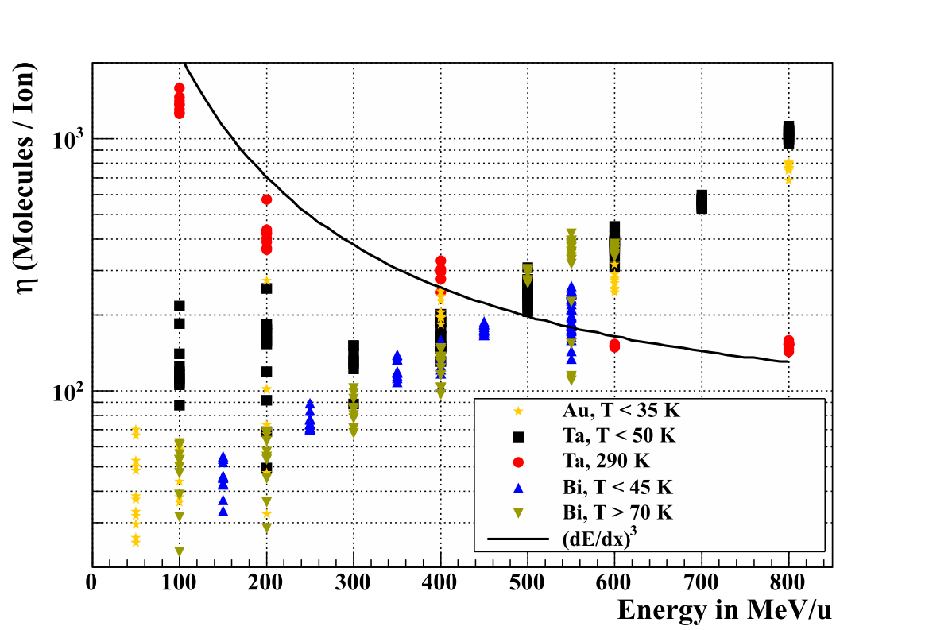
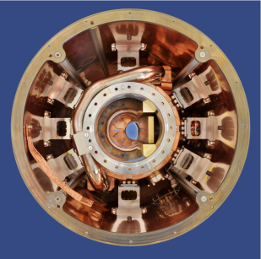
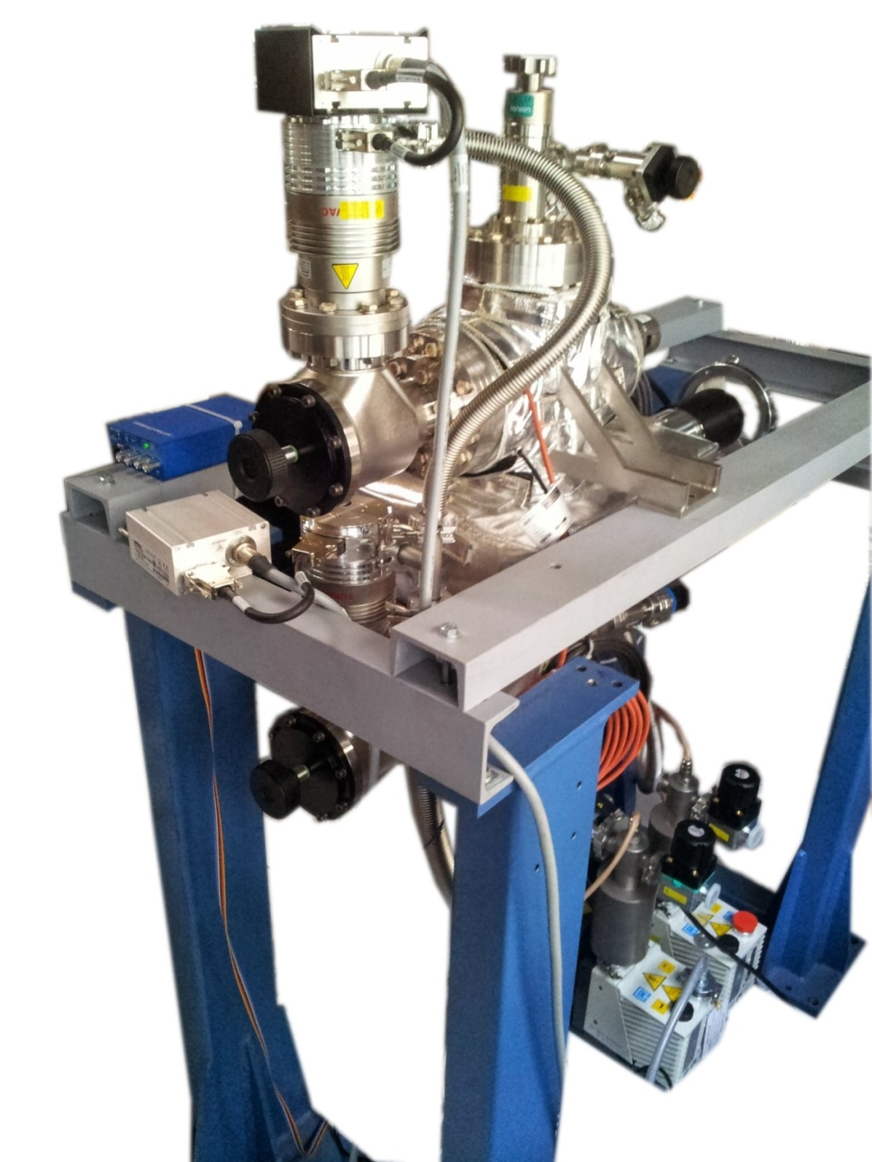
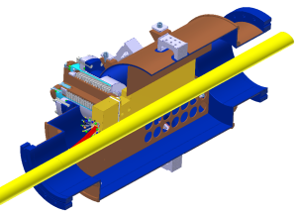
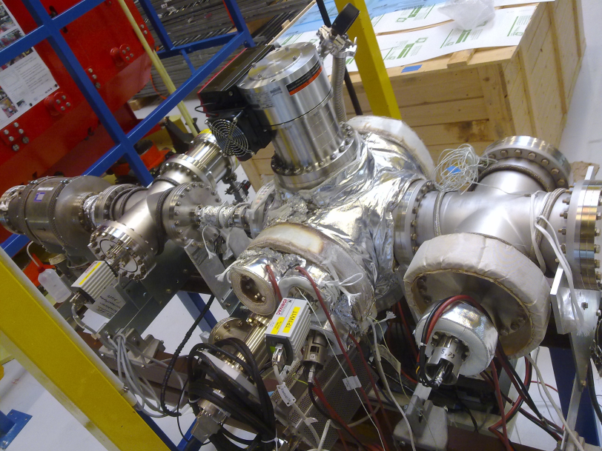
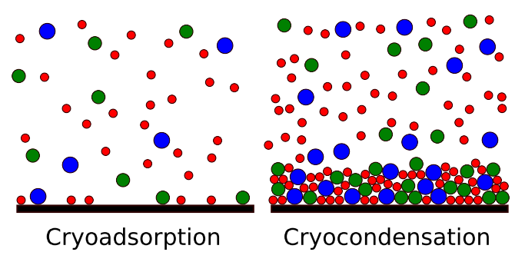
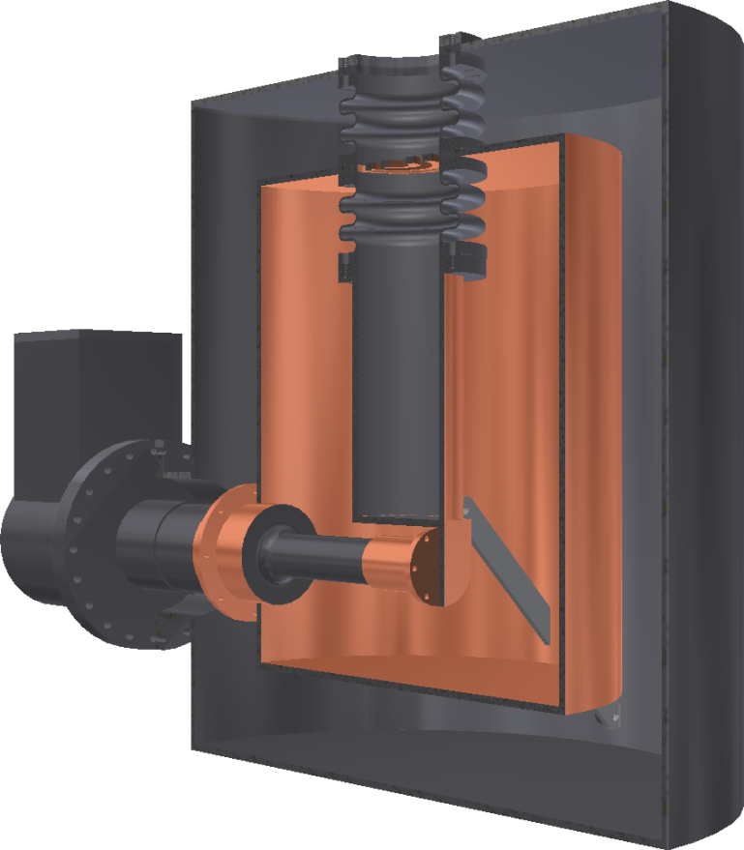
Ultimate Heavy Ion Intensities
ST2: Concepts and Technologies for Hadron Accelerators
Lars Bozyk (GSI)
Motivation
Ionization Beam Loss is the Main Loss Mechanism and Intensity Limitation for Heavy Ion Beams
FAIR-goal: Highest intensities
Medium charge state heavy ions (U²⁸⁺) have to be used to achieve highest intensities
Lower stripping losses
Higher space charge limit
Charge state can change in collision with rest gas
Self amplification of beam loss via ion-impact stimulated desorption possible
Worldwide unique parameter range for heavy ion beams at GSI
Generation of ultimate intensity heavy ion beams requires fundamental understanding of ionization loss mechanism
Ionization Cross Sections
5$⋅$10¹¹ particles of
U²⁸⁺ per pulse
Achieved so far: High Intensity Heavy Ion Beams – World Records
Key technologies for high intensity heavy ion synchrotrons have been developed at GSI
SIS18 upgrade program for booster operation:
Rf upgrade, h=2 acceleration
Power converters, ramping rate 10 T/s
Injection / Extraction: Minimization if in-ring losses
UHV upgrade – minimization of ionization loss
Low desorption ion catcher
Intense Heavy Ion Beams in SIS18
Simulation of Ionization Loss with "StrahlSim"
Unique code for the simulation of dynamic vacuum effects
Self consistent simulation of pressure profiles
Pumping and outgasing
Ionization of beam ions and subsequent loss
Simulation of feedback between vacuum and heavy ion beam
Simulation of catcher currents
Benchmarks with SIS18
U²⁸⁺ beam lifetime in SIS18
Accelerated Ions in SIS18
World record!
Simulation
Measurement
R&D-Program for High Intensity Heavy Ion Beams in Superconducting Synchrotrons and Results
Measurement of Cryogenic Desorption and Cryogenic Pumping Properties
Experiments on ion impact stimulated desorption from cryogenic surface found an unexpected energy scaling of the desorption yield
New experiments on cryogenic desorption ongoing
Understanding of cryogenic desorption
Optimization of cryogenic ion catcher
Low desorption materials at cryogenic temperatures for SIS100 and higher energies are developed
Pumping properties of cryogenic surfaces are described by sticking coefficient and mean sojourn time
Both depend on surface temperature and coverage
Dedicated test setup for systematic measurement
Results will improve the simulation data basis

