Slide 1
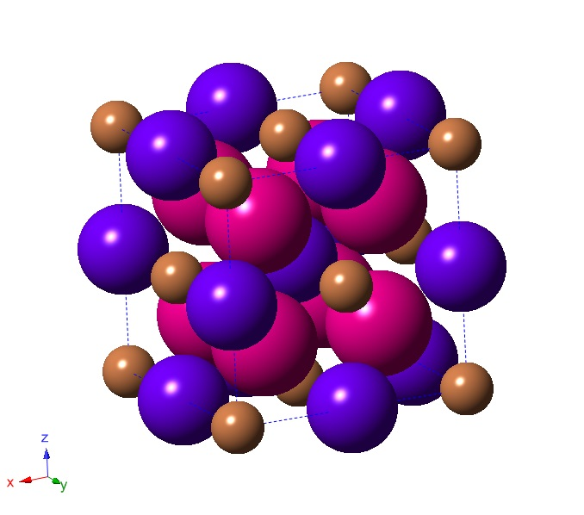
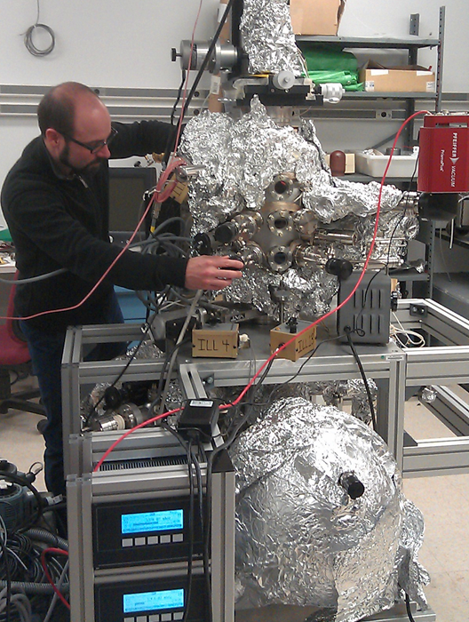
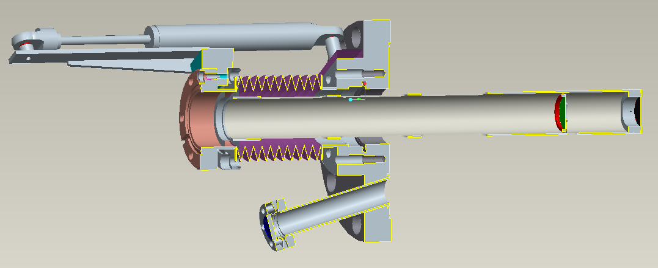
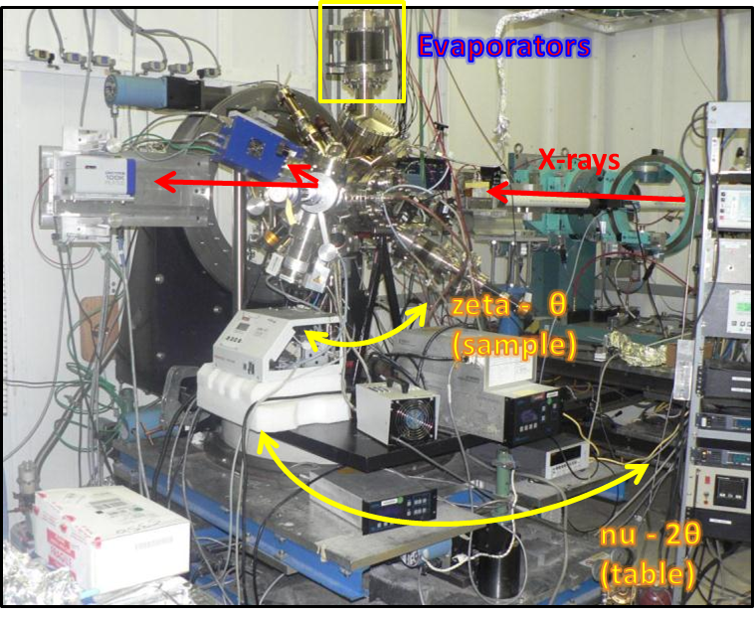

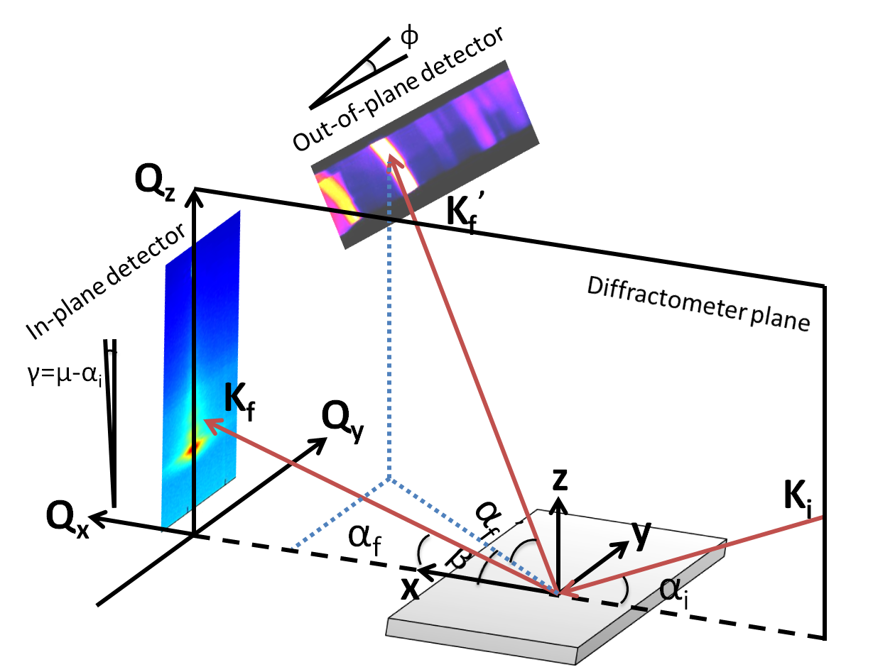

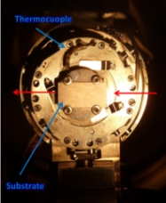
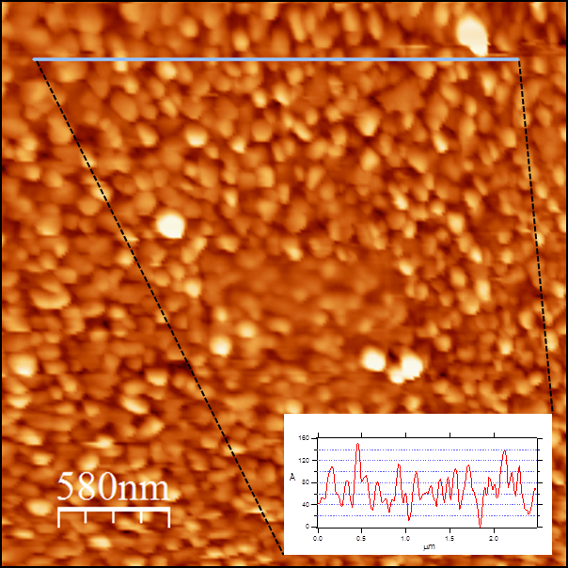
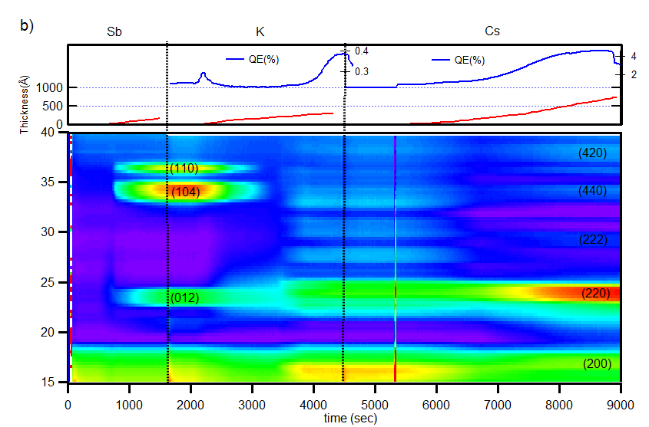
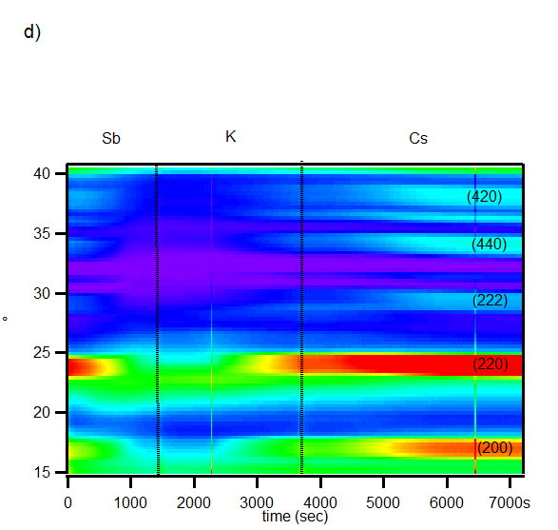
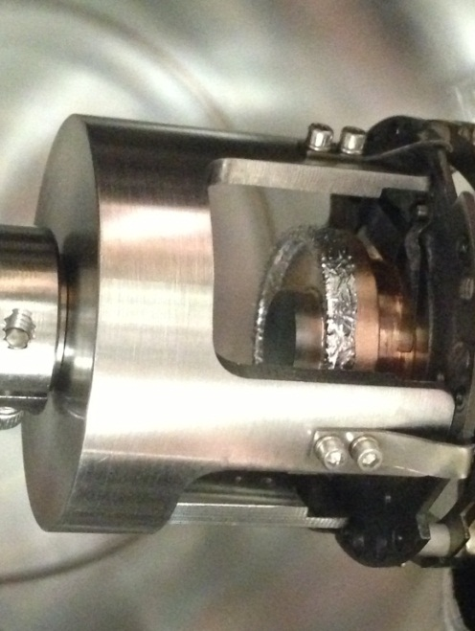

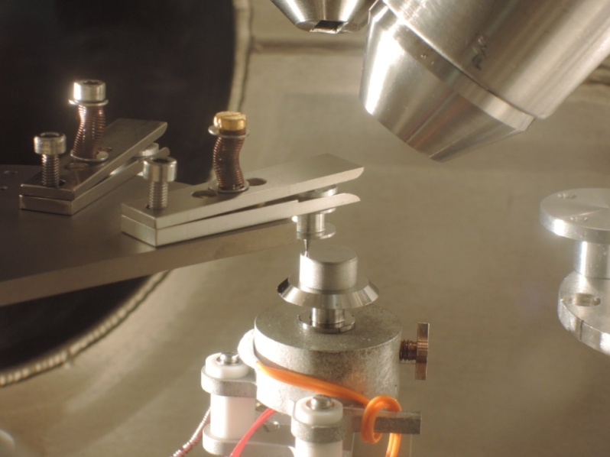
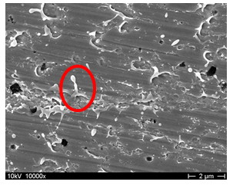


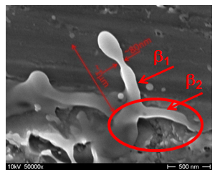
From Alchemy to Understanding –
Photocathodes for High Brightness Electron Sources
ARD – ST1 Superconducting RF Science and Technology
Susanne Schubert, HZB/BNL
Photoelectron emission from laser driven photocathode embedded in SRF cavity allows generation and acceleration of high brightness electron bunches.
Prime candidate materials for photocathodes
are multi-alkali antimonides like CsK₂Sb or
Na₂KSb.
By understanding the growth and properties
of these materials optimization is possible
towards excellent performance in the SRF
gun environment.
Therefore a variety of materials and surface science tools on todays synchrotron light sources are used to enable the next generation particle accelerators.
Preparation chamber:
Four evaporation sources, mass spectrometer, two quartz crystal microbalances, photo current meter, and sputter gun for substrate preparation
Analysis chamber:
XPS, LEIS, energy analyzer for chemical composition, depth profiling, surface composition, deposition rate, spectral response.
CsK₂Sb structure : brown- Sb, blue – K,
purple-Cs.
Momentratron:
Transverse energy distribution of photoelectrons → intrinsic source emittance.
grid
view
screen
camera
viewport
Understanding the growth mechanism, function of the individual materials, and bulk crystal structure with X-Ray Diffraction (XRD) measurements. A collaborative effort with US labs at BNL.
sample
laser viewport
Out-of-plane XRD to monitor lattice information
Goal is to understand correlations between photocathode growth and electron bunch properties after photoemission, and to study limits from unwanted beam generation.
Setup of UHV photocathode preparation and analysis chamber for high quantum efficiency photocathodes including load-lock for UHV cathode transfer.
Combined growth and analysis experiments at synchrotron radiation source beamline.
Beam tests in high brightness SRF gun test facilities at GunLab/BERLinPro (HZB) and ELBE (HZDR).
GiSAXS, XRR and XRD to monitor morphology, growth mechanism, roughness, thickness and preferred orientations
X21 experimental setup at NSLS/BNL and CHESS/Cornell
Incoming
X-ray
Photocurrent to determine QE
UHV-AFM:
Measurement of the film morphology after deposition.
Surface shows rms roughness of 25 nm.
In electron gun with gradients > 3 MV/m this roughness would be the dominate intrinsic source of emittance.
Growing of 1st cathode
Growing of 2nd on top of 1st
Sb
K
Cs
Sb
K
Cs
Collaboration with industry (Photonis):
Multi-alkali antimonide cathodes commonly used in PMTs.
Photonis interested in XRD analysis and layer-by-layer growth procedure.
Current Photonis cathode has reliable high QE (4.6% at 532nm) but exhibits rough surface.
XPS studies allow to look into the chemical composition of the surface and bulk of the photocathode material → the surface is Cs enriched with a stoichiometry close to Cs₂KSb.
XRR gives average roughness, measuring the height difference of the particles on the surface, not sensitive to properties of single emitters → field emission measurements.
New preparation approaches:
Preparation of sputter targets from powder, prepared from stoichiometric mixture of the elements (yield 96%).
Sputtered films are expected to show lower surface rougness than evaporated films.
Field emission (generating unwanted beam) from single emitters or surface structure is a fundamental limit for operation of electron gun: dark current, particle losses and multipactoring sources.
FE setup and field emission scanning microscope experiments to learn about FE sources and strategies to mitigate FE.
People involved:
S. Schubert, T. Kamps, R. Barday, A. Jankowiak, G. Klemz, J. Knobloch, E. Panofski, M. Schmeißer, J. Völker (HZB), C. Brau, B. Choi (U Vanderbildt), S. Lagotsky, G. Müller (U Wuppertal), M. Ruiz-Oses, J. Smedley (BNL), J. Teichert, R. Xiang (HZDR)
Key publications:
S. Schubert, et al., APL Materials 1, 032119 (2013)
R. Barday, et al., Phys. Rev. ST Accel. Beams 16, 123402
T. Kamps, et al., arXiv:1307.1571 [physics.acc-ph]
Anode
Sample
FESM: study surface morphology and chemical composition of emitters with SEM and EDX. Investigate effect of dry-ice cleaning and heat treatment.
.
Mo FE map at 100 MV/m
SEM

