Slide 1
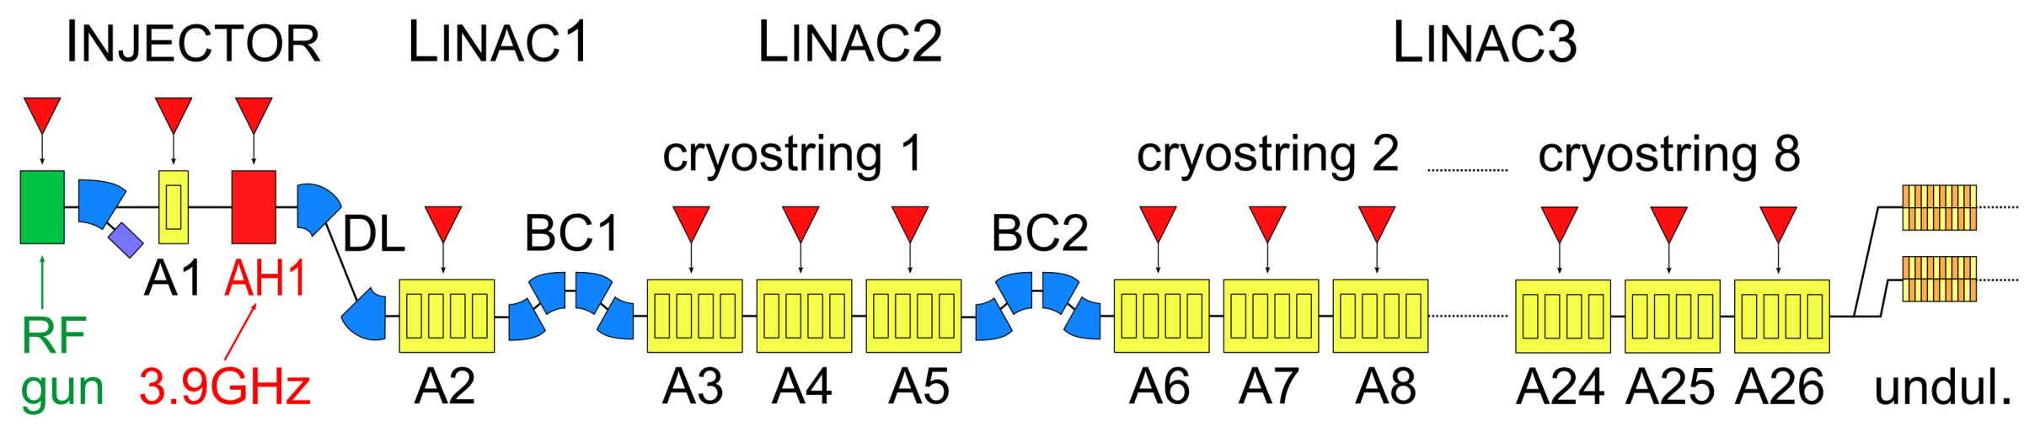
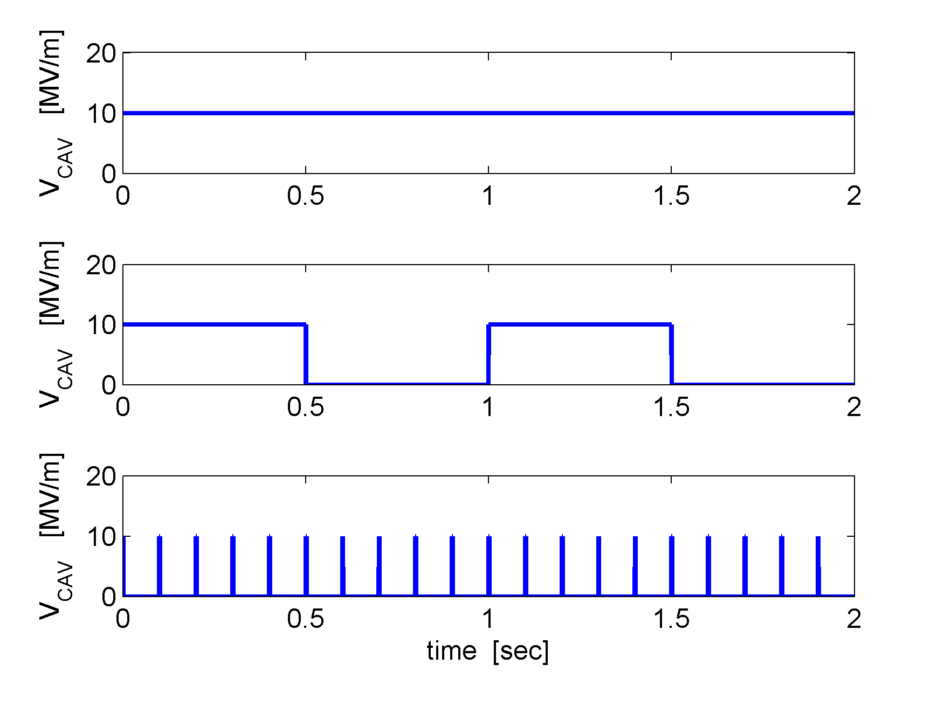
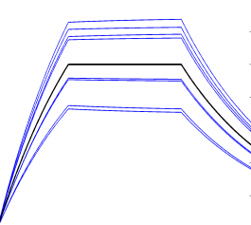
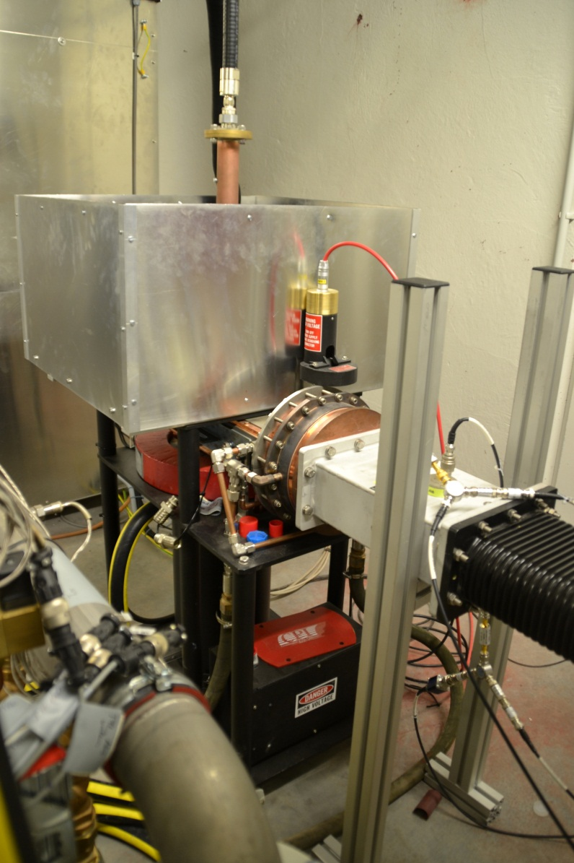
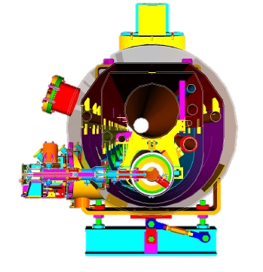
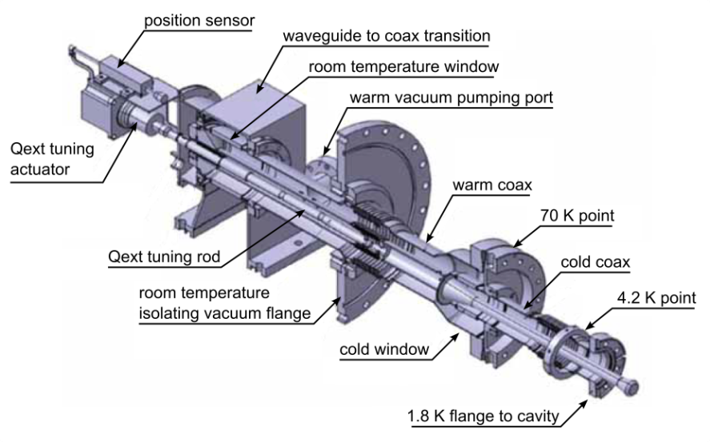
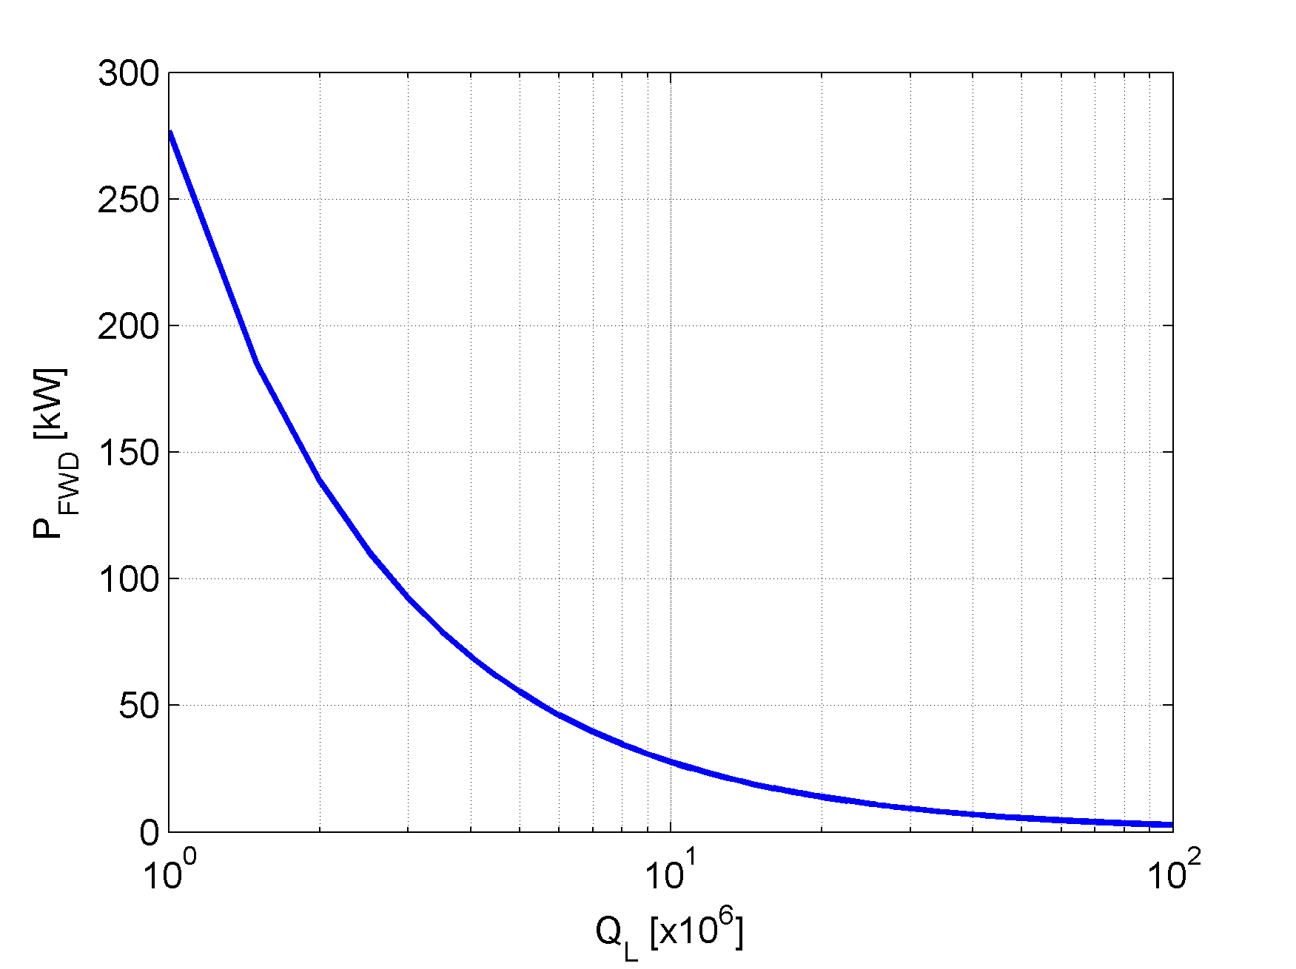
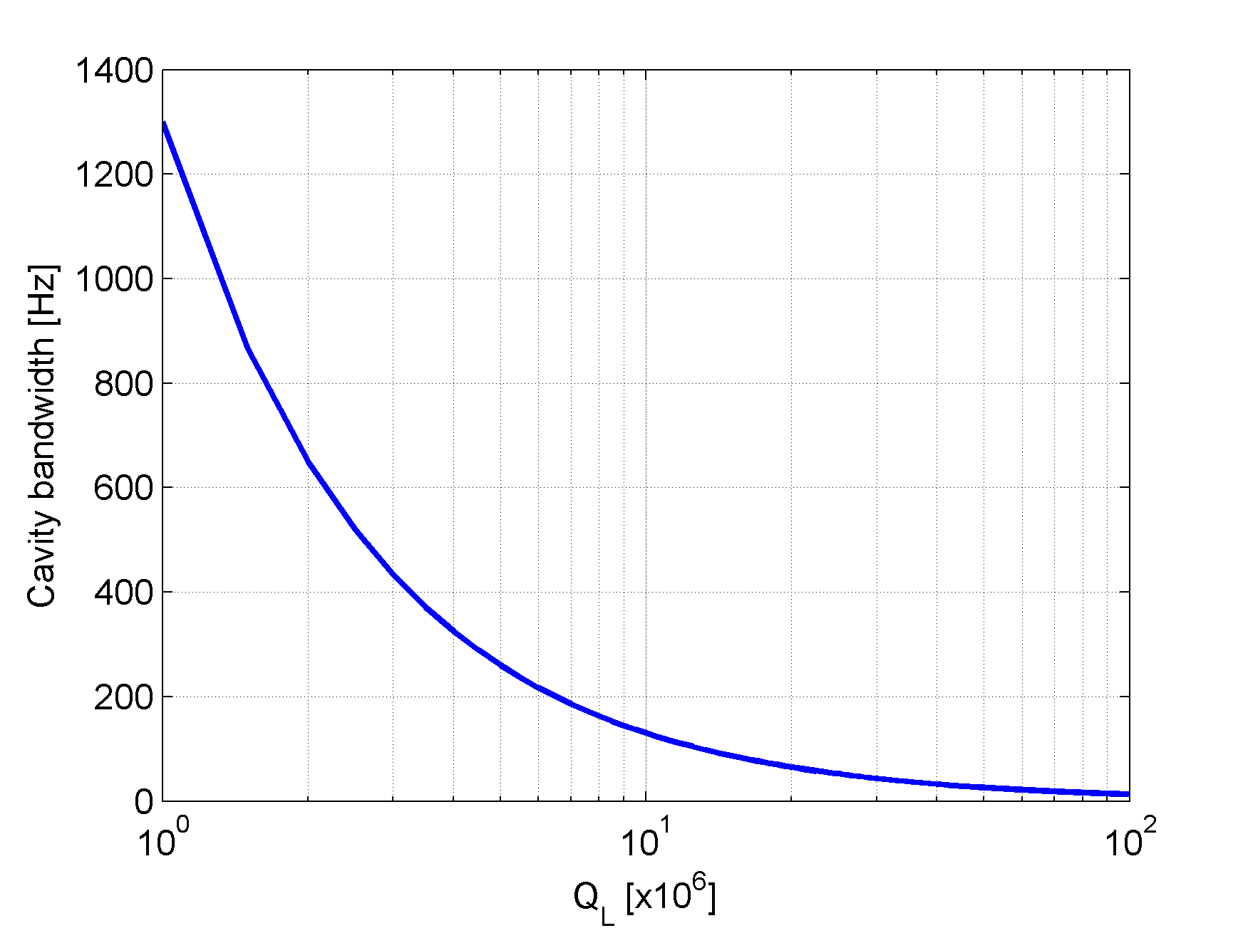
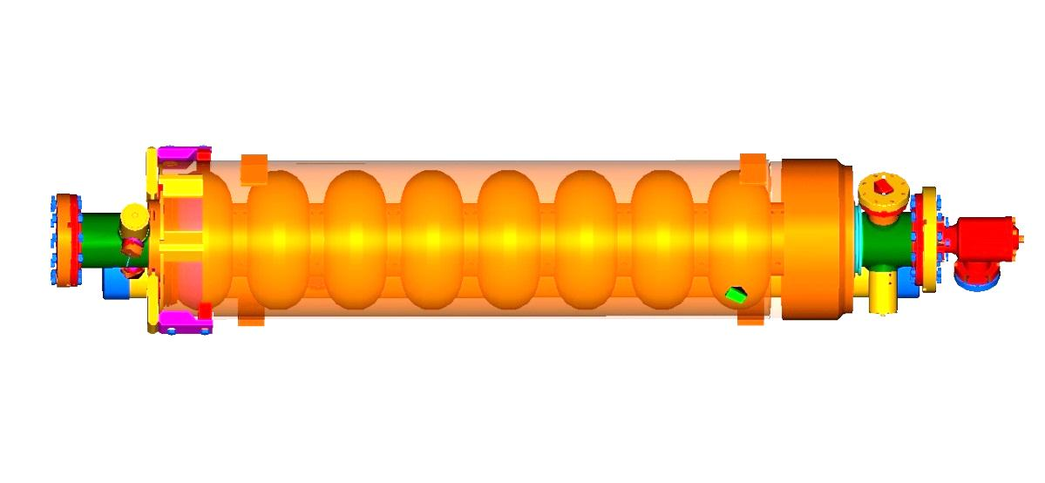
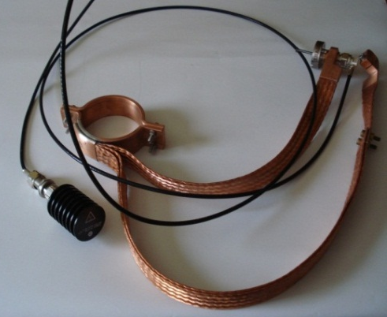
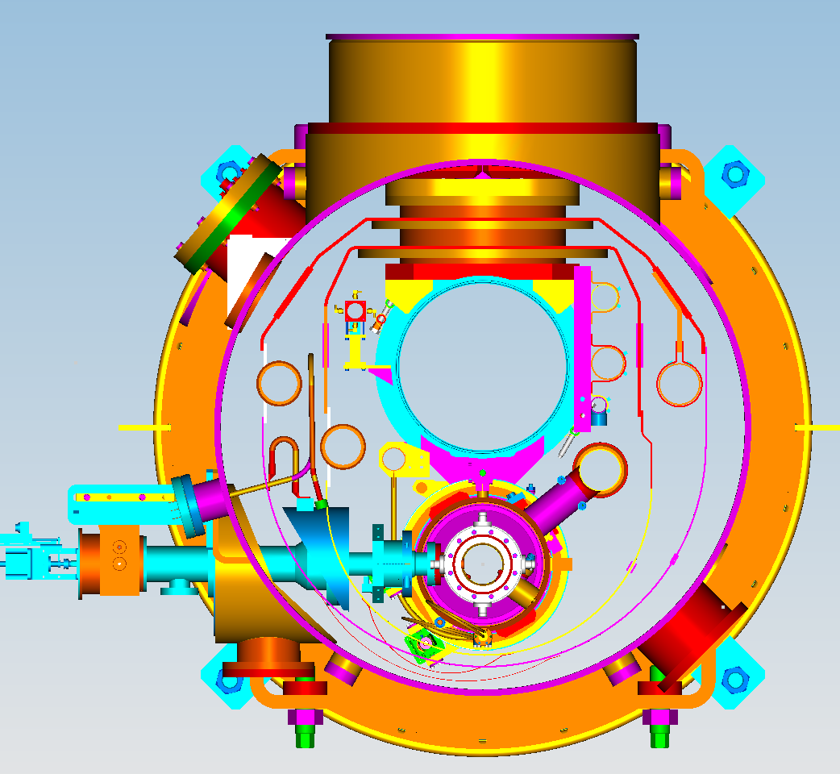
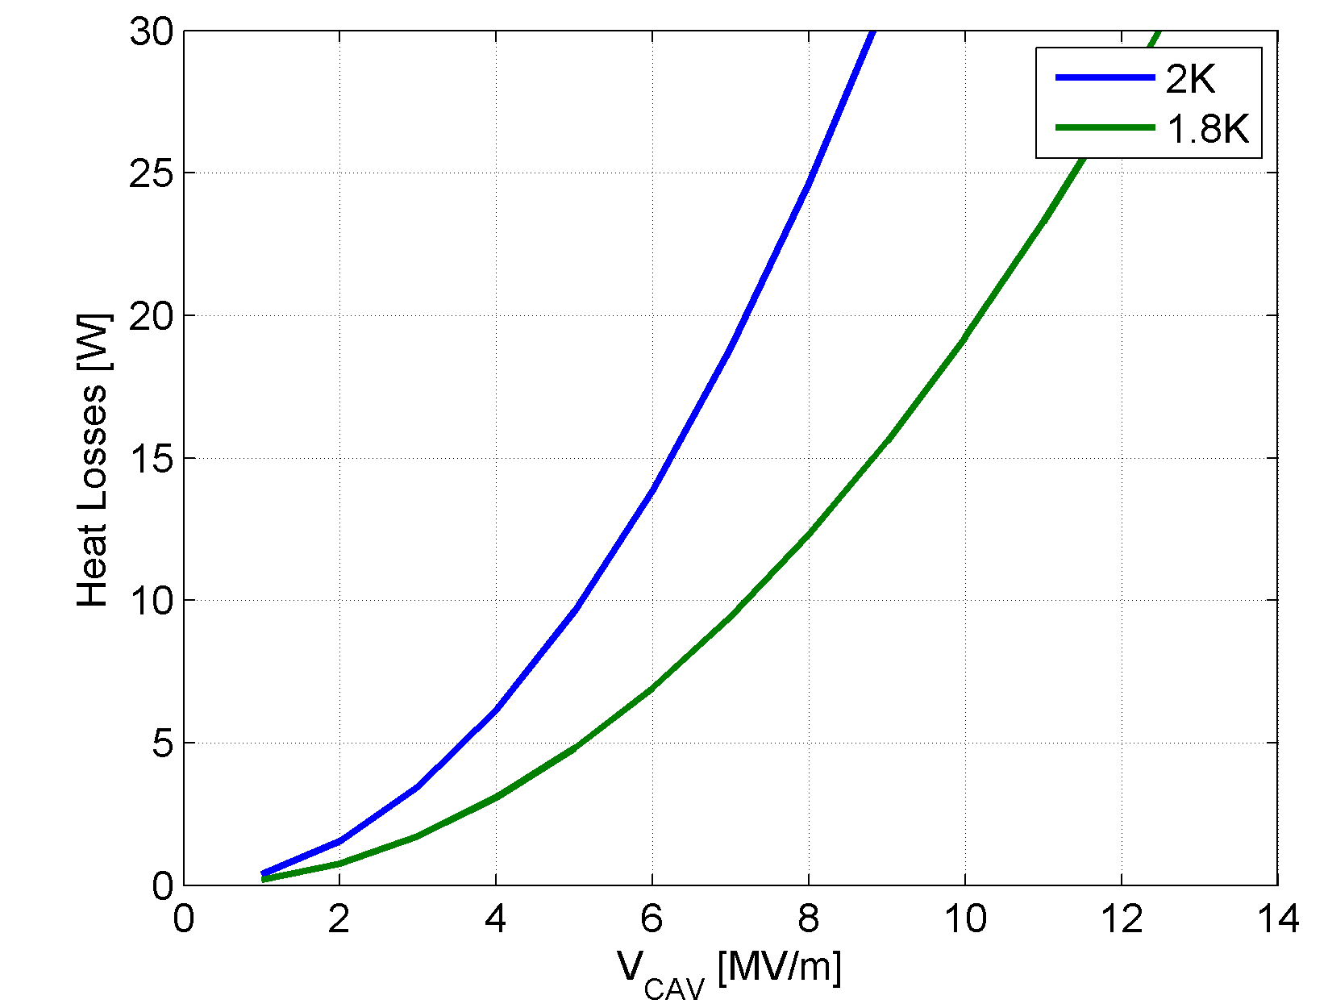
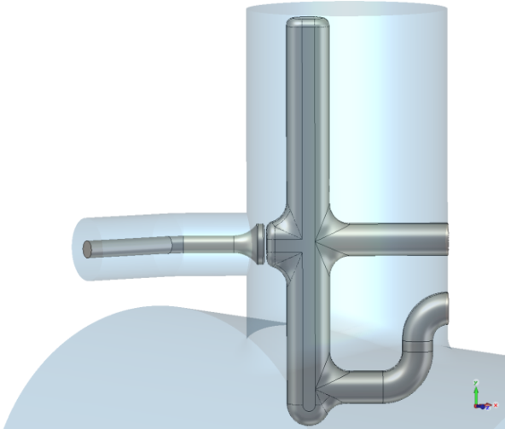
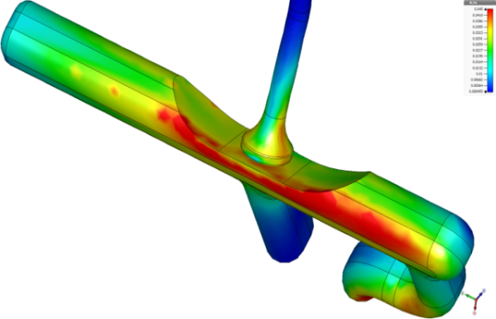
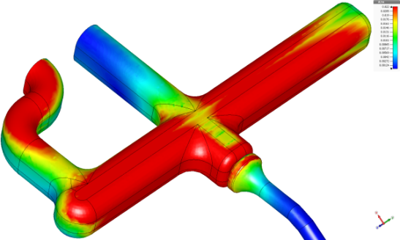
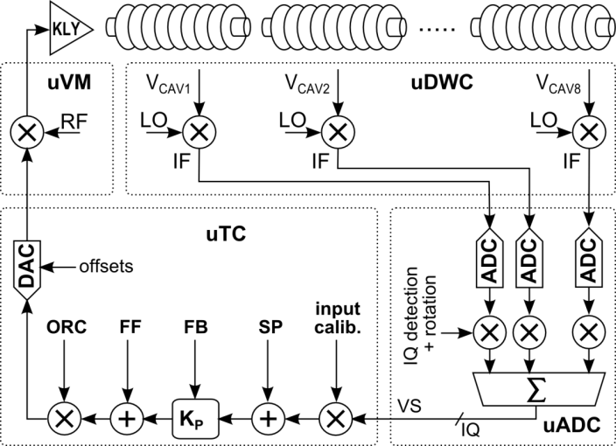
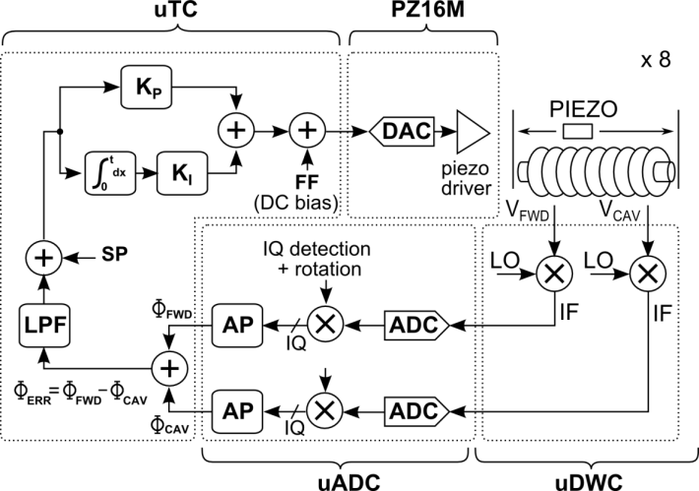
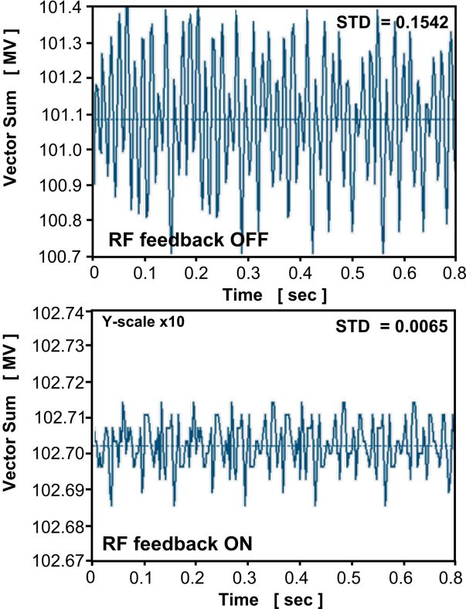
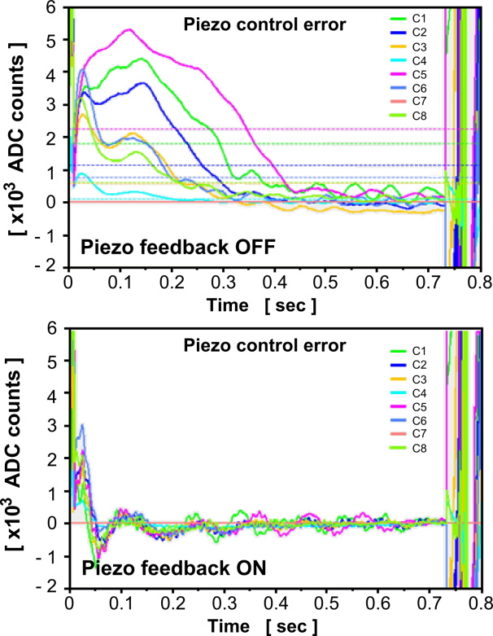
The European XFEL goes CW
ARD-ST1 SRF Science & Technology
Julien Branlard, DESY
Motivations
The European X-ray free-electron laser
17.5 GeV pulsed SRF LINAC, 0.05 ≤ λ ≤ 6 nm, pulses ≤ 100 fsec
101 cryomodules, 8 SRF cavities / cryomodule (1.3 GHz TESLA)
10 MW klystron / RF station (32 cavities)
Benefits of continuous wave (CW) operations
Higher efficiency
More flexible beam time structure
Slower repetition rate lasers, cheaper/simpler detectors
Lorentz force detuning and fill-transients no longer an issue
Benefits of long-pulse (LP) operations
Still high duty factor (DF = 10-50%)
Higher gradients with same heat load
Possible operation scenarios*
CW
DF = 100%
E = 7.8 GeV
N_{bunch} ≤ 450k
LP
DF = 10-50%
E = 8.8 GeV
N_{bunch} ≤ 110k
pulsed
DF = 1.3%
E = 17.5 GeV
N_{bunch} ≤ 27k
* Calculations are based on
100 kW IOT, 1nC bunch charge, Eacc = 16 MV/m in injector
for CW : Eacc = 7 MV/m in main linac
for LP : Eacc = 10 MV/m in main linac , 35 % duty factor
What is required
Actions required for an XFEL CW upgrade
Upgrade cryo plant 2.5 kW → 5 kW
Replace the first 17 cryomodules (injector, L1, L2) with “CW-ready” modules
(Note: the replaced modules can be added at the end of LINAC3)
Use 1 IOT/cryomodule instead of 1 klystron / RF station
Adjust cavity loaded quality factor (Q_{L})
Why change Q_{ext} ?
Cavity power coupler
Q_{L} Cavity loaded quality factor
Q₀ Cavity unloaded quality factor
Q_{ext} Cavity external quality factor
Higher Q_{L} → lower P_{K} required
Higher Q_{L} → lower bandwidth
Present limitations
Heating of the HOM couplers (end groups) must not cause cavity quench
Heat load at 2K should not exceed ~ 20 W per cryomodule
V_{CAV} = 12 MV/m
R/Q = 1040 Ω
Δf (cryo) ≈ 1 Hz (for a well-regulated cryo bath)
P_{K} = 92 kW
P_{K} = 18 kW
B.W. = 433 Hz
B.W. = 87 Hz
End groups (FP and HOM couplers) are outside of the liquid He vessel
Cooling through heat conduction only
Q_{L} = 3e6
Q_{L} = 1.5e7
Q_{L} = 3e6
Q_{L} = 1.5e7
CPI first prototype IOT: 85 kW 22 dB
With higher Q_{L}, less power is required to achieve same gradient.
Increasing Q_{L} decreases the cavity bandwidth, making it more sensitive to microphonics.
FPC
Courtesy J. Sekutowicz
Benefits of operating at 1.8K instead of 2K
HOM coupler
HOM coupler
2K, GRT
2.2K forward
  RF heats up cavity walls → dynamic heat losses
  Surface resistivity (R_{S}) decreases exponentially with temperature
  Operations at 1.8K instead of 2K
  Q₀ increases by factor of 2
  Heat load (HL) decreases by factor of 2
  Proportional to duty factor (DF)
  Gradients can be increased by 40%
80K, Return
5K forward
*
8K, Return
40K forward
2-phase tube: 240 W
(~20 W/cryomodule) is the estimated limit for one XFEL cryostring (12 modules)
High thermal conductivity HOM
feedthroughs with sapphire window
Copper braids used to dissipate the HOM
coupler heat along the 2-phase tube
Cryomodule cross section, showing the 2 K gas return tube (GRT) and
the 2-phase He tube setting the 20 W / CM dynamic heat load limit
*
* Reference: “RF superconductivity for accelerator”, H.Padamsee
R&D programs and results
CW and LP tests at the cryomodule test bench
New HOM coupler design
H = 0.045 A/m
Low level radio frequency control
Dynamic heat load (DHL) versus duty factor (DF) at Eacc=5.6 MV/m
3rd inductance
Courtesy D. Kostin
Vector-sum RF feedback
Individual piezo feedback
output antenna “hidden” inside output tube
two inductances
H = 0.022 A/m
New HOM coupler with additional inductance and pulled back output antenna provides better heat dissipation and 50% less magnetic field
CW operation at 2K and at 1.8K
DF [%] | 38 | 60 | 75 | 100
Estimated DHL [W] | 4.2 | 6.5 | 8.3 | 10.7
Additional Heat / End group [W] | 0.07 | 0.23 | 0.29 | 0.41
factor of 24
Resonance controlled
during fill time (first 400 msec)
Courtesy J. Sekutowicz
2K
1.8K
Courtesy J. Sekutowicz
Reference: “LLRF System Design and Performance for XFEL Cryomodules Continuous Wave Operation”, J. Branlard et al. SRF 2013 Proceedings
Special Thanks
Acknowledgments to all involved with the CW tests: V. Ayvazyan, W. Cichalewski, M. Ebert, N. Engling, J. Eschke, T. Feldmann, A. Goessel, W. Jalmuzna, D. Kostin, M. Kudla, D. Makowski, F. Mittag, W. Merz, C. Müller, R. Onken, A. Piotrowski, K. Przygoda, I. Sandvoss, J. Sekutowicz

