Slide 1
Compact Laser Synchronization
MTCA.4 Based Laser to RF Synchronization
Peter Peier
Compact Laser Synchronization
Dresden, 26. February 2014

Slide 2
Contents
Motivation
Electro-Optic Bunch Length Measurement
Laser Synchronization Scheme
MTCA.4 Components
Data Transmission
Short and Long Term Measurements

Slide 3
Motivation – Lasers at Accelerators
Accelerator
e⁻
Gun
Laser
Laser
Heater
Laser
Diagnostic
Seeding
Laser
Pump-Probe
Laser
Timing and Synchronization

Slide 4
Motivation – Electro-Optic Bunch Length Measurement
synchronization
oscillator
RF
timing signal
timing
AOM
amplifier
detector
compact
EO Monitor
Synchronized Ytterbium fiber laser is modulated by Coulomb field of the electrons (E_{THz}) in EO crystal (GaP)

Slide 5
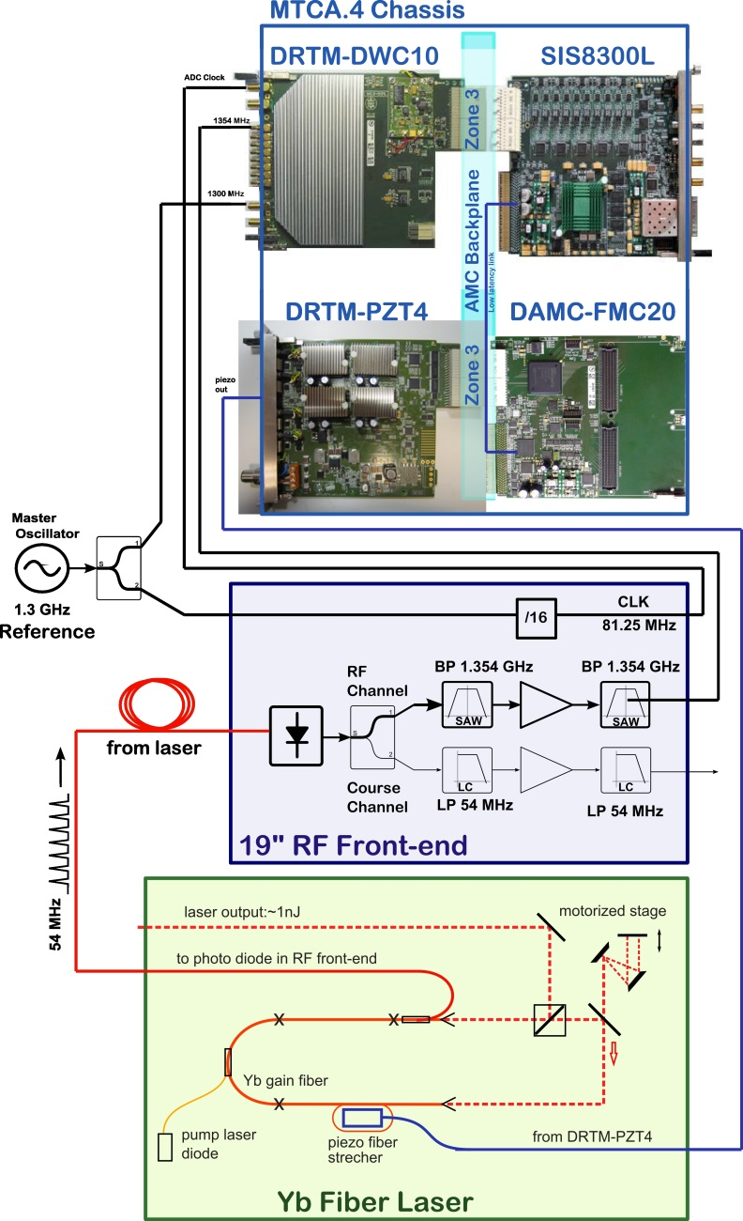
Synchronization of EOD Laser

Slide 6
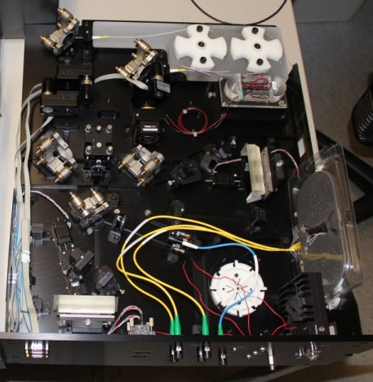
EOD Laser
Optimized laser for electro-optical bunch length measurement at XFEL
Mode locked Yb fiber laser developed at PSI and assembled at DESY
Specifications:
Wavelength: 1030nm
Bandwidth: 25-50nm (amplified: 100nm)
Pulse length: 5ps (compressible to <100fs)
Pulse energy: 1-2nJ (amplified: 100nJ)
Repetition rate: 54MHz (amplified: 4.5MHz)
Temperature stabilized to 0.1°C

Slide 7
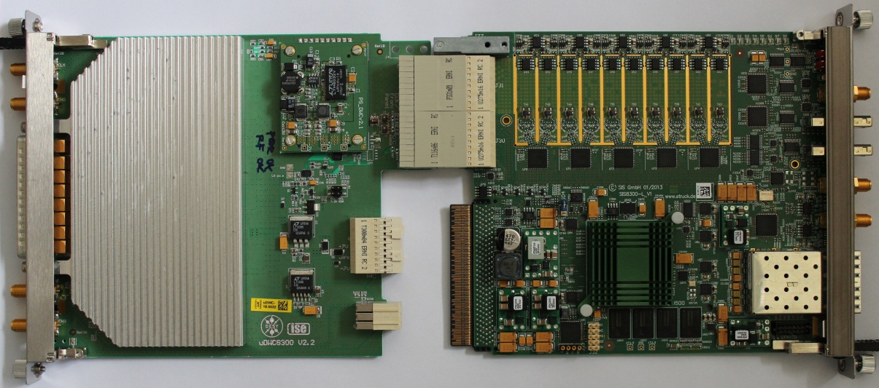
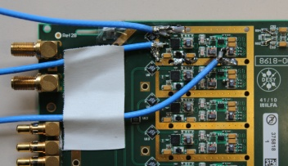
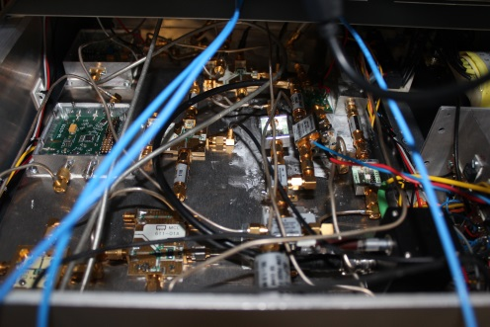
RF Generation and Detection
DRTM-DWC10
RF
IF
LO
RF generation Box (19”) to generate sinusoidal RF signals from laser pulses
10 channel high-frequency down-conversion from 1GHz – 4GHz
Merge 19” RF box and downconverter board to a single RTM unit

Slide 8
Digitizing and Signal Processing
SIS8300-L
10 channel, 16 bit digitizer (AC or DC coupled) – low noise design
10 MS/s to 125 MS/s
Virtex 6 FPGA
Two 16bit DACs
IF in
ADC
DAC
PCIe & PtP
FPGA

Slide 9
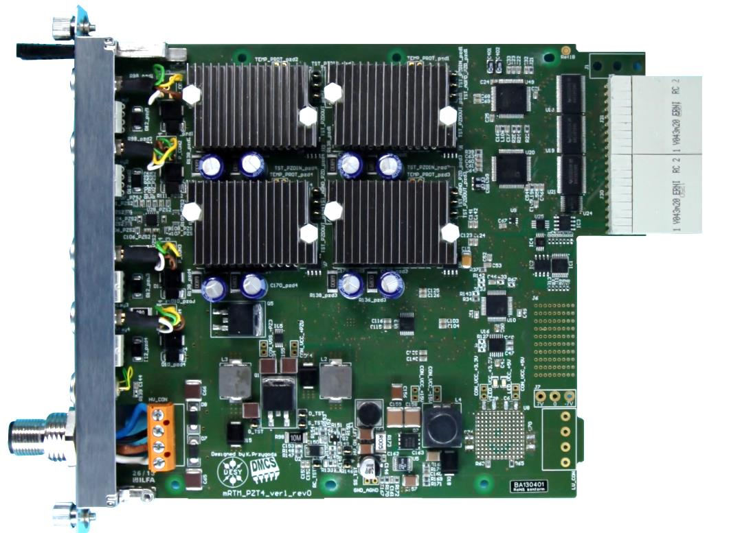
MTCA.4 4-Channel Piezo Driver
DRTM-PZT4
DAC
4 power amplifier with 0-100V, -85V/+85V
DAC outputs +/-5V, +/-10V, 0/5V, 0/10V
Each power amplifier can drive up to 10uF capacitance.
Applications:
Cavity fine tuning
Laser to RF synchronization
Link Stabilization
PA 2
PA 1
PA 3
PA 4
DAC
EXT. PS Input

Slide 10
Blockdiagram of Signal Processing
PI: PI controller
PCIe: Peripheral Component Interconnect express
MGT: Multi-gigabit transceiver
LLL: Low Latency Link
SPI: Serial Peripheral Interface

Slide 11
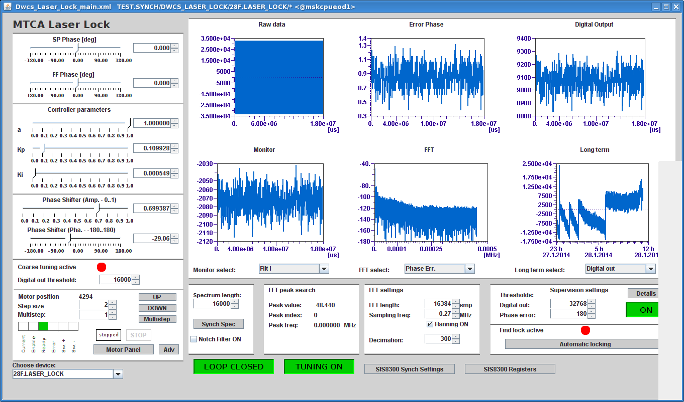
Integration in Control System – Server and Panel

Slide 12
Phase Noise and Baseband Noise

Slide 13
Long Term Locking

Slide 14
Conclusion and Outlook
Laser to RF synchronization with MTCA.4 components successfully tested!
Short and long term measurements carried out on the EOD Laser.
Competitive jitter numbers measured.
System was also tested with commercial laser (Gun Laser 3).
Second revision of Piezo driver board will arrive in March.
EOD measurements at FLASH planned.
Merge RF Box and downconverter RTM to a new RTM.
Control motor with DFMC-MD22 on DAMC-FMC20.

Slide 15
“Laser Synchronization Task Force”
Uroš Mavrič
Konrad Przygoda
Lukasz Butkowski
Hans-Thomas Duhme
Matthias Felber
Michael Fenner
Christopher Gerth
Tomasz Kozak
Paweł Prędki
Holger Schlarb
Bernd Steffen

Slide 16
Thank you for your attention!

