Slide 1
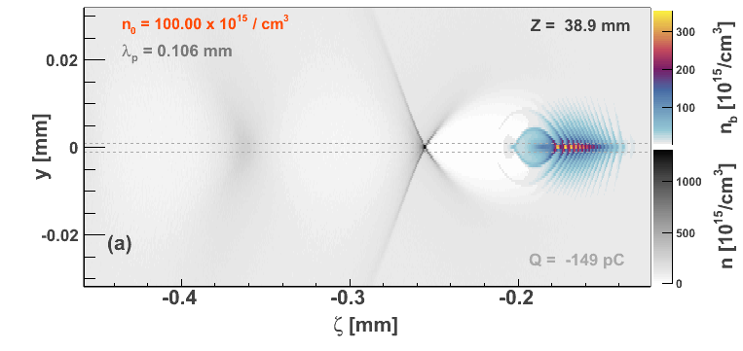
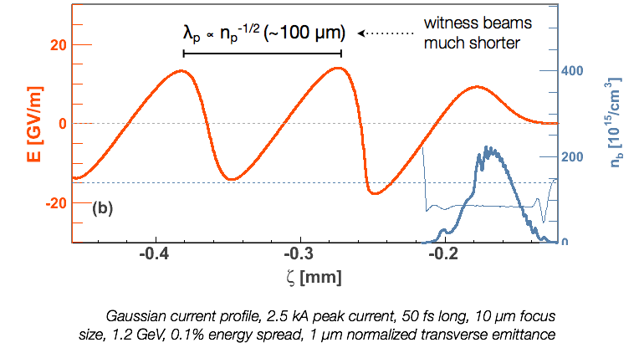
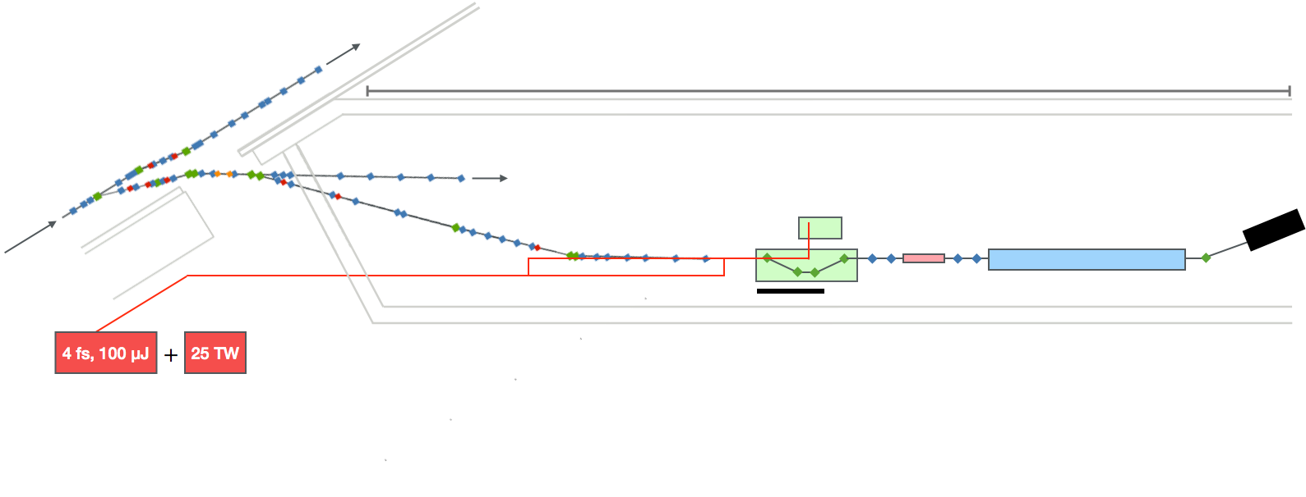
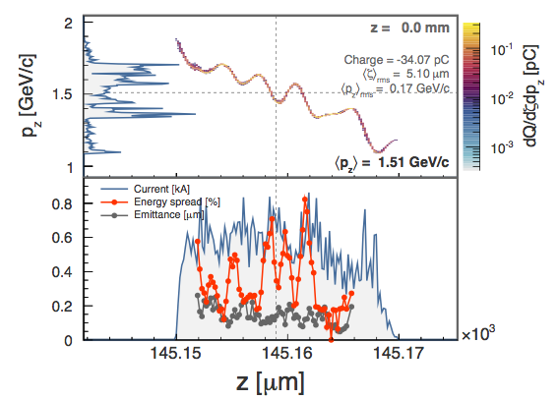
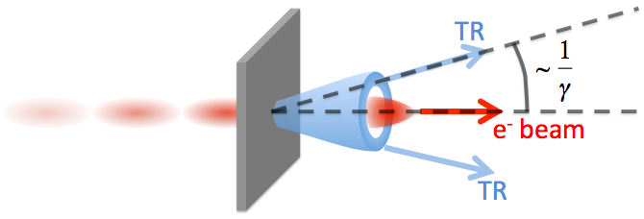
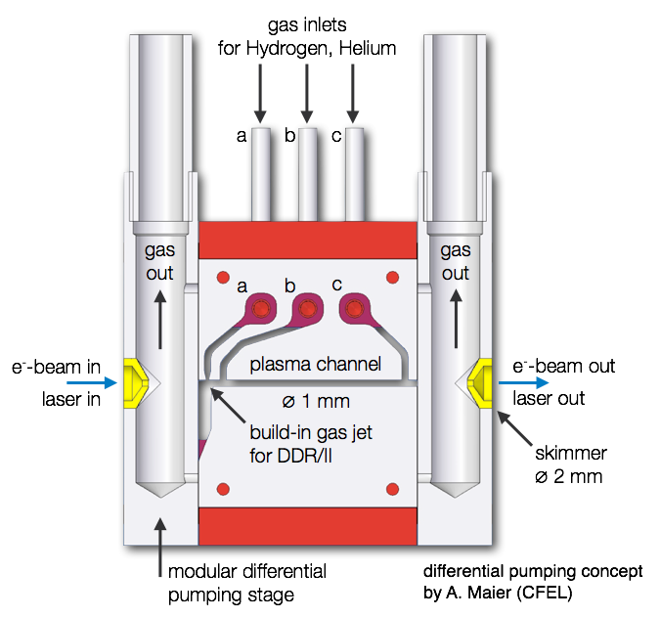
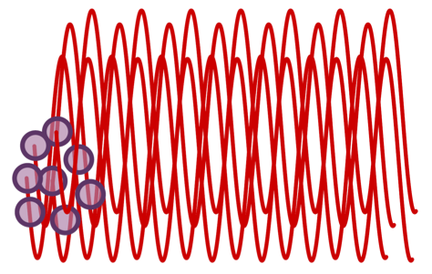
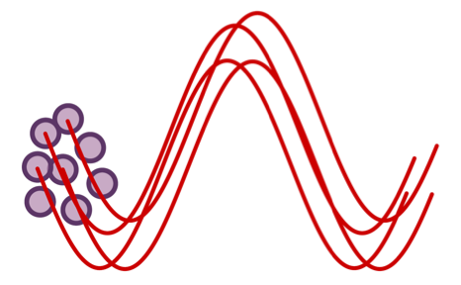
Low-emittance electron bunches accelerated in plasma wakefields
C. A. J. Palmer, L. Schaper, J. Grebenyuk, A. Martinez de la Ossa, J. Dale, V. Libov, J. Zemella, C. Behrens, M. J. V. Streeter, T. Kleinwächter, T. Mehrling,
J.-P. Schwinkendorf, S. Wunderlich, L. Goldberg, O. Kononenko, A. Aschikhin, H. T. Olgun, C. Entrena, B. Schmidt and J. Osterhoff
DESY, Notkestr. 85, HAMBURG
Plasma-based particle acceleration
FLASHForward‣‣
Future-oriented wakefield-accelerator research and development at FLASH
New beamline dedicated to the study of beam-driven plasma wakefield acceleration.
Driver bunch pushes electrons aside.
Charge separation fields pull electrons back.
Electrons overshoot and oscillate forming wakefield.
Witness bunch accelerated and focused by fields.
Driver bunch
FLASH bunch parameters
Wakefield
Main goals:
Novel witness-bunch generation for unprecedented bunch quality: Energy > 4 GeV, Duration ~ fs, Current > 1 kA,
Norm. emittance ~ 100 nm
Transformer ratios of greater than 2 using triangular driver bunch.
Use of plasma accelerated beams in an undulator to generate photon energies up to 1 keV.
Energy ~ 1.25 GeV
Energy spread ~ 0.1% rms
Trans. norm. emittance = 1 μm
Duration 20 – 500 fs
Charge 20 – 500 pC
Repetition rate 10 Hz
Figure 1: (top) Simulated density plot of wakefield. (bottom) Longitudinal accelerating fields from simulation.
FLASH 1 FEL
~ 80 m
Medium is a plasma
Accelerating gradient not limited by breakdown
~ 10s GV/m
FLASH 1 accelerator
FLASH 2 FEL
Plasma cell
Laser/plasma photon diagnostics
Witness dump
Witness bunch duration intrinsically short
Measurements¹ indicate duration of < 10 fs ≪ λ_{p}
Extraction
Differential
pumping
Why use a particle driver rather than a laser?
Lower normalised emittance predicted ≤ 100s nm
Higher average power
Higher efficiency
Beam matching and focusing section
Beam diagnostics section
X-ray diagnostics
Required for good luminosity
Probe/Ionization lasers
Driver dump
TDS (optional)
Undulator
Figure 2: Schematic of FLASHForward experiment.
Controlled injection of electrons from the background plasma
Techniques may require specialised targets, synchronised lasers etc.
Controlled internal injection
i.e. laser triggered ionisation²,
wake-triggered ionisation³ and
Final electron bunch properties depend on injection of bunch into accelerating structure
Controlled external injection
i.e. Two pulses from photo-gun
Plasma must be ‘matched’ to injected bunch parameters to avoid emittance growth
Density Downramp Injection⁴
Self-injection of background plasma electrons (longitudinal wave-breaking) facilitated due to a plasma density gradient;
Allows for controllable stable particle injection of high-quality beams which was experimentally demonstrated in laser-driven schemes⁵;
Ramp height/length variations provide control over beam charge, emittance and length.
n
~ mm
~ cm
What bunch parameters are expected:
Strongly correlated longitudinal phase-space as shown in Figure 3.
Excellent slice properties:
Energy spread < 0.5%,
Normalised emittance < 0.2 μm
Peak current 〜0.8 kA.
z
Figure 3: (Left) Schematic of plasma density profile for downramp injection (Right) Example of electron beam induced due to a density down-ramp: longitudinal phase space (top) and slice properties (bottom) after 15 mm of propagation in plasma.
Transition radiation diagnostics
Important to characterise electron bunches to determine:
Effectiveness of injection technique. Suitability for further application.
Tailored plasma targets to allow control of electron bunch properties
Measurement of femtosecond electron bunches poses a particular challenge.
Transition radiation as longitudinal bunch diagnostic.
Gas-jet for injection control fed by inlet a)
The embedded gas-jet allows introduction of
very confined and localised density variations, e.g.
1. A density peak allowing for density downramp injection (DDR).
2. Introduction of a different gas species at constant electron density, important for ionisation injection (II).
Plasma channel fed by inlets b) & c)
A flat profile with adjustable electron density is formed within the plasma channel and allows for stable acceleration conditions.
The target design allows for full transverse access of injection as well as acceleration region, allowing probing of the generated wakefield and its spatial evolution.
Generated by charge crossing interface between materials with different ε₀.
Bunch of charges adding of radiation fields.
INCOHERENT
COHERENT
Spectral intensity related to bunch shape.
e⁻ beam in
Laser in
e⁻ beam out
Laser out
Spectrum can be Fourier transformed to give estimate of temporal profile.
Fluctuations of incoherent radiation can also indicate bunch duration^{6,7}.
Additional information from transition radiation:
Imaging of incoherent radiation longitudinally integrated transverse profile.
total bunch charge.
Emittance measurement using several screens along the beam pipe⁸.
Figure 4: Schematic of gas target
Current experimental work:
Broadband spectrometer under testing 400 – 20,000 nm at Rutherford Appleton Lab.
Incoherent radiation diagnostics under development for use in Helmholtz Center Jena.
References
1. O. Lundh et al. Nat. Phys. 7 Pp. 219-222 (2011)
2. A. Pak et al. PRL 104 025003 (2010)
3. A. Martinez de la Ossa et al. PRL 111 245003 (2013)
4. A. J. Gonsalves et al. Nat. Phys. 7 Pp. 862-866 (2011)
5. C. G. Geddes et al. PRL 100 215004 (2008)
6. P. Catravas et al. PRL 82 Pp. 5261-5264 (1999)
7. B. Smit et al. Proc. IBIC 2013 (2013)
8. C. Thomas et al. J. Instr. 6 P07004 (2011)

