Slide 1
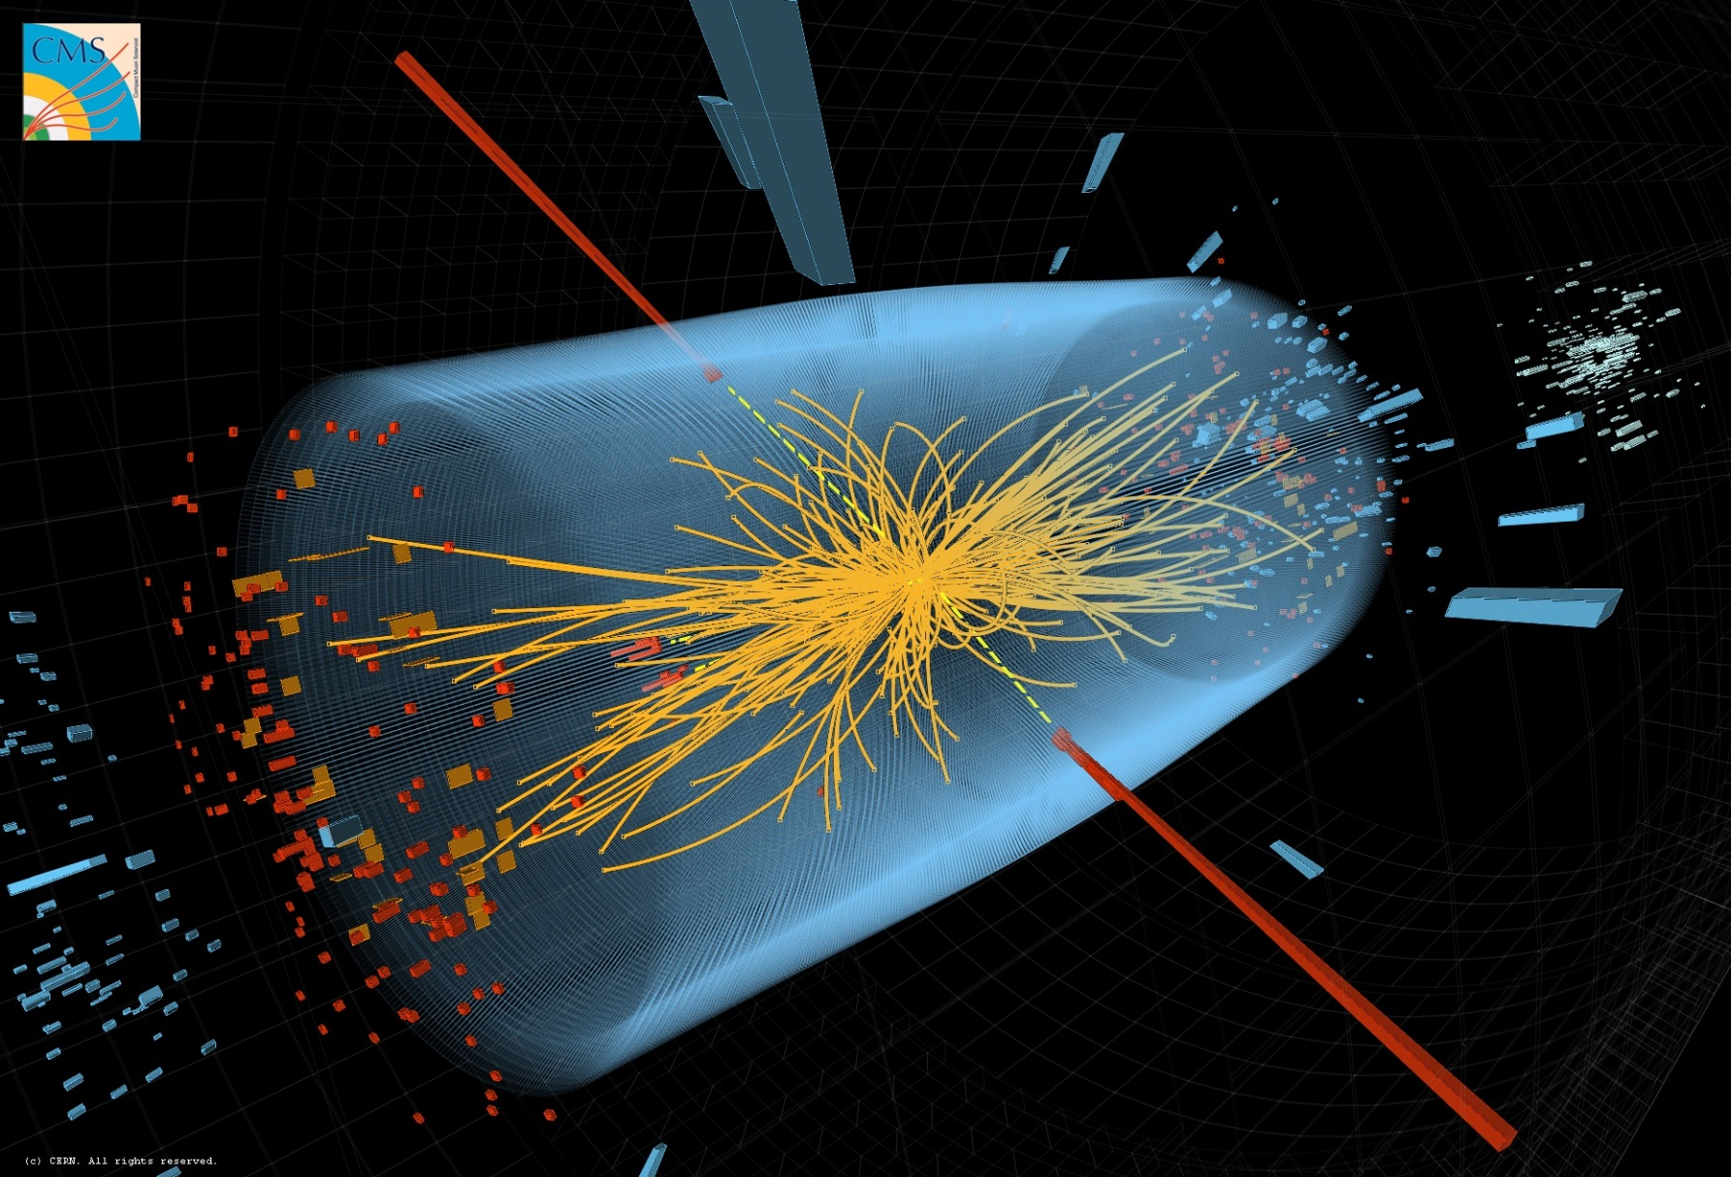
Fundamental Particles and Forces

Slide 2
Missing issues:
  Felicitas: Entwicklung ET über die letzten 5 Jahre basierend auf Empfehlungen
  Roadmaps (KET, Update European Strategy)
  Hera pdf, data preservation
  Revise theory

Slide 3
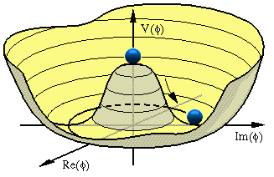
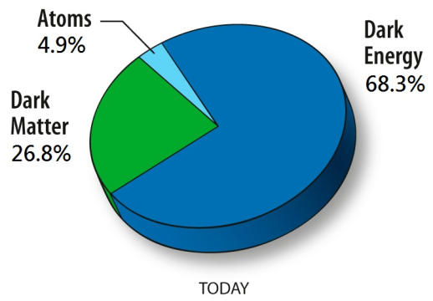
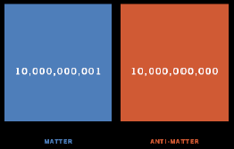
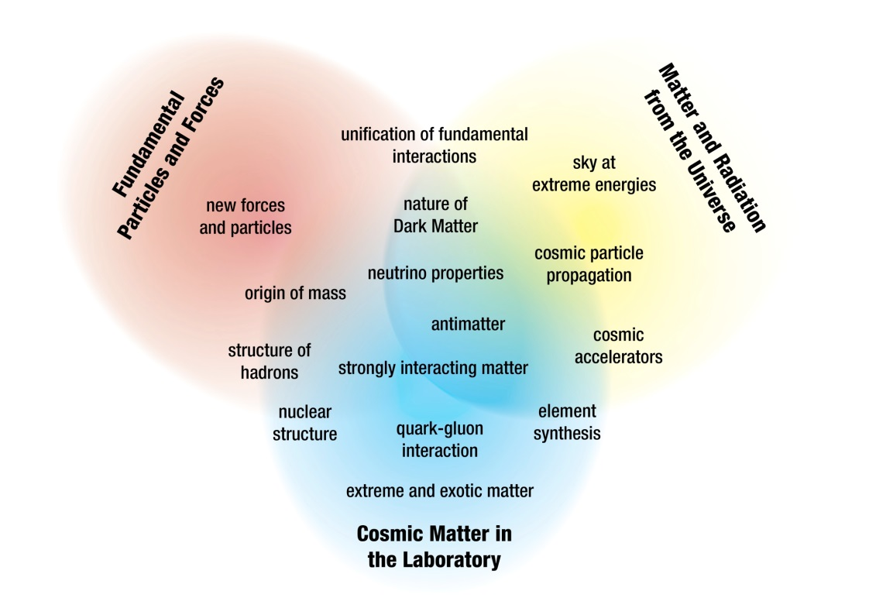
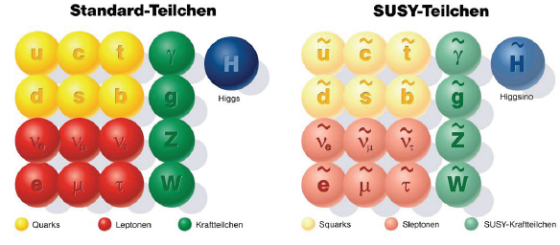
Elementary Particle Physics
The Big Questions:
  Origin of mass
  Nature of Dark Matter
  New forces and particles
  Matter-antimatter asymmetry
  Unification of fundamental forces
  …
Particle Physics in the programme context:

Slide 4

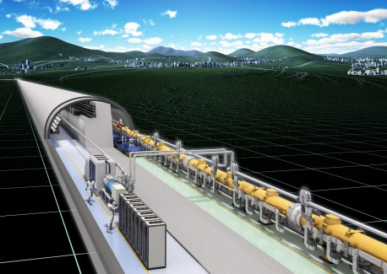
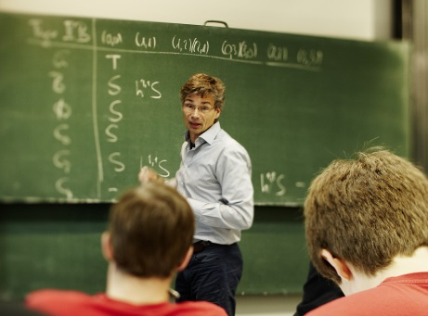
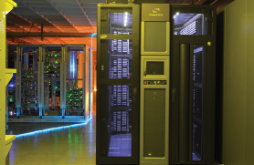
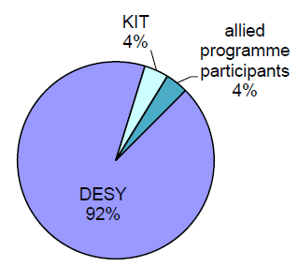

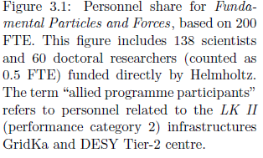

Elementary Particle Physics
The Big Questions require cutting-edge research in the triangle
  Proton-proton physics
  Large Hadron Collider (LHC)
  Electron-Positron Physics
  Belle (II)
  International Linear Collider (ILC)
  Theoretical Particle Physics
Computing Infrastructure
  Tier-1 GridKa
  Tier-2 DESY Grid Centre
Participating Helmholtz Centres
Personnel share financed by Helmholtz
Total 138 scientists plus 60 PhD students

Slide 5
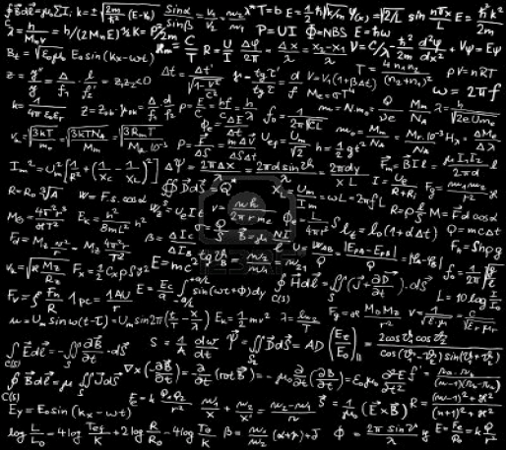
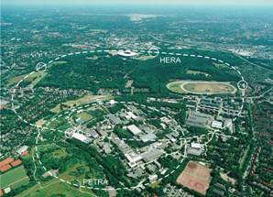
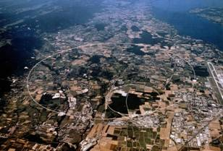
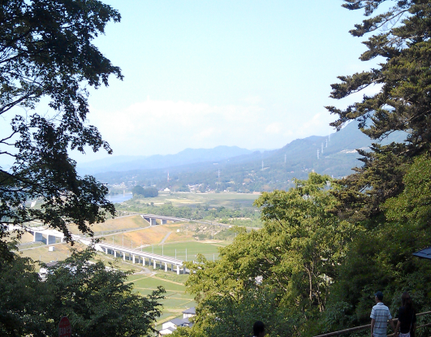
Particle Physics Strategy 2015-19
Maximum discovery potential
Highest sensitivity
Guidance and interpretation by theory
Theory
Strategy in agreement and supported by national and international roadmaps
HERA
LHC
ILC
Computing: Tier 1 & Tier-2, LSDMA
Detector & Accelerator development (→ Matter and Technology)
Testbeam

Slide 6
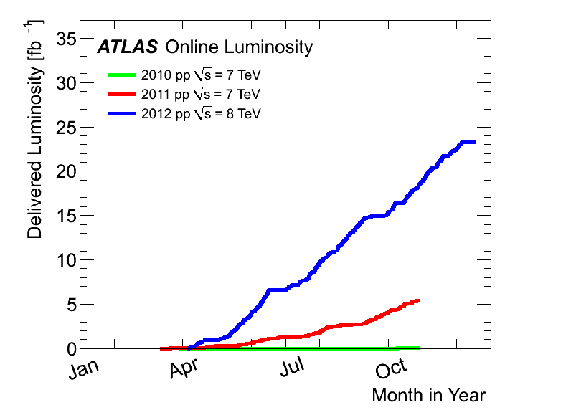
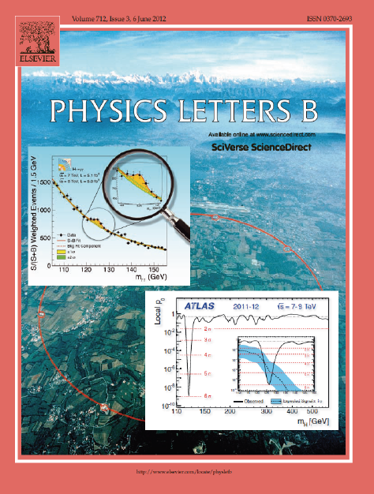
The Large Hadron Collider LHC
Very successful run in 2012 at 8 TeV
> 400 publications so far by each experimemt (ATLAS & CMS)
  Higgs discovery and properties
  Search for new physics
  Physics at 10⁻¹⁹ m
2013/14 consolidation work
  Preparation of LHC and experiments for full energy
  (14 TeV) from 2015
  work progressing on schedule

Slide 7
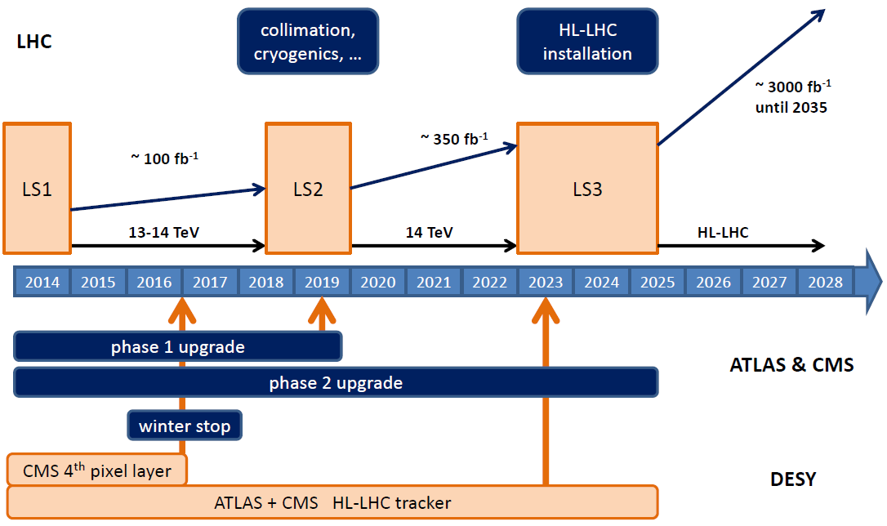
LHC Future
Physics programme until 2035
LHC just started:
  so far just about half the
  maximum energy reached
  8 TeV wrt. 14 TeV
  and 1% of the luminosity
  ≈ 30 fb⁻¹ by end of 2012
  ≈ 3000 fb⁻¹ expected by 2035
2015 ff LHC running at 13-14 TeV
  ≈ 100 fb⁻¹ by 2019
after 2022 High Luminosity LHC
  Increase luminosity beyond 10³⁴/cm²/s by approx factor 5 to 10
Major detector upgrades required
Mainly tracking detectors
Reach end of their lifetime with O(300 fb⁻¹)
Higher luminosity requires finer granularity and trigger capabilities

Slide 8
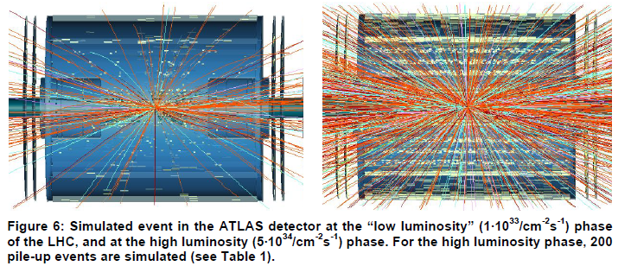
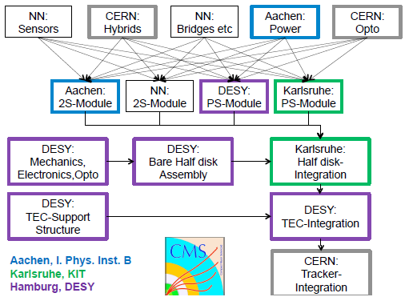
LHC Detector Upgrades
Proposal for Helmholtz Strategic Large Investments
  DESY: 20 M€ for investments into ATLAS & CMS tracker (phase II)
  KIT: 3.8 M€ for CMS electronics
  GSI: 4.2 M€ for ALICE TPC
Proposal in preparation
  To be considered in this evaluation for submission 2nd half 2014
Coherent approach with
national and international
partners
  e.g. plan for CMS tracker endcap

Slide 9

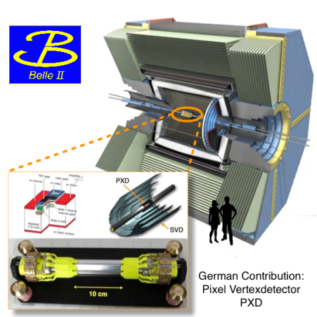

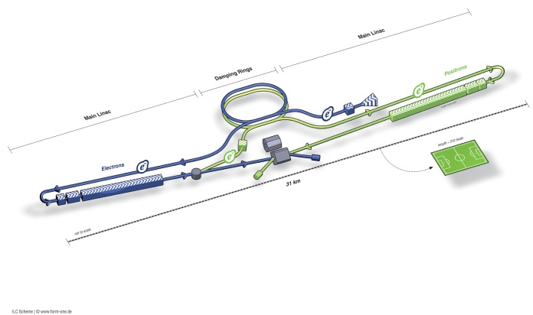
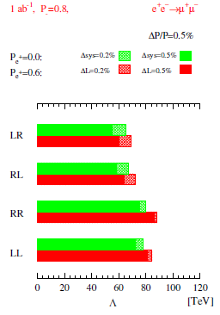
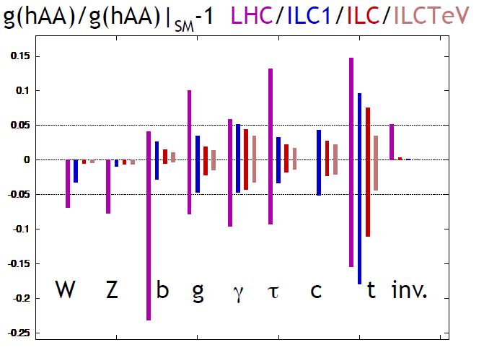
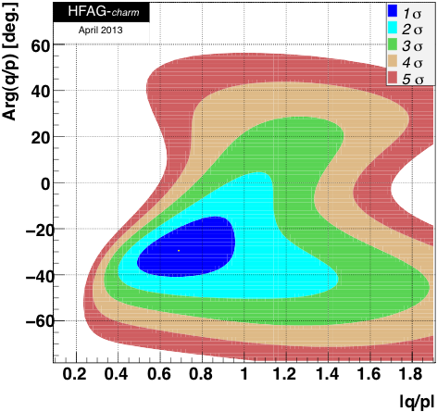

Electron-Positron Physics
Precision physics through collisions of fundamental particles:
Model-independent studies of the Higgs
Indirect signals of New Physics at high mass scales
Matter-Antimatter Asymmetry
CPV in the D⁰-D⁰ System
Belle II 50 ab⁻¹
No CPV: (|q/p|, ϕ) = (1,0)

Slide 10
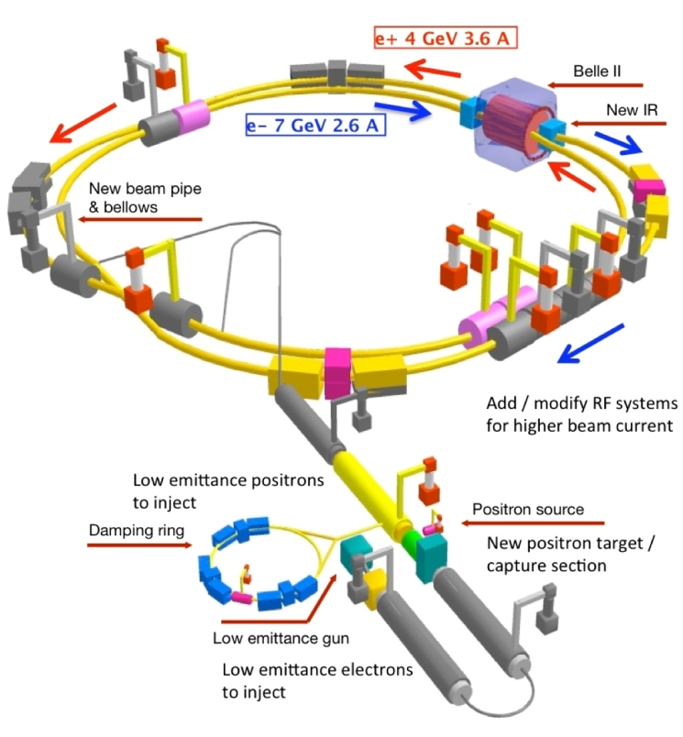
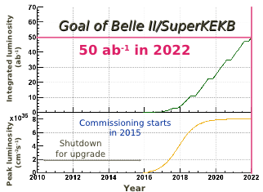

BELLE II at SuperKEKB
German contribution: pixel vertex detector in DEPFET technology
  Germany 2nd largest country in BELLE II, one of the largest HEP projects in D
Helmholtz: support German Belle II groups by exploiting specific infrastructure and expertise available
  Cooling, mechanics, alignment , testbeam, …
Computing
  Tier-1 at GridKa
  Tier-2 at DESY
Install & commission vertex detetor in 2016
Accumulate > 3 ab⁻¹ by 2019

Slide 11
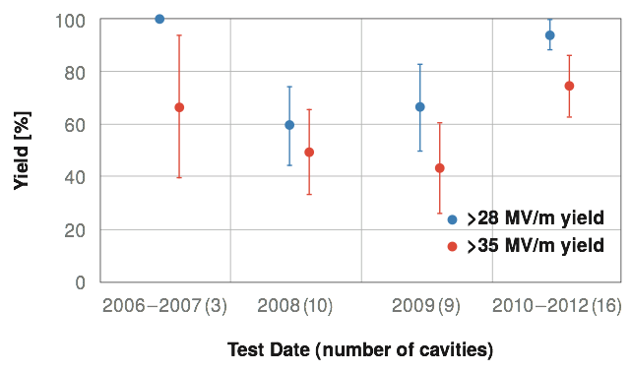
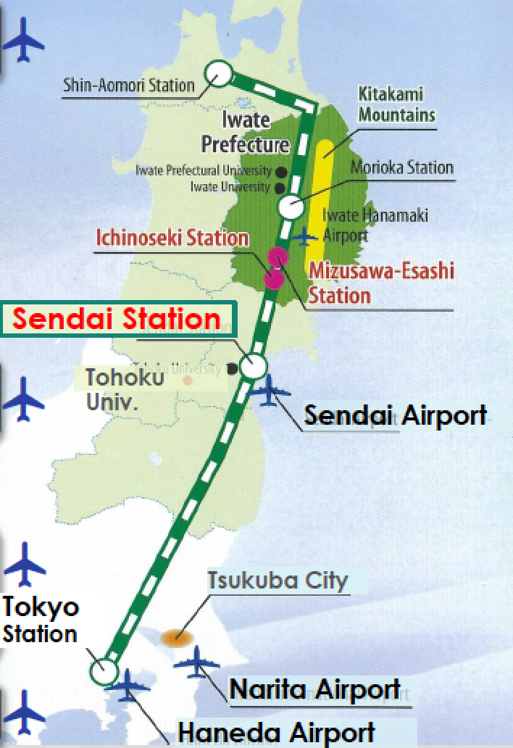
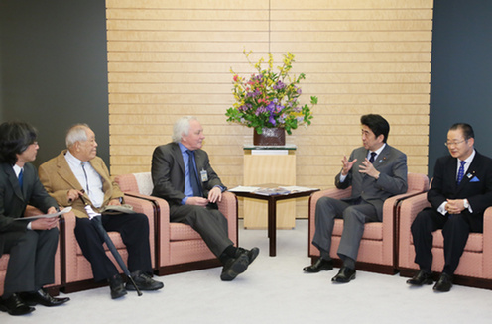
International Linear Collider
From ILC TDR
2013: Technical Design Report submitted and evaluated
  R&D goals reached
  Synergy with XFEL construction
Strong interest by Japanese scientists and politics to host the ILC
  Selection of a site in northern Japan
R&D for accelerator & detector
  Strong synergy with
  Matter & Technology

Slide 12
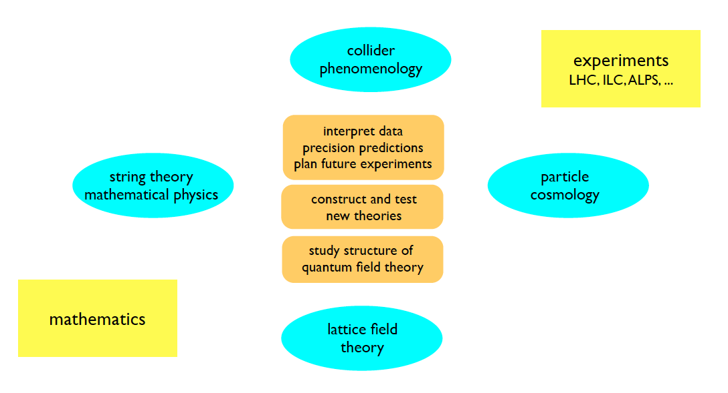


Particle Physics Theory
Maintain and develop strong particle physics theory in Helmholtz with a broad spectrum firmly connected with experimental programme:
John von Neumann
Institute for Computing
Collaboration between different HGF centres: DESY, Jülich, GSI, KIT (new)
closely integrated with local Universities (Hamburg, Berlin, Karlsruhe, theory & experimental groups)

Slide 13






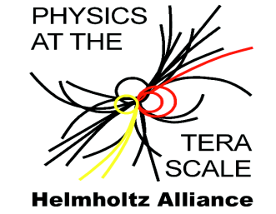
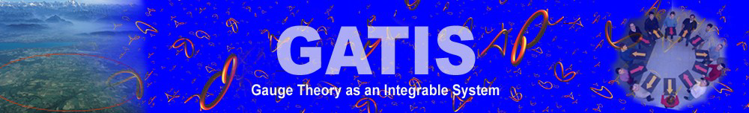




Particle Physics Theory
Shapes theoretical particle physics in Germany & beyond
    Lectures, schools, conferences, workshops
    Fellowship programme (each year >300 applications from around the globe)
    Large fraction of theory staff in Germany have a DESY history
Networks and grants
HiggsTools
  Industry cooperations: Wolfram Research, Maplesoft, RISC Software GmbH

Slide 14
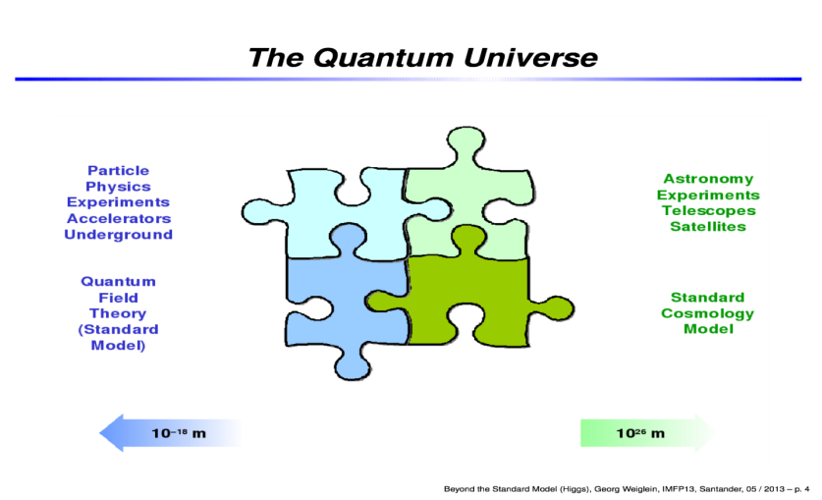

Particle Physics Theory
Maintain and develop strong particle physics theory in Helmholtz with a broad spectrum
  Collider phenomenology
  Particle cosmology
  Lattice field theory
  (Neumann Institute for Computing,
  collab. with Jülich and GSI)
  String theory
The novel activitity of KIT particle physicist in Helmholtz is an element of the strategy to foster the collaboration of different HGF centres.
Deeply rooted in experimental programme
  Analysis Centre of Helmholtz Alliance, SFB
Theory is very closely integrated with local Universities (Hamburg, Berlin, Karlsruhe, theory & exp. groups)
Old version

Slide 15
Particle Physics Theory
Shapes theoretical particle physics in Germany & beyond
  Lectures, schools, workshops, …
Pillar of theoretical particle physics in Europe & beyond
  Conferences, fellows, networks, …
  Example: > 50% of theory staff member in Germany have a DESY history
Old version
Many cooperation projects:
  Helmholtz Alliance Physics at the Terascale
  DFG: SFB 676, SFB TR 9, Emmy‐Noether YIG
  EU: Higgstools, GATIS, IntGaugeString, LHCphenonet, HadronPhysics III, Flavianet
  Grants: Alexander von Humboldt, Joachim‐Herz‐Stiftung
  Industry: Wolfram Research, Maple Soft, RISC Software GmbH

Slide 16
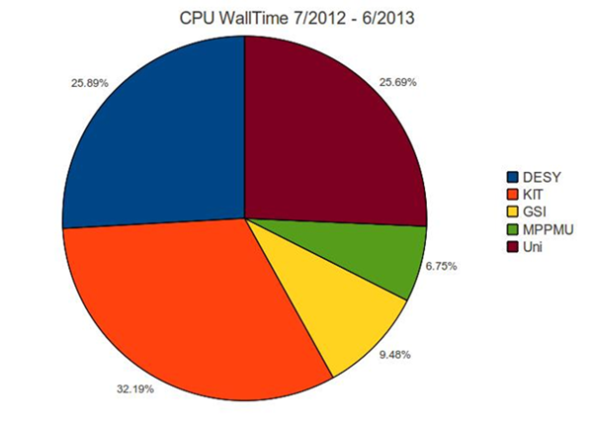
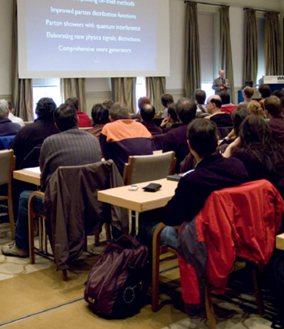
Infrastructure
LK II topics: GridKa and DESY Grid Centre
  German Tier-1 centre at KIT (GridKa)
  for all LHC experiments and more
  DESY operates Tier-2 centres
  for ATLAS, CMS, LHCb
  NAF as crucial element for LHC analyses in Germany
  Helmholtz provides > 2/3 of the German LHC computing share!
DESY testbeam (→ next slide)
Laboratory for large detectors
  Intended as detector development hub for particle physics (LHC) in Germany
  → LHC Detector Upgrade
Alliance Physics at the Terascale
  Platform for exchange in German HEP community
  physics, detectors, computing
  Analysis Centre at DESY as central hub
  Education: ≈ 15 schools & workshops per year
  attracting many young people
  Common events of the 3 Alliances (→ MUTLINK)
Univer
sities
DESY
MPG
KIT
GSI

Slide 17
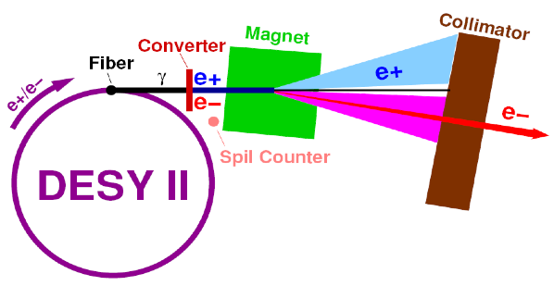
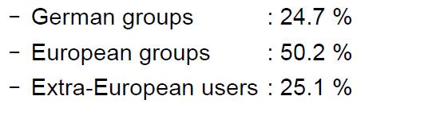
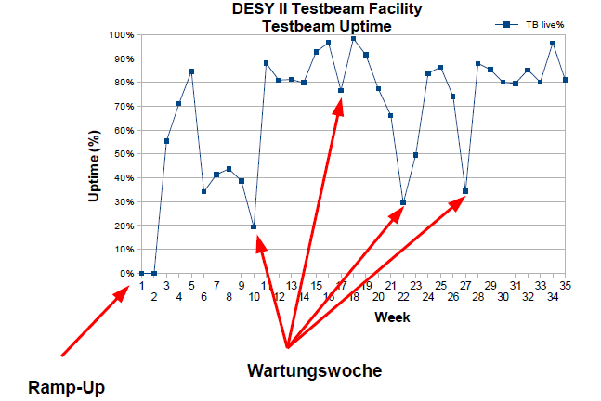
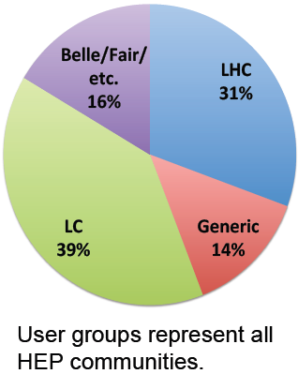

DESY Testbeam
Increasingly important facility for detector R&D
→ Matter & Technology
Used by many projects
  $≈4$00 users in 2013

Slide 18
Summary & Conclusions
Exciting times for particle physics
Proton-proton physics at the LHC:
  spectacular discovery of a Higgs boson
  just started and 20 years more to come
Electron-positron physics:
  BELLE II: complementary physics to LHC (precision)
  ILC: strong physics case, encouraging developments in Japan
Theory
  great opportunities for major progress in understanding the fundamental laws of nature
LK II Computing facilities
  essential for the physics programme
Helmholtz Particle Physics programme 2015-19
  addresses the big challenges
  Shapes - and is aligned with - national and international roadmaps

Slide 19
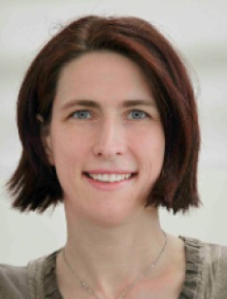
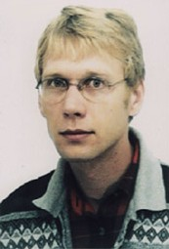
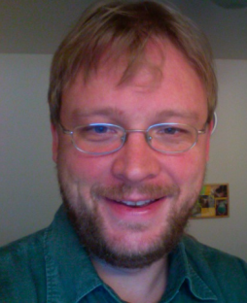
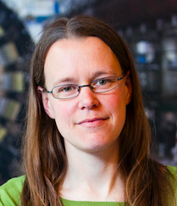
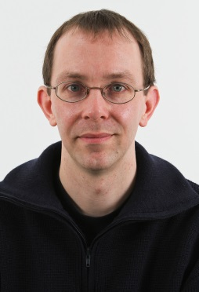
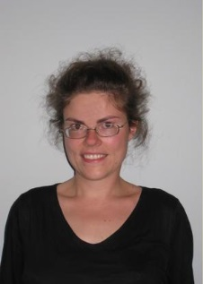
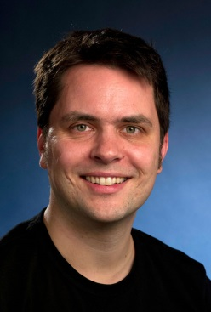
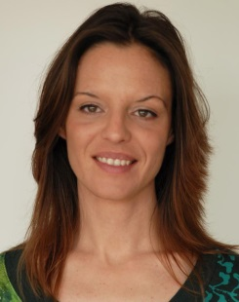
The Guarantors of the Future:
Leaders of Young Investigator Groups
2009 Isabel Melzer-
Pellmann
CMS SUSY
2009 Alexei Rasperezza
CMS Higgs
2010 Alexander Westphal
Theory Cosmology
2011 Kerstin Tackmann
ATLAS Higgs
2012 Frank Tackmann
Theory Phenomenology
(Emmy Noether)
2012 Yvonne Peters
ATLAS top physics
2012 Ralf Ulrich
CMS forward physics for cosmic ray analysis
2014 María Aldaya Martín
CMS top physics

Slide 20
Backup & Old Versions

Slide 21
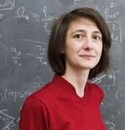



PERSONALIA – ERFOLG IN REKRUTIERUNGSINTIATIVE
Geraldine Servant (Barcelona)
  International Expertin an Schnittstelle
  Kosmologie – Collider-Physik;
  u.a. EPS-Plenarvortrag 2013
  Ruf von UHH in Vorbereitung
Christophe Grojean (Barcelona)
  Führender LHC-Phänomenologe,
  ebenfalls EPS-Plenarvortrag 2013
  Gespräche mit HU Berlin laufen
Elisabetta Gallo (Florenz)
  Frühere Sprecherin von ZEUS; derzeit CMS. Wird Higgs bei LHC+ILC machen.
  Berufung mit UHH
Kerstin Borras (DESY)
  W2/W3-Initiative mit RWTH Aachen –
  Vorbereitungen für eine W3-Berufung
  201415: CMS Deputy Spokesperson!

Slide 22




Young People
Helmholtz Young Investigator Group Leader:
Laura Covi accepted
W3 professorship at
U Göttingen
Erika Garutti accepted
W2 professorship at
U Hamburg
Bild von Moch
Sven Moch accepted
W2 professorship at U Hamburg
Ulrich Husemann accepted W3 professorship at KIT Karlsruhe

Slide 23

Elementary Particle Physics
The Big Questions
  Origin of mass
  Nature of Dark Matter
  New forces and particles
  Matter-antimatter asymmetry
  Unification of fundamental forces
Requires cutting-edge research in the triangle
  Proton-proton physics
  Large Hadron Collider (LHC)
  Electron-Positron Physics
  Belle (II)
  International Linear Collider (ILC)
  Theoretical Particle Physics
Computing Infrastructure
  Tier-1 GridKa
  Tier-2 DESY Grid Centre

Slide 24

Particle Physics in the Programme Context

Slide 25



Physics at the LHC: Highlights 2010-14
Example ATLAS:
  Higgs detection in γγ
  Coordination of H→γγ subgroup
Example CMS:
  MSSM Higgs search Φ → 3 b
  with KIT
In both examples analysis performed by YIGs

Slide 26
Plans 2015-2019
Fulfill DESY’s role as a national lab for the LHC :
Physics
Operation
Detector upgrades
Performing physics analyses & preparatory studies for upgrade
  physics topics: Higgs, SUSY, top-quark, QCD, electro-weak
Operation and maintenance of detectors
  Fulfill long-term commitments and prepare for future role as integration centre
Short term & long term detector upgrades
  Construction of new CMS pixel & contributions to ATLAS IBL
  R&D for tracker upgrade ⇒ annual research field budget increment
  Prepare infrastructure for future upgrade
  Construction of new tracker end-caps for ATLAS and CMS
⇒ application for a capital investment

Slide 27

LHC Future
Physics programme until 2035
LHC just started:
  so far just about half the
  maximum energy reached
  8 TeV wrt. 14 TeV
  and 1% of the luminosity
  ≈ 30 fb⁻¹ by end of 2012
  ≈ 3000 fb⁻¹ expected by 2035
2015 ff LHC running at 13-14 TeV
  ≈ 100 fb⁻¹ by 2019
after 2022 High Luminosity LHC
  Increase luminosity beyond 10³⁴/cm²/s by approx factor 5 to 10
F. Bordry, 02.12.2013
Major detector upgrades required
Mainly tracking detectors
Reach end of their lifetime with O(300 fb⁻¹)
Higher luminosity requires finer granularity and trigger capabilities

Slide 28


ILC site selection

Slide 29









DESY Activities around Belle II PXD
Support German Belle II groups by exploiting specific expertise available
Thermal Mock-up & Shield for VXD
CO2 Cooling System
Remote Vacuum Connection
DESY Testbeam
PoF III Milestones
Install & commission PXD in 2016
Align detector & start physics programme
Ramp up SuperKEKB and accumulate > 3 ab⁻¹
DAQ/DQM/SC Software
Grid/NAF/Data Preservation
SynRad Background MC
Tracker Alignment and Calibration

Slide 30



DESY in Belle I
Access to the world largest data sample at the Y(4S)
  about 1000 fb⁻¹ collected between
  1999 and 2010
Start analysis of A_{FB} e⁺e‒ →µ⁺µ ‒ (γ)
  replicate full Belle I data set at DESY
  one of the leading centres for Belle II MC production

Slide 31

e⁺e‒ physics:

Slide 32

ILC
ILC in short
  ~18000 SCRF cavities
  31.5 MV/m
  1750 cryomodules
European XFEL
  based on same technology
  840 cavities
  24 MV/m req.
  100 cryomodules
main goal

Slide 33





LC Physics and Detector Highlights
→ Programme Matter and technology
  DESY leading centre in the LC detector effort
  Physics studies (with theory)
  Detector concept ILD
  Time projection chamber
  Hadron calorimeter
  Forwd calorimeter, vtx detector
  Strategic asset: test beam
stau discovery reach
MC
Integration and software
ILD
Ecm=500 GeV
TPC tracks
DESY test beam
HCAL prototype

Slide 34
LHC Schedule
akdfhksafhsak
F. Bordry, 02.12.2013

Slide 35

LHC Schedule
ALTER PLOT!

Slide 36
LHC Phase II Upgrades
Proposal for Helmholtz Strategic Large Investments:
  DESY: 20 M€ for investments to ATLAS and CMS (core, R&D, tooling)
  KIT: 3.8 M€ for CMS electronics
  GSI: 4.2 M€ for ALICE
Proposal in preparation
  to be considered in PoF evaluation and to be submitted in 2014

Slide 37

LHC Detector Upgrades
Proposal for Helmholtz Strategic Large Investments
  DESY: 20 M€ for investments into ATLAS & CMS tracker (phase II)
  KIT: 3.8 M€ for CMS electronics
  GSI: 4.2 M€ for ALICE TPC
Proposal in preparation
  To be considered in this evaluation for submission 2nd half 2014
Coherent approach with
national and international
partners
  e.g. ATLAS tracker endcap

Slide 38


