Slide 1
The DESY Grid&Cloud Centre A LKII infrastructure

Slide 2
Overview
The DESY Grid&Cloud Centre (DGCC)
The Tier-2 @ DESY
The NAF @ DESY
Challenges & Strategy
Summary

Slide 3
The Desy Grid & Cloud Centre
Resources:
~ 10.000 cores in the Grid
~ 8 PB disk (dCache)
~ 4000 cores in the NAF
~ 1 PB disk in the NAF
Tape storage
Services:
VOMS, Catalogues, Cloud, NAF remote desktop ….
Development:
Big Data mgmt: dCache (holding ~50% LHC data), networks (LHCone)
Communities:
WLCG Tier-2, Belle I+2, ILC, XFeL, … ∑ = 20 Virt. Organisations

Slide 4
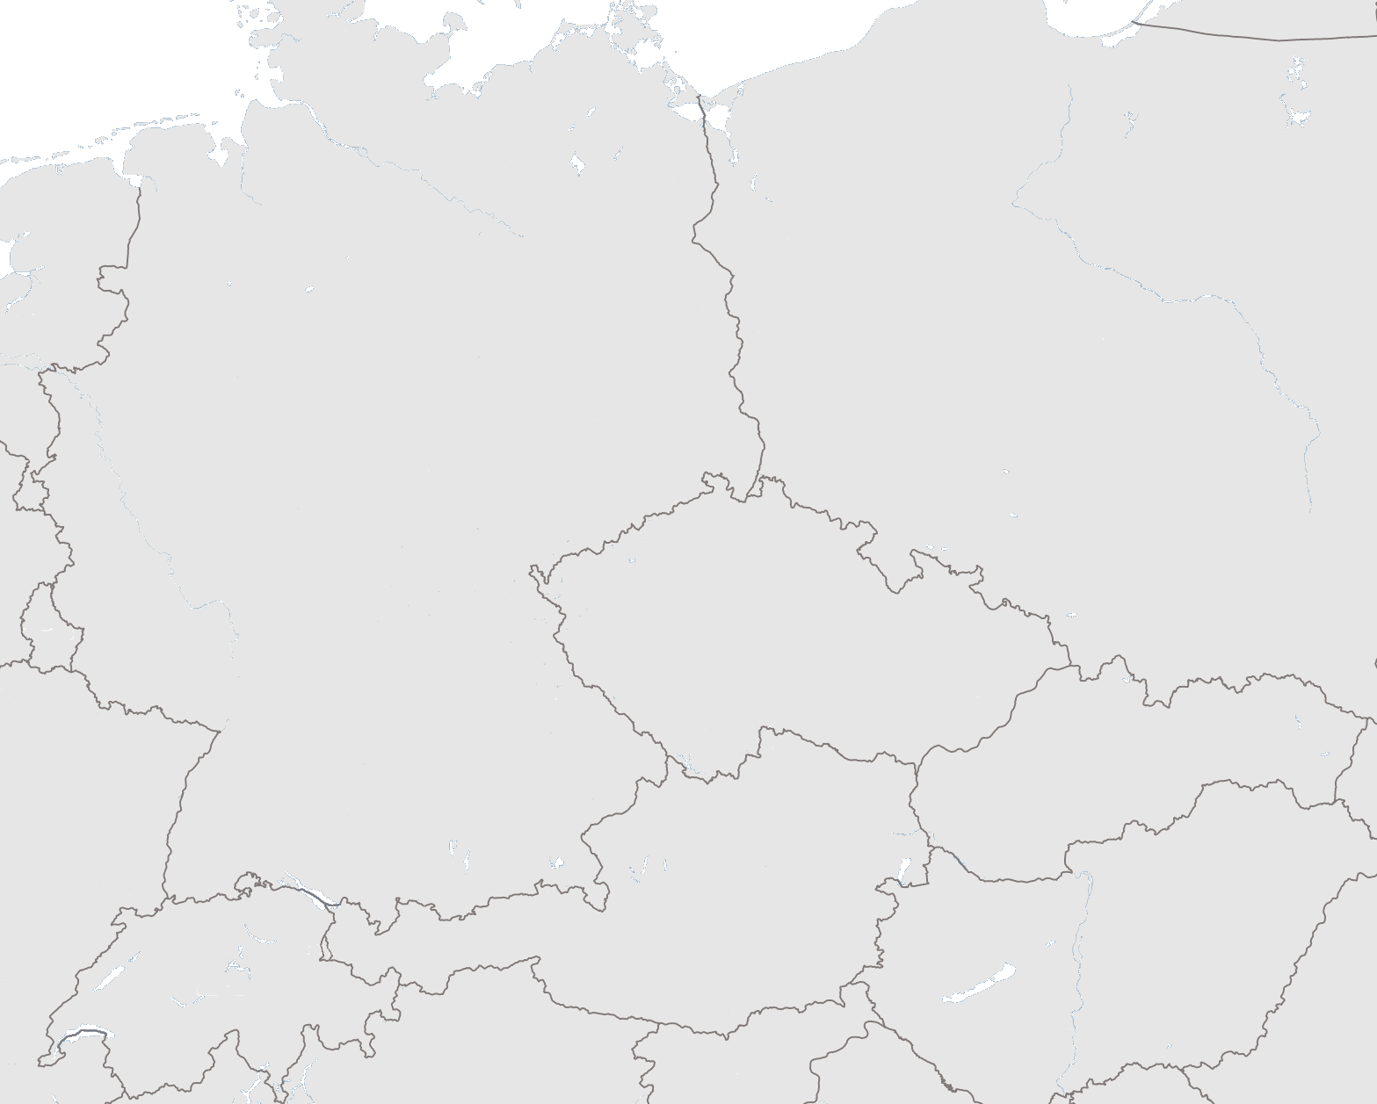
The Tier-1/2 Structure in Germany
Role of Tier-2:
Simulation and user analysis
German Tier-2 shares of WLCG:
CMS: 8%
Atlas: 10%
LHCb: 7%
Financing:
DESY: POF 2, base, BMBF
Univ.: Phys. a.t.Terascale, BMBF, DFG
-> Future open!
Challenges:
> 2x resources in 2015 + 20% increase/year, scalabity, financing
DESY Hamburg
DESY
Zeuthen
Göttingen
Wuppertal
Aachen
GSI Darmstadt
KIT
Freiburg
Munich

Slide 5
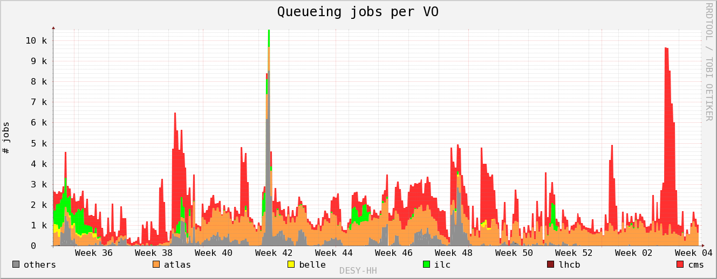
DESY Grid Usage (Hamburg)
# jobs
Atlas
CMS
LHCb
Belle
ILC
others

Slide 6
LHC wall clock time distribution Germany

Slide 7
LHC wall clock Tier 2 only delivered, Germany

Slide 8
Completed Jobs/Site in 2013: Atlas
DESY HH
DESY ZN

Slide 9
Completed Jobs/Site in 2013: CMS

Slide 10
The DESY Tier 2 site availability

Slide 11
Why the NAF? Grid vs. NAF
The Grid
Batch
Centrallized
Large volumes
The world LHC data

Slide 12
Why the NAF? Grid vs. NAF
The Grid The NAF
Batch interactive
Centrallized user driven
Large volumes proof
flexible
The world LHC data Germany

Slide 13
NAF usage
NAF CPU usage by institutes
Dec. 2009 – Apr. 2013
The Grid The NAF
Batch interactive
Centrallized user driven
proof
flexible
The world LHC data Germany
+16 German
Institutes
(39%)
DESY
31%
Uni-HH
30% (partially own contribution)

Slide 14
Challenges for the DGCC
Community | Challenge
LHC | Big Data (streaming mode), scalability of solutions, change of computing modells, grid & cloud evolution , data preservation, networks (lhcone)
Belle II | Synergy with LHC computing
ILC | Synergy with LHC computing
Astroparticle | Synergy with LHC computing
Photon Science | Big data (burst mode), scalability, cloud style,Tier-0, consultancy, federated identities, meta data, data formats

Slide 15
Future Strategy
Continue to enable outstanding scientific work
Maintain and further develop of Big Data management
Preserve Data
Consult & Support
Coordination of computing activities in MATTER
Major player in Matter for cooperation with LSDMA
Apply for 3rd party funding
Enlarge Education and Training

Slide 16
Summary
The DESY Tier 2 is among the best worldwide delivering cycles & TB well above the pledges
The NAF plays an essential role for LHC analysis in Germany
The concept of shared resources significantly improves the overall efficiency
The excellent performance of the LK II facility attracts an increasingly diverse user community
DESY will continue to develope next generation IT solutions in collaboration with scientific and industrial partners
Attracting young people

