Slide 1
Radiation measurement and comparison between VT/CM tests at KEK-STF
Kirk

Slide 2
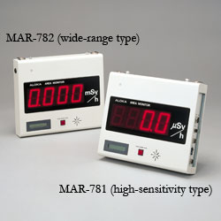

Radiation Detector in KEK-STF
There are two types of detectors, MAR-781 and MAR-782.
Specifications:
Radiation detected: X-ray and γ-ray
Detector type: Silicon semiconductor
Energy range: 50 keV to 6 MeV
Measurement range: 0.1-999.9μSv/h
0.001-99.99mSv/h
Accuracy: within ±10%
These detectors are used in VT and CT.
But, each position is different.
http://www.hitachi-aloka.co.jp/english/products/data/radiation-011-MAR781782

Slide 3
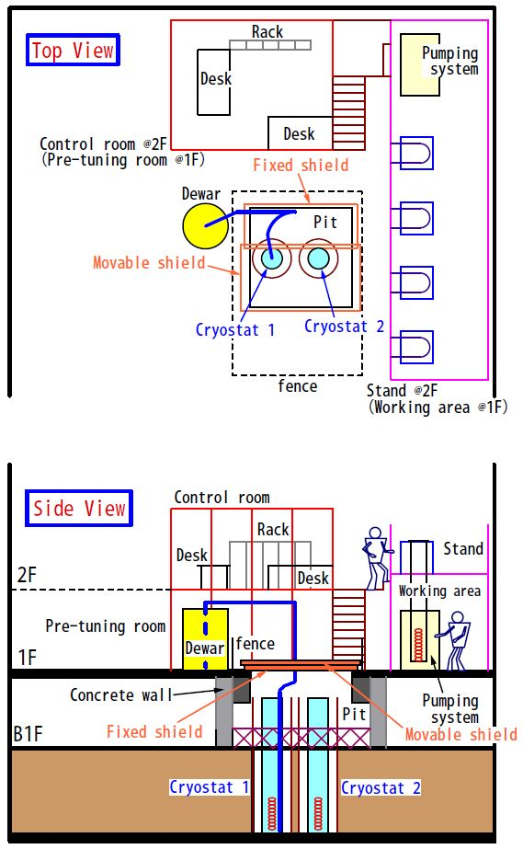
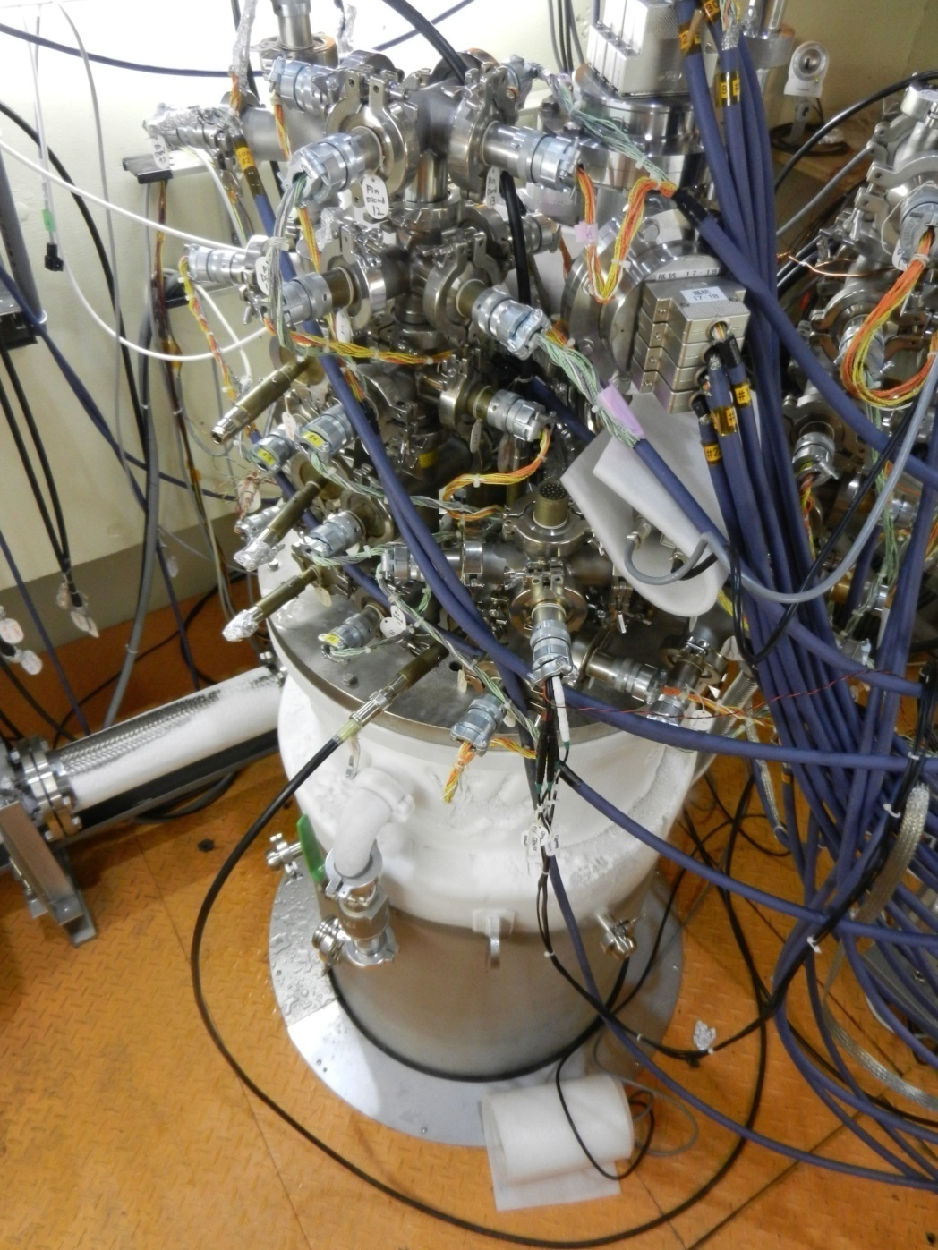
Detector position in VT area
Cavity position is 4m below from top plate of cryostat.
Center of Beam Axis
①
~80cm
~100cm
③
Floor of pit
②
Floor of pit

Slide 4
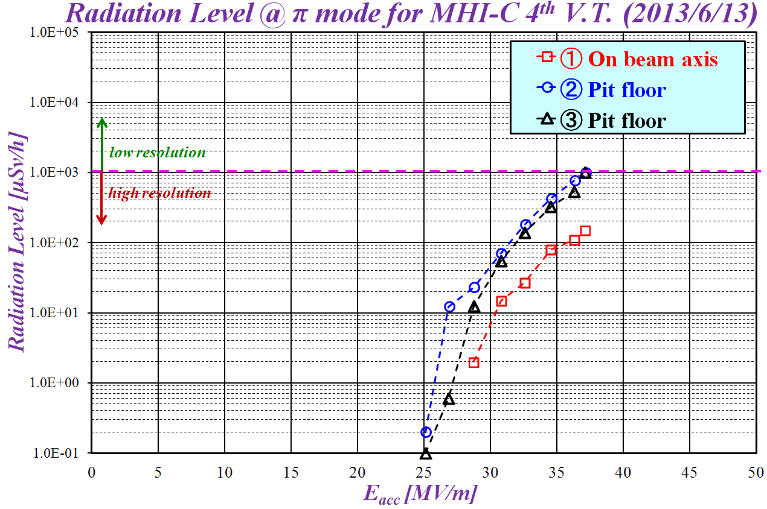
Detector position in VT area
Cavity position is 4m below from top plate of cryostat.
Center of Beam Axis
①
~80cm
~100cm
Radiation level depends on
material kind and thickness,
and distance from a cavity.
Representatively, we use
“On beam axis” position.
③
Floor of pit
②
Floor of pit

Slide 5
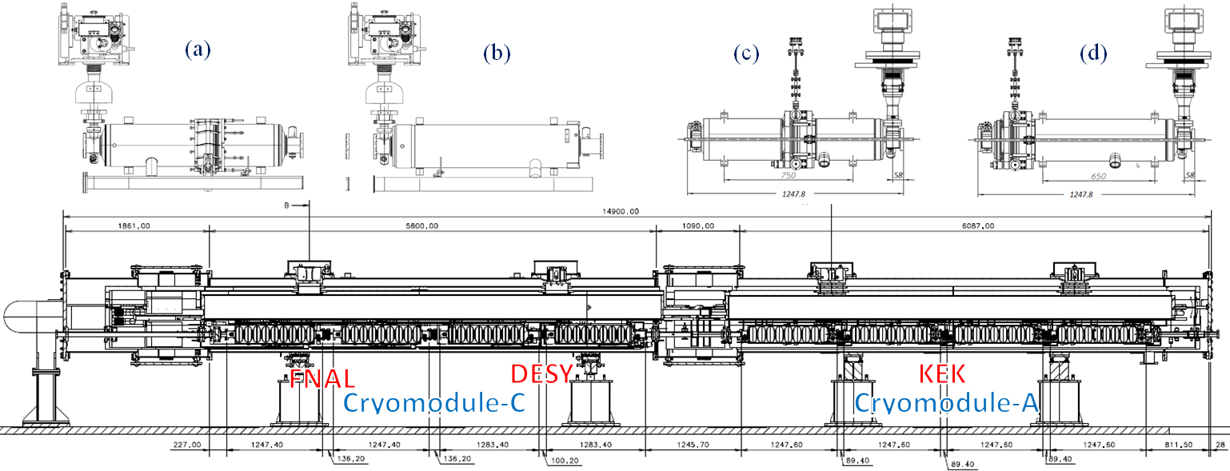
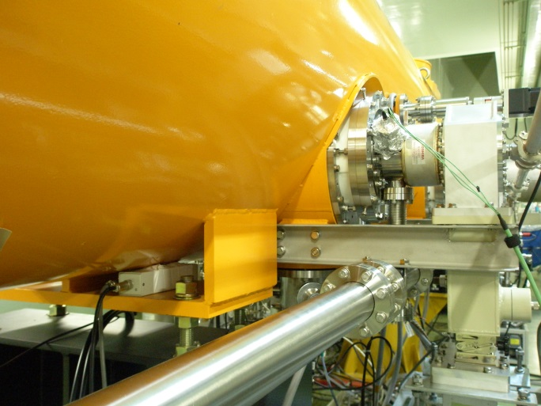
Detector position in CT area
“S1-Global” cryomodule
Set positions of radiation detector
There is “No” detector on beam axis in CT!

Slide 6
Comparison of cavity performance
Cryomodule - C
Cryomodule - A
Degradation
of Eacc,max
Coupler
Vacuum
Tuner
Trouble
Tuner
Trouble
C1
C2
C3
C4
A1
A2
A3
A4
U
X-ray
M
X-ray
D
X-ray
Up-stream
Down-stream
E. Kako

Slide 7
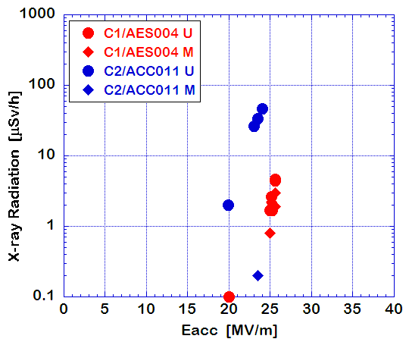
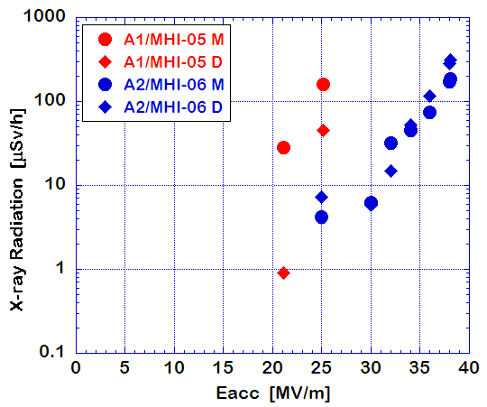
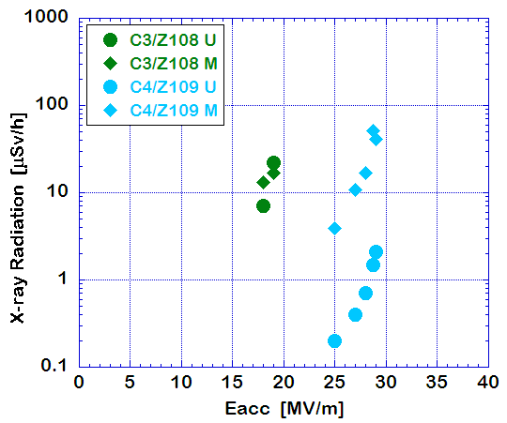
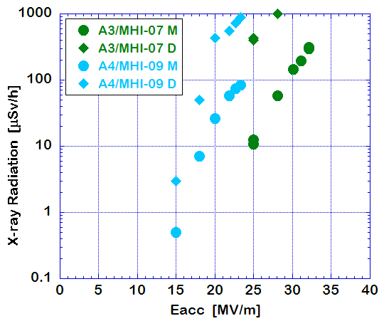
Comparison of cavity performance
Degradation
of Eacc,max
A1
A2
C1
C2
at 25MV/m
A3
C4
A4
C3
at 25MV/m
E. Kako

Slide 8
Conclusion
There is no simple comparison of radiation level
between VT and CT in KEK-STF.
  Different location
    On axis/Off axis, distance from cavity
  Different material and thickness
    Cryostat design/material, different thickness
  Different operation mode (CW/pulse)
    Dependence on time response/accuracy of radiation detector

