Slide 1

Via Vicenza 113 - 36015 Schio ( VI )
Italia
Infrastructure for SC cavities production at Ettore Zanon s.p.a.
Ing. G. Corniani Ettore Zanon s.p.a.
TTC Meeting –WG3 DESY-Hamburg 24-27 March 2014

Slide 2

Infrastructure for SC cavities production
Short Summary
Ettore Zanon s.p.a. Company
Overview of past production of SC cavities and cryomodules
Company participation to the R&D phase of the XFEL project and actual involvement (SC cavities serial production)
Cavities production lay-out and Infrastructures
Production toolings
Conclusion

Slide 3
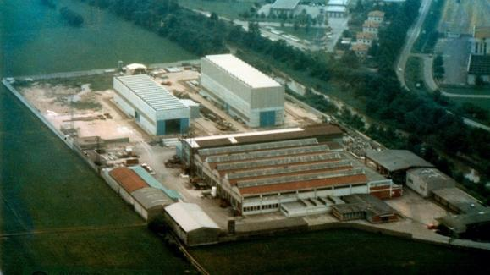
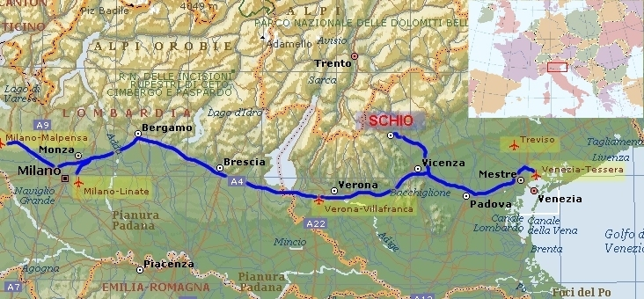
Infrastructure for SC cavities production (A)
The company was founded in 1919
It is located in the North-east of Italy
90 KM from Venezia
Number of personnel 210
Shop’s workers 160
Machining , forming , welding and testing facilities
Standard production for chemical industry
(reactors, heat exchangers)
Production of special components
for research institutes and laboratories
(UHV , cryogenics , Fusion ,
Superconductivity )

Slide 4
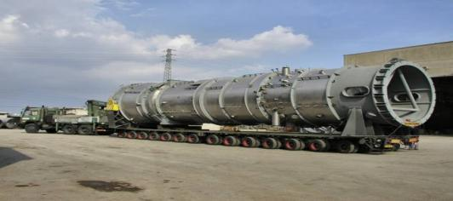
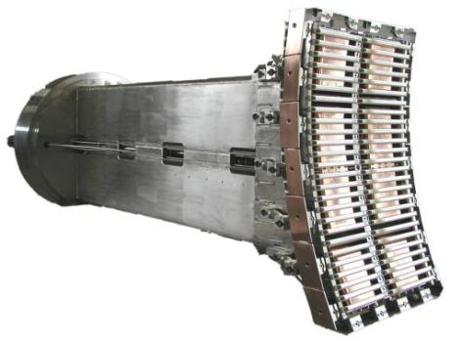
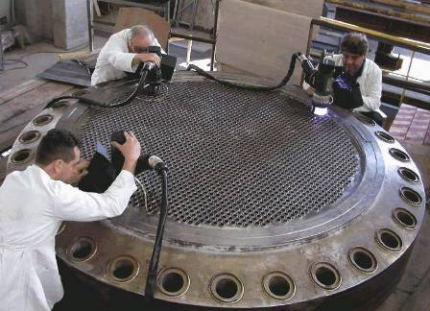
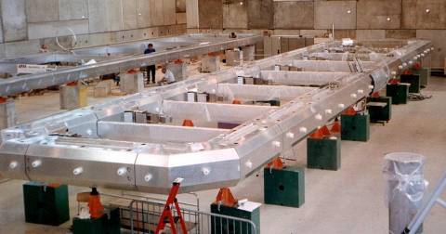
Infrastructure for SC cavities production (A)
Standard productions
Special components for research
Oxychlorination reactor -Cladded material
Dimension Dia. 4,1 m X L. 20m , 165 Tons
ITER like ICRH antenna – 8 MW RF antenna (Inconel 625) EFDA-JET
Orbital welding of heat exchanger tubesheet
Material S.S. And Zirconium
Aluminium thermal shield for the ATLAS detector at CERN

Slide 5
Infrastructure for SC cavities production (B)
Overview of past production of SC cavities and cryomodules
Ettore Zanon s.p.a has been working and manufacturing special components for superconducting applications since more than 20 years.
Experience with niobium superconducting cavities started in the early 90’s and has continued without interruption since nowadays.
In a similar way , by using the available in house production facilities and processes , the production and test of cryostats and cryomodules were successfully completed for many different scopes and projects.
Here a quick non-complete overview of past productions

Slide 6
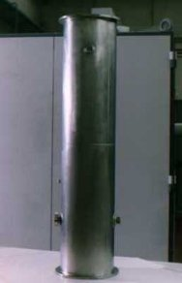
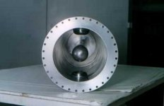
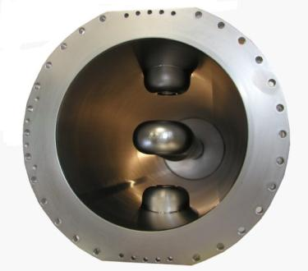
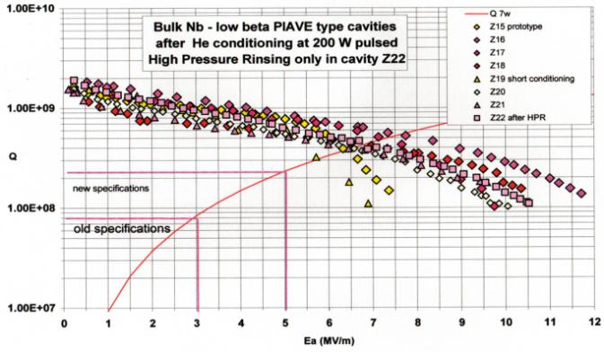
Infrastructure for SC cavities production (B)
Quarter wave superconducting cavities for ALPI-PIAVE linacs INFN Laboratori Nazionali Legnaro –Italy
Quarter wave superconducting cavities for ISAC-II project
TRIUMF laboratories at Vancouver-Canada
Production in different steps
of 48 units

Slide 7
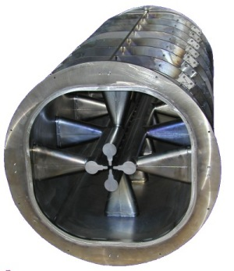
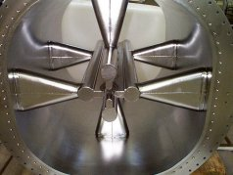
Infrastructure for SC cavities production (B)
RFQ2 and RFQ1 quadrupole cavities for ALPI Linac
RFQ2 cavity , 80 MHz RF , full-niobium quadrupole superconducting cavity
overall dimensions ∅810mm x800mm. length
RFQ1 cavity , 80 MHz RF , full-niobium quadrupole superconducting cavity ,
overall dimensions ∅810mm x1410mm. length
Basically the union of two cavities SRFQ2

Slide 8
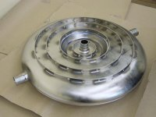
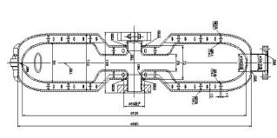
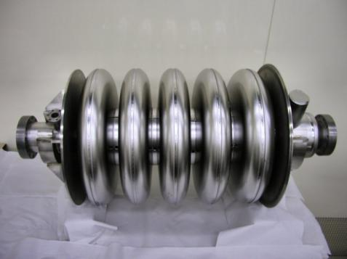
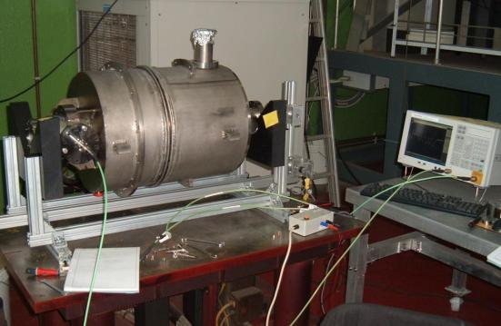
Infrastructure for SC cavities production (B)
Re-entrant cavity (TRASCO program)
Double wall circular components made of RRR niobium sheets thickness 4mm.
inner shell diameter 536 mm ,outer shell diameter 560mm
5 cells superconducting cavity 700MHZ β=0,5 (TRASCO Program)
Titanium tank manufacture and cavity integration Tuning tooling design and manufacture , tuning operations
(collaboration with INFN lab. LASA) Similar design of the next ESS project

Slide 9
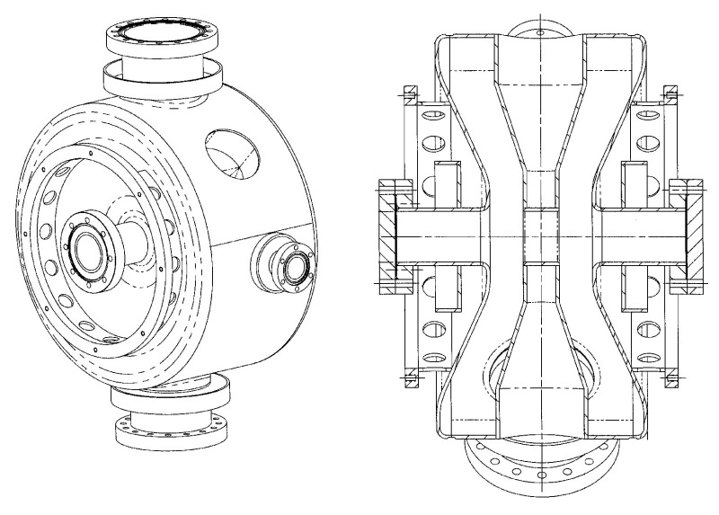
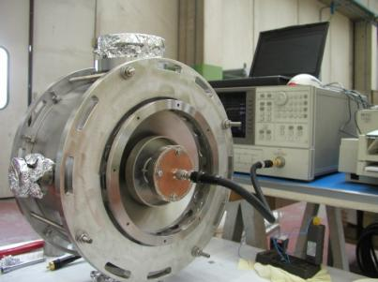
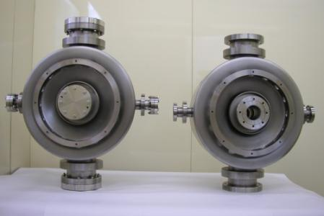
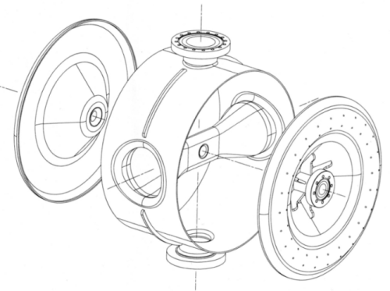
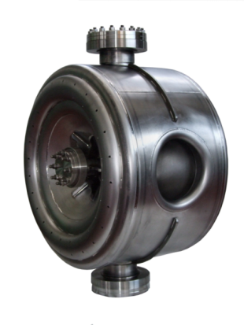
Infrastructure for SC cavities production (B)
ß=0,175 2 GAP SPOKE RESONATORS
LANL Los Alamos National Laboratory Accelerator Driven Test Facility project
ß =0,22 , 325 MHz single Spoke Resonator -FERMILAB FNAL Proton Driver

Slide 10
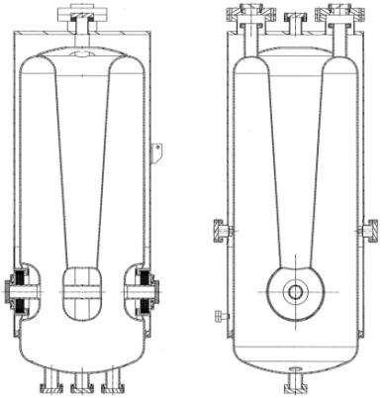
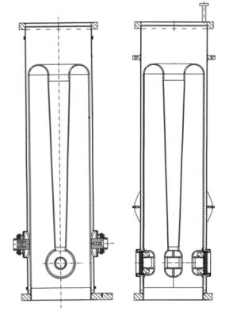
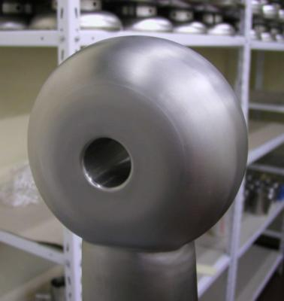
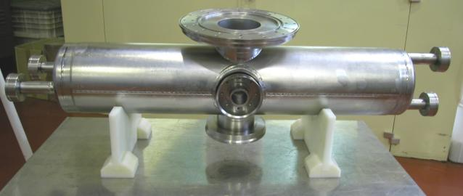
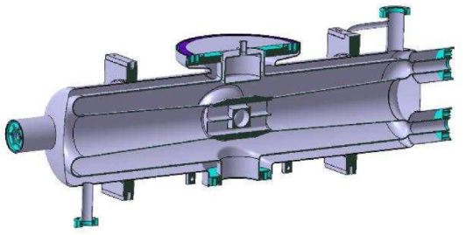
Infrastructure for SC cavities production (B)
ß 0,12 and ß 0,07 , 88 MHz Quarter Wave Resonators
CEA , SPIRAL II Project – GANIL (several units with S.S. He tank)
ß 0,094 175 MHz Half Wave Resonator (and titanium He tank )
CEA , IFMIF –International Fusion Material Irradiation Facility

Slide 11
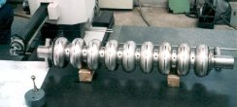
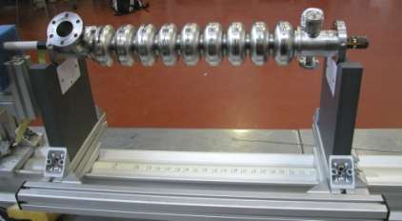
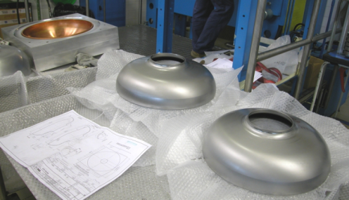
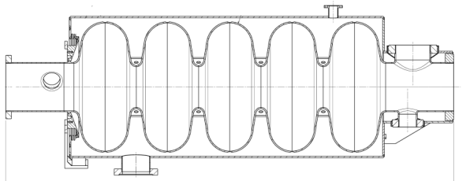
Infrastructure for SC cavities production (B)
9 cells superconducting cavity 1,3GHz and 3.9 GHz for XFEL project (DESY)
Development and manufacture of 1,3GHz superconducting cavities (past delivery of 66 units - performances above 30MW/m) and infrastrucutre for serial production
Development and manufacture of the 3,9GHz superconducting cavities (3 units) and relevant toolings for BCP , RF and HPR operations
5 cells , 700 MHz SC elliptical cavities for EUCARD –ESS project
(CEA-2 units delivered )

Slide 12
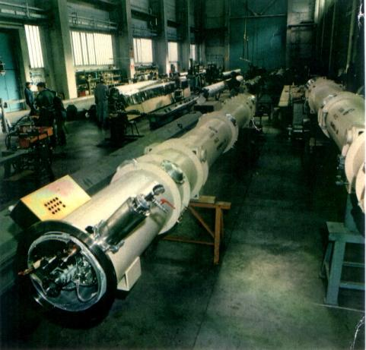
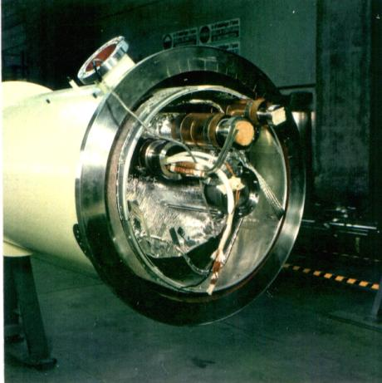
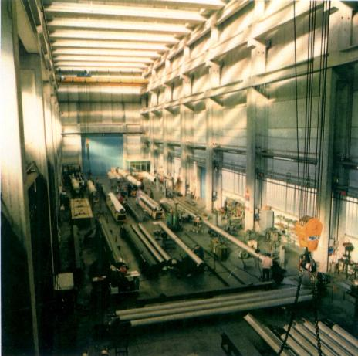
Infrastructure for SC cavities production (B)
Production of cryostats and cryomodules for SC applications
HERA Project at DESY-Hamburg
Production and assembling of 242 cryostats for the
S.C. dipole magnets

Slide 13
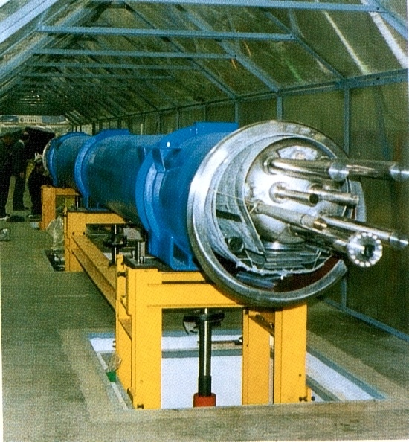
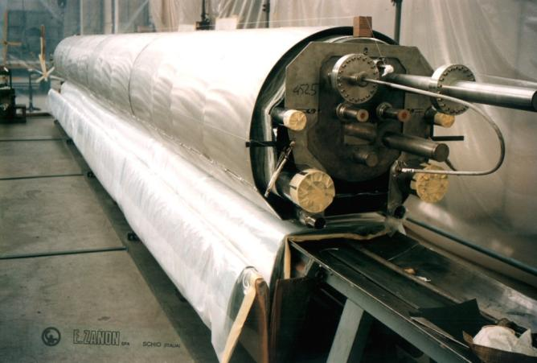
Infrastructure for SC cavities production (B)
LHC Project at CERN-Geneve
Pre-series manufacturing and assembling of 10m. and 15m. long cryostats for the S.C. dipole magnets

Slide 14
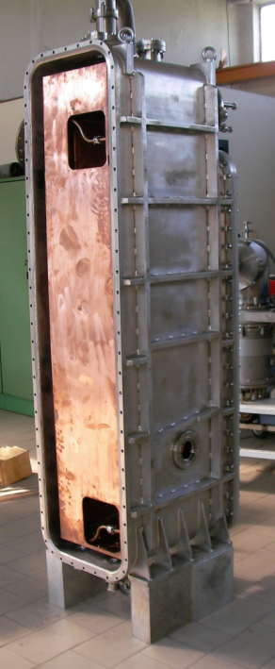
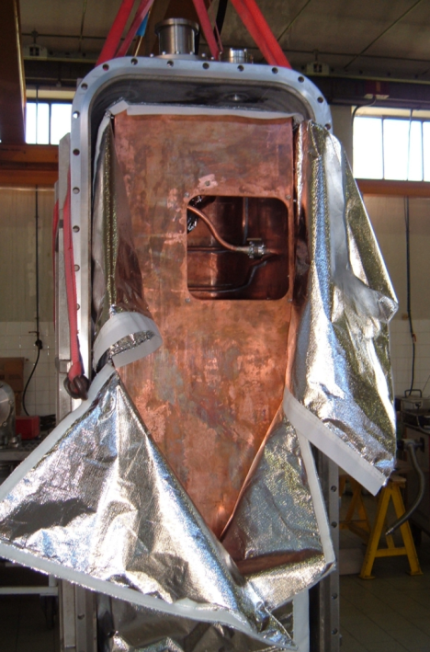
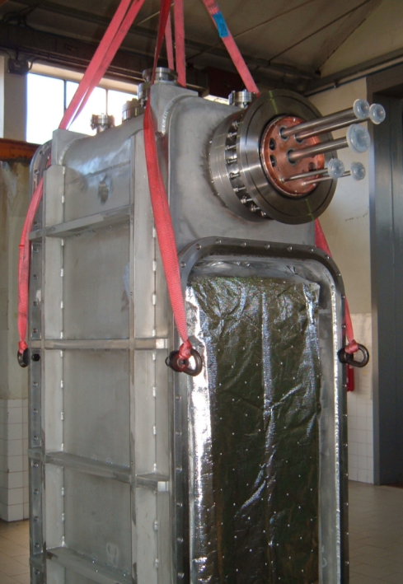
Infrastructure for SC cavities production (B)
SPIRAL II Project – GANIL ,CEA
Series of cryomodule for SC cavities

Slide 15
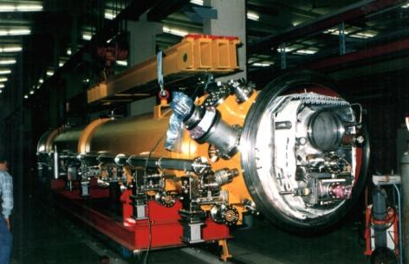
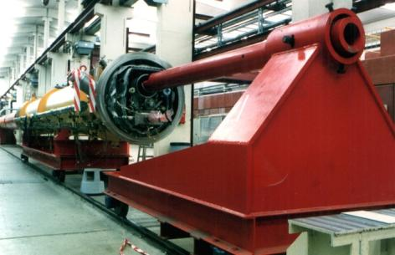
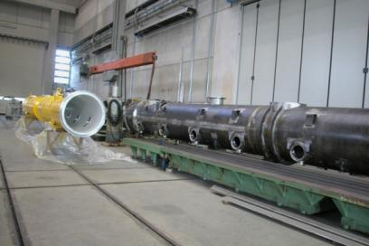
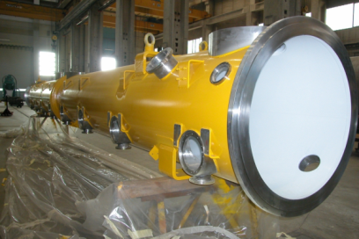
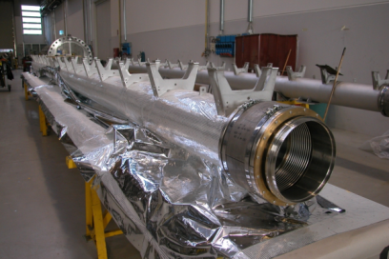
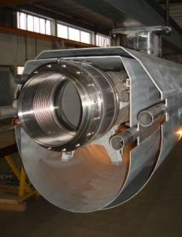
Infrastructure for SC cavities production (B)
TESLA Test Facility – XFEL Project at DESY
Past production of cryomodule for R&D phase
Actual production of cryomodule for XFEL

Slide 16

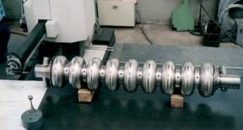

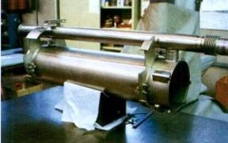
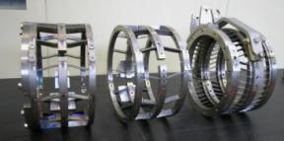
Infrastructure for SC cavities production (C )
Company participation to the R&D phase of the XFEL
project and actual involvement
(SC cavities serial production)
Development and manufacture of the cryomodules and assembling tooling ( 10 units supplied )
Development and manufacture of 1,3GHz superconducting cavities
(66 units supplied - performances above 30MW/m))
Development and manufacture of the 3,9GHz superconducting cavities
Manufacture of the Titanium helium tanks (111 units supplied)
Manufacture of the titanium blade tuner
(40 units , alternative design solution to the standard tuners)

Slide 17


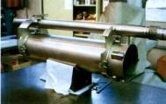
Infrastructure for SC cavities production (C)
Actual involvement to the XFEL project
August 2010 to 2011 , Award of DESY contracts for
A) Manufacture and final treatement of 420 units of the 9 cells , 1,3GHz SC cavities
Scope of work includes :
Manufacture of the 1,3GHz cavities / Manufacture of their Titanium Helium tanks
Integration of the cavities into their tank /Treatments and Surface cleaning treatments
Components manufacture and certification according to PED (Presssure Equipment Directive)
Delivery production rate 4 units/week
B) Manufacture and testing of 45 units of XFEL Cryomodules
Scope of work includes
Vacuum vessel and cold-mass prefabrication and testing
Delivery to the assembly site ( CEA-France)
C) Manufacture and testing of 146 units of Titanium Helium tanks
Scope of work includes
Tank prefabrication and He leak check
Delivery to DESY

Slide 18
Infrastructure for SC cavities production ( D )
Cavities serial production lay-out and Infrastructures
To fulfill the contractual requirements decision to separate this production from others Ettore Zanon s.p.a. production and strong effort to study and optimize the production lay-out
Cavities production into two dedicated buildings
( building lot I and building lot IV )
Building lot I
prefabrication of cells , dumb-bell ,subassemblies , end groups
EB welding , chemistry
Building lot IV (renewed building)
Final cavity welding , integration with Helium tank , surface treatments
(Prefabrication of the titanium Helium tank in the “standard” shop)

Slide 19
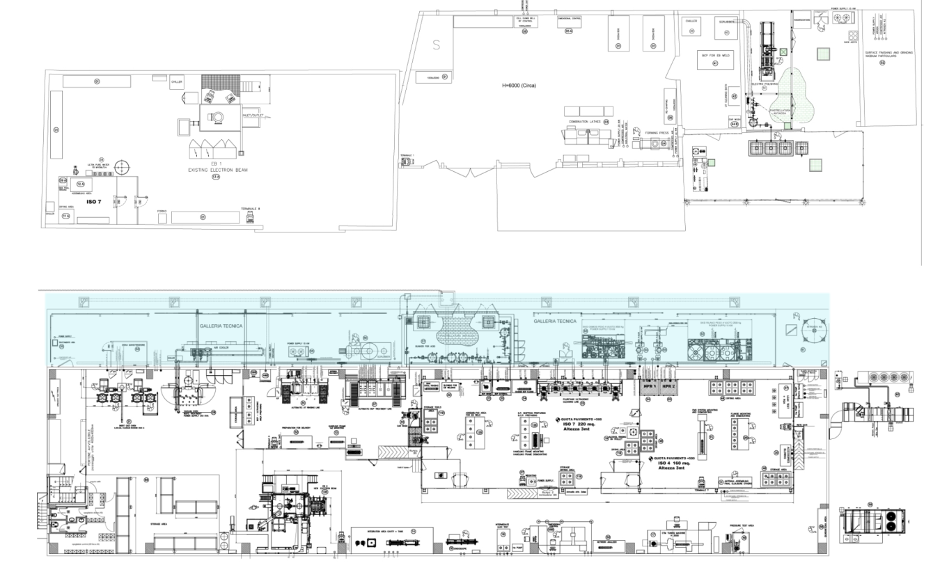
Infrastructure for SC cavities production ( D )
Cavity’s production lay-out
Building lot I about 600 m²
Building lot IV 1200 m² (plus 600 m² for services)

Slide 20
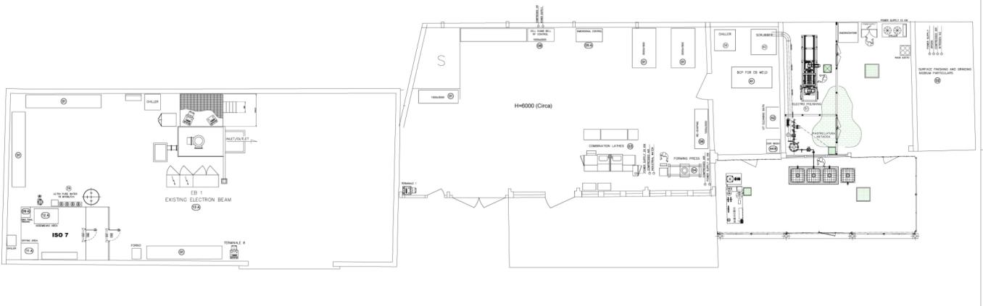



Infrastructure for SC cavities production ( D )
Building lot I
Clean room ISO7
UPW production unit (18MΏcm)
Dedicated 200T forming press (cells , tube's pulling , reshaping ) CNC turning machine (cell Dumb-bell machining, others)
Electron beam plant
150KV-30KW with cryogenic pump
*

Slide 21


Infrastructure for SC cavities production ( D )
Building lot I
Material (Niobium) storage area and incoming controls
Dimensional controls
Electropolishing with UPW plant(18MΏcm)
UT and BCP treatment of sub-components

Slide 22
Infrastructure for SC cavities production ( D )
Building lot IV
The building has been completely “restored” for this production with installation of central conditioning system too
(clean environment)
Into the building
Designed–optimized lay-out for the cavities serial production
Organization by manufacturing/testing station (MTS) located to suit the production flow
Outside of the building
“Service area” to concentrated all the equipments/services for the MTS

Slide 23


Infrastructure for SC cavities production ( D )
Building lot IV Service area

Slide 24


Infrastructure for SC cavities production ( D )
Maintenance area
Building lot IV Service area
Chemistry service area : storage of BCP acid tanks-cooling systems for BCP stations
Scrubber for acid gasses vent
Ultra pure Water (UPW ) production production up to 3m³/h at 18 MΩcm
5m³/h at >10 MΩcm

Slide 25


Infrastructure for SC cavities production ( D )
Building lot IV Service area
Pumps
(water 18 MΩcm ,>100 bar 1,5 m3/h )
for High Pressure Rinsing cabinets
Storage tank for LN2
Venting of EBW machine
and of leak check groups

Slide 26


Infrastructure for SC cavities production ( D )
Building lot IV
The buidling is organized
in three main areas
Chemical treatment area
Clean room ISO7/ISO4
Controls , Integration ,
800°C -120°C treatments
and testing area

Slide 27


Infrastructure status for XFEL (D)
Building lot IV
Chemical treatment area
Preparation and drying areas
Automatic pluritank station for
UT cleaning , rinsing
water 10 MΩcm and 18 MΩcm
Automatic BCP treatment line
2 cooled acid baths for Niobium
and Nb-55-Ti
1 bath first rinsing 1 bath final rinsing
water 10 MΩcm and 18 MΩcm
protection tunnel ,fumes extraction to the scrubber

Slide 28

Infrastructure for SC cavities production ( D )
Building lot IV Clean room ISO7/ISO4
Dedicated to
clean assembling , final surface treatments , final assembling for the RFcold test
Total surface of about 450 m²
ISO7 area 220m² ISO4 area 200m²
Operators dressing rooms , air showers
All metallic floating floor
Customized treatment stations

Slide 29



Infrastructure for SC cavities production ( D )
Building lot IV Clean room ISO7/ISO4
ISO 7
100 bar UPW cleaning
cabinet for ISO7 entrance
Pre-assembling stations
for cavity
EBW preparation

Slide 30


Infrastructure for SC cavities production ( D )
Building lot IV Clean room ISO7/ISO4
ISO 7
Automatic pluritank station
for
UT cleaning and
rinsing baths
water 10 MΩcm
and 18 MΩcm
Cabinets for BCP close circuit
of the inner / outer cavity surfaces
Alcol rinsing , Others

Slide 31



Infrastructure for SC cavities production ( D )
Building lot IV Clean room ISO7/ISO4
ISO 4
N° 2 cabinet for final HPR
UPW 18 MΩcm water p>100bar , 1.5m³/h
Cavity's rotation , vertical translation Nitrogen overlay
Station for final leak test
special equiments for
slow-controlled venting
of the cavity ,…others
Assembling stations for
FMS installation - RF antennas assembly
*

Slide 32




Infrastructure for SC cavities production ( D )
Building lot IV Clean room ISO7/ISO4
ISO 4
*
*

Slide 33


Infrastructure for SC cavities production ( D )
Building lot IV Control , Integration , 800°C -120°C treatments and testing area
The area is organized to suit part of the production and control operations
(good clean environment , not classified)
New EB welding plant : S.S. Chamber ,
size 3,4x2x2 m , oil free pumping group with cryogenic pump
(3x10⁻⁵ mbar 35 minutes)
nitrogen venting , RGA

Slide 34


Infrastructure for SC cavities production ( D )
Building lot IV Control , Integration , 800°C -120°C treatments and testing area
Station with automatic TIG equipment for Cavity-tank final integration
Visual examination with
photo recording of the cavity
inner welds and surfaces
(boroscope)
*

Slide 35




Infrastructure for SC cavities production ( D )
Building lot IV Control , Integration , 800°C -120°C treatments and testing area
Intermediate leak test (oil free equipments)
CMM , semi-automatic ControlMeasuring Machine for dimensional survey
*
*

Slide 36


Infrastructure for SC cavities production ( D )
Building lot IV Control , Integration , 800°C -120°C treatments and testing area
Dedicated Desy equipment for sub-component RF control and cavity final tuning
Shielded pressure test area
(final PED certification)
Quarantine closed cabinet
(non conform pieces)
*
*

Slide 37



Infrastructure for SC cavities production ( D )
Building lot IV Control , Integration , 800°C -120°C treatments and testing area
Inert gas oven for final treatment
(120°C , 1x10⁻⁵ mbar , 52 Hours)
Vacuum oven for 800 °C annealing Molibdenum Hot-chamber 0,6x0,6x1,5m
(4 units per batch)
cryogenic pumps , RGA

Slide 38


Infrastructure for SC cavities production ( E )
Production toolings
Optimization of the production lay-out useless without optimization of the production toolings and manufacturing methods.
A parallel tecnical effort was done to reach good efficiency of the production toolings
A total off 97 new tools have been designed and manufactured
Typical example : new tooling for multiple loading of EBW machine

Slide 39



Infrastructure for SC cavities production ( F )
Nowaday results
Ettore Zanon s.p.a. has finished his big effort and investements to organize the dedicated lay-out for the production of SC cavities (priority XFEL project) in December 2012 performing successfully the all required qualifications steps.
-Cavity serial production is running and more than 160 units have been delivered.
-First series of 25 cryomodule delivered
-First series of 96 helium tank delivered

Slide 40

Infrastructure for SC cavities production ( F )
Conclusion and company target
We are fulfilling the requirements of the XFEL contracts
We are gaining new knowledges and competitivness for future similar tasks
We train and growth new and young expertises for this sector
( about 50 people are actullay fully involved to the XFEL task)
*
* Photos by Heiner Müller-Elsner
Our production team for SC cavities

Slide 41
Infrastructure for SC cavities production
END
Thanks for the attention

