Slide 1
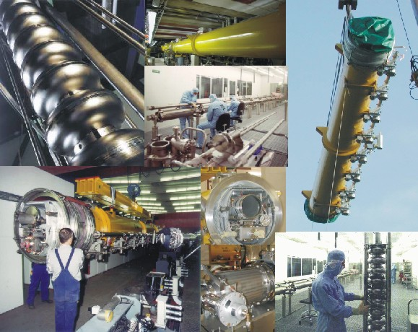
Welcome @

Slide 2
Name (SSID): TTC
Password (WPA/WPA2-PSK): r4hkMzgv
works in all areas

Slide 3
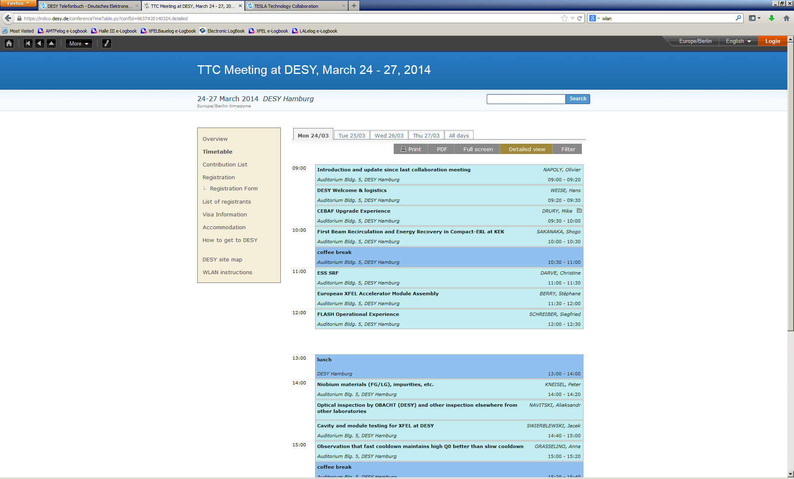

Slide 4
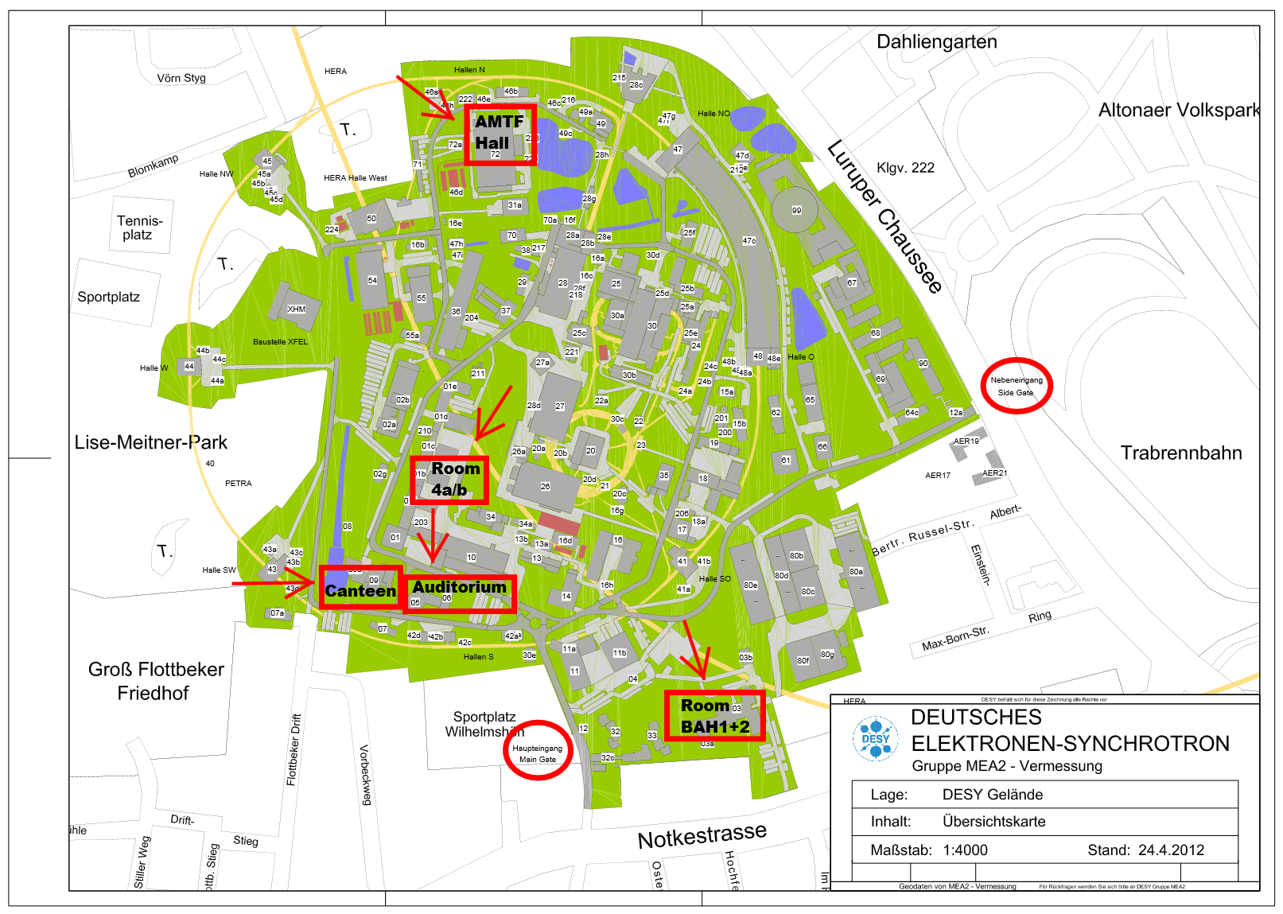

Slide 5
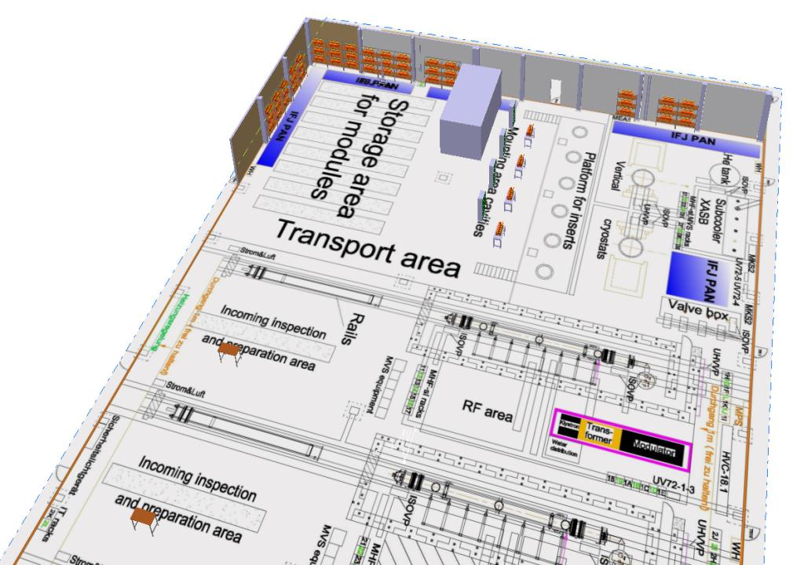
TTC Meeting Area
AMTF Access

Slide 6
AMTF Safety
we do not stop XFEL activities during the TTC meeting
please feel free to ask for individual tours but request your personal DESY guide
tours on Wednesday also require DESY guides; please ask!
WG8 members please stay in the dedicated meeting area
cryogenic installations are in operation and require respect; in case of gas blow-out leave the hall instead of curious inspections
almost all tours can be made available but a friendly reminder to DESY colleagues: be aware of safety, remember your own safety training (even if you want to proudly present your own work…)

Slide 8
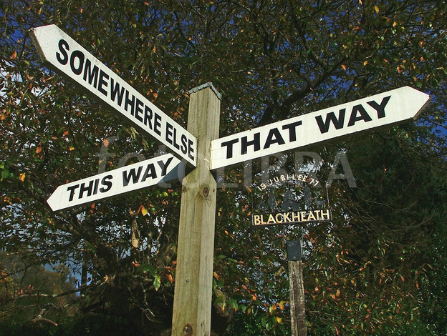
if you lost track of your DESY friend…
if WLAN doesn’t work and you have no access to further info…
please go to the DESY main gate and RESET your sense of orientation

