Slide 1
SIMS, LEM muSR, nanohydrides in nitrogen doped vs standard
Alex Romanenko, Yulia Trenikhina and Anna Grassellino
TTC DESY
25th March 2014

Slide 2
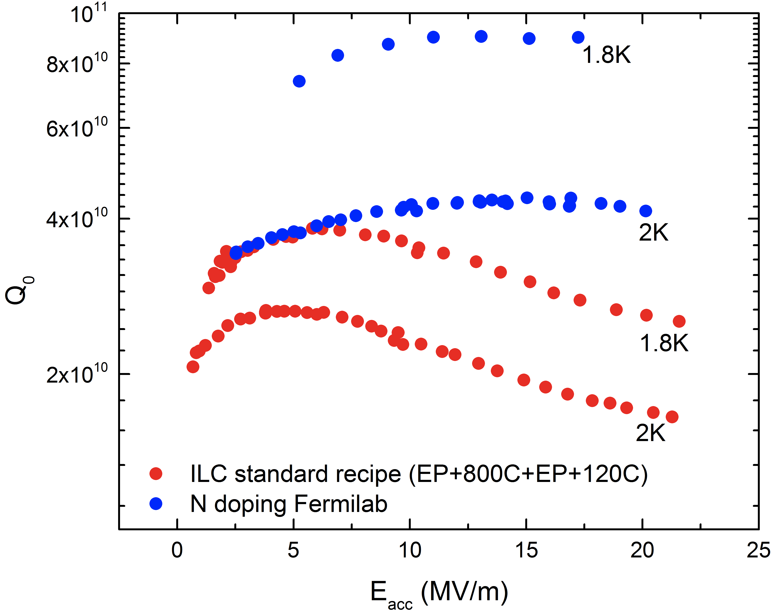
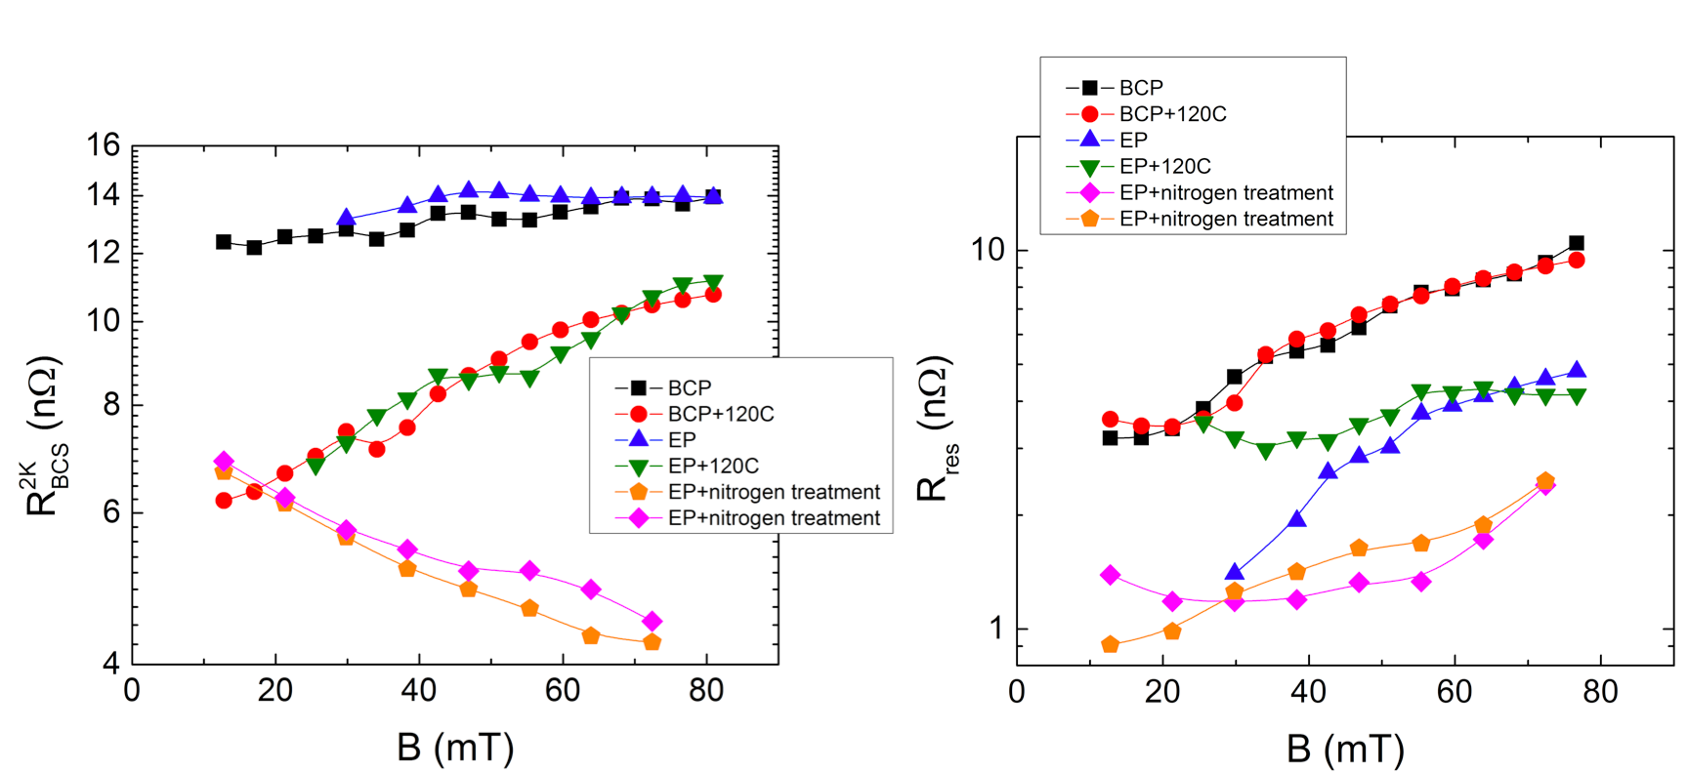
Nitrogen doping

Slide 3
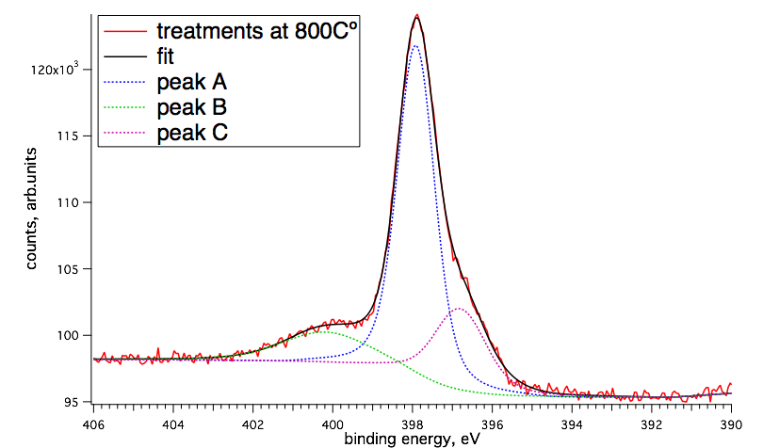
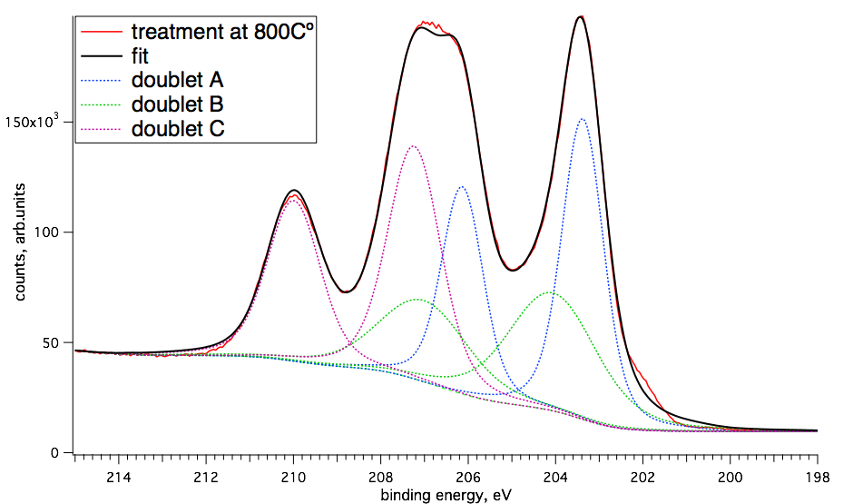
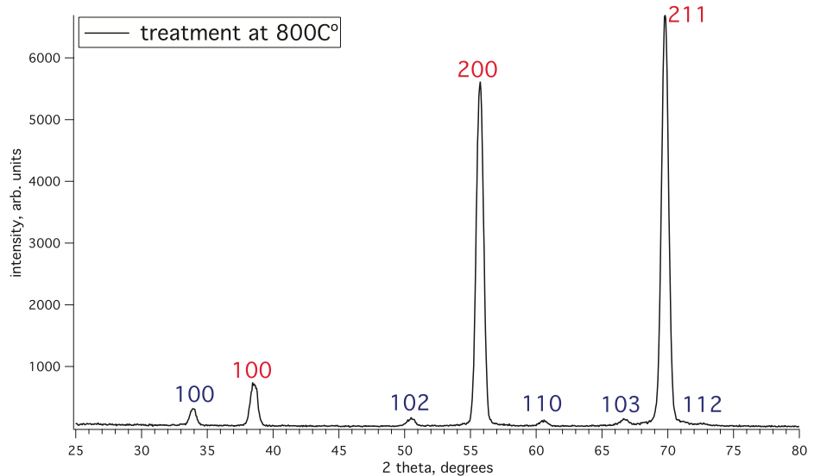
Investigation of cause of reversed MFQS and untypically high Q in N2-treated cavities.
1. Spectroscopic step-by-step characterization of preparation procedure [A. Grassellino, Supercond. Sci. Technol. 26 102001 (2013)] that gave reversed MFQS cavities. X-ray Photoemission Spectroscopy (XPS) and X-ray Diffraction (XRD) on Nb samples processed parallel with reversed MFQS cavities.
Grassellino’s procedure:
Step 1: furnace bake at 800C-1000C in N2 gas (~2*10⁻² Torr) for various times.
XPS: N 1s peak
XPS: Nb 3d peak
XRD spectra
Result 1: XPS: NbNx, NbNxOy on the surface (within few nm); XRD: NbN0.5 in the bulk (within several um)
Step 2: EP and HPR.
Result 2: no NbN stoichiometric phases formation!

Slide 4
SIMS – nitrogen doping level
Only about 40 ppm of N is enough

Slide 5
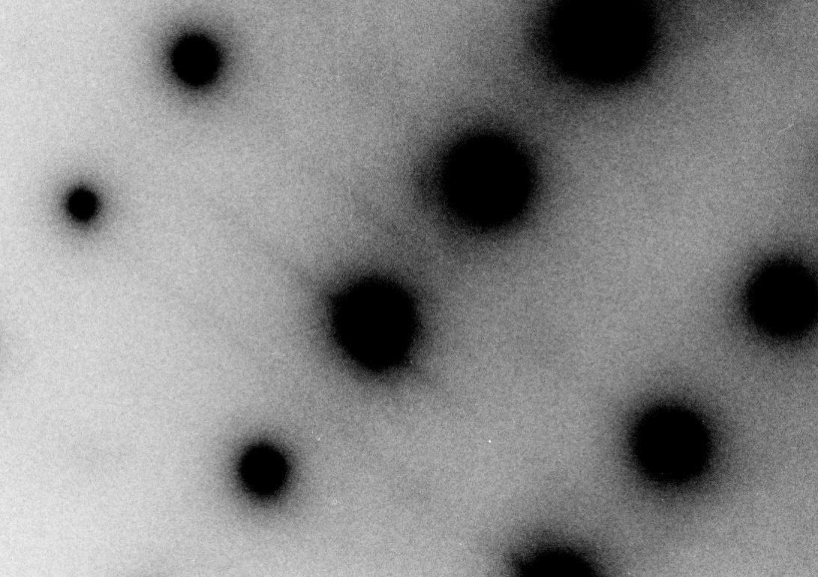
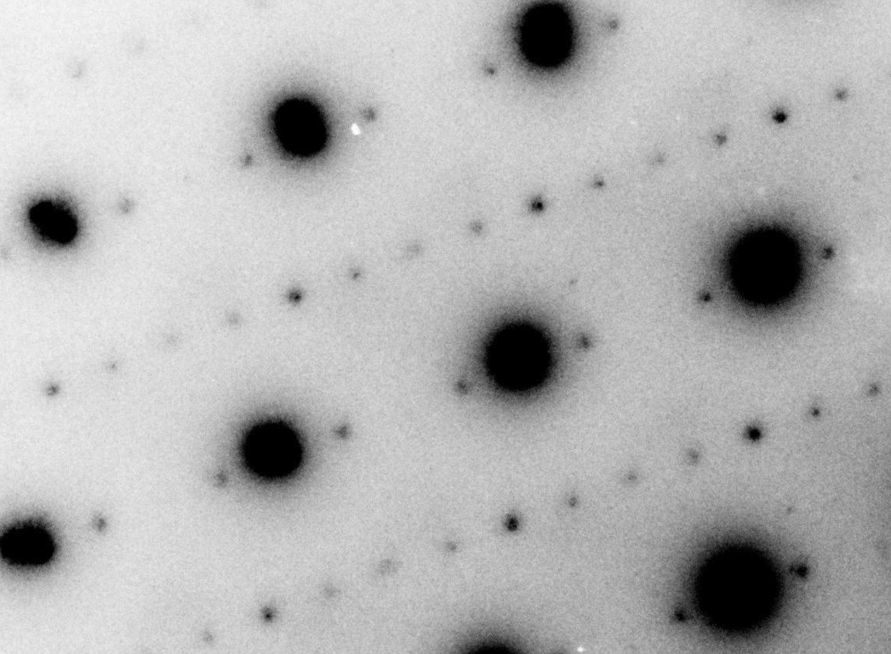
No nanohydrides found in nitrogen doped cutouts
2. T-dependent TEM structural characterization (NED) at room T and at 94K.
Room T and 94K: NO additional Nb hydride phases right underneath an oxide (within ~50 nm)!!!
94K: stoichiometric Nb hydrides deeper into the bulk Nb! Further investigation is needed...

Slide 6


Muon spin rotation – measure B(z)
B(z)
Superconductor
in the Meissner State
B_{ext}
λ
z
0

Slide 7
LEM – data on EP baked/unbaked
Use variable energy muons, which stop in the first ~100nm
~15 nm - no screening
mfp ~ 2 nm at the surface, increasing deeper
mfp~40 nm
mfp > 400 nm
BCP and EP unbaked -> strong screening, excellent fit provided by the clean limit Pippard/BCS model
EP+120C bake-> strongly suppressed m.f.p., gradient of the m.f.p. from the surface, dirty limit
N-doped -> intermediate m.f.p., no gradient
Ba = 25 mT
Fit by Gaussian model for the field at the muon site – approximate, qualitative comparison

