Slide 1
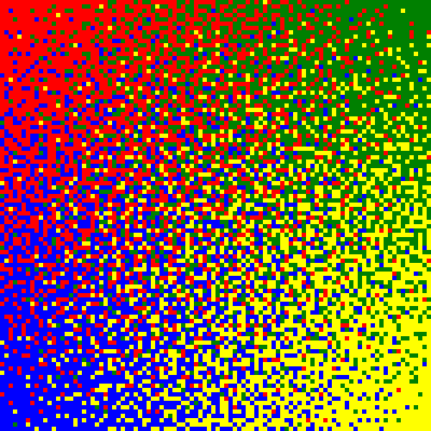
The Interpolating SiPM (ISiPM) & Friends:
Novel Devices for
Position Resolved Photon Cluster Detection
Peter Fischer
Heidelberg University

Slide 2
Content
Motivation
ISiPM
principle
expected performance
device design
first results
Other concepts (‘friends’ / ‘competitors’)
Steps towards a full ISiPM module
First Implementation in SPAD-CMOS technology

Slide 3
Motivation: Scintillator Crystal Identification
How to identify many small crystals (in PET)?
1:1 coupling
Light Spreading
The Goal
Coupling
(too) many channels
Must detect small signals (light an many SiPMs)
Light losses by coupling
Problems in SiPM gaps and at edges
Spacer thickness fixed by SiPM pitch becomes too large for small crystals
Spatially Sensitive Sensor

Slide 4
Detail: Light Spreader Limits
What light spread is best?
Note: An extreme approach is no crystal pixilation (‘block detector readout’) with light on all SiPMs. Challenge: high hit occupancy (requiring neighbor logic), data analysis Advantage: can measure interaction depth from light cluster shape
SiPMs
Light sources (crystals) in this area cannot be distinguished – spread too small
Light spot
Need many SiPM signals for reconstruction. S/N bad.
– spread too large
Good width: ~ pixel size
Edge Problem: Difficult to distinguish positions close to edge
Edge Problem: Difficult to distinguish positions close to edge

Slide 5
Module Concepts
Many principles possible:
1:1 coupling
+ all light in one
detector → fast
+ low data rate
+ energy res. relaxed
- many channels
Light spreader
+ crystals < sensors
- much data
- neighbor trigger
- energy res. crucial
- edge problems
(hard to identify cryst.)
Spatial Resolving
Sensor
+ crystals < sensors
+ medium data
+ no edge problems
Block detector
- light everywhere
+ no binning
+ cheap crystal
+ good timing
- high data rate
- large dead time
Shifted
+ measure
DOI via
double
hits
Photo Detectors can be
analogue SiPMs + ASICs
Digital SiPMs

Slide 6
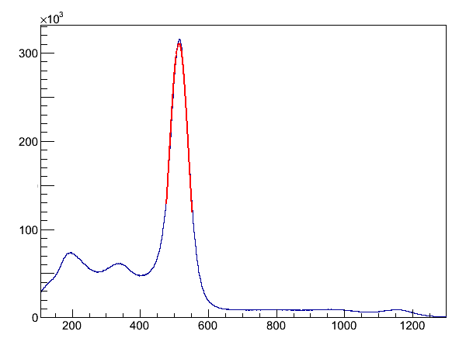
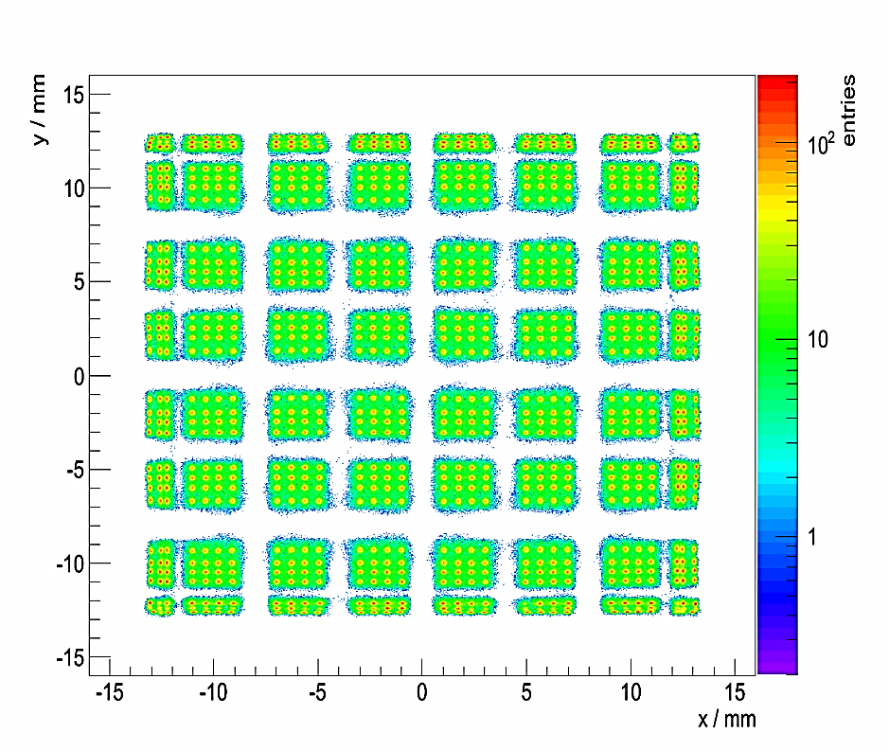
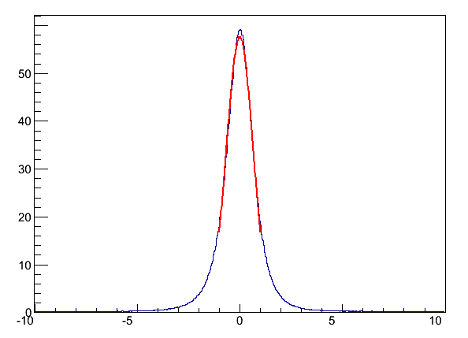
Example of Light Spreader Readout
Position of crystal is calculated as (e.g.) Centre-of-Gravity of pixel signals
Homogeneous Illumination should give peak @ each crystal
Distortions from light sharing properties. Only peaks matter!
With crystal and pixel gain correction
Energy
Counts/ [10³]
dE/E = 12.3% (FWHM)
Counts
0 200 400 600 800 1000
dE/E/[keV]
Timing
Counts/ [10³]
CRT = 1.5ns (FWHM)
-10 -5 0 5 10
Flood histogram using Center-of-Gravity, trig. 4, eval. 52 ph
CRT/[ns]
DSiPM

Slide 7
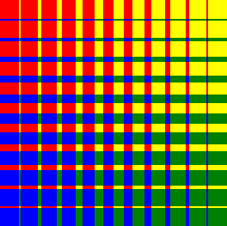
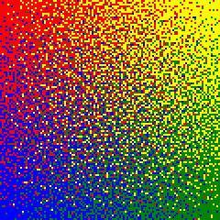
Spatially Resolving Devices (for Light CLUSTERS)
Two ways to go:
Analogue mixing of signals (by APD implants or resistors), e.g. devices from RMD → large noise, slow
100% assignment of SiPM cells to few readout channels:
Classical: Wedge & Strip
Linear strip gradients
ISiPM
Top/Bottom: Blue fraction
Left/Right: Green fraction
Top/Bottom: G+B fraction
Left/Right: R+B fraction
Top/Bottom: G+B fraction
Left/Right: R+B fraction

Slide 8
SiPM Principle

Slide 9
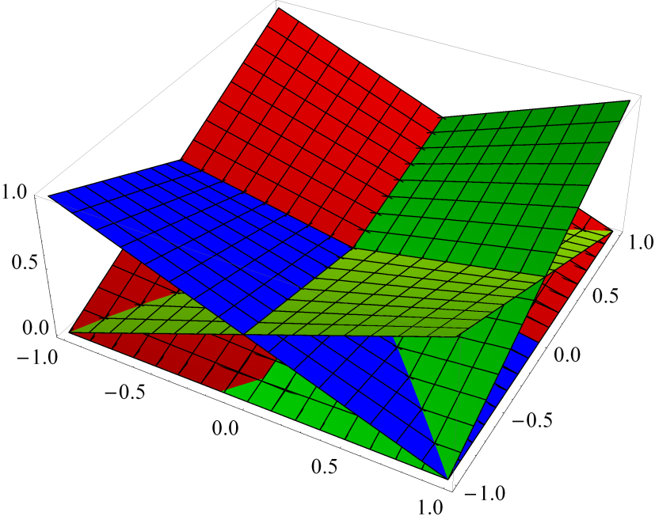
ISiPM Idea
Chose 4 weight functions S_{i,j} (x,y) (amplitude in corner (i,j) for hit at (x,y) )
For instance with corners at
Get a corresponding reconstruction function to find (x/y) from the 4 S_{i,j}.
Here: (center of Gravity, CoG)

Slide 10
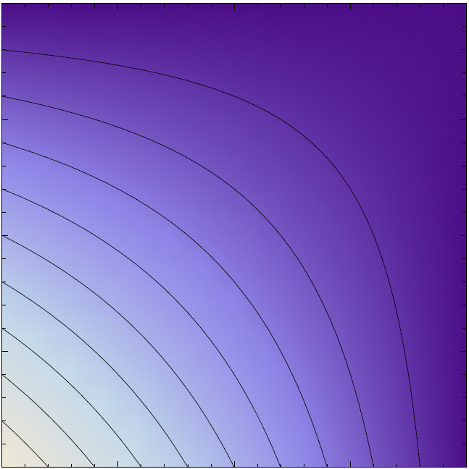
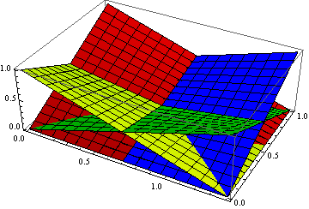
Weight Function
Simplest Case for ‘normal’ Center of Gravity reconstruction: Superposition of two linear gradients
Note: Other functions & only 3 corners are possible!!
0.1
0.2
0.4
0.6
0.8
1.0
Signal Fraction associated to lower left corner
NB: Sum of all 4 weight functions = 1

Slide 11
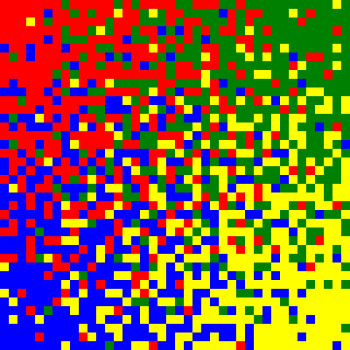
Discretization of Weight Function
Assign each SiPM cell to one of N = 4 corners ( , , , )
Do this such that the local density of cells matches the Weight Function(s)
/ / /
0 / 100 / 0 / 0 (%)
/ / /
0 / 50 / 0 / 50 (%)
/ / /
25 / 25 / 25 / 25 (%)
40 x 40 cells

Slide 12
Algorithm to Obtain Cell Assignment
For each SiPM cell, calculate the ideal corner assignments according to the desired weighting function. (The sum of these 4 values should be 1.)
L
R
0.90
0.10
-
2D
Example
0.85
0.15
-
0.8
0.2
-
0.8
0.2
-
Assign all cells to no corner, to start with.
Set clustersize = 2
0.90
0.10
-
1.75
0.25
0.85
0.15
-
0
0
Process all blocks of clustersize × clustersize SiPM cells, starting at a corner, stepping by clustersize. For each block:
Calculate the sum of ideal corner assignments for each corner I(ix,iy)
0.8
0.2
-
1.60
0.40
0.8
0.2
-
0
0
0.90
0.10
-
1.75
0.25
0.85
0.15
1
0
0.8
0.2
1.60
0.40
0.8
0.2
-
1
0
Calculate the number of already fixed assignments to each corner F(ix,iy)
0.90
0.10
-
3.35
0.65
0.85
0.15
As long as any of the I(ix,iy) > F(ix,iy) + 1, we can be sure that an assignment to corner (ix,iy) in this block is missing. Pick a random free position in the block and assign it to corner (ix,iy).
0.8
0.2
2
0
0.8
0.2
-
0.90
0.10
-
3.35
0.65
0.85
0.15
Double clustersize and repeat the above until all cells are assigned
0.8
0.2
3
0
0.8
0.2

Slide 13
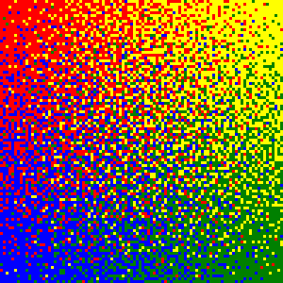
Larger Maps (100 × 100)

Slide 14
Simulation Results

Slide 15
A: Systematic Reconstruction Error
Discretized weight function → systematic reconstruction errors
Use square photon clusters (‘crystals’) for simple study
Systematic errors depend on
# cells on ISiPM (many:better)
Size of cluster (large:better)
Quality of cell assignment algorithm
0/1
1/1
Picture of all ‘offset’ arrows
x_{rek} = ( + )/16 = 0.875 (35)
y_{rek} = ( + )/16 = 0.875 (35)
2 12 0 2
40 x 40 cells
0/0
1/0
ISiPM with 32 × 32 cells
Clusters of 7 × 7 cells

Slide 16
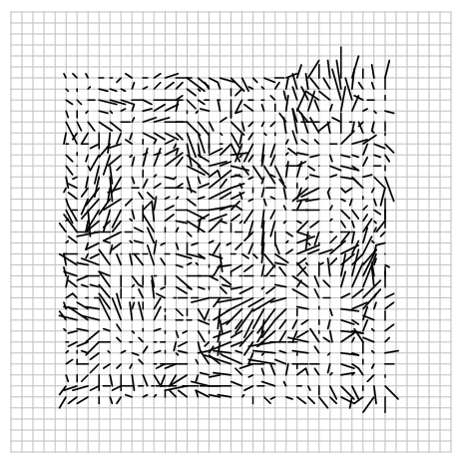
A: Systematic Reconstruction Error vs. Cluster Size
Example: ISiPM with 40 × 40 cells
Cluster = 5 × 5 cells
σ_{x} / σ_{y} = 5.5 / 6.0 %
Cluster = 10 × 10 cells
σ_{x} / σ_{y} = 2.0 / 2.1 %
Cluster = 15 × 15 cells
σ_{x} / σ_{y} = 1.2 / 1.0 %
Averaged over all (integer) cluster positions fully on SiPM
(σ given in % of SiPM size)

Slide 17
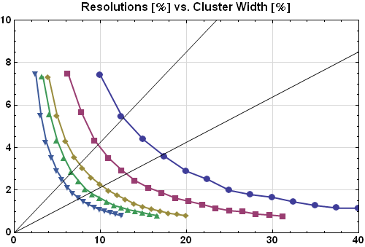
A: Systematic Reconstruction Error vs. Cluster Size
Clusters (i.e. crystals) with pitch p can be identified if σ_{Err} « p
Note:
When plotting σ in % of SiPM vs. cluster size in cells, curves superimpose!
These systematic deviations are known and may be corrected for (?)
Error (σ)
[% of SiPM]
100 × 100 cells
Cluster size =
FWHM
64 × 64
120 × 120
40 × 40
Cluster size =
2 x FWHM
160 × 160
(Square)
cluster size p
[% of SiPM]

Slide 18
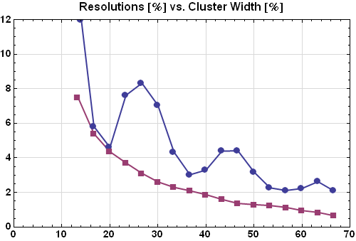
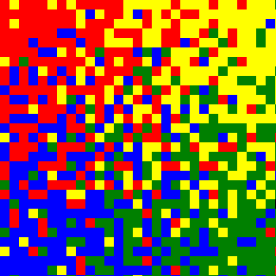
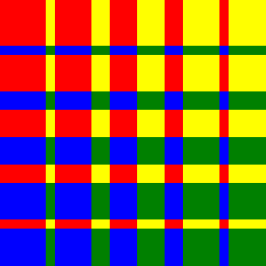
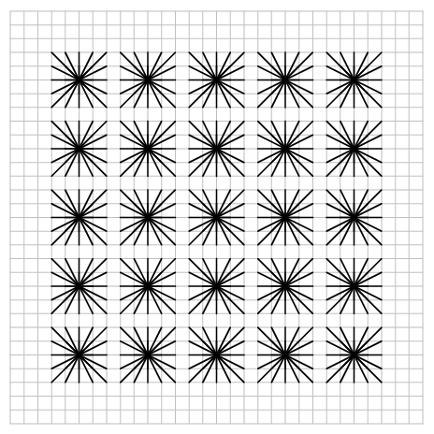
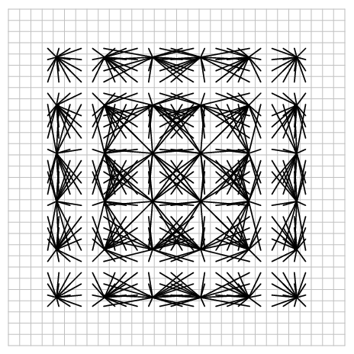
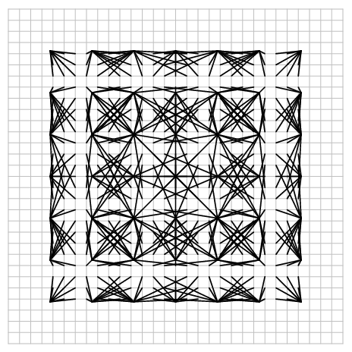
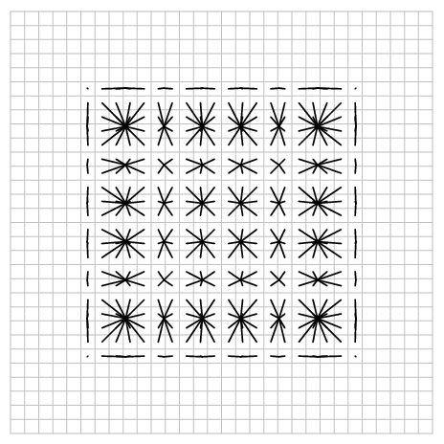
ISiPM Mapping is ‘smoother’ than ‘Stripe’ Mapping:
30 × 30
30 × 30

Slide 19
Large SiPM

Slide 20
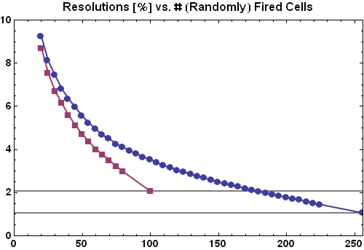
B: Statistical Reconstruction Errors: Cell Statistics
When only part of the cells of a cluster fire → statistical reconstruction error
Observations:
Need to fire significant fraction
Large Clusters are more tolerant
Note: When firing most cells, energy information is degraded
This is a general problem of 1:1 coupling with small crystals
Error (σ)
[% of SiPM]
ISiPM with
160 × 160 cells
Cluster size
10 × 10 cells
Cluster size
16 × 16 cells
Systematical
limits
Systematical
limits
fired cells

Slide 21
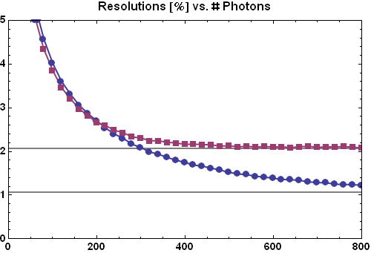
B: Statistical Reconstruction Errors: Photon Statistics
Multiple photon hit sin one cell fire cell only once ☹ → photon is ‘lost’
How many photons to we need?
Note: # photon = # fired cells / PDE
Error (σ)
[% of SiPM]
ISiPM with
160 × 160 cells
Cluster size
10 × 10 cells
Cluster size
16 × 16 cells
Systematical
limits
Systematical
limits
randomly
picked cells

Slide 22
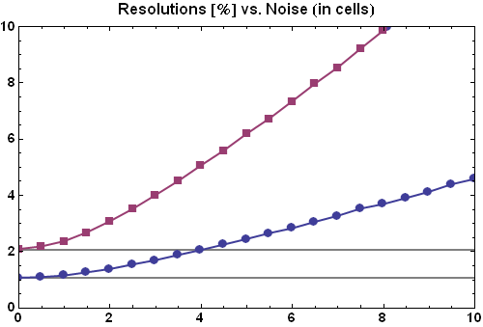
C: Statistical Reconstruction Errors: Noise
Noise on the corner signals → statistical reconstruction error
This is a general property of position reconstruction from several signals
It depends on the S/N ratio, which is better for large clusters
Error (σ)
[% of SiPM]
SiPM with
160 × 160 cells
Cluster size
10 × 10 cells
Cluster size
16 × 16 cells
Systematical
limits
Systematical
limits
Noise per corner
in units of cells

Slide 23
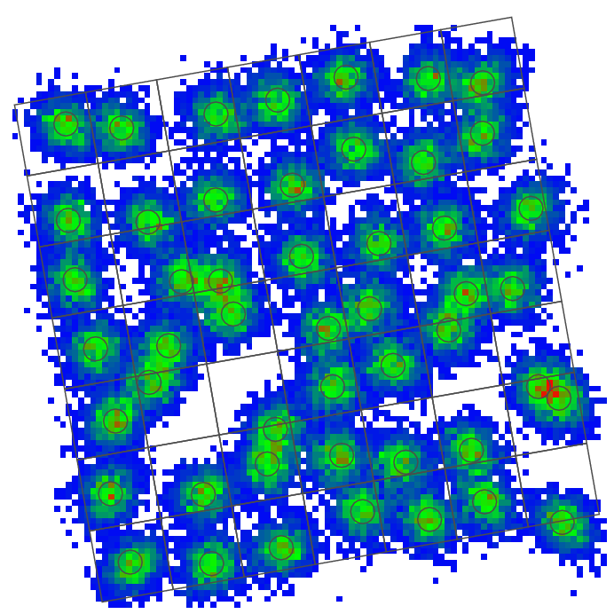
Putting all together: Flood Map Simulation
Example for device simulation:
ISiPM with 100² cells (e.g. 7.4 mm²)
crystals of 12 × 12 cells (0.9 mm²)
Array of 7 × 7 crystals (tilted to show robustness)
Fire 250 random cells / crystal
noise per corner: 2 cells (rms)
Circles show systematic, (known) offsets
Hit is associated to closest
7% of hits are associated to wrong crystal (offset by 1)
7.4 mm²

Slide 24
Device Design

Slide 25
Technology Options
With one available metal layer
With two available metal layers
C
C
D
cell
cell
cell
cell
A
A
B
cell
cell
Poly Bridge
cell
cell
C
C
D
cell
cell
cell
cell
A
A
B
B
D
B
B
A
A
large capacitances, series resistance
short circuit risk, crosstalk
area loss
more complex technology
+ higher fill factor
+ less crosstalk

Slide 26
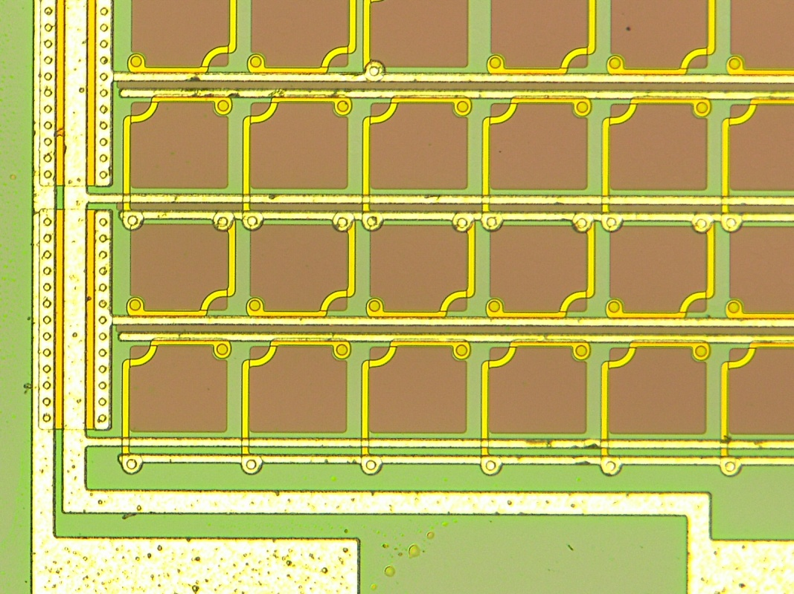
One Metal Layer Design
Fabricated at FBK, Trento, Italy
100 x 100 cells
Total size ~7.4 x 7.4 mm²
Signal
collection
4 different
vertical busses
Cell:
74.5 x
73 µm²
Wire bond pads for
4 Corner signals

Slide 27
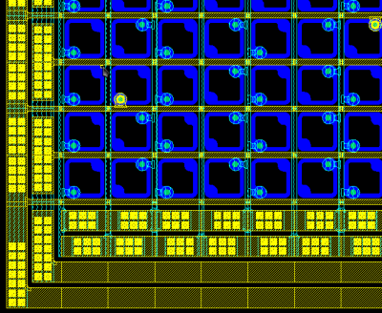
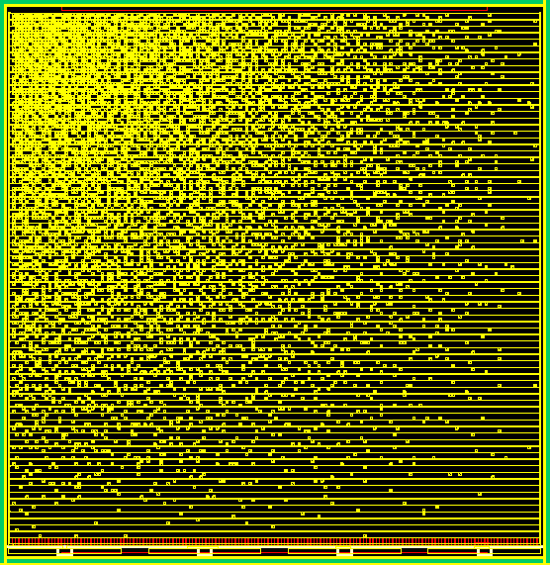
Two Metal Layer Designs
2 types: 160 × 160 cells (45µm)², 120 × 120 cells (60µm)²
Massive busses to reduce trace resistances
(Unfortunately only few devices available)
Busses collecting hor. Signals (on both sides)
Assignments to upper left corner
4 busses for 4 corner signals

Slide 28
Implemented Devices
 |  | #1 | #2 | #3
Technology |  | One metal layer | Two metal layers
Pixels |  | 100 × 100 | 120 × 120 | 160 × 160
Pixel Size | µm² | 74.5 × 73 | ~60 × 60 | ~45 × 45
Active Area | mm² | 7.45 × 7.3 | 7.2 × 7.2 | 7.2 × 7.2
Device Size | mm² | 7.61 × 7.84 | 7.84 × 7.84 | 7.67 × 7.84
For non-experts: These are LARGE SiPM devices
Problem: Devices have NO passivation layer, so that many got destroyed (Alu shorts) by placing crystals.

Slide 29
Measurements

Slide 30
(Very First, Simple) Test Setup
Non inverting amplifiers with overall gain = 1 (into 50 Ω). Rin = 100Ω
Readout with 4 channel TDS 3034B Scope (BW = 300MHz, max. 2.5 GS/s). Input BW set to 20 MHz (lower peak noise)
Single shot mode
peak amplitude or integral are taken from measurement function of scope
Slow readout via GPIB & USB: (6 Min / 1000 Events) → low statistics
Bias
+
-
50
Scope
(50 Ω)
100
400
400

Slide 31
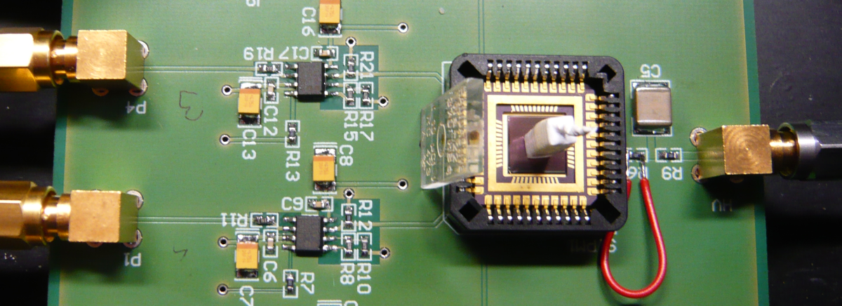
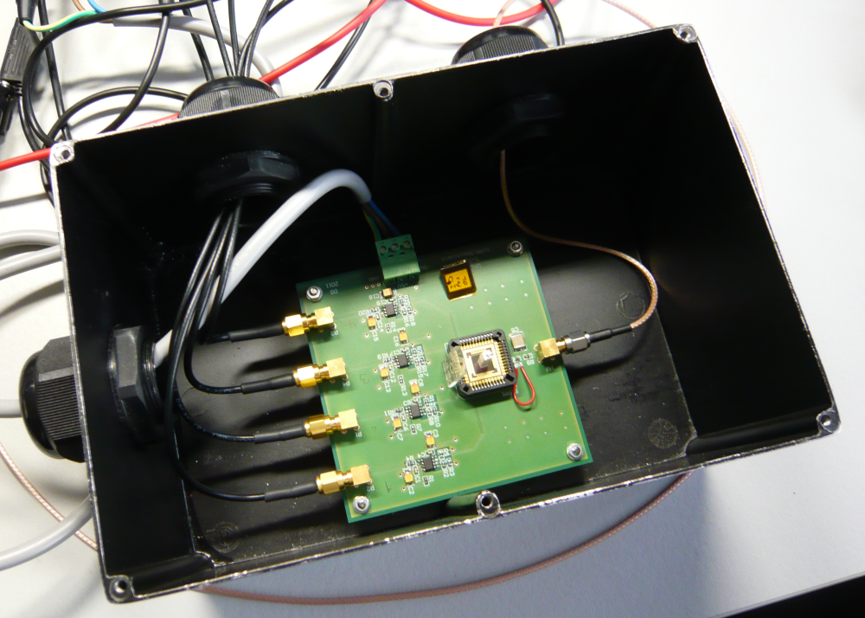
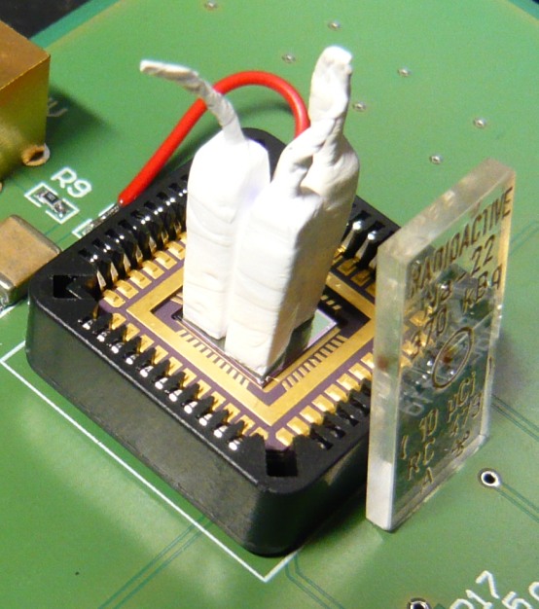
Setup in Dark Box

Slide 32
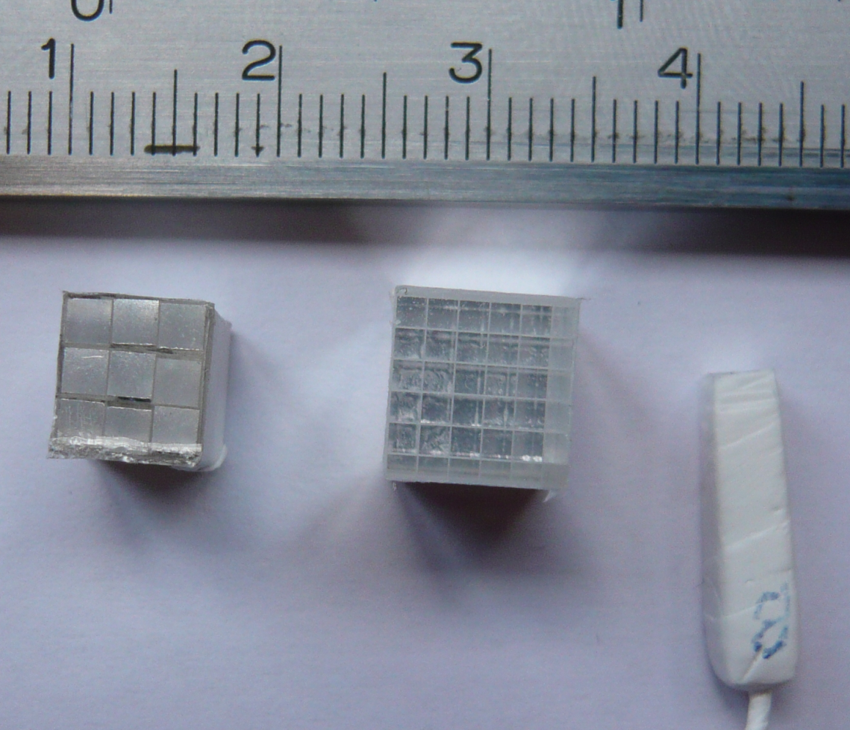
Crystals & Arrays
LYSO
Crystals are standing on SiPM with bad optical coupling
(3x3)
x
(2mm)²
(5x5)
x
(1.3mm)²
1
x
(3mm)²

Slide 33
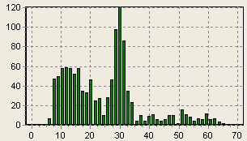
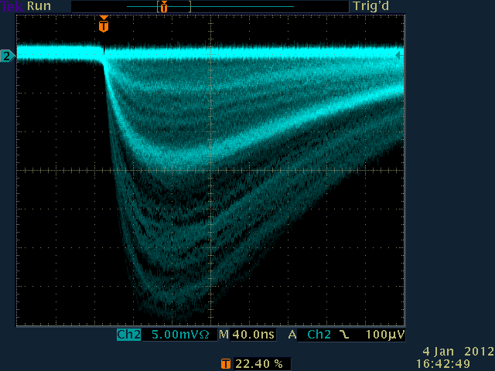
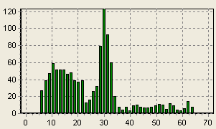
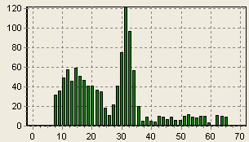
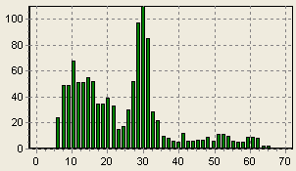
‘Spectra’
3×3 mm² crystal in centre
511 keV peak is visible
CH1
CH2
CH3
CH4

Slide 34
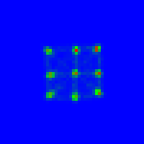
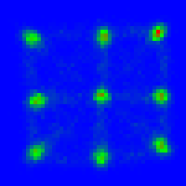
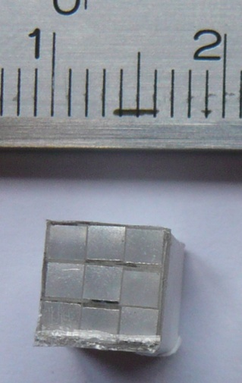
Array of 2 mm Crystals
20000 events (only), pulse integral used
No source (natural LYSO radioactivity, mix of many amplitudes.)
No cuts on data (energy, odd events)
Observation: Positions compressed to center (Xtalk)
2 mm crystals
2 SiPM pixels / screen pixel
1 SiPM pixels / screen pixel
(3×3) × (2mm)²

Slide 35
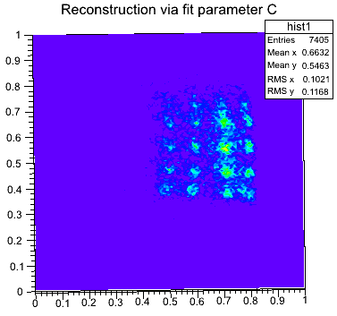
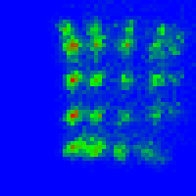
Array of 1.3 mm Crystals
22Na source used in the case
1.3mm Crystals can still be resolved on 7.4mm device with 100² cells
Note: Scope Trigger favors one corner!
2 SiPM pix / screen pix
1.3mm crystals
1.3mm crystals
10000 events, integral, COG, No cuts.
7400 events, fit, COG, some cuts.

Slide 36
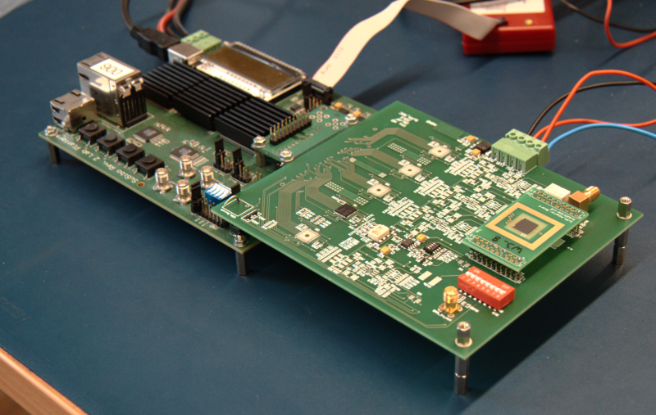
Faster Setup
Use discrete ADCs & USB readout

Slide 37
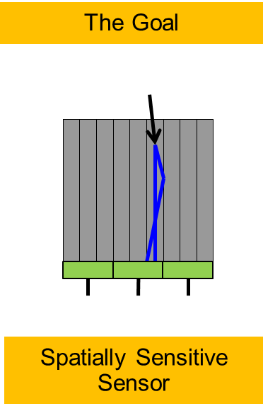
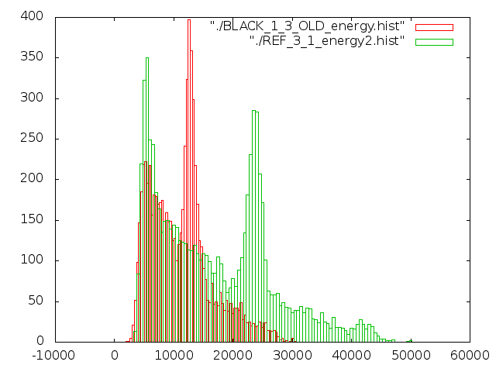
Measurements of LYSO array
Array: Optically Isolated 1×1 mm² crystals
Flood map: Place source over array, plot reconstructed COGs
1 mm very clearly resolved (~ 7.4mm active area)

Slide 38
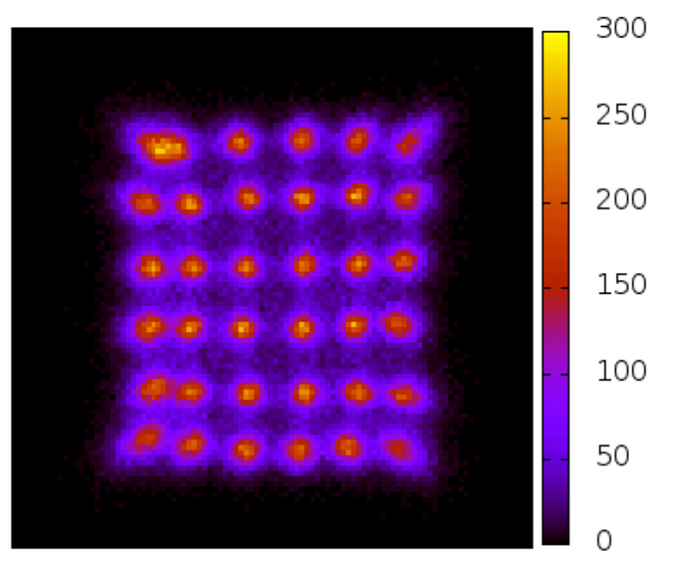
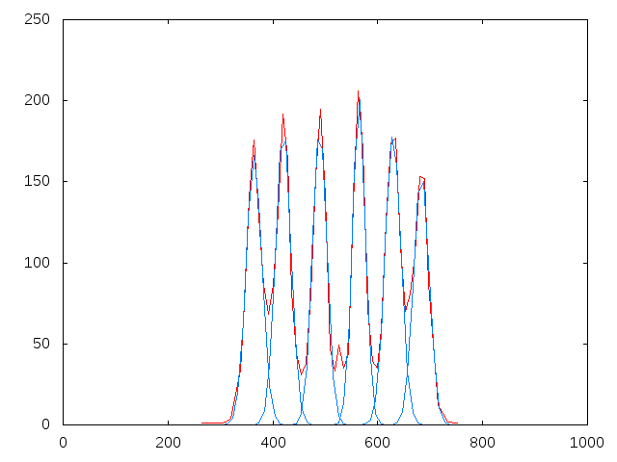
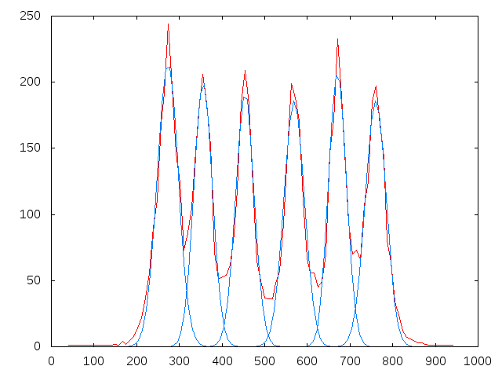
Origins of Compression
Top side of LYSO array (1x1x10mm³) black → less compression
Large amount of photons seem to traverse ‘optical isolation’
Note: Equal optical X-talk to all side should NOT change CoG position!
Reflective top
Back
top

Slide 39
Sub-mm Resolution and DOI
Stack 1mm crystals (very improvised, but it works!)
ISiPM
0.7mm
0.7mm distance clearly resolved !
DOI works !

Slide 40
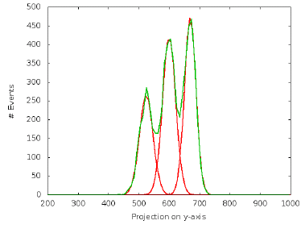
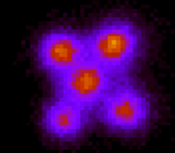
Separation of DOI Peaks
Projection along diagonal:

Slide 41
Going Further: Sub-millimeter Array
LYSO array (0.8x0.8x10mm³) NOT optically isolated (small n-mismatch)
Not so nice yet….
Reflective wrapping
Black
wrapping

Slide 42
Other Concepts have been proposed in parallel / after ISiPM idea

Slide 43
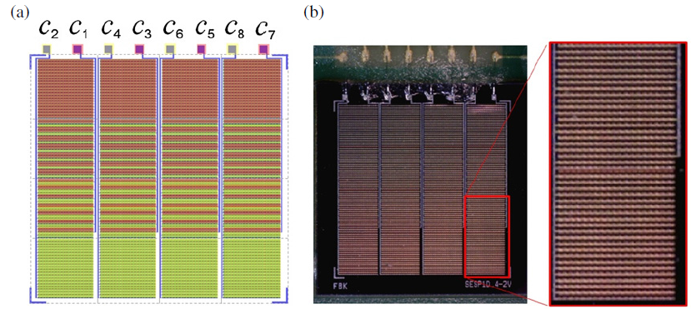
SeSP (Sensitivity Encoded SiPM)
Linear SeSPs
V. Schulz et al.,
Sensitivity encoded silicon photomultiplier—a new sensor for high-resolution PET-MRI Phys. Med. Biol. 58 (2013) 4733–4748

Slide 44
2D SeSPs
Extension in 2D

Slide 45
Results
1D SeSP
- 8 readout channels (2 per row)
-> less noise
2DSeSP
- 4 readout channels -> more noise
Main drawback: Crystal must be positioned very precisely!

Slide 46
Linear Graded SiPM (LG-SiPM)
Basic Idea: Distribute the quenching signal of each cell to multiple (2) nets with separate quenching resistors / capacitors
1D concept:
Parallel impedance of pair of Rs is kept constant to equalize current contributions
A. Gola, Member, IEEE, A. Ferri, A. Tarolli, N. Zorzi, C. Piemonte: A Novel Approach to Position-Sensitive Silicon Photomultipliers: First Results

Slide 47
Extension to 2D
Collect row/column contributions with (equal) Rs in pixels
Generate linear gradients in x- and y in periphery

Slide 48
Results with 2D LG-SiPM
Can resolve 0.8mm very clearly
Smaller arrays difficult to get… (but promising results seen)

Slide 49
Steps towards a full ISiPM ‘module’

Slide 50
Goal
Demonstrate ultimate ISiPM / LG-SiPM performance
latest SiPM technology from FBK (high PDE, Small pixels, small edge)
operate at stable temperature
Demonstrate array readout across multiple SiPM dies
Demonstrate system aspects
trigger threshold stability
HV control of multiple SiPMs
high data rate
cooled module operation
….

Slide 51
Starting Point: Hyperimage Stack with PETA chip
Normal SiPMs on PCB
3.2 × 3.2 cm²
ac coupling components
2 PETA ASICs
wire bonded
LDO, FPGA
wire bonded chips
Empty area for cooling
block + tube

Slide 52
PETA Single Channel Architecture
1/36 channels

Slide 53
Making Modules Compact: Chip with Solder Balls
Wire bonds take much space → New chips PETA4 and PETA5 use solder balls
5 × 5 mm²

Slide 54
Making Modules Compact: LTCC with internal cooling
LTCC Ceramic
Cooling channels inside
PETA & Components on one side, SiPMs on other side → one PCB less…

Slide 55
Frontend Design
Fully differential-ended frontend
Single-ended frontend
∫
∫
Very flexible
Reliable & tested in MR (previous version)
External decoupling needed
Signal integrator + SAR-ADC
Input impedance ~ 7Ω
Adjustable input DC potential ± 0.4V
NO external component needed
Threshold circuit same as differential
Signal integrator + discharge time counter

Slide 56
LTCC with tube connection
4 chips
144 channels
36 ISiPMs of ~ 5×5 mm² size on bottom side
Tubes for coolant

Slide 57
Planned Assembly
LTCC
(1 of 4)
Cooling Block
PCB
Tube Conn.
Cover Plate
Screw

Slide 58
Status
PETA5 chips available & working fine
LTCC designed, back in ~ 1 month
mechanics (nearly) frozen
Sensors ready by ~ July
Exciting times!

Slide 59
ISiPM in a CMOS Technology

Slide 60
The Fraunhofer SPAD process
Fraunhofer Institute IMS (Duisburg, Germany) has modified their in-house 0.35µm 4M2P-CMOS technology to obtain good SPADs
Very encouraging results published at last NSS/MIC:
low DCR @ RT: ~ 20kcps / mm²
Breakdown Voltage V_{BD} = 26 V
High Uniformity: 95% of 2048 pixels have similar DCR
Low afterpulsing (< 1%)
IMS has opened this process for outside users
We have made a ‘quick’ design on an MPW to implement an ISiPM
~ 20kcps / mm²
100
10
1
Proceedings of the ESSDERC 2012 (European Solid-State Device Research Conference)

Slide 61
IPD1 (Interpolating Photo Detector in CMOS)
Geometry
88 × 88 pixels
56.44 × 56.44 µm² pixels
5 × 6.5 mm² chip size
Mirrored pixels
38 % geometric SPAD fill factor
Schedule
Submission 15.5.2013
Chips back 9.1.2014
Goals
Check IMS SPAD quality
First ‘dense’ layout (SPAD – CMOS)
Characterize crystals, light sharing,...
Test timing circuits (homogeneity,...)
5 × 6.5 mm²

Slide 62
Some Design Features
Pixels can be masked
Double buffering in pixels
Serial readout of columns
Each pixel can be assigned to one of 4 ‘colors’ = counters
Serial output data: hit count for 4 colors, flags
Timing via external TDC
Fast column multiplicity circuit.
Serout<3:0>
Serout<3:0>
RAM
RAM
Address
2
2
ColSel
ColSel
4
4
ColorAccumulator (4 x)
12
FIFO
Serialize

Slide 63
Chip Photo: Top
88 x 88 Pixels
Hit-OR, Color RAM
Autonomous Readout
Pads

Slide 64
Chip Photo: Pixel Array
Pixel

Slide 65
SPAD Functional Test
Chip is covered with Alu-Mask with rectangular hole
Illuminate Chip during Integration window
Can see Light!

Slide 66
Voltage Dependence
OV~0V
OV~1V
OV~2V
OV~3V

Slide 67
Image Overlay
OV ~ 3V, 1000 Events
Bad Pixel

Slide 68
Spatially Resolved DCR
OV~4V, 2000 Events
Full Scale
= 100
1700

Slide 69
Summary CMOS Chip
Very first submission successful
Testing has only started
Exciting times…

Slide 70
Summary
ISiPM determines center of gravity of clusters of any shape
ISiPMs gives high spatial resolution with few readout channels
Have shown 0.7 mm crystal identification on a 7.4 mm device (so far)
No restrictions on position / size / orientation of crystal or light spot!
Advantages compared to traditional light sharing:
Avoid edge problems (no neighbor information)
Better SNR because signal is confined to N=4 electrodes only
Simple neighbor logic sufficient
No fundamental problem for small crystals (becomes difficult with light sharing because light spreader must follow SiPM pitch)
A first implementation if CMOS looks promising

Slide 71
Acknowledgements
I would like to thank
Claudio Piemonte and Alberto Gola from FBK for helping in design and for fabrication of the ISiPM devices
Torsten Solf from Philips, Aachen for providing crystal arrays
Ilaria Sacco from my group for help in the new setup & last minute measurements
Roberto Blanco for test of the CMOS chip
This work is supported by the EU under contract #241711 within the Sublima Project

