Slide 1
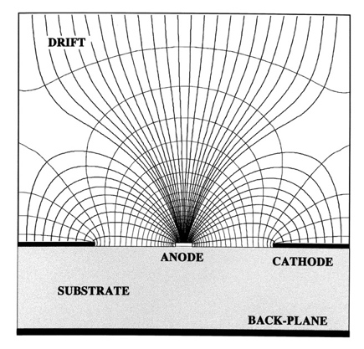
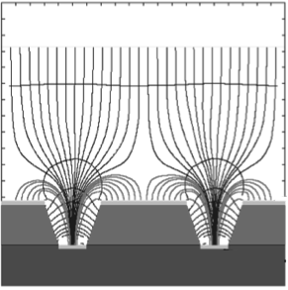
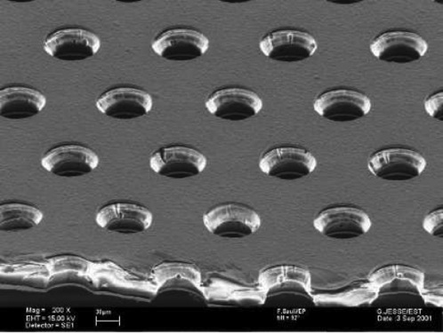
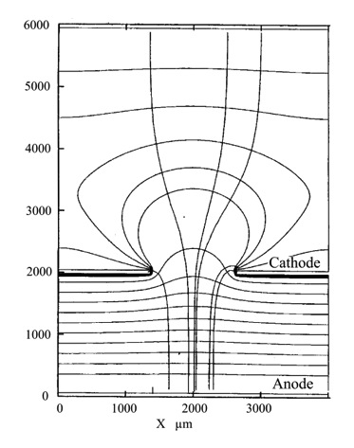
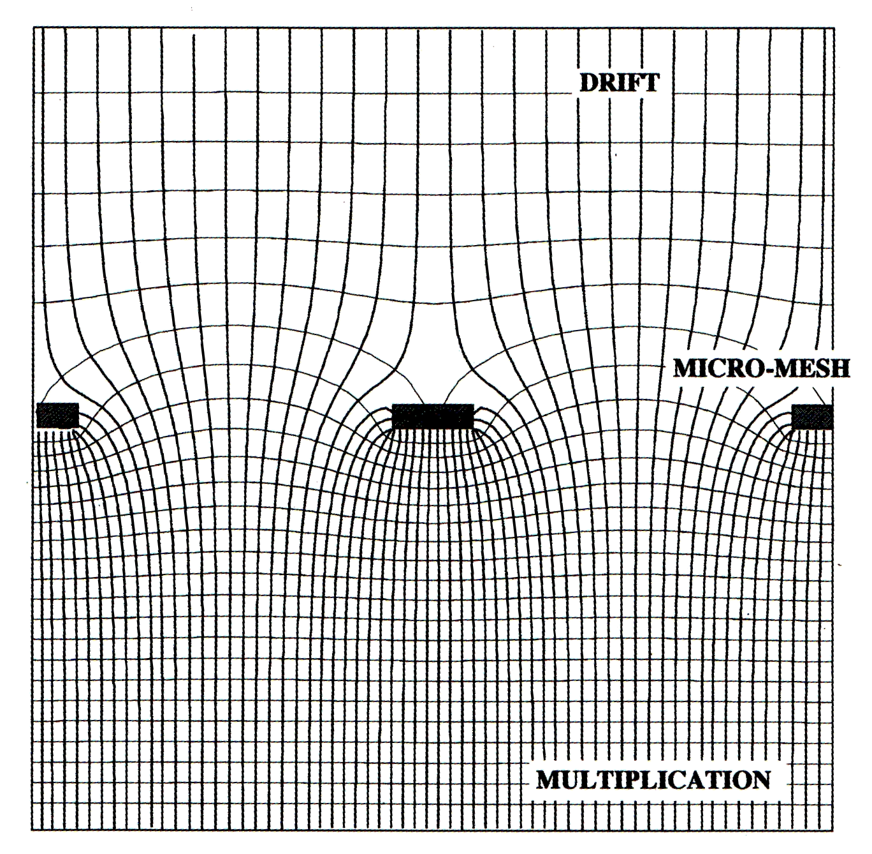
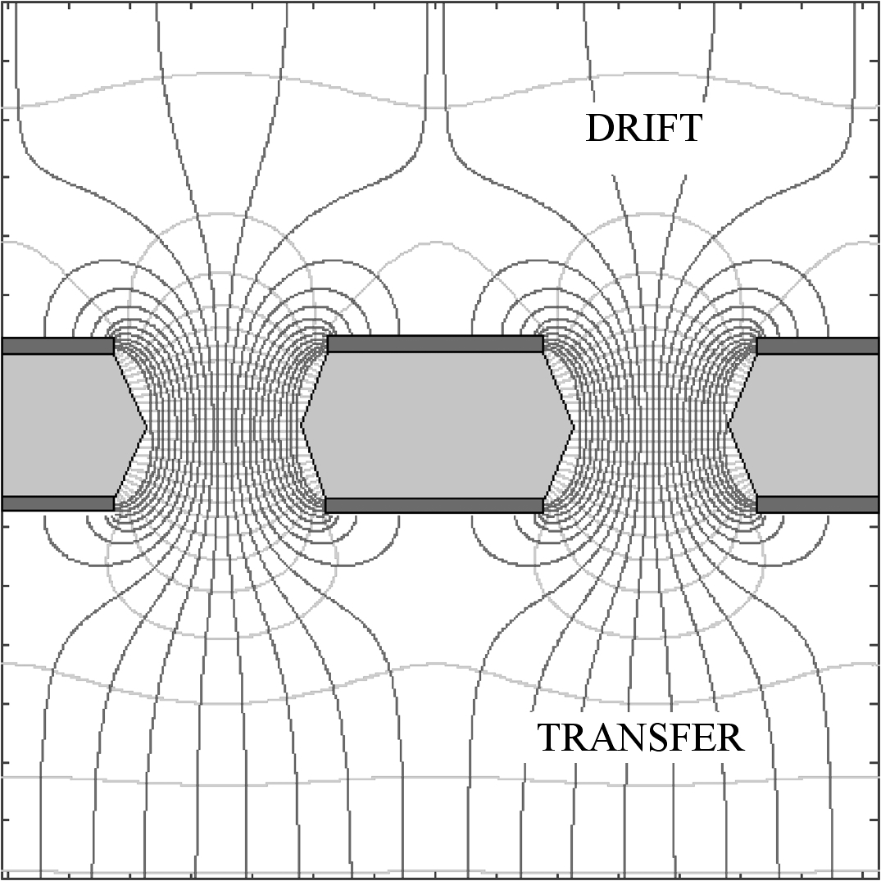
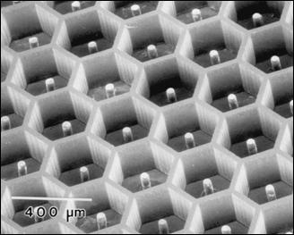
Micro-Pattern Gaseous Detectors
Fabio Sauli
TERA Foundation and CERN
Bethe Forum on Particle Detectors
Bonn, March 31-April 11, 2014

Slide 2
PART 2
MPGD READOUT
OF TIME PROJECTION CHAMBERS

Slide 3
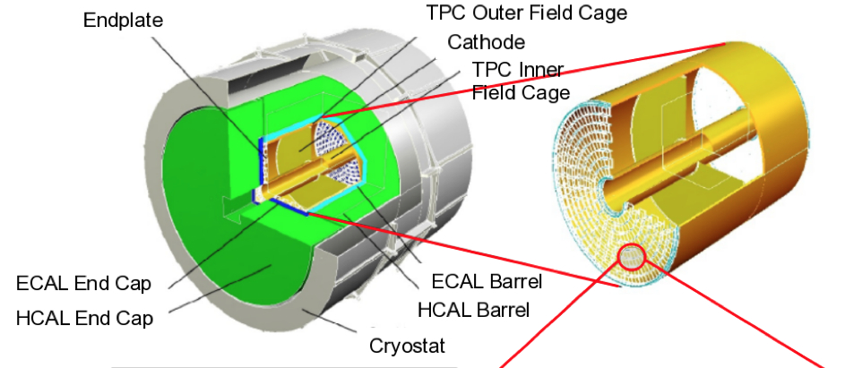
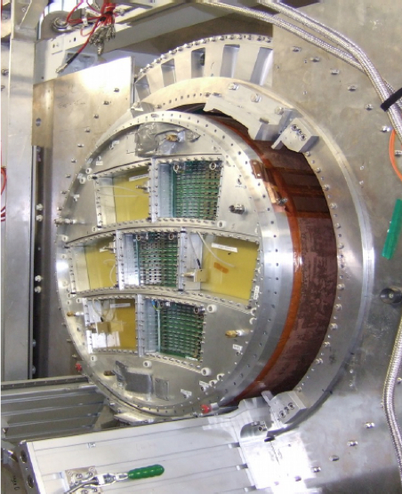
MPGD TPC FOR THE INTERNATIONAL LINEAR COLLIDER
GENERAL PURPOSE END-CAP
FOR PROTOTYPE ASSEMBLY AND TEST

Slide 4
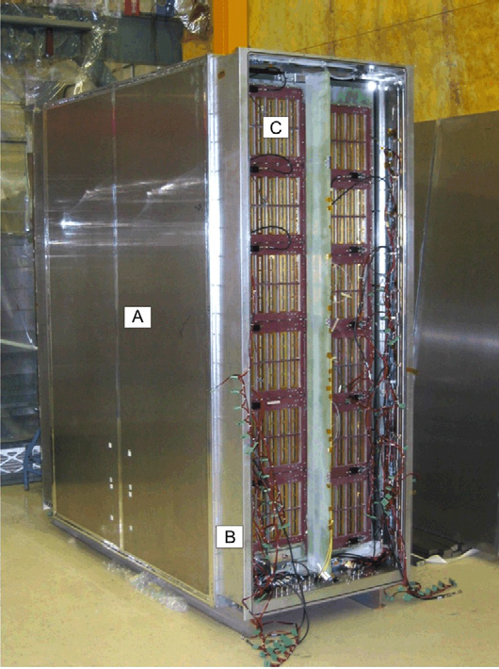
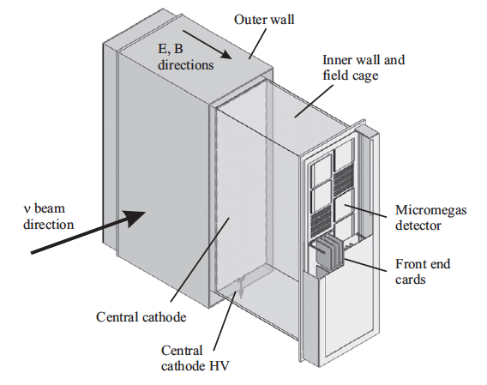
T2K MICROMEGAS TIME PROJECTION CHAMBER
72 MICROMEGAS MODULES (35x36 cm²)
READOUT: 36x48 PADS of 9.7x6.9 mm²
A. Delbart, Nucl. Instr. and Meth. A623(2010)105
N. Abragall et al, Nucl. Instr. and Meth. A637(2011)25

Slide 5
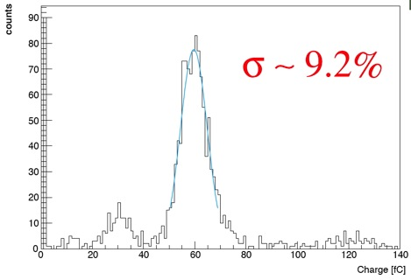
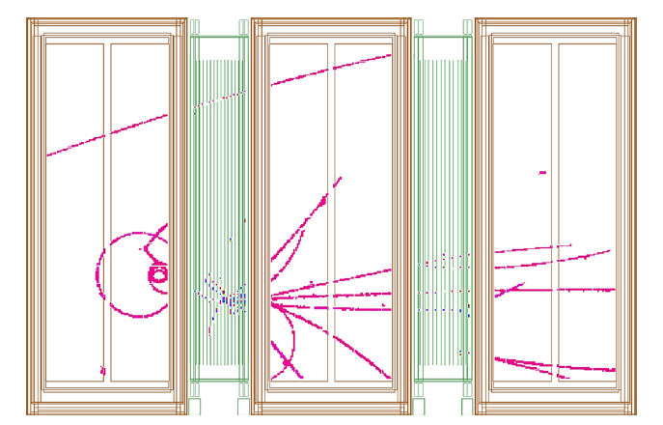
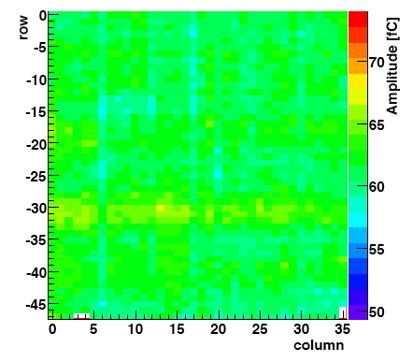
T2K MICROMEGAS TIME PROJECTION CHAMBER
ENERGY RESOLUTION ON ⁵⁵Fe:
GAIN UNIFORMITY
~ 2% RMS
N. Abragall et al, Nucl. Instr. and Meth. A637(2011)25

Slide 6
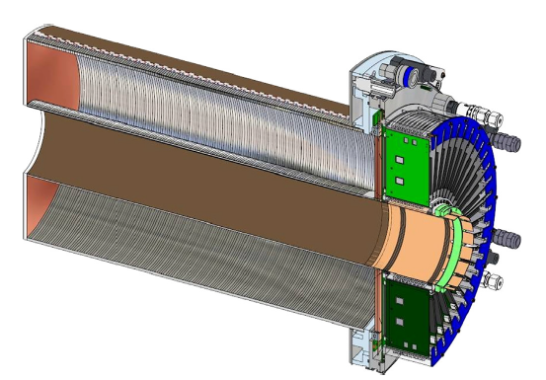
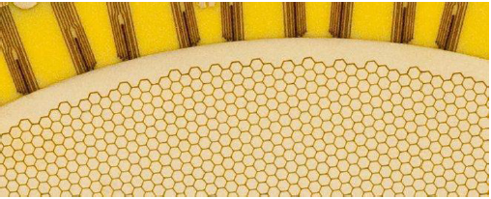
GEM-TPC
FOPI GEM-TPC: PROTOTYPE STUDY FOR THE ALICE TPC UPGRADE
GEM TPC READOUT:
10,254 HEXAGONAL PADS, 3 mm Ø
B. Ketzer, Nucl. Instr. and Meth, A732(2013)237

Slide 7
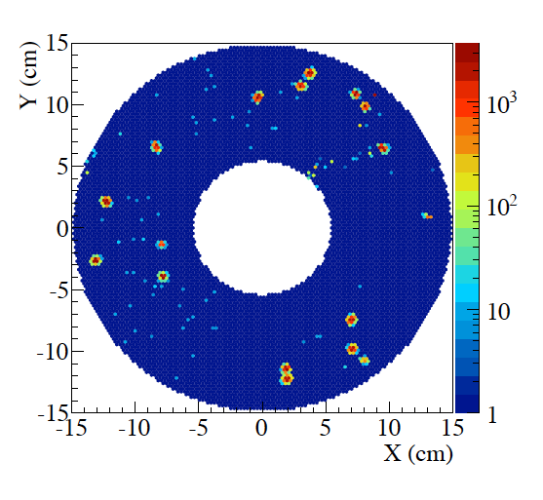
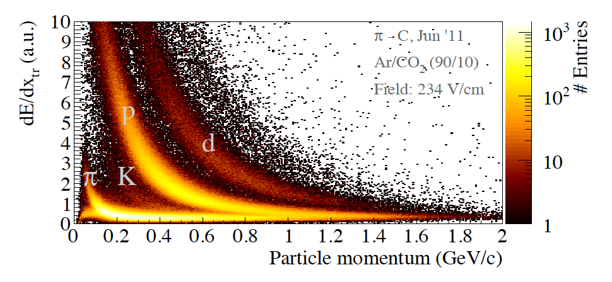
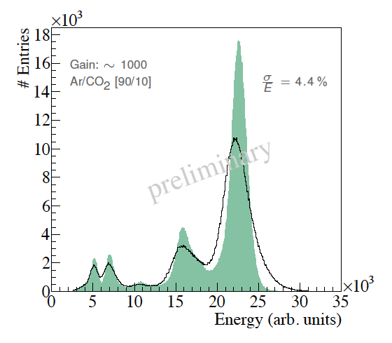
GEM-TPC
FOPI GEM-TPC: ENERGY RESOLUTION
CALIBRATION: ^{83m}Kr SOURCE IN THE GAS VOLUME
dE/dx RESOLUTION IN 0.6 T:
41 KeV
F. Böhmer et al, Nucl. Instr. and Meth. A737(2014)214

Slide 8

MPGDs:
HAVE THEY SOLVED THE MWPC
PROBLEMS?
DISCHARGES AND SPARKING
GAIN REDUCTION AT HIGH RATES
RADIATION DAMAGE (AGING)
POSITIVE IONS BACKFLOW IN TPCs

Slide 9
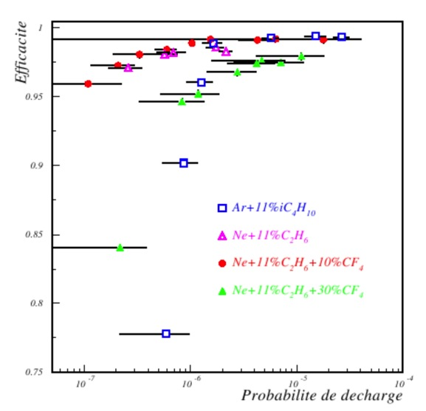
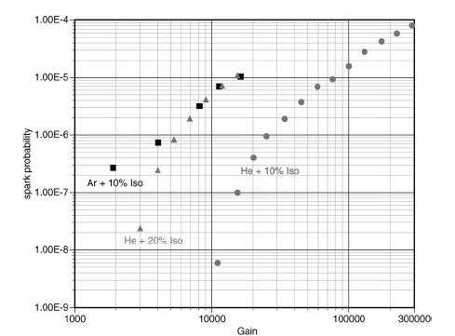
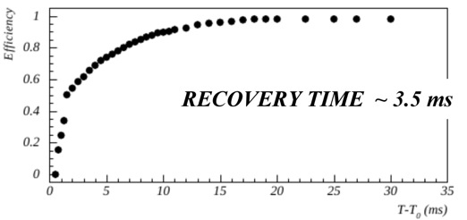
MICROMEGAS SPARK RATE
SPARK PROBABILITY IN HADRON BEAM
1
0.95
0.9
0.85
EFFICIENCY
10⁻⁷ 10⁻⁶ 10⁻⁵ 10⁻⁴
DISCHARGE PROBABILITY
For a gain of 5.10³ , 10⁶ particles s⁻¹:
~ one discharge per second
A. Delbart et al, Nucl. Instr. and Meth. A478(2002)205
A. Bay et al, Nucl. Instr. and Meth. A488(2002)162
D. Neyret, MPGD2009 (Crete, June 12-17, 2009)

Slide 10
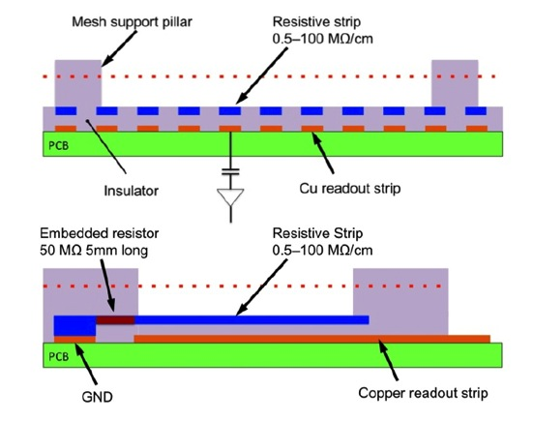
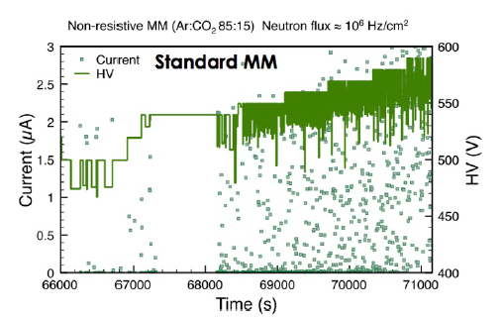
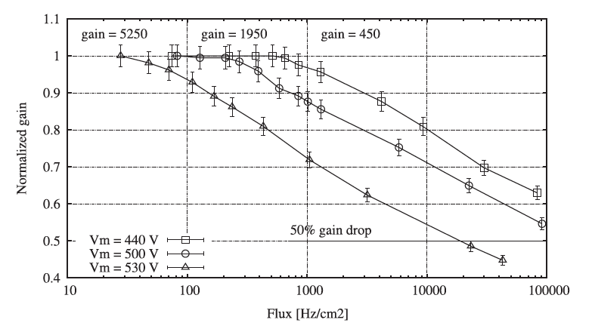
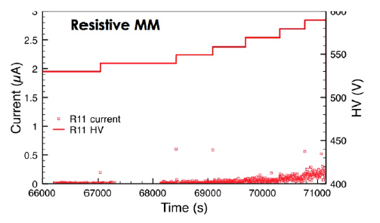
RESISTIVE MICROMEGAS
Spark rates in neutron beam exposure:
Rate capability:
T. Alexopolous et al,
Nucl. Instr. and Meth. A640(2011)110
J. Galán et al, Nucl. Instr. and Meth. A732(2013)229

Slide 11
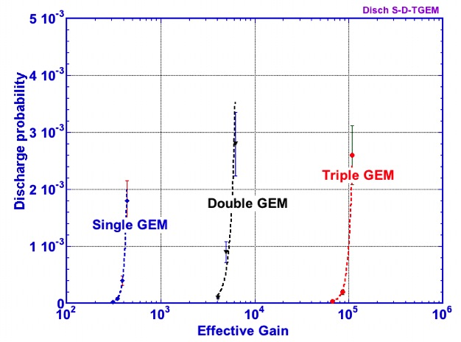
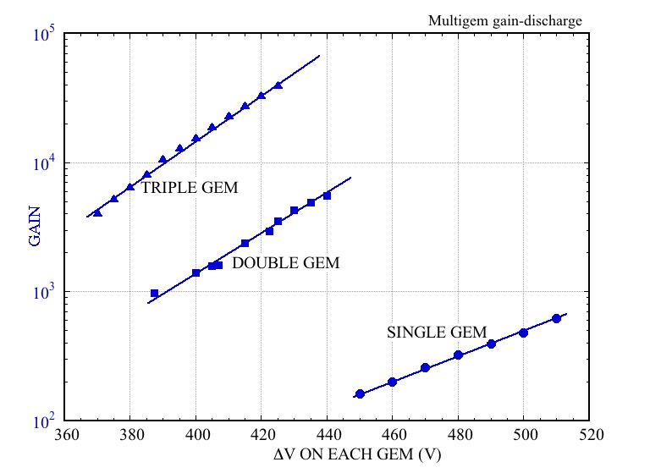
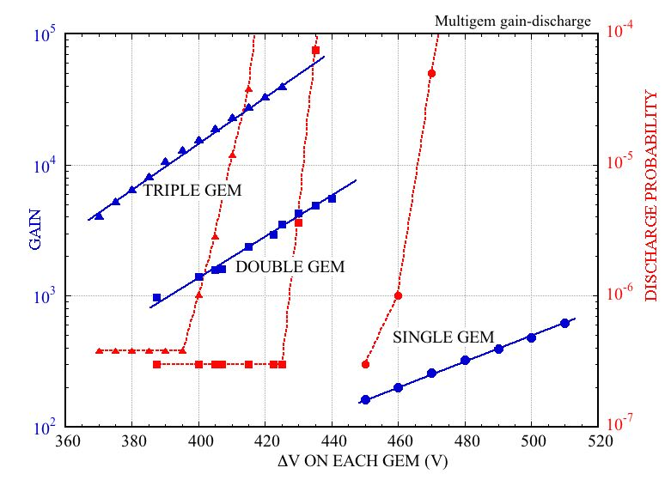
MULTIGEM DISCHARGE PROBABABILITY
GAIN VS VOLTAGE – 5.9 keV
DISCHARGE PROBABILITY VS GAIN:
DISCHARGE RATE ON ~ 5 MeV α
Q~10⁸
Q~10⁹
Q~10⁷
Q~10⁹
Q~10⁷
Q~10⁸
WHAT ABOUT THE RAETHER LIMIT?
S. Bachmann et al,
Nucl. Instr. and Meth. A479 (2002) 294
IN MULTI-GEMS, THE CHARGE SPREADS OVER MANY INDEPENDENT HOLES!

Slide 12
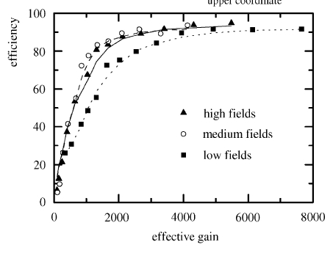
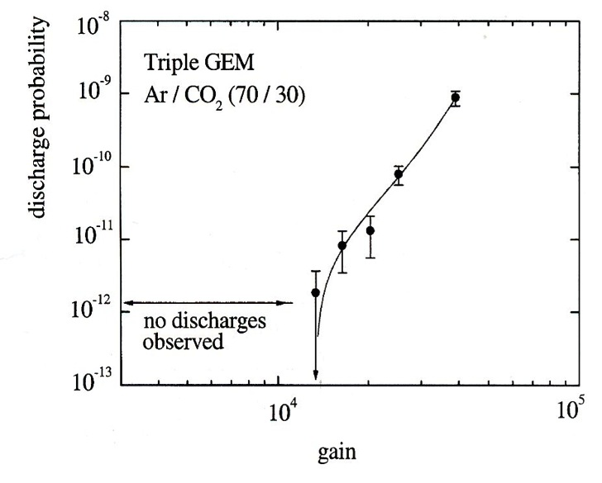
GEM DISCHARGES
COMPASS TRIPLE GEM DETECTOR
EFFICIENCY VS VOLTAGE
DISCHARGE RATE VS GAIN
No discharges in 12 hrs of operation at gain 10⁴
G=10000
S. Bachmann et al,
Nucl. Instr. and Meth. A470(2001)548

Slide 13
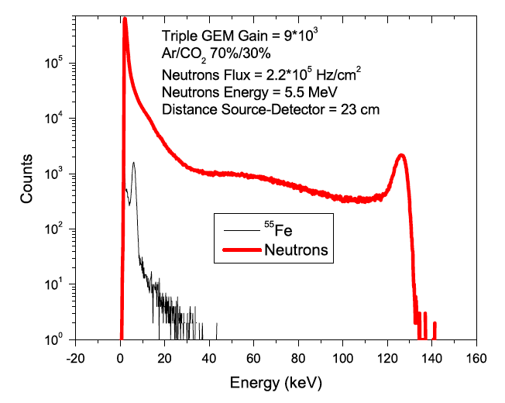
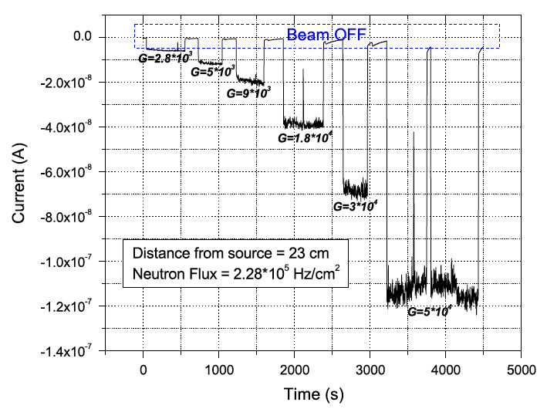
GEM EXPOSURE TO NEUTRONS
10x10 cm² TRIPLE-GEM tested in neutron beam
G. Croci et al, Nucl. Instr. and Meth, A71292013)108

Slide 14
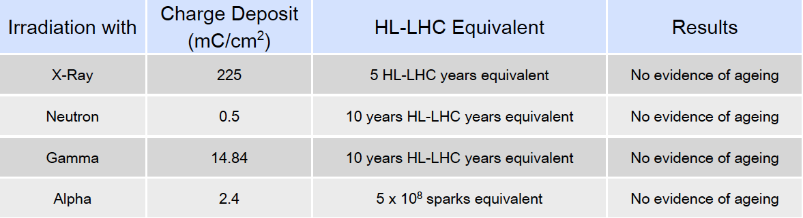
RADIATION HARDNESS: MICROMEGAS
Systematic irradiation of small (10x10 cm²) prototypes:
G. Iakovidis, MPGD 2013
20 C cm⁻²
~ 4 10¹⁴ MIPS cm⁻²
F. Hartjes, MPGD 2009

Slide 15
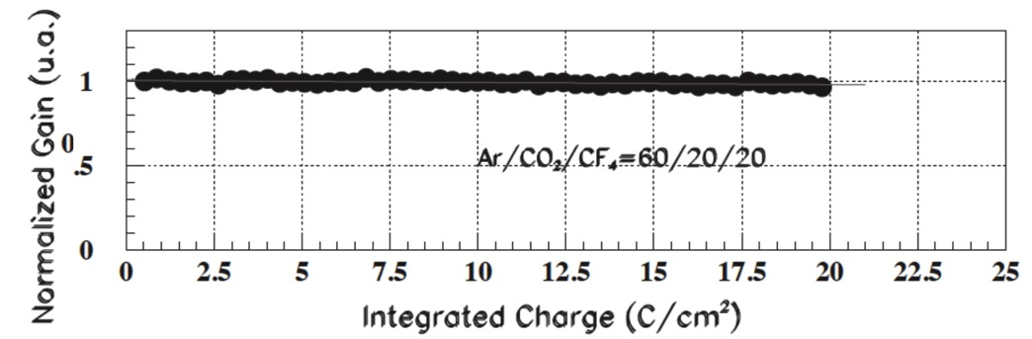
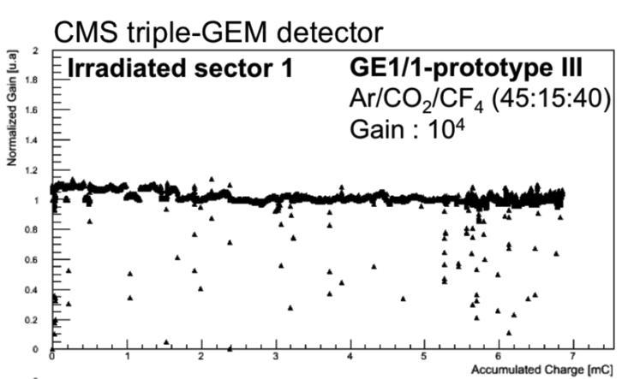
RADIATION HARDNESS: GEM
LHCb Triple-GEM tracker
20 C/cm²
~ 4 10¹⁴ MIPS cm⁻²
M. Alfonsi et al, Nucl. Instr. and Meth. A518(2004)106
CMS Muon Upgrade Triple-GEM
Exposed at the Gamma Irradiation Facility (GIF) at CERN
7 mC/cm²
D. Abbaneo et al, JINST 9(2014)C01053

Slide 16
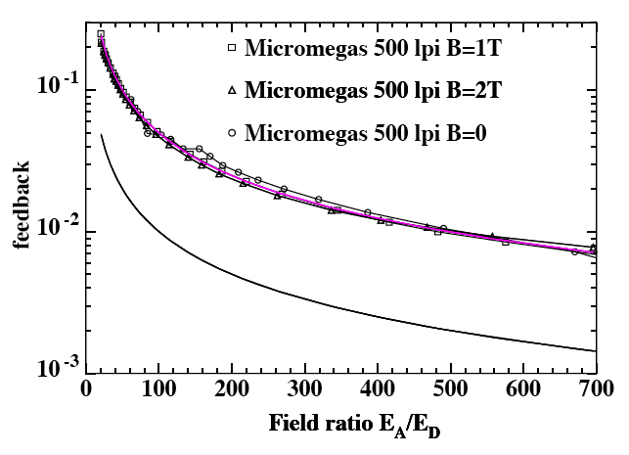
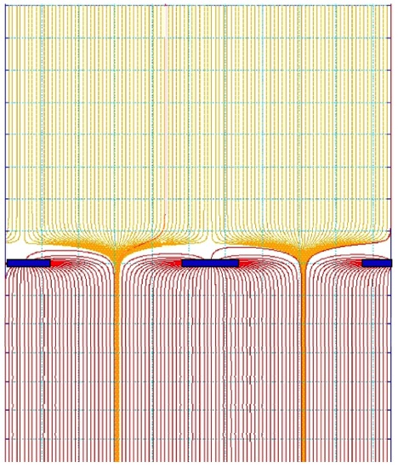
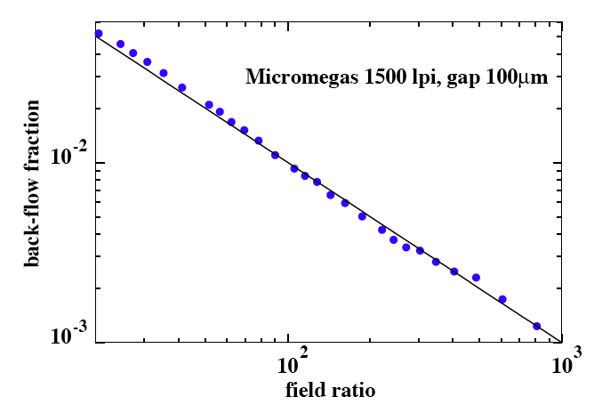
POSITIVE IONS BACKFLOW (IBF): MICROMEGAS
(MWPC-TPC: IBF~30%)
MICROMEGAS:
5%
The ions backflow depends on avalanche spread but cannot be smaller than the field ratio:
1%
FIELD RATIO
E_{D}
1%
E_{A}
Ar-CH₄ 97-3
P. Colas et al, Nucl. Instr. and Meth. A535(2004)226
E_{A}/E_{D}

Slide 17
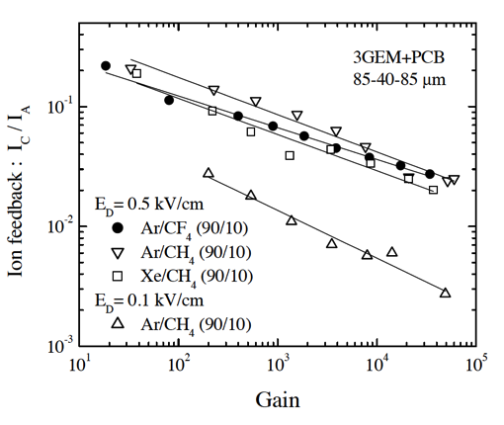
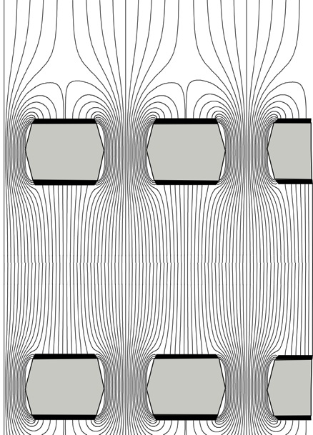
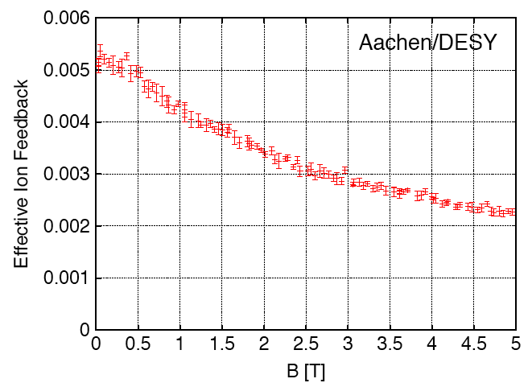
POSITIVE IONS BACKFLOW: GEM
IBF IN MULTIGEM DETECTORS
GAS:
The fractional ion backflow detectors results from a complex interplay of geometry, fields, diffusion:
5 10⁻³
A. Bondar et al, Nucl. Instr. and Meth. A496(2003)325
MAGNETIC FIELD:
THE WISH:
2 10⁻³
M. Killenberg et al, Nucl. Instr. and Meth. A530(2004)251

Slide 18
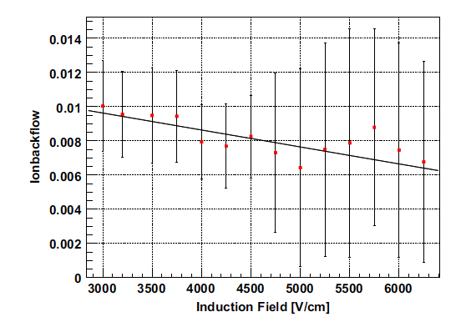
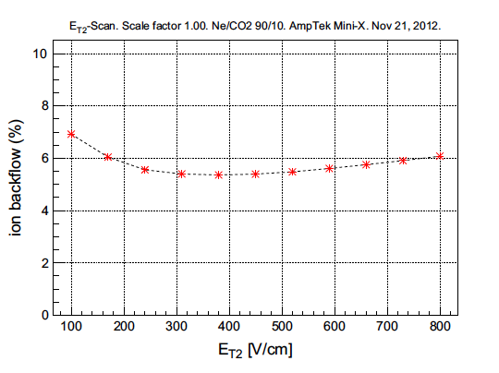
POSITIVE IONS BACKFLOW: GEM
GAS DEPENDENCE OF THE IBF
Ar-CO₂ 70-30: ~ 0.8%
Ne-CO₂ (ALICE): ~ 5%
B. Ketzer et al, Nucl. Instr. and Meth. A732(2013)237

Slide 19
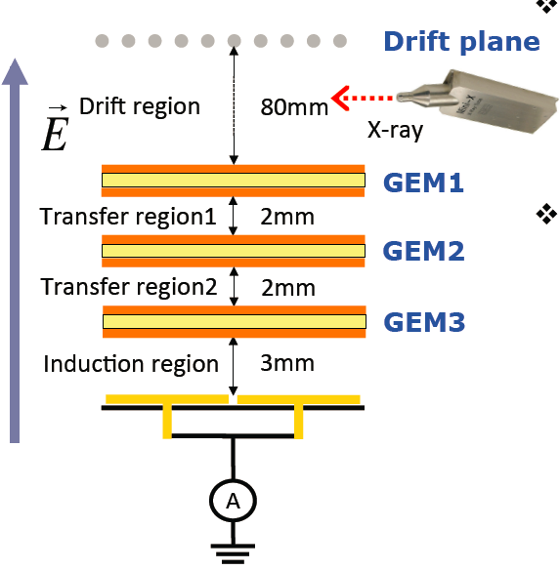
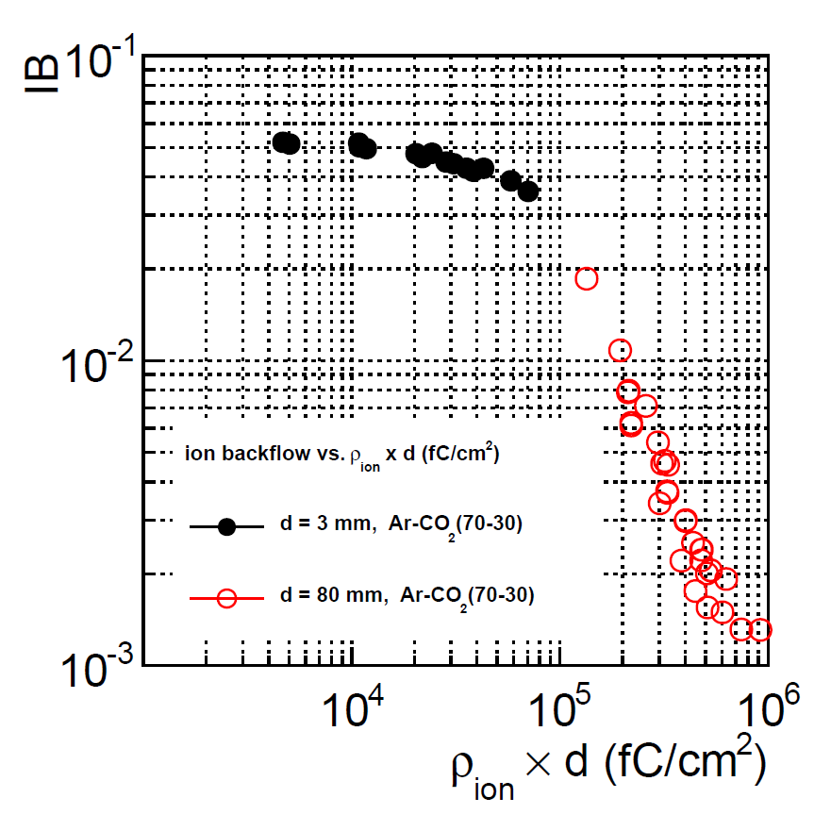
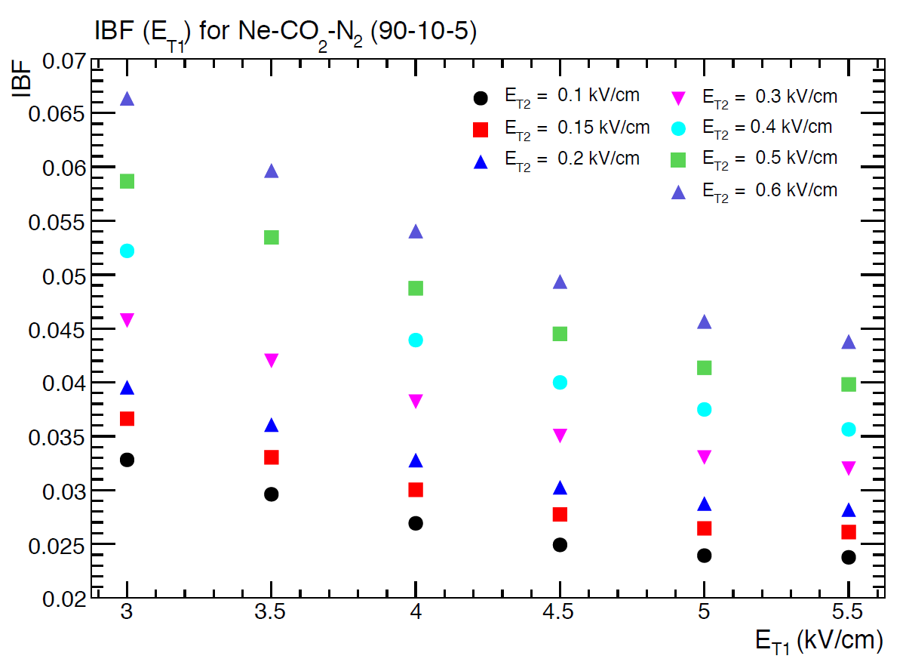
RATE DEPENDENCE OF IBF
MULTIGEM DETECTORS
RATE (CHARGE DENSITY) DEPENDENCE:
Ar/CO₂ (70/30)
ALICE UPGRADE STUDIES
B. Ketzer
INSTR2014 Novosibirsk

Slide 20
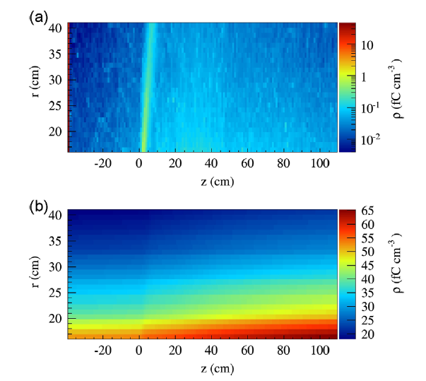
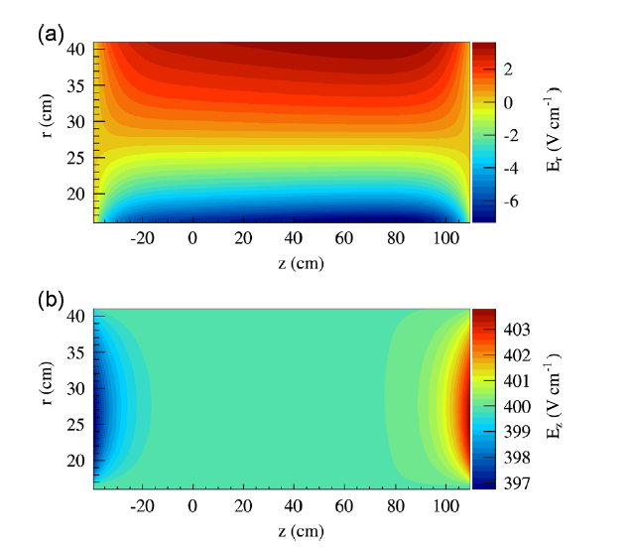
POSITIVE IONS: SPACE CHARGE DISTORTIONS
SIMULATION STUDIES FOR PANDA
2 10⁷ p-p ANNIHILATIONS
TRIPLE GEM OPERATED IN Ne-CO₂ 90-10
GAIN M=2000 IBF 2.5 10⁻³ (M⁻¹=0.5 10⁻³ )
SPACE CHARGE DENSITY
ELECTRIC FIELD DISTORTIONS
F.W. Bohmer et al,Nucl. Instr. and Meth. A719(2013)101

Slide 21
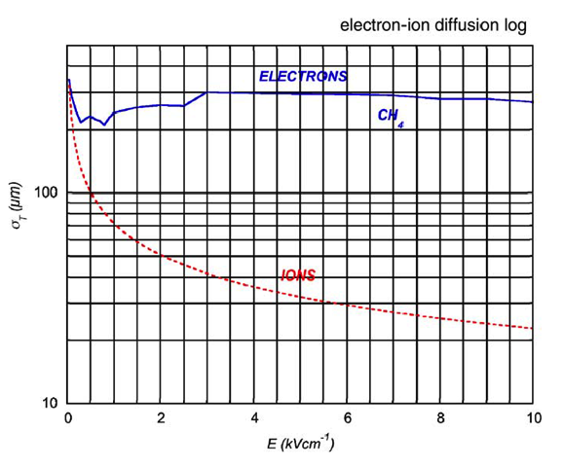


NEW APPROACHES FOR IBF REDUCTION: GEM
EXPLOIT THE DIFFERENCE BETWEEN IONS AND ELECTRONS DIFFUSION IN AN OFFSET DOUBLE THICK-GEM
F. Sauli et al,
Nucl. Instr. and Meth. A560(2006)269

Slide 22


NEW APPROACHES FOR IBF REDUCTION: MICROMEGAS
MICROMEGAS WITH OFFSET METAL MESHES:
10⁻⁵
F. Jeanneau et al, Nucl. Instr. and Meth. A623(2010)94
OPEN PROBLEMS:
LARGE AREAS?
EFFECT OF MAGNETIC FIELD?
REALISTIC TPC GAS?
NEW IDEAS WELCOME!

Slide 23

MPGD APPLICATIONS

Slide 24


UV PHOTON DETECTION
REFLECTIVE CsI PHOTOCATHODE COATING
RELATIVE QUANTUM EFFICIENCY AS A FUNCTION OF EXTRACTION FIELD:
E_{DRIFT} ~ 0
CsI LAYER
e
D. Mormann et al,
Nucl. Instr. and Meth. A478(2002)230
A. Breskin et al,
Nucl. Instr. and Meth. A483(2001)670

Slide 25


PHENIX HADRON BLIND DETECTOR
Protons
e⁺
e⁻
E
C. Aidala et al, Nucl. Instr. and Methods A502(2003)200
Z. Fraenkel et al, Nucl. Instr. and Methods A546(2005) 466

Slide 26



PHENIX HDB CONSTRUCTION
TRIPLE-GEM MODULES 268x221 mm²
HEXAGONAL PADS READOUT
GAS FILLING: PURE CF₄
HADRONS
ELECTRONS
W. Anderson et al,
Nucl. Instr. and Meth. A645(2011)35

Slide 27



CHERENKOV RING IMAGING
COMPASS RICH-1 UPGRADE
TRIPLE-THICK GEM CsI-COATED 30x30 cm²
TEST BEAM: SINGLE EVENT
EVENTS OVERLAP:
M. Alexeev et al, Nucl. Instr. and Meth. A732(2013)264

Slide 28



OPTICAL IMAGING CHAMBERS
GEM SCINTILLATION
Monochromator
EMISSION SPECTRUM:
PHOTON YIELD/ELECTRON
He-CF₄ (60-40)
M.M.F. Fraga et al, Nucl. Instr. and Meth. A504(2003)88

Slide 29




OPTICAL IMAGING CHAMBERS
GEM-BASED OPTICAL TPC
LIGHT YIELD OF END-OF RANGE 5.48 MeV α:
NEUTRON INTERACTIONS IN ³He
F.A.F. Fraga et al,
Nucl. Instr. and Meth. A478(2002)357
L.M.S. Margato et al,
Nucl. Instr. and Meth. A535(2002)231

Slide 30



OPTICAL IMAGING CHAMBERS
DOSE MEASUREMENT IN HADROTHERAPY
BRAGG PEAK:
COLLIMATED BEAM PROFILE
A.V. Klyaxhko et al,
Nucl. Instr. and Meth. A694(2012)271

Slide 31


MPGD NEUTRON DETECTORS
CASCADE
¹⁰B-COATED GEM ELECTRODES
M. Klein and Ch. Schmidt,
Nucl. Instr. and Meth. A628(2011)9

Slide 32


MPGD NEUTRON DETECTORS
CASCADE
EXAMPLE OF NEUTRON RADIOGRAPHY
M. Klein and Ch. Schmidt,
Nucl. Instr. and Meth. A628(2011)9

Slide 33


MPGD NEUTRON DETECTORS
bGEM: Aluminum foil cathode coated with 1 µm of Boron Carbide
n
¹⁰B(n,α)⁷Li
α
2-D THERMAL NEUTRON BEAM PROFILE
G. Croci et al, Nucl. Instr. and Meth. A732(2013)217

Slide 34



DUAL-PHASE MPGDs
EXTRACTION PROBABILITY
IONIZATION ELECTRONS ARE EXTRACTED FROM THE LIQUID, AMPLIFIED AND DETECTED
CRYOGENIC Triple-GEM GAIN
A. Bondar et al, Nucl. Instr. and Meth. A556(2006)273

Slide 35


DUAL-PHASE MPGDs
LIQUID ARGON TPC
LARGE ELECTRON MULTIPLIER (LEM)
MUON TRACK IN THE LEM-TPC
A. Badertscher et al, Nucl. Instr. and Meth. 641(2011)48

Slide 36

GAS MEETS SILICON

Slide 37


THE ULTIMATE MPGD: SILICON PIXELS READOUT
DEDICATED ASIC WITH PIXEL READOUT
~ 10⁵ HEXAGONAL PIXELS AT 50 µm PITCH
HIGH GRANULARITY GEM, 50 µm PITCH
6 KeV PHOTOELECTRON:
1 mm²
E. Costa et al, Nature 411(2001)662
R. Bellazzini et al, Nucl. Instr. and Meth. A572(2007)160

Slide 38




THE ULTIMATE MPGD-TPC
MICROMEGAS OR GEM BUILT OVER A SILICON PIXEL READOUT:
INGRID, GRIDPIX, …..
ELECTRON TRACKS FROM ⁹⁰Sr IN MAGNETIC FIELD (0.2 T):
H. Van der Graaf, Nucl. Instr. and Meth. A628(2011)27
Harry van der Graaf
Lectures

Slide 39

WAT’S NEXT?
THIS IS UP TO YOU!

Slide 40

AND IF YOU WANT TO KNOW MORE…
… COMING SOON
THANKS FOR YOUR ATTENTION

