Slide 1
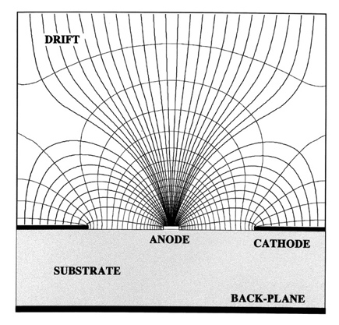
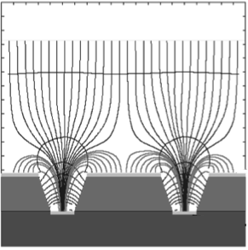
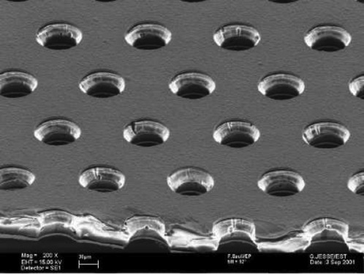
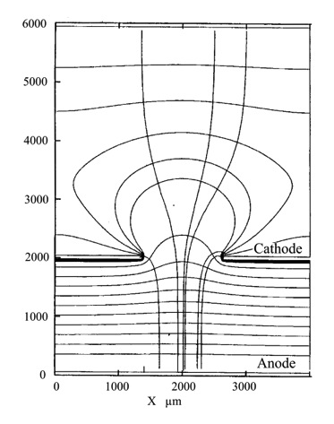
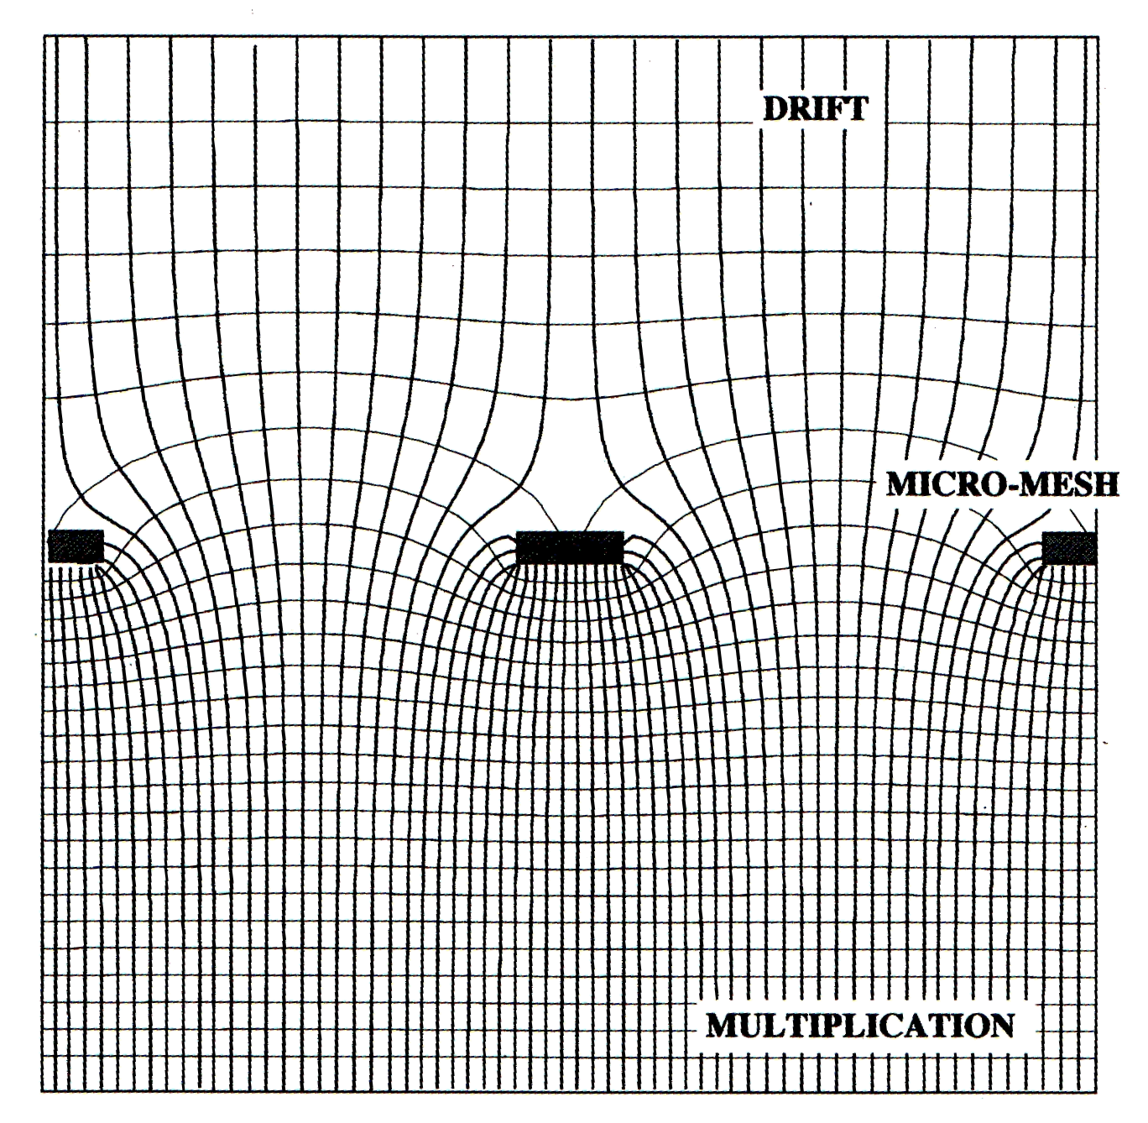
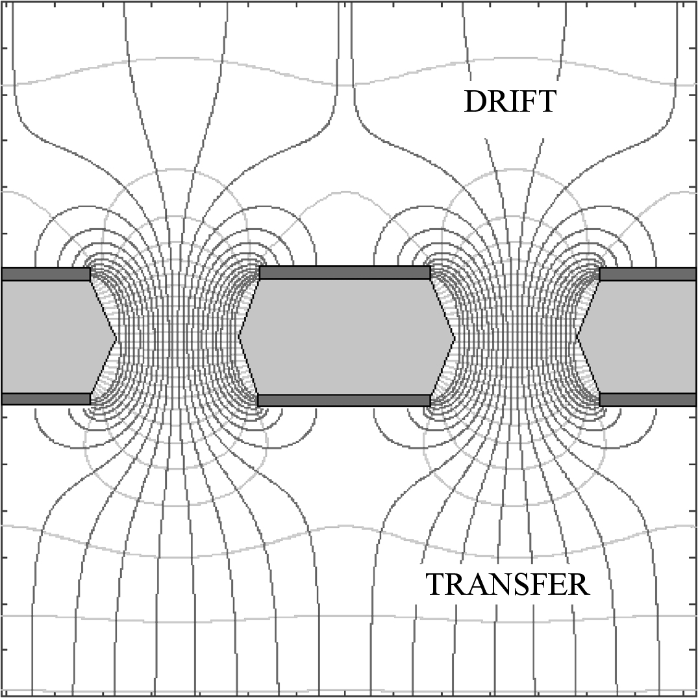
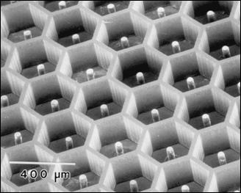
Micro-Pattern Gaseous Detectors
Fabio Sauli
TERA Foundation and CERN
Bethe Forum on Particle Detectors
Bonn, March 31-April 11, 2014

Slide 2
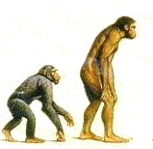
PART 1
THE ANCESTORS

Slide 3
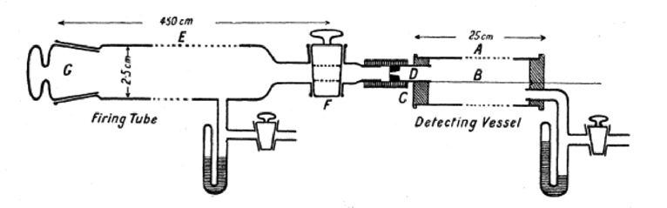
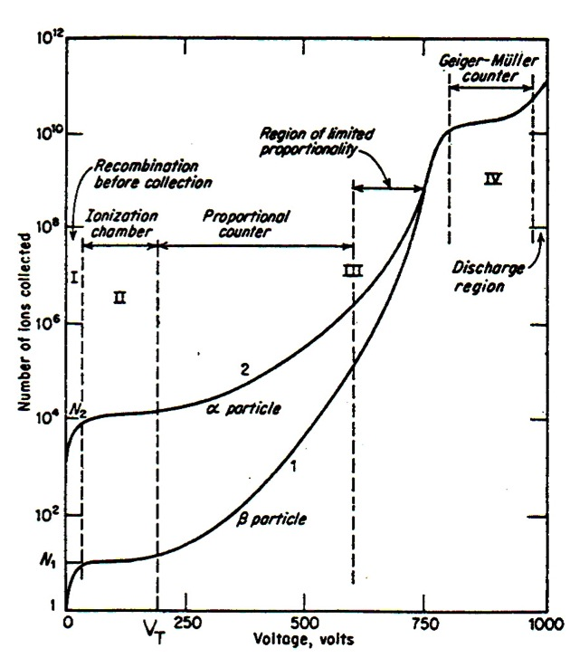
HISTORICAL BACKGROUND
The first proportional counter:
Charge-voltage characteristics:
E. Rutherford and H. Geiger,
Proc. Royal Soc. A81(1908)141
Thin anode wire centered in a cylindrical cathode:
Charge
Collection
Charge
Multiplication
G.C. Montgomery and D.D. Montgomery
J. Franklin Inst. 231(1941)447

Slide 4
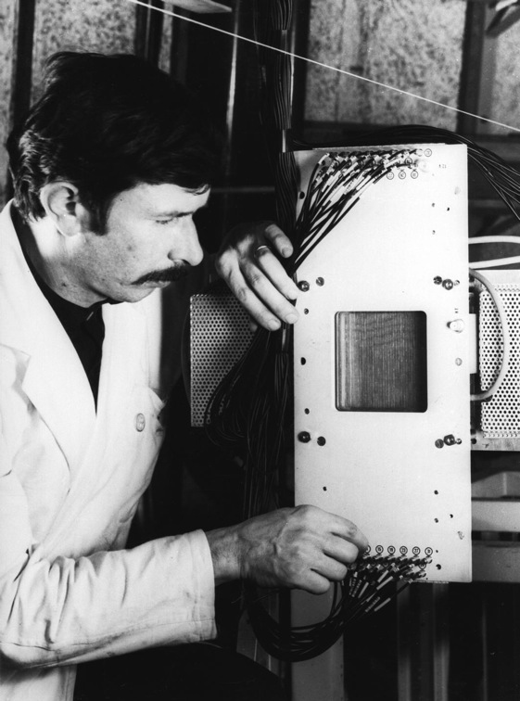
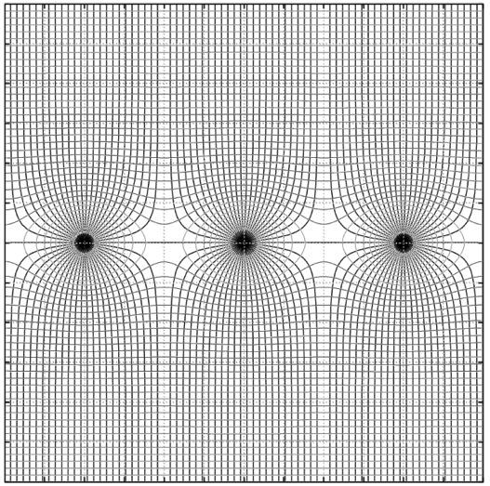
MULTIWIRE PROPORTIONAL CHAMBERS (MWPC)
Georges Charpak (1968)
The first MWPC (10x10 cm²)
Grid of thin anode wires between two cathode planes:
Roger Bouclier
G. Charpak et al, Nucl. Instr. and Meth. 62(1968)262

Slide 5

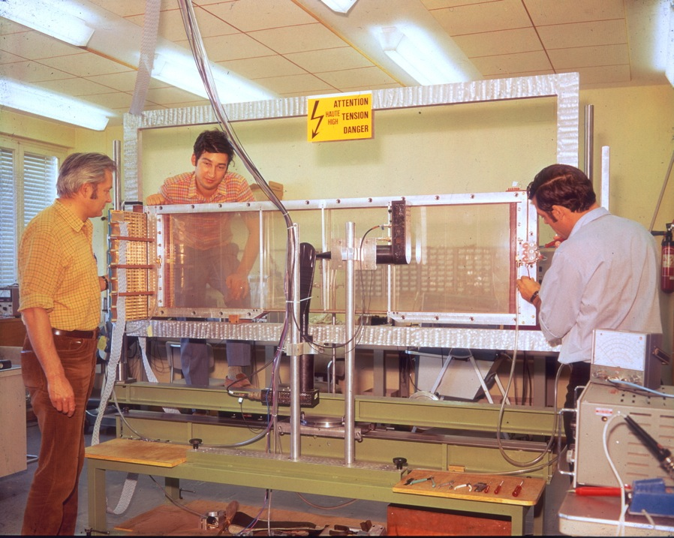
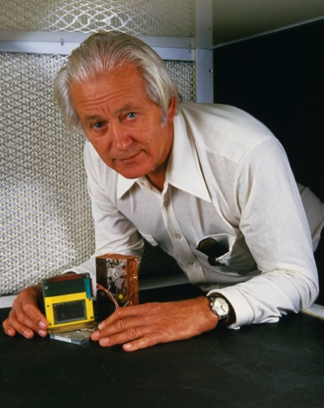
EARLY LARGE MWPC (1970)
Prototype for the Split Field Magnet detector
1992
Georges Charpak
1992 Nobel Laureate for Physics
Santiard
Sauli
Charpak
G. Charpak et al, Nucl. Instr. and Meth. 97(1971)377

Slide 6
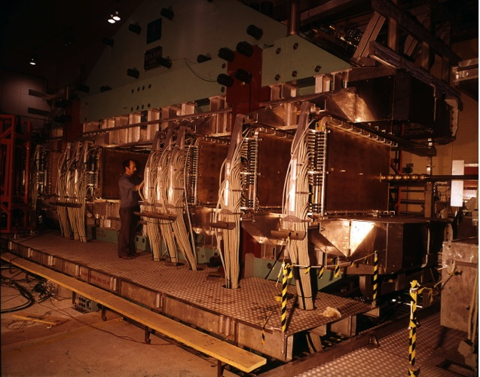
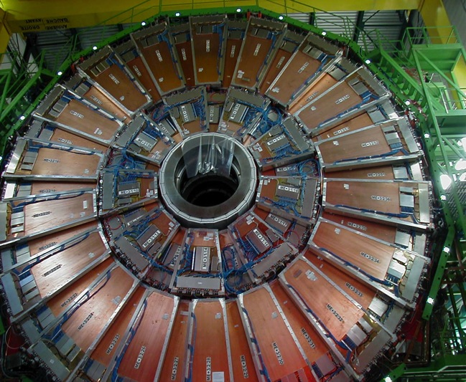
MWPC-BASED LARGE TRACKING DETECTORS
SPLIT FIELD MAGNET (1973)
40 large MWPCs
CMS muon end-cap detectors (2007)
~ 2000 Cathode Strip Chambers
R. Bouclier et al,
Nucl. Instr. and Meth. 115 (1974)235
D. Acosta et al,
Nucl. Instr. and Meth. 453(2000)182

Slide 7
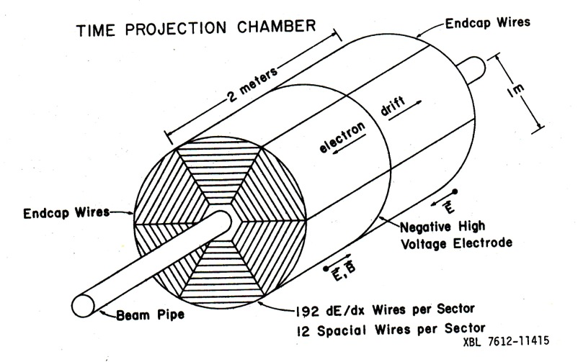
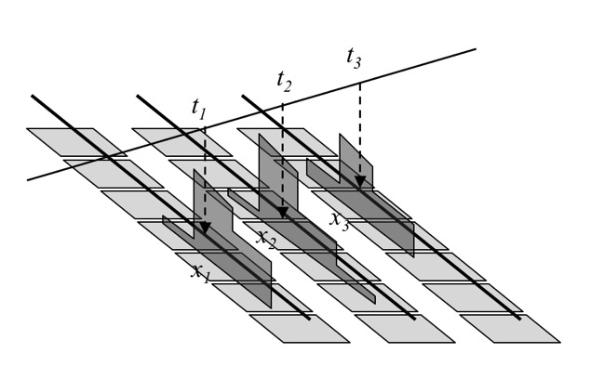
TIME PROJECTION CHAMBER (TPC)
David Nygren, 1976
Full 3-D localization:
x: Anode wire
y: Center of Gravity (COG) on charge induced on Pad Rows
z: Drift Time
D. Nygren and J, Marx, Phys. Today 31 (1978) 46

Slide 8
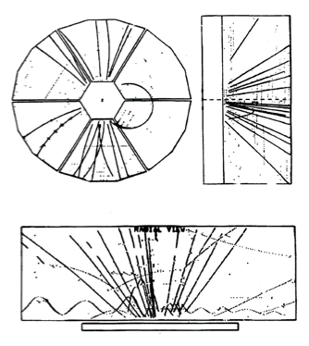
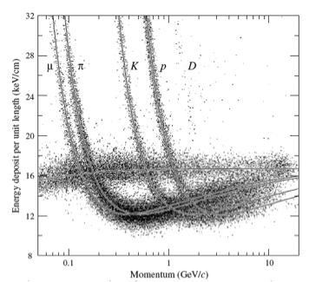
PEP-4 TPC AT SLAC
3-D Tracking:
Particle Identification from dE/dx:
PEP4 TPC, D. Nygren personal communication

Slide 9
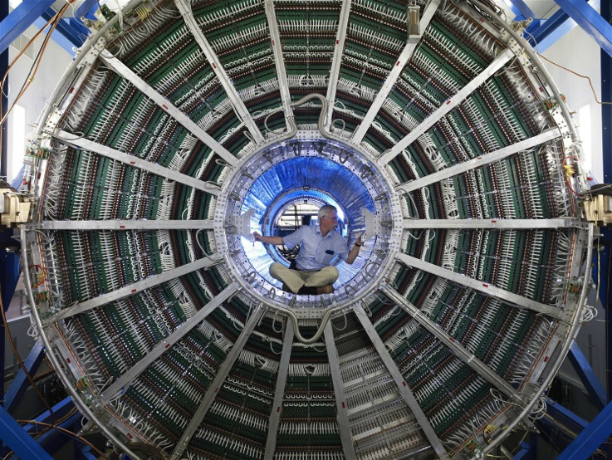
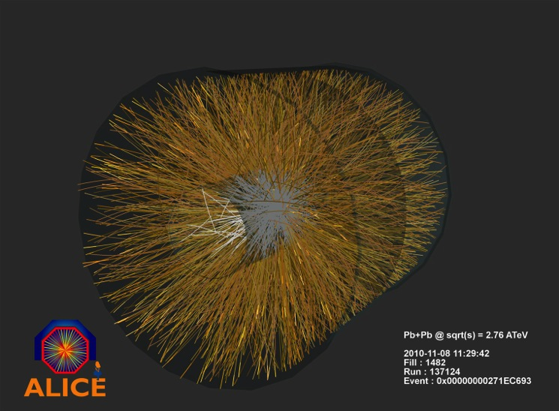
ALICE TPC AT CERN LHC (2007)
5 m Ø - ~ 100 m³
Pb-Pb interaction at 2.76 TeV:
J. Alme et al,
Nucl. Instr. and Meth. A622(2010)316

Slide 10

WIRE CHAMBER
LIMITATIONS

Slide 11
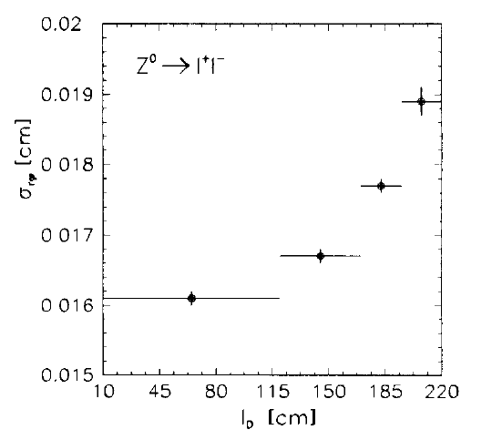
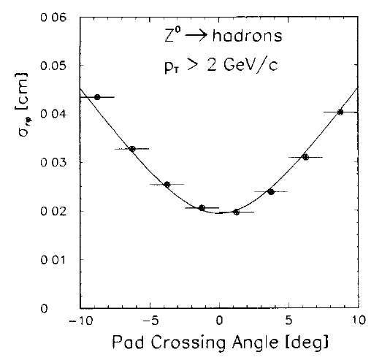
LOCALIZATION ACCURACY
Z: Drift time
electrons diffusion
ACCURACY VS DRIFT LENGTH
200 µm
Y: Wire spacing
~ 5 mm
X: COG on Pad rows
ACCURACY VS ANGLE
160 µm
500 µm
200 µm
W. Atwood et al,
Nucl. Instr. And Meth. A306(1991)446

Slide 12
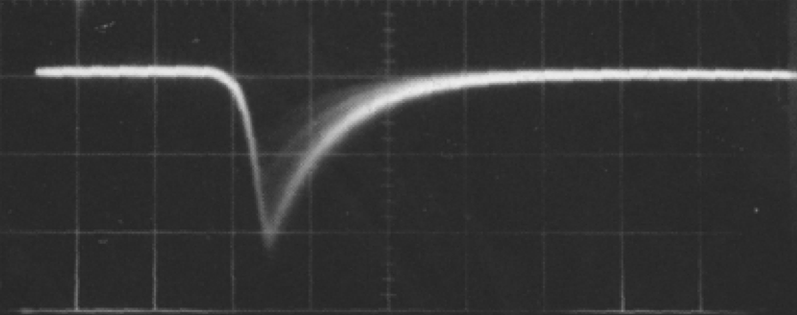
VOLUME RESOLUTION
Z: Drift time
Signal width ~ 200 ns
ΔZ ~ 10 mm
Y: Wire spacing
ΔY ~ 10 mm
X: Charge induction on pad rows:
ΔX ~ 10 mm
Volume resolution
ΔV~ 50 mm³
8 mm
-8
-4
0
4
8 mm

Slide 13
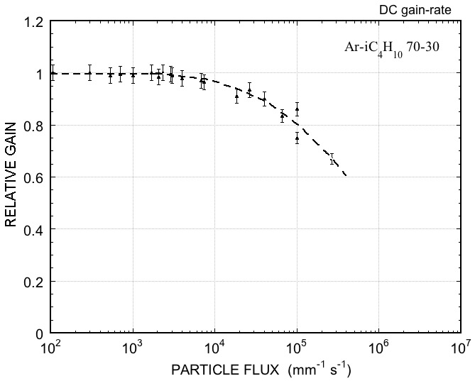
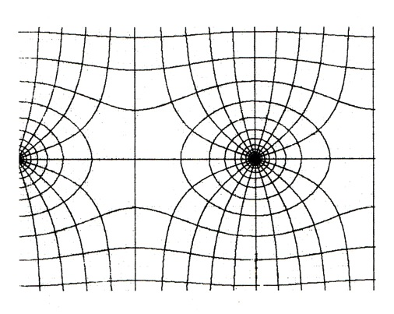
RATE-DEPENDENT GAIN REDUCTION
Space charge near the anode:
Slow Positive Ions buildup modifies the electric field
Relative gain as a function of rate:
e⁻
~ 100 ns
I⁺
~ 100 µs
~ 10⁴ mm⁻¹s⁻¹
A. Breskin et al, Nucl. Instr. and Meth. 124(1974)189

Slide 14
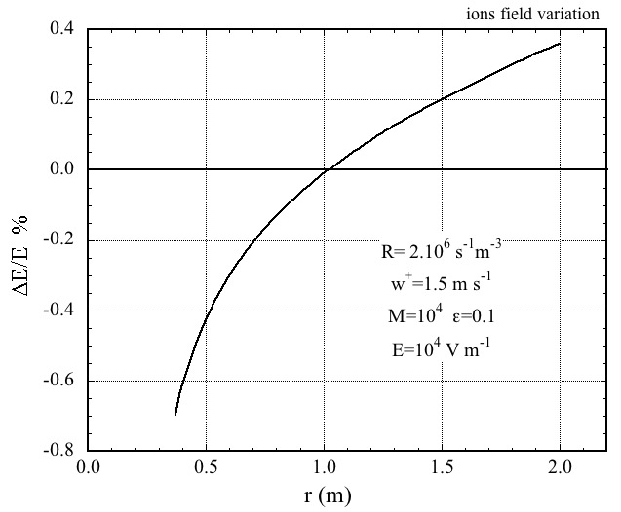
POSITIVE IONS BACKFLOW
SLOW POSITIVE IONS ACCUMULATE IN THE DRIFT VOLUME AND MODIFY THE FIELD RESULTING IN TRACKS DISTORTIONS:
PERCENTAGE DRIFT FIELD MODIFICATION (ALEPH MWPC-TPC)
I_{D}
I_{A}
GATING:
ADD A WIRE MESH WITH VOLTAGE-CONTROLLED TRANSPARENCY
ION BACKFLOW FRACTION:
DRIFT CURRENT/ANODE CURRENT
ONLY POSSIBLE AT SMALL RATES:
Max electron drift time
< Time between events
MWPC-TPC TYPICAL: IBF~30%

Slide 15
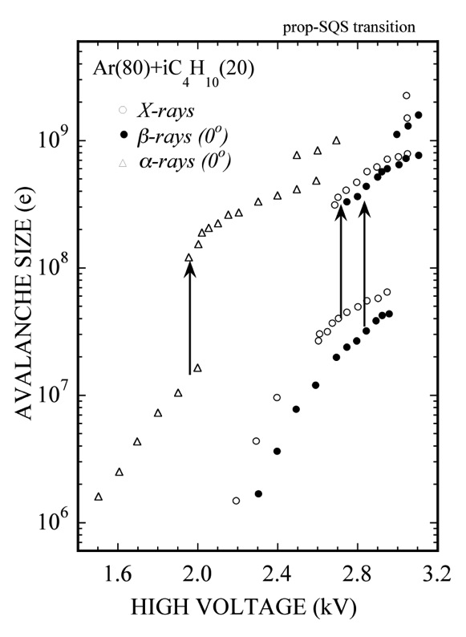
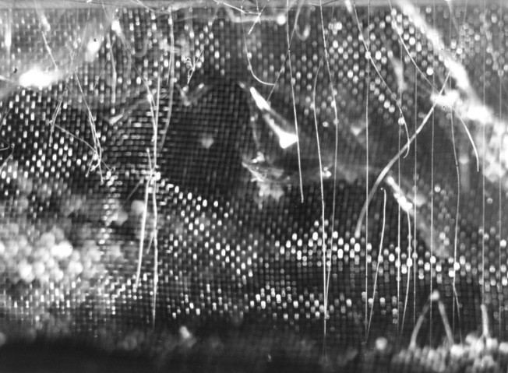
DISCHARGES AND BREAKDOWN
High gains: Transition from proportional amplification to streamer and/or breakdown
Spark damages in MWPCs:
Fabio’s Museum of Horrors
N. Koori et al, Jap. J. Appl. Phys. 25(1986)986

Slide 16
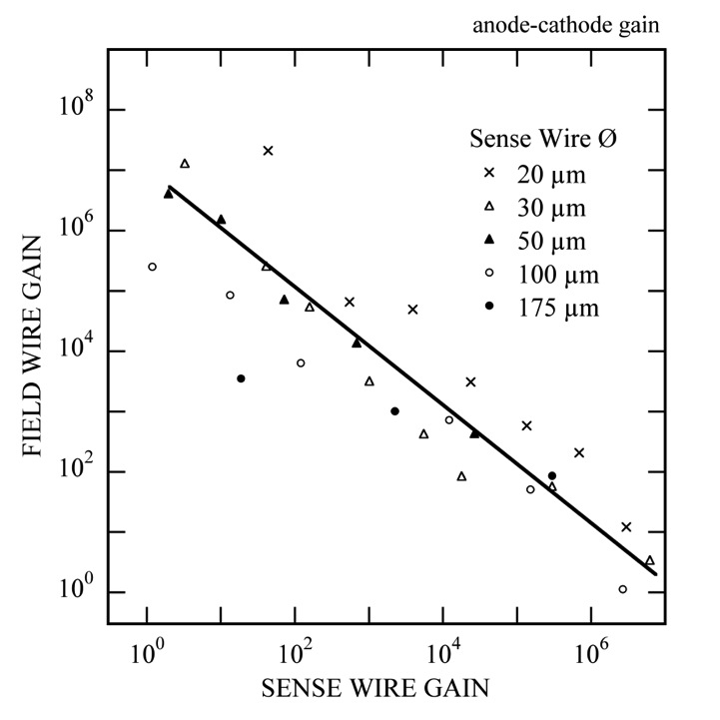
THE RAETHER LIMIT
Maximum avalanche size before transition or breakdown:
Q_{MAX}=(Primary ionization)x(Gain) ~ 10⁷ e
Typical proportional gain ~ 10⁴
Fast particles ΔE ~ 2 keV:
Q=(100)x(10⁴)=10⁶
Neutrons ΔE ~ 2 MeV
Q=(10⁵)x(10⁴)=10⁹
Multiwire structures:
Cathode pre-amplification of field emitted electrons
10³
M_{C}
M_{A}
10⁴
M=M_{C} x M_{A}
P. Giubellino et al, Nucl. Instr. and Meth. A245(1986)155

Slide 17
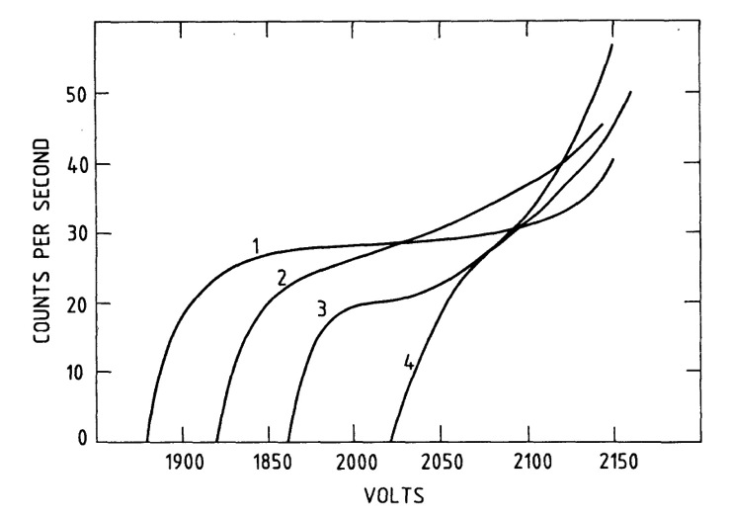
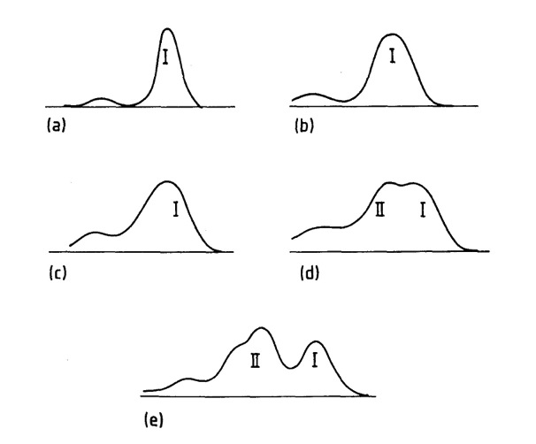
GASEOUS COUNTERS AGING UNDER IRRADIATION
Counting rate plateau degradation after long term irradiation:
Gradual loss of the energy resolution:
T=0
~ 10⁸ counts
E. Farmer and S. Brown, Phys. Rev. 74(1948)902

Slide 18
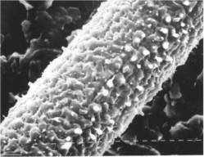
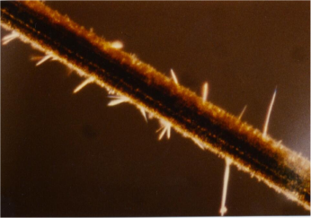
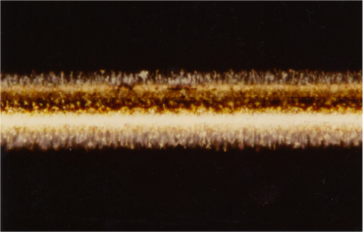
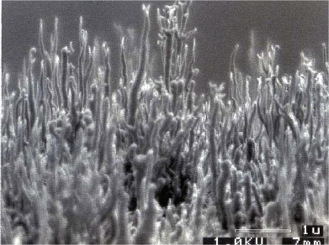
MWPC: ORGANIC DEPOSITS AND AGING
Polymerization of organic compounds with formation of deposits on thin wires:
O. Ullaland, LBL-21170 (1986)107
I. Juric and J. Kadyk, LBL-21170 (1986)141
I. Juric and J. Kadyk, LBL-21170 (1986)141
M. Binkley et al,
Nucl. Instr. and Meth. A515(2003)53

Slide 19
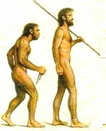
MICROPATTERN:
THE NEW APPROACHES

Slide 20

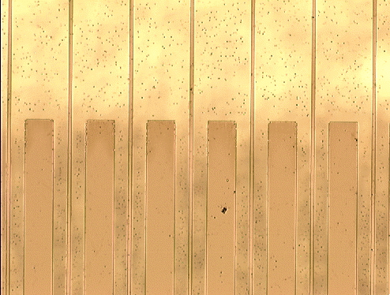
MICRO-STRIP GAS COUNTER (MSGC)
Anton Oed, 1988
10 µm wide anode strips, 50 µm cathode strips at 100 µm pitch on glass substrate:
A. Oed, Nucl. Instr. and Meth. A263(1988)351

Slide 21
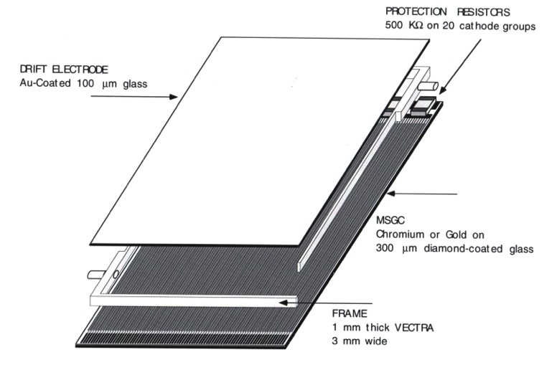
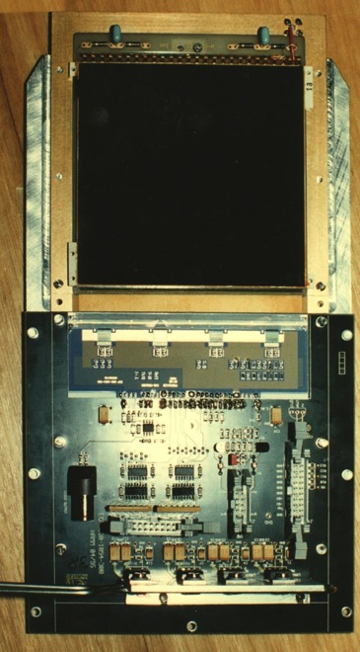
MSGC CONSTRUCTION
MSGC prototype
400 anode strips at 200 µm pitch:
J. Bohm et al, Nucl. Instr. and Meth. A360(1995)34
R. Bouclier et al,
Nucl. Instr. and Meth. A367(1995)163

Slide 22
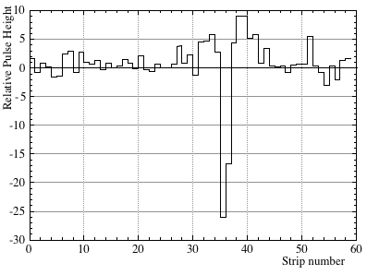
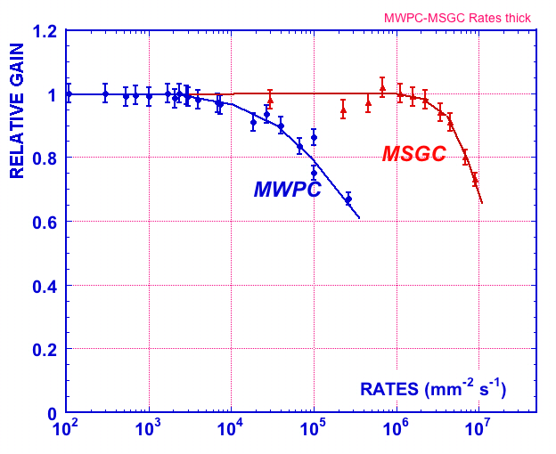
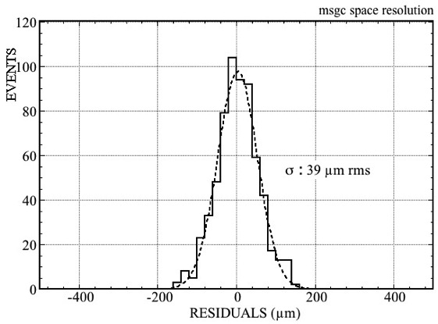
MSGC PERFORMANCES
Single track signal width (two-track resolution):
Rate capability: 1 MHz/mm²
FW ~ 400 µm
200 µm pitch
10⁶ mm⁻² s⁻¹
Position accuracy (fast particles):
~ 40 µm rms
Fast signals ~ 30 ns (1.5 mm)
Volume resolution
ΔV ~ 1 x 1 x 2= 2 mm³
R. Bouclier et al, Nucl. Instr. and Meth. A367(1995)163

Slide 23
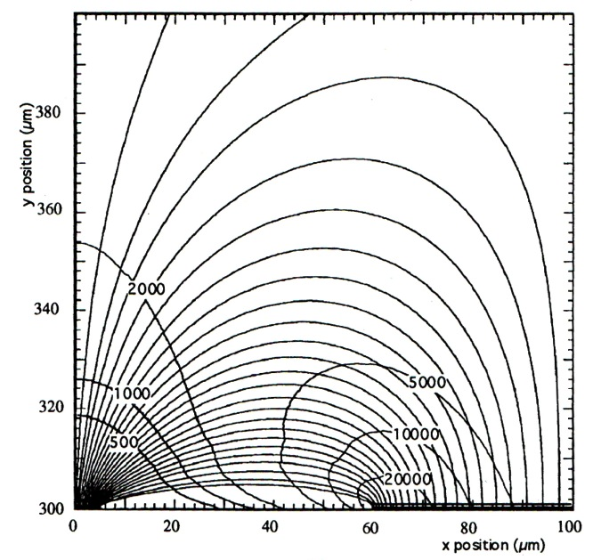
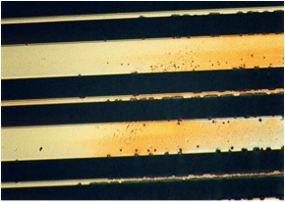
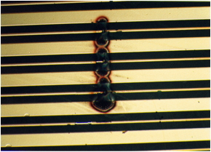
MSGC DISCHARGE PROBLEMS
Pre-amplification of electrons emitted by cathode strip edges
“Normal” gain 2000
PA gain 20000
T. Beckers et al, Nucl. Instr. and Meth. A346(1994)95
Fabio’s Museum of Horrors

Slide 24
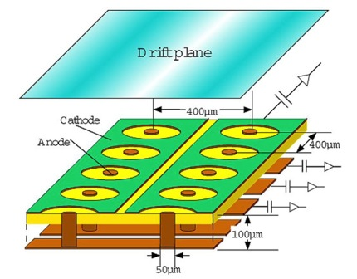
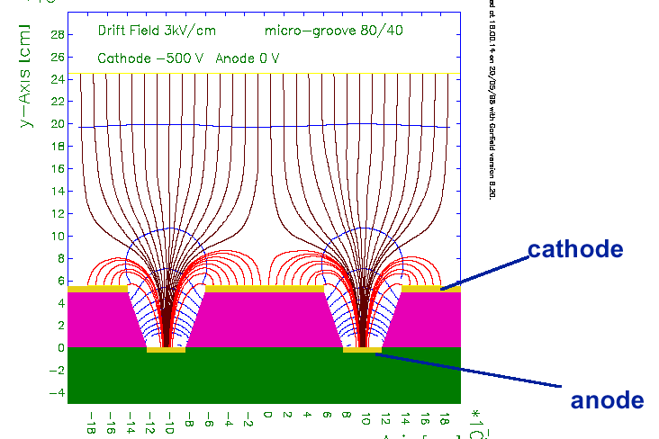
NEW MICRO-PATTERN GAS DETECTORS (MPGD)
MICRO-GROOVE CHAMBER
MICRO-PIXEL CHAMBER
A. Ochi et al,
Nucl. Instr. and Meth. A478(2002)196
R. Bellazzini et al,
Nucl. Instr. Meth. A424(1998)444
COMPTEUR A TROUS
MICRO-PIN ARRAY
F. Bartol et al
J. Phys.III France 6(1996)337
P. Rehak et al
IEEE TNS-47(2000)1426

Slide 25
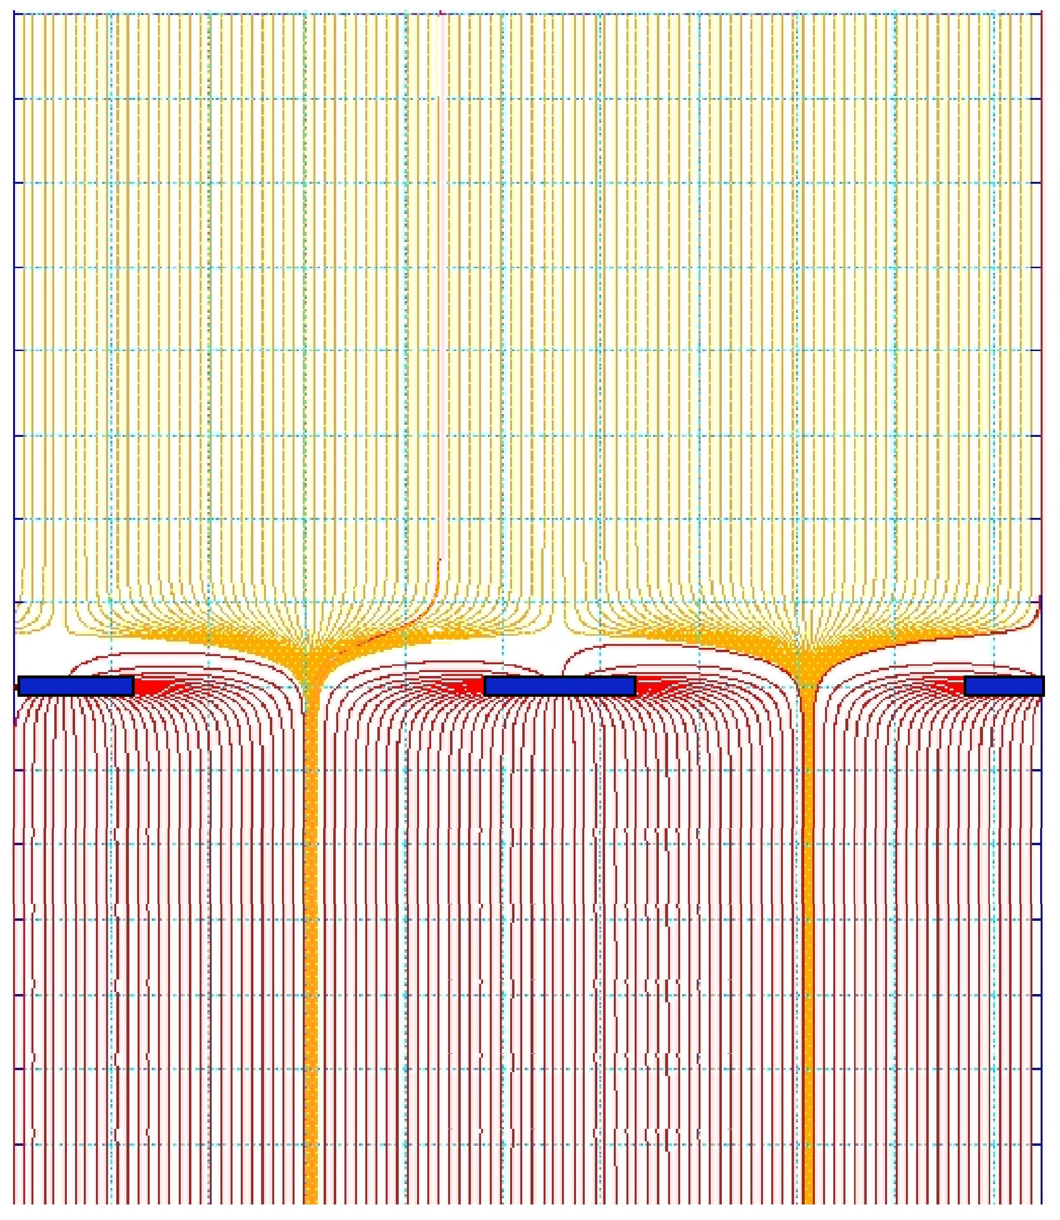

MICRO-MESH GASEOUS STRUCTURE (MICROMEGAS)
HIGH/LOW FIELD REGIONS SEPARATED BY A MESH
GAP UNIFORMITY:
SPACERS OR PILLARS
200 V/cm
50-100 µm
50 kV/cm
Y. Giomataris et al,
Nucl. Instr. and Meth. A 376(1996)29

Slide 26


BULK MICROMEGAS MANUFACTURING
Read-out board
pad
Laminated Photoimageable coverlay
pillar
Stainless steel
mesh on frame
Frame
Exposure
Development
+ cure+ cut
I. Giomataris et al,
Nucl. Instr. and Meth. A560(2006)405
J. Bouchet et al,
Nucl. Instr. and Meth. A574(2007)425

Slide 27



MICROMEGAS PERFORMANCES
Fast electron signal with slow ion tail:
Signal distribution: 200 µm fwhm
Energy resolution:
100 µm pitch
J. Derré et al,
Nucl. Instr. and Meth. A459(2001)523
A. Delbart et al, Nucl. Instr. and Meth. A461(2001)84

Slide 28



MICROMEGAS FOR THE COMPASS EXPERIMENT AT CERN
12 planes in 3 stations X,Y, U, V
40x40 cm² active
350 µm strips with digital readout
SPACE RESOLUTION:
70 µm rms
TIME RESOLUTION:
9 ns rms
C. Bernet et al, Nucl. Instr. and Meth. A536(2005)61

Slide 29



LARGE SIZE MICROMEGAS
ATLAS Forward muon upgrade:
1024 mm
J. Wotschack, RD51 Meeting (CERN 2013)
J. Wotschack, JINST 7, C02021 (2012)
T. Alexopoulos et al,
Nucl. Instr. and Meth. A717(2010)161

Slide 30


GAS ELECTRON MULTIPLIER (GEM)
Thin (50 µm) metal-coated polymer foil with high density of holes:
SINGLE GEM WITH 2-D READOUT BOARD
F. Sauli, Nucl. Instr. and Meth. A386(1997)531
A. Bressan et al, Nucl. Instr. and Meth. A425(1999)254

Slide 31

GEM MANUFACTURING
DOUBLE MASK PHOTOLITHOGRAPHY
Standard GEM:70 µm Ø at 140 µm pitch
50 µm Kapton
5 µm Cu
Photoresist coating, masking and exposure to UV light
Metal etching
Kapton etching
70 µm
5 µm
Second masking
55 µm
Metal etching
and cleaning

Slide 32

GEM DETECTOR PERFORMANCES
TWO-TRACK RESOLUTION (DRIFT TIME):
FAST ELECTRON SIGNAL ONLY
ON ANODE STRIPS
30 ns ~ 1.5 mm
10 ns
DRIFT
M. Ziegler, PhD Zürich Univ. (2002)
GEM
TWO-TRACK RESOLUTION (PROJECTION):
INDUCTION
VOLUME RESOLUTION
~ 1 mm³
400 µm fwhm
A. Bressan et al, Nucl. Instr. and Meth. A425(1999)262

Slide 33


MULTI-GEM DETECTORS
Triple-GEM (TGEM):
Cascaded GEM electrodes
HIGHER GAIN, LOWER VOLTAGE ON EACH GEM
C. Büttner et al, Nucl. Instr. and Meth. A409(1998)79

Slide 34



TRIPLE-GEM DETECTORS FOR COMPASS
31x31 cm² active 2-D strip readout
Total thickness in active area ~ 0.7% X₀
Honeycomb
plates
GEM foils
Readout
board
2-D readout board: 400 µm pitch strips
350 µm
C. Altumbas et al,
Nucl. Instr. and Meth. A490(2002)177
80 µm

Slide 35



GEM SECTORING
COMPASS TRIPLE-GEM DETECTORS:
12 SECTORS WITH PROTECTION RESISTORS
CENTRAL BEAM KILLER
SECTOR SEPARATION
VOLTAGE-CONTROLLED
CENTER

Slide 36

TRIPLE-GEM DETECTORS FOR COMPASS
22 DETECTORS, OPERATIONAL 2002-2012

Slide 37


GEM DETECTOR PERFORMANCES
SPACE ACCURACY
RATE CAPABILITY
65 µm rms
TIME RESOLUTION
12 ns rms
J. Benlloch et al, IEEE NS-45(1998)234
C. Altumbas et al, Nucl. Instr. and Meth. A490(2002)177

Slide 38


TOTEM TRIPLE-GEM DETECTOR
SEMI-CIRCULAR MODULES
M.G. Bagliesi et al, Nucl. Instr. and Meth. A617(2010)134

Slide 39


CYLINDRICAL GEM DETECTORS
KLOE-2 Inner Tracker: Three layers of Triple-GEM detectors
SPATIAL RESOLUTION
(X: Bending Plane):
A. Balla et al, Nucl. Instr. and Meth. A732(2013)221

Slide 40



COMPASS UPGRADE: TGEM WITH PIXEL AND STRIPS READOUT
CENTER: 32x32 PIXELS, 1 mm² SIDES: 512x512 STRIPS, 400 µm pitch
MEASURED FLUX IN HADRON BEAM:
1.2 10⁵ Hz/mm²
B. Ketzer et al, 2007 IEEE Nucl. Sci. Symp. Conf. Rec.
M. Krämer et al, 2008 IEEE Nucl. Sci. Symp. Conf. Rec.

Slide 41


LARGE GEM MANUFACTURING
SINGLE MASK PROCESS
M. Alfonsi et al, Nucl. Instr. and Meth. A617(2010)151

Slide 42




LARGE TRIPLE-GEM
CMS Muon Detector Upgrade
990 x (220-455)mm²
Radial Readout Strips
0.6 to 1.2 mm pitch
M. Tytgat, MPGD 2013

Slide 43



LARGE TRIPLE-GEM
EFFICIENCY
TRIPLE GEM
990 mm
POSITION ACCURACY
~ 260 µm
D. Abbaneo et al, JINST 9(2014)C01053

Slide 44


THICK GEM (THGEM)
MECHANICAL DRILLING OF METAL-CLAD PC BOARD:
SELF-SUPPORTING
HIGH GAIN
R.Chechik et al,
Nucl. Instr. and Meth. A535(2004)303
Breskin et al,
Nucl. Instr. And Meth. A623(2010)132
ALSO NAMED LARGE ELECTRON MULTIPLIER (LEM)
P. Janneret, Thesis at Neuchatel University (2001)
A. Badertscher et al, Nucl. Instr. And Meth. A617(2010)188

Slide 45



THICK GEM (THGEM)
LARGE RIM:
HIGH GAIN
CHARGING UP
RIMLESS:
LOW GAIN
STABLE
GAIN
100 µm
10 µm
0
ΔV (kV)
0.1 mm rim
No rim
M. Alexeev et al, Nucl. Instr. and Meth. A695(2012)159

