Slide 1
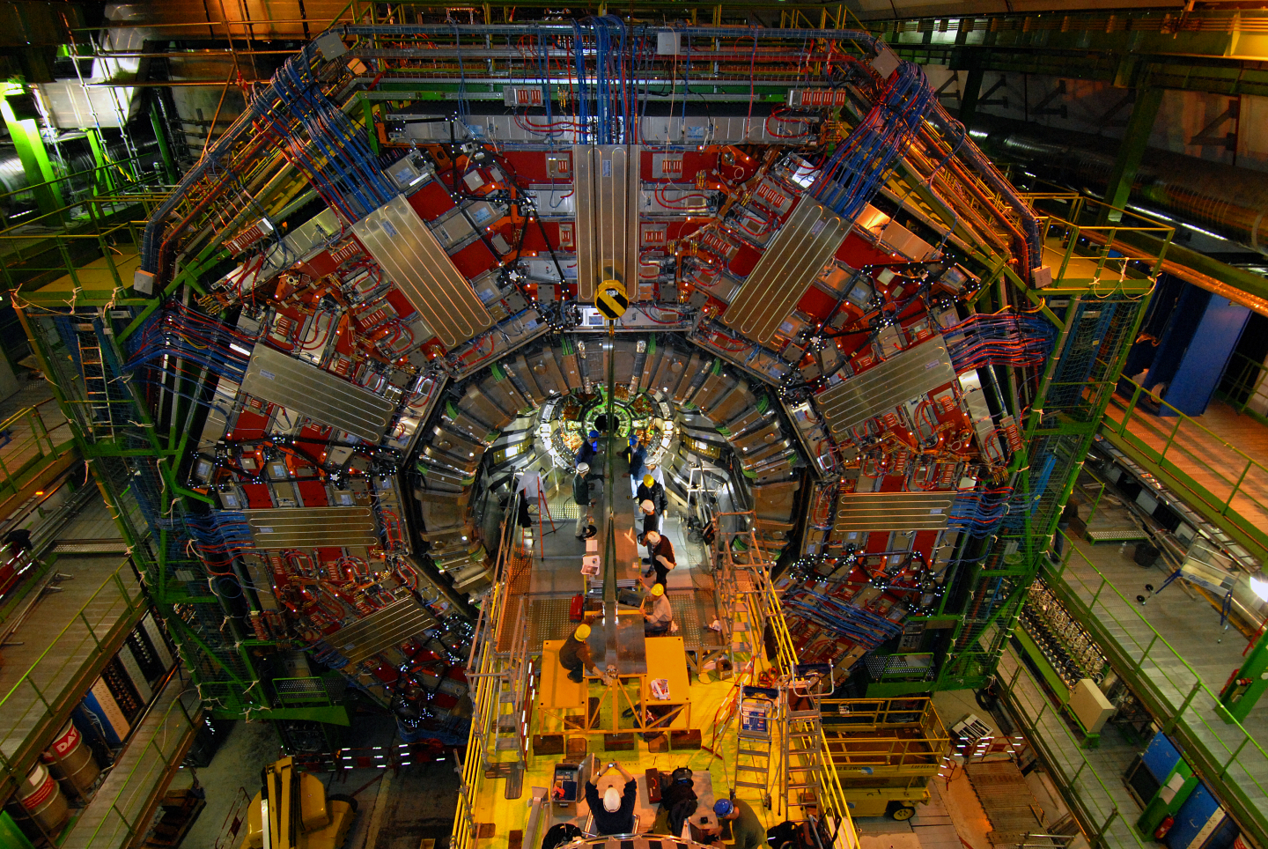
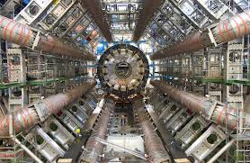
LHC – ATLAS & CMS

Slide 2
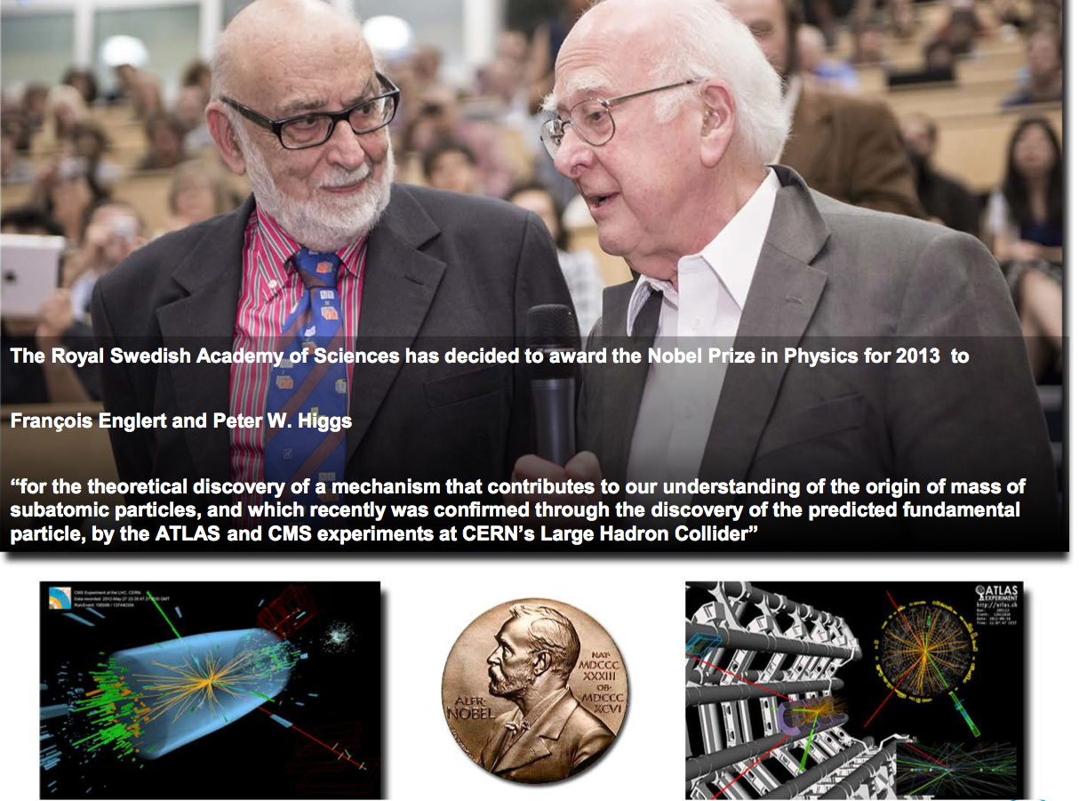
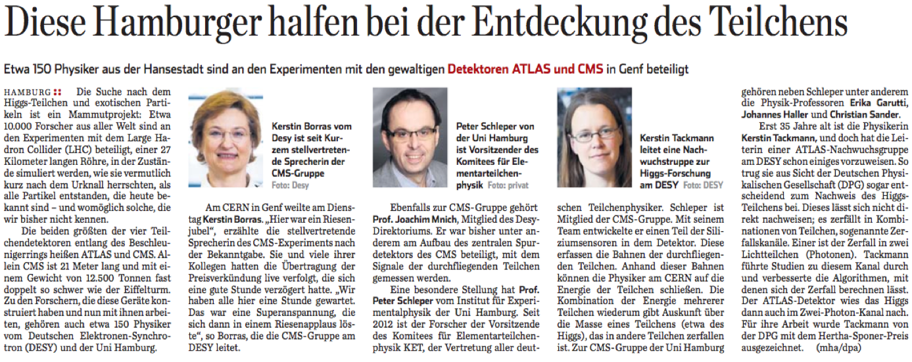
Helmholtz has a strong role in the Higgs discovery
CMS Deputy
Spokesperson
Hertha Sponer
award from German
Physical Society

Slide 3
Helmholtz has a strong position in LHC
Strong LHC groups at DESY and KIT:
80 scientists (50% postdocs)
50 PhD students
Undergraduates, engineers, technicians
6 Young Investigator Groups (YIG)
Significant management responsibilities:
Deputy Spokesperson, Publication Committee, Authorship Board, Conference Committee, Speakers Committee Advisory Board, Collaboration Board (deputy), Technical Coordinator (deputy), Physics Conveners (Top, SM, Forward Physics, Monte Carlo)
ATLAS, CMS and Theory located at the same institute
+ strong university groups in Hamburg, Karlsruhe and Berlin
→ essential synergies!
Contribution to key strategic areas in the ATLAS and CMS experiments:
Detector upgrade
Detector operation
Physics analysis
Computing

Slide 4
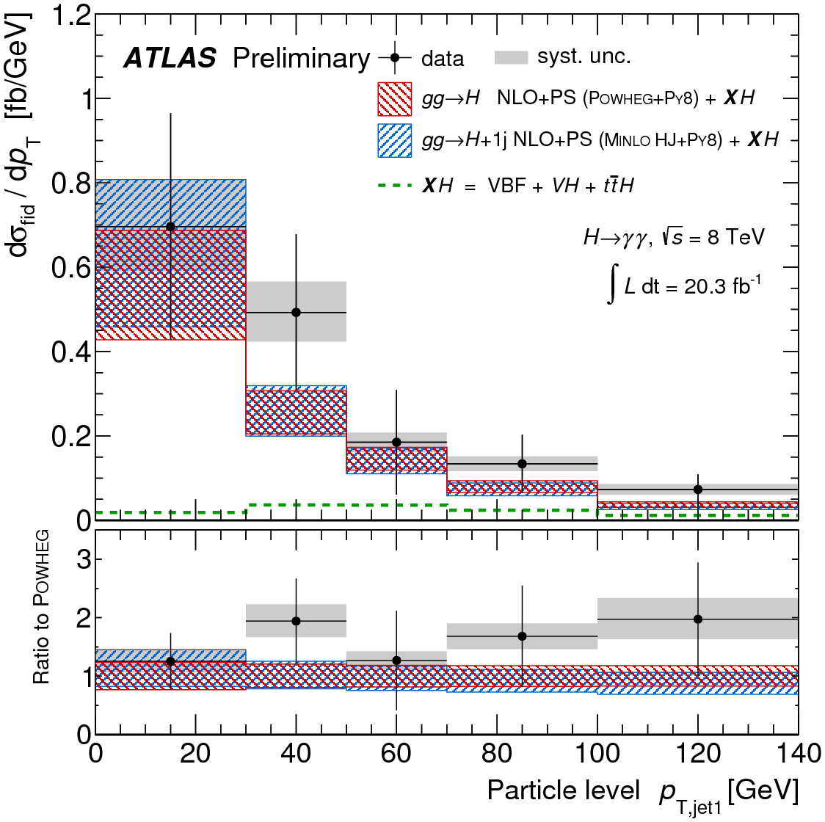
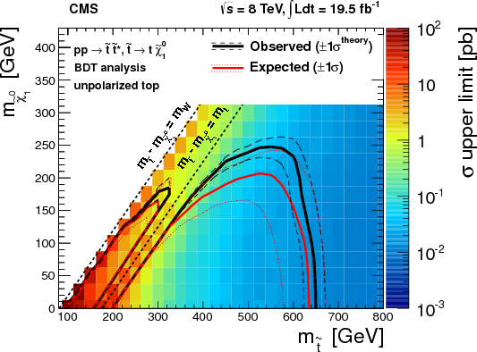
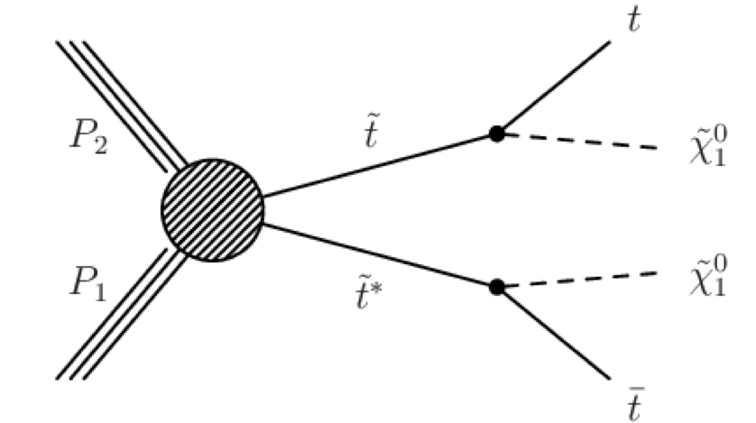
LHC Physics Highlights
Diff. Higgs cross section vs p_{T}^{jet}
First differential Higgs cross section measurement
  Better understanding the kinematics of Higgs production and decay
Large radiative corrections to Higgs mass not yet understood
  Possible explanation: Cancelling due to additional new particles in loop diagrams, e.g. SUSY partner of top
Limit on top squarks

Slide 5
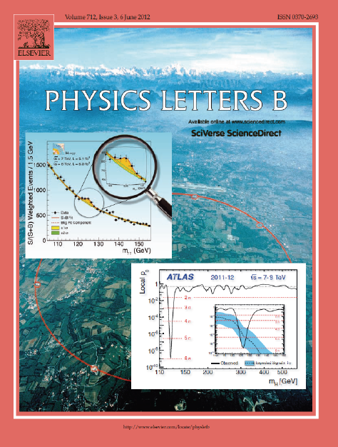
LHC Research at the Forefront of Particle Physics
ALTAS and CMS published up to now ~400 papers, about 20% with direct contribution of Helmholtz groups
  Continue to fully exploit LHC physics potential
  Preparation of 13 TeV analyses
Physics area | ATLAS | CMS
Higgs analyses | 5 | 14
Standard Model physics | 15 | 13
Top quark measurements | 3 | 11
Searches for new physics | 13 | 6
Phenomenology papers | 14 | 9

Slide 6
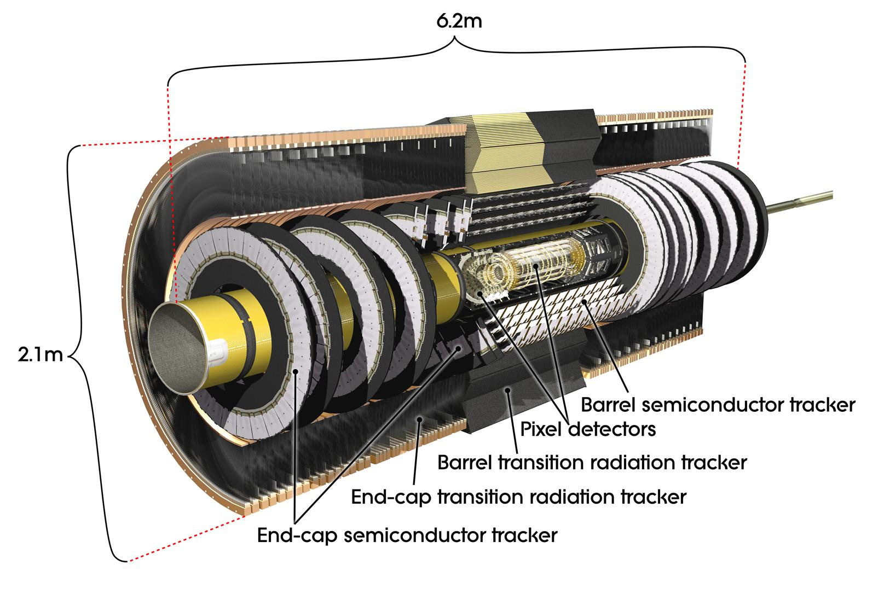
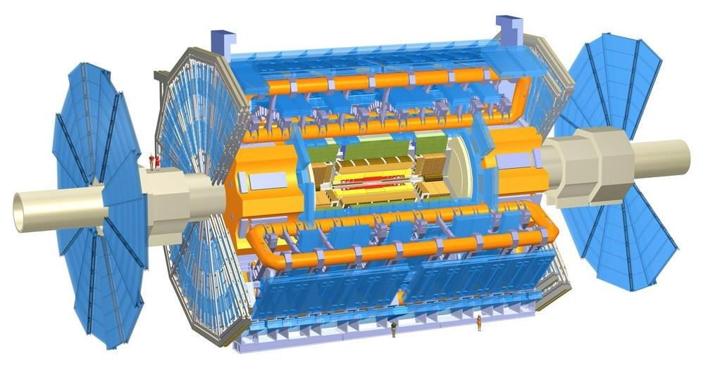

Contributions to ATLAS Components
Generic:
Trigger
eγ performance
Jet calibration
Fast Track Trigger
(FTK – Phase 1 Upgrade)
~200 m
ALFA
(very forward
detector)
Innermost Pixel
Layer (IBL)
Silicon Tracker
(SCT – operation)
ITK Strip
(Phase 2 Upgrade)
Notes:
Der schwimmt sogar in Milch

Slide 7
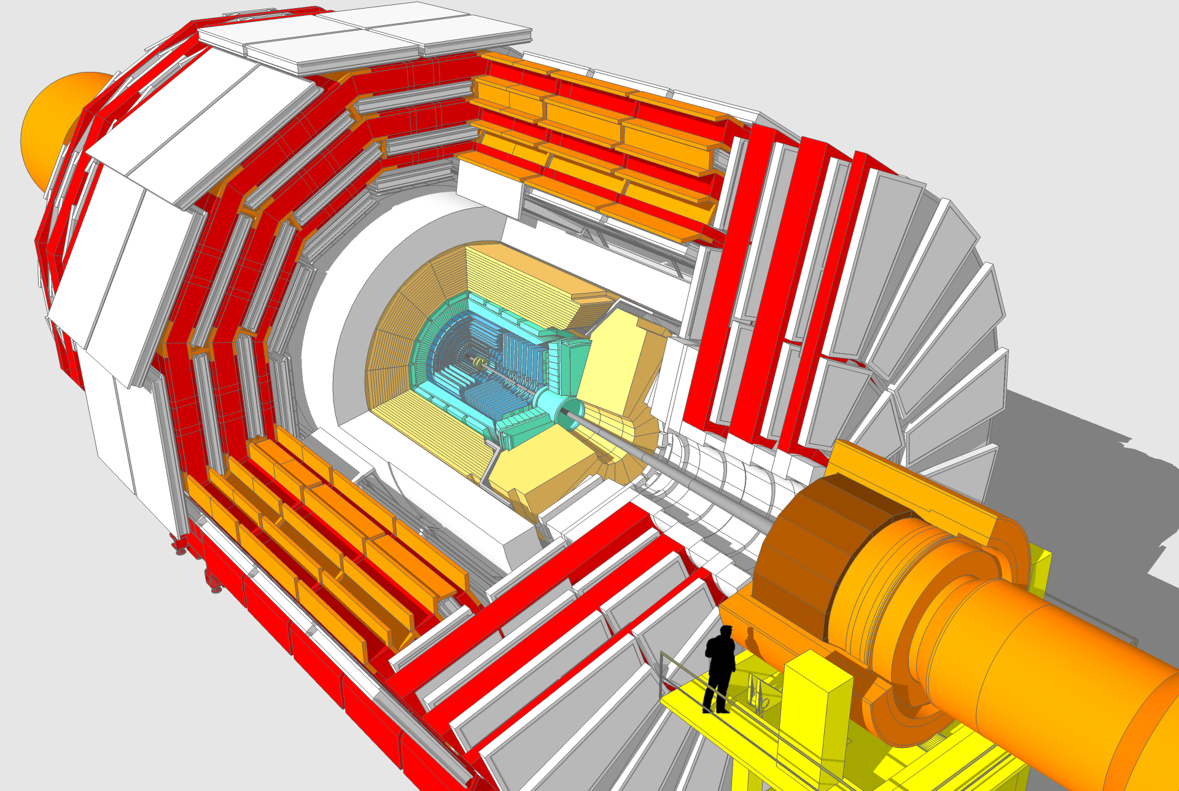
Contributions to CMS Components
HCAL Outer Calorimeter
(tail catcher for
hadronic showers)
Generic:
Data acquisition
Data quality monitoring
µTCA developments
Beam Condition Monitors
(diamond sensors)
CASTOR Calorimeter
(forward calorimeter
tungsten-quartz plates)
Vertex Detector
(Silicon pixels
Phase 1 upgrade)
Tracker Endcap
(Silicon strips
Phase 2 upgrade)

Slide 8
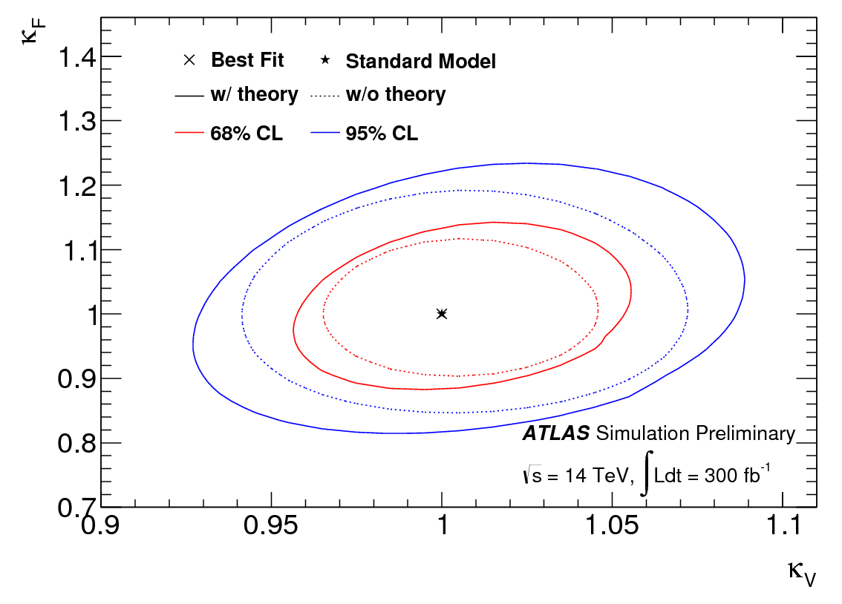
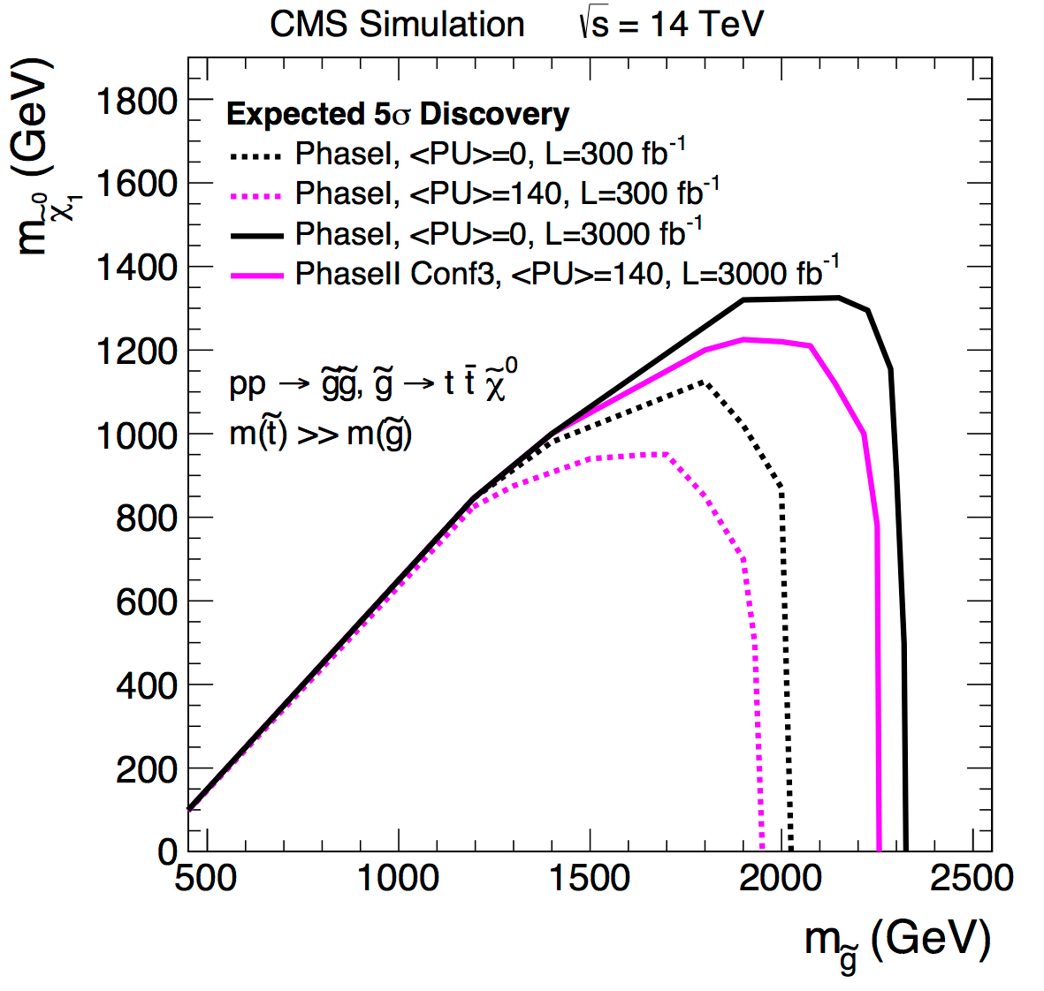
LHC Research Topics 2015-2019
Keep leading role in many physics areas exploiting higher energy and luminosity:
Higgs precision measurements
  Couplings
  Properties
  Higgs physics as probe for new physics
  Understanding the origin of mass
Extend searches for new particles
  Supersymmetry
  Finding and understanding Dark Matter
Use strength in Standard Model precision measurements, including top, as key to high sensitivity searches
Higgs couplings
Limit on Gluinos
Notes:
avoid: ‘missing manpower’
Better: contributions from desy;helmholtz groups are vital/essential and expected for high performance operation of the detectors.
Higgs physics -> "exploit electroweak symmetry breaking

Slide 9
LHC Schedule – the Big Picture
In preparation for Phase 2 upgrade:
Generic R&D on new silicon based detectors (link to Matter and Technology)

Slide 10
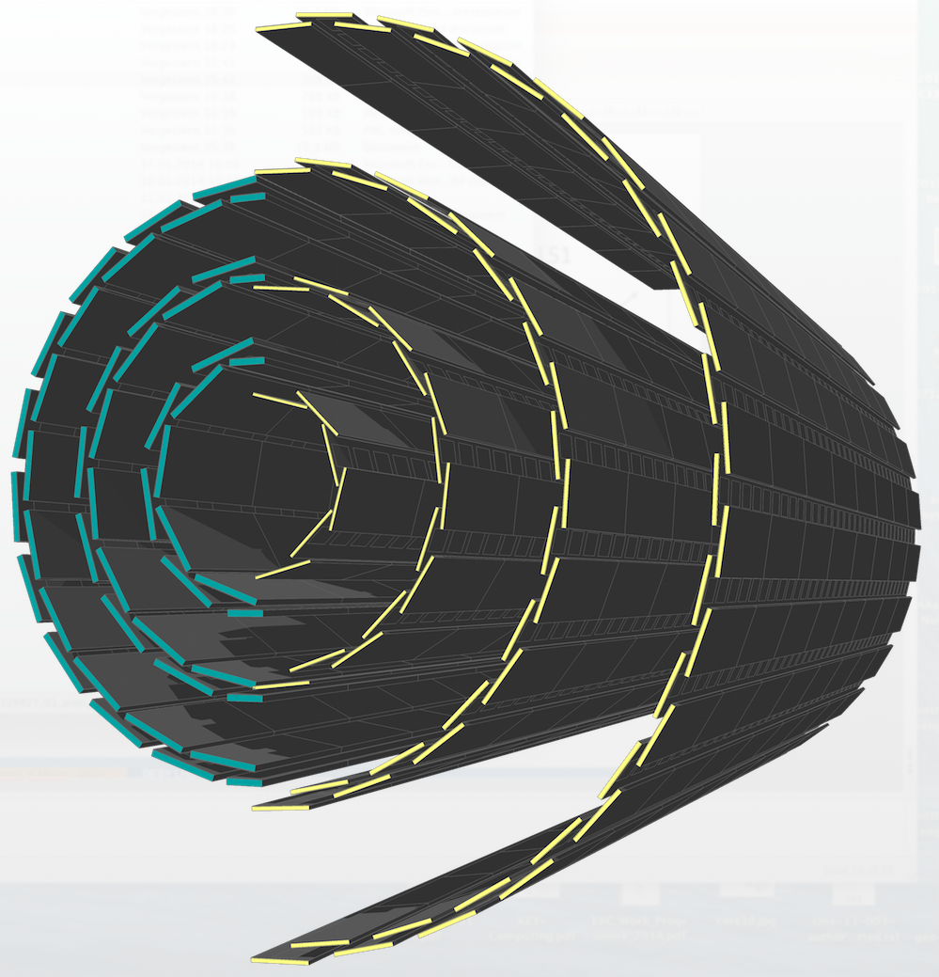
Phase 1 LHC Detector Improvements
CMS: 4th layer of pixel detector
  DESY to build outer layer in collaboration with German universities
  DESY’s tasks:
    Produce ~50% of the modules
    Assemble the complete 4th layer
ATLAS: additional innermost layer (IBL)
  DESY’s contributions:
    Test beam campaigns
    Responsibility for the optical fibres for signal transport
    Fast Track Trigger
old new
CMS pixel detector

Slide 11
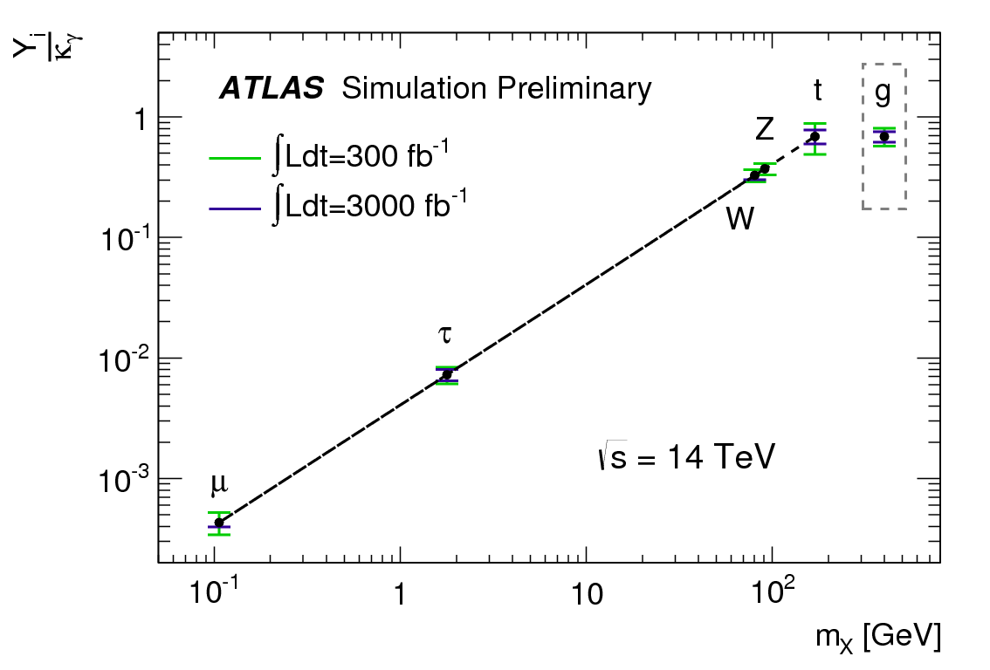
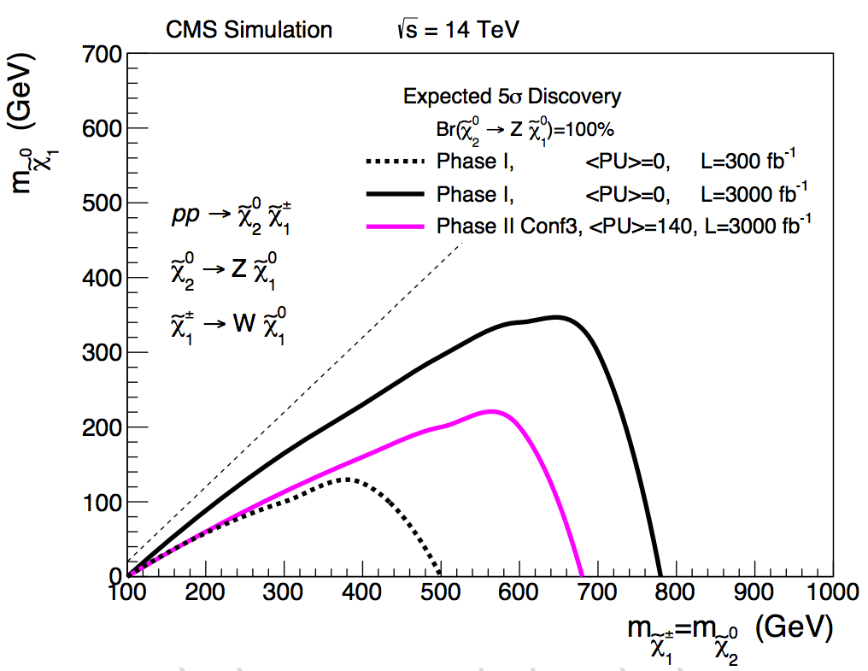
Going beyond 300 fb⁻¹ → High-Luminosity-LHC
Significant gain in physics reach with 3000 fb⁻¹:
Couplings of the Higgs boson can be measured at the 5% level (based on theoretical assumptions)
First glimpse of Higgs self-coupling
Search reach in channels with low cross section significantly increased
  Testing naturalness
Problem: Current tracking detectors only designed for Phase 1 luminosity (300-500 fb⁻¹)
  Will reach end of their lifetime by 2022
Need to be replaced by improved tracking detectors
Normalized Higgs couplings
Limit on EWKinos

Slide 12
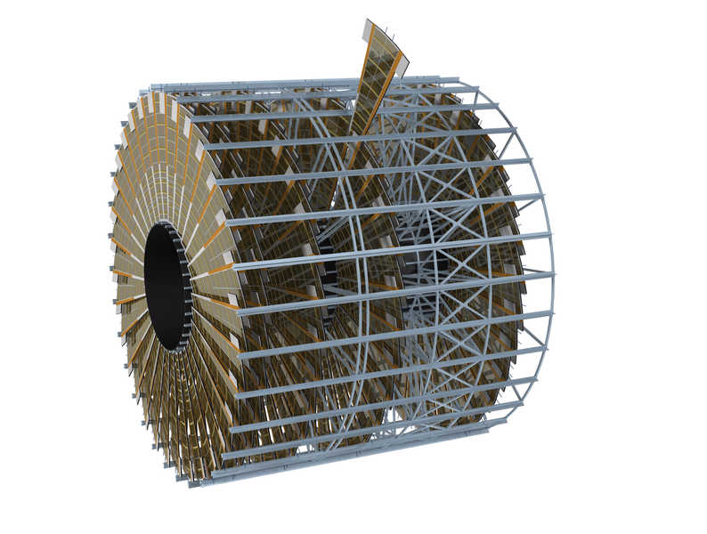
Phase 2 Upgrade Program: Improved Tracking Detectors
DESY was accepted at the LHC without significant hardware contributions!
For the Phase 2 tracker upgrade we must fulfil our role as a national lab
Contributions from DESY:
  Strong R&D for new silicon based trackers
  Building of one endcap detector for each of the two experiments in collaboration with German universities
  Provide the infrastructure for the final assembly
Capital investment (Helmholtz) needed for detector construction:
proposal in preparation for 23.8 M€ (assembly hall to be financed by DESY)
Notes:
Mention CAPITAL INVEST proposal
DESY to set up infrastructure
CMS: was designed for 500
Macroassembly -> integration
‘such devices’

Slide 13
Helmholtz @ LHC – Summary and Conclusion
Highest priority tasks for 2015-2019:
  Tracker and pixel detector upgrades → large capital investment
  Physics analysis → shaping the future of the LHC physics program
  Detector operation
The Tier-1 and Tier-2 centers and the National Analysis Facility (NAF) are key to the scientific success at the LHC!
  Maintain and develop our leading role in the LHC experiments
  In our role as a national laboratory we work with and provide support to the German universities!
Notes:
Add:
Where we will be in 5 years
Explicit goals, milestones

Slide 14
Thank you for your attention!
Additional information follows…

Slide 15
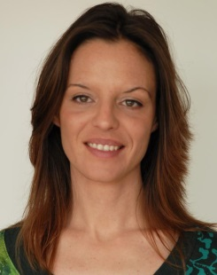
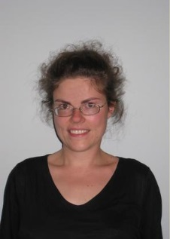
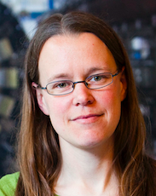
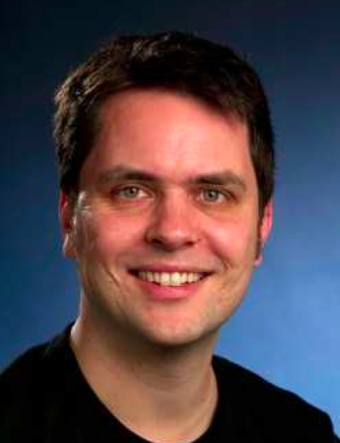
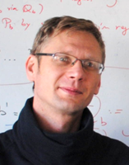
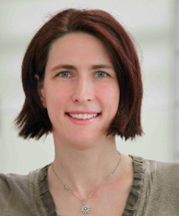
Leaders of Young Investigator Groups
2014 María Aldaya Martín
CMS top physics
2012 Yvonne Peters
ATLAS top physics
2011 Kerstin Tackmann
ATLAS Higgs
2011 Ralf Ulrich
CMS Forward physics
and Pièrre Auger
2009 Alexei Rasperezza
CMS Higgs
2009 I. Melzer-Pellmann
CMS SUSY

Slide 16
List of PhD Theses completed: ATLAS 13
July 2013 | Clemens Lange | A novel approach to precision measurements of the top quark-antiquark pair production cross section with the ATLAS experiment
April 2013 | Valentina Ferrara | Extraction of the top quark mass from the total top quark pair production cross section in the single lepton channel
December 2012 | Martin Wildt | Search for new physics in diphoton and missing transverse energy final states using the ATLAS detector at the LHC
July 2012 | Dörthe Kennedy | Search for Supersymmetry in Tau Final States at ATLAS and Constraints on New Physics Using Electroweak Precision Data
May 2012 | Mikhail Karnevskiy | Measurement of the Z Boson Production with the ATLAS Experiment at the LHC
March 2012 | Sebastian Johnert | Measurement of the W → Tau Nu Cross Section in Proton-Proton Collisions at ATLAS and the Development of the HepMCAnalysis Tool
March 2012 | Michael Böhler | Exclusive Search for Supersymmetry with Same-Flavour Di-Lepton Final States with the ATLAS Detector
September 2011 | Martin Goebel | Tests of the Electroweak Standard Model and Measurement of the Weak Mixing Angle with the ATLAS Detector
May 2011 | Gordon Fischer | Determination of the tau-lepton reconstruction and identification efficiency using Z -> tautau events in first data at ATLAS
March 2011 | Björn Gosdzik | Identification of Hadronic Tau Decays and Observation Potential of CP-Violating Effects in SUSY at ATLAS
May 2010 | Sascha Mehlhase | Development of a Data-Driven Algorithm to Determine the W+Jets Background in ttbar Events in ATLAS
April 2010 | Sami Kama | Automatic Monte-Carlo Tuning for Minimum Bias Events at the LHC
October 2009 | Mark Terwort | Study of GMSB Models with Photon Final States Using the ATLAS Detector
ATLAS PhD Theses ongoing: 20

Slide 17
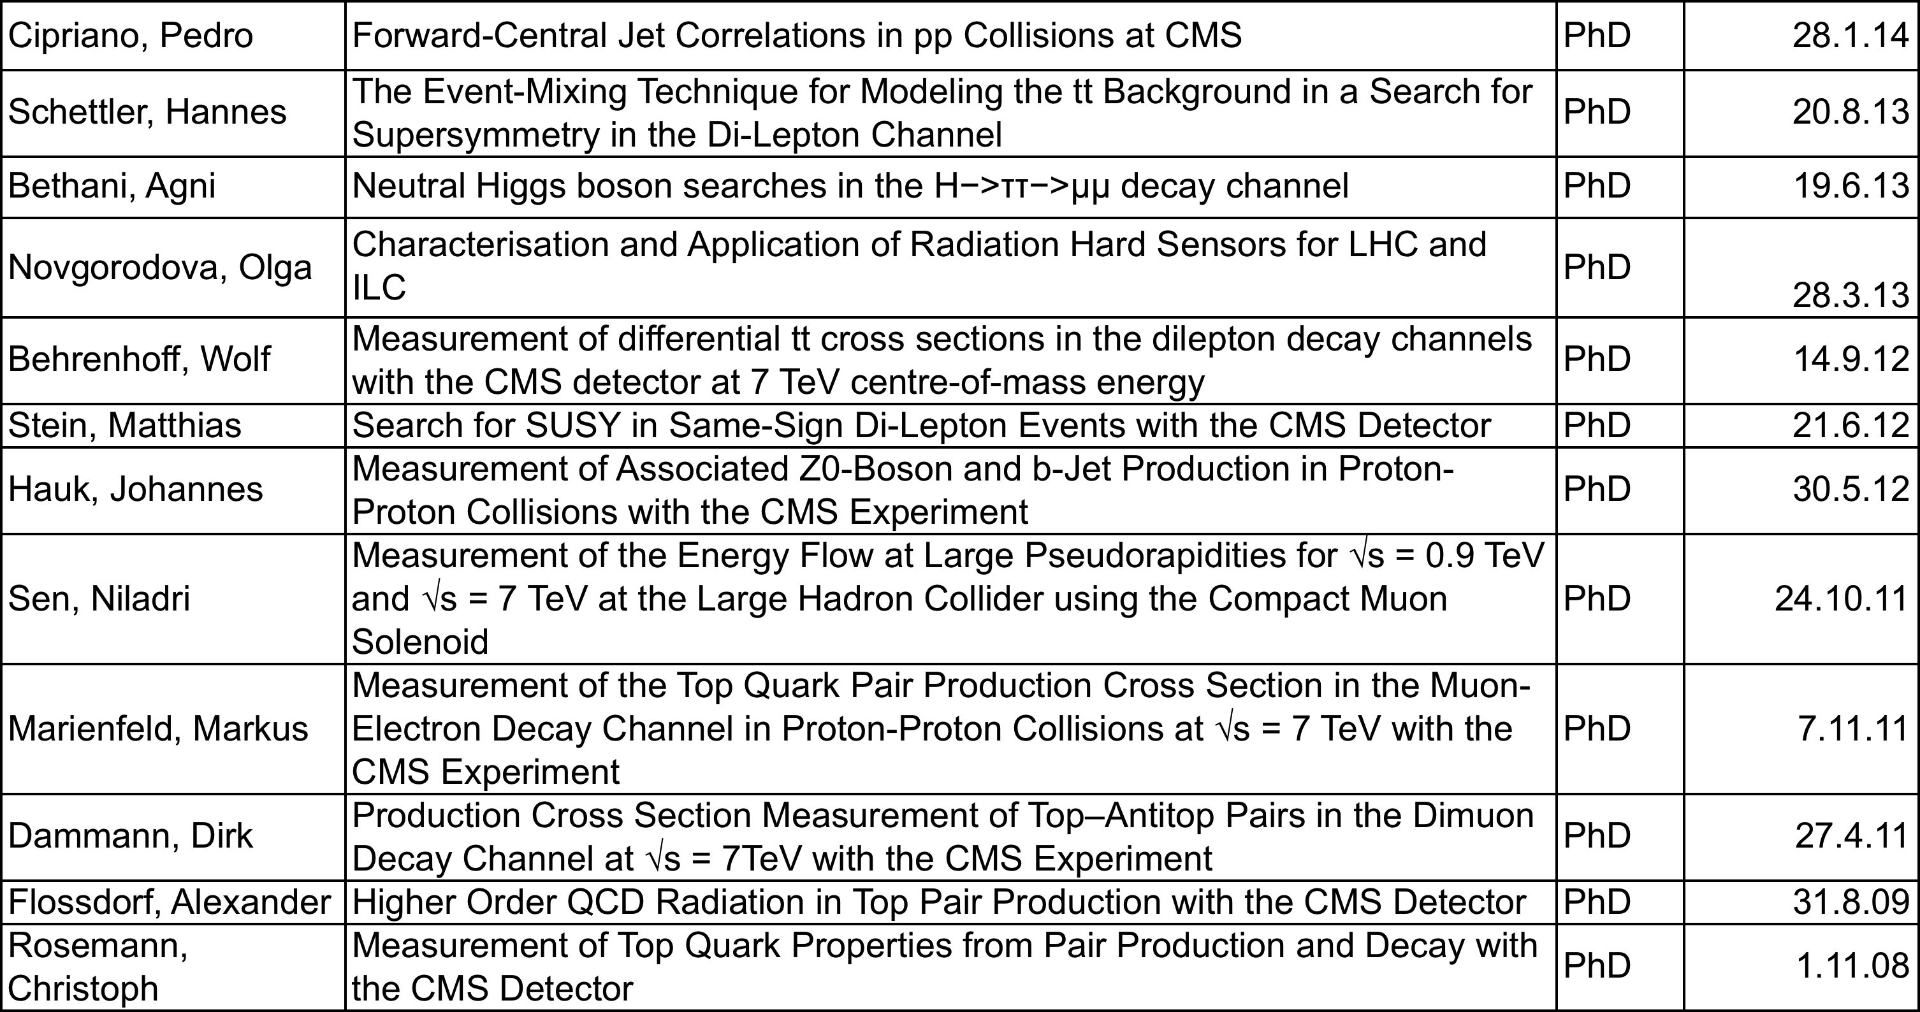
List of PhD Theses completed: CMS 12
CMS PhD Theses ongoing: 28

Slide 18
LHC groups – detector and analysis related work
The long list of key responsibilities and significant contributions shows the impact of the groups at the LHC:
Data and analysis related work:
    MC generator interfaces, conditions database, e-gamma reconstruction, Tracker alignment, Data Quality monitoring, Remote Operations Centres, b-tagging for Higgs, lepton trigger for top
Detectors and operations related work:
    SCT operations, ALFA, IBL, CASTOR, BCM1F, BCM4LHC, DAQ, µTCA

Slide 19
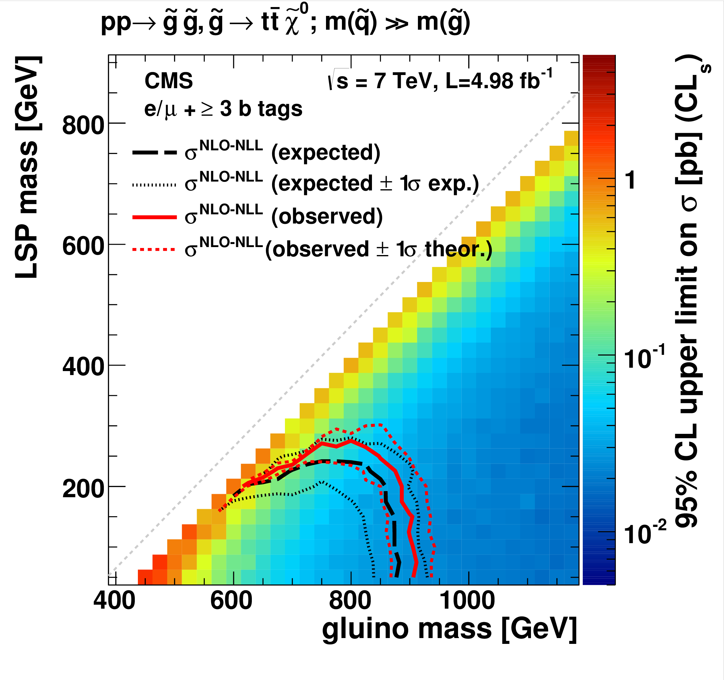
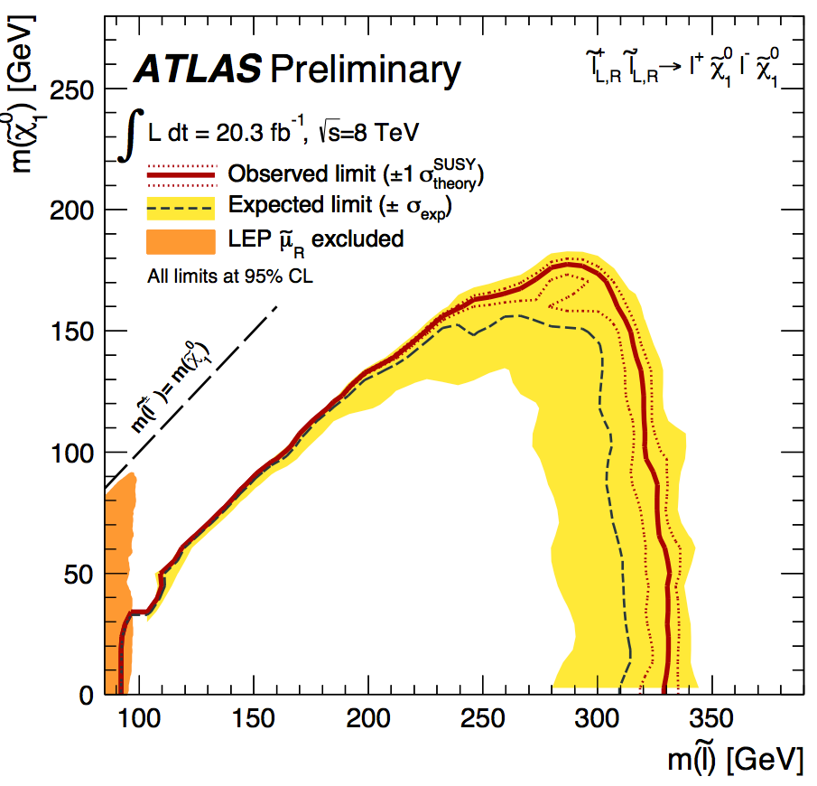
Helmholtz Contributions to SUSY Searches
PRD 87, 052006 (2013)
Limit on slepton mass
First limit on gluino mass
decaying to 3rd generation
squarks

Slide 20
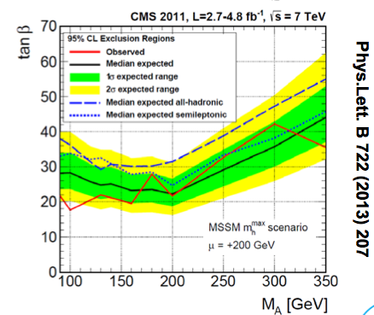
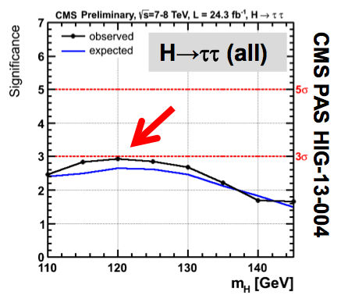
Helmholtz Contributions to MSSM Higgs and H→ττ
MSSM 7 TeV H->bb analysis:
World-best sensitivity in this channel
Higgs decaying into tau pairs
measures leptonic couplings

Slide 21
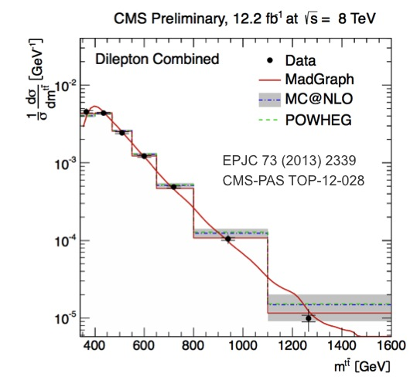
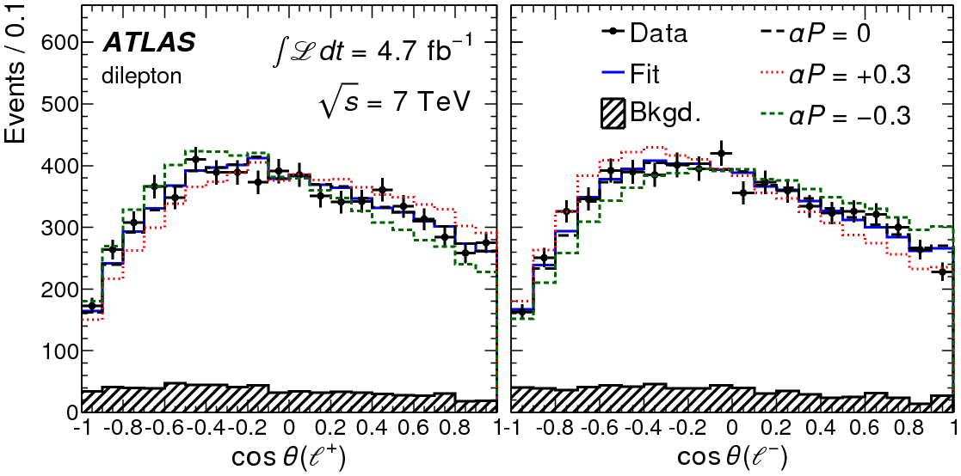
Helmholtz Contributions to Top Physics
Top Quarks: unique means to challenge the SM and the key for BSM physics
PLB 728 (2013) 496
EPJ C73 (2013) 2339,
CMS-PAS TOP-12-028
Determination of top-quark pole mass from top-quark-pair cross sections
Differential top-quark-pair cross section
PRL 111 (2013) 232002
PLB 728 (2013) 496
Top quark polarization in top-quark-pair events consistent with SM
First determination of α_{S} from top-quark-pair cross sections
New YIG in Top Quark research: Maria Aldaya, in cooperation with UHH & KIT

Slide 22
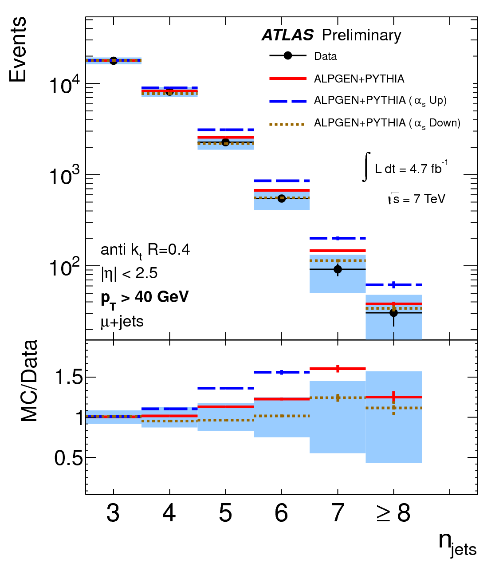

Helmholtz Contributions to Top Physics
Jet multiplicity in top-anti-top final states

Slide 23
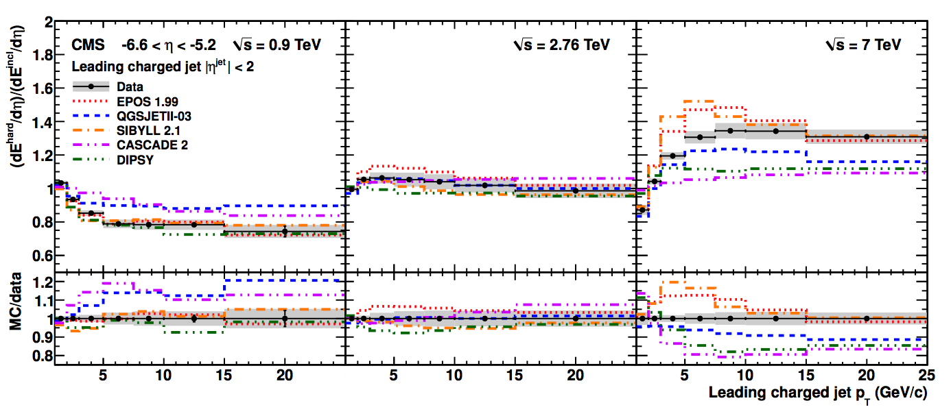
Helmholtz Contributions to Forward Physics
Forward energy flow
including CASTOR
Testing MC models used in cosmic
ray physics with LHC energies
→ Connection to Topic 3

Slide 24
Helmholtz Contributions to Forward Physics and Connection to Topic 3
Testing MC models used in cosmic
ray physics with LHC energies
→ Connection to Topic 3

Slide 25
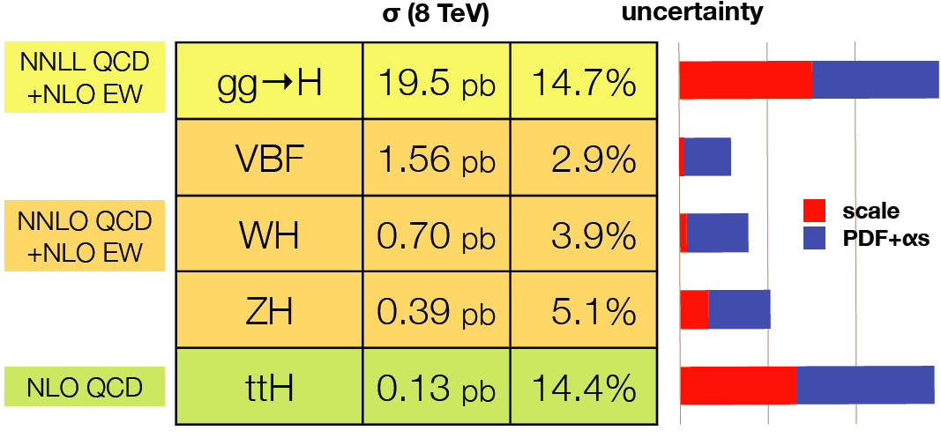
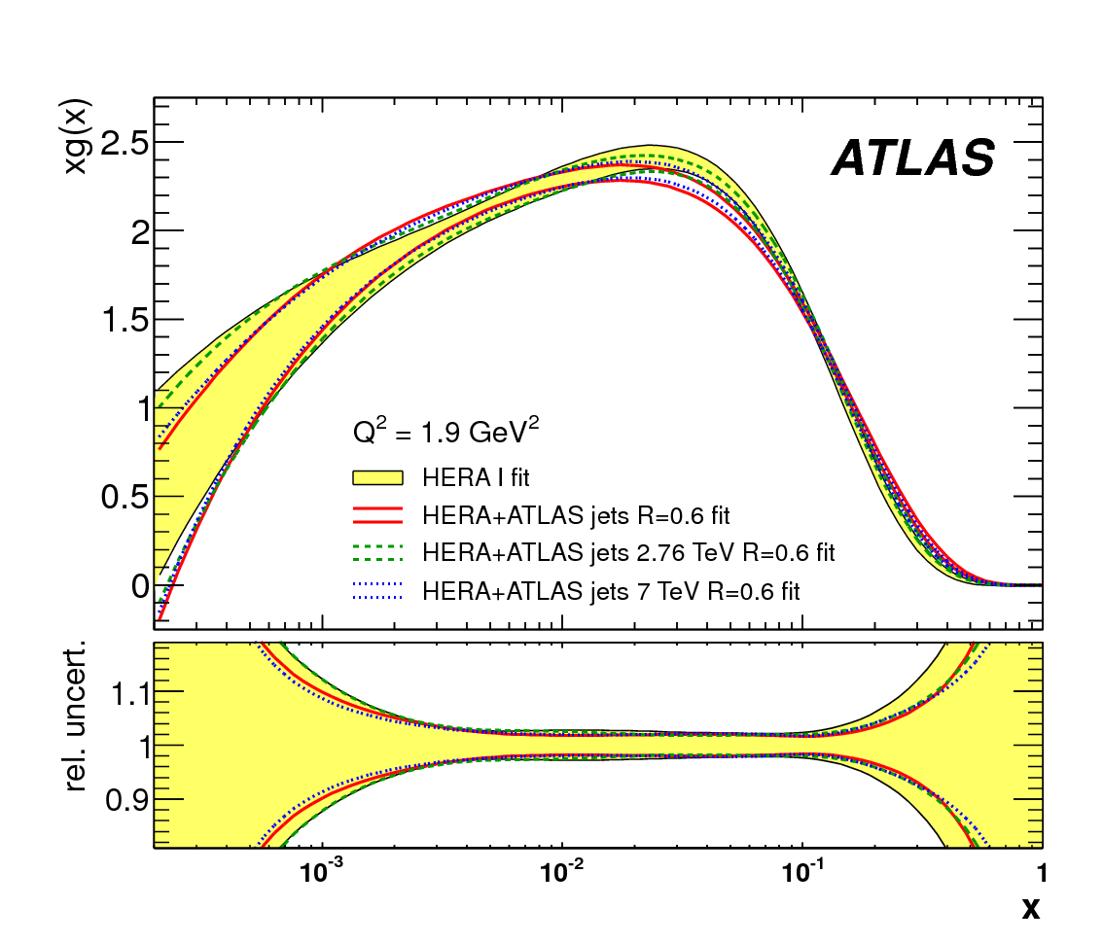
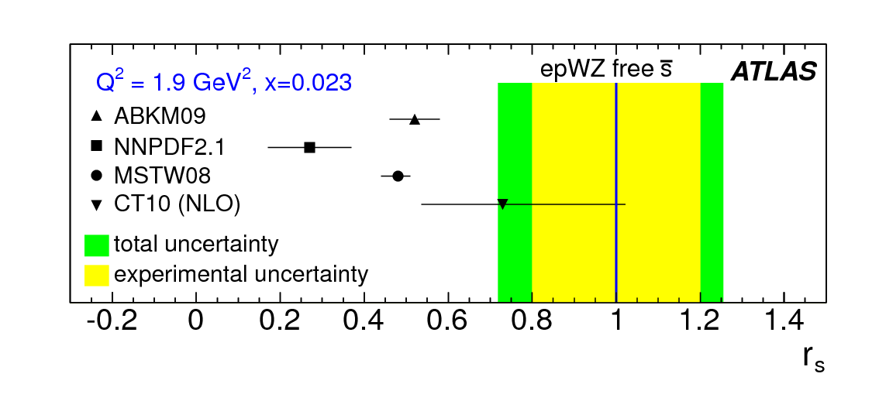
Helmholtz Contributions to Proton Structure
The HERA legacy is continued with the HERAfitter www.herafitter.org
Used at the LHC to improve constraints on the proton structure
Accuracy of proton structure important for the Higgs and searches
Improved gluon distributions using jet production
EPJC (2013) 73 2509
Determination of the strange-quark density at hadronic collider using W, Z and associated W+c production
Strange-quark fraction in the proton using W -> l nu and Z -> ll
arXiv:1312.6283
PRL109 (2012) 012001

Slide 26
Detector Operation Tasks in the Past
CMS:
  Significant fraction of the data-quality monitoring tasks, assessing the quality of new data and releasing them for physics analysis
  Leading role in the alignment of the inner tracker exploiting Millepede, a method originally developed at DESY and the University of Hamburg during the HERA programme
ATLAS:
  Coordination of the prompt reconstruction of the data and the production of simulated events; also responsible for the “conditions database”
  Responsibility for the maintenance of the interfaces of event generators to the ATLAS simulation software package
Notes:
Add:
Where we will be in 5 years
Explicit goals, milestones

Slide 27
Detector Operation Tasks 2015-2019
Future:
CMS: continuing tasks from Run 1
  Significant fraction of the data-quality monitoring tasks, assessing the quality of new data and releasing them for physics analysis
  Leading role in the alignment of the inner tracker exploiting Millepede, a method originally developed at DESY and the University of Hamburg during the HERA programme
  In addition: operation of the silicon strip tracker
ATLAS:
  Coordination of the prompt reconstruction of the data and the production of simulated events; also responsible for the “conditions database”
  Operation of the silicon strip tracker (SCT)
Notes:
Add:
Where we will be in 5 years
Explicit goals, milestones

Slide 28
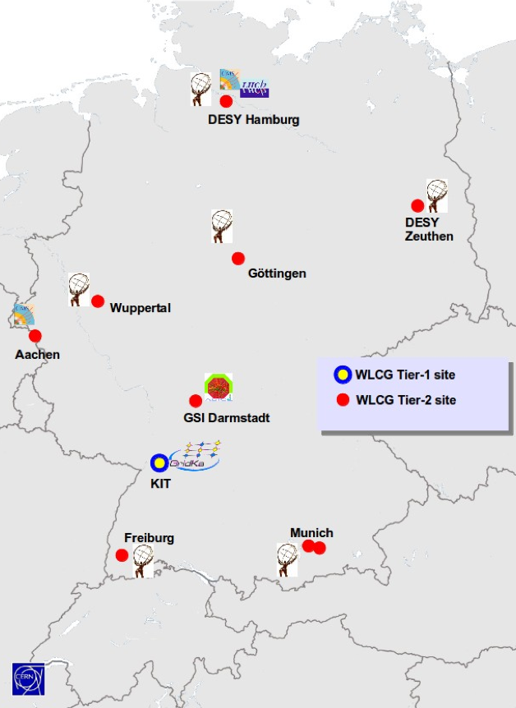
Computing for LHC Data Analysis
The Tier-1, Tier-2 centers and the National Analysis Facility (NAF) are key to the scientific success at the LHC!
The German Grid infrastructure includes the Tier-1 center at KIT, the Tier-2 centers at DESY, GSI, MPI and at University sites.
German sites rank among the most-used and most-efficient sites in the WLCG.
Sufficient funding is not secured yet for Tier-1 and Tier-2 resource replacements and upgrades.

Slide 29
Detector upgrades for high luminosities
Detailed plans for a share of the workload within Germany in both collaborations:
Plans already discussed with the funding agency (BMBF)
Notes:
29
Mention CAPITAL INVEST proposal
DESY to set up infrastructure
Wir sind voll im Trend mit europaeischen und deutschen Roadmaps, und wir haben uns bestmoeglich organisiert mit den anderen Instituten. Ich wuerde den Punkt als staerker betonen.
Benefits of upgrade: show a physics plot

Slide 30
Capital Investment Proposal
Cost estimates based on ATLAS Phase-2 Letter of Intent and CMS RRB preparation
Research equipment covers core contributions and prototypes
Technical Infrastructure -> special tooling for production
Requested Funding DESY | Cost [M€]
Technical infrastructure | 2
Sensors | 5.5
Readout electronics | 5
Mechanics | 5.4
Power supplies etc. | 1.1
Other items | 1.2
Total | 20.0

Slide 31
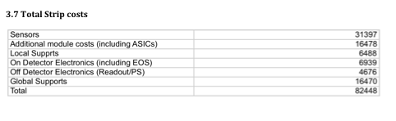
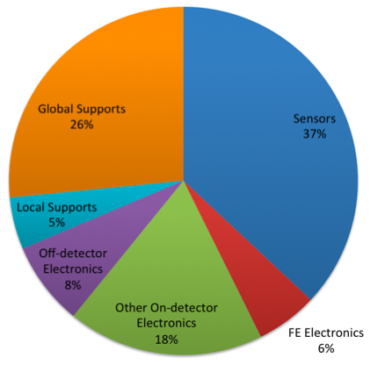
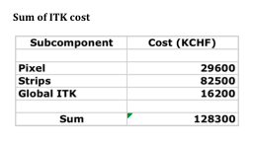
New Strip Tracker Costs (example from ATLAS LOI)
Strip Tracker 82.5MCHF + 50% of Global ITK
  ~90.1MCHF
  ~75M€
One EndCap -> ~20M€

Slide 32
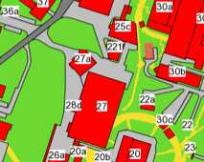
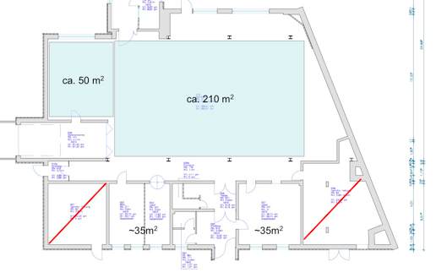
Assembly Facility
Refurbish and extend building 25c
  Reasonable hall space for end-caps assembly
  Extension for the required laboratory space
Start of construction ~2015

Slide 33
POF2 Proposal and HGF Senate Recommendations
Strengthen the concerted efforts on detector upgrades, remote control room, training courses, and NAF!
The program of schools and workshops organized by the Terascale is targeted to a large extend to the ongoing analysis of the LHC program.
  It is well attended by by scientists at junior and senior level from universities and HGF laboratories involved in the LHC experiments and HEP theory.
The resources provided by the National Analysis Facility were upgraded continuously to match the growing data samples. A large fraction of LHC results were achieved using the NAF.
The concept of provisioning all Tier-2 datasets has been proven very successful and lead to large acceptance and usage from institutes all throughout Germany.
The remote control rooms are routinely used for remote experiments shifts on controlling the computing infrastructure, detector components and data processing in the experiments.
Notes:
Add:
Where we will be in 5 years
Explicit goals, milestones

Slide 34
POF2 Proposal and HGF Senate Recommendations
Explore solutions to participate to the LHC upgrade program!
The detector upgrade strategies of ATLAS and CMS have emerged into sound plans and proposals to build substantial parts of the tracking detectors together with German institutes.
A concrete proposal has been worked out to build two large tracking endcap detectors, one for the ATLAS and one for the CMS experiment.
  Both detectors will be build in a concerted effort with several German Universities, the integration and assembly is planned to be done at DESY.
  The funding request for the detector is being prepared and is attached to the material for this review. Submission of the request is expected this fall.
  DESY will provide the assembly hall and lab space infrastructure.
Notes:
Add:
Where we will be in 5 years
Explicit goals, milestones

