Slide 1
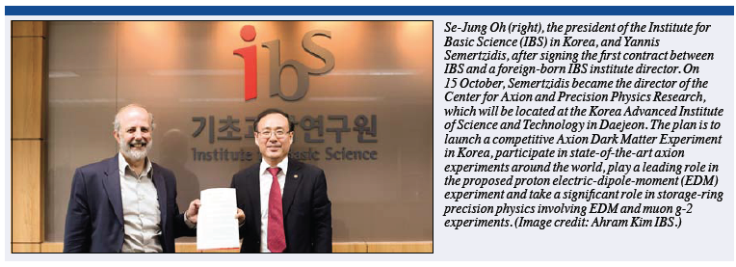
Center for Axion and Precision Physics Research: CAPP/IBS at KAIST, Korea
27 February 2014
Seminar at DESY
by Yannis K. Semertzidis
CERN Courier, Dec. 2013
Completely new (green-field) Center dedicated to Axion Dark Matter Research and Storage Ring EDMs/g-2. KAIST campus.

Slide 2
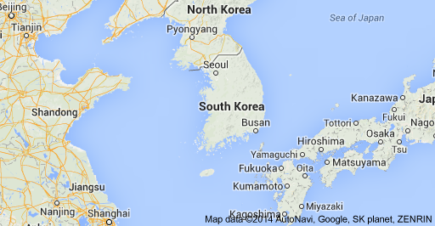
Center for Axion and Precision Physics KAIST, Daejeon, Korea

Slide 3
Center for Axion and Precision Physics KAIST, Daejeon, Korea

Slide 4
Korea, KAIST
Economy is based on technology, exports
They realized they need to invest in long term-basic science
Foreigners are welcome, opening up the society/economy
KAIST President wish list: 10% foreign faculty, 10% women faculty, 10% foreign students
All courses are taught in English

Slide 5
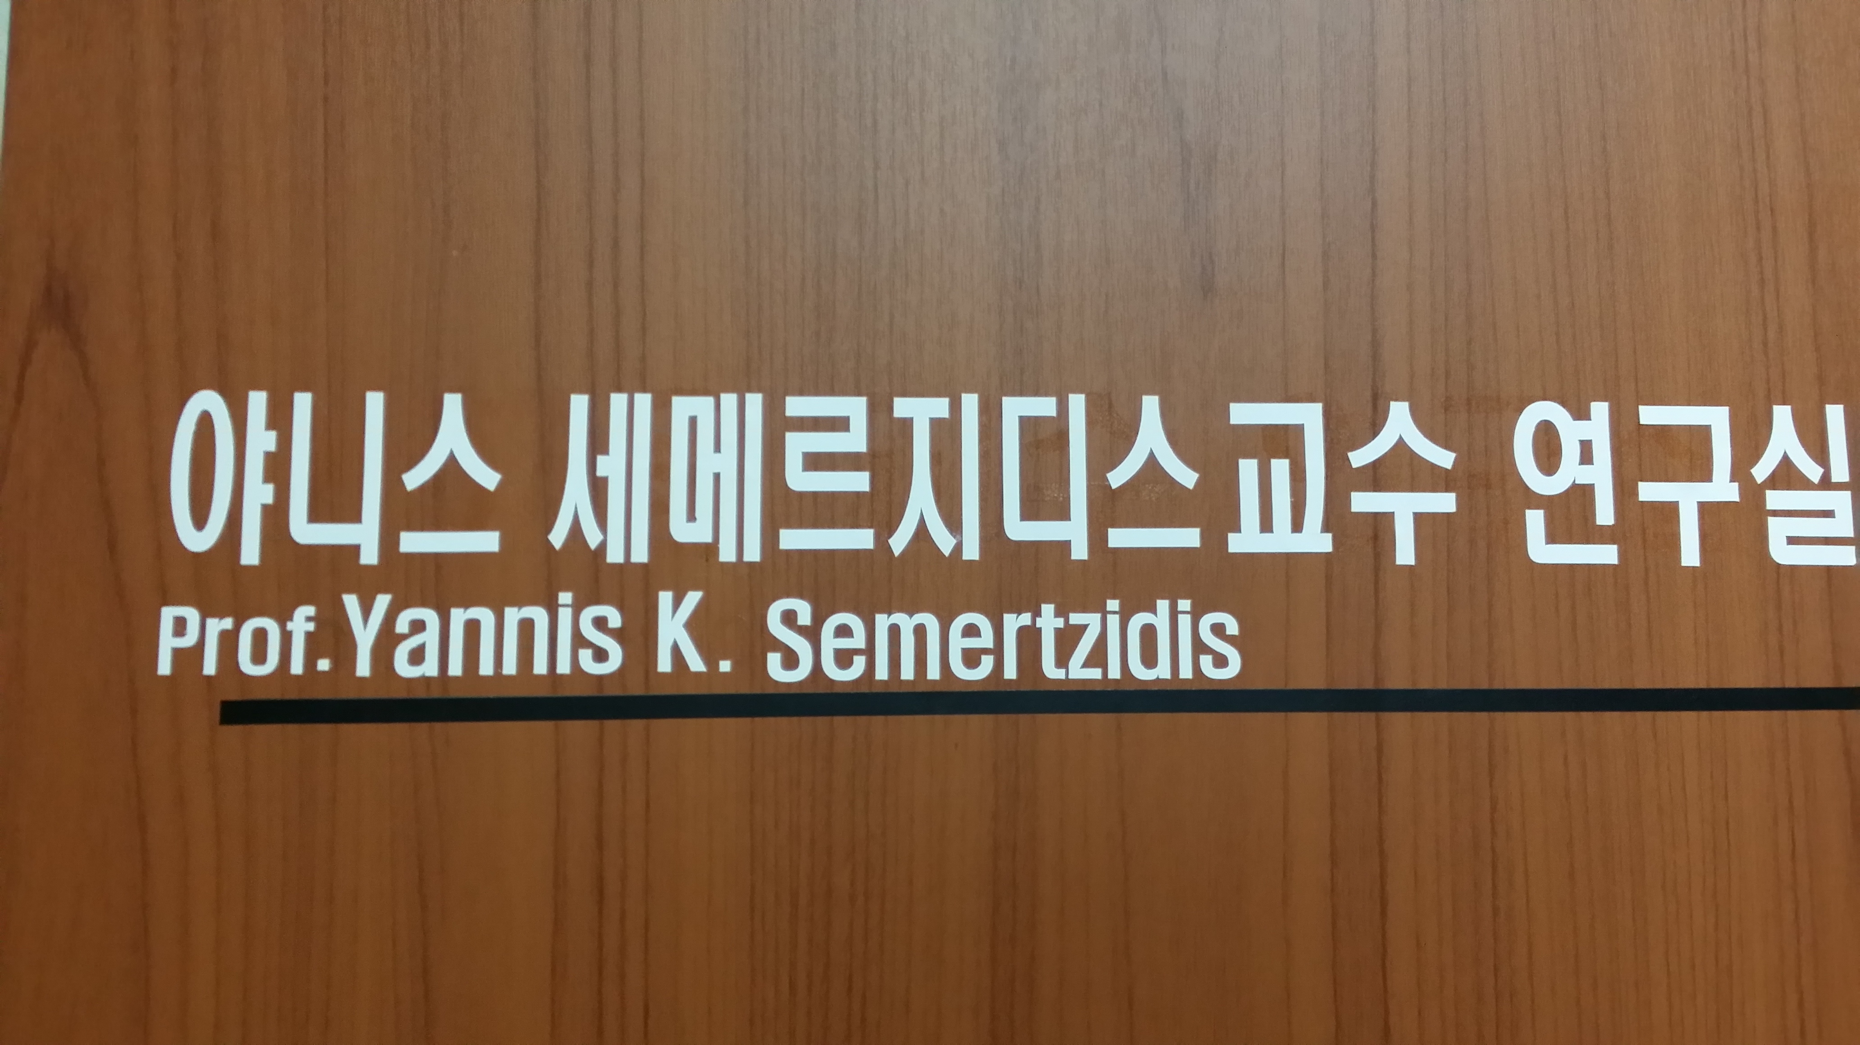
Korean Alphabet (Hangul, 1443AD)
24 characters, consonants and vowels
Easy to read, understand short sentences, orient yourself at public places
Hard to understand complicated sentences
Many people understand English

Slide 6
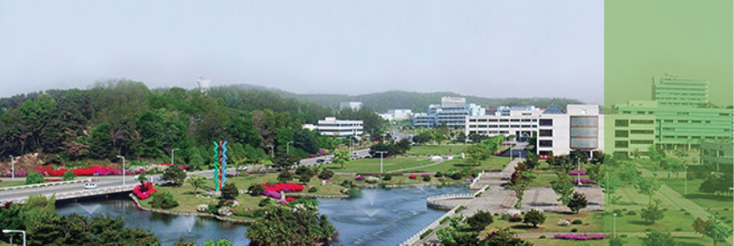
Center for Axion and Precision Physics Research: CAPP/IBS at KAIST, Korea
Four groups
15 research fellows, ~20 graduate students
10 junior/senior staff members, Visitors
Engineers, Technicians
A new building at KAIST funded by IBS

Slide 7
CAPP’s lab space at KAIST (CAPP is a “green-field” center)

Slide 8
CAPP’s lab space at KAIST

Slide 9
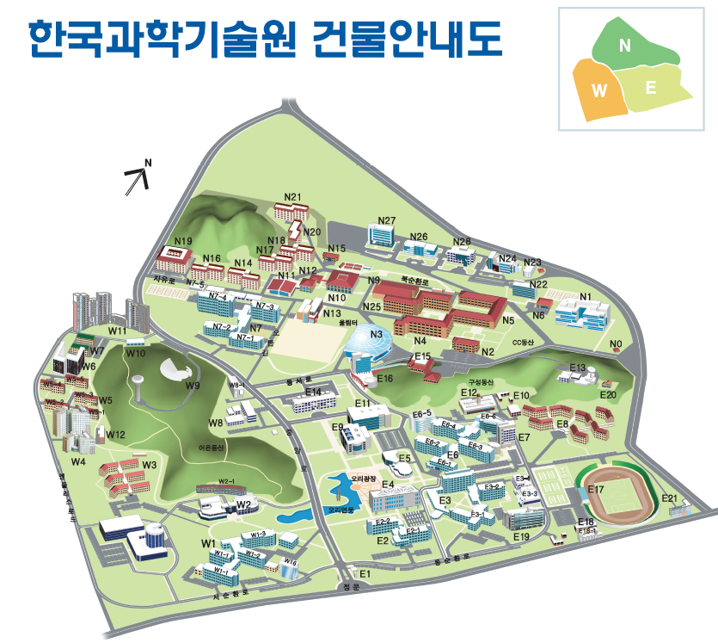
CAPP’s New building location at KAIST
Physics
building

Slide 10
CAPP’s New building at KAIST

Slide 11
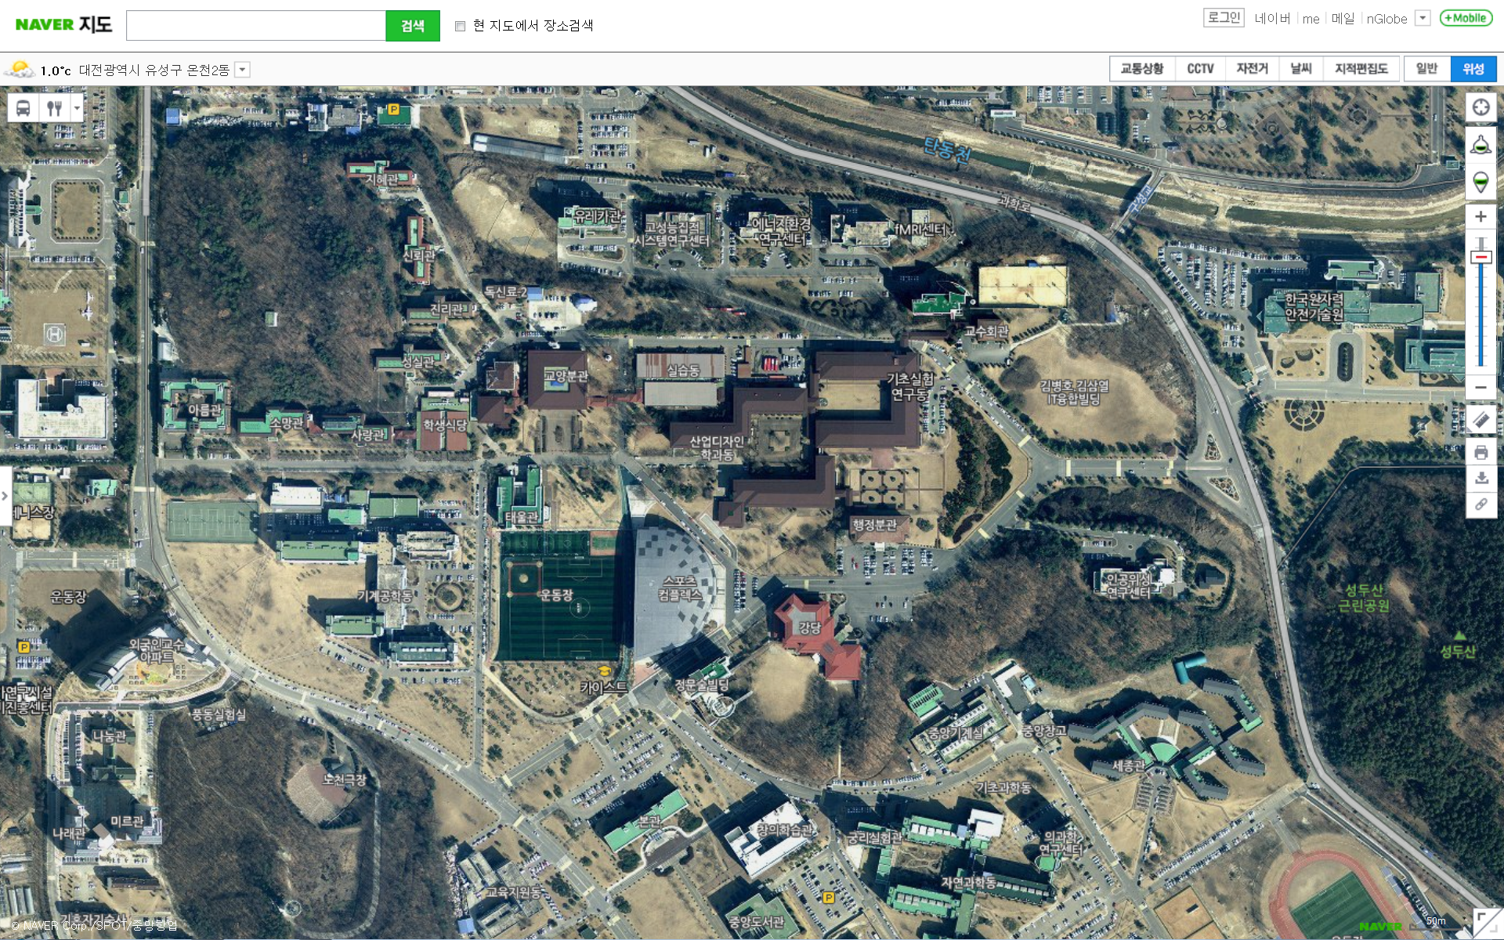
The yellow polygon shows the confirmed construction site for the IBS building in KAIST campus.
The red polygon shows a suggested area for IBS physics building.

Slide 12
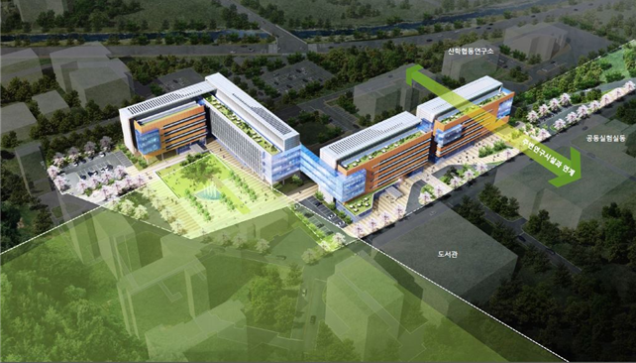
A bird’s eye view for the IBS building in KAIST campus. The four connected buildings may enclose up to 10 IBS centers.
The red polygon shows a suggested area for IBS physics building which may change shape and size in the future.

Slide 13
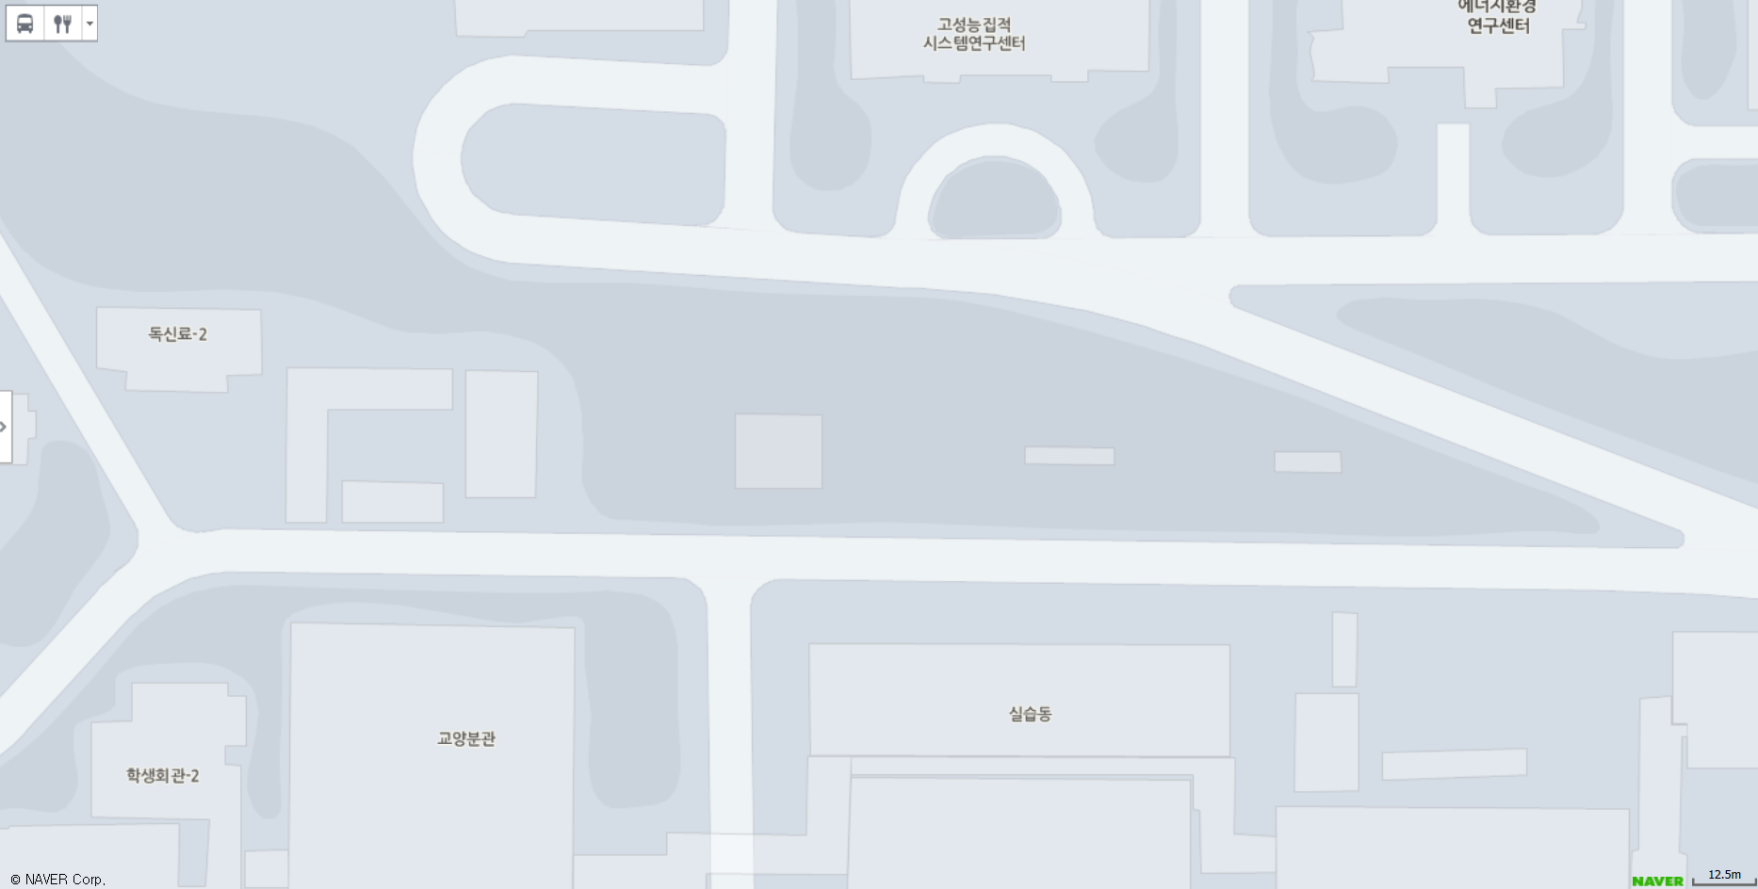
N
B2F (G-8.8m)
150m
Equipment entrance
LN2 storage
Loading dock
IBS Physics
IBS CAPP
28m x 62m (x15m)
48m
28m x 45m (x13m)
Helium Liquefier
S
E
R
E
S
R
E
F E
S: Staircase R: Restroom E: Passenger Elevator FE: Freight Elevator
10m=32.81ft

Slide 14
N
Heavy Equipment Entrance
B2F (G-8.8m)
Pump & Storage Room
Experiment Room 2 (High Q Cavity)
Local Controller
Local Controller
Experiment Room 1 (SQUID & RF)
Local Controller
Local Controller
Control Room
Micro-Kelvin Lab
IBS CAPP
28m x 62m (x15m)
5m
2.78 m/cm
1m

Slide 15
IBS CAPP
Main Entrance
N
South Ground
0m
1F
3 Axis Hoist
-4.4m
B1F
-8.8m
B2F
62m
North Ground
28m
15m
Heavy Equipment Entrance
-15m
B3F
(not to scale)
Concrete floor thickness > 1.2m
Concrete piles
Bedrock

Slide 16
N
2F
IBS CAPP
Main Entrance
1F
0m
hoist
RF shields
B1F
Axion detector cavity
-4.4m
Equipment Entrance
B2F
-8.8m
high magnetic field & low temperature helium dewar
Utility Pipelines
B3F
(not to scale)
-15m

Slide 17
CAPP-Physics
Establish Experimental Particle Physics group. Physics involvement driven by the interest of CAPP individual scientists.
Involved in important physics questions:
Strong CP problem
Cosmic Frontier (Dark Matter axions)
Particle Physics (most sensitive proton EDM experiment, flavor conserving CP-violation)
Muon g-2; muon to electron conversion (flavor physics)

Slide 18
CAPP Physics plan
Setup lab for axion dark-matter search at KAIST based on
High Field magnets: 25T, 35T,…
R&D towards utilizing high super-conducting cavities with large magnetic fields
Coordinate with ADMX to avoid duplication. Aim to start taking data within 5-6 years.
Play a leadership role in the Storage Ring Proton EDM experiment at Fermilab and significant roles in the muon g-2/EDM experiments, …

Slide 19
CAPP Structure
IBS
CAPP Director
International Advisory Committee
Admninistrative support team
Scientific Research Group
Technical support team
Group 1
Axion dark matter experiment
Group 2
State of the art amplifiers/physical temperature
Resonators/Quality factors
Proton EDM

Slide 20
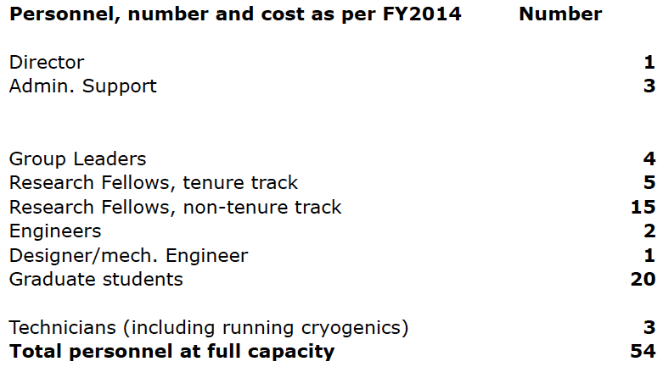
CAPP Personnel at full capacity Plus a large number of visiting positions

Slide 21
Visitors
Send me an email when you want to visit
Write down what you want to work on
Develop your ideas
Come and do your experiment (you as PI)
(Leading to eventual publishable results)
Incentives for teaching Nuclear/Particle Physics/Cosmology at KAIST (need at least six months warning to setup course).

Slide 22
Axion Dark matter
Dark matter: 0.3 GeV/cm³
Axions in the 2-300μeV range: 10¹²-10¹⁴/cm³
Lifetime ~7×10⁴⁴s (100μeV / m_{a})⁵
They condense, kinetic energy ~10⁻⁶m_{a}

Slide 23
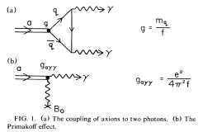
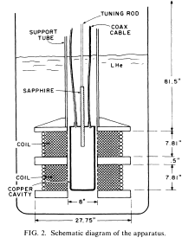
Axion dark detection mechanism
Sikivie invented a method to detect the “invisible” axions using Primakoff effect

Slide 24
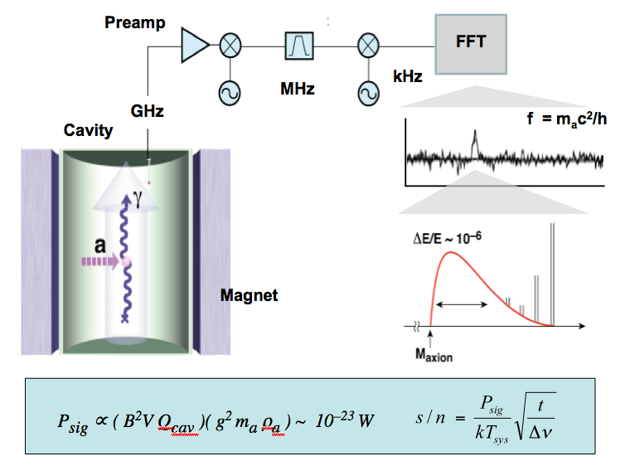
Axion Dark Matter eXperiment

Slide 25
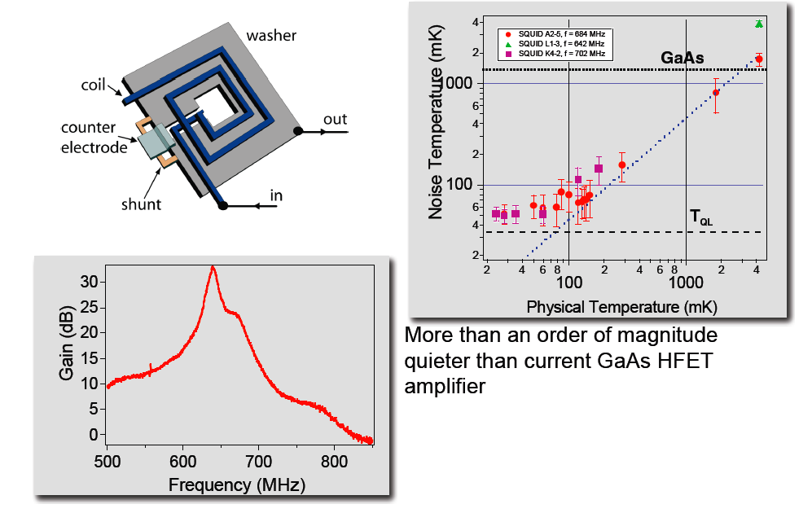
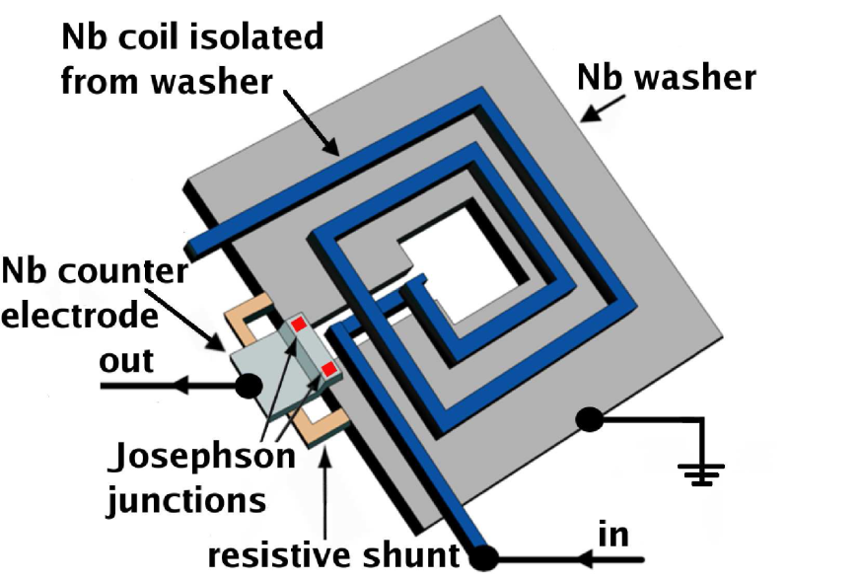
What next? Q, B, V, T_{Noise}

Slide 26
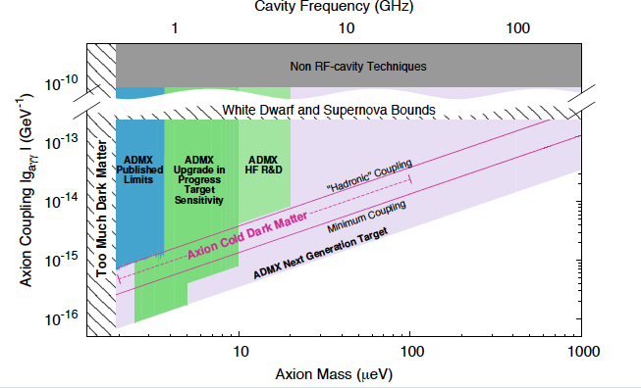
Projected coverage in next few years

Slide 27
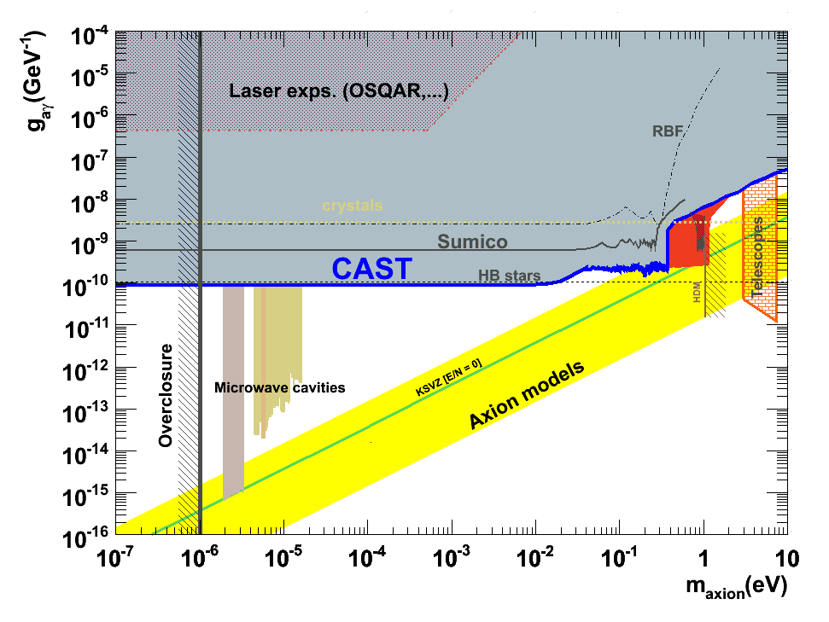
Axion limits

Slide 28
Axion dark matter plan, 1
Important parameters in the Sikivie method:
B², V, Q, Noise Temperature
We have started an R&D program for new magnets: goal 25T first, then 35T. Currently all axion experiments are using <10T.
Based on high Tc cables (Korean companies involved). Program length is ~5 year, ~$10M

Slide 29
Axion dark matter plan, 2
Important parameters in the Sikivie method:
B², V, Q, Noise Temperature
We have started an R&D program to achieve large Q in the presence of large B-fields. Presently: Q~10⁵ copper cavities. Aiming for >10⁶.
KAIST is a world renowned Institute in condensed matter physics. We are planning to invest ~$2M/year.

Slide 30
Axion dark matter plan, 3
Important parameters in the Sikivie method:
B², V, Q, Noise Temperature
We have started a development program with KRISS (Korean NIST equivalent) to provide us with (near) quantum noise limited SQUID amplifiers in the 1-10 GHz range. Evaluate method for higher frequency. 5 year program.
Physical temperature: aiming for 30mK (QL: 50mK at 1GHz).

Slide 31
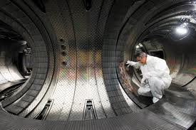
Axion dark matter plan, 4
Important parameters in the Sikivie method:
B², V, Q, Noise Temperature
Large volume for low frequencies (e.g., Tokamaks). Critical issue is temperature. Very expensive. We have started a group at KAIST to study ways to produce such a system

Slide 32
Proton EDM plan
Produce a proposal for Fermilab to do the proton EDM experiment with 10⁻²⁹ e•cm sensitivity (1st stage). November 2014.
Start developing systems (funding from Korea when needed):
SQUID-based Beam Position Monitors using SQUID technology from KRISS (3fT/√Hz)
Proton EDM polarimeter, high efficiency, low systematic errors (<1ppm systematic errors)
E-field plate development (J-LAB)
Precision tracking (ppb accuracy)

Slide 33
Physics reach of magic pEDM (Marciano)
Sensitivity to new contact interaction: 3000 TeV
Sensitivity to SUSY-type new Physics:
The proton EDM at 10⁻²⁹e∙cm has a reach of >300TeV or, if new physics exists at the LHC scale, δ<10⁻⁷-10⁻⁶ rad CP-violating phase; an unprecedented sensitivity level.
The deuteron EDM sensitivity is similar.
Notes:
33

Slide 34
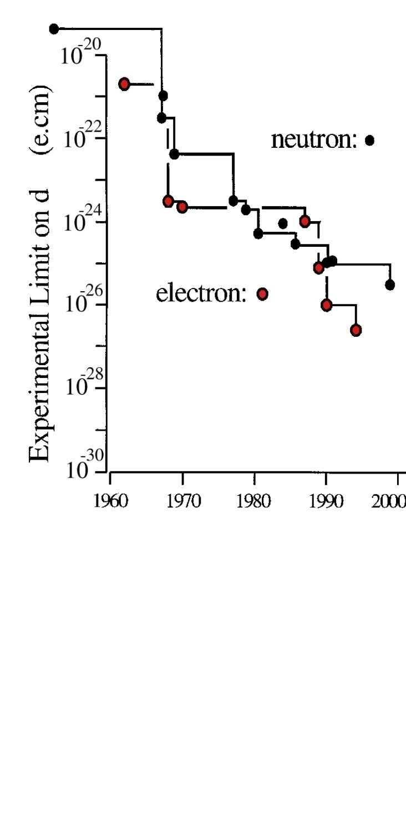
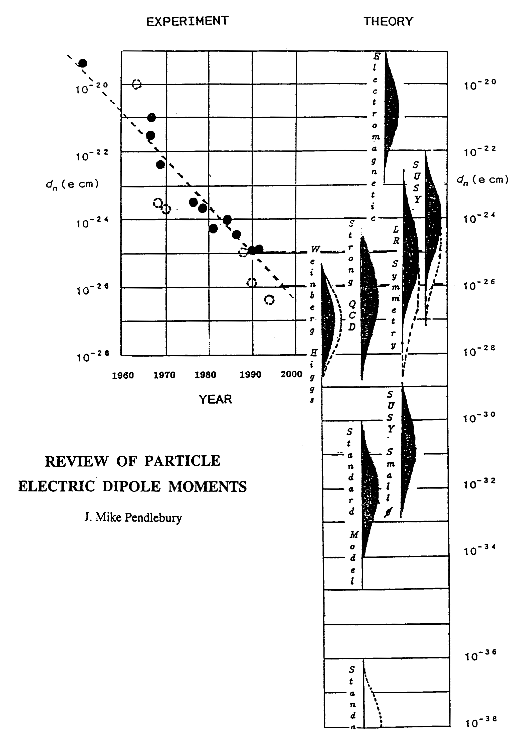
Sensitivity to Rule on Several New Models
Gray: Neutron
Red: Electron
If found it could explain
Baryogenesis
(p, d, n (or ³He))
n current
e current
GUT SUSY
Electroweak
Baryogenises
n target
p, d target
e target
Upgrade?
Electron EDM New Physics reach: 1-3 TeV,
Gabrielse et al., 2013
Statistics limited
Much higher physics reach
than LHC; complementary
e-cm
J.M.Pendlebury and E.A. Hinds, NIMA 440 (2000) 471

Slide 35
Our proton EDM plan
Develop the following systems (funded by IBS/Korea, COSY/Germany, applying for NSF support, and seek support from DOE-HEP/NP):
SQUID-based BPM prototype, includes B-field shielding (UMass, CAPP/Korea, BNL,…)
Polarimeter development (Ind. Univ., CAPP, COSY,…)
Electric field prototype (Old Dom. Un. (NSF), JLab,…)
Study of systematic errors (BNL, FNAL, Cornell,…)
Precision beam and spin dynamics simulation (BNL, CAPP, Cornell, COSY,…)
Lattice optimization, beam diagnostics (MSU (NSF),…)

Slide 36
Technically driven pEDM timeline
13
14
15
16
17
18
19
20
21
22
Two years system development
One year final ring design
Three years beam-line construction and installation

Slide 37
P5 process in the US (Particle Physics Project Prioritization Panel)
If you want to contribute:
http://www.usparticlephysics.org/p5/form

Slide 38
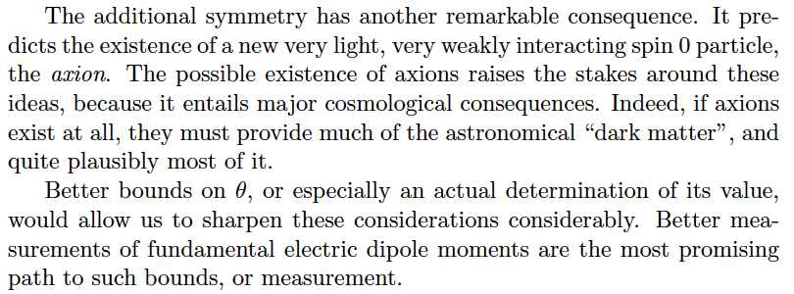
Frank Wilczek

Slide 39
Time Matters
Emphasis on getting early results
Emphasis on getting best results in long-term
We need first results within the first 3-4 years
First major evaluation 4 years from now. Rigorous, in-depth evaluation.
Then every three years.

Slide 40
CAPP R&D: collaboration opportunities
Axion dark matter
Superconductivity and B-fields, new geometries, new techniques
High B-fields
Low noise SQUID amplifiers, low physical temp
Bring your ideas to Korea.
Collaboration with existing/future dark matter experiments (dish antenna?)

Slide 41
CAPP R&D: collaboration opportunities
SQUID-based beam position monitor ~1fT/√Hz
Polarimeter prototype, high rate, low syst. err.
Proposal to FERMILAB in fall 2014
Protons

Slide 42
Summary
Axion dark matter experiments are the highest priority. CAPP can have a significant role in probing the axion mass range 1-100 μeV and beyond.
Proton EDM: Probe EW-Baryogenesis, high-mass scale New Physics at ~10³ TeV.
Some of the most important physics questions today: 1) What is the Dark Matter? 2) Probe the matter-antimatter asymmetry (Baryogenesis) and Physics Beyond the Standard Model.

Slide 43
Extra slides

Slide 44
Physics strength comparison (Marciano)
System | Current limit [e⋅cm] | Future goal | Neutron equivalent
Neutron | <1.6×10⁻²⁶ | ~10⁻²⁸ | 10⁻²⁸
¹⁹⁹Hg atom | <3×10⁻²⁹ | <10⁻²⁹ | 10⁻²⁵-10⁻²⁶
¹²⁹Xe atom | <6×10⁻²⁷ | ~10⁻²⁹-10⁻³¹ | 10⁻²⁵-10⁻²⁷
Deuteron nucleus |  | ~10⁻²⁹ | 3×10⁻²⁹- 5×10⁻³¹
Proton nucleus | <7×10⁻²⁵ | ~10⁻²⁹-10⁻³⁰ | 10⁻²⁹-10⁻³⁰
Notes:
44

Slide 45
IBS Physics
Main Entrance
N
South Ground
0m
1F
3 Axis Hoist
-4.4m
B1F
-8.8m
B2F
62m
North Ground
28m
15m
Heavy Equipment Entrance
-15m
B3F
(not to scale)
Concrete floor thickness > 1.2m
Concrete piles
Bedrock

Slide 46
Axion dark-matter limits
HEMT
<2004

