Slide 1
XFEL beamline development
Lutz Winkelmann
XFEL beamline development

Slide 2
Outline
Injector laser setup and characteristics
Route of the beamline
Concepts for the injector laser beamline
Results from optical simulations
Diagnostics at laser room and gun

Slide 3
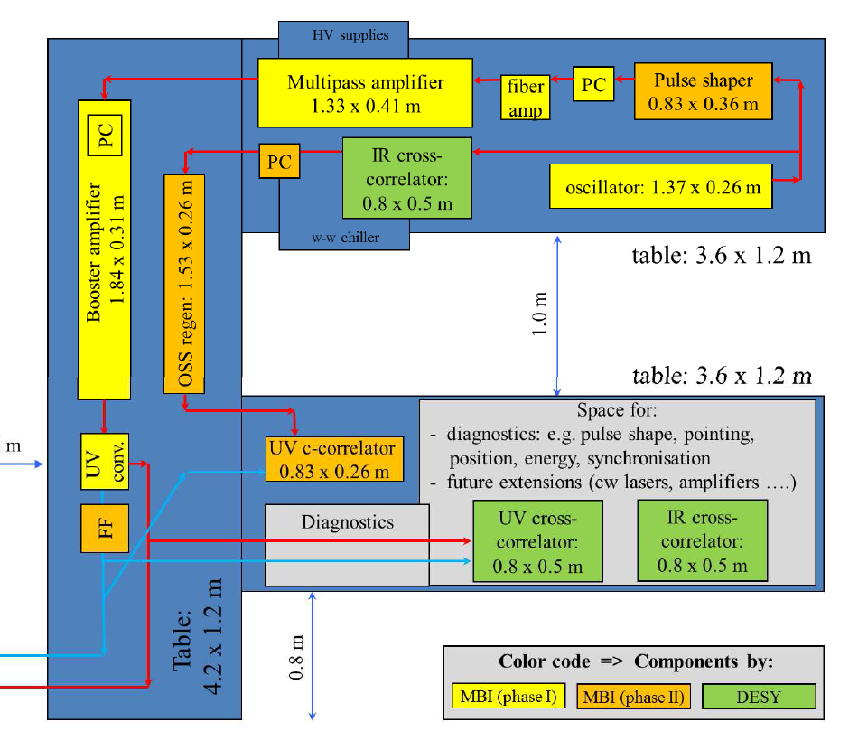
Injector laser setup and characteristics

Slide 4
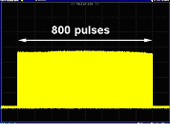
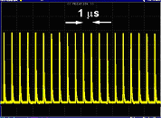
Injector laser setup and characteristics
2700 pulses
2700 pulses
0.6 – 1 ms
99.X ms
0.6 – 1 ms
Pulse trains (bursts) of ps-pulses
Single pulse duration 3-12 ps
Repetition rate for XFEL up to 4.5 MHz
Burst repetition rate 10 Hz
Pulse energy 3-4 µJ at 257 nm (fourth harmonic)
222 ns
2700 pulses at 4.5MHz in XFEL
Laser setup: http://www.mbi-berlin.de/de/research/projects/4-1/subprojects/UP1/Laser_and_gun.swf

Slide 5
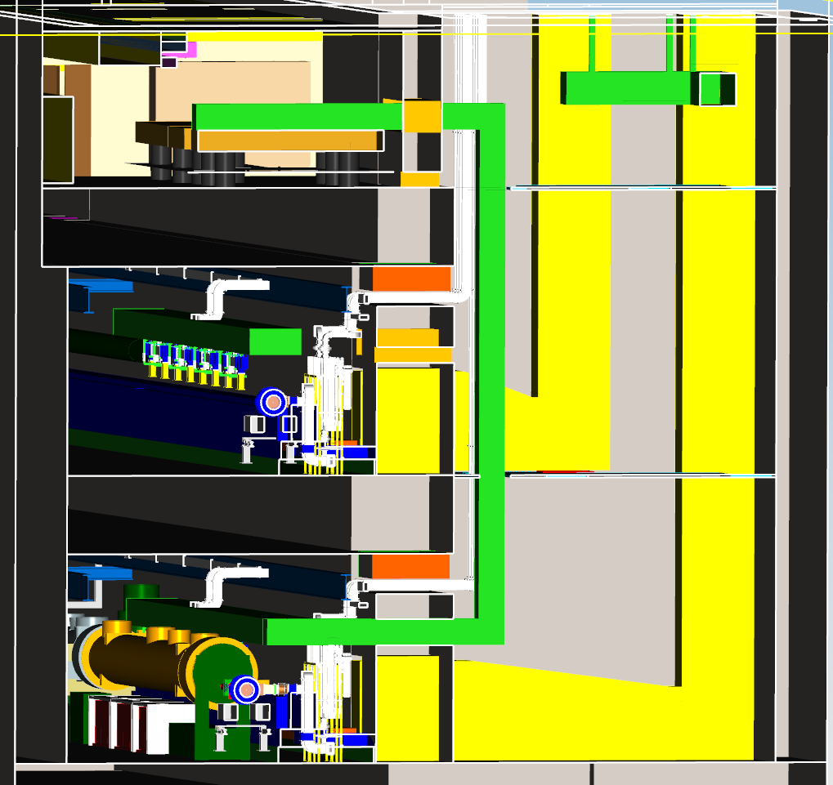
Route in XFEL building to the gun section
laser room in UG5
beamline
media shaft
gun section of XFEL

Slide 6
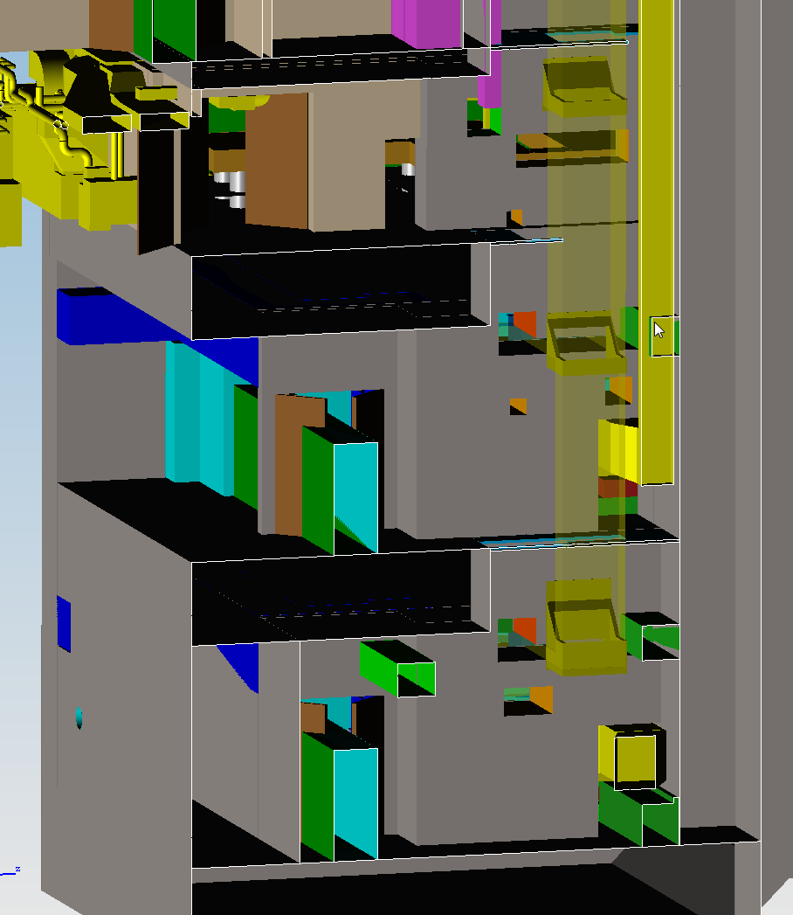
Route in XFEL building to the gun section

Slide 7
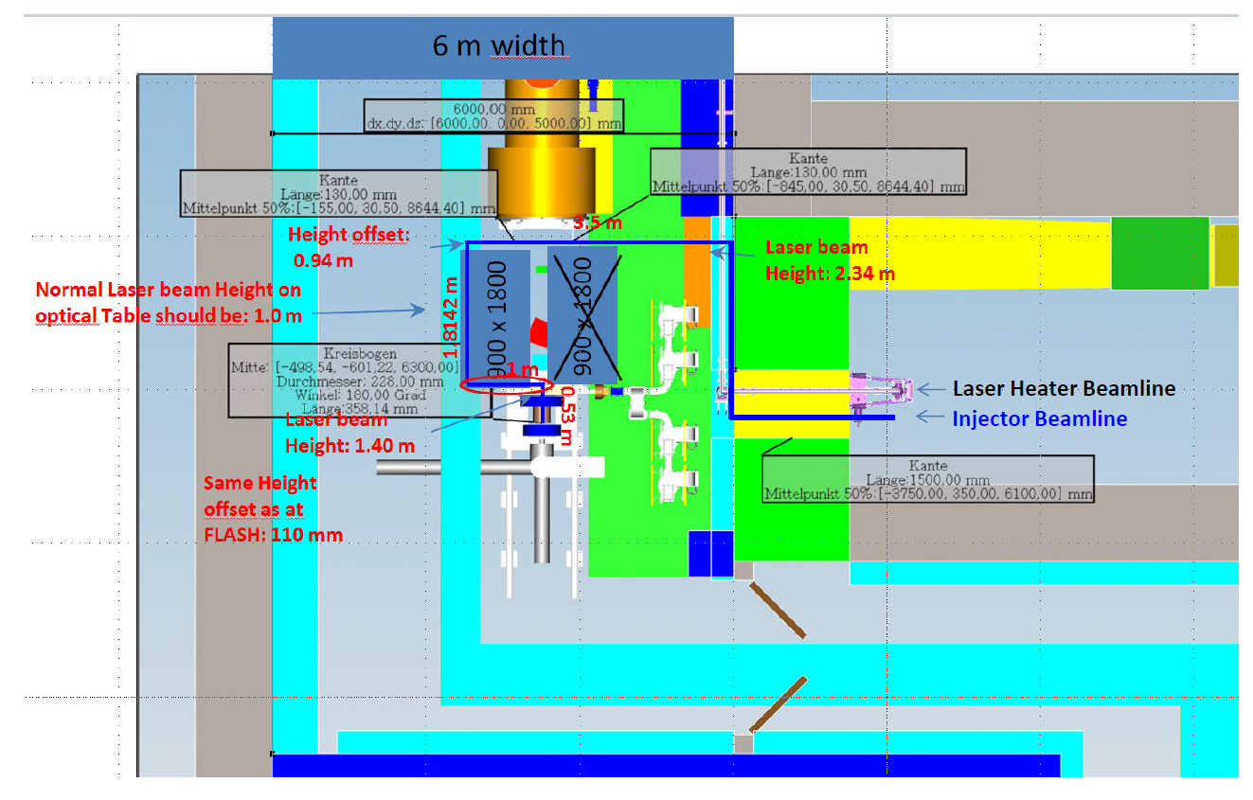
Lengths in XFEL building to gun – Old concept

Slide 8
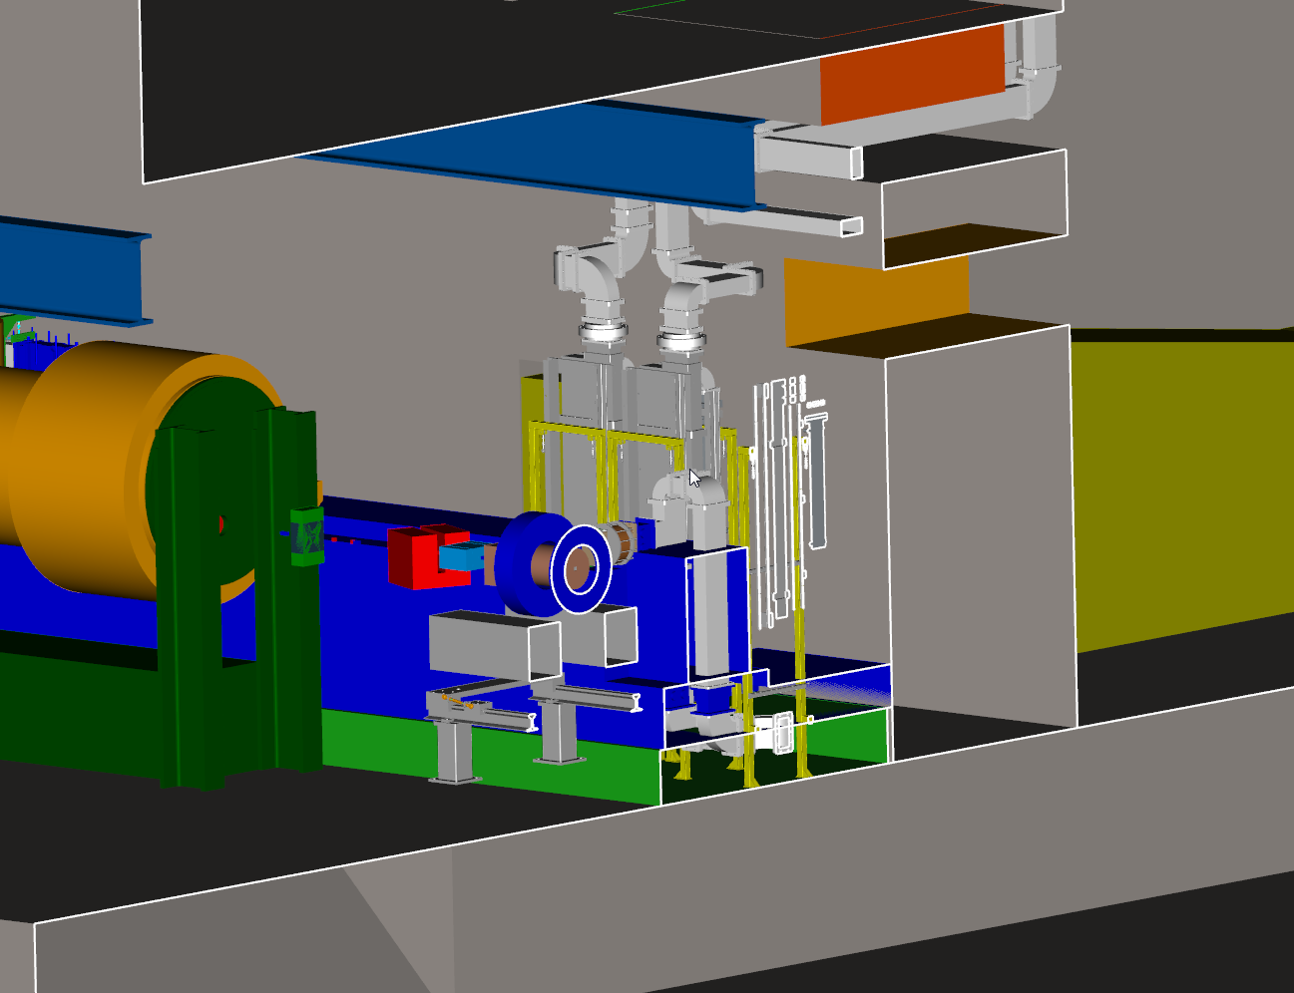
Route in XFEL building to the gun section

Slide 9
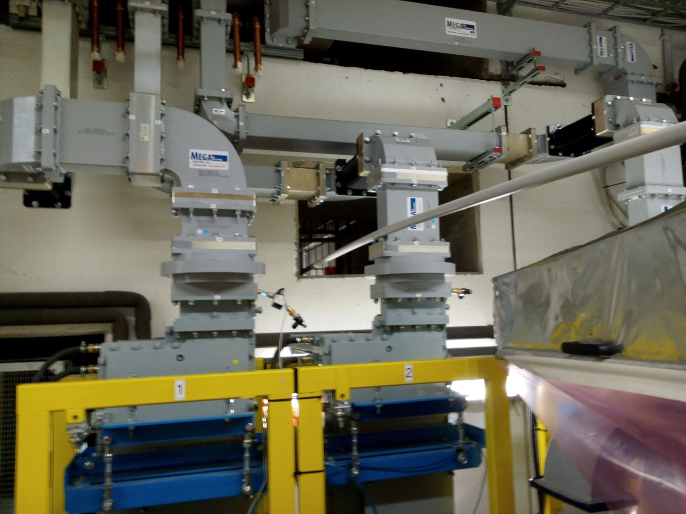
Route in XFEL building – model to reality

Slide 10
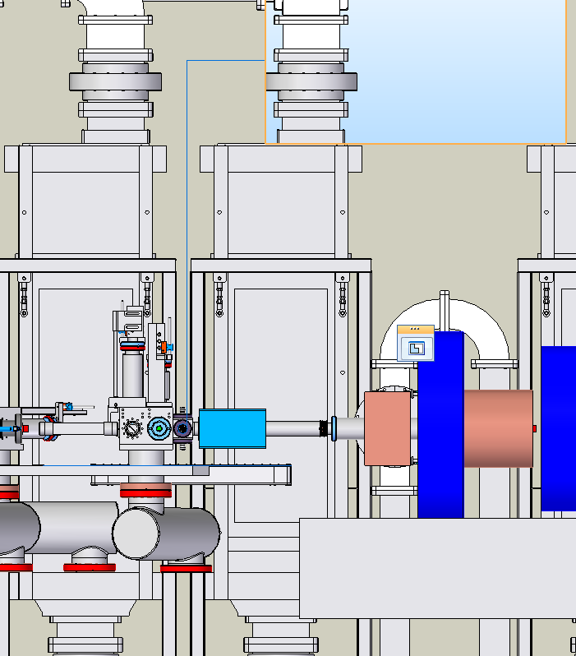
Route in XFEL building – model to reality

Slide 11
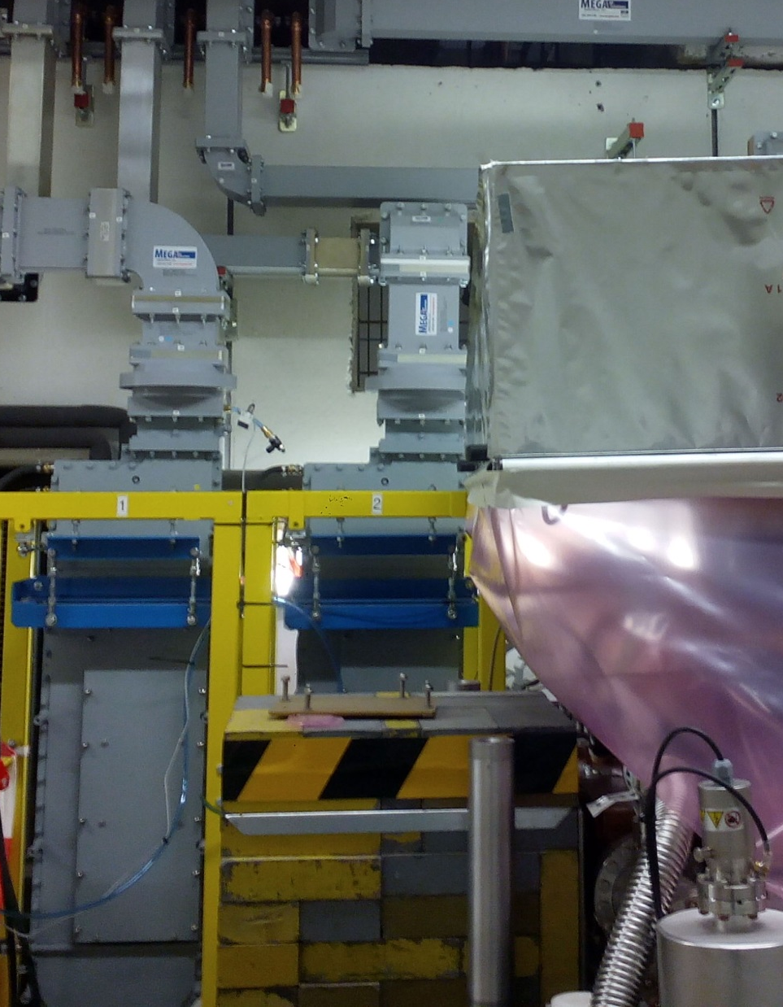
Route in XFEL building – model to reality

Slide 12
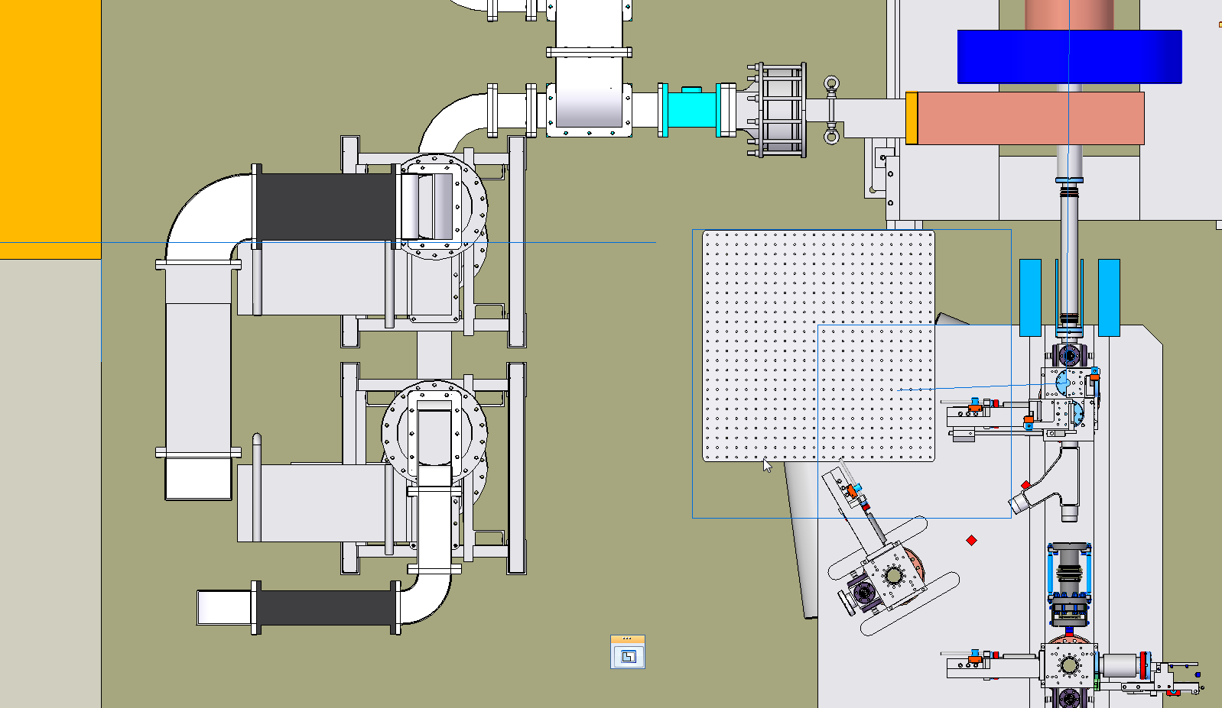
Route in XFEL building to the gun section

Slide 13
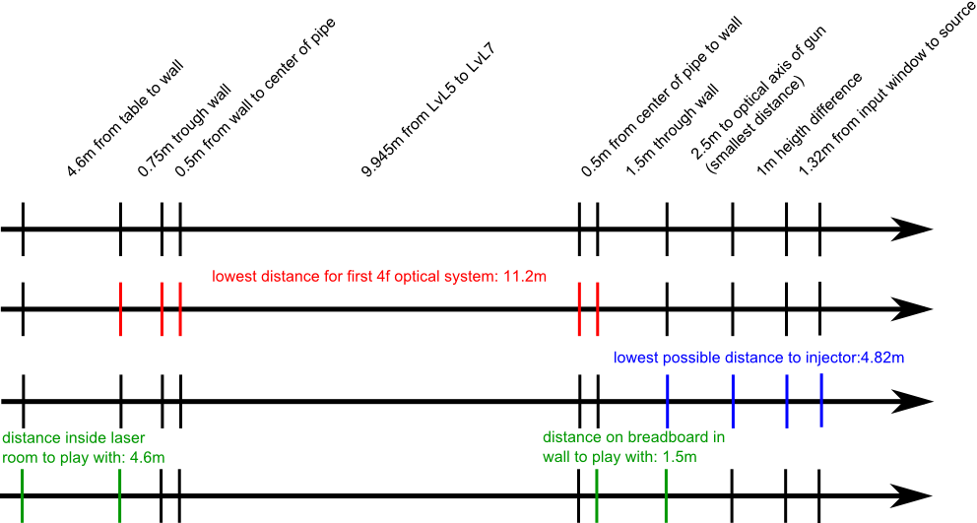
Lengths in XFEL building to gun

Slide 14
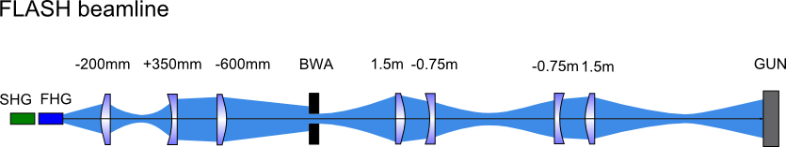
Concepts for beamline optical setup

Slide 15
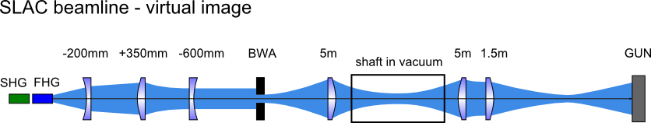
Concepts for beamline optical setup

Slide 16
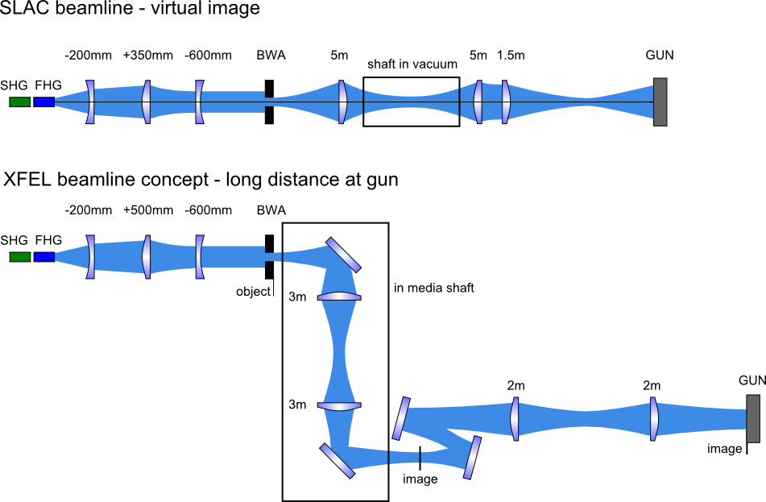
Concepts for beamline optical setup

Slide 17
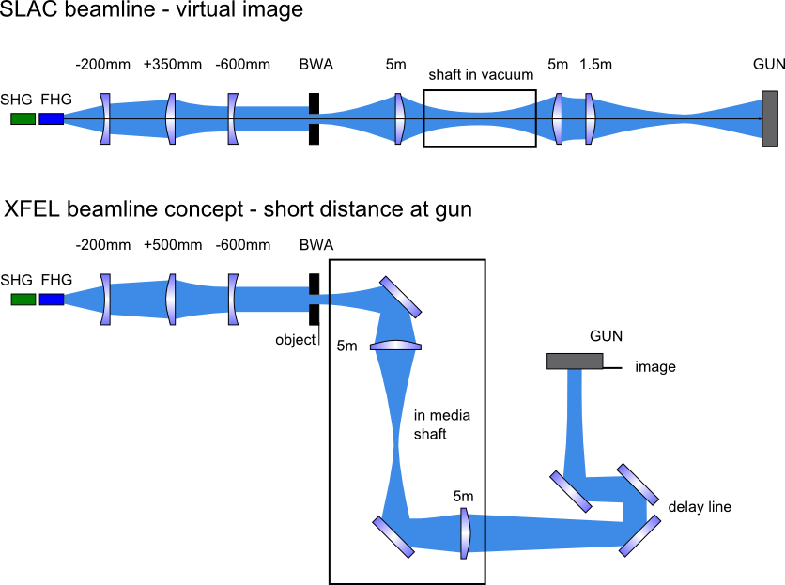
Concepts for beamline optical setup

Slide 18
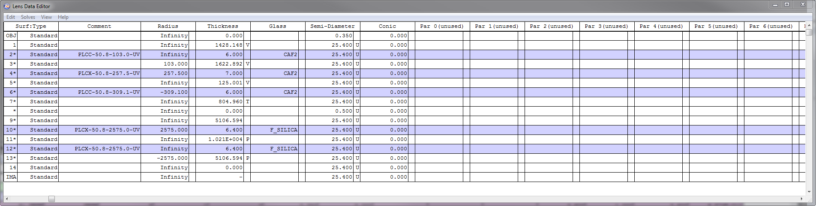
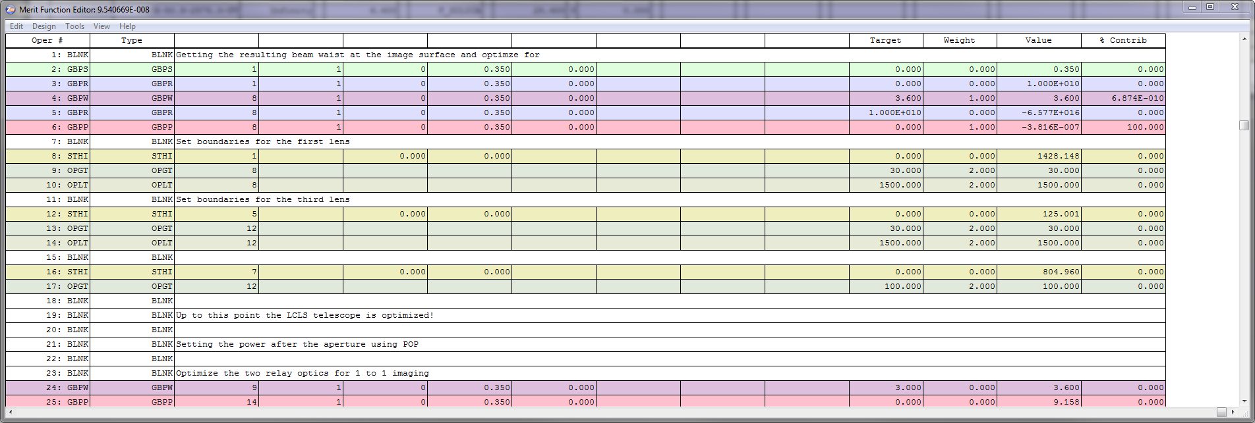
ZEMAX – modeling the beamline – sequential mode
Surface definition of the optical system
Function of merit definition –
optimize positiuon of lenses for beam waist and radius of curvature

Slide 19
ZEMAX – sequential optical system
waist between SHG and FHG
at position of aperture
image of aperture at gun

Slide 20
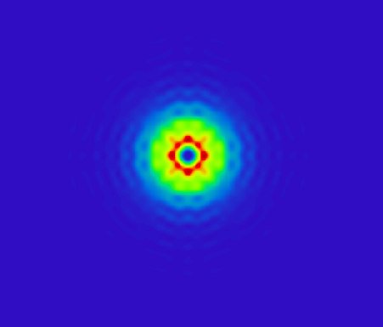
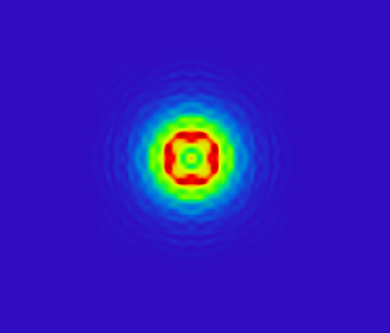
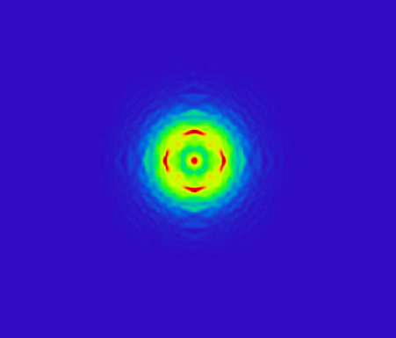

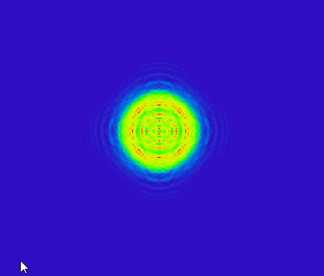

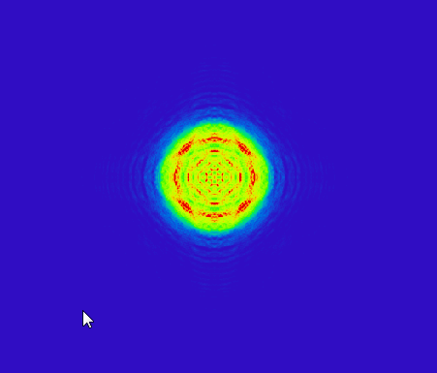
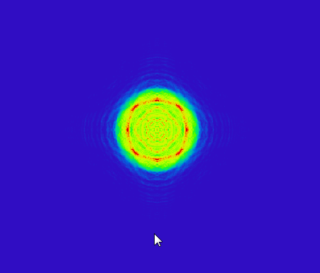

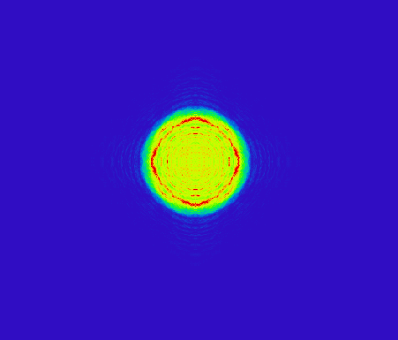
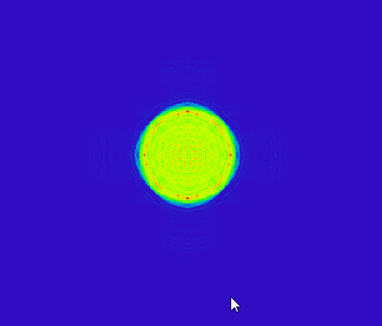
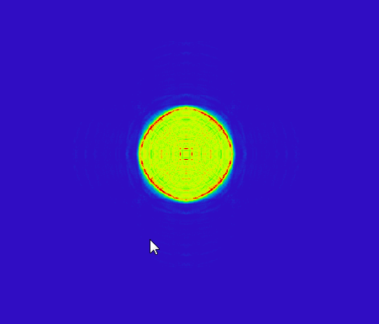
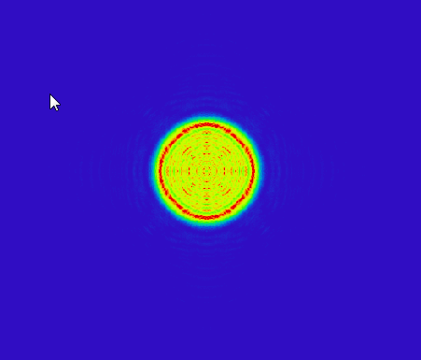
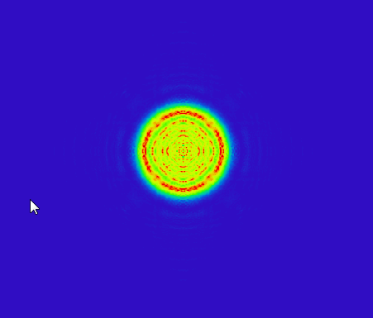


Evolution of beam profile along z-axis downstream of 4f
photocathode

Slide 21
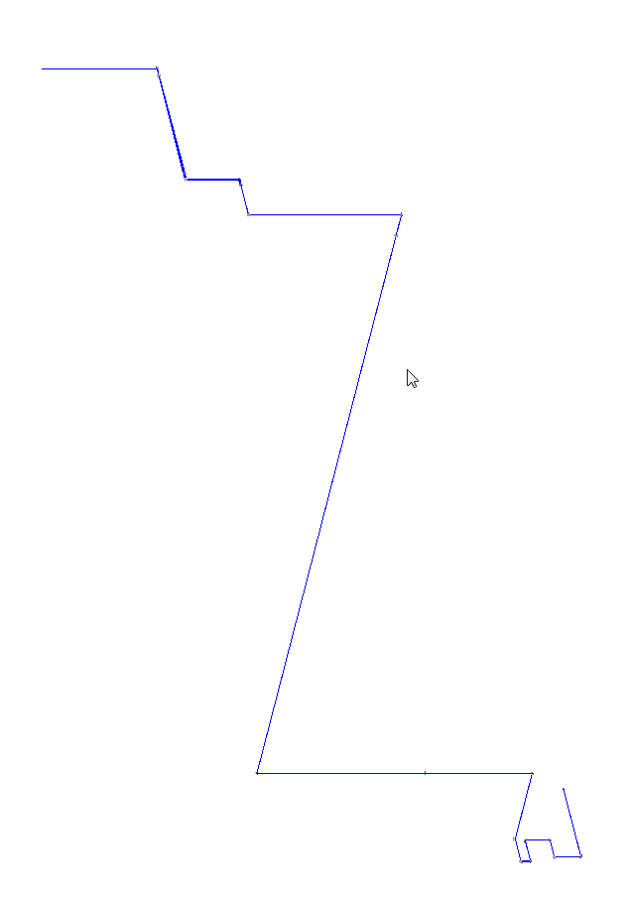
ZEMAX non-sequential model of the beamline
fourth harmonic
position of aperture
Beam expander telescope
lens 1 in media shaft
lens 2 in experimental hall

Slide 22
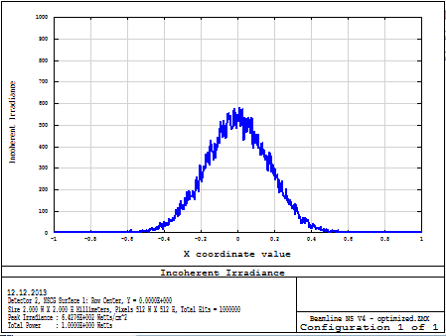
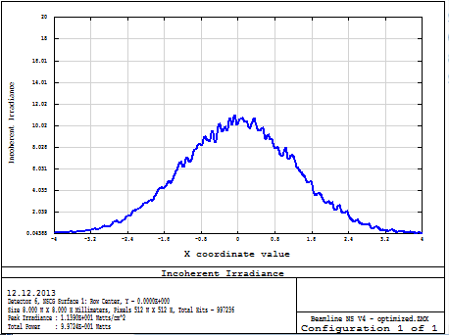
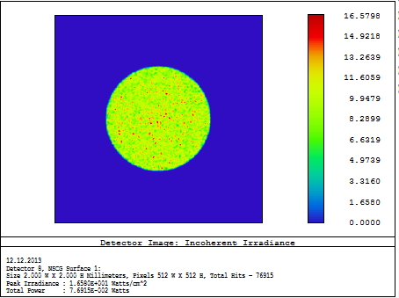
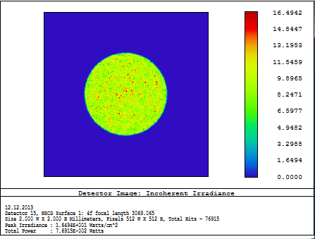
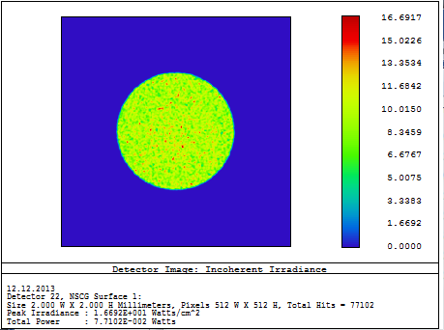
ZEMAX non-sequential model of the beamline

Slide 23
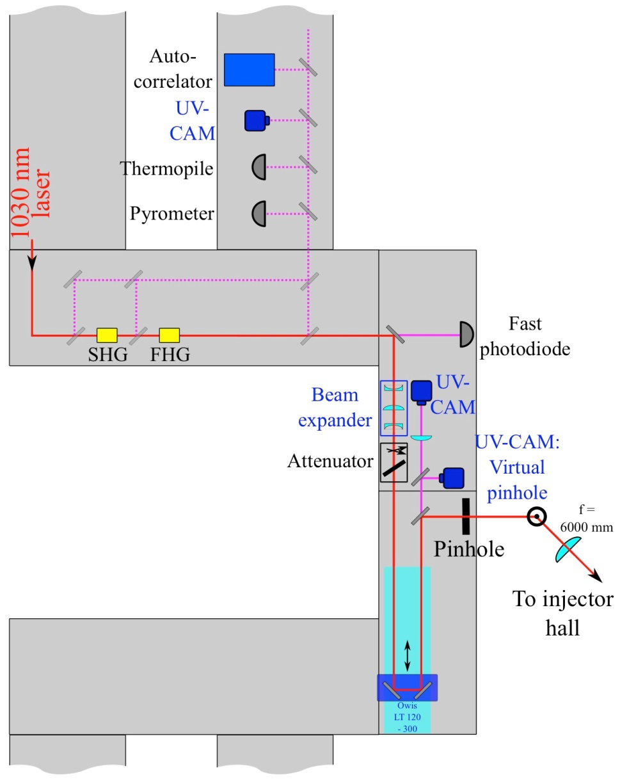
Beam diagnostics and control – laser room UG5
Diagnostics
& controls
Occasional
use
Beam pointing
stabilization
Pulse
delay
Average
power
Pulse duration
shape
Beam shape
Laser energy/power
Single pulse
energy
Waist/Caustic/M²
Beam
diameter

Slide 24
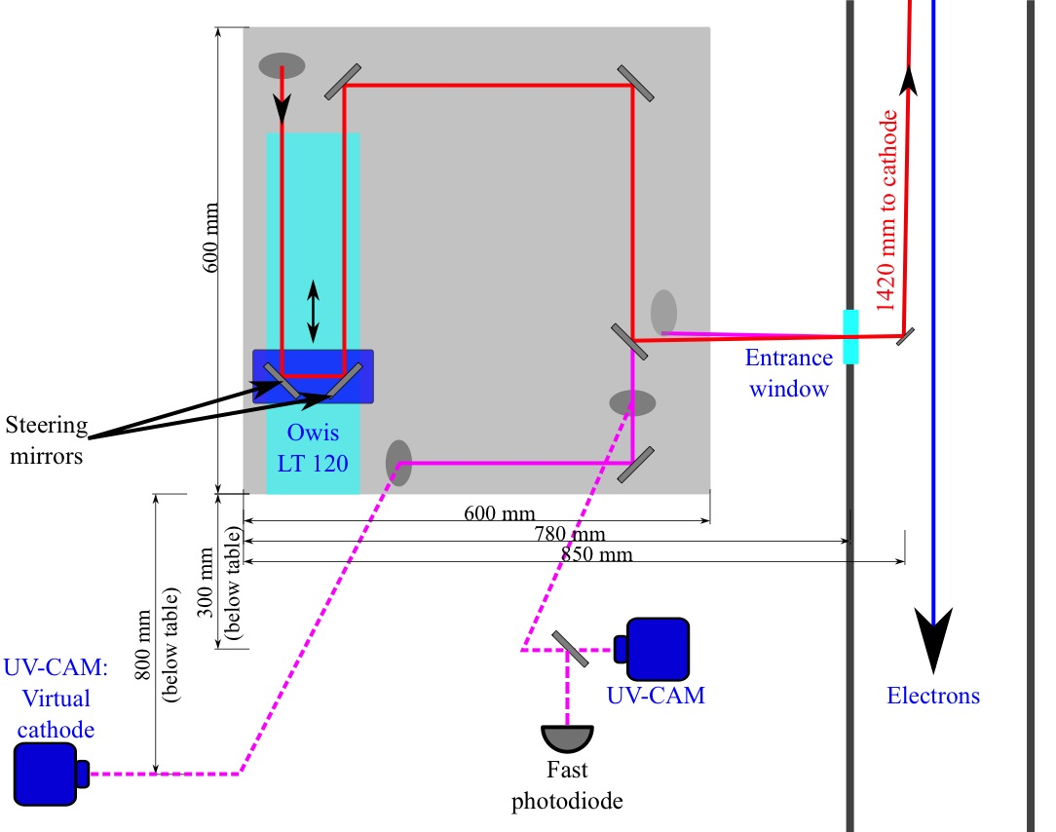
Beam diagnostics and control – at gun
Diagnostics
& controls
Beam pointing
stabilization
Average
power
Beam shape
Single pulse
energy
FLASH:
  Fused silica plate can be moved into the beam, has to be removed when operated
XFEL:
  Leakage port for beam diagnostics (PD and first CCD)
  Virtual cathode (CCD camera at optical path position of photocathode) - beam taken from input window to gun

Slide 25
Summary
Clear descission on the optics selection depends on the possibilities for extra room at the gun section
Quotes for lenses and mirrors allready there
SLAC beam expander system favourable (no focus)
XFEL building structure does not fit to CAD model
Diagnostics are currently sortet out – plan so far:
  Photo diodes for single pulse monitoring
  CCD-cameras for diagnosis and auto-alignment
  UV cross-correlator for pulse length control, needs full power laser for operation
  Optional for debugging: energy meter, power meter, beam waist analyser
Plan for auto-alignment loop and control with DOOCS interfacing
DOOCS interfaces for all diagnostic components

