Slide 1
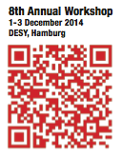
Organisational Details
Where:
Main auditorium (here)
Seminar room area in building 1b (rooms 3,4,5)
Seminar room 2 (across the road, in building 2a)
When
Session on Tuesday morning start 8:30
Plenary session on Wednesday starts 9:00
Lunches:
DESY canteen
Follow signs!
Tonight:
After plenary session: Screening of the film “Particle Fewer” in the main auditorium
Reception starting around 19:30, in the canteen extension

Slide 2
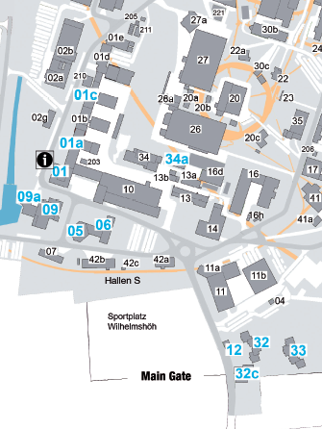
Organisational Details
SR 2
SR 3,4,5
Canteen
Lecture Hall Guest services
Main entrance

Slide 3
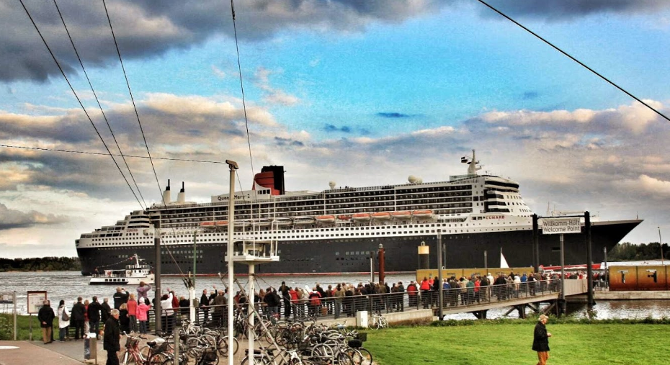
Organisational Details II
Coffee breaks:
In front of the main auditorium every day
In front of seminar room 4 tomorrow
Institute assembly:
Tomorrow (Tuesday) during the lunch break (lunch bag provided)
Dinner:
Tomorrow evening, at the “Schulauer Fährhaus” in Wedel
Transport to the dinner place by bus, departing 18:30 in front of the main auditorium
Please tell us TODAY if you do not come to the dinner!!!

Slide 4
Organisational Details III
Mini Media Training
Wednesday 3 December, 14:30 in seminar room 4
Will introduce participants to different media and the daily challenges of journalists.
includes practical exercises for interviews with friendly and less friendly journalists.
Please fill your name into list at registration desk.

Slide 5
Organisational Details IV
WLAN: please get an instruction sheet at the registration
Registration desk: your central help point. We try to have someone there at all times, certainly during coffee breaks.
If you have questions / suggestions:
Contact:
Thomas Schoerner-Sadenius (9-3429 from any DESY telephone)
Ties Behnke (Tel 9-4918 from any DESY telephone)

