Slide 1


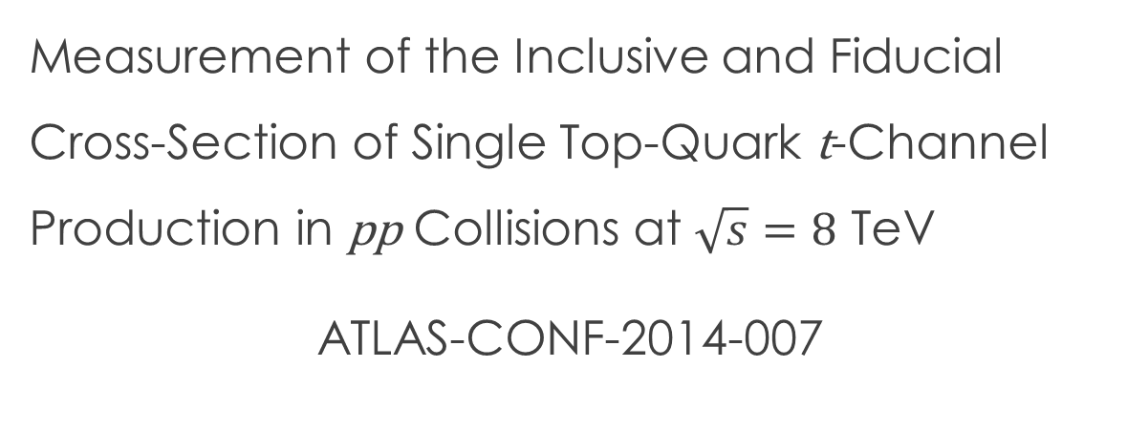
Measurement of the Inclusive and Fiducial Cross-Section of Single Top-Quark t-Channel Production in pp Collisions at $\sqrt{s}=8$ TeV
ATLAS-CONF-2014-007
Phillipp Tepel
Supervisor: Dominic Hirschbühl,
Wolfgang Wagner
Inhalt
Event selection
Background estimation
Measurement
Neural Networks

Slide 2
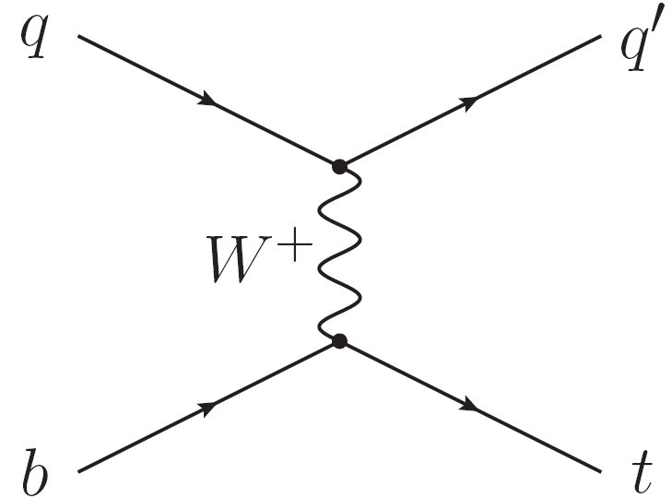
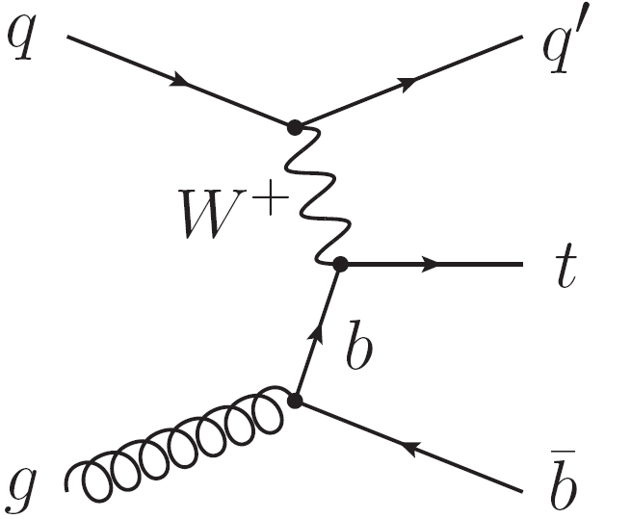

Single Top-Quarks
Treatment of b-Quarks in the initial state in MC generatoren / calculations
Test of the V-A structure of the $W_{tb}$ vertex: polarisation of the top-quark
Test of the V-A structure of the 𝑊_𝑡𝑏 vertex: polarisation of the top-quark
$σ_{t}$ sensitive to PDFs, b-Quark PDF, also to the ratio of u- to d-quark PDF
𝜎_𝑡 sensitive to PDFs, b-Quark PDF, also to the ratio of u- to d-quark PDF
Important for new physics
i.e. FCNC
4-,5-flavour-scheme
i.e. important for $Hb\overline{b}$ production
i.e. important for 𝐻𝑏𝑏 ̅ production
$σ_{t}$∝ ${\left|V_{tb}\right|}^{2}$ without assumptions on the unitarity of the CKM matrix
𝜎_𝑡∝ |𝑉_𝑡𝑏 |^2 without assumptions on the unitarity of the CKM matrix
Dominant production channel: t-channel (tq)
$$σ_{NLO+NNLL}={87.76}_{−1.91}^{+3.44} pb$$
5-Flavour-scheme
4-Flavour-scheme

Slide 3
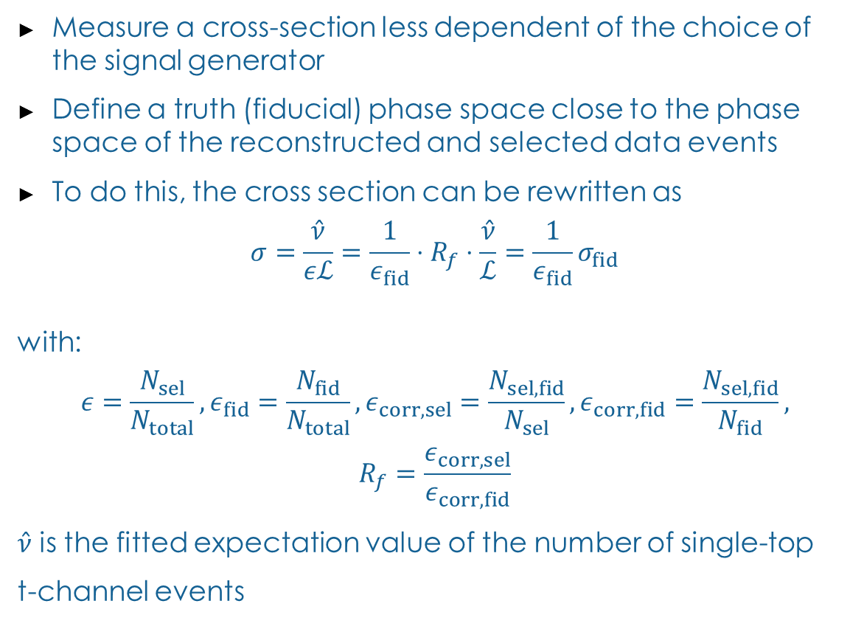




Measurement of the Fiducial Cross-Section
Measure a cross-section less dependent of the choice of the signal generator
Define a truth (fiducial) phase space close to the phase space of the reconstructed and selected data events
To do this, the cross section can be rewritten as
$$σ=\frac{\hat{ν}}{εℒ}=\frac{1}{ε_{fid}}⋅R_{f}⋅\frac{\hat{ν}}{ℒ}=\frac{1}{ε_{fid}}σ_{fid}$$
with:
$$ε=\frac{N_{sel}}{N_{total}},ε_{fid}=\frac{N_{fid}}{N_{total}},ε_{corr,sel}=\frac{N_{sel,fid}}{N_{sel}},ε_{corr,fid}=\frac{N_{sel,fid}}{N_{fid}},$$
$$R_{f}=\frac{ε_{corr,sel}}{ε_{corr,fid}}$$
$\hat{ν}$ is the fitted expectation value of the number of single-top
t-channel events
$$N_{sel,fid}$$
$$N_{sel}$$
Obtained from ML fit of the NN output
$$N_{fid}$$
$$N_{total}$$

Slide 4




Analysis Strategy
Input Format
Event Selection
Background estimation
Neural Network
MC Truth Event selection
$$N_{sel,fid}$$
$$N_{sel}$$
Extract fiducial
cross-section
Extract $V_{tb}$
Extract 𝑉_𝑡𝑏
$$N_{fid}$$
$$N_{total}$$

Slide 5
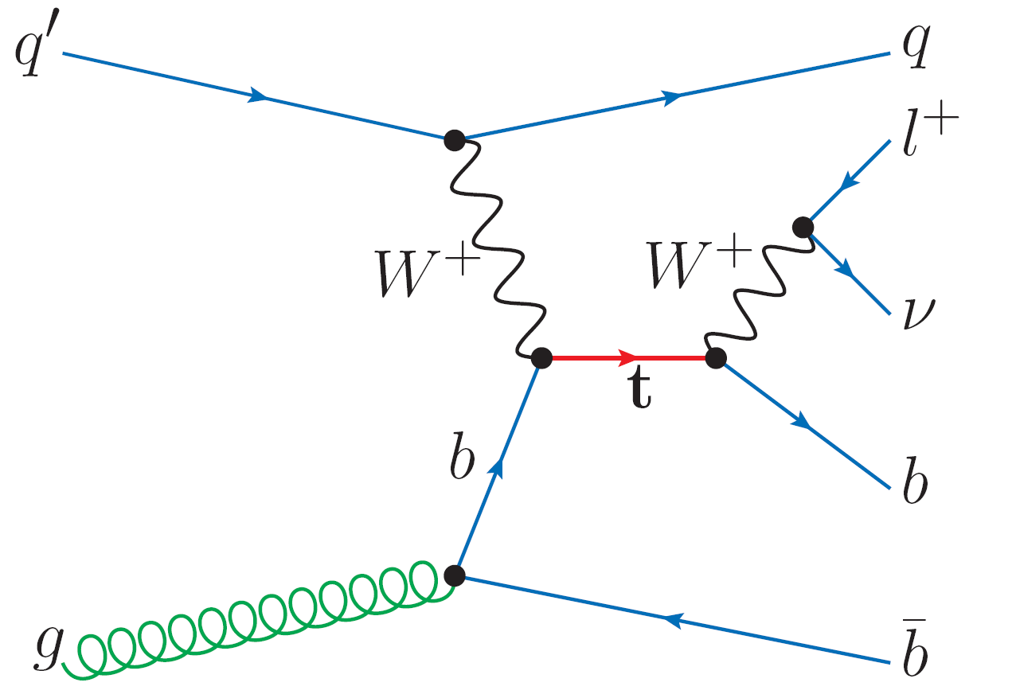
Selection Single Top-Quark t-channel(tq)
Lepton isolation:
Electron:
Multijet veto:
$$E_{T}^{miss}>30 GeV$$
𝐸_T^miss>30 GeV
Etcone20@90% & Ptcone30@90
Muon:
MiniIso MI10/pt $>0.05$
MiniIso MI10/pt >0.05
Jets:
2 Jets
Jet $\left|η\right|<4.5$
Jet |η|<4.5
Lepton $p_{T}>25 GeV$
Lepton 𝑝_T>25 GeV
MV1c@50%
$$M_{T}\left(W\right)>50 GeV$$
𝑀_𝑇 (𝑊)>50 GeV
Control Region W+jets
MV1@80% tag & MV1c@50% veto
$$p_{T}\left(l\right)>40 GeV⋅\left(1−\frac{π−|Δφ\left(j_{1},l\right)|}{π−1}\right)$$
𝑝_T (𝑙)>40 GeV⋅(1−(𝜋−|Δ𝜙(𝑗_1,𝑙)|)/(𝜋−1))
Jet $p_{T}>30 GeV, if 2.75<\left|η\right|<3.5 :p_{T}>35 GeV$
Jet 𝑝_T>30 GeV, 𝑖𝑓 2.75<|𝜂|<3.5 :𝑝_T>35 GeV
Control Region Top
2 tagged jets with MV1c@50%
Truth $E_{T}^{miss}$:
Truth 𝐸_T^miss:
$E_{T}^{miss}$: Fourvector sum of all neutrinos
𝐸_T^miss: Fourvector sum of all neutrinos
Truth Jets
2 Jets (Fastjet 3.0.6 , anti-k_{t} with R=0.4)
B-hadron association with ghost-tagging

Slide 6
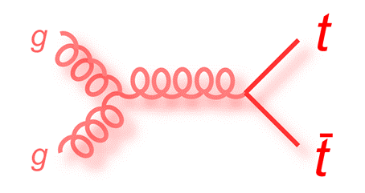
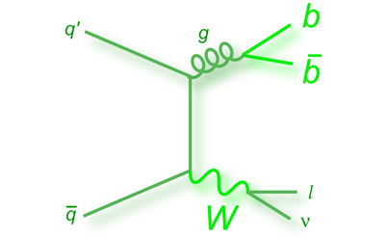
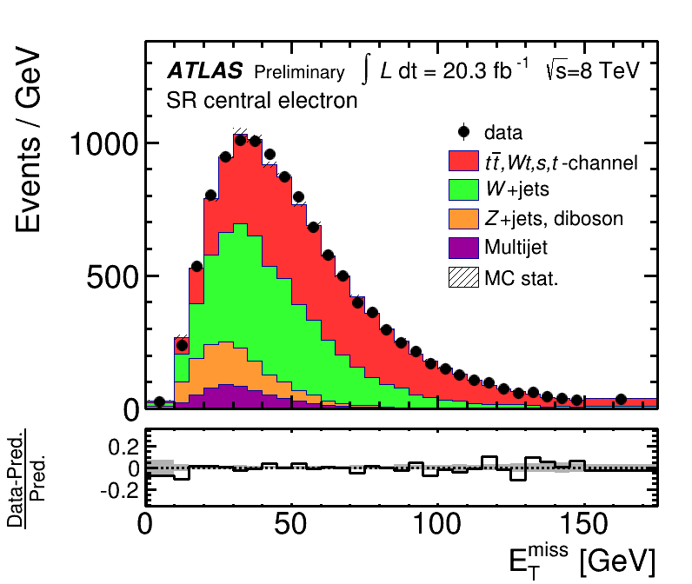


Background Estimation
Primary Backgrounds:
$$t\overline{t}$$
$$W+jets$$
Other backgrounds:
Single top-quark $t\overline{b}$and Wt production
Single top-quark 𝑡𝑏 ̅ and Wt production
$$Z+jets$$
𝑍+𝑗𝑒𝑡𝑠
Multijets (Normalisation with ML Fit
$E_{T}^{miss}$-distribution)
Multijets (Normalisation with ML Fit
𝐸_T^miss-distribution)
ATLAS-CONF-2014-007

Slide 7
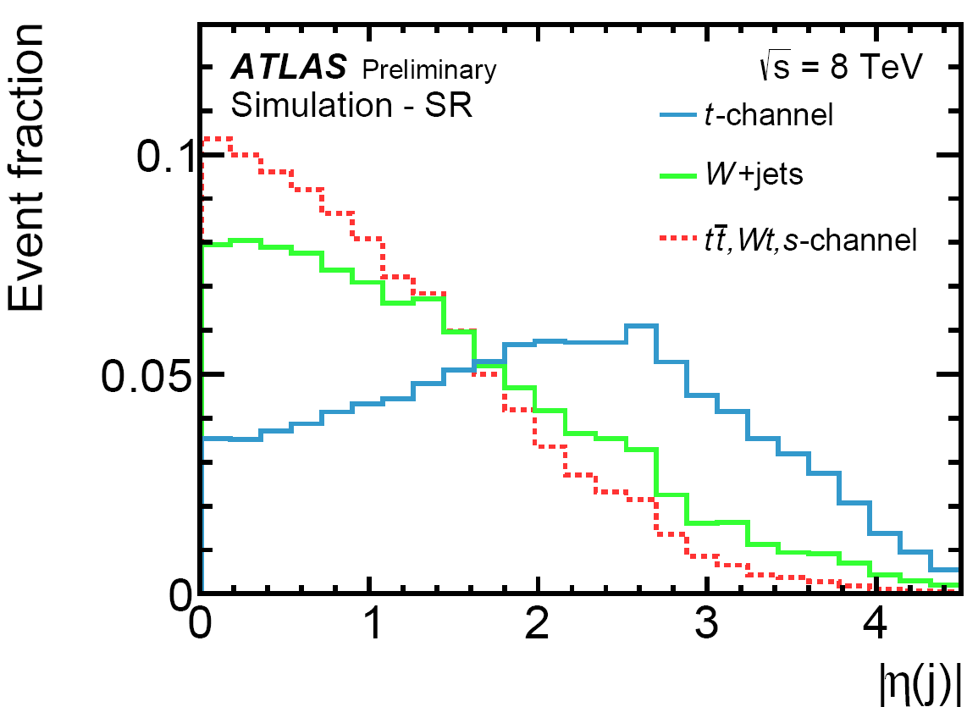

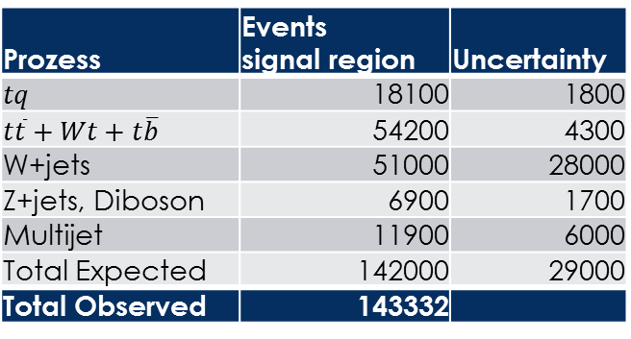
Event Yield and Signal Extraction
Only 13 % tq Events in the signal region
To improve the sensitivity, artificial neural networks are employed
Neural networks combine the discriminating power of muliple variables into one discriminant distribution
Prozess | Events signal region | Uncertainty
$$tq$$ | 18100 | 1800
$$t\overline{t}+Wt+t\overline{b}$$ | 54200 | 4300
W+jets | 51000 | 28000
Z+jets, Diboson | 6900 | 1700
Multijet | 11900 | 6000
Total Expected | 142000 | 29000
Total Observed | 143332
$$t\overline{t}+Wt+t\overline{b}$$
ATLAS-CONF-2014-007

Slide 8
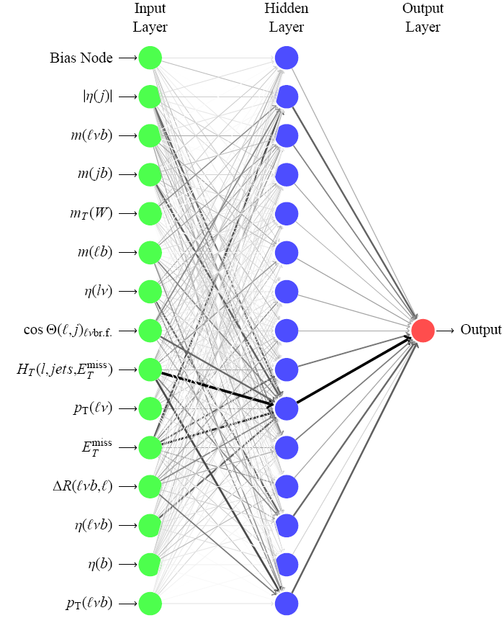
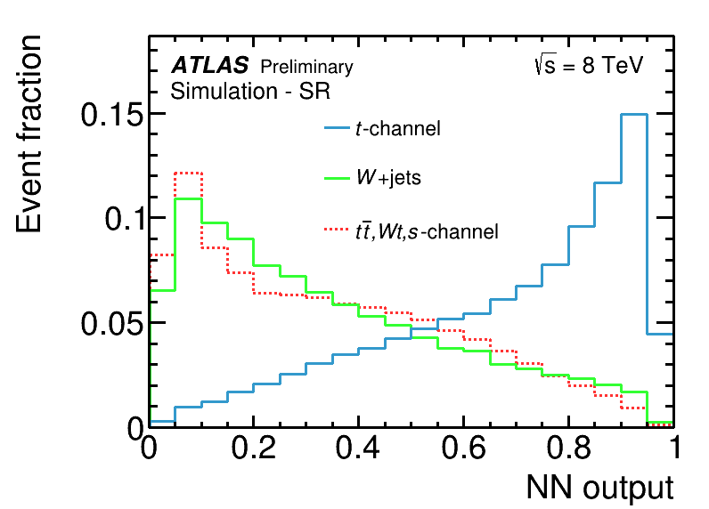
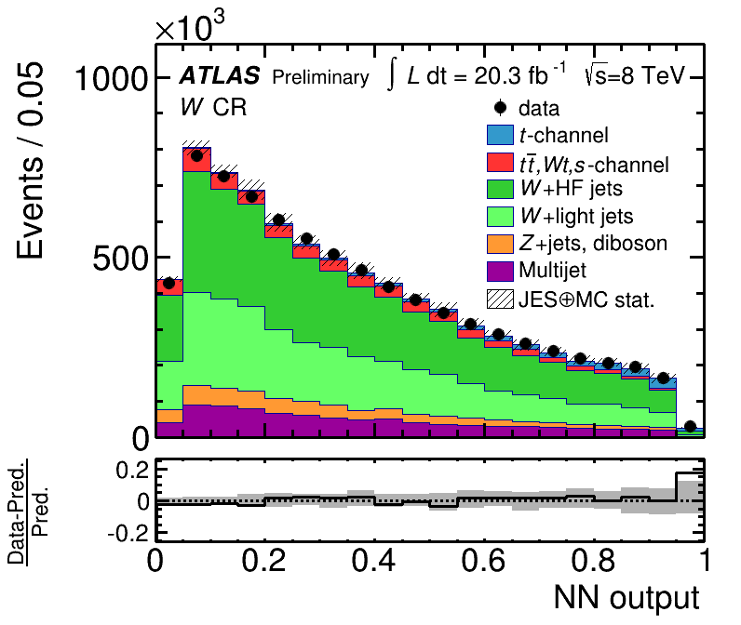
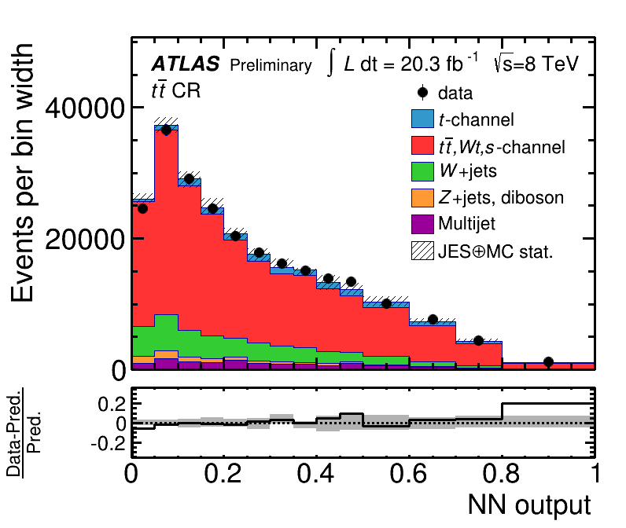


Neural Network
$W+jets$ Control Region
$t\overline{t}$ Control Region
NN is trained with 14 variables to separate the t-channel signal from background events
Correlation of all input variables is considered
Check of the NN discriminate in the background dominated control region
ATLAS-CONF-2014-007

Slide 9
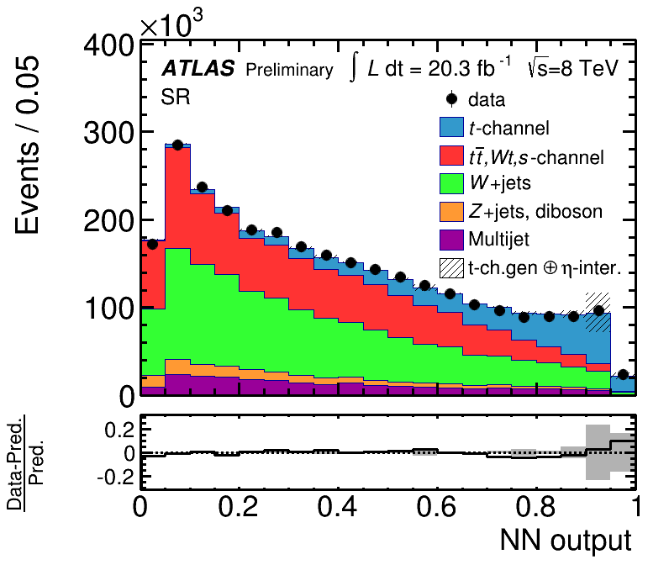
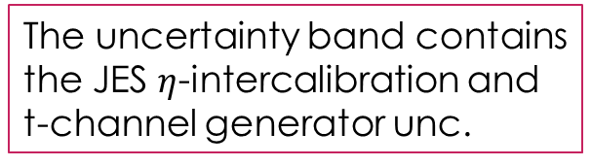
Der Maximum Likelihood Fit
A binned maximum likelihood fit is performed on the NN-output discriminate distribution to ascertain the signal- and background fractions
The uncertainty band contains the JES $η$-intercalibration and t-channel generator unc.
ATLAS-CONF-2014-007

Slide 10


Systematic Uncertainties
Only systematic uncertainties larger than 1.0% are shown
Types of systematic uncertainties
Object modelling
Monte Carlo generator
PDF
Background normalisation
Luminosity
$$\frac{Δσ_{fid}}{σ_{fid}}[\%]$$
JES $η$-intercalib.
tq Generator
b-tag efficiency
JES physics model.
$E_{T}^{miss}$ modelling
Leptons
Multijet rate
JER
PDF
W+jets generator
MC statistics
Data statistics
Jet Energy Scale $η$-intercalibration
Jet Energy Scale 𝜂-intercalibration
$tq$generator
𝑡𝑞 generator
Calibration of forward jets.
Modelling difference of AcerMC+Pythia (matched LO) and aMC@NLO+Herwig (NLO)
Benefits from fiducial measurement
ATLAS-CONF-2014-007

Slide 11
Results
Fiducial Cross-Section:
$$σ_{fid}=R_{f}⋅\frac{\hat{ν}}{∫ℒ dt}=3.37±0.05\left(stat.\right)±0. 47\left(syst.\right)±0.09(lumi) pb$$
𝜎_fid=𝑅_𝑓⋅𝜈 ̂/(∫ℒ 𝑑𝑡)=3.37±0.05(stat.)±0. 47(syst.)±0.09(lumi) pb
Evaluate different MC generators
Large scale dependence for signal-MC generator
NLO generators are in good agreement
with measured cross-section
ATLAS-CONF-2014-007

Slide 12
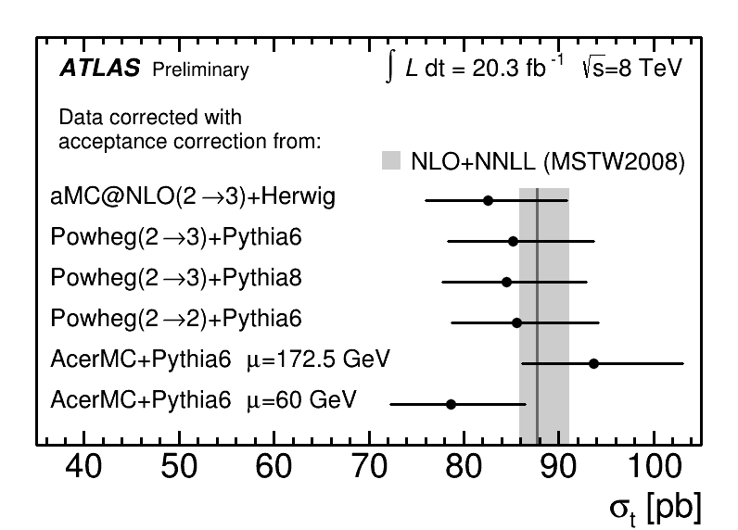
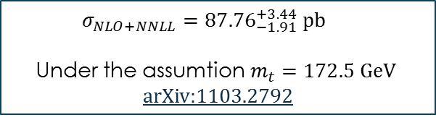
Results
Fiducial Cross-Section:
$$σ_{fid}=R_{f}⋅\frac{\hat{ν}}{∫ℒ dt}=3.37±0.05\left(stat.\right)±0. 47\left(syst.\right)±0.09(lumi) pb$$
𝜎_fid=𝑅_𝑓⋅𝜈 ̂/(∫ℒ 𝑑𝑡)=3.37±0.05(stat.)±0. 47(syst.)±0.09(lumi) pb
Extrapolated to the full Phasespace:
We extract the CKM-matrix element $|V_{tb}|$:
We extract the CKM-matrix element |𝑉_𝑡𝑏 |:
And the lower limit:
$$σ=\frac{1}{ε_{fid}^{aMC@NLO}}σ_{fid}=82.6±11.6 pb$$
𝜎=1/(𝜖_fid^(aMC@NLO) ) 𝜎_fid=82.6±11.6 pb
$$\left|V_{tb}\right|={0.97}_{−0.10}^{+0.09}$$
|𝑉_𝑡𝑏 |=〖0.97〗_(−0.10)^(+0.09)
$$\left|V_{tb}\right|>0.78$$
|𝑉_𝑡𝑏 |>0.78
$σ_{NLO+NNLL}={87.76}_{−1.91}^{+3.44} pb$
Under the assumtion$m_{t}=172.5 GeV$ arXiv:1103.2792
ATLAS-CONF-2014-007

Slide 13
Conclusion
The first measurement of the fiducial single-top quark tq cross-section with $\sqrt{s}=8$ TeV ATLAS data has been performed.
The first measurement of the fiducial single-top quark tq cross-section with √𝑠=8 TeV ATLAS data has been performed.
The inclusive production cross-section for different single-top quark mc generatrors have been extrapolated.
The CKM-matrix element $\left|V_{tb}\right|$ was extracted and a lower limit has been set.
The CKM-matrix element |𝑉_𝑡𝑏 | was extracted and a lower limit has been set.
The dominant uncertainties are the JES $η$-intercalibration and the tq-generator uncertainty.
The dominant uncertainties are the JES 𝜂-intercalibration and the tq-generator uncertainty.

Slide 14
Thank you for your attention

