Slide 1
ERC Concept @ DESY
Why?
Draft Concept by EUP
ERC in HORIZON 2020
Dr. Ute Krell
Dr. Isabelle Rauschenbach
EU-Projektbüro/EUP
DESY Wissenschaftlicher Ausschuss Hamburg, 18 March 2014

Slide 2
Why a ERC Concept at DESY?
Hosting ERC Grants becomes an impact factor for research organisations
Status in 2013: no successful ERC Grant at DESY
=> DESY directors asked for a concept
„To improve & optimize the ERC grant application at DESY“
Aug 2013: EUP presented first ideas
=> DESY directors requested from EUP to design a concept in
collaboration with the „Wissenschaftlicher Ausschuss“

Slide 3
ERC Proposals @ DESY in FP7
18 proposals in total
DESY | StG |  | CoG |  | AdG |  | SyG
2007 | 2 | FH | - | - | - |  | -
2008 | - |  | - | - | 1 | FS | -
2009 | - |  | - | - | - |  | -
2010 | 1 | FS-CFEL | - | - | - |  | -
2011 | - |  | - | - | 2 | FH | -
2012 | 4 | 3FH/1FS | - | - | 1 | FH | 1 | FH
2013 | - |  | 4 | 3FH/1FS | - |  | 2 | 1FS&M/ 1FH
Gesamt | 7 |  | 4 |  | 4 |  | 3
2 successful proposals in 2013 by CFEL/FS and CFEL/FS & M:
CoG (Comotion) : J. Küpper
SyG (AXIS) : F. Kärtner, H. Chapman, R. Assmann, P. Fromme
StG Starting Grant (2-7 y), CoG Consolidator Grant (7-12 y), AdG Advanced Grant, SyG Synergy Grant

Slide 4
ERC Grants @ HGF in FP7
Status: 03.02.2014
Ported
after
Proposal
http://www.helmholtz.de/forschung/eu_projekte/ideen/
Zentrum | Starting Grants | Consolidator Grants | Advanced Grants | Synergy Grants | Gesamt 2007-2013
AWI | 2 |  | 1 |  | 3
DESY |  |  |  | 1 | 1
DKFZ | 1 |  | 5 |  | 6
DZNE | 1 | 1 |  |  | 2
FZJ |  |  | 2 |  | 2
GFZ
HMGU | 7 | 2 | 1 |  | 10
HZB | 1 |  |  |  | 1
HZDR | 1 |  |  |  | 1
HZI | 4 |  |  |  | 4
IPP | 1 |  |  |  | 1
KIT | 6 |  | 1 |  | 7
MDC | 5 | 1 | 4 |  | 10
UFZ | 1 |  | 1 |  | 2
Gesamt | 30 | 4 | 15 | 1 | 50
1
1
1
1

Slide 5
ERC Concept Outline
Implement measures for screening of internal candidates
Qualification of internal candidates
Qualified preparation of the proposal
Rise attractiveness of DESY for hosting ERC grants
Set up an ERC task group
Members: EUP, Representatives of the Wiss. Ausschuss,??
=> to design the ERC concept and its implementation plan

Slide 6
Choice of Qualified Canditates: Draft
Screening of potential scientists:
Master & Phd students, young PostDocs
HGF-Nachwuchsgruppenleiter (preferably at the beginning)
Team- and group leaders
How ?
EUP provides an ERC qualification catalogue which will be distributed to group leaders
Regular CV-screening of scientists by group leaders
Information send to EUP about potential candidates
Interview of candidate with EUP and supervisor
to be defined: timing, GL list,……

Slide 7
Qualification of Potential Candidates 1
Stimulate qualification of candidates to pass the ERC PI benchmarks:
Support mobility & independancy
Encourage involvement in committees, participation in panels & editorial boards
Suggest the candidate for awards and invited talks
Encourage to become evaluator (AdG candidates)
Bonus for a good ERC proposal even if not successful (e.g.fail at step2) ?
Evaluate the right timing of a proposal

Slide 8
Qualification of Potential Candidates 2
Train potential candidates
Train management skills: Organisation of workshops, summerschools, projects…
Train third party rising skills: early involvement in third party funding proposals/own proposals
Train leadership skills and make them credible
Develop an individual qualification plan
well in advance

Slide 9
Qualified Preparation of the ERC Proposal
Regulations for submitting ERC grants
Early consultation
Early start of proposal writing: at least 6 -12 month before deadline
polishing the proposal !!!
http://andreas-zeller.blogspot.de/2013/02/twelve-tips-on-how-to-prepare-erc-grant.html
Mentoring
ERC grants are „the highest research funding of individuals“
ERC grants are not for aquisition of job position
Young researchers need more time for polishing than they will expect

Slide 10
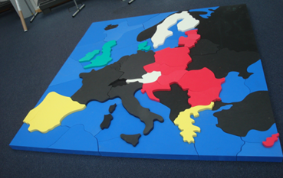
ERC in HORIZON 2020
HORIZON 2020 & Budget
ERC goal & regulations
Profile of PI, frontier research
Needs for a successful proposal
EU Puzzle @ EUP-DESY

Slide 11
HORIZON 2020: three priorities
2014 – 2020
* 100% for non-profit

Slide 12
HORIZON 2020 – ERC
European Research Council (ERC)
Societal Challenges
Health, demographic change
Future and Emerging Technologies (FET)
Research infrastructures
Food security, water
Secure, clean and efficient energy
Smart, green and integrated transport
Inclusive, innovative and reflective societies
Climate action, resource efficiency & raw materials
Marie Skłodowska Curie Actions
Protecting freedom and security
Industrial Leadership
Leadership in enabling and industrial technologies
Access to risk finance
Support innovation in SMEs
Excellent Science
13.1 B€
Spreading excellence & widening participation
Science with and for society
EIT
JRC

Slide 13
ERC Budget
ERC Budget in FP7 and Horizon 2020
3860 Projects
43000 Proposals

Slide 14
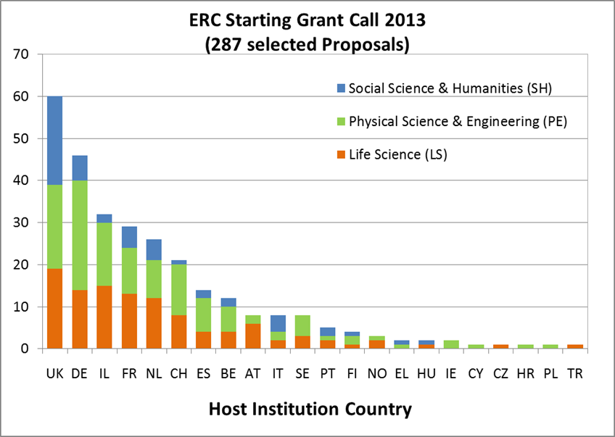

Slide 15
European Research Council: goal
Rising excellence science in Europe
support frontier & groundbreaking research
supportexcellent scientists
Achieve independence for young researchers
Improve working conditions for all researchers

Slide 16
European Research Council: Regulations
Single-stage submission / two-stage evaluation
Host Institution must be in MS/AC
PI can be from anywhere

Slide 17
ERC : Overview
Success rate FP7
Starting Grant | 2 - 7 years after PhD
Consolidator Grant | 7-12 years after PhD
Advanced Grant | Leading researchers in their field
(Synergy Grant | Group of 2-4 researchers)
Proof of Concept Grant | Verify innovation potential of results from ERC funded projects
10.2%
8.7%
13.9%
2.1 %

Slide 18
ERC Frontier Research Grants: Overview 1
Program |  | Starting Grants |  | Consolidator Grants
Who? |  | 2-7 years after PhD extension possible up to 11,5 years |  | 7-12 years after PhD extension possible
Objectives |  | Promising scientist at the start of an independent research career |  | Consolidation of an own research team of the junior scientists
Funding |  | Max 1.5 M€ for 5 years (+ 500 000 € Equipment/ PIs from Third Countries) |  | Max 1.5 M€ for 5 years (+ 750 000 € Equipment/ PIs from Third Countries)
Time Commitment |  | ≥ 50% (min. 50% in Europe) |  | ≥ 50% (min. 50% in Europe)
Deadlines |  | 25 March 2014 03 February 2015 |  | 20 May 2014 12 March 2015
Success rate FP7
10.2%
Success rate FP7
8.7%

Slide 19
ERC Frontier Research Grants: Overview 2
Programm |  | Advanced Grants |  | Synergy Grants
Who ? |  | Established excellent researchers: track-record of the last 10 years |  | Group of 2-4 outstanding excellent researchers
Objectives |  | Further development of a research team in Europe |  | Support complementarities & synergy by creating a research group
Funding |  | max. 2.5 M€ for 5 years (exceptional 3.5 Mio. €) |  | max 15.0 M€ for 6 years
Time Commitment |  | ≥ 30% (min 50% in Europe) |  | ≥ 30% (min 50% in Europe)
Deadlines |  | 21 October 2014 02 June 2015 |  | no call in 2014
Success rate FP7
13.9%
Success rate FP7
2.1 %

Slide 20
ERC: Evaluation & Feedback
Commitment Letter
A: Online Forms
B1: Abstract
CV (2P)
Synopsis of project (5P)
Track record (2P)
B1
B2: Extended scientific
project (15P)
EUP
One Proposal
Evaluation Summary Report:
Comments by all reviewer
Ranking in %
(x%) FP7 experiences

Slide 21
ERC – Starting and Consolidator Grants
Profile of competitive PI
Can be of any nationality or age, reside in any country at time of application
Intellectual maturity, potential for excellent, innovative research
Proven leadership potential, ability to carry out independent research and lead project team
Track record of promising early achievements
Benchmarks: at least one publication without PhD adviser; list of significant publications as main author in major international, peer-reviewed journals in field with high impact factor; membership on editorial board of major journals, invited presentations, patents, awards or prizes; organisation of international conferences, research expeditions or summer schools; supervision of students,etc.
☞
☞

Slide 22
What is frontier research?
High risk, high gain
Discovery research at the utmost frontiers of knowledge without
regard for established disciplinary boundaries (innovative, ground-
breaking, experimental, risky)
Beyond the state of the art: permits significant breakthroughs or paradigm shifts, transformative discoveries, develops innovative methods with broad applicability
Interdisciplinary: overcoming traditional boundaries of disciplines
Can be „basic“ or „applications-oriented“ research
Pioneering: includes new and emerging fields of research
Unconventional, innovative approaches and inventions
NOT: incremental improvements on previous developments,
more of the same, confirmation of previous results
☞

Slide 23
ERC: successful proposal needs
Easy to read and easy to understand for non experts
Part B1:
Clear identification and description of the aim
What would change the research field if the project will be successful?
Attractive diagrams/figures/illustrations
Vision and enthusiasm of PI
CV of PI reflect the benchmarks and PI must be recognized in its community (facts!!)
Part B2:
Good project plan
Feasibility and risk assessment

Slide 24
ERC: Proposal Submission StGr & CoGr
General Information for Applicants and Proposal Templates
Obtainable by EUP or
At the EU Participant Portal: http://ec.europa.eu/research/participants/portal
Commitment letter of the host institution
Provided by EUP: Requests for completion at least 4 weeks before call deadline
Part A: Online Forms
Please contact EUP for assistance to ensure correct completion
General Information
Administrative data of participating organisations
Budget
Ethics
Call Specific Questions

Slide 25
ERC: Proposal Submission StGr & CoGr
Part B1
Part B1 is evaluated both in Step 1 and Step 2
Cover Page
Name of the Principal Investigator (PI)
Name of the PI's host institution for the project
Proposal duration in months
Proposal summary (identical to the abstract from the online proposal submission forms, section 1)
Section a: Extended Synopsis of the scientific proposal (max. 5 pages)
Section a: Extended Synopsis of the scientific proposal (max. 5 pages)
Please respect the following formatting constraints: Times New Roman, Arial or similar, at least font size
11, margins (2.0 cm side and 1.5cm top and bottom), single line spacing.
Section b: Curriculum vitae (max. 2 pages)
Appendix: All ongoing and submitted grants and funding of the PI (Funding ID)
Mandatory information (does not count towards page limits)
Section c: Early achievements track-record (max. 2 pages)

Slide 26
ERC: Proposal Submission StGr & CoGr
Part B2
The scientific proposal (max. 15 pages)
Please respect the following formatting constraints: Times New Roman, Arial or similar, at least font size
11, margins (2.0 cm side and 1.5 cm top and bottom), single line spacing.
Section a. State-of-the-art and objectives
Section b. Methodology
Section c. Resources (including project costs)
Please indicate the % of working time the PI dedicates to the project over the period of the grant.
Please note that you are expected to devote at least 50% of your total working time to the ERC-funded
project and spend at least 50% of your total working time in an EU Member State or Associated Country.

Slide 27
Many thanks
for
your attention
Ute.Krell@desy.de 4508
Isabelle.Rauschenbach@desy.de 2888
EU-Projektbüro/EUP@DESY
EU Puzzle @ EUP-DESY

