Slide 1
Status of data management and data storage
Krzysztof Wrona, WP76
16th XFEL DAC meeting
May 26th, 2014, Hamburg

Slide 2
Outline
Data management big picture, scientific data definitions and policies
DAQ and DM architecture, prototype implementation
Data formats
Offline data storage and access
Catalogs and web applications
IT services for test stands

Slide 3
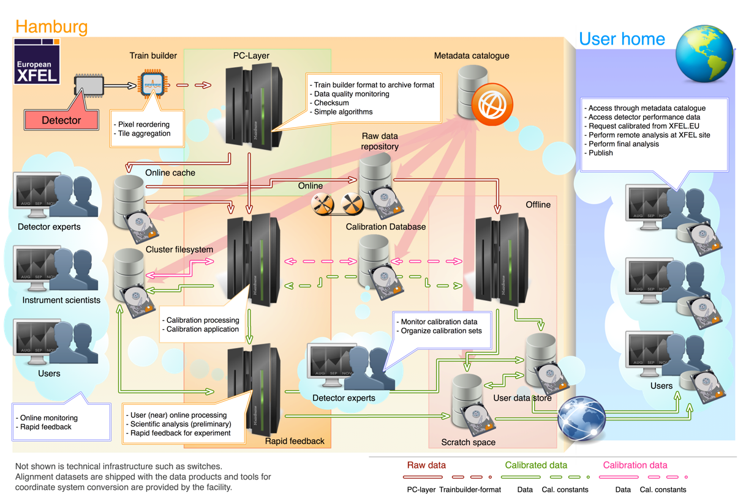
Data management – functional overview
Figure describes:
Data types
Data flow
Components
Functionality
Actors
Drawing by S.Hauf
Data management “Big Picture” (common view WP75 and WP76)
Detailed description of calibration data handling on WP75 session by S.Hauf
Details and implementation status on WP76 session by K.Wrona/D.Boukhelef

Slide 4
Scientific Data – definitions & policies
Raw data, […], represents digitized signals captured by detectors and not altered by detector-specific corrections or calibrations, […]. Vetoing, either by hard- or software triggers and zero-value suppression, […], may have been performed and are irreversible. […]. Raw data is the main archival data product at the European XFEL. It is not foreseen to be exported outside the facility, and is not meant to be directly user accessible.
Calibrated data is generated from raw data, by applying detector-specific corrections and transformation to physical units (calibration) […]. Calibrated data is the standard data product users will be provided with. It is not archived though; […], it will be reprocessed on the fly from the raw data repository using the appropriate calibration parameters provided by the calibration database.
Extracted from a draft for a special issue of Synchrotron Radiation News (and in similar wording for a IEEE NSS/MIC 2014 contribution)

Slide 5
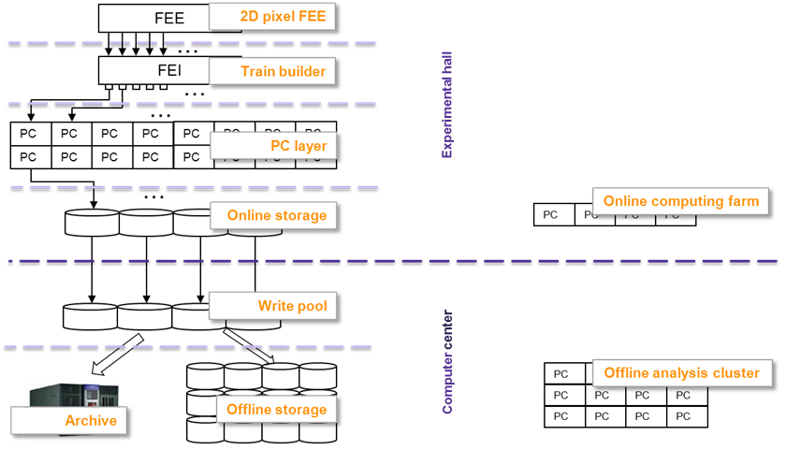
DAQ and DM architecture
Architecture
Main DAQ stream
Fast feedback stream
Layered architecture focusing on scalability and flexibility
Allows for data processing on each layer
Addresses issue of simultaneous reliable data recording and fast user access
Includes offline data analysis at the facility

Slide 6
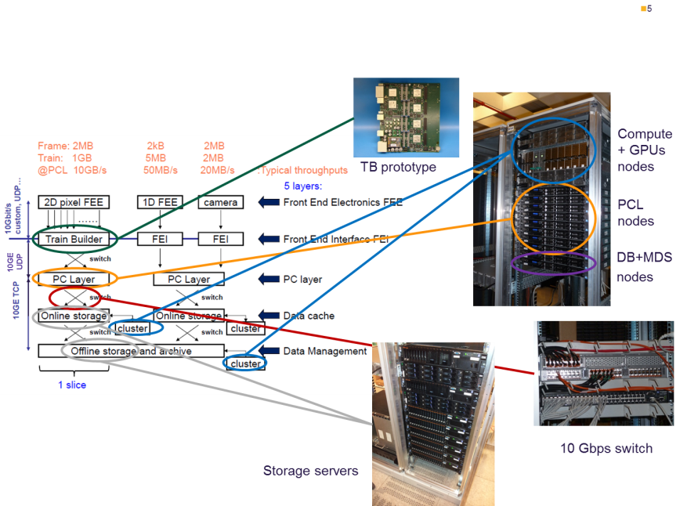
Slice test (prototype)
Prototype
Demonstrated sufficient performance of DAQ chain for ½ Mpxl detector from train builder to online data storage using prototype system
Easily scalable to 1Mpxl – requires more hardware
16 streams per 1Mpx det., 1GB/s per data stream
Final acceptance tests when detectors are available

Slide 7
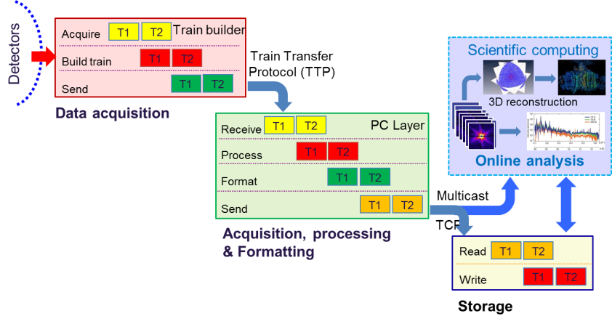
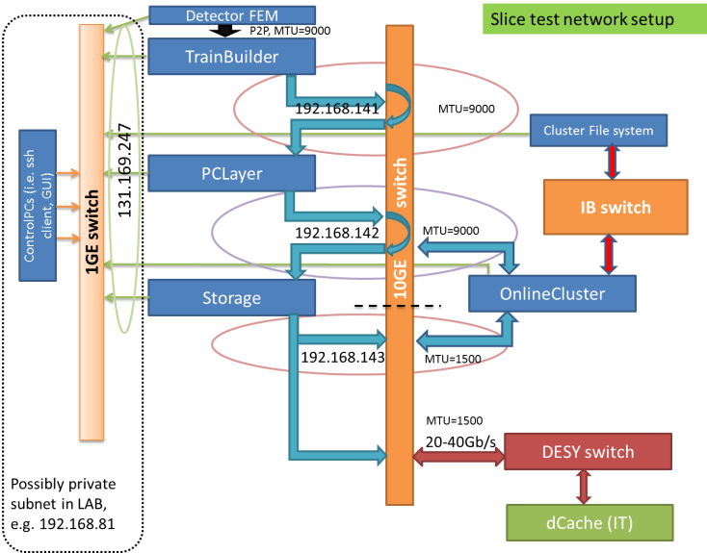
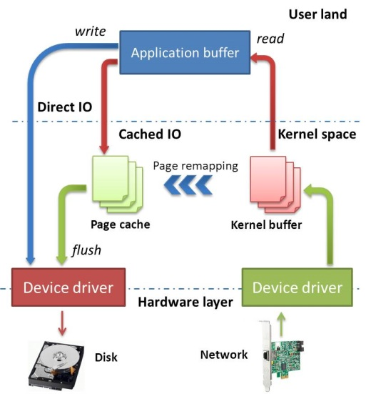
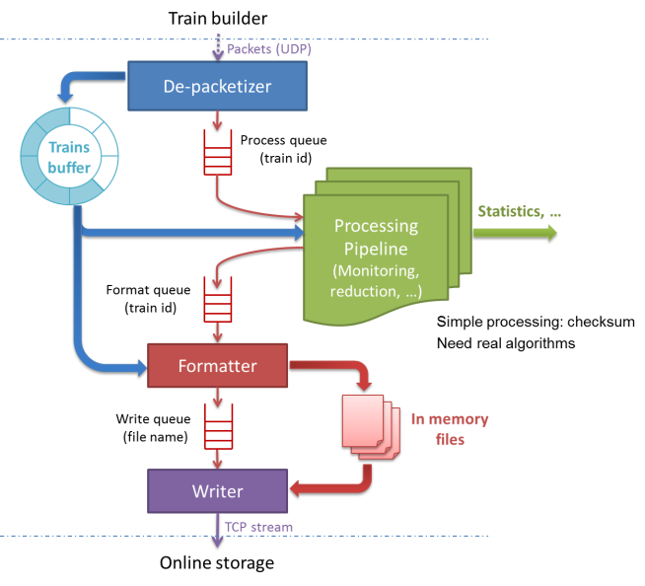
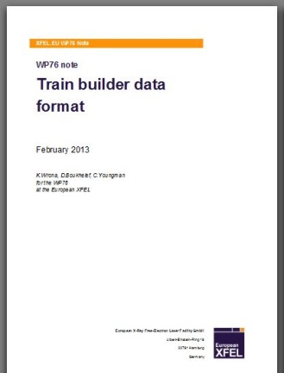
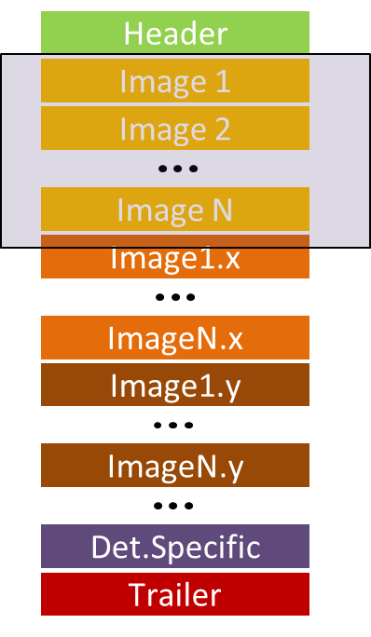
Prototype implementation
Details in D.Boukhelef presentation – WP76 review
Network setup
Data flow in DAQ
PC layer software
Writing data to disks
Definition of data formats

Slide 8
Ongoing work
Generic data sink
Generalization of PC layer to cope with data format from all different data sources, not only 2D detectors
Data format description language and API for encoding binary data at source and decoding data format on sink device
Prove of concept has been demonstrated,
Data description specification and API will be released after selected use cases (i.e. 2D, digitizers, commercial cameras) are implemented and tested (estimated for July)
Naming convention for raw data files
Naming scheme for files defined
Raw data repository structure
Calibration data repository structure
raw.rXXXX.sXXXXXX.h5
r – run number, s – sequence number, X – digit

Slide 9
HDF5 Data format
HDF5 is chosen as a container to store experiment data
Structure of HDF5 file resembles the file system view with HDF5 groups and datasets corresponding to folders and files
XFEL API for HDF5 implemented in Karabo and used at slice test and calibration pipeline
Organize data according to the data source
Provide the same high level data organization scheme
Provide HDF5 data navigation and correlation scheme using simple relational database model (data are written as records)
Use simple data dataset types to maximize portability between different tools and languages
FLASH and LCLS expressed the interest to implement this model for the next stage of their experiments i.e. FLASH-II and LCLS-II
Data converter – xtc to XFEL hdf5 format
Converter for CFEL data collected at LCLS developed and files made available to FLASH DM experts and CFEL users – waiting for feedback
CFEL scientist will start using it mid-June for ‘data reduction’ developments
Discussion on high level data format with LCLS, Flash and CFEL ongoing

Slide 10
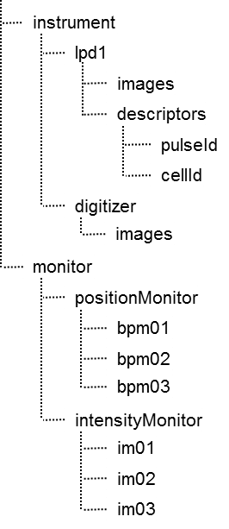
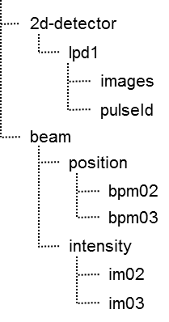
Export and transformation tool
From D.Boukhelef presentation – WP76 review
Tool for exporting calibrated, slow/fast data to external users
Selective, i.e. allow users to select which data parameters they want in the export file.
Personalized view: users may rearrange data groups in the new dataset according to their own needs
Predefined templates (for major use-cases) can be provided
Actual physical layout
User’s desired view
Mapping
Exported dataset
Data repository

Slide 11
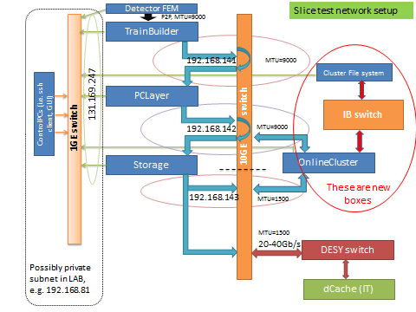
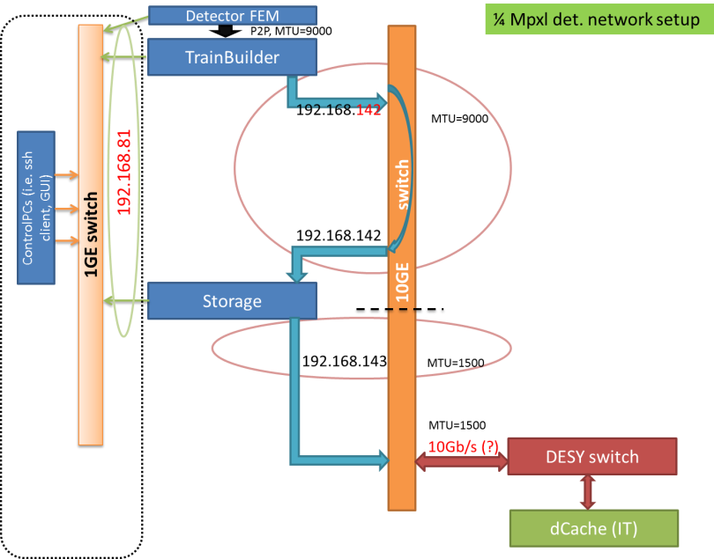
Preparation for ¼ Mpxl test stand
¼ Mpxl detector test stand
Initially PC layer and storage servers combined – 4 servers
Per host: 24 CPU cores, 128GB RAM, 30TB disk space, 2 x 6Gbs SAS, 2 x 10GE
Servers purchased, installed and waiting to be moved from CC to Hera-South
Network configured according to the slice test design
Software
PC layer, data formatting, integration with calibration pipeline, storing data
Slice test network setup
¼ Mpxl test stand network setup

Slide 12
Offline data storage & processing
Offline data storage classes
Raw and calibration data repositories – commodity storage, distributed system (dCache) with parallel NFS (pNFS) access protocol. Raw data files will be organized according to experiment runs and appropriate ACL will be defined using NFS4.1 ACL. Initially ~10PB capacity
Archive – tape backend for data repositories (e.g. LTO6 technology)
Scratch space – cluster file system, ~1-2PB, used for hot data processing, export of calibrated data, no backup, fast access
Space for user data, e.g. 5TB per beamtime, backup
Offline Computing
1000 CPU cores per 1PB

Slide 13
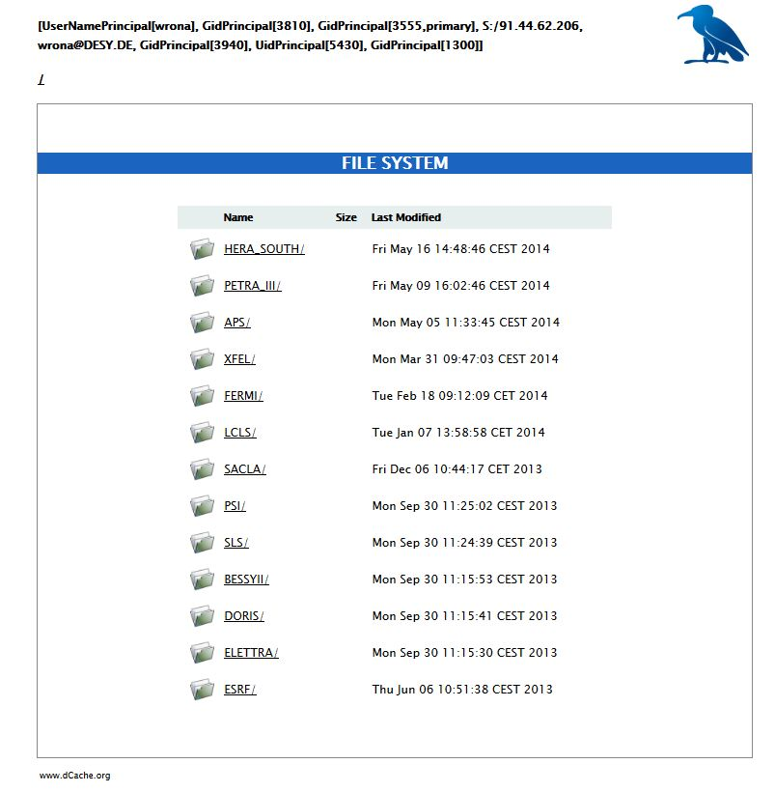
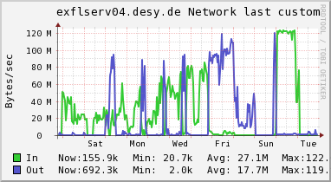
Data storage and archive – current status
Service provided to XFEL scientists:
data import using Globus Online, rsync, scp, USB media
Data stored on dCache system
Distributed over 18 servers with 120TB allocated to XFEL
Tape archive
Access
Webdav interface (simple browsing)
NFS4.1 (parallel NFS)

Slide 14
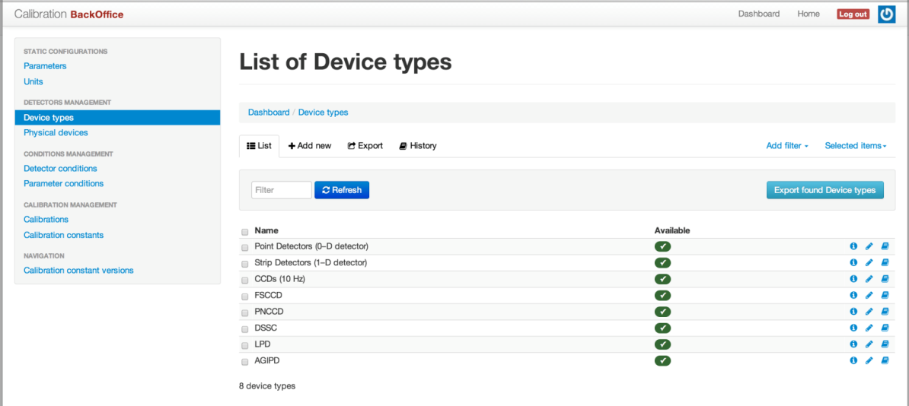
Calibration catalog
Details in L.Maia presentation – WP76 review
Calibration catalog
Manages calibration data and defines which constants to use
Calibration database concept defined (presented on the last DAC meeting)
Technical design including database model – done
Implementation: web application + Restful API for constants management and access – in progress (advanced)
First tests and validation with ¼ Mpxl test stand (July)

Slide 15
Metadata catalog
Decided for in-house implementation
Pros for in-house development
Easy integration with calibration database and other services already implemented at XFEL (e.g. authentication)
Much easier to include new features if required
Usage of the same technology as for the other apps (rapid development, easier maintenance)
Cons
Will consume developer resources
Development plan
1st stage: Simple database model (beamtime, investigation, runs, files)
Fulfills all current requirements, cross-checked with WP75 and LCLS developer
1st stage implementation estimated to be ready in few months (i.e. first results next DAC)
Recruitment of additional man power for web application in progress
Next stage:
Define exact requirements for facility operation phase (in 2017)
Enhance authorization
Integration with karabo (e.g. insertion of experiment parameters)
Possibly implementation of log book according to LCLS model

Slide 16
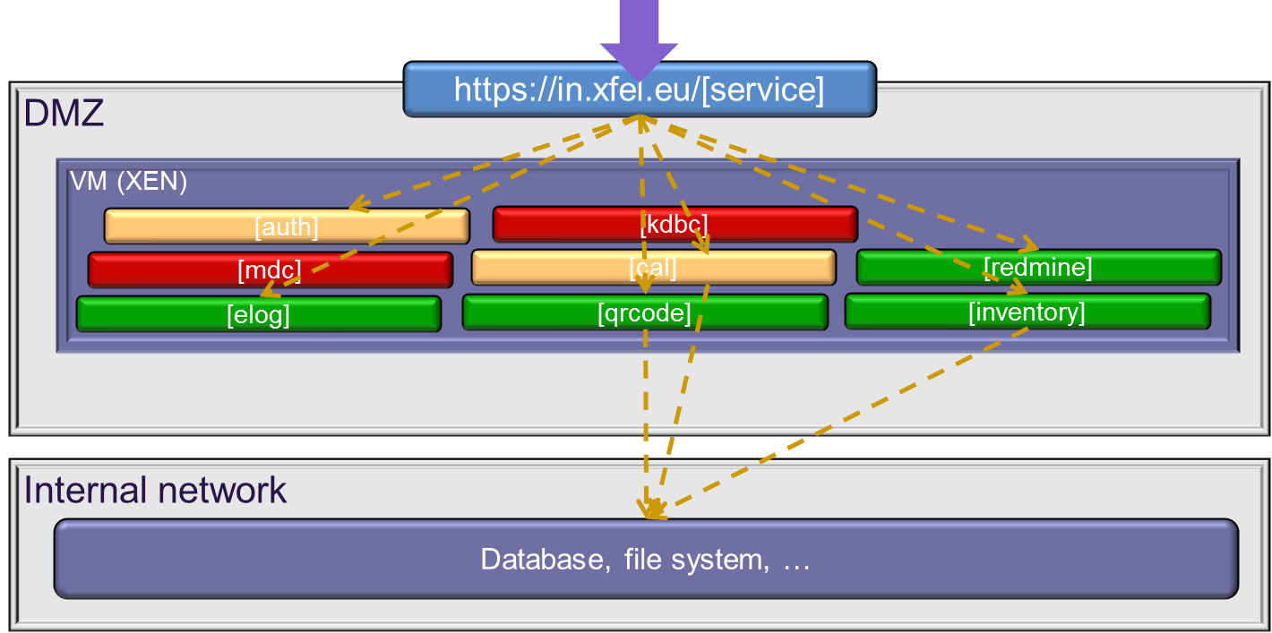
Status of web applications deployment
Similar setups for development and testing exist
General concept for web applications deployment
Single entry point via F5 switch
Each application running on separate Virtual Machine
Allows for independent applications deployment
Allows for load balancing and redundancy (i.e. high availability)
Next step:
implement full redundancy (including DB replication) and load balancing (where appropriate) according to the existing concept

Slide 17
Test stands management
Details in J.Szuba presentation – WP76 review
Services required for test stands management (later for instruments)
Tool | Function | Status (Dec 2013) | Status ( May 2014)
Puppet | Basic computer installation and configuration | In preparation | In production
Asset Management | Describe physical devices, link documentation, firmware and software compatibility | Prototype | In production
ePlan | Planning and documentation of wiring | Installed | Definition of templates, first usage by CIE group, Integration with asset management required
Package repository | Collection of software packages | Partially | In production
Karabo Configuration DB (KCDB) | Defines needed hardware and software resources for installation | In preparation, currently using XML | Prototype database
Karabo-server-control | Installation of karabo device servers and devices according to KCDB | Not exist yet, currently manual | Interface to KCDB defined, prototype exists
eLog | Provide history of the Test Stand | Production | In production
Alfresco | Documentation, definition | Production | In production
Redmine | Project management and issue tracker | Mantis was used for bug tracking | In production

Slide 18
Summary
Export data policies defined
¼ Mpxl test stand will be used to further validate DAQ developments using real detectors
Work is progressing on data formats
Development of web applications in good shape. Decision on in-house development of metadata catalog
Services supporting “test stand” management improved

Slide 19
Acknowledgments
Acknowledgments
D.Boukhelef
S.Hauf
B.Heisen
L.Maia
J.Szuba
C.Youngman
WP76 members
DESY IT group

Slide 20
Backup slides

Slide 21
Metadata catalog
Justification for in-house implementation
iCat does not fulfill XFEL requirements
Desy experience shows this project is very complex and difficult to setup
Production level service would require a lot of effort (administration, close collaboration with STFC would be required)
Doesn’t fulfil all our requirements, this means we would have to try to influent it’s future developments (as discussed in last XDAC)
LCLS catalog – much closer to the needs, but:
many dependencies on other LCLS internal services
direct dependencies on database level
difficult to extract required parts
Implements processes specific to LCLS (e.g. conversion from xtc to hdf5, cable management)
no user defined parameters (is planned)
would require additional developments using different technology
no software release management
LCLS tool developed by single person
continues changes and enhancements according to current LCLS needs and internal schedule

