Slide 1
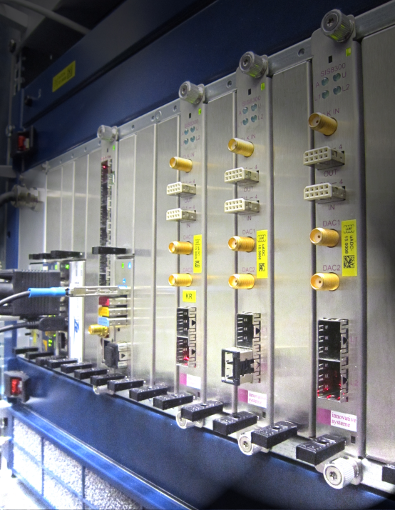
Overview of Future Projects
Outline
HVF 2015+
Accelator Research and Development
Future LLRF projects
Dr. Holger Schlarb
MSK, DESY
13.05.2014

Slide 2
Helmholtz Validierungsfond
“MTCA.4 for Industry”
Notes:
Before you start editing the slides of your talk change to the Master Slide view:
Menu button “View”, Master, Slide Master:
Edit the following 2 items in the 1st slide:
1) 1st row in the violet header:
Delete the existent text and write the title of your talk into this text field
2) The 2 rows in the footer area: Delete the text and write the information
regarding your talk (same as on the Title Slide) into this text field.
If you want to use more partner logos position them left
beside the DESY logo in the footer area
Close Master View

Slide 3
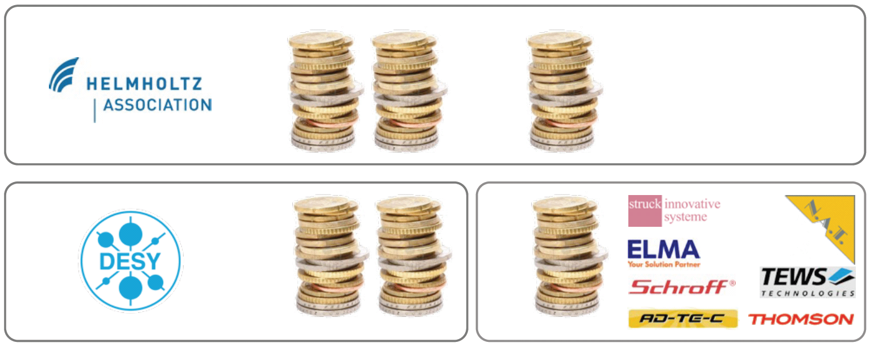

HGF Validation Fund – Objectives -
3
Establish MTCA.4 electronic crate system in:
  the accelerator community
  various industrial sectors
  the scientific community
by reducing the market entry barriers and foster MTCA.4 to industry
Build consortium:
Funding 3.9 Mio€
50%
30%
20%
Notes:
Before you start editing the slides of your talk change to the Master Slide view:
Menu button “View”, Master, Slide Master:
Edit the following 2 items in the 1st slide:
1) 1st row in the violet header:
Delete the existent text and write the title of your talk into this text field
2) The 2 rows in the footer area: Delete the text and write the information
regarding your talk (same as on the Title Slide) into this text field.
If you want to use more partner logos position them left
beside the DESY logo in the footer area
Close Master View

Slide 4



















Helmholtz Validation Fund – Consortium -
4
Status 01. 04.2014
  Cooperation partners
Original HVF Consortium (7):
New Partners (6):
Negotiation phase(7):

Slide 5
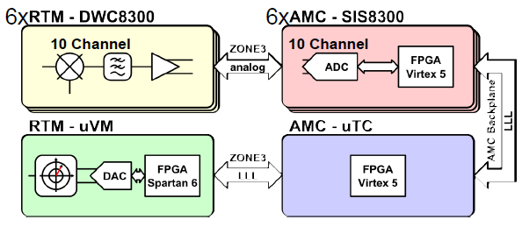
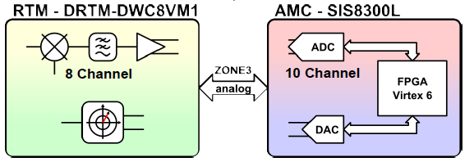
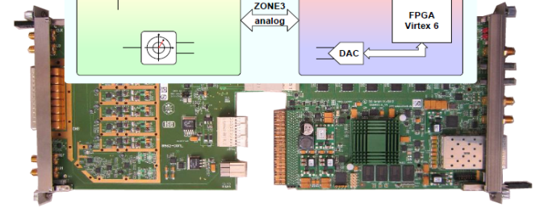

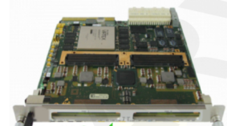
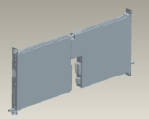

Helmholtz Validation Fund - Work Packages
AP1: RF control system in MTCA.4
AP1.1 Revision of existing modules
AP1.2 Cost opt. for Single Cavities Applications
AP1.3 Extending Portfolio in Frequency
AP1.4 Supplementary systems for RF control
AP1.5 Introduction of RTM-RF Backplane
AP2: Completion of MTCA.4 for
industry and institutions
AP2.1 Extension of product portfolio for MTCA.4
    AP2.2 EMI optimization and classification of MTCA.4 components
    AP2.3 Application of MTCA.4 in industry
  AP2.4 Evaluation of MTCA.4 market
  AP2.5 Integral test of MTCA.4 in large facility, availability, failure analysis
→ 4x10 Gbps
AP3: Support and consulting for industry and institutions
AP3.1 MTCA.4 support and consulting
AP3.2 MTCA.4 users guide
AP3.4 Products marketing & information (Webpage/Exhibition/Workshops)
Notes:
Ribosom

Slide 6
Helmholtz Validation Fund – 2015 beyond
6
1
Accelerator core activities
DESY
Spin-offs
GmbH associated to DESY
MTCA.4 Innovation Lab
DESY Technology Centre
DESY Groups: TT, MSK, …
Service & Maintenance Licensed Board / MMC
(External for Industry and Institutes
Cryotech
Service Group
EMI Laboratory
(Service internally / external)
Detector Developments
Industrialize future MTCA.4 modules for market
(DESY developments)
Material Processing Service Group
Forward development of MTCA.4 standard and modules
…
Service Group
Training, Service und Support
Synchronization / Laser Optics
Service Group
Network Events
(MTCA/Interoperability-WS)
MTCA.4 Service Group
System Integration / Commissioning / User Support
(within DESY)
Test and Certification
Development contract
Service and Support
R&D- Cooperation
Third party Aquisition
Consulting
Funding
Measurement, Controls, Communication Systems
Acquisition of third party funding
DESY Baseline Fundung
License fee
Start this year
2015-2016… beyond

Slide 7
ARD
Accelerator Research & Development
(ARD) Program
2015 – 2019
Superconducting RF Technologies → MSK
Hadron accelerators
Ps and fs Electron and Photon Beams → MSK
Plasma acceleration → MSK
Notes:
Before you start editing the slides of your talk change to the Master Slide view:
Menu button “View”, Master, Slide Master:
Edit the following 2 items in the 1st slide:
1) 1st row in the violet header:
Delete the existent text and write the title of your talk into this text field
2) The 2 rows in the footer area: Delete the text and write the information
regarding your talk (same as on the Title Slide) into this text field.
If you want to use more partner logos position them left
beside the DESY logo in the footer area
Close Master View

Slide 8
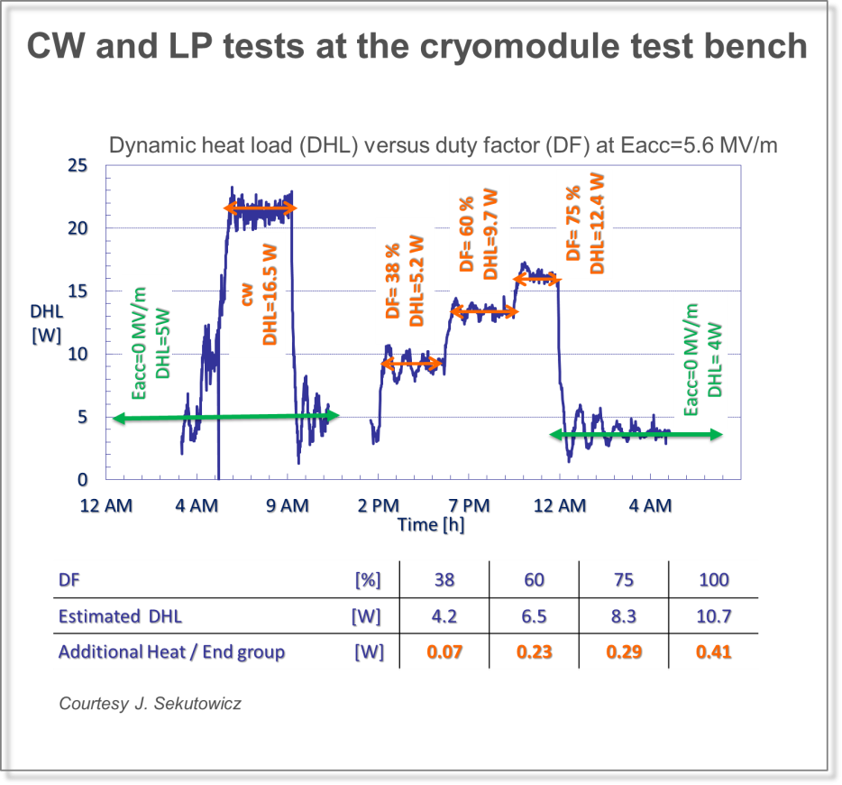
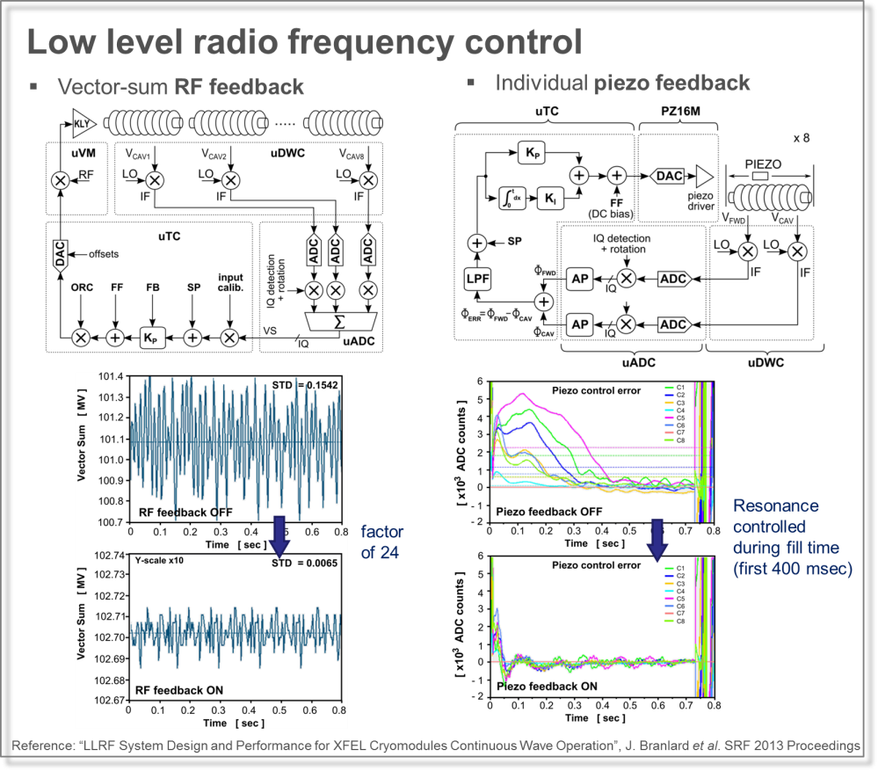
ARD – ST1: Superconducting RF Technology
CW operation for European XFEL
+ strong Link to HZDR / HZB
Notes:
Before you start editing the slides of your talk change to the Master Slide view:
Menu button “View”, Master, Slide Master:
Edit the following 2 items in the 1st slide:
1) 1st row in the violet header:
Delete the existent text and write the title of your talk into this text field
2) The 2 rows in the footer area: Delete the text and write the information
regarding your talk (same as on the Title Slide) into this text field.
If you want to use more partner logos position them left
beside the DESY logo in the footer area
Close Master View

Slide 9
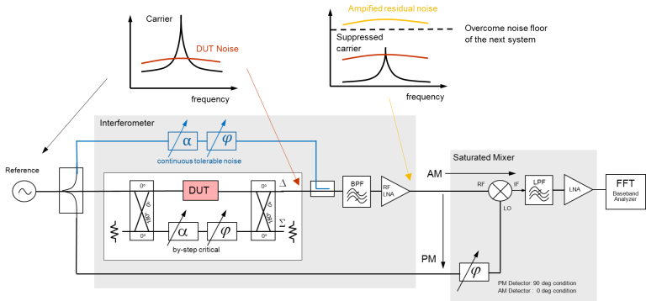
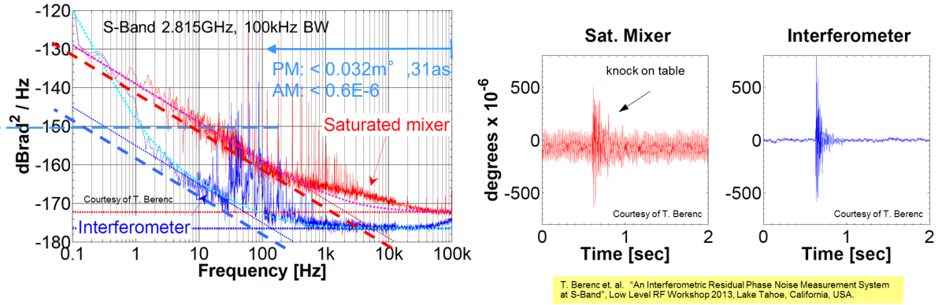
ARD - ST3: Pico- and fs Electron and Photon Beams
RF control towards sub-femtosecond stability
Notes:
Before you start editing the slides of your talk change to the Master Slide view:
Menu button “View”, Master, Slide Master:
Edit the following 2 items in the 1st slide:
1) 1st row in the violet header:
Delete the existent text and write the title of your talk into this text field
2) The 2 rows in the footer area: Delete the text and write the information
regarding your talk (same as on the Title Slide) into this text field.
If you want to use more partner logos position them left
beside the DESY logo in the footer area
Close Master View

Slide 10
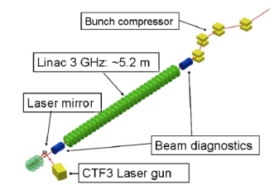
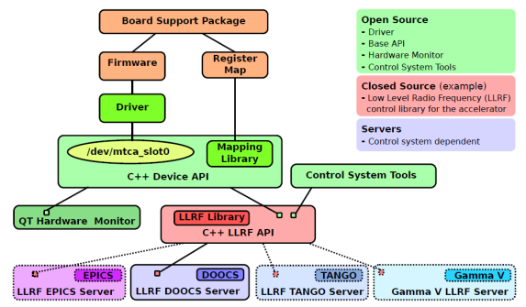
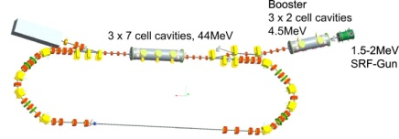
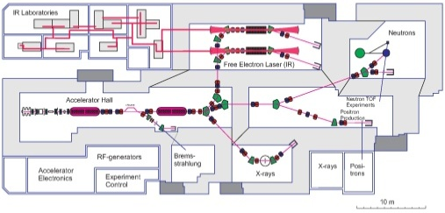
ARD - ST3: Pico- and fs Electron and Photon Beams
Technology transfer MTCA.4 / LLRF / Controls / high speed Feedback Algorithm
FLUTE
Generic software architecture
HZB
HZDR
Notes:
Before you start editing the slides of your talk change to the Master Slide view:
Menu button “View”, Master, Slide Master:
Edit the following 2 items in the 1st slide:
1) 1st row in the violet header:
Delete the existent text and write the title of your talk into this text field
2) The 2 rows in the footer area: Delete the text and write the information
regarding your talk (same as on the Title Slide) into this text field.
If you want to use more partner logos position them left
beside the DESY logo in the footer area
Close Master View

Slide 11
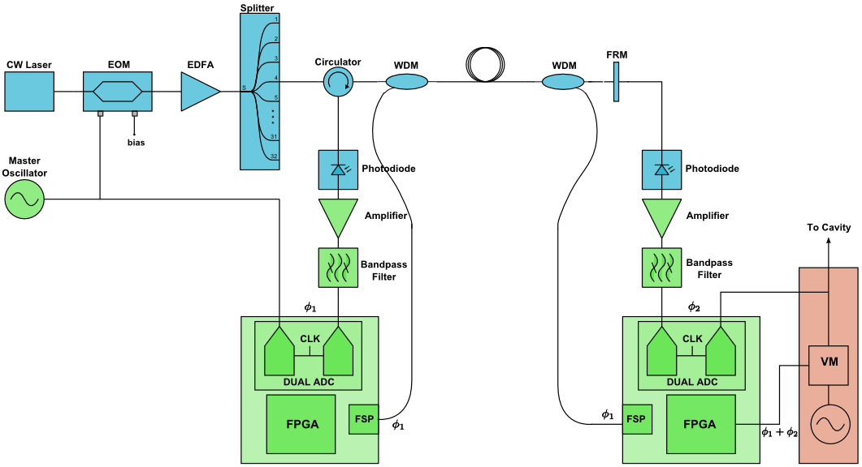
ARD - ST3: Pico- and fs Electron and Photon Beams
CW optical synchronization
Appropriate scheme for large distances and facilities with mainly RF stations
XFEL upgrade of main linac
ILC
SINBAD (see talk from R. Assmann)
R&D by:
J. Frisch, NLC
K. Czuba, TESLA
T. Naito, ILC/ERL
Renaissances:
PSI&I-TECH (SwissFEL)
Goal:
Jitter < 10 fs rms
Drift < 50 fs pkpk
Costs < 10k/link (x5)
fully integrate MTCA
New:
remove link actuator
use fs 360deg
phase detector
only digital correction
Scheme of the synchronization reference distribution
~
LLRF
Ampl.
Cavity
Notes:
Before you start editing the slides of your talk change to the Master Slide view:
Menu button “View”, Master, Slide Master:
Edit the following 2 items in the 1st slide:
1) 1st row in the violet header:
Delete the existent text and write the title of your talk into this text field
2) The 2 rows in the footer area: Delete the text and write the information
regarding your talk (same as on the Title Slide) into this text field.
If you want to use more partner logos position them left
beside the DESY logo in the footer area
Close Master View

Slide 12
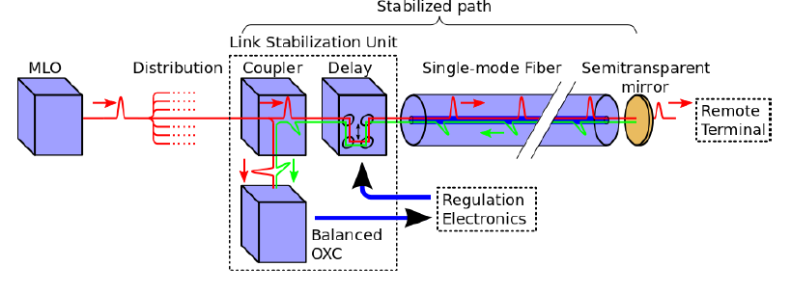
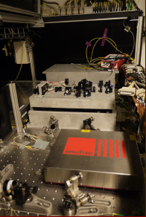
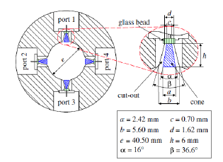
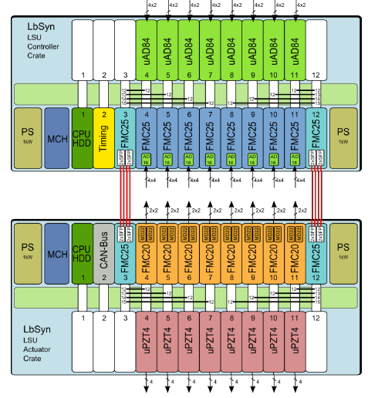
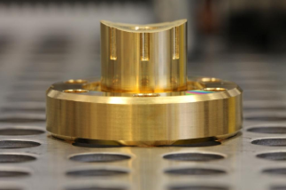
ARD - ST3: Pico- and fs Electron and Photon Beams
Pulsed optical synchronization system
Notes:
Before you start editing the slides of your talk change to the Master Slide view:
Menu button “View”, Master, Slide Master:
Edit the following 2 items in the 1st slide:
1) 1st row in the violet header:
Delete the existent text and write the title of your talk into this text field
2) The 2 rows in the footer area: Delete the text and write the information
regarding your talk (same as on the Title Slide) into this text field.
If you want to use more partner logos position them left
beside the DESY logo in the footer area
Close Master View

Slide 13
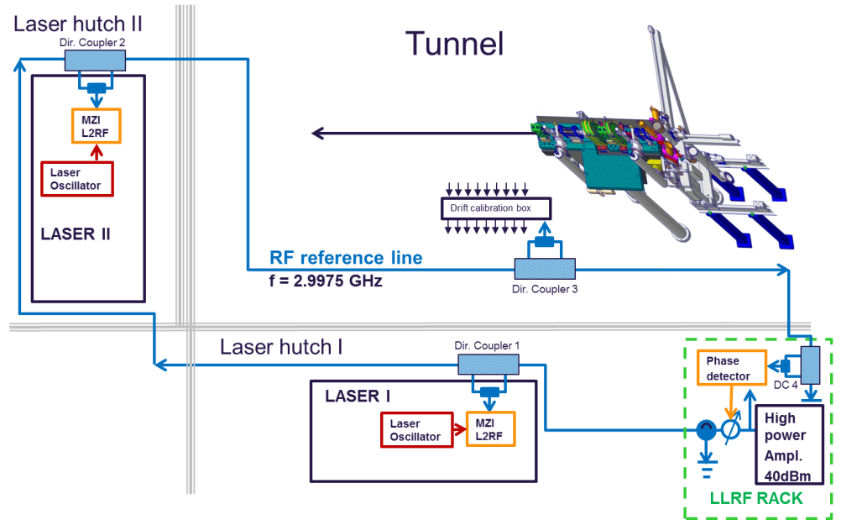
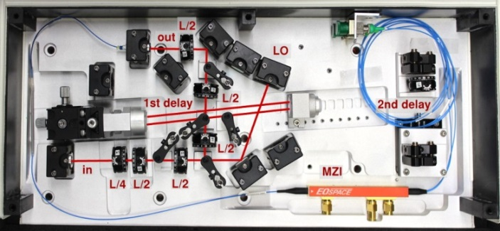
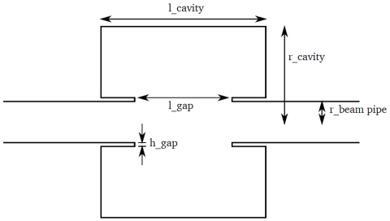
ARD – ST4: REGAE precision synchronization
RF Interferometer
LLRF Single cav.
L2RF@800nm
RF Cavity
Notes:
Before you start editing the slides of your talk change to the Master Slide view:
Menu button “View”, Master, Slide Master:
Edit the following 2 items in the 1st slide:
1) 1st row in the violet header:
Delete the existent text and write the title of your talk into this text field
2) The 2 rows in the footer area: Delete the text and write the information
regarding your talk (same as on the Title Slide) into this text field.
If you want to use more partner logos position them left
beside the DESY logo in the footer area
Close Master View

Slide 14
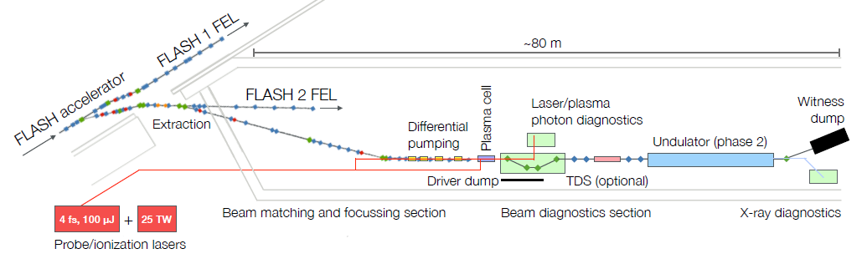
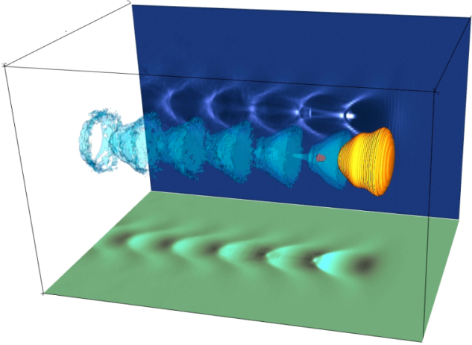
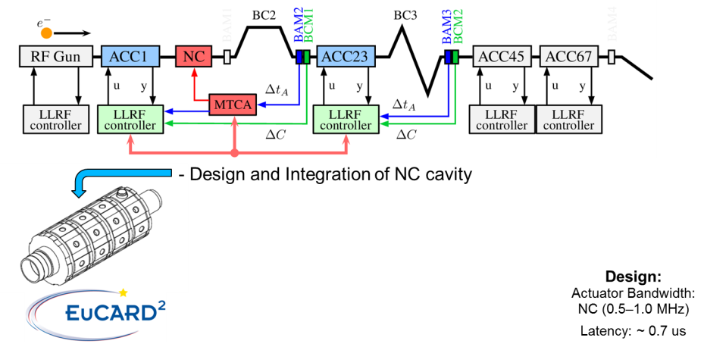
ARD – ST4: FLASHForward
Improvement LLRF, Upgrade Synchronization, Large bandwidth NRF Cavity FB
Beam and/or Laser driven
Plasma Wake Field Acceleration
Broad band Long. FB
2015-2016
Notes:
Before you start editing the slides of your talk change to the Master Slide view:
Menu button “View”, Master, Slide Master:
Edit the following 2 items in the 1st slide:
1) 1st row in the violet header:
Delete the existent text and write the title of your talk into this text field
2) The 2 rows in the footer area: Delete the text and write the information
regarding your talk (same as on the Title Slide) into this text field.
If you want to use more partner logos position them left
beside the DESY logo in the footer area
Close Master View

Slide 15
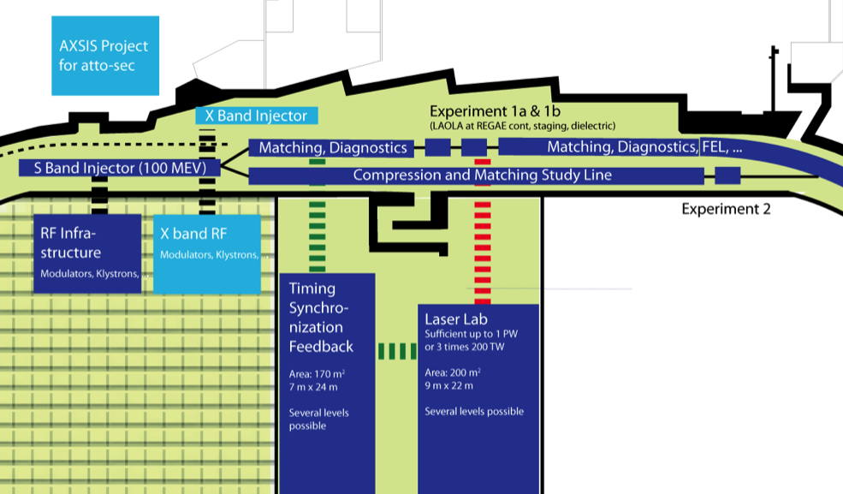
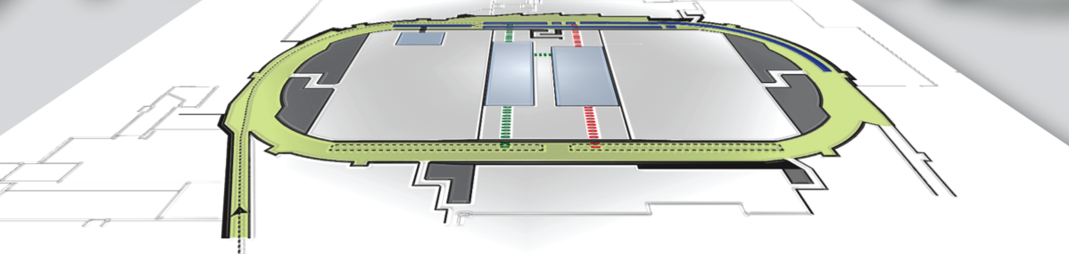
ARD – ST4: SINBAD > 2016
Laser / Synchronisation / Stabilisation Systems
Compact Atto-Second Light Source
50 as, ICS
ERC Synergy Grant 14 M€, DESY, Uni HH, Arizona
Develop ability to use plasma acceleration, scalability
> 1 GeV/m, useable beam quality, FEL?
LAOLA, ARD, DESY, Uni HH
Ultrashort electron pulse
< 1 fs with conven-tional technology
ARD, DESY, Uni HH, KIT
Room for further phases and users
Third party funding, interest from ELI, …
Footprint: 90 m x 50 m
Notes:
Before you start editing the slides of your talk change to the Master Slide view:
Menu button “View”, Master, Slide Master:
Edit the following 2 items in the 1st slide:
1) 1st row in the violet header:
Delete the existent text and write the title of your talk into this text field
2) The 2 rows in the footer area: Delete the text and write the information
regarding your talk (same as on the Title Slide) into this text field.
If you want to use more partner logos position them left
beside the DESY logo in the footer area
Close Master View

Slide 16
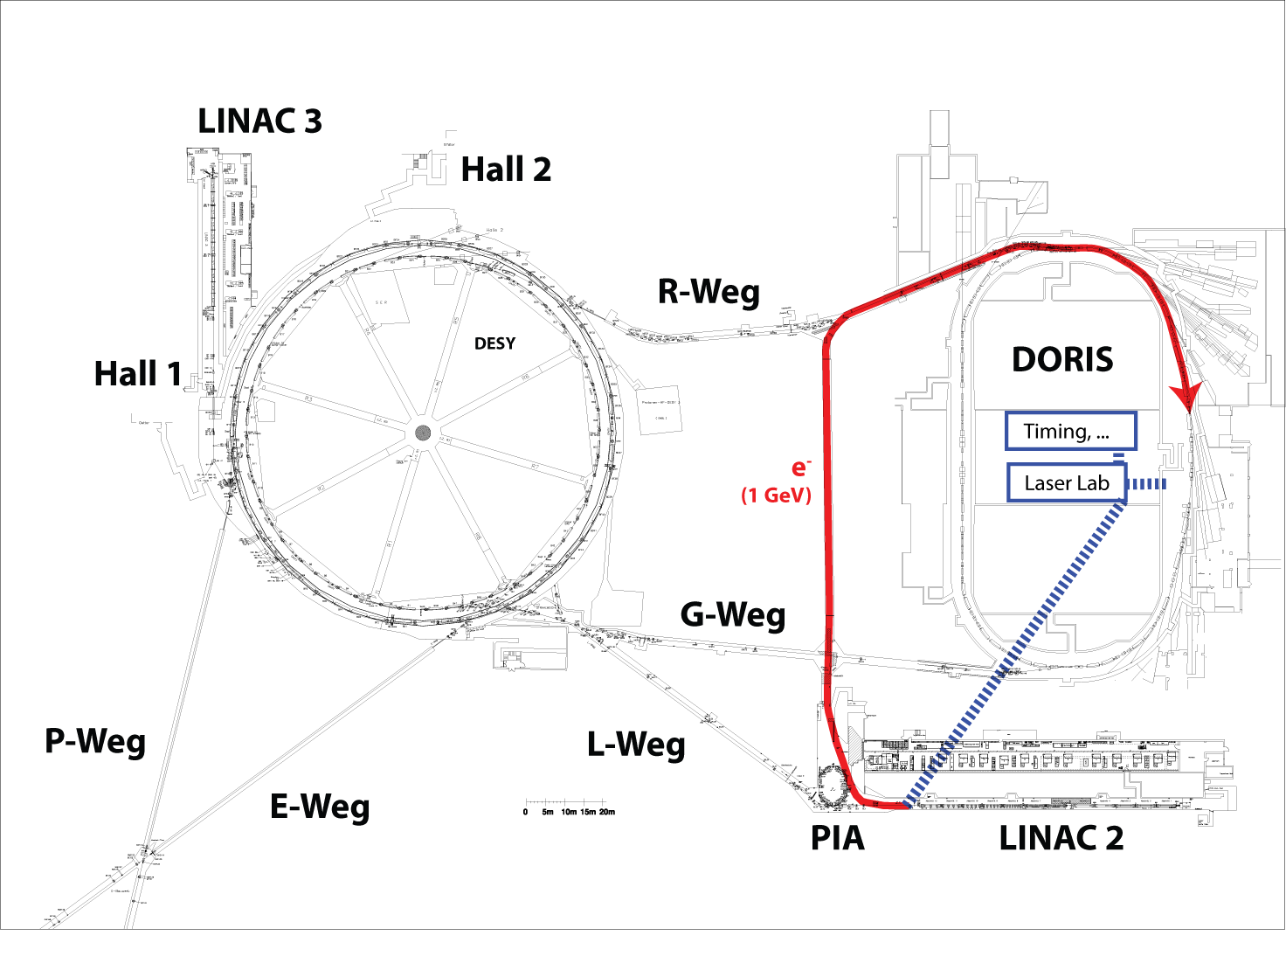
ARD – ST4: SINBAD >2016
Excellent integration into DESY accelerator park!
1 GeV allows FEL studies, seeding, … in DORIS, outside of user‘s operation.
Shows enormous potential of DORIS für accelerator R&D!
PIA allows positrons→ needed for collider applications (HEP)!
Must address RP aspects in transfer tunnel below building 30.
Ultra-fast
FB systems
Mayor LLRF Upgrade: first evaluation autumn 2014
Notes:
Before you start editing the slides of your talk change to the Master Slide view:
Menu button “View”, Master, Slide Master:
Edit the following 2 items in the 1st slide:
1) 1st row in the violet header:
Delete the existent text and write the title of your talk into this text field
2) The 2 rows in the footer area: Delete the text and write the information
regarding your talk (same as on the Title Slide) into this text field.
If you want to use more partner logos position them left
beside the DESY logo in the footer area
Close Master View

Slide 17
LLRF Projects
LLRF Projects
2014 – 2019
Notes:
Before you start editing the slides of your talk change to the Master Slide view:
Menu button “View”, Master, Slide Master:
Edit the following 2 items in the 1st slide:
1) 1st row in the violet header:
Delete the existent text and write the title of your talk into this text field
2) The 2 rows in the footer area: Delete the text and write the information
regarding your talk (same as on the Title Slide) into this text field.
If you want to use more partner logos position them left
beside the DESY logo in the footer area
Close Master View

Slide 18
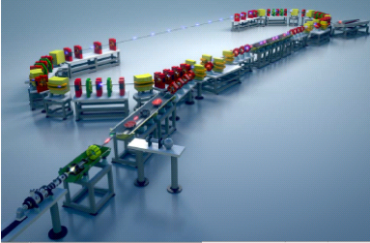
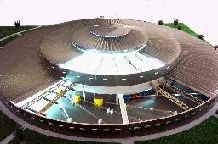




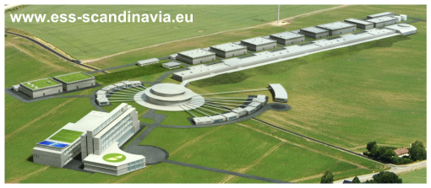

LLRF Projects
FLUTE: 2 Systeme (S)
ELBE: 6 Systeme (L)
BERLinPro: 7 Systeme (L)
Candle: 2+1 Systeme (S)
Armenia
Synergien mit ARD Programm
ESS: 218 Systeme
+ …
DESY:
Potential candidate for
building LLRF system
2016-2024
Lund
Notes:
Before you start editing the slides of your talk change to the Master Slide view:
Menu button “View”, Master, Slide Master:
Edit the following 2 items in the 1st slide:
1) 1st row in the violet header:
Delete the existent text and write the title of your talk into this text field
2) The 2 rows in the footer area: Delete the text and write the information
regarding your talk (same as on the Title Slide) into this text field.
If you want to use more partner logos position them left
beside the DESY logo in the footer area
Close Master View

Slide 19
Summary
Significant number of future project will keep us extremely busy…
Primarily application of developed hardware
Mayor part relates Firmware & Software
System design / Commissioning / Operation / Maintenance
Notes:
Before you start editing the slides of your talk change to the Master Slide view:
Menu button “View”, Master, Slide Master:
Edit the following 2 items in the 1st slide:
1) 1st row in the violet header:
Delete the existent text and write the title of your talk into this text field
2) The 2 rows in the footer area: Delete the text and write the information
regarding your talk (same as on the Title Slide) into this text field.
If you want to use more partner logos position them left
beside the DESY logo in the footer area
Close Master View

