Slide 1
MSK workshop summary
Julien Branlard
Notes:
How to edit the title slide
Upper area: Title of your talk, max. 2 rows of the defined size (55 pt)
Lower area (subtitle): Conference/meeting/workshop, location, date, your name and affiliation, max. 4 rows of the defined size (32 pt)
Change the partner logos or add others in the last row.

Slide 2
MONDAY AM
XFEL installation
JB: LLRF installation: steps, team and schedule for WP02
CG: WP18 installation: not so systematic, keep an eye for personnel overbooking
MF: test stands: some problems but should be OK for selected devices (uDWC, uADC, TCK7) + guidelines for designers
WW: racks: preparation stage, on-track, in time for L1
CS: commissioning (warm) sequential, (cold) in parallel, 2 teams, open questions about FW, HW upgrade during installation
MO and Reference distribution
LZ: MO: 1 channel ready for Dec. 2014, open points about distributing 216MHz, 10MHz and split the distribution into passive and active part
DS: REFMs: 68 modules, 13 different types, redundancy control unclear
CS: laser synch: 46 stabilization units (!), mostly on track, RF for July gun test, final phase noise performance MO delivered in Jan. 2015.

Slide 3
MONDAY PM
Hardware production
FL/MF: overview: 33 projects (WP02) 17 projects (WP18) + more! Delays due to unclear/changing requirements, lack of reviews, bad habits
MC: TMCB2: 2.5 k€, prototypes mid June, visit to ELMA → ask for quote
MZ: LOGM: almost finished, industrial partner chosen, 2 prototypes mid June, LOGM39 = universal LOGM with standard 450mm chassis
JP: DCM: new design meets all requirements, 2 units for June, DCM39 unclear
WP02 special diagnostics
SBH: DS800: project clean up + bug fixes, next production June-July
SBH: KLM-RTM: general purpose RTM + mezzanine for KLM, write specifications + review required, establish schedule
SBH: HOM-RTM: tuning filters require several iterations, impact of temperature ? review in DESY required with people in charge
UM: uLOG: uRFB with MCH-RTM in time for L3, Reset scheme from x2timer-RTM works, full test in July – August
JB: PZ16M: ITech and call for tender on hold, clarify CE certification, review design modification mid June

Slide 4
TUESDAY AM
Server and software
AP: server: working at FLASH, ZMQ, reorganization, CVS -> SVN, unique bin, future work : propr. clean up and automatic update
CS: software: long list, development team ramps up for XFEL
Discussion: properties name guildelines, work moving toward real time
MSK lab space:
FZ: laser lab: space problems, effort toward making OCAS work
BZ: Helgoland: safety, identified problems, good lab practice,
Discussion: easy steps to implement, follow up on proposal

Slide 5
TUESDAY PM
Firmware
LB: overview: MTCA for FLASH, single cav. Controller, framework, man power is a problem
CG: summary on parallel session: prioritize WP18 / WP02
BY : documentation : time consuming draw understandable diagrams, effort to use Doxygen for minimal documentation for users
Discussion: compatibility with server, deployment, good documentation would require changing working habits, only hope for us is automation (SVN, redmine, doxygen, etc…)
Beyond the XFEL
TW: HVF: 5/9 licensing in 2013, put DESY on the map, front edge of MTCA.4
FL: HVF future: some 80-90% done, missing 4 months, other not: EMI classification (additional $$ requested)
HS: future projects: HVF (licensed module maintenance, EMI lab), ARD (CW RF CW optical synch, sub-fs RF controls, technology transfer DESY-> Helmholtz, FLASH forward plasma, SINBAD), future LLRF projects (Flute, Elbe, BerlinPro, Candle, ESS) → FW, SW mostly

Slide 6
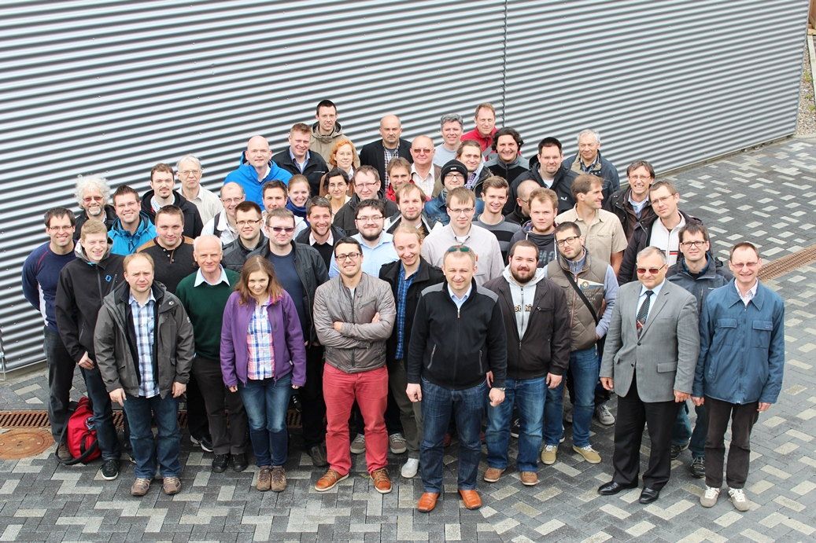
THANK YOU!

