Slide 1
Firmware needs for special diagnostics
Presented by: Christopher Gerth
Notes:
How to edit the title slide
Fill in the text written in brown

Slide 2
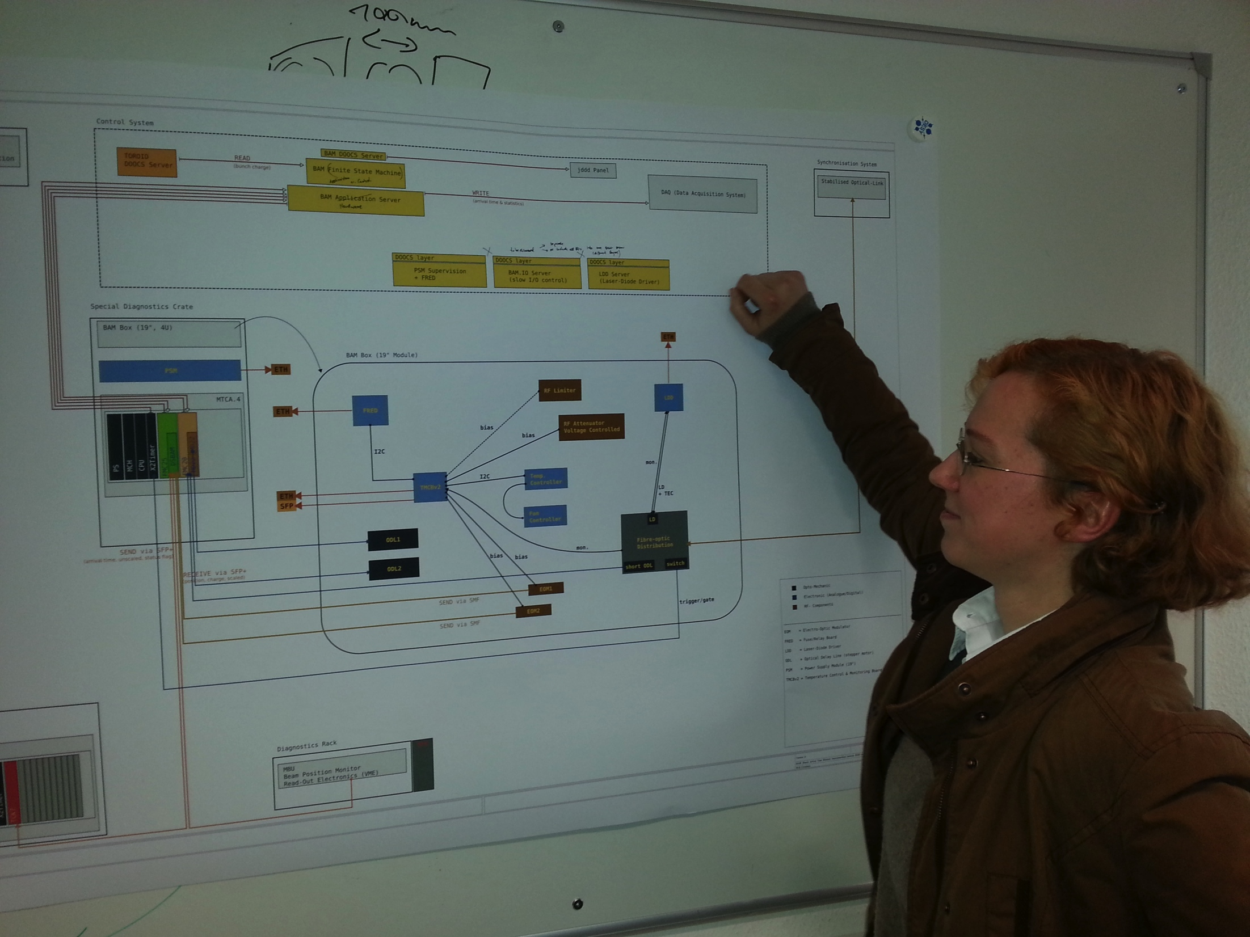
Introduction
  Summary of ‘Working Groups’ (parallel sessions)
  BAM:
  Links:
  Laser Synchronization:
Monday
16:05 BAM overview
16:20 FMC25 _ DSBAM board test results
16:35 BAM MTCA firmware /server needs
16:50 Guided discussion: server and firmware integration
17:15 Link lock and MTCA needs
17:30 Guided discussion : server and firmware integration
Tuesday
09:00 Laser synchronization overview
09:20 LASY board development status
09:40 Guided discussion : LASY development
10:00 Laser synch server / firmware needs
10:10 Laser synch server / firmware status
10:20 Guided discussion : server and firmware integration

Slide 3
BAM and Links
FMC25 required by BAM and LSU in different configuration
BAM: FMC25 + DSBAM
LSU: 1) FMC25 + MD22
2) FMC25 + SFP4
Urgent need identified for both projects (1 year delay)
BAM at FLASH, LSU at XFEL
Prototypes in test/operation by July 14
Notes:
Before you start editing the slides of your talk change to the Master Slide view:
Menu button “View”, Master, Slide Master:
Edit the following 2 items in the 1st slide:
1) 1st row in the violet header:
Delete the existent text and write the title of the EoI for WPnumber
2) The row in the footer area: write the institute name
Close Master View

Slide 4
BAM and Links
Next steps FMC25 testing and firmware development:
Application Software and integration
In SimuLink library – Pawel
Firmware for AD84 and test – Konrad
Board support package - Lukasz
LSU
procedure for board tests – Lukasz
Tests for BAM - Jarek
Board support package - Lukasz
BAM
Simple application Software for BAM - Jarek
July 14
Review
Notes:
Before you start editing the slides of your talk change to the Master Slide view:
Menu button “View”, Master, Slide Master:
Edit the following 2 items in the 1st slide:
1) 1st row in the violet header:
Delete the existent text and write the title of the EoI for WPnumber
2) The row in the footer area: write the institute name
Close Master View

Slide 5
BAM Server
Marie discussing the BAM server layout
After firmware test and tests with simple application software => New Server in ‘Killenberg’ framework

Slide 6
WP-18 Diagnostics and Beam-Based Feedback

Slide 7
Laser Synch – FMC20/MD22
7
MD22:
  Change from XFEL framework to LLRF framework to make it work on FMC20 (Konrad)
Many tasks on the server part were discussed ….
Notes:
7
Before you start editing the slides of your talk change to the Master Slide view:
Menu button “View”, Master, Slide Master:
Edit the following 2 items in the 1st slide:
1) 1st row in the violet header:
Delete the existent text and write the title of your talk into this text field
2) The 2 rows in the footer area: Delete the text and write the information
regarding your talk (same as on the Title Slide) into this text field.
If you want to use more partner logos position them left
beside the DESY logo in the footer area
Close Master View

Slide 8
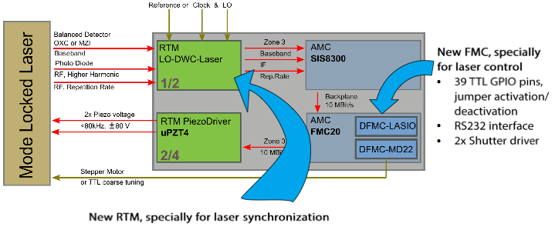
Laser Synch
8
New boards under development: LASIO, LASY
=> Firmware when boards are produced
Notes:
8
Before you start editing the slides of your talk change to the Master Slide view:
Menu button “View”, Master, Slide Master:
Edit the following 2 items in the 1st slide:
1) 1st row in the violet header:
Delete the existent text and write the title of your talk into this text field
2) The 2 rows in the footer area: Delete the text and write the information
regarding your talk (same as on the Title Slide) into this text field.
If you want to use more partner logos position them left
beside the DESY logo in the footer area
Close Master View

