Slide 1
WP-18 Special Diagnostics Installation Overview
Presented by: Christopher Gerth
Notes:
How to edit the title slide
Fill in the text written in brown

Slide 2
Scope of WP-18 Devices
Distribution of fs-stable optical synchronization signals over entire facility (~ 3.5 km)
Monitoring of long. properties: beam energy, bunch profile/length and bunch arrival time.
Igor Zagorodnov, 2011
Energy | 130MeV | 600MeV | 2.5GeV | 17.5GeV
20pC | 4.53ps | 1.46ps | 185fs | 5.23fs
100pC | 4.80ps | 1.55ps | 197fs | 11.6fs
250pC | 5.27ps | 1.70ps | 223fs | 25.4fs
500pC | 6.00ps | 1.96ps | 259fs | 43.0fs
1000pC | 6.77ps | 2.23ps | 303fs | 84.0fs
Energy change (x 100) after accelerating sections: I0, L1, L2, L3
Bunch length change (x 1000) after bunch compressors: BC0, BC1, BC2
Bunch arrival time may change after dispersive sections: BC0, BC1, BC2
=> Long. Diagnostics after Accelerating and Dispersive Sections

Slide 3
Overview on WP-18 Devices
Beam energy
Bunch arrival
Laser-based
Synchronization
Bunch length/profile
TDS⁽¹⁾
Transverse
Deflecting
Structure
EOD
EO
Diagnostics
BCM
Bunch
Compression
Monitor
EBPM
Energy BPM
SRM
Synchrotron
Radiation
Monitors
Reference
Distribution
(MLO, FSD, LSU)
Bunch profile
Slice emittance
Phase space
Bunch profile
Compression
Beam energy
(Bunch arrival)
Beam Energy
Energy profile
CRD
THz
Spectrometer
BAM
Bunch Arrival
Monitor
L2L
Laser
Synchronization
REFM
LLRF
Synchronization
Bunch profile
Bunch arrival
Beam energy
1)
High-Power RF system and TDS are part of contract between European XFEL GmbH and Inst. for Nuclear Research (INR).
Yellow: involves lasers (=> laser lab space required)
REFM part of LLRF system (hardware: WP02, personnel: WP18)
BAM, BCM and EBPM to be used for fast intra bunch-train Beam-Based Feedback (BBFB)
Notes:
Before you start editing the slides of your talk change to the Master Slide view: Menu button “View”, Master, Slide Master:
Edit the following 2 items in the 1st slide: 1) 1st row in the violet header: Delete the existent text and write the title of the EoI for WPnumber 2) The row in the footer area: write the institute name
Close Master View

Slide 4
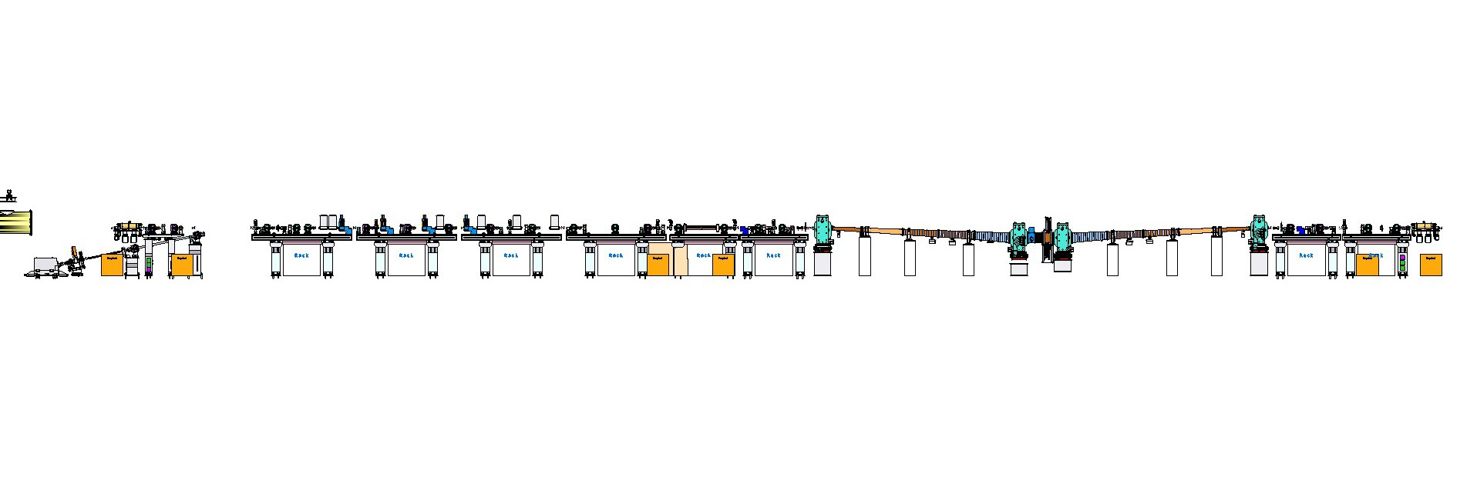
Diagnostics and Interfaces to LLRF: Example BC1/L1
Diagnostic Sections:
Bunch Compression (BCM)
Bunch-Arrival Time (BAM)
Long. Bunch Profile (EOD)
BC1
Matching Section:
FODO Lattice
Slice Emittance (TDS)
Long. Bunch Profile (TDS)
e-spectrometer:
Energy
Long. PS
BC chicane:
Energy (EBPM)
Energy spread (SRM)
BC0
Beam direction
L2
L1
BCM
EBPM
BCM
BAM
BAM
Controller
Beam Based FB
REFM
Experimental Hall:
SLO
~ 3.5km
Pump-Probe Laser 1
Links
x 24
MLO
MO
Pump-Probe Laser n
* MLO: master laser oscillator
WP-02 LLRF

Slide 5
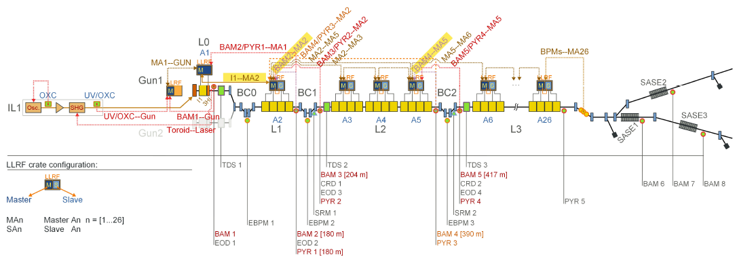
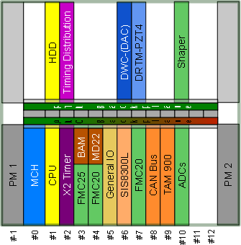
WP-18 Diagnostics and Beam-Based Feedback
Planning: M.K. Czwalinna, C. Gerth, C. Schmidt
Simualations: H. Dinter, S. Pfeiffer
BAM, EOD and BCM are combined in 1 MTCA crate
 | INJ | BC0 | BC1 | BC2 | COLL | UND | Sum
BAM | 1 | - | 2 | 2 | 2 | - | 7
EOD | 1 | 1 | 1 | - | - | - | 3
BCM | - | 1 | 1 | 2 | - | - | 4
CRD | - | - | - | - | 1 | - | 1
SRM | - | - | 1 | 1 | - | - | 2
TDS | 1 | - | 1 | 1 | - | - | 3
EBPM | - | 1 | 1 | 1 | - | - | 3
Sum | 3 | 3 | 7 | 7 | 3 | - | 23
Combined Signals with EBPM are sent to upstream LLRF station
=> FW needs for SD

Slide 6
Generic Layout
6
In addition to Rack equipment => Vacuum Setups
Time schedule depends on WP19/TC (exact date hard to plan)
May need assistance by expert in clean room
Additional Hardware: EOD, BCM, CRD, SRM (later installation in XTL)
In addition to Rack equipment => Operation of Reference Distribution
More details => 11:40 Laser-based Synchronization (Cezary)
Rack
19’’ Modules:
Operation of Hardware
Vacuum
setup
Control and Conversion to electrical signals
LLRF
MTCA:
Signal detection, computation, …
19’’ Module:
Conversion for signal detection
e-beam
Notes:
6
Before you start editing the slides of your talk change to the Master Slide view: Menu button “View”, Master, Slide Master:
Edit the following 2 items in the 1st slide: 1) 1st row in the violet header: Delete the existent text and write the title of your talk into this text field 2) The 2 rows in the footer area: Delete the text and write the information regarding your talk (same as on the Title Slide) into this text field.
If you want to use more partner logos position them left beside the DESY logo in the footer area Close Master View

Slide 7
WP-18 Rack/Crate/Device test and installation
7
Rack installations:
Every rack configuration different (22 stations, shared, room reserved => TC rack inventory)
Installation of MTCA and 19’’ modules at final location (no RATA)
Installation and cabling by experts plus others (depends on rack)
MTCA Crate installation
Almost every crate configuration different (about 22 crates)
Integration tests: should be close to MTCA device storage and testers (55a digi-Lab ?)
Crate storage unclear (to be worked out with TC)
MTCA Devices
Device labeling and documentation in KDS (Matthias Felber, Maciek Kudla)
Storage and documentation procedure to be worked out
Device testing: only for LLRF boards, other boards by company or during integration
Too many side constraints for each rack => no standard procedure
However, good/easy documentation required not to lose track of components
Needs to be organized (learn from LLRF?)
Notes:
7
Before you start editing the slides of your talk change to the Master Slide view: Menu button “View”, Master, Slide Master:
Edit the following 2 items in the 1st slide: 1) 1st row in the violet header: Delete the existent text and write the title of your talk into this text field 2) The 2 rows in the footer area: Delete the text and write the information regarding your talk (same as on the Title Slide) into this text field.
If you want to use more partner logos position them left beside the DESY logo in the footer area Close Master View

Slide 8
WP-18 MTCA Crates
Mixture of 2U and 9U MTCA crates in different configuration distributed over XFEL

Slide 9
WP-18 MTCA Devices
AMC
RTM
Mezzanine
X2 Timer
FMC25
FMC20
SIS8300L
AD84
ADIO24
TAMC200
TAMC532
AM900
AM4301
GPIO
22
21
21
23
9
14
6
4
3
6
n
≈ 130
X2 TIMER RTM
SIS-RTM
DWC/LASY
DWC8-VM1
PZT4
3
4
9
3
15
≈ 34
MD22
AD16
DSBAM
30
9
7
≈ 46
About 20 different board types
Over 200 boards in total

Slide 10
Timeline and Milestones (Commissioning WG: Winni Decking)
2014
2015
2016
2017
2018
First e-beam out of RF gun
Injector cooldown
Linac cooldown
SA1
SA3
SA2
Start user operation
Full TDR performance
1st lasing possible
Finish Developments
Start series production
Installation Vacuum Parts
1 year Injector Commissioning
Operation of 4 Links, BAM, EOD Laser, TDS
Installation all other WP-18 hardware
Commissioning of all hardware with beam

Slide 11
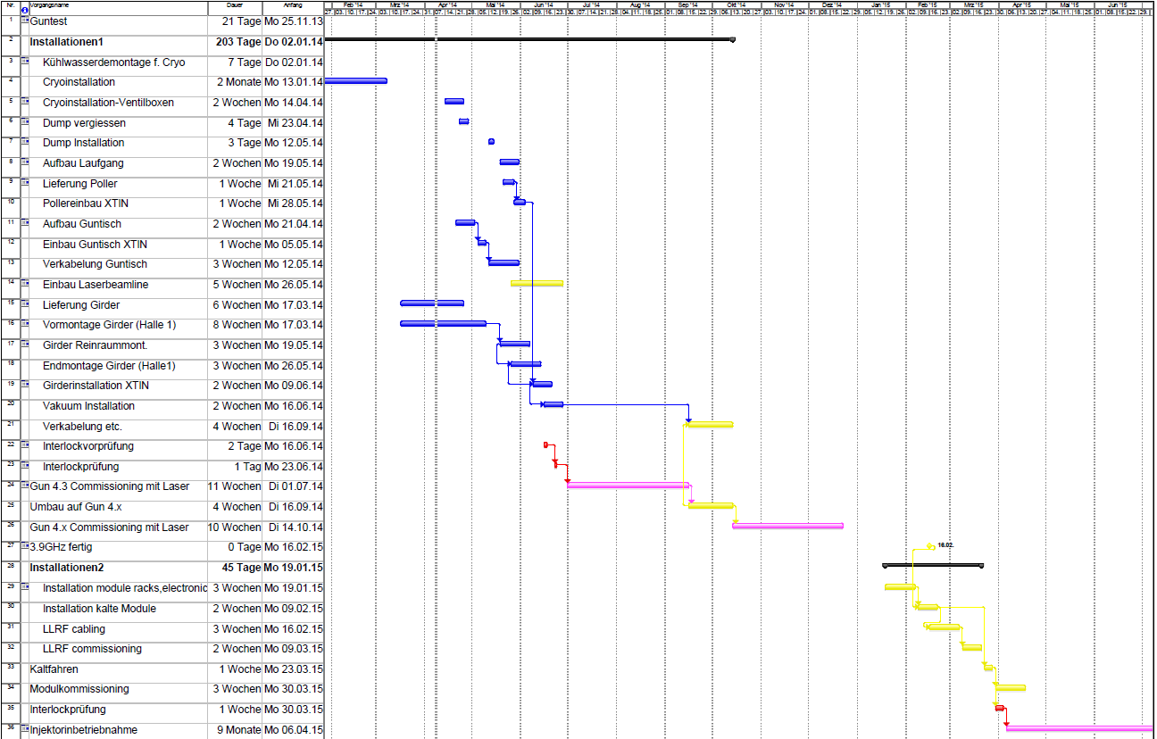
Installation schedule Injector until mid 2015
Installation Vacuum Parts:
06-07/14 - BAM, EOD
10/14 Installation TDS
EOD installation
4 LSU in operation
BAM EO Front-end after ACC39
ACC39 delayed?

Slide 12
Summary
Overall Schedule:
Injector Commissioning ≈ 04/15 – 04/16: BAM, EOD, TDS, 4 LSU
Installation of all other hardware (20 systems and 20 LSU) until 06/16
Installation schedule
No rigid schedule as for LLRF (A01 – A26)
Needs to be planned by device responsible persons and coordinated in team
Coordination will depend on
Availability of WP-18 hardware
Availability of sub-system experts for device testing
Availability of support for installation
Availability of support for firmware / server installation
Overall schedule (vacuum installation, infrastructure and rack installation, …)
=> Needs to be worked out
All hardware developments finished by end 2014
All hardware available beginning of 2015
Establish installation routines and teams (may conflict with WP-02 as same personnel involved)

Slide 13
Thank you for
your attention

