Slide 1
DS800 status, results and production plans
Samer Bou Habib
Notes:
How to edit the title slide
Upper area: Title of your talk, max. 2 rows of the defined size (55 pt)
Lower area (subtitle): Conference/meeting/workshop, location, date, your name and affiliation, max. 4 rows of the defined size (32 pt)
Change the partner logos or add others in the last row.

Slide 2
Agenda
Status
Results
Plans

Slide 3
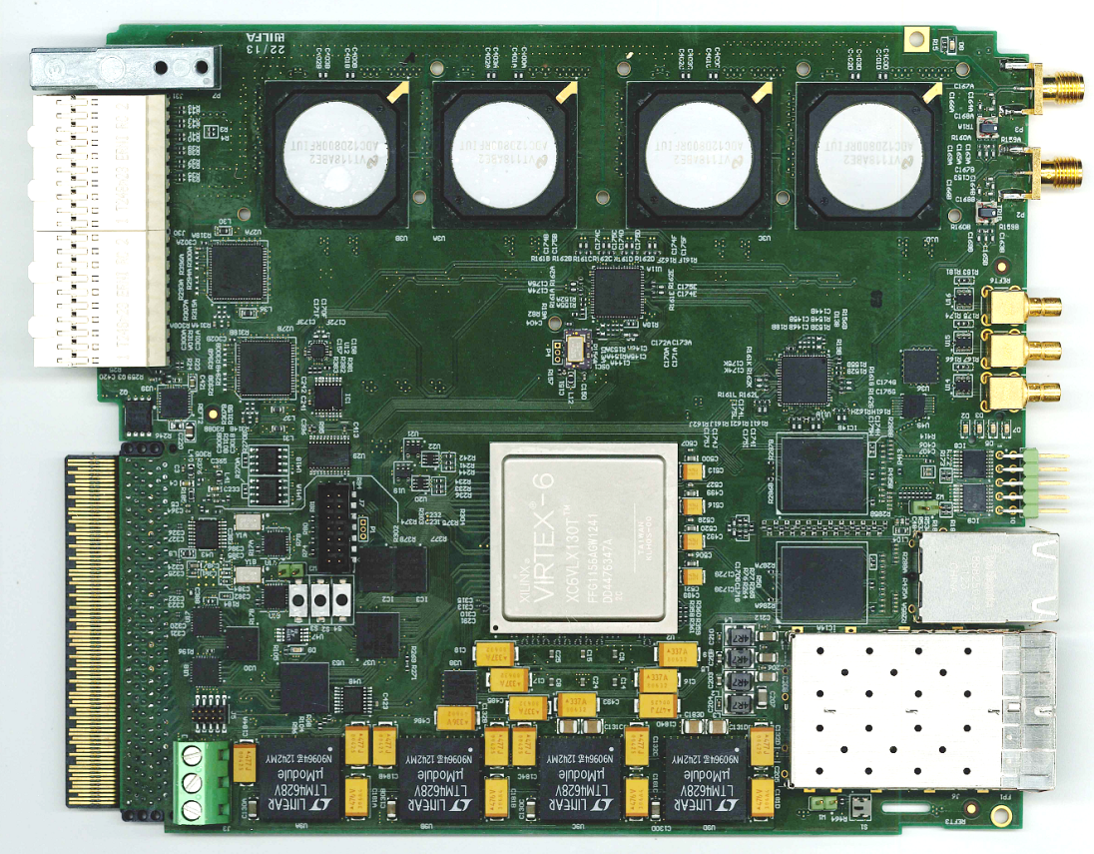
Status
All ICs tested and operational (except SRAM)
ADC performance checked
Mechanical issue
Rev 1.1 in progress

Slide 4
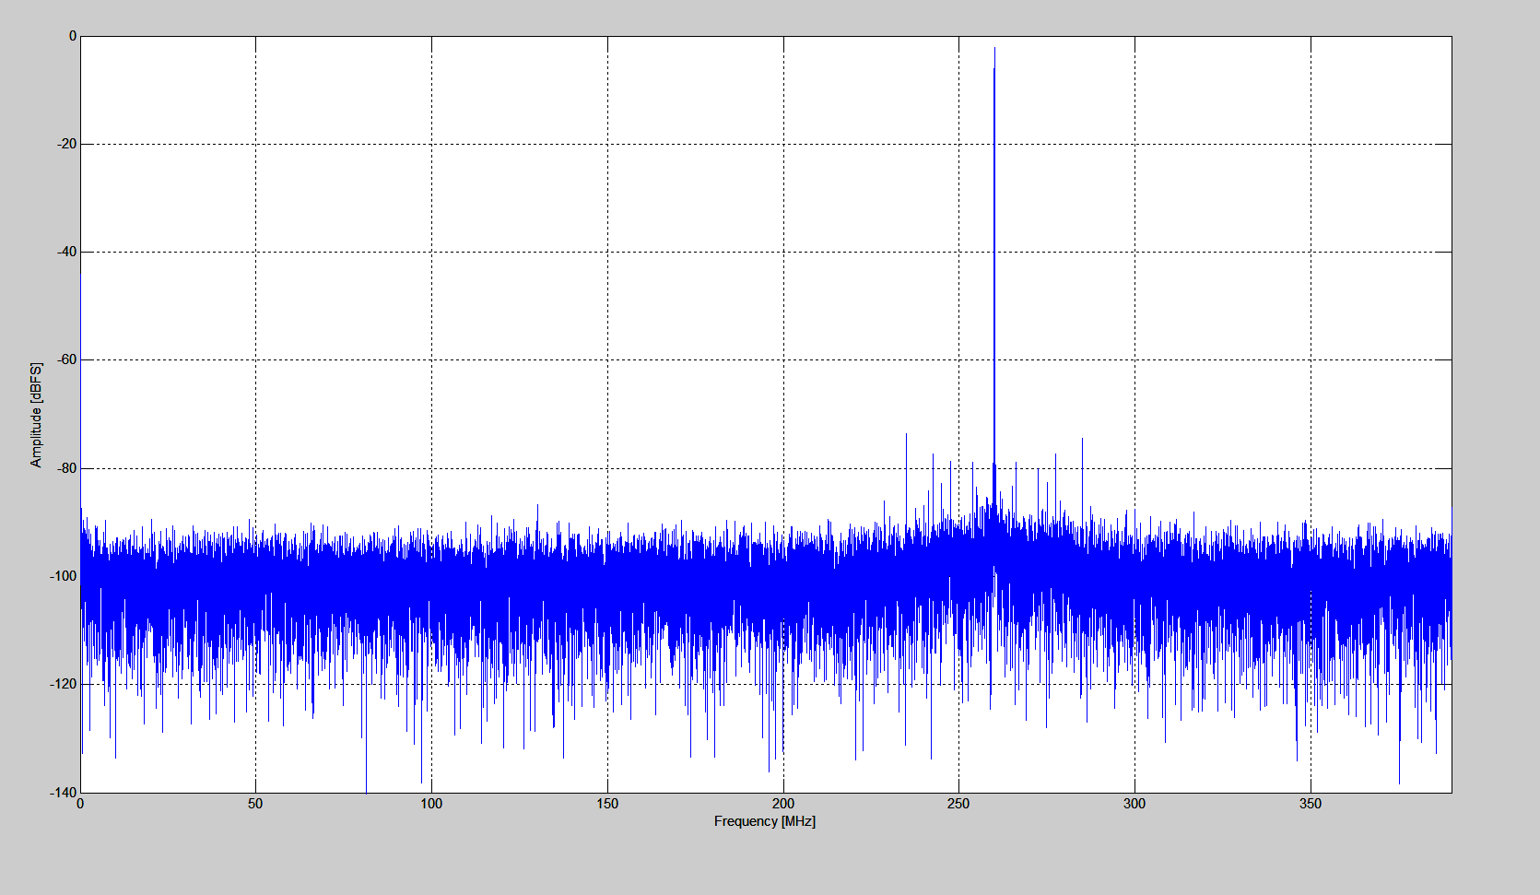
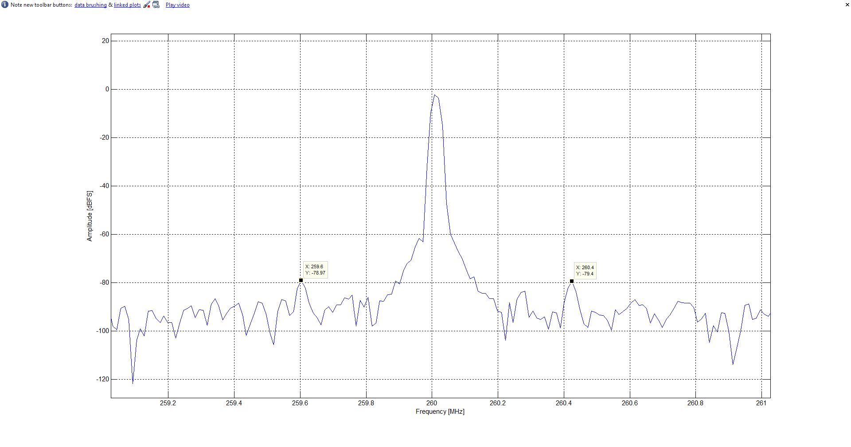
Results @ 780 MSPS
Sampling Parameters | SNR (SINAD) [dB] | PSD [dBfs/Hz] | ENOB [bits] | SNR (SINAD) in 1 MHz BW [dB] | ENOB in 1 MHz BW [bits]
Measured | 53.4 | 140 | 8.57 | 79.3 | 12.88
Data sheet Value for 1.5GHz input | 55.1 | 149 | 8.8 | No data | No data
2/3 demodulation scheme | 260 MHz BW (3 samples) | 1 MHz BW | 100 KHz BW
RMS relative amplitude resolution | 0.00086 | 0.00012 | 5.54 e-005
RMS Phase resolution [°] | 0.09 | 0.016 | 0.0055

Slide 5
Plans
May
SRAM this week
Bug fix
Project cleaning
integration with RM library
June
Production + Assembly
BSP
July
Verification
Performance
BSP bug fix
August
License release

Slide 6
Thank you for your attention
S.BouHabib@elka.pw.edu.pl
Samer.Bou.Habib@desy.de

