Slide 1
HOM RTM status and production plans
Samer Bou Habib
Notes:
How to edit the title slide
Upper area: Title of your talk, max. 2 rows of the defined size (55 pt)
Lower area (subtitle): Conference/meeting/workshop, location, date, your name and affiliation, max. 4 rows of the defined size (32 pt)
Change the partner logos or add others in the last row.

Slide 2
Agenda
Status
Test board results
Plans

Slide 3
Status
Filter test board finished
Tests made
Some tuning required
1.3 GHz
A
1.7 GHz
Input signal
A
2.4 GHz
A

Slide 4
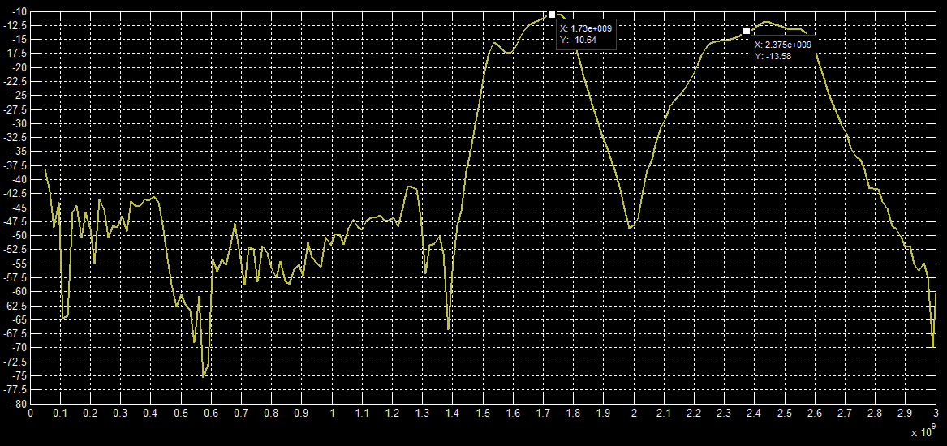
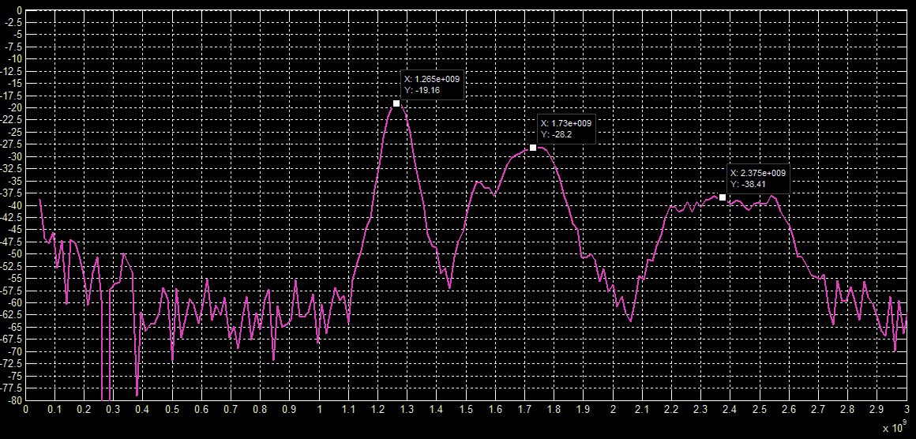
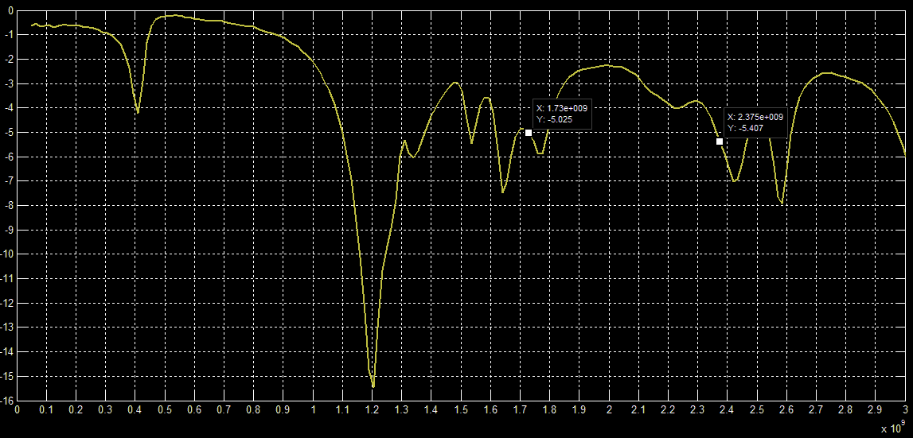
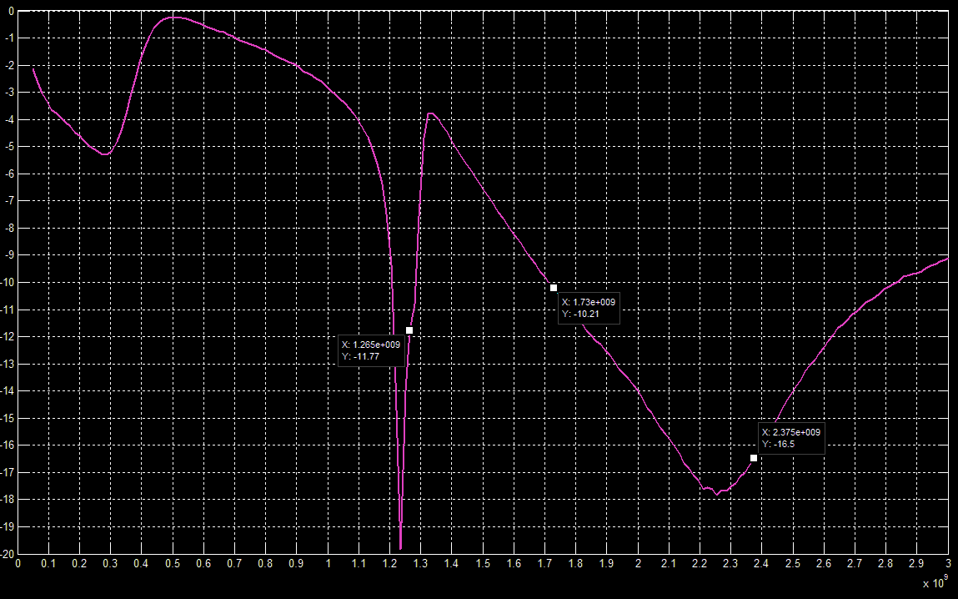
Results
Att. Settings [dB]
@1.3, 1.7, 2.4 GHz
32, 0, 0
8, 16, 24
S21
S11

Slide 5
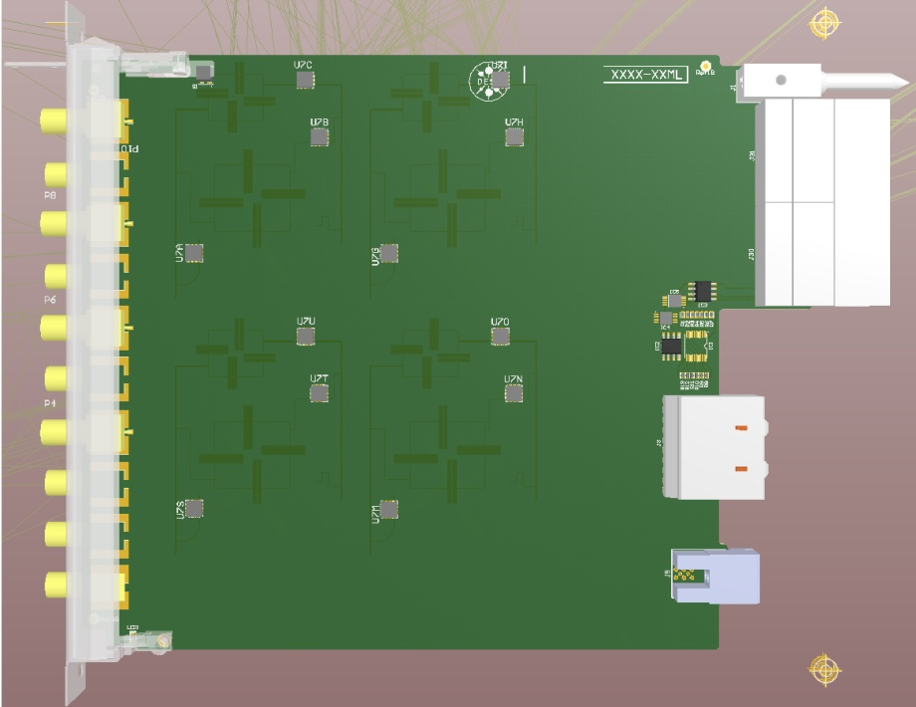
Status
RTM schamtics 70% done
PCB <50% done
Some open issues
Power levels

Slide 6
Plans
May - June
Filter tuning
RTM design finish
July
Production + Assembly
Application firmware
August
Verification
Performance
Application firmware test
September
REV 2?

Slide 7
Thank you for your attention
S.BouHabib@elka.pw.edu.pl
Samer.Bou.Habib@desy.de

