Slide 1
KLM RTM status and production plans
Samer Bou Habib
Notes:
How to edit the title slide
Upper area: Title of your talk, max. 2 rows of the defined size (55 pt)
Lower area (subtitle): Conference/meeting/workshop, location, date, your name and affiliation, max. 4 rows of the defined size (32 pt)
Change the partner logos or add others in the last row.

Slide 2
Agenda
Introduction
Status
Plans

Slide 3
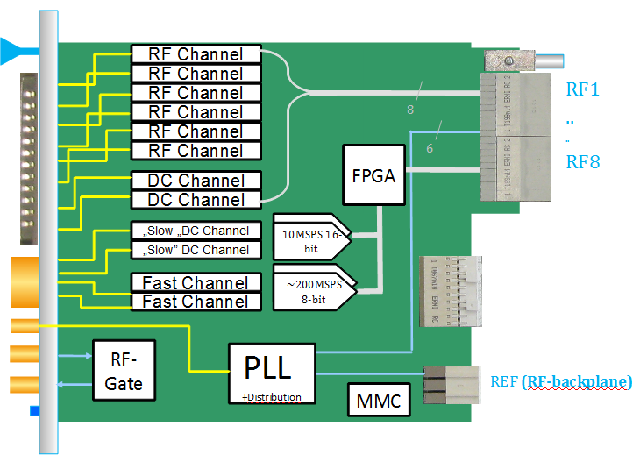
KLM
A1.1 compatible RTM
8 AC/DC HS channels
6 AC HS channels
2 DC HS channels
2->1 „slow DC channel”
2 -> 1 fast low resolution channel
2x VM slots with RF gates

Slide 4
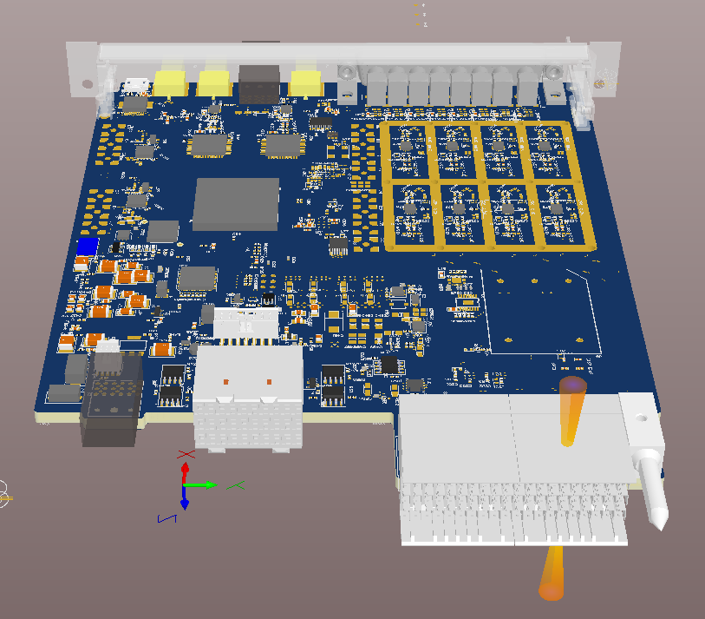
Status
PCB „finished”
Review required
PLL dividers should be changed
Power levels should be checked (amplifiers to be added)
Not needed channels?
FP connectors?

Slide 5
Plans
May
Review
Implement changes
June
Production + Assembly
BSP
July
Verification
Performance
BSP bug fix
August
Rev 2?

Slide 6
Thank you for your attention
S.BouHabib@elka.pw.edu.pl
Samer.Bou.Habib@desy.de

