Slide 1
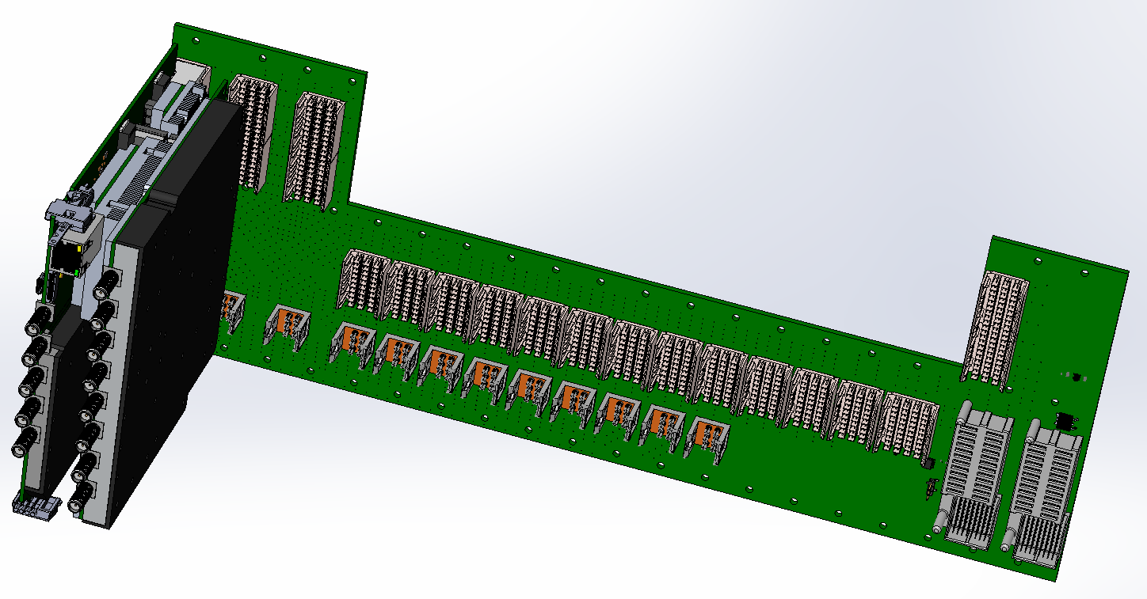
Toward uLOG operation (uLOG, uRFB and MCH-RTM).
Uroš Mavrič on behalf of all the people involved
MSK Collaboration Workshop, DESY, 12.05.2014

Slide 2
Talk Overview.
The main question of the talk:
“What is needed for the first working prototype?”
Basic HW building blocks:
  uRF Backplane (Tomasz L.)
  RTM-MCH-MB (Annika R.)
  DRTM-LOG1300 (Uroš M.)
  Trigger RTM (Christoph S.)
Required actions for operation
To-be-defined items
Possible operational scenarios

Slide 3
uRF Backplane.
3 LVDS Lines for comm. with DRTM-LOG1300
RESET from X2 Timer RTM
MP and PP interconnections
RF and CLK signal distribution
Management signals (PS, PWR_ON etc.)
X2 Timer RTM
MCH-RTM-BM
DRTM-LOG1300
(Test to be performed by next week)
3.1
3.1

Slide 4
RTM-MCH-MB
uLOG IPMB-L
uLOG +12V
uLOG EN
uLOG PS
uLOG PWR_ON
uLOG +3.3V
uLOG Serial Comm.

Slide 5
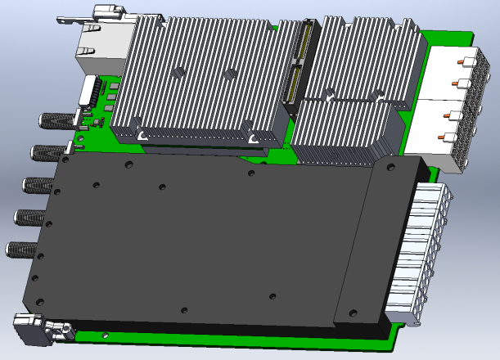
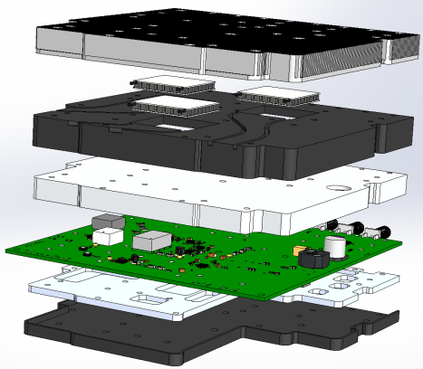
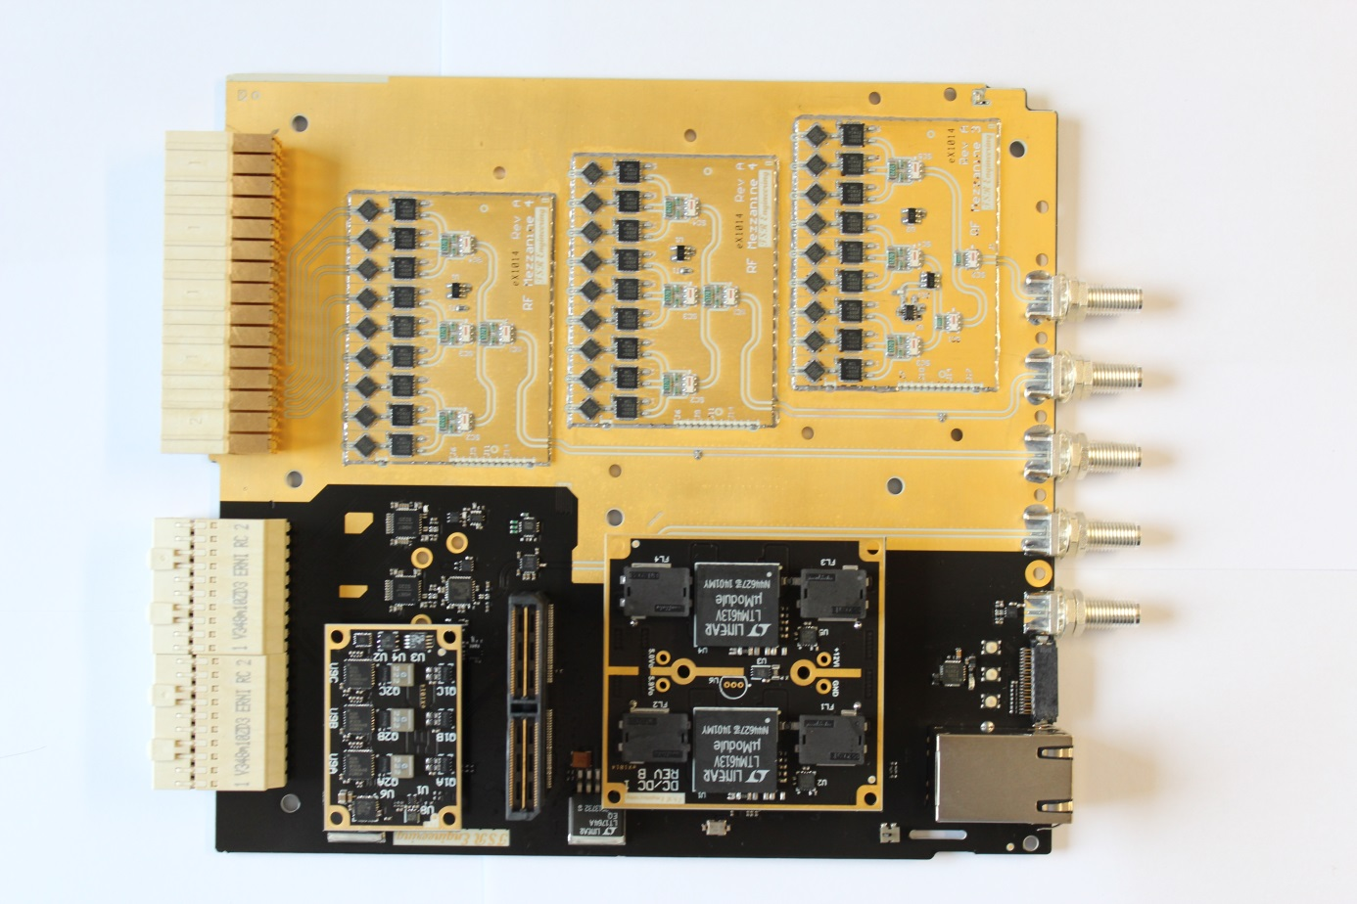
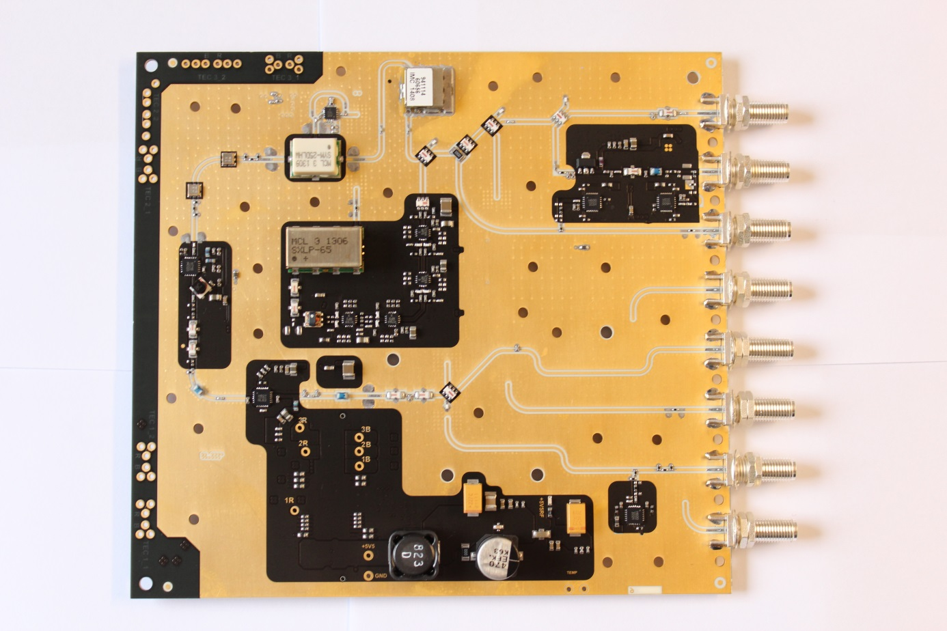
DRTM-LOG1300 (uLOG).
Carrier Mechanicals
RF Mechanicals
LO
CAL
REF
REF IN
30 x RF Out
From RF
To Carrier
SPI Comm.
22 x CLK Out
JTAG/USB
Ethernet
DC/DC Mezz.
The DRTM-LOG1300 generates and splits the LO and CLK signals needed for the digitalization.
3 x TEC

Slide 6
X2 Timer + Trigger RTM
X2 Timer
Trigger RTM
108 MHz
1.3 GHz
Delay
(5 ps)
DIV
FPGA
algrthm
Reset circuit
RESET 1
RESET 2
RESET 3
Server STOP
Server START
X2 timer reset principle has been successfully tested
HW is available and tests are planed by the end of next week with uRF backplane ver 3.1 and uLOG ver A.
uLOG RESET must be at least 5 ns long.

Slide 7
Required actions for “full concept” operation.
Assuming the HW is delivered and it has been successfully tested according to the specific test plan,….
…we also need:
  FW for RTM-MCH-MB (for board-management control and appl. Zynq processor)
  FW for DRTM-LOG1300 (for MMC and application processor)
  FW change on the front MCH? Do we also need HW changes?
  Various FRU records (RF backplane, DRTM-LOG1300, MCH-RTM-BM, DWC, VM)
Server for:
  Controlling DRTM-LOG1300 (logging data)
  RESET signal in X2 timer server

Slide 8
To-be-defined.
Protocol for shipping data from DRTM-LOG1300 to RTM-MCH- MB
  Which data will be shipped, how often, precision?
High-level server for operating DRTM-LOG1300 is needed. In standard configuration of the MCH-RTM-BM not part of the standard infrastructure.
The “RESET” button will be located on the X2 Timer server panel. Modifications of the X2 timer server are needed. No FW changes are needed.

Slide 9
Other possible operating scenario.
If the MCH-RTM-MB is not present:
  The DC power is delivered by a standard PM plugged into the RF backplane and operated in autonomous mode (successfully tested).
  The comm. to DRTM-LOG1300 is established via Ethernet or USB connected to the front CPU (successfully tested).

