Slide 1
MSK lab organization
Current status, problems and previous attempts
Bartlomiej Szczepanski
MSK collaboration workshop
Hamburg, 13.05.2014

Slide 2
MSK lab organization - topics
Necessary safety trainings
Using the standard tools in the labs
Measurement equipment and special tools
Occupying working stations in the labs for longer time
Expendable items in the labs
Time schedule for visitors

Slide 3
Necessary safety trainings
General health and safety briefing -> D5
Mandatory for everybody
takes place in the audimax „Hörsaal“
prescribed dates, invitations from Fr.Brandis via email
period of validity : 1 year
Special safety briefing
labs in „Helgoland“ -> B.Szczepanski
mechanical workshop in “Helgoland“ -> M.Schäfer
Mandatory for everybody who wants to use the labs / workshop in building 3 (analog
lab,digital lab and/or machanical workshop)
takes place in the labs in small groups or individual
time has to be arranged with BS / MS
period of validity : 1 year
No access authorization to the labs without vaild safety briefing !

Slide 4
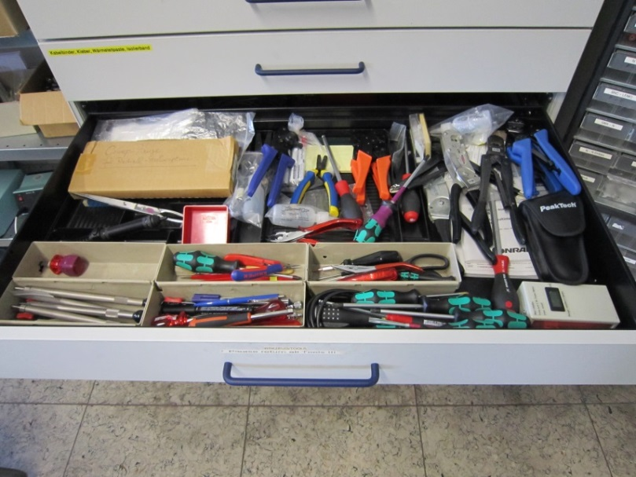
Using the standard tools in the labs
Standard tools for general usage are in the drawer in the analog lab (303) and in the cupboards in the small analog lab and in the digital lab.
The main problem is simple:
People take them and do not bring them back.
This costs a lot of time and money.

Slide 5
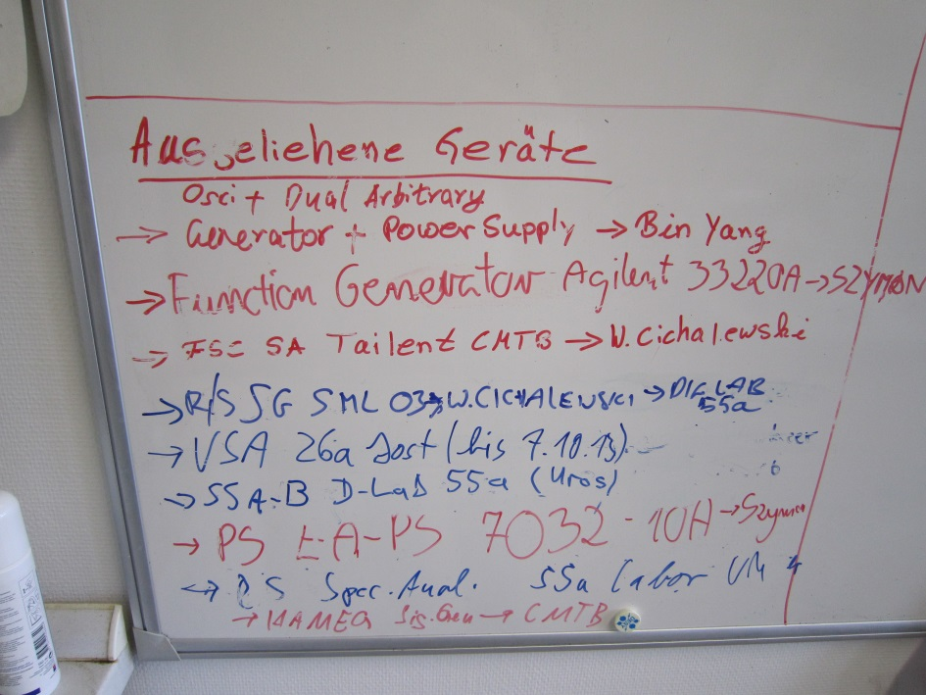
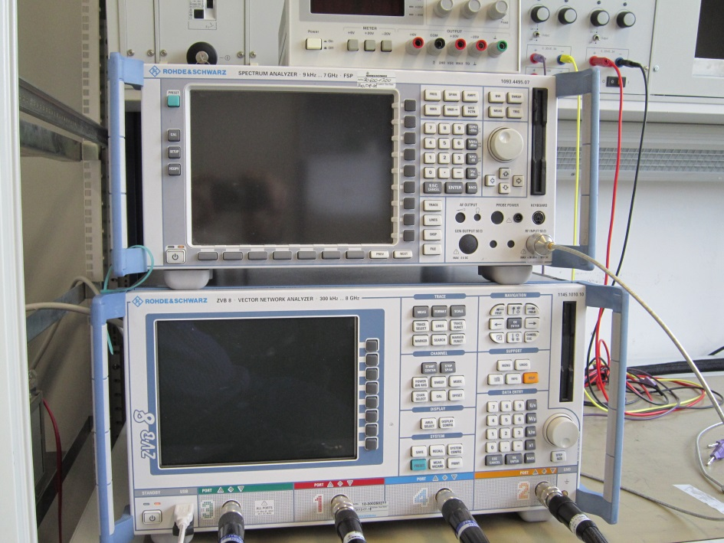
Measurement equipment and special tools
Please leave a note on our whiteboard (in 303 / Analog lab) when you want to take equipment to other buildings / tunnel -> “who, what, where, until when”. Remember to remove the note after the item is back.
If you know that you will need a device on a given date, you can reserve it with a note on it.

Slide 6
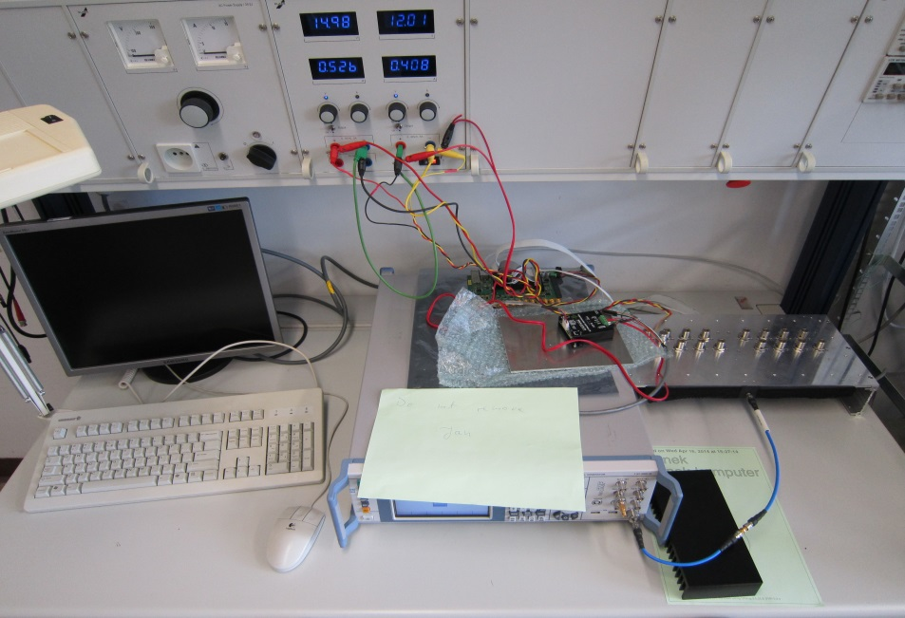
Occupying working stations in the labs for longer time
Always leave a note when you have to leave your measurement setup unattended -> “who, what (firmware test, temperature measurement…), until when”
Check if your colleagues will need a device before you occupy it for a longer time.
Unattended measurements with voltages above 50V have to be absolutely safe.
If a setup does not comply to this rules, it can be removed without a warning. Unattended setups with high voltages that are not according to safety rules will be switched off instantly !

Slide 7
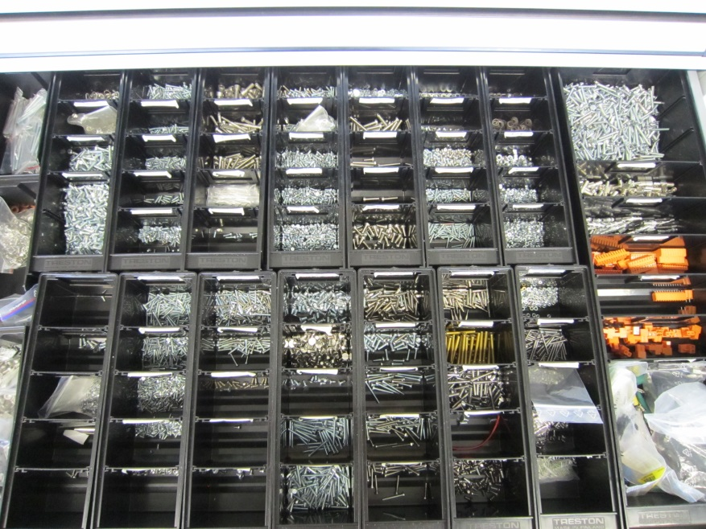
Expendable items in the labs
The expendable items in the labs, like screws and connectors are destined for experiments, prototypes and repairing purposes only. They are not for mass production.
Measurement cables are inventory of the labs. They are not for permanent installation purposes.

Slide 8
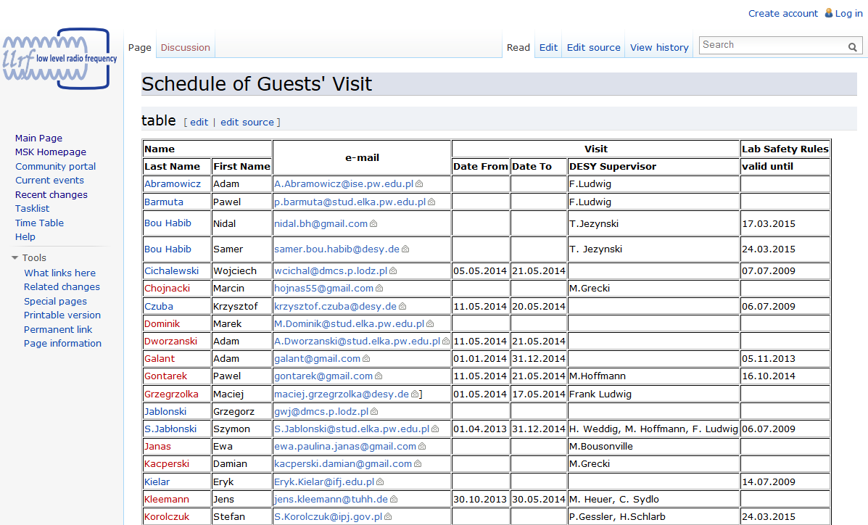
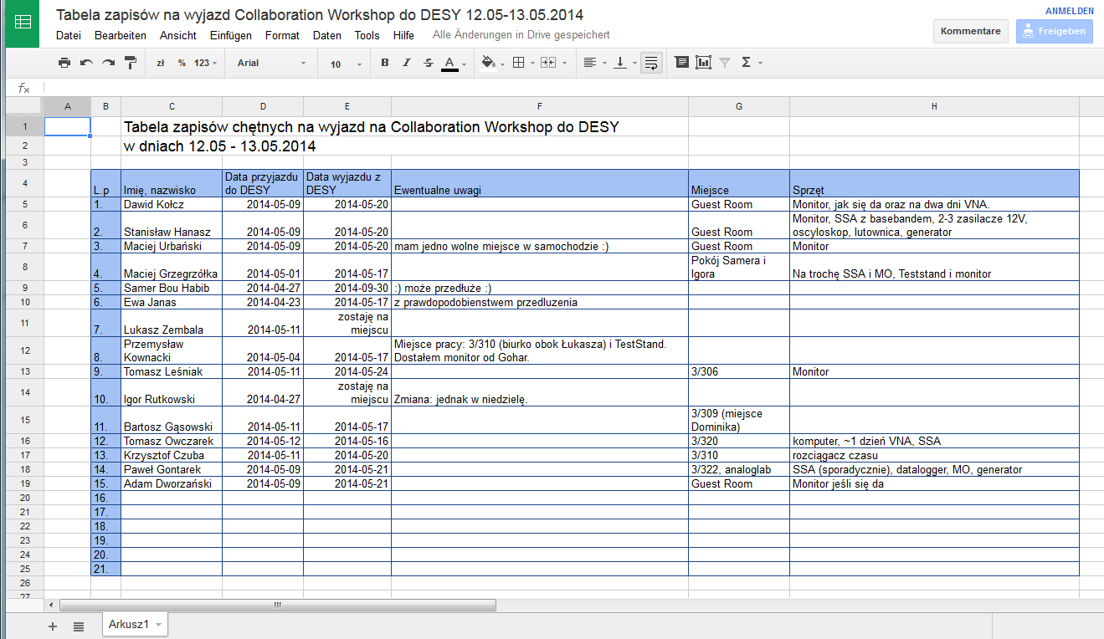
Time schedule for visitors
Helps a lot to organize working places and equipment
Name
Date (from / to)
email
Tasks / project
Preferred place (lab / office, 55a / 03)
Needed equipment (e.g. monitor for laptop, Scope, SSA)
support from technicians -> what exactly ?

Slide 9
MSK lab organization
Thank you !

Slide 10
MSK lab organization – to be discussed …
Necessary safety trainings
Using the standard tools in the labs
Measurement equipment and special tools
Occupying working stations in the labs for longer time
Expendable items in the labs
Time schedule for visitors

