Slide 1
Laser synchornization software/firmware status
Recent software development for Laser Synchronization System
Tomasz Kozak and Paweł Prędki
Department of Microelectronics and Computer Science (DMCS),
Lodz University of Technology (LUT)
MSK Group
DESY, 13th May, 2014

Slide 2
Agenda
Laser Synchronization with MTCA
Recent changes in the Laser Synchronization Server (down-conversion scheme)
Future Laser Synchronization firmware scheme
Motor Driver (DFMC-MD22) software development
New Laser Diode Driver Server (P. Prędki)
Conclusions and future plans

Slide 3
Recent changes in the Laser Synchronization Server
Server for Laser Synchronization with Down-Conversion Scheme
Running in Injector Hutch (Photo Injector Laser 3) and REGAE – implementation based on SIS8300 for around 1 year.
Still old structure (DOOCS dependent). Redesign postponed.
Bug fixes and small features implementation requested by REGAE crew has been done.
improved autolocking routine (work with motor tuned lasers),
fixed switching for monitor signals bug
changed FFT units, check beat frequency calculation (FFT calculation) and others minor issues
Jitter and timing drift calculation added but values still need to be verified.
Jitter calculated as standard deviation of phase error expressed in [fs]
Timing drift calculated as mean of phase and expressed in [fs]
New, test location – Laboratory 28F launched.
Setup based only on MTCA devices (SIS8300L + DTRM-DWC10, DAMC-FMC20 + DRTM-PZT4, DAMC02 + DFMC-MD22)
Server was adjusted, but still some problem with correct initialization (will be fixed soon)
No support for DRTM-PZT4 board included
Added basic support for MTCA motor driver (DFMC-MD22)
Problems with too sensitive motor (no automatic locking)

Slide 4
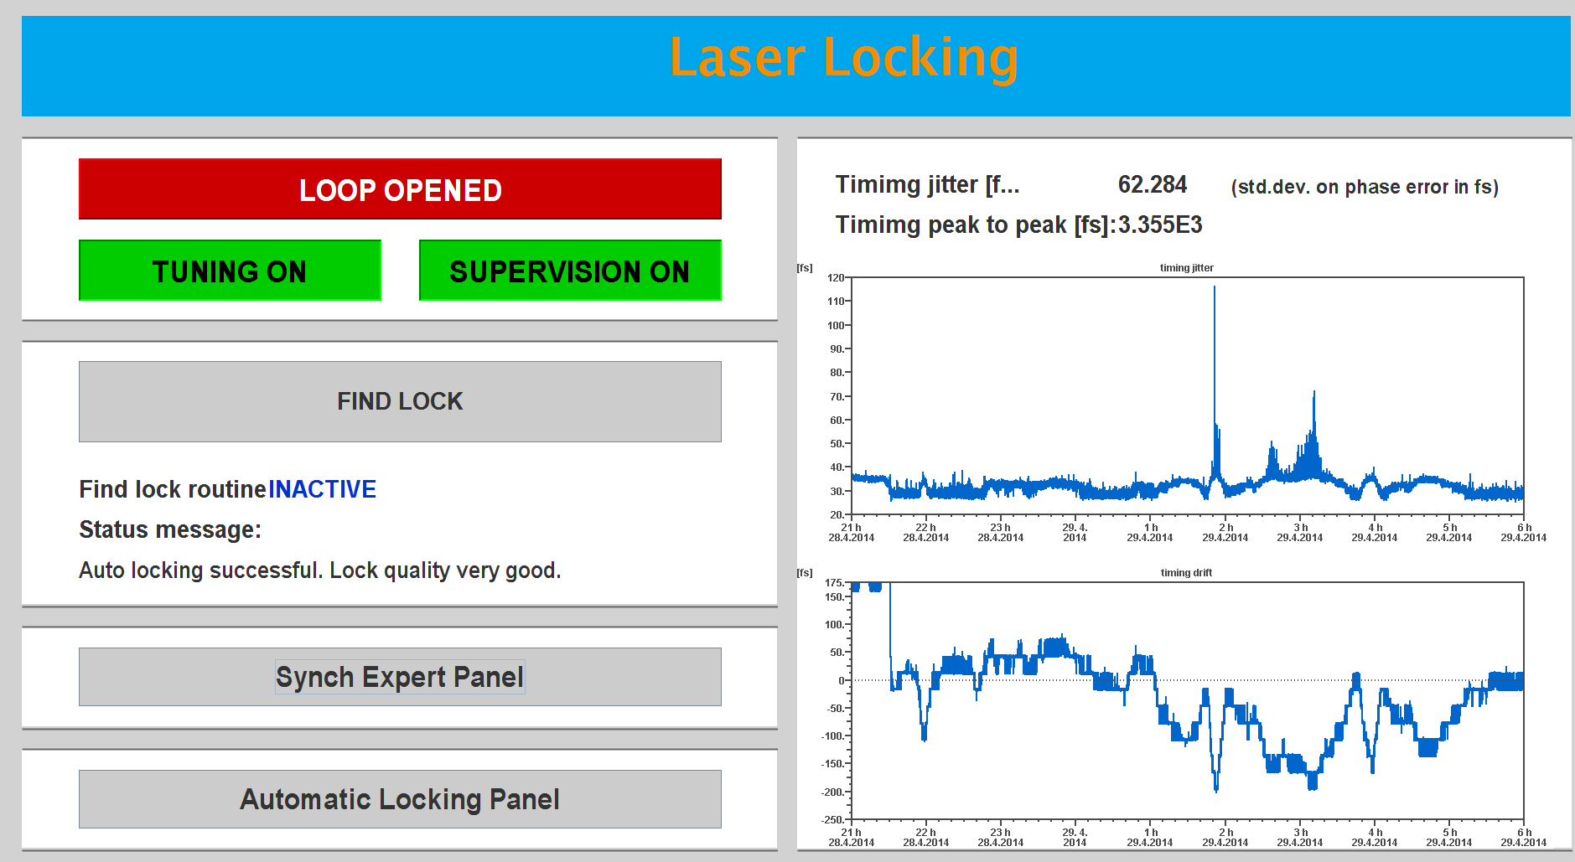
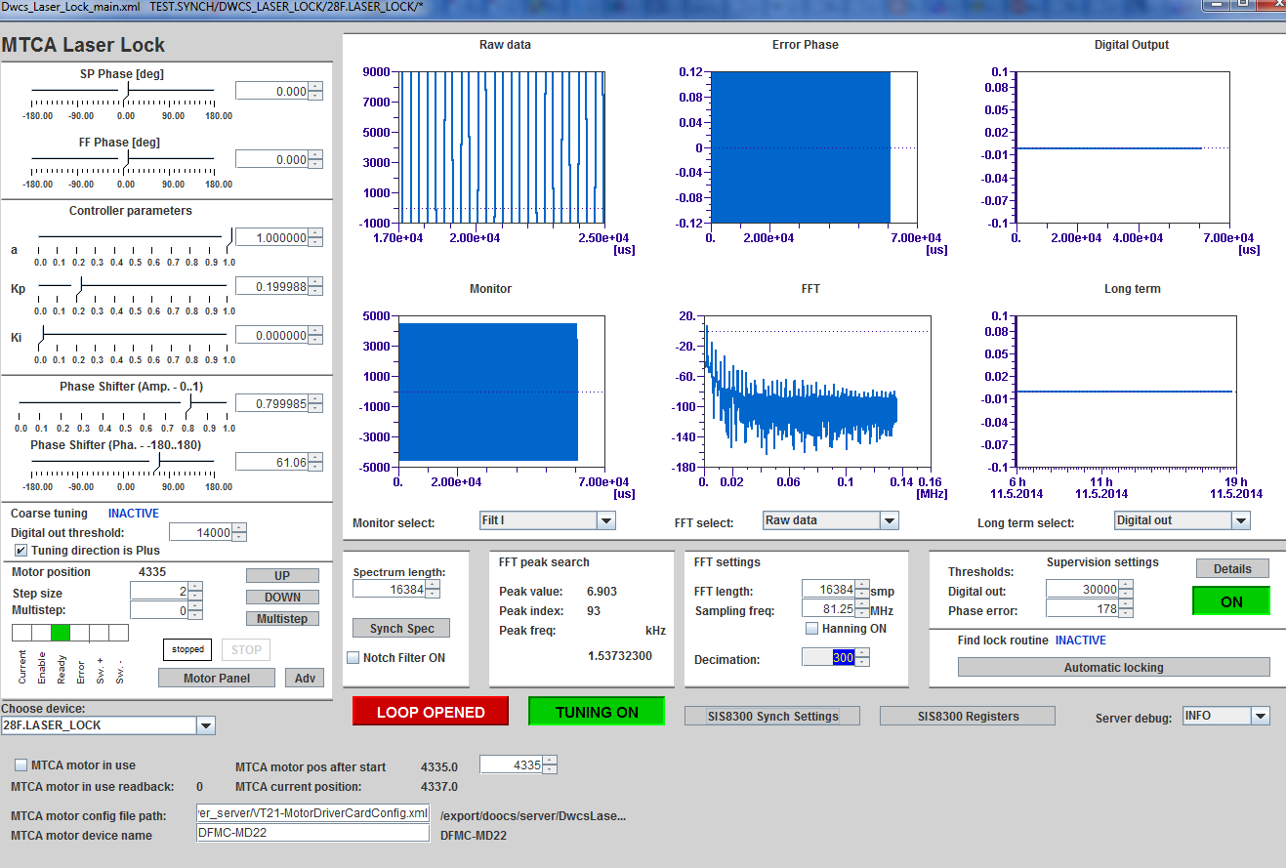
Recent changes in the Laser Synchronization Server
New timing jitter and drifts calculations
Basic support for DFMC-MD22

Slide 5
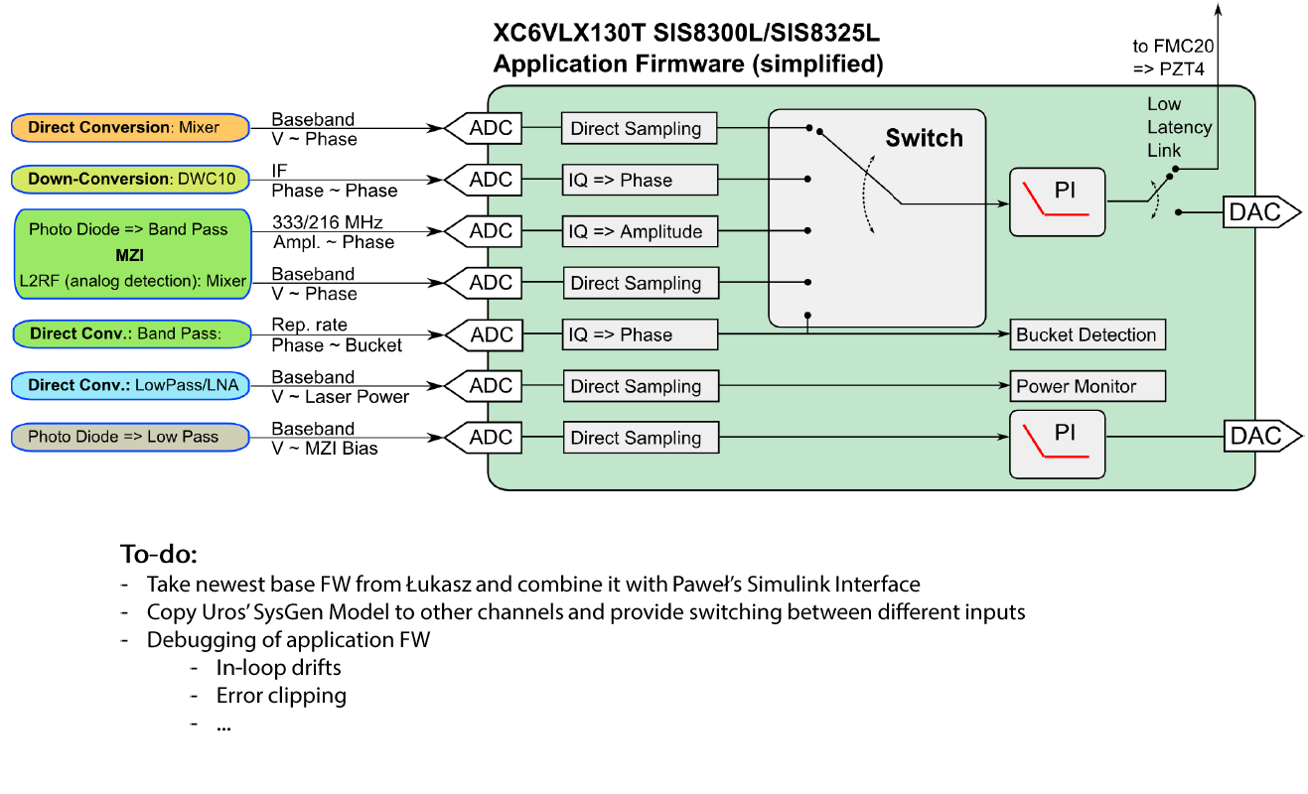
Future firmware scheme
Courtesy: M. Felber

Slide 6
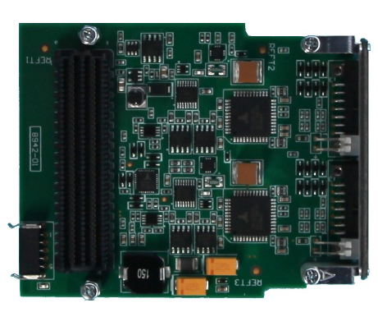
Motor Driver (DFMC-MD22)
FMC card suitable to drive two independent stepper motors
Communication with Motor Driver and Controller over SPI and I2C via PCIE
Needed for coarse tuning of timing drifts both by
Optical Links locking
Lasers locking
Can be used in other project e.g. BAM -> needs layered, Control System independent software

Slide 7
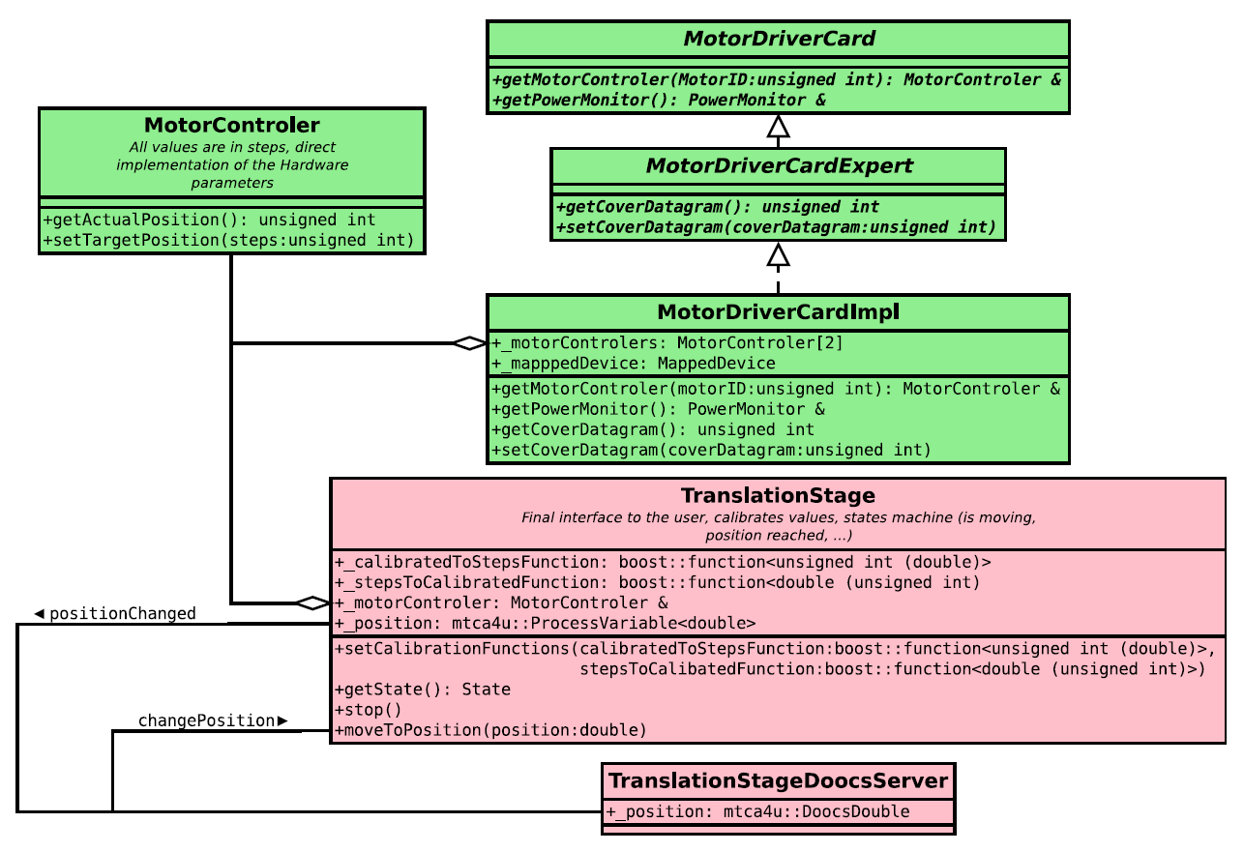
Motor Driver (DFMC-MD22) software development
Software architecture
Programmer: M. Killenberg
Programmer: T. Kozak
Courtesy: M. Killenberg
Low level access classes prepared by Martin.
Software is much more complicated than expected in the beginning.
Still some bugs and problems (Martin is working on it).

Slide 8
Motor Driver (DFMC-MD22) software development
StepperMotor class (library)
Name changed from TranslationStage class
Control system (DOOCS) independent
Simple way to control single motor – moving, status, calibration, errors
User freandly interface
startMotor();
stopMotor();
setMotorPosition(float newPosition);
float getMotorPosition();
StepperMotorStatus getMotorStatus();
calibrateMotor();
EqMtcaDfmcMd22Driver (server)
DOOCS representation of StepperMotor class
Provides history and initialization features
Can be used in others DOOCS server (eq. Link Locking or Laser Locking)
DFMC_MD22_server (server)
DOOCS server for two independent Stepper Motors

Slide 9
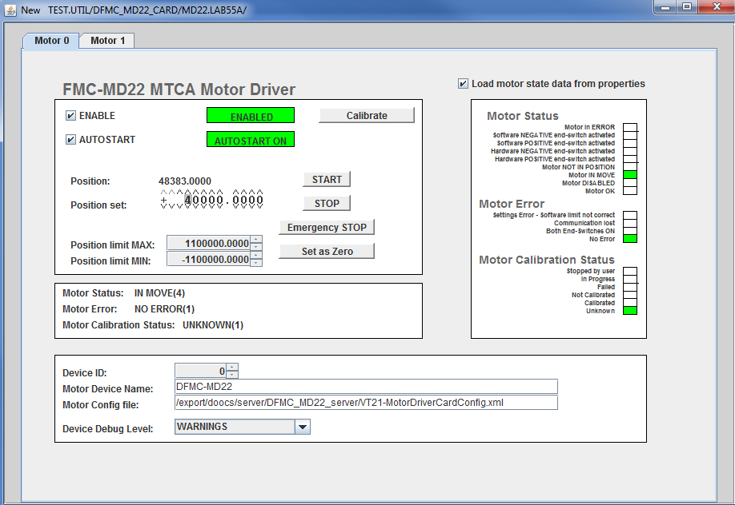
Motor Driver (DFMC-MD22) software development
Motor test stand installed in Digital Lab. in 55A
Only one DFMC-MD22 card available. Waiting for at least one more.
Still C++ interface details need to be clarified and discussed (with users).
Tests and development done with one type of stepper motor (need different types and more tests).
Panel for new DFMC_MD22_server

Slide 10
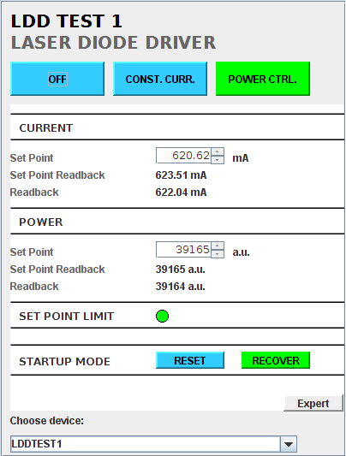
New Laser Diode Driver Server
Based on the new design by S. Ruzin
Two main modes of operation:
Constant current – no control based on optical power monitoring
Constant power – uses optical power monitoring control
Communication via CAN bus using ESD AMC CAN4 board
Planned support of Ethernet communication
Layered software architecture
Hardware access layer (library)
LDD control layer (library)
DOOCS layer (server)
Submit bugs & requests to Redmine!!!
Courtesy: P. Prędki

Slide 11
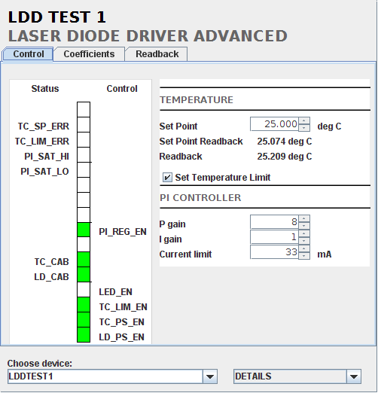
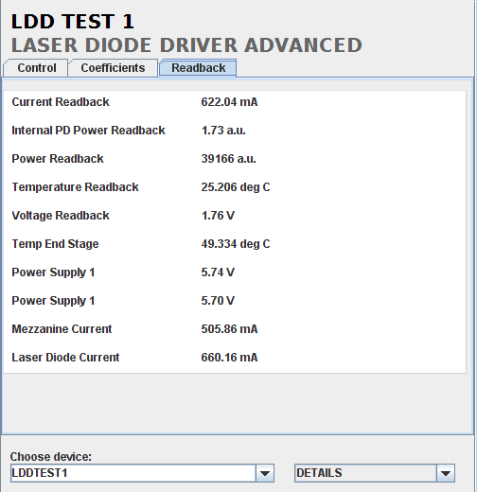
New Laser Diode Driver Server – Expert panel
Courtesy: P. Prędki

Slide 12
Conclusions and future plans
Near future plans:
Continue work on MD22 motor software
Still low level classes are adjusted by Martin. Robert is modifying the firmware, but interfaces shouldn’t be strongly modified.
Work done in 50%. Still much functionality missing/not tested, but bacis one is provided.
Need to be tested with different motor (question: What kind of motor will be used for links, lasers and BAMs ???).
Need one person from user side to consult solutions (Matthias ?, Thorsten?, Cezary?).
Rough time needed for first implementation – 1 week, but for finale version of software can’t be estimated (no full software specification exists – iterative process, maybe AdvStepperMotor class will be needed).
Launch work od firmware side for the Laser Synchronization upgrade (slide 5)
Server will not be rewritten until
new version of firmware will be prepared (T. Kozak)
stable version of software for MD22 will be ready (T. Kozak and M. Killenberg)
new approach to bound the CS with independent software will be delivered (M. Killenberg)
Conclusion: Still a lot work to be done!!!

Slide 13
Laser synchornization software/firmware status
Recent software development for Laser Synchronization System
Thank you for your attention.
tomasz.kozak@desy.de
Building 55a, room: 125
Phone: 1749

