Slide 1
Injector UV Laser Beamline
H. Dachraoui, S. Köhler and L. Winkelmann
Injector UV Laser Beamline
30.03.2014

Slide 2
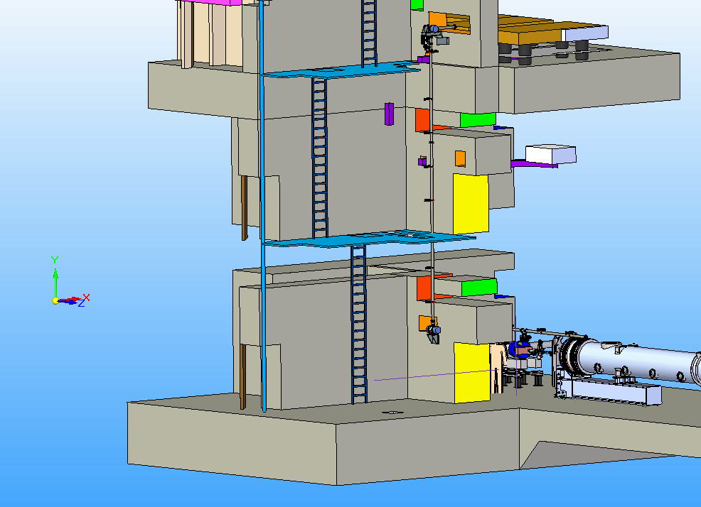
Laser Injektor beam Line
y
x
z

Slide 3
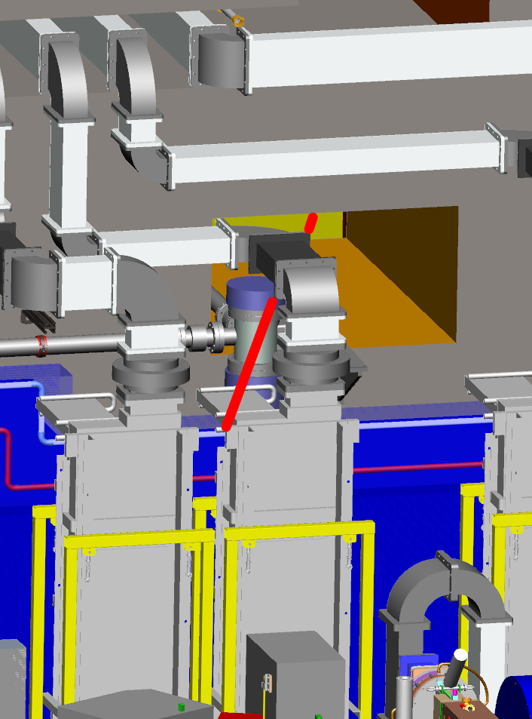
Three possibilities
1
Diagnonal from media shaft to
gun diagnostics
Mirror chamber of heater beamline blocked
Diagnoal input at laser laboratory level will chross heater beamline input

Slide 4
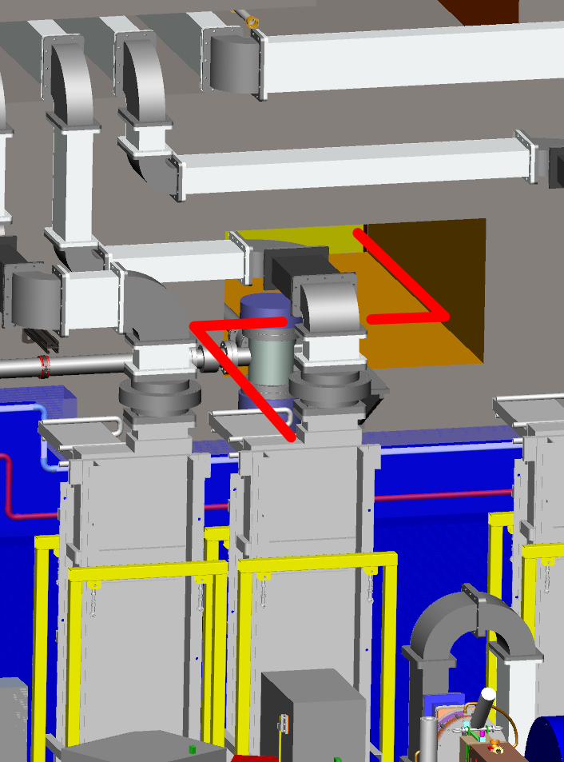
Three possibilities
1
2
Periscope at injector section with additional mirror chambers
Mounting of first mirror chamber not possible with actual heater beamline support
Second mirror chamber very hard to squeeze between RF-waveguides and circulators

Slide 5
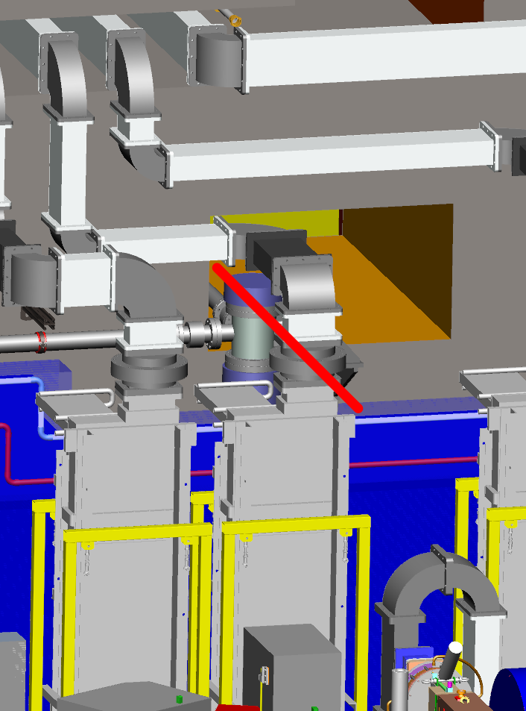
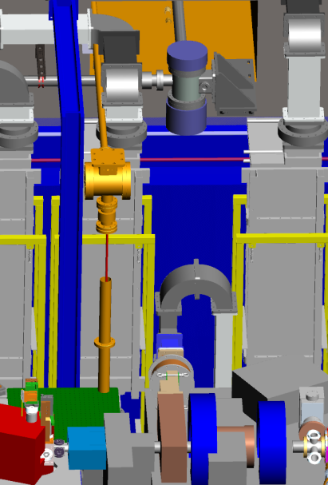
Three possibilities
1
2
3
final concept
Straight line between concrete wall and RF-waveguide
DN40 flange needed
Space checked at the real thing inside XFEL
Less mirrors needed
  Drawback = heater beamline has to move to free space at the left hand side of the concrete opening

Slide 6
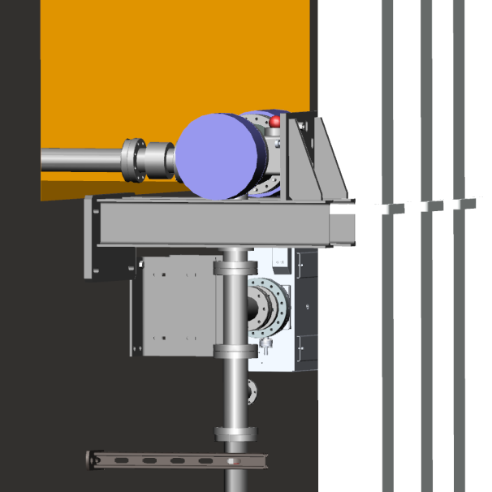
Three possibilities
1
2
3
final concept
0
Old concept collision with RF-waveguide

Slide 7
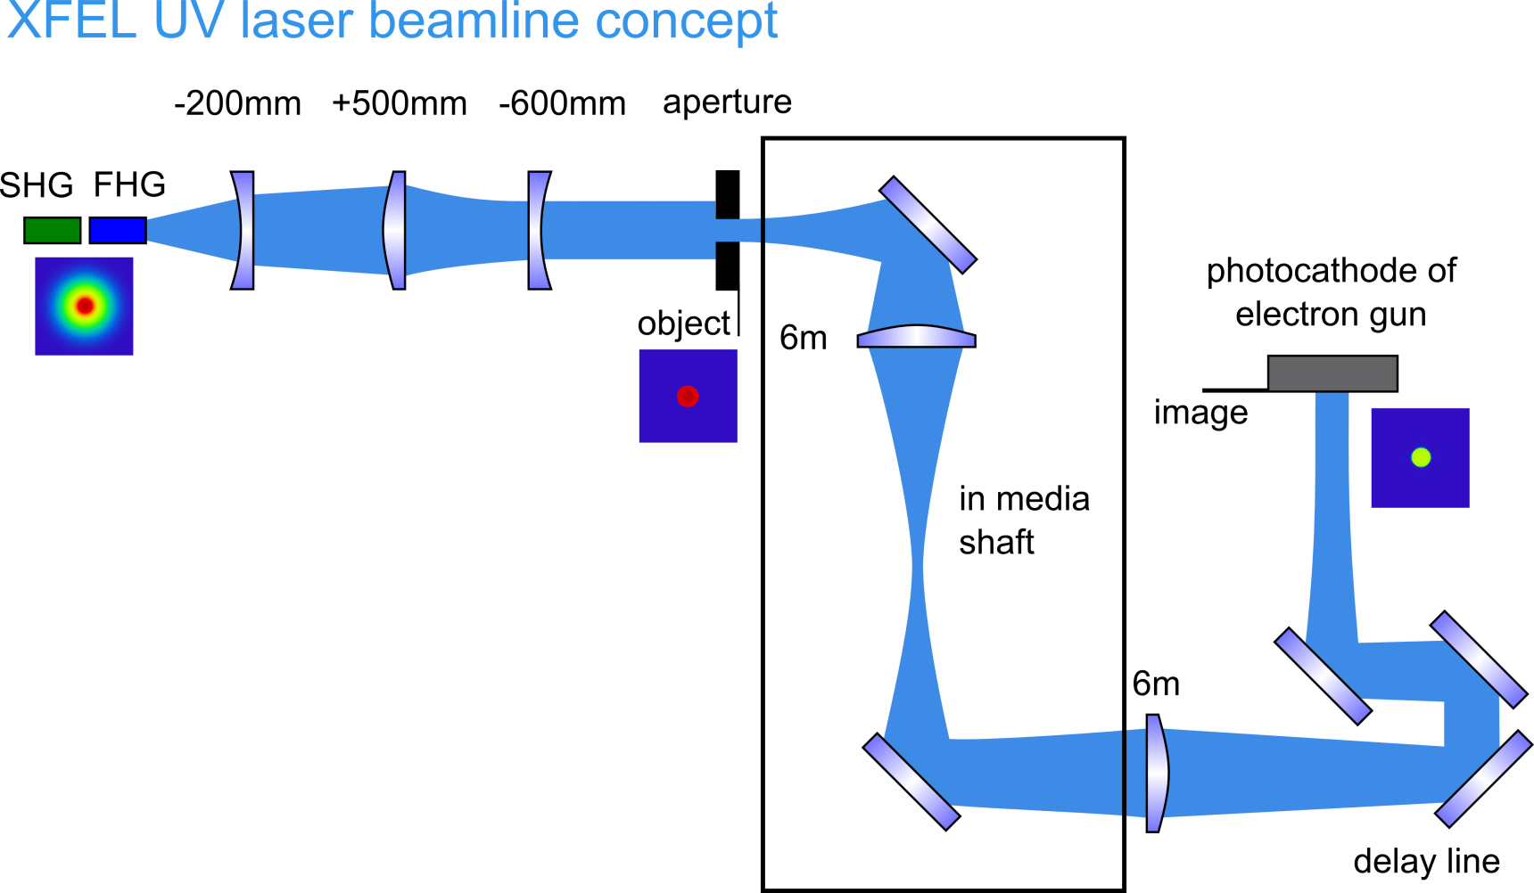
Beamline concept

Slide 8
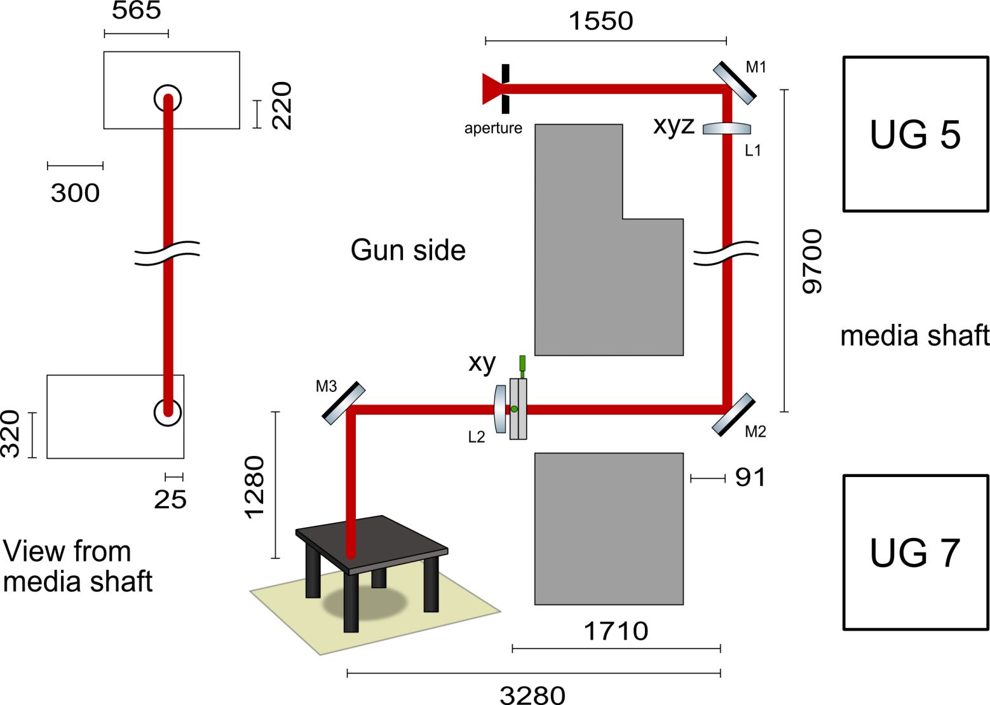
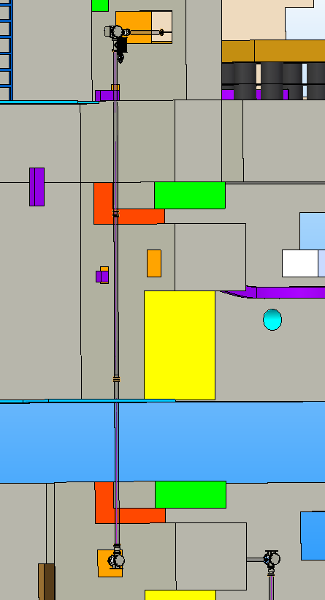
Beamline concept

Slide 9
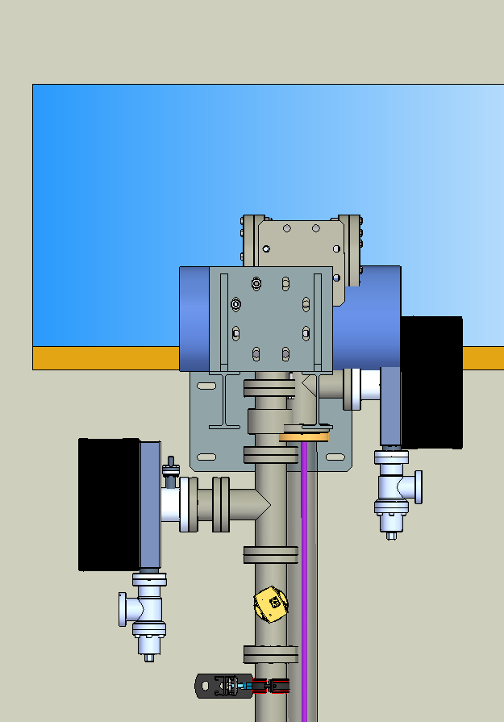
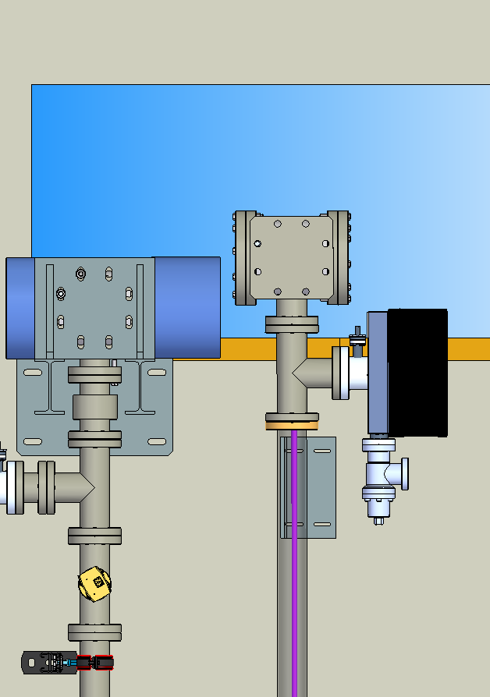
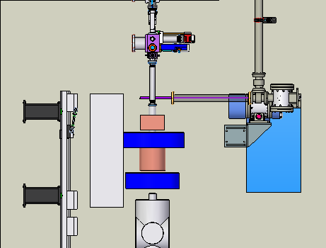
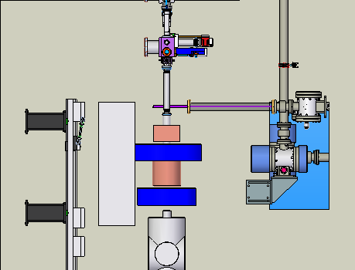
Old concept - collision with heat beamline
y
UG5 media shaft
IJ-B
IJ-B
H-B
z
H-B
x
400 mm
HB should be moved
H-B
Heater beamline
IJ-B
Injector beamline
IJ-B
y
IJ-B
H-B
H-B
z
x
UG7 gun side
400 mm

Slide 10
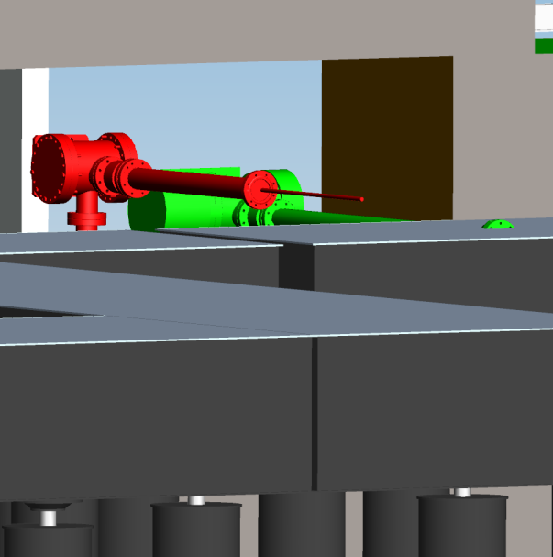
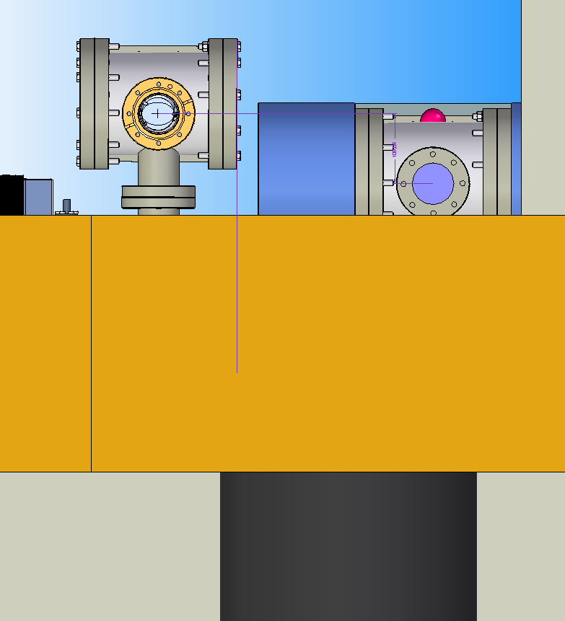
Heater beamline
IJ-B
110 mm
110 mm
Laser lab.
H-B
H-B
Heat beamline concept collision with RF-waveguides in media shaft

Slide 11
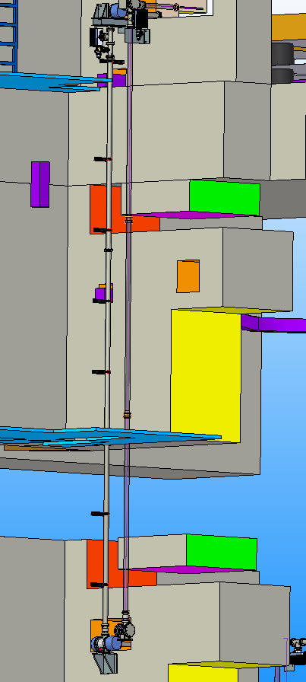
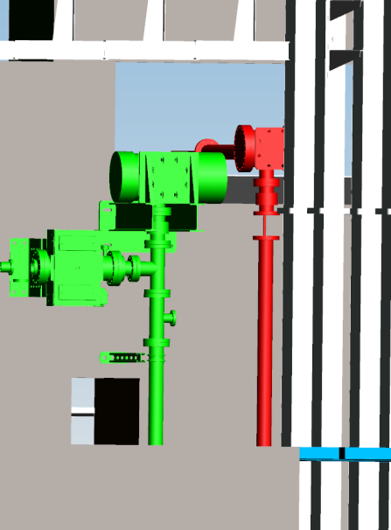
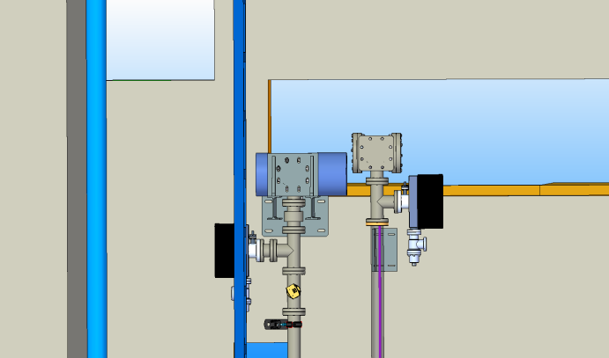
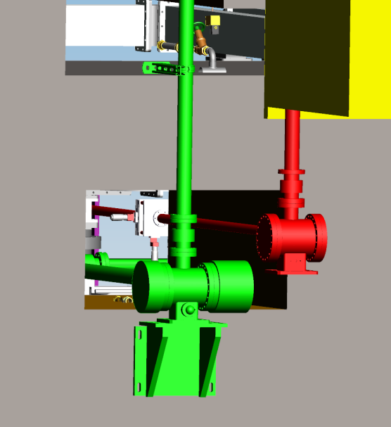
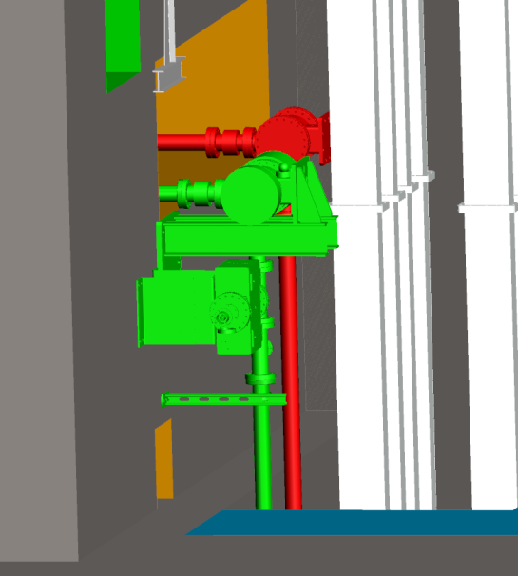
Proposed concept
H-B
IJ-B

Slide 12
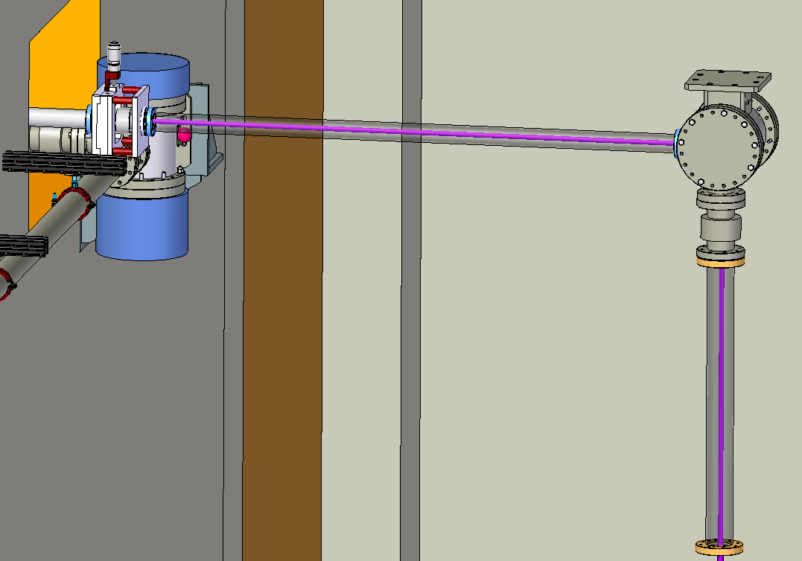
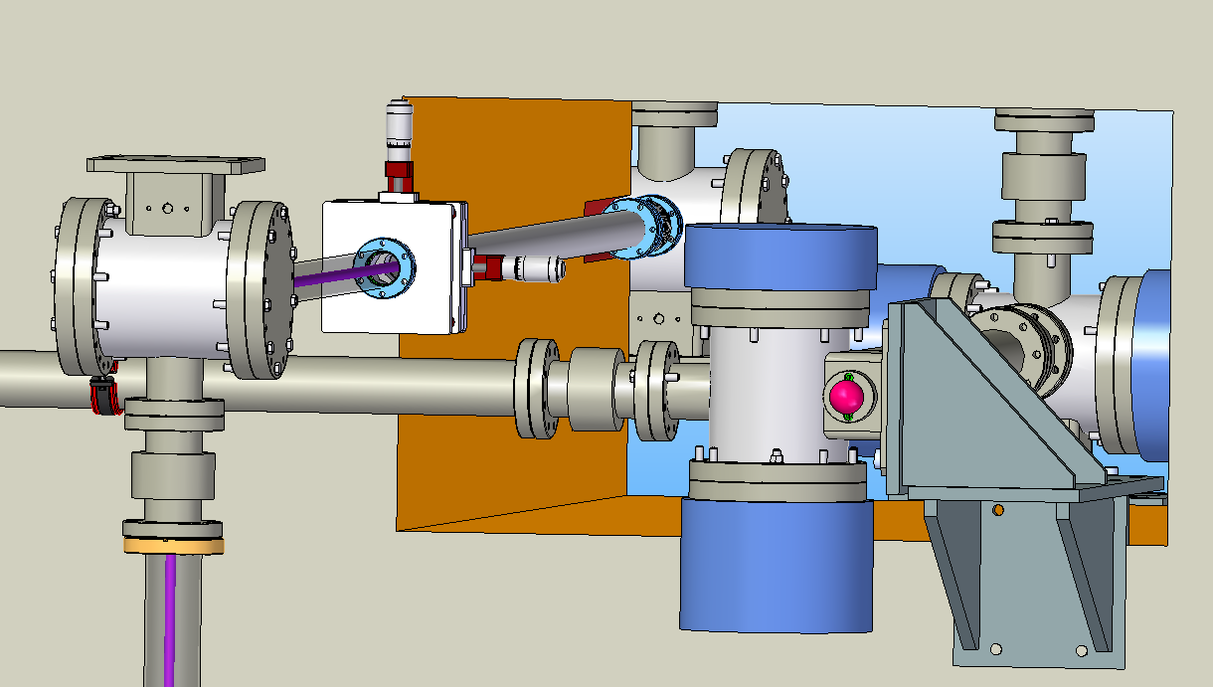
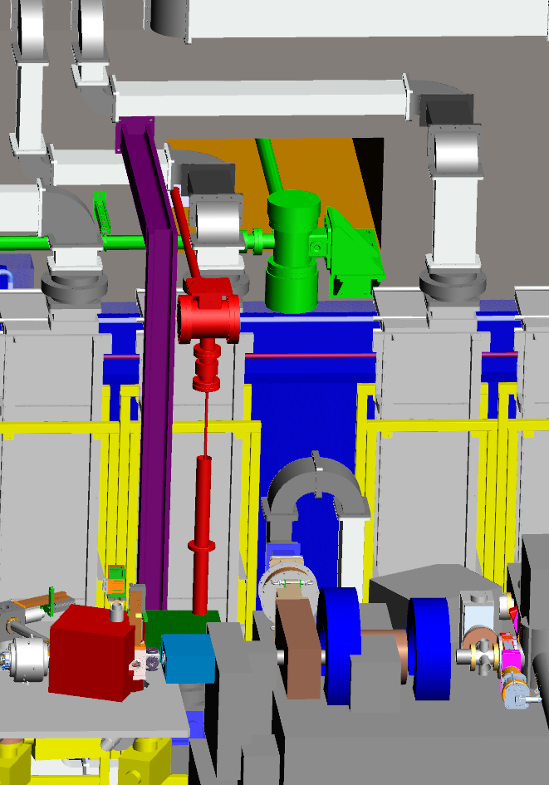
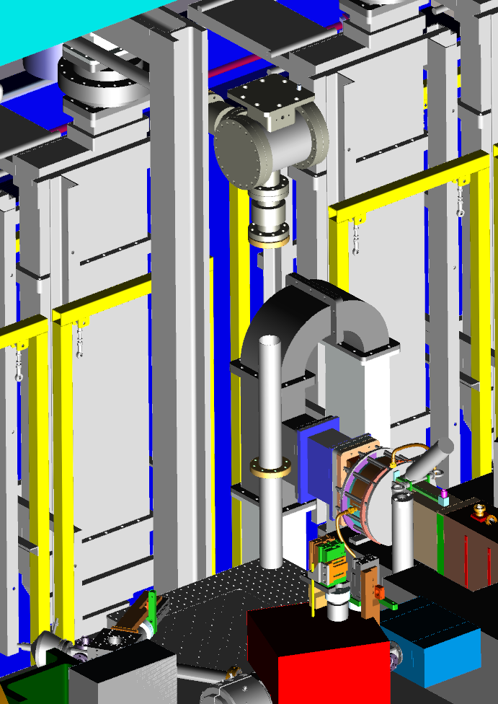
Proposed concept
y
z
x

Slide 13
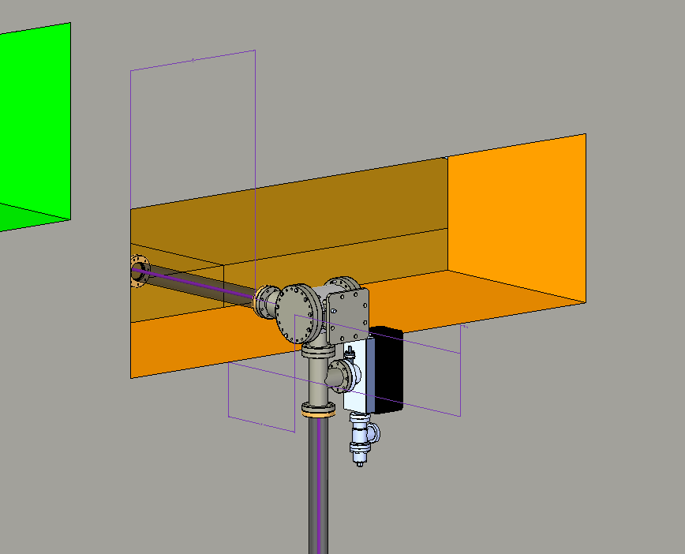
Vacuum-chambers position
Media shaft UG5
565
224
357

Slide 14
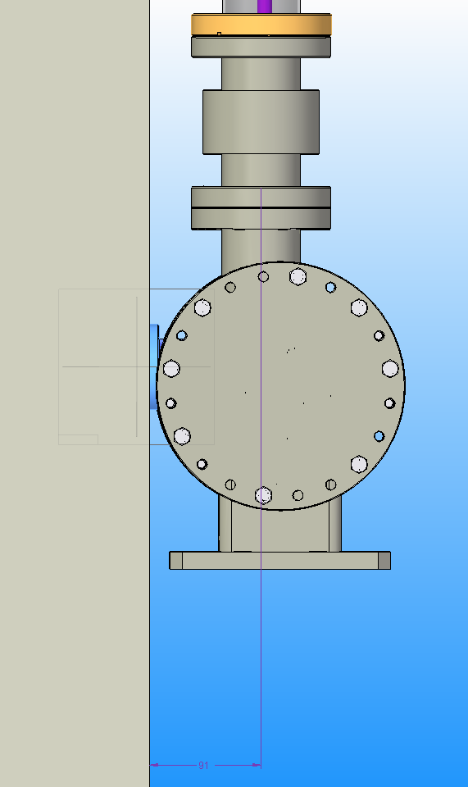
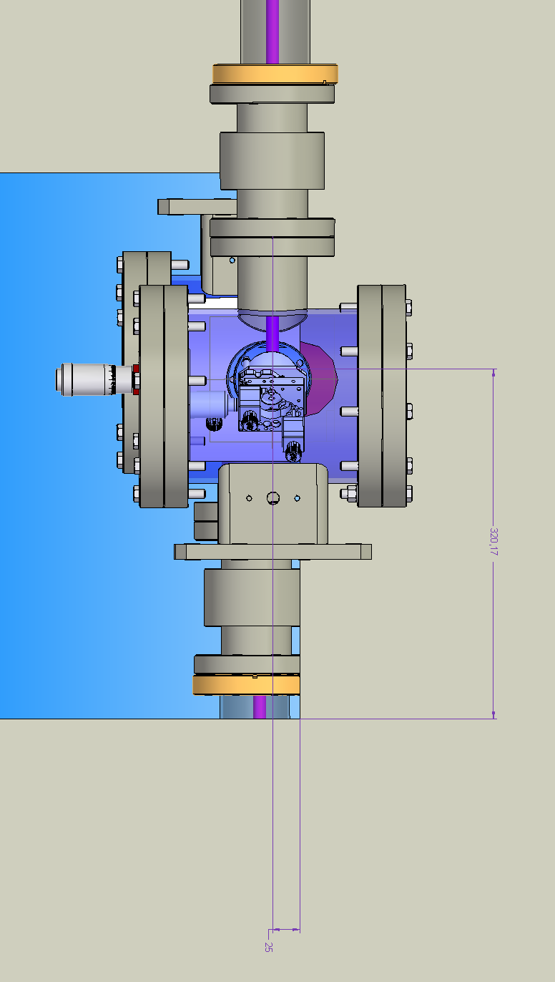
Vacuum-chambers position
y
x
Media shaft UG7
320
91
y
z
25

Slide 15
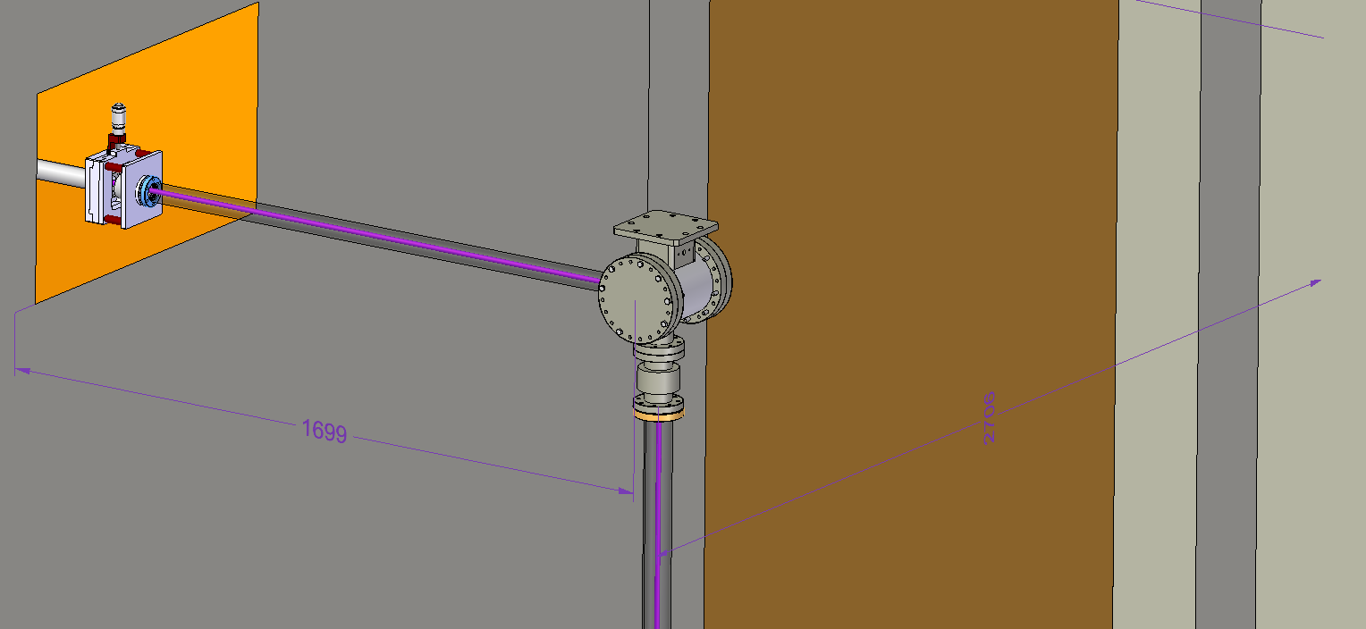
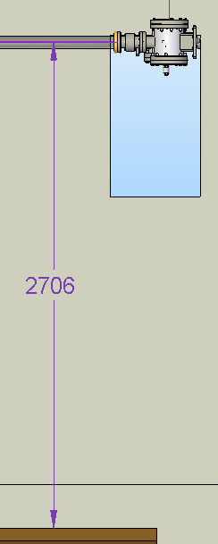
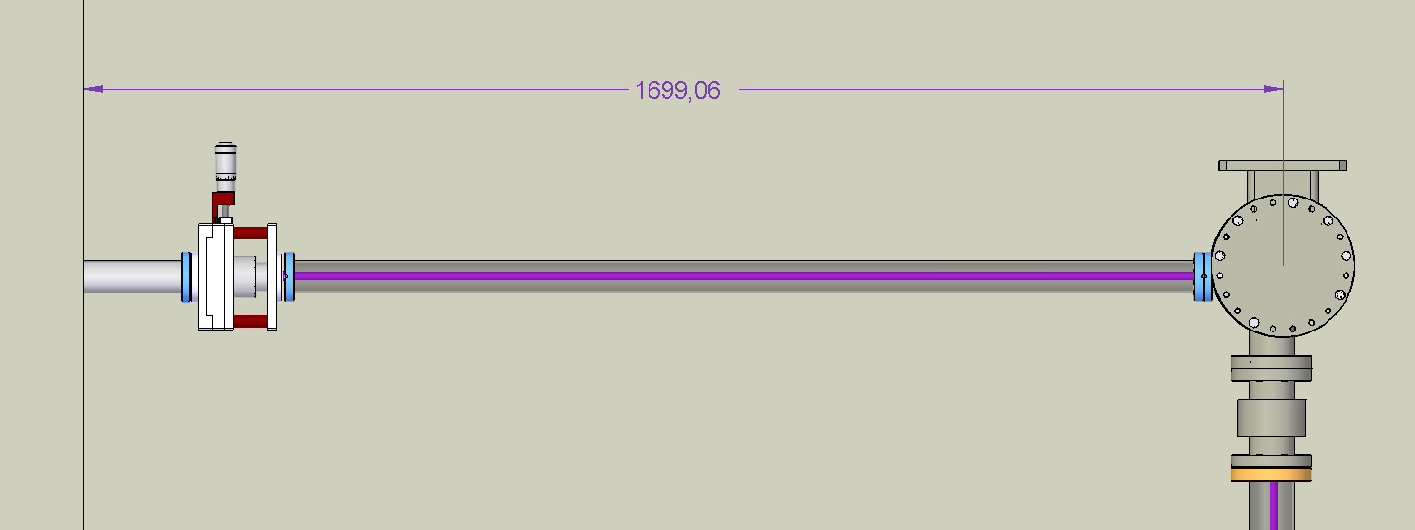
Vacuum-chambers position
2706
1700
1700
2577
2706
Floor level

Slide 16
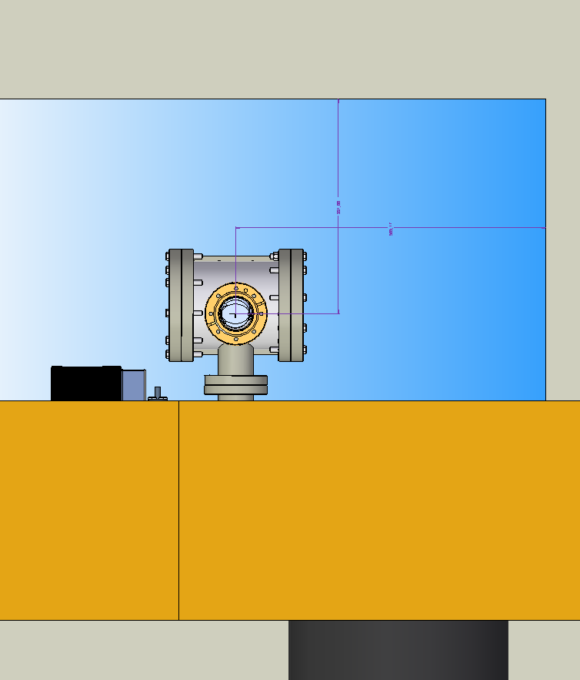
Incoupling mirror: Laser lab
392
565

Slide 17
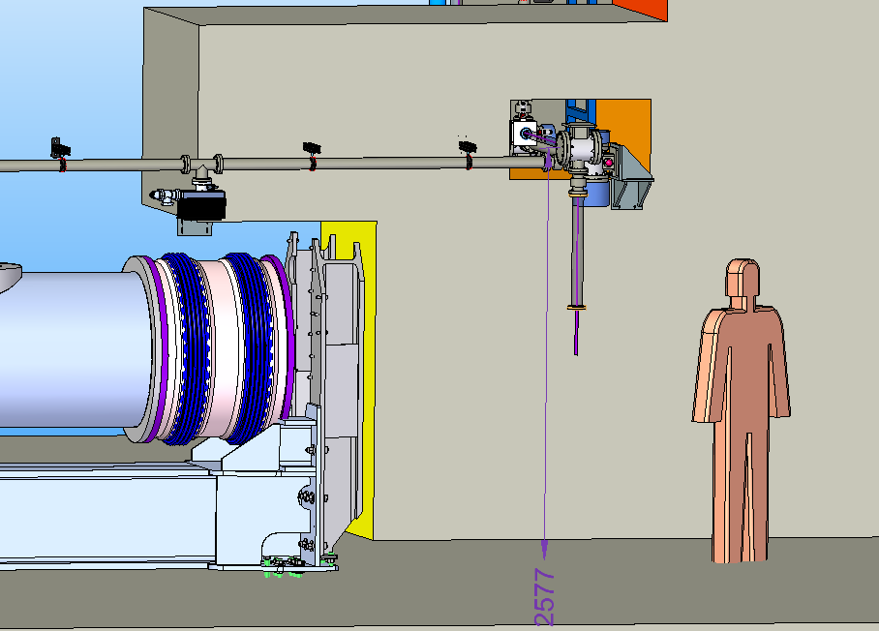
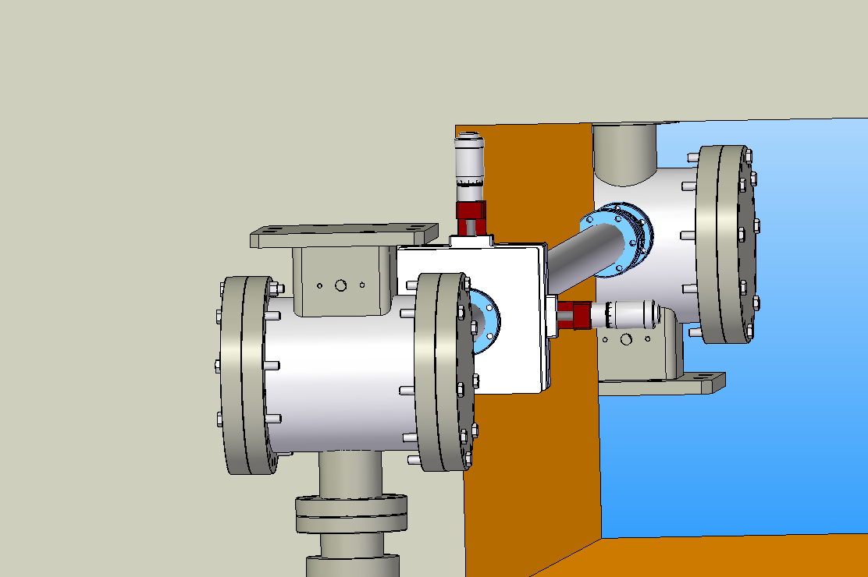
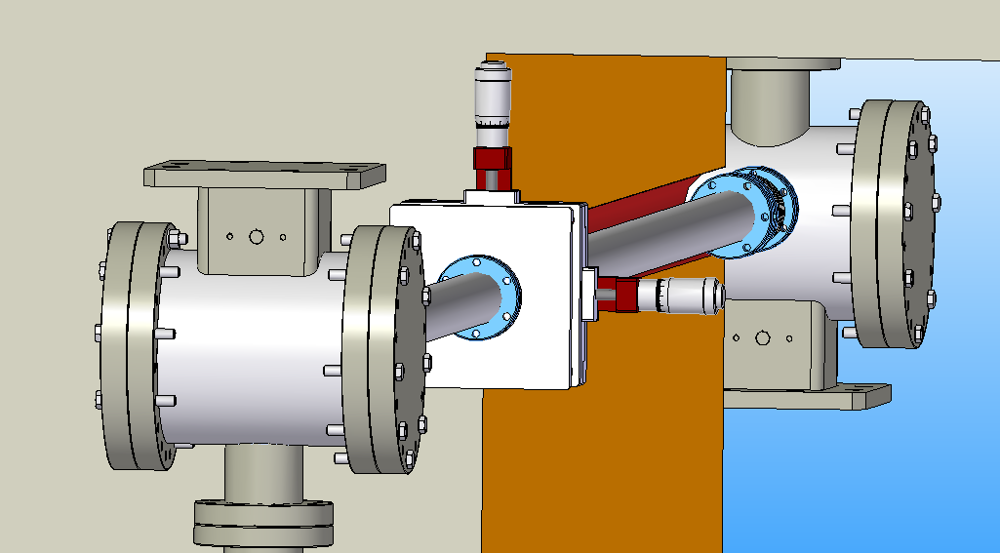
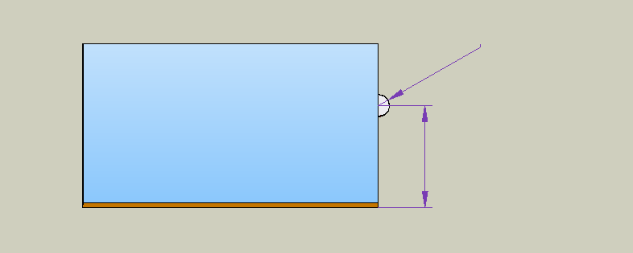
Vacuum-chambers position
y
Concrete works needed at the inside of the media shaft to support the flange connection
z
R60,
300
310

