Slide 1
Inverted effective SUSY
Jihn E. Kim
Seoul National University
Gwangju Institute of Science and Technology
Bethe 2012 at Bad Honnef, 1 Oct 12

Slide 2
What is axino? Goldstino? Mass?
Higgs boson? (g-2)_{μ}?
1. Weak CP, QCD, and the PQ symmetry with SUSY
2. Goldstino and axino
3. IeffSUSY from string
4. Numerical study
J E Kim IeffSUSY, Bethe12, Bad Honnef, Germany, 1 Oct. 2012
2/67

Slide 3
1. Weak CP, QCD, and the PQ symmetry with SUSY
J E Kim IeffSUSY, Bethe12, Bad Honnef, Germany, 1 Oct. 2012
3/67

Slide 4
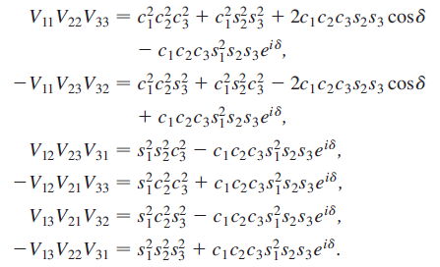
Flavor physics
on maximal CP
JEK-Seo, PRD84, 037303 (2011) [arXiv:1105.3304[hep-ph]]
J E Kim IeffSUSY, Bethe12, Bad Honnef, Germany, 1 Oct. 2012
4/67

Slide 5
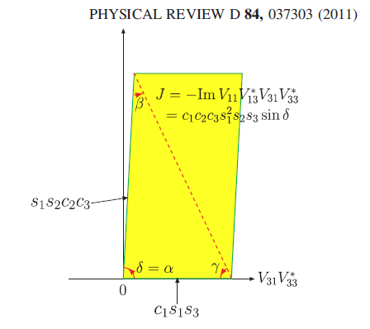
Jarlskog
determinant
Maximal CP
violation
J E Kim IeffSUSY, Bethe12, Bad Honnef, Germany, 1 Oct. 2012
5/67

Slide 6
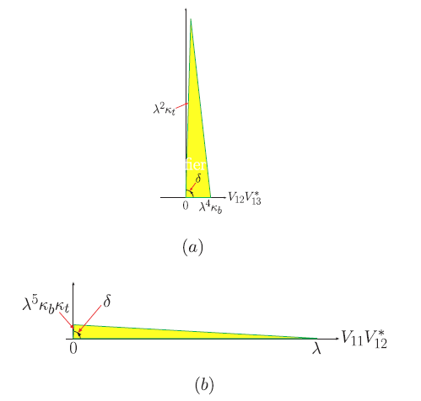
Jarlskog
Determinant
Area the same
Maximal CP
violation
J E Kim IeffSUSY, Bethe12, Bad Honnef, Germany, 1 Oct. 2012
6/67

Slide 7
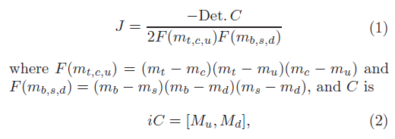
JEK+Seo proved it recently. J det consists of two elements
of V and two elements of V*. But det consists of three
elements of V. It is not obvious at the outset.
The Jarlskog det is
J= V₁₁ V₃₃ V*₁₃ V*₃₁
J E Kim IeffSUSY, Bethe12, Bad Honnef, Germany, 1 Oct. 2012
7/67

Slide 8
The determinant is real. If it is not real, we can change
the quark phases to make it real. This process changes
the coefficint of the gluon anomaly term, i.e. the θ term.
So, it is reasonable to work in this basis.
Multiplying V*₁₃ V*₂₂ V*₃₁, we have
J E Kim IeffSUSY, Bethe12, Bad Honnef, Germany, 1 Oct. 2012
8/67

Slide 9
In the same way, the 4th term can be written with two terms
And one of them combine with the 3rd term to make
(1- |V*₁₁ |²) V₁₂ V₂₃ V*₁₃ V*₂₂.
So we have
The Jarlskog det
J= V₁₁ V₃₃ V*₁₃ V*₃₁
ImV*₃₁V*₂₂V*₁₃ =
J E Kim IeffSUSY, Bethe12, Bad Honnef, Germany, 1 Oct. 2012
9/67

Slide 10
So the essence of the weak CP violation can be
looked upon by scrutinizing the CKM matrix.
We can also say that the weak CP violation is
maximal. PDG gives
J E Kim IeffSUSY, Bethe12, Bad Honnef, Germany, 1 Oct. 2012
10/67

Slide 11
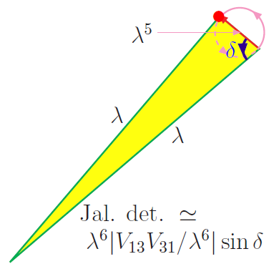
Since the area of the J det is the same, we look for
two long sides triangles. For example,
The area is maximum when δ=π/2. So, we observed the maximal CP violation.
The CP violation is modeled in
JEK, PLB704 (2011) 360 [1109.0995].
J E Kim IeffSUSY, Bethe12, Bad Honnef, Germany, 1 Oct. 2012
11/67

Slide 12
A brief history of QCD:
QCD started with the prediction of Ω⁻ [Okubo, Prog. Th. Phys. [Received 06. 12. 1961]. In terms of spin-1/2 quarks of Gell-Mann and Zweig,
Guersey & Radiccatti: It must be antisymmetric under the exchange of
two s quarks [Received 15. 07. 1964]
Greenberg: tried a paraquark model [Received 27. 10. 1964]
The real solution of the spin statistics problem was suggested by
Han and Nambu: by introducing another SU(3) degrees but with
regretably with integer charged quarks quarks [Received 12. 04. 1965]
Soon after, the fractionally charged quarks by
Hori [Rec. 10. 02. 1966]
Fritzsch and Gell-Mann: named it as QCD [papers in 1972-1973]
J E Kim IeffSUSY, Bethe12, Bad Honnef, Germany, 1 Oct. 2012
12/67

Slide 13
The discovery of the asymptotic freedom crowned the QCD as
the theory of strong interaction theory quarks [Received 27. 04. 1973
03. 05. 1973]
This has led to the consideration of eight gluons interacting
strongly with color triplet quarks. The current quark masses
were first estimated in Gell-Mann-Oakes-Renner [Received 22. 07. 1968]
After the advent of QCD it has been
calculated again by Langacker and Pagels quarks [Received 11. 06. 1973]
But, QCD with MeV order quark masses gives a light η’ [Weinberg 1975]
The U(1) problem.
With 8 gluons in QCD the vacuum has a parameter angle θ with,
which is a total derivative, but it cannot be neglected due to the surface
contributions at Euclidian space infinity (due to instanton solutions).
J E Kim IeffSUSY, Bethe12, Bad Honnef, Germany, 1 Oct. 2012
13/67

Slide 14
Weinberg's U(1) problem is solved by this gluon anomaly term
[‘t Hooft, 1986 review]
This suggest that the vacuum angle term is working. Otherwise,
the U(1) problem is not solved.
This is the brief QCD history with our current understanding
of hadron spectrum and high energy collision rates.
J E Kim IeffSUSY, Bethe12, Bad Honnef, Germany, 1 Oct. 2012
14/67

Slide 15
So, in QCD we consider
The surface term violates the CP symmetry.
This has led to the strong CP problem, and led
to the current study of DM very light axion.
J E Kim IeffSUSY, Bethe12, Bad Honnef, Germany, 1 Oct. 2012
15/67

Slide 16
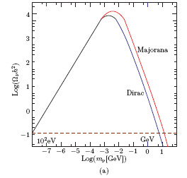
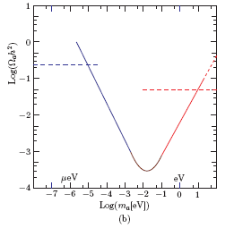
Dark matter in the universe is the most looked-for particle(s)
in cosmology and at LHC, and also at low temperature labs.
The 100 GeV scale DM and the10-1000 micro eV axion are
the most promising candidates.
Neutrinos Light bosons
J E Kim IeffSUSY, Bethe12, Bad Honnef, Germany, 1 Oct. 2012
16/67

Slide 17
It is very flat if the axion decay constant is large,
CP conserving point
In the evolving universe, at some temperature, say T₁, a
starts to roll down to end at the CP conserving point
sufficiently closely. This analysis constrains the axion decay
constant (upper bound) and the initial VEV of a at T₁.
J E Kim IeffSUSY, Bethe12, Bad Honnef, Germany, 1 Oct. 2012
17/67

Slide 18
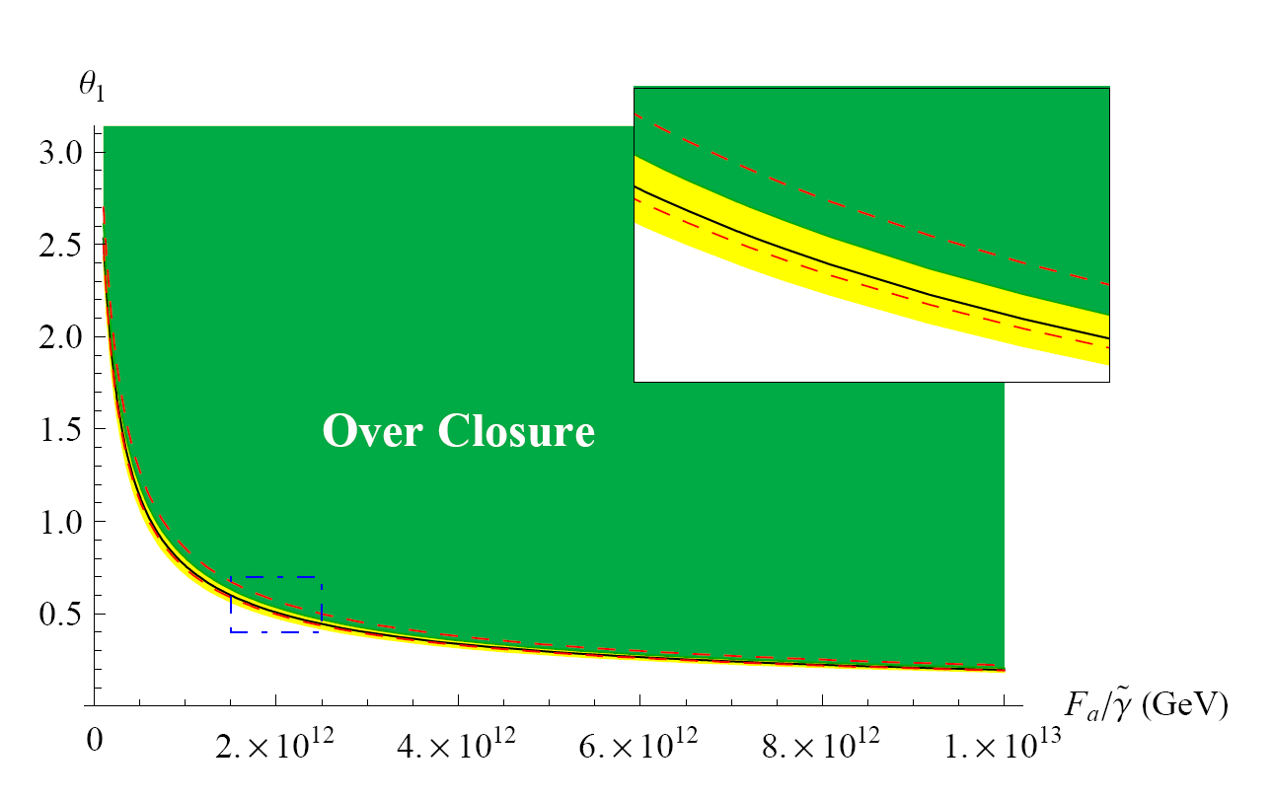
Bae-Huh-Kim, JCAP0809, 005
m_{q}
Λ_{QCD}
J E Kim IeffSUSY, Bethe12, Bad Honnef, Germany, 1 Oct. 2012
18/67

Slide 19
By discovering the axion, QCD is completed satisfactorily.
If the axion is ruled out at the window,
Either, its mass is too small to be
detected, or the small-θ problem
remains as a fine-tuning.
J E Kim IeffSUSY, Bethe12, Bad Honnef, Germany, 1 Oct. 2012
19/67

Slide 20
The PQ symmetry
with SUSY

Slide 21
The SUSY Peccei-Quinn symmetry with invisible axion, axino, has been considered :
Nilles-Raby, NPB198, 102 (1982)
Frere-Gerard, Lett. Nuovo Cimento. 37 135 (1983)
Cosmology with axino has been considered :
Kim-Masiero-Nanopoulos, PLB139, 346 (1984) : eV axino
Rajagopal-Turner-Wilczek, NPB 358 ,447 (1991) : keV axino
Covi-Kim-Roszkowski, PRL 82, 4180 (1999) : GeV axino
Covi-Kim-HBKim-Roszkowski, JHEP05, 033 (2001) : GeV axino
Covi-Roszkowski-Small, JHEP07(2002)023 (hep-ph/0206119)
Covi-Roszkowski-Ruiz de Austri-Small, JHEP06(2004)003
Brandenburg-Covi-Hamaguchi-Roszkowski-Steffen, PLB617, 99
(2005) (hepph/0501287)
Choi -Kim -Lee -Seto , PRD77, 123501 (2008)(arXiv:0801.0491)
:TeV axino
and many more
J E Kim IeffSUSY, Bethe12, Bad Honnef, Germany, 1 Oct. 2012
21/67

Slide 22
The axino interaction for cosmology has been considered :
Tamvakis-Wyler, PLB112, 451 (1992) : considered
Kim, PRL67, 3465 (1991) : saxion effect
Chang-HBKim, PRL77, 591 (1996): saxion effect to DM
Brandenburg-Steffen, JCAP08(2004)008 (arXiv:hep-ph/0405158):hot
thermal loop
A. Strumia, JHEP1006 (2010) 036 [arXiv:1003.5847 [hep-ph]]: squark
term is added with hot thermal loop comment
The axino mass has been considered :
Chun-Kim-Nilles, PLB287, 123 (1992) : acc. symmetry
Chun-Lukas, PLB 357 ,43 (1995) : general discussion
Cheung-Nomura -Thaler, JHEP03(2010)073} [arXiv:1002.1967]: not
the QCD axino
Higaki-Kitano, arXiv:1104.0170: A try of non-minimal K¨ahler
Kim-Seo: NPB 864, 296 (2012) [arXiv:1204.5495: General]
J E Kim IeffSUSY, Bethe12, Bad Honnef, Germany, 1 Oct. 2012
22/67

Slide 23
The axion in the spontaneously broken PQ is parametrized by
With SUSY, how can we define a spontaneously broken PQ
symmetry? Or more generally, a spontaneously broken global symmetry?
J E Kim IeffSUSY, Bethe12, Bad Honnef, Germany, 1 Oct. 2012
23/67

Slide 24
The superpotential is taken as
With SUSY breaking also, one introduces
Kim, PLB136, 378 (1984): A Common Scale for the Invisible Axion, Local SUSY GUTs and Saxino Decay
J E Kim IeffSUSY, Bethe12, Bad Honnef, Germany, 1 Oct. 2012
24/67

Slide 25
The PQ symmetry: the axion multiplet is
In SUGRA, we must consider the Kaehler potential also.
J E Kim IeffSUSY, Bethe12, Bad Honnef, Germany, 1 Oct. 2012
25/67

Slide 26
The potential breaking U(1) is of the Mexican hat form,
J E Kim IeffSUSY, Bethe12, Bad Honnef, Germany, 1 Oct. 2012
26/67

Slide 27
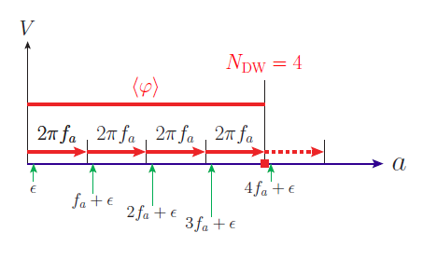
The axion model has the DW number
Sikivie, PRL48, 1156 (1982) : DW problem
Choi-Kim, PRL55, 2637 (1985) : Degenerate vacua
Barr-Choi-Kim, NPB283, 591 (1987): N=1 allowed
J E Kim IeffSUSY, Bethe12, Bad Honnef, Germany, 1 Oct. 2012
27/67

Slide 28
So, the phase must be of the complex scalar:
This φ appears in the coefficient outside the exponent.
J E Kim IeffSUSY, Bethe12, Bad Honnef, Germany, 1 Oct. 2012
28/67

Slide 29
2. Goldstino and
axino
J E Kim IeffSUSY, Bethe12, Bad Honnef, Germany, 1 Oct. 2012
29/67

Slide 30
When fields carrying the PQ charges develop VEVs, the PQ symmetry is broken. When fields develop F-terms, SUSY is broken.
What about if fields carrying the
PQ charges develop VEVs and F-terms?
Related references are the following:
Kim-Nilles, PLB138, 150 (1984)
Giudice-Masiero, PLB206, 480 (1988)
J E Kim IeffSUSY, Bethe12, Bad Honnef, Germany, 1 Oct. 2012
30/67

Slide 31
Consider the minimal Kaehler plus
The PQ symmetry is preserved. So,
This is a kind of Giudice-Masiero by the F-term X_{F}. The PQ symmetry is broken by this F-term.
It can be obtained from the superpotential
J E Kim IeffSUSY, Bethe12, Bad Honnef, Germany, 1 Oct. 2012
31/67

Slide 32
It is Kim-Nilles
In the Giudice-Masiero, μ=(X_{F})*, since X_{F}*= ∂W/ ∂X, or the same result as that of Kim-Nilles
J E Kim IeffSUSY, Bethe12, Bad Honnef, Germany, 1 Oct. 2012
32/67

Slide 33
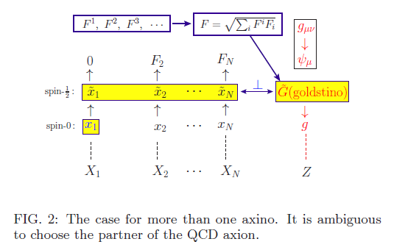
So, considering just W with θ⁰ components and considering θ² components seem to be clarified.
The PQ symmetry depends on θ⁰ components showing global symmetries, and Goldstino depends on θ² components showing SUSY breaking .
PQ: upward direction
Goldstino: downward direction
There is an ambiguity in the definition of axino.
J E Kim IeffSUSY, Bethe12, Bad Honnef, Germany, 1 Oct. 2012
33/67

Slide 34
If there is one axino, there is no ambiguity. The other is Goldstino. Even if there is one axino, the definition of axino has to be taken judiciously:
F_{A} = 0. Even in this case, the Goldstino direction may not be orth. to axino direction. F^{A} ∝ goldstino
J E Kim IeffSUSY, Bethe12, Bad Honnef, Germany, 1 Oct. 2012
34/67

Slide 35
Even though we start with an axion multiplet A and Goldstino multiplet Z, the final multiplets below SUSY breaking may mix some of the original components.
J E Kim IeffSUSY, Bethe12, Bad Honnef, Germany, 1 Oct. 2012
35/67

Slide 36
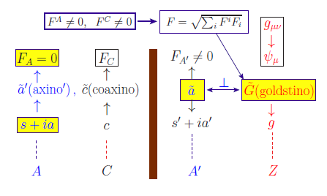
F_{A} = 0:
J E Kim IeffSUSY, Bethe12, Bad Honnef, Germany, 1 Oct. 2012
36/67

Slide 37
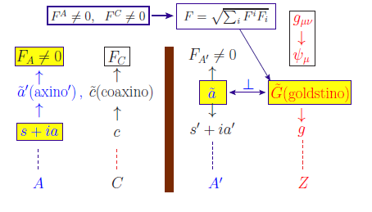
F_{A} ≠ 0 :
In any case, F_{A} = 0 or F_{A} ≠ 0 is a detail and we present an example later.
J E Kim IeffSUSY, Bethe12, Bad Honnef, Germany, 1 Oct. 2012
37/67

Slide 38
Definition of axion is without an ambiguity.
Definition of Goldstino is without an ambiguity:
But, axino is defined such that it belongs to a subset
J E Kim IeffSUSY, Bethe12, Bad Honnef, Germany, 1 Oct. 2012
38/67

Slide 39
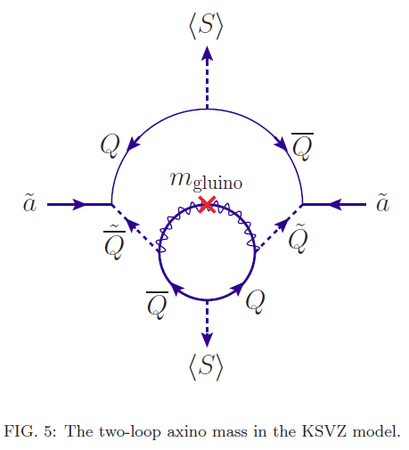
If all these contributions are not important, such as in GMSB scenario, the gaugino mass contributes: for the KSVZ axion
Anomaly mediation can contribute too.
But it is subdominant to gravity mediation.
J E Kim IeffSUSY, Bethe12, Bad Honnef, Germany, 1 Oct. 2012
39/67

Slide 40
Axino mass

Slide 41
So axino mass is parametrized as
The gaugino contribution was shown above.
Now, we concentrate on the first term.
And explicitly calculate for only one axino
to avoid the ambiguity.
J E Kim IeffSUSY, Bethe12, Bad Honnef, Germany, 1 Oct. 2012
41/67

Slide 42
Local SUSY with one axino:
(i) Vanishing CC condition
(ii) The vacuum stabilization condition
(iii) We use the following for the U(1) invariance
J E Kim IeffSUSY, Bethe12, Bad Honnef, Germany, 1 Oct. 2012
42/67

Slide 43
The axino mass matrix is
The Goldstino direction is zero mass eigenstate.
J E Kim IeffSUSY, Bethe12, Bad Honnef, Germany, 1 Oct. 2012
43/67

Slide 44
G_{A}=0, G^{A}≠0
(i) <C> = 0
(ii) <C> ≠ 0
(2) G_{A}≠0, G^{A}≠0
J E Kim IeffSUSY, Bethe12, Bad Honnef, Germany, 1 Oct. 2012
44/67

Slide 45
G_{A}≠0, G^{A}≠0 example
We have shown that it can take any value, even almost zero for the sequestered case.
J E Kim IeffSUSY, Bethe12, Bad Honnef, Germany, 1 Oct. 2012
45/67

Slide 46
For the gravity mediation, most likely of the form
J E Kim IeffSUSY, Bethe12, Bad Honnef, Germany, 1 Oct. 2012
46/67

Slide 47
This is for the one axino case.
But the mixing in the Kaehler potential with specific forms can lead to any mass. And, many coaxinos can be different from this.
J E Kim IeffSUSY, Bethe12, Bad Honnef, Germany, 1 Oct. 2012
47/67

Slide 48
In addition, kinetic mixing has to be taken into account also. The result is that the axino mass is of order the gravitino mass, probably larger than the gravitino mass.
J E Kim IeffSUSY, Bethe12, Bad Honnef, Germany, 1 Oct. 2012
48/67

Slide 49
3. Effective SUSY

Slide 50
Effective SUSY
Has been proposed in the middle of
90s. The third generation and
Higgs doublets are the necessary ingredient of the gauge hierarchy solution through SUSY.
Dimopoulos-Giudice, PLB357, 573 [hep-ph/9507282];
Pomarol-Tommasini, NPB466, 3 [hep-ph/9507462];
Cohen-Kaplan-Nelson, PLB388, 588 [hep-ph/9607394]; recently
Giudice-Nardecchia-Romanino, NPB813, 156 [0812.3610 [hep-ph] ]
J E Kim IeffSUSY, Bethe12, Bad Honnef, Germany, 1 Oct. 2012
50/67

Slide 51
To raise the 1st and 2nd family squark
masses a little bit, from FCNC effects one needs a symmetry of the first two family squarks. Probably U(2).
But, if the 1st and 2nd family squark
masses are raised above 10⁵ –10⁶ GeV, one does not need such a light family symmetry. However, this raises another problem, which will be remdied in IeffSUSY.
J E Kim IeffSUSY, Bethe12, Bad Honnef, Germany, 1 Oct. 2012
51/67

Slide 52
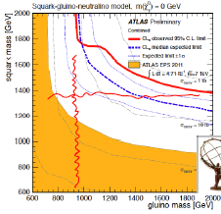
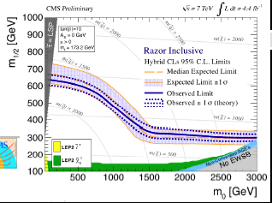
Interpretation in CMSSM & simplified model CMS SUS-12-005
ATLAS-CONF-2012-033
ATLAS-CONF-2012-037
Latest CMS results from Razor analysis (4.4 fb⁻¹) exclude squark
and gluino masses up to 1.35 TeV (CMS SUS-12-005).
Latest ATLAS results from meff on 0-lepton (4.7fb⁻¹) is mapped on
simplified model with the massless LSP assumption
m_{gl}<940GeV, m_{sq}<1380GeV are excluded (ATLAS-CONF-2012-033).
J E Kim IeffSUSY, Bethe12, Bad Honnef, Germany, 1 Oct. 2012
52/67

Slide 53
Z’ mediation:
SUSY breaking at the hidden sector is manifested in the visible sector (SM) by the Z’ charged sector.
It is not just saying effSUSY, but
realizing such a model explicitly in heterotic string models.
J E Kim IeffSUSY, Bethe12, Bad Honnef, Germany, 1 Oct. 2012
53/67

Slide 54
● Z’ mediation
The Z’ mediation has been studied relatively recently.
P. Langacker, G. Paz, L.-T. Wang, and I. Yavin, PRL100, 041802 (2008);
R. N. Mohapatra and S. Nandi, PRL 79, 181 (1997);
T. Kikuchi and T. Kubo, PLB 666, 262 (2008).
Langacker et al discusses one Z’ and MN discusses Z’ and Z. In the latter case, it is proper for it to be called the mixed mediation (MM). The MM needs a fine-tuning of parameters. So, we discuss the Z’ mediation only. The U(1)’ charge is carried by the mediators, but NOT by the 3rd family members and Higgs doublets. It is effSUSY.
At least, it is a CALCULABLE MODEL with only a SUSY
gauge theory knowledge.
J E Kim IeffSUSY, Bethe12, Bad Honnef, Germany, 1 Oct. 2012
54/67

Slide 55
For the SUSY hierarchy solution, we need a light Higgs.
The large top mass (or Yukawa couplings) at TeV scale
and also its superpartner mass needed at TeV scale
(for gauge hierarchy solution) and it supports
the SU(2) x U(1) breaking radiatively
[Ibanez-Ross, Inoue et al., Ellis et al.]
H_{u} and H_{d} light and the 3rd family members light = effSUSY
H_{u} and H_{d} light and the 3rd f. mem. heavy =
IeffSUSY
J E Kim IeffSUSY, Bethe12, Bad Honnef, Germany, 1 Oct. 2012
55/67

Slide 56
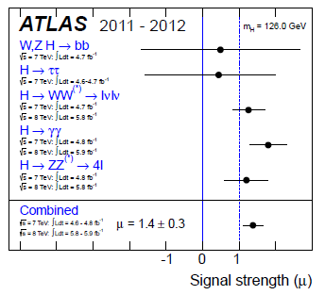
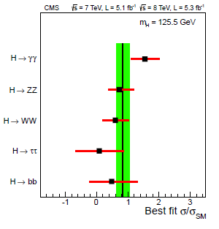
arXiv:1207.7214
arXiv:1207.7235
Higgs to two photons is the spectacular mode. Details will be known
with more data, but Higgs discovery at 126 GeV is most likely.
Is it from SUSY?
J E Kim IeffSUSY, Bethe12, Bad Honnef, Germany, 1 Oct. 2012
56/67

Slide 57
The 126 GeV Higgs is rather difficult to obtain in the CMSSM.
To raise it sufficiently above the tree level limit m_{h} < M_{Z},
we need a large A-term and/or large stop masses.
Gravity mediation is an easy one for A-term. For a large
stop, we take an opposite view from effSUSY:
Inverted effSUSY=IeffSUSY
where stop is the heaviest squark.
Z’ mediation & gravity mediation with IeffSUSY
J E Kim IeffSUSY, Bethe12, Bad Honnef, Germany, 1 Oct. 2012
57/67

Slide 58
(1) Superpartner
Zprimino is effec.
in the mediation.
(2) The SUSY
breaking source
DSB does not
carry the weak
hypercharge Y.
The messenger
sector carries the
Z’ charge but no
weak hypercharge Y.
(3) The 2nd family and Higgs do not carry
the Z’ charge.
(4) The 3rd f. carry the Z’ charge. This scenario can be generic, compared to
the f. universal Z’ charge.
f(0,1,5’*)
f*(0,-1,5’)
t, b,
τ, ν_{τ}
DSB
H_{u}, H_{d}, μ, ν_{μ} ,…
J E Kim IeffSUSY, Bethe12, Bad Honnef, Germany, 1 Oct. 2012
58/67

Slide 59
This leads to the combined Z’ and gravity mediation with
the hidden sector scale bigger than 10¹³ GeV.
J E Kim IeffSUSY, Bethe12, Bad Honnef, Germany, 1 Oct. 2012
59/67

Slide 60
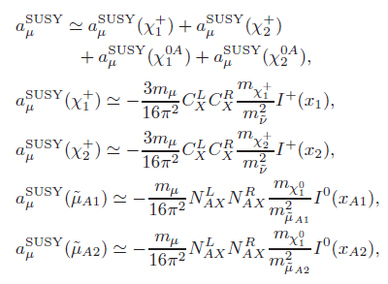
arXiv:1208.5484v2[hep-ph]
J E Kim IeffSUSY, Bethe12, Bad Honnef, Germany, 1 Oct. 2012
60/67

Slide 61
4. Numerical study

Slide 62
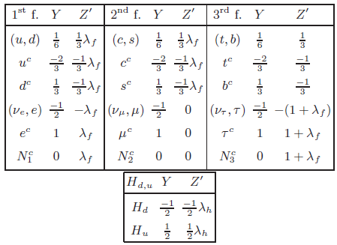

Slide 63
J E Kim IeffSUSY, Bethe12, Bad Honnef, Germany, 1 Oct. 2012
62/67

Slide 64
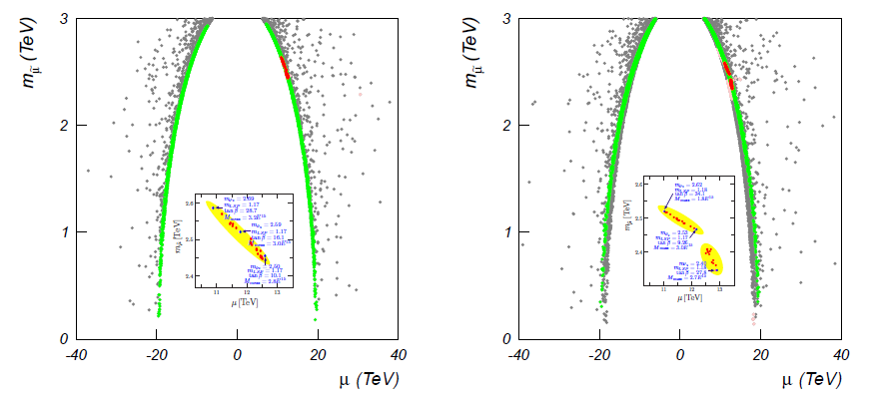
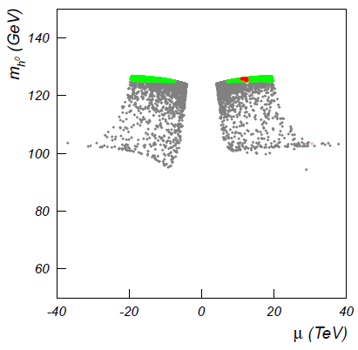
There exists a range of parameters,
allowing 126 GeV Higgs and a large
(g-2)_{μ}. Mu is above 10 TeV and the
LSP mass is about 1.2 TeV.
Choi-Kim-Lee-Seto, arXiv:0801.0491
Kim-Seo, NPB864, 296[arXiv:1204.5495]
J E Kim IeffSUSY, Bethe12, Bad Honnef, Germany, 1 Oct. 2012
63/67

Slide 65
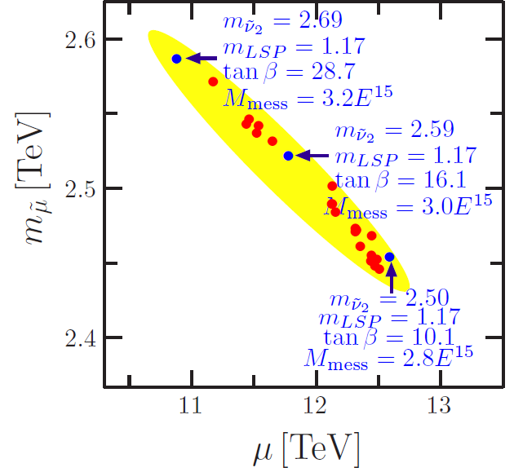
J E Kim IeffSUSY, Bethe12, Bad Honnef, Germany, 1 Oct. 2012
64/67

Slide 66
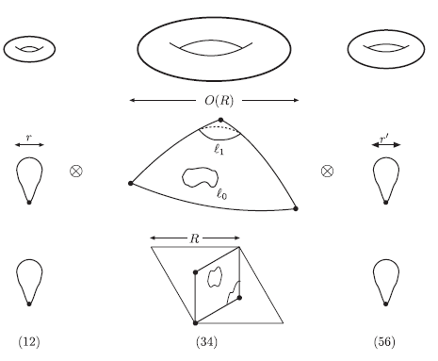
Z(12-I) orbifold

Slide 67
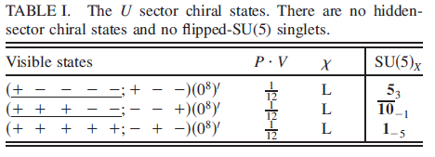
SU(5)xSU(5)’ from Z(12-I) orbifold compactification:
This leads to three families and sin²θ_{W} =3/8 at the GUT scale.
Also, the SU(5)’ hidden sector with one (10’+5’*) allowing
DSB. [Huh-Kim-Kyae, PRD80,115012[arXiv:0904.1108]]
Z’=(0⁵ -1 -1 2)(0⁸)’
J E Kim IeffSUSY, Bethe12, Bad Honnef, Germany, 1 Oct. 2012
65/67

Slide 68
Then, the 3rd family squarks are heavy and the first two
family squarks and Higgs doublets are light. It may be
close to the case (a) above.
Murayama-Nomura [hep-ph/0701231]:
J E Kim IeffSUSY, Bethe12, Bad Honnef, Germany, 1 Oct. 2012
66/67

Slide 69
Conclusion
1. CP: the weak CKM parametrization and the strong CP via very light axion
2. Axino mass can take any value depending on the axion model and SUSY breaking scheme.
3. We discussed the IeffSUSY to have a
126 GeV Higgs boson and (g-2)_{μ}.
J E Kim IeffSUSY, Bethe12, Bad Honnef, Germany, 1 Oct. 2012
67/67

