Slide 1
Notes:
Slide 1: Company Logo Full Page
Before you start editing the slides of your talk change to the Master Slide view:
Microsoft Office :Menu: View > Slide Master;
Macintosh – View > Master > Slide Master
Edit the following items:
On the Slide Master (first master slide) – lower area
a) On the left Delete the text and write the title of the event/Conference, Location
b) On the right delete the text and write the name and surname of the speaker and the date (day, month , year)
Close Master View

Slide 2
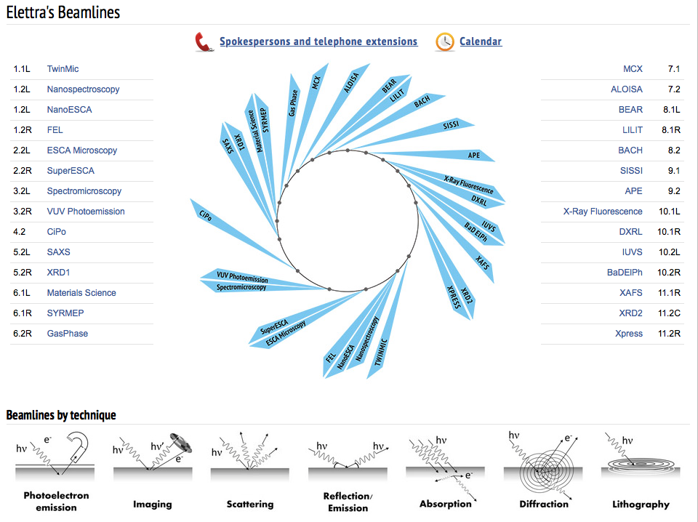
28 Elettra Operative Beamlines

Slide 3
6 FERMI Beamlines

Slide 4
Users’ Office main activities
Call for Proposals for Elettra & FERMI
Handling the entire proposals process (Virtual Unified Office)
Handling the Access of users, collaborators, Elettra partners
Access requests
Organization of supported users : travel, accommodation, logistics (in collaboration with Elettra Travel Office)

Slide 5
Organization of Meetings and Workshops
Elettra Review Panel meetings (biannual)
Support to specific EU & Research programs
Training
FERMI Review panel meeting (annual)
Elettra Users’ Meeting
Satellite Workshops/Conferences
Administrative/organization support to CalipsoPlus, FERMI LaserLab, SESAME (EU Projects), POC (India), SISTER-MAE (South Africa), ICTP (Developing Countries)
Handling Visas requests

Slide 6
Interface between Users and Elettra-Sincrotrone Trieste!
Administrative infos
Scientific infos
Logistics
Complaints
Etc.

Slide 7
Elettra Submitted proposals by semester

Slide 8
Proposals submitted/allocated

Slide 9
Elettra Users’ Office Staff
Michela Bassanese
Letizia Pierandrei
Elettra Users’ Office

Slide 10
Conceived in 1997 by Roberto Pugliese and the Users’ Office (originally named “Virtual User Office”), is presently managed and developed by the VUO Development Team
It is a totally integrated system that allows to handle and connect many functions and databases

Slide 11
VUO integrated functions
Proposal Workflow
Users registration
Privacy procedure, validations
Proposals submission
Evaluation process: Technical, Scientific
Allocation of the Proposal in the Calendar
Access requests
Users’ reimbursement procedures

Slide 12
Handling of the experiment: Data acquisition, storage and access
Access to support laboratories (chemical, structural biology, support lab., etc.)
Safety training (integrated with Security Service: entrance badge)
Publications database
Users satisfaction feedback (BEST form)

Slide 13
Users reporting activities (Experimental report)
Preparation of statistics
Automatic workflow management functions and communications to the users

Slide 14
User Area

Slide 15
Deadlines for proposals submission

Slide 16
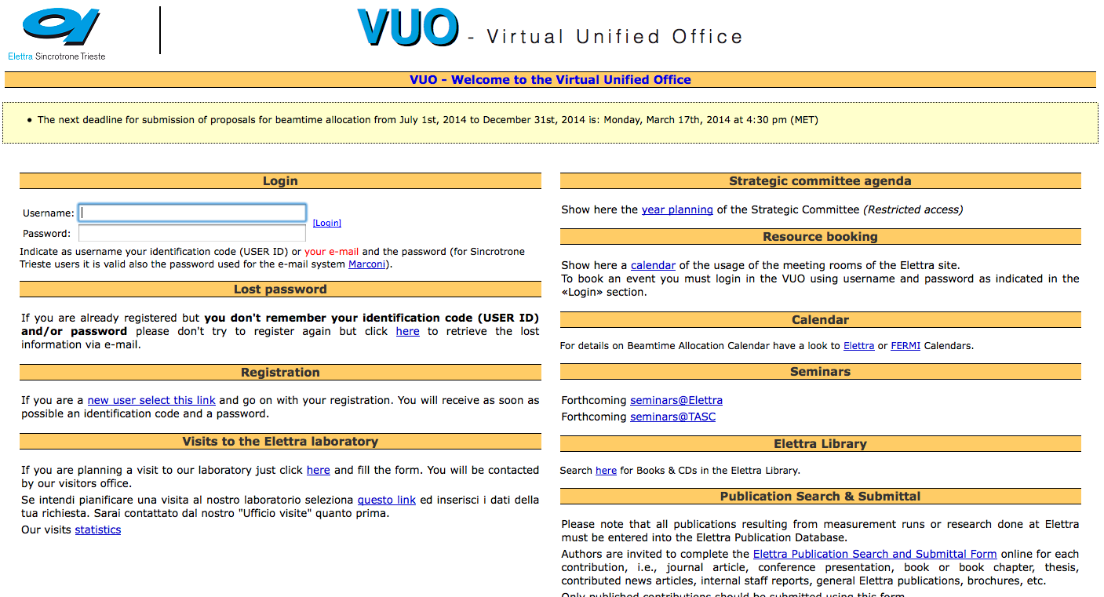
User registration
VUO main page: https://vuo.elettra.trieste.it/pls/vuo/guest.startup

Slide 19
Proposal Form
Proposal submission form is composed by 4 parts:
General Information
Sample Description (Safety Form)
Local contact and participants
Proposal Description

Slide 20
Proposal workflow
Editing
Registered
Evaluation
Submitted
Deleted
Final evaluation
Evaluated
Reserve list
Scheduled
Experiment
Completed

Slide 21
Type of Proposals

Slide 23
Proposal evaluation process: Technical evaluation
Technical evaluations are performed by BL Coordinators
The evaluation considers if the experiment is feasible or not, and if the amount of time requested is appropriate.
Comments are requested to help scientific reviewers

Slide 24
Scientific evaluation
Two/three reviews per proposal
Reviewers define a quality ranking
Feedback comments help users for writing new successful proposals
Top quality proposals are scheduled

Slide 25
Elettra Review Panel

Slide 26
FERMI Review Panel

Slide 27
Beamtime allocation phase
After the scientific grading, positively evaluated proposals are allocated in the Calendar by the Beamline Coordinator
Rejected proposals are notified via e-mail by means of a specific workflow procedure (end of allocation phase)

Slide 28
Calendar

Slide 29
User guide

Slide 30
Access requests

Slide 31
Safety and Radioprotection training
Training can be done:
On-line via VUO
On the arrival, before entering the Laboratory

Slide 32
After the experiment

Slide 33
After the experiment: Reporting

Slide 34
VUO statistics functions

Slide 35
Proposals statistics

Slide 36
Proposals submitted by country in 2016

Slide 37
Elettra proposals allocated by Research Area in 2016

Slide 38
Non VUO functions: Users’ Office skills
Communication
Patience
Diplomacy
Problem solving
English language (spoken/written)
More …

Slide 39
Thank you!

Slide 40
