Slide 1
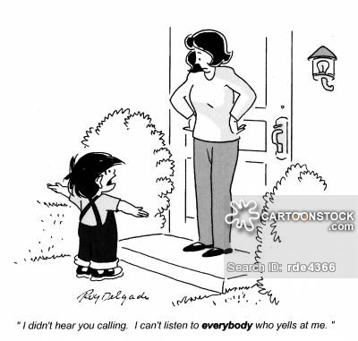
User Feedback
Joanne McCarthy
Head of ESRF User Office
Information for Users : http://www.esrf.fr/UsersAndScience

Slide 2
paths open to obtain user feedback
Direct contact with User Office
Direct contact with beamline scientist
Science Advisory Council representatives
User Organisation and User Meeting
User Evaluation Forms
Experiment Reports

Slide 3
User organisation

Slide 4
User meeting
Forum for exchange with users
Topical discussions (e.g. facility upgrades) - Inform users and listen to reactions and concerns
Question/answer sessions
Smaller group tutorials
…

Slide 5
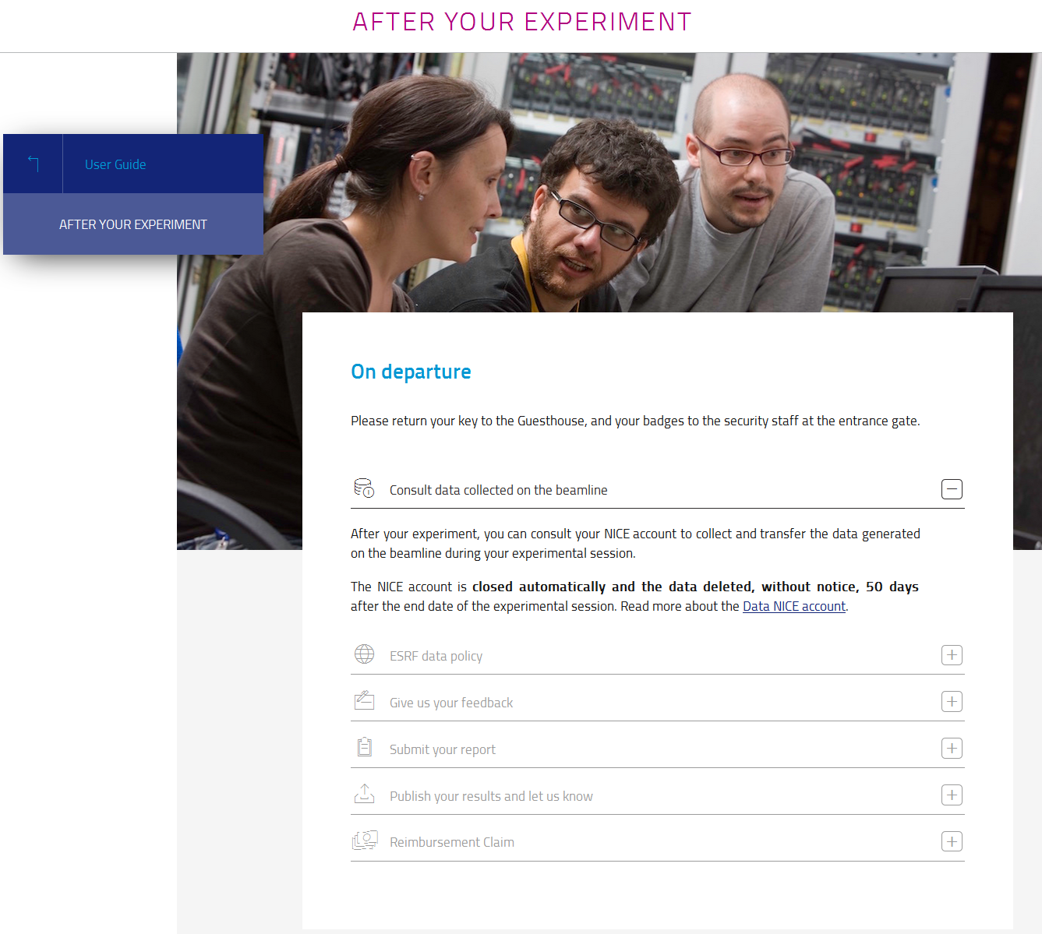
User evaluation forms
Easily accessible
User Portal
Web pages
Email link

Slide 6
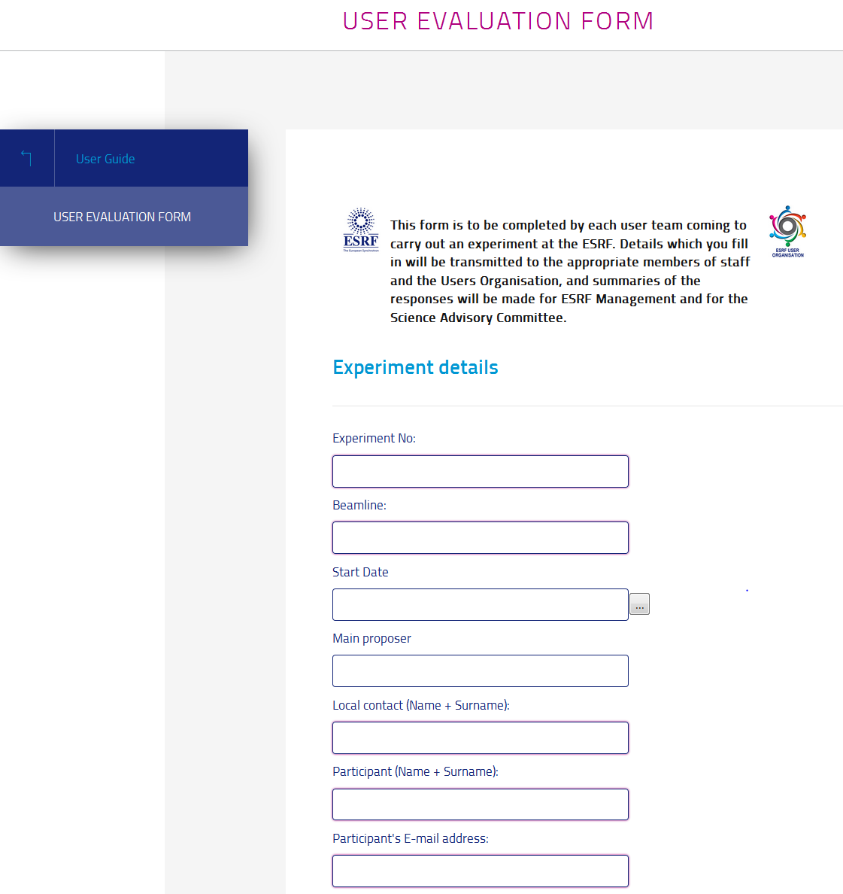
User evaluation form

Slide 7
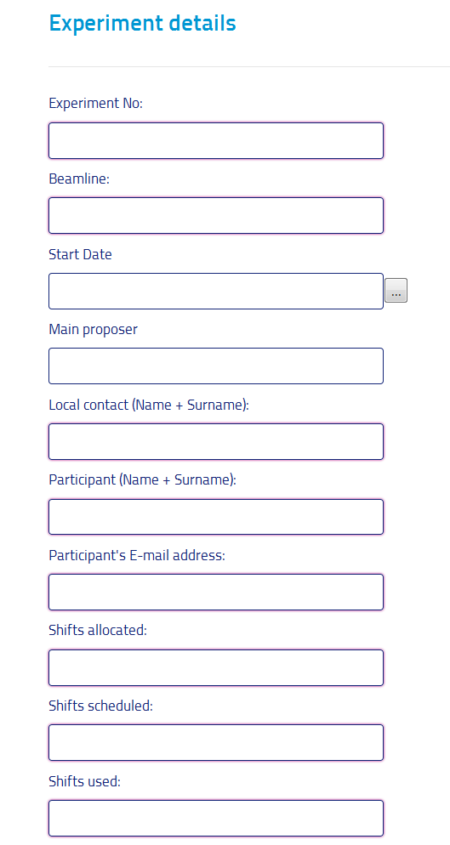
User evaluation forms
To improve % return = least effort for user
Easily accessible
Users on A-form receive an automatic email from our SMIS system following the end of their experiment (some synchrotrons request 1 feedback per team)
The Experiment Details fields are automatically filled in from the database
Users only have to answer the questions
Reminder sent every 6 months by User Office

Slide 8
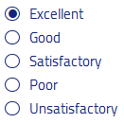
User evaluation form
Questions
Indicate the degree of success of your experiment:
Very Successful – Satisfactory - Fell below expectations - Unsuccessful
If less than satisfactory, please estimate the total time lost:
Please give reason for any time lost:
Computer failure - Failure of beamline components - Machine or storage ring failure - Sample problems - Other
Details concerning time loss:
What measures could be taken to improve the effectiveness of your beamtime?
[ Comment ]
[ Comment ]
[ Comment ]
Please evaluate the support from your local contact and members of staff:
Please evaluate the quality and reliability of the beamline components:
Please evaluate the quality of the beam:
Please evaluate the availability and ease of use of the Beamline User Guide:
Please evaluate the detectors and data acquisition:
Please evaluate the data retrieval and transfer:
Please evaluate the quality of practical arrangements before and during your visit (travel, canteen, guesthouse...):
What aspects of the ESRF do you particularly appreciate?
What improvements would you suggest?
[ Comment ]
[ Comment ]

Slide 9
User evaluation form
Questions (continued)
The Users' Organisation at the ESRF
This is an independent body which organises the annual User Meeting, awards an annual Young Scientist prize, and provides ESRF management with feedback on user operation.
What suggestions do you have for the format of the meeting and topics to be discussed?
What aspects of the user service at the ESRF would you like the Users' Organisation to look into?:
Checkboxes Comments
Statistics Improvements

Slide 10
User evaluation forms
Return
from 1/9/2016 to 14/1/2017: 689 user evaluation forms received out of 890 experiment sessions ~75% from 17/01/2017 to 1/9/2017: 1277 user evaluation forms received out of 1656 experiment sessions ~75%
Who gets the information ?
Beamline scientists receive all feedback for experiments carried out on their beamline
The ESRF User Organisation Chairperson receives all feedback for all experiments
The User Office summarises feedback concerning central services such as the Guesthouse, the onsite restaurant, the Travel Office, etc and presents this to the relevant service (external company for Guesthouse and restaurant).

Slide 11
User evaluation form - My advice
Aim of questions is to improve
Source performance
Beamline performance (beamline components and software)
Support services (User Portal, data handling, offline labs…)
Staff support
Administrative services (Reception, Travel, User Office, Guesthouse, canteen…)
Any aspects that make the user experience pleasant or unpleasant
Least effort for user (force doesn’t work)
Make the questionnaire short and quick to fill
Pre-filled fields whenever possible
Access directly from the User Portal account or email Inbox
Checkboxes but ask for an explanatory comment if reply indicates less than satisfactory
Dedicate somebody to the task of analysing and reacting to the feedback
Personal user taste or real issue ?
What are most urgent issues to deal with ?

Slide 12
Experiment reports
Use of PUBLIC ESRF beamtime
= OBLIGATION to PUBLISH and REPORT on beamtime used
Reporting
Users allocated beamtime must provide a 2-page Experimental Report after each experiment
difficult and time-consuming to follow up (nearly 1900 experiments per year)
if not submitted, what sanctions can be reasonably applied – difficult
Major Axis of Force = future access / new proposals
forwarded to Review Committees who monitor effective use of beamtime
required as support for new requests for beam time
relevant reports and reports on recent beam time (status of project , productivity)
especially important in absence of publication
confidential reports may be sent to the User Office
the committees reject proposals by groups who have not submitted reports on beam time used

Slide 13
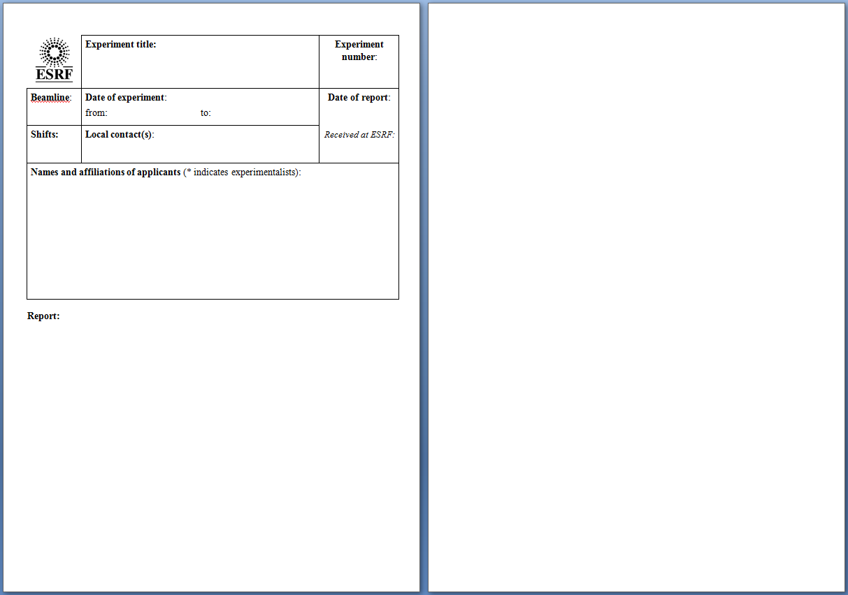
Experiment reports
Use of PUBLIC ESRF beamtime
= OBLIGATION to PUBLISH and REPORT on beamtime used

Slide 14
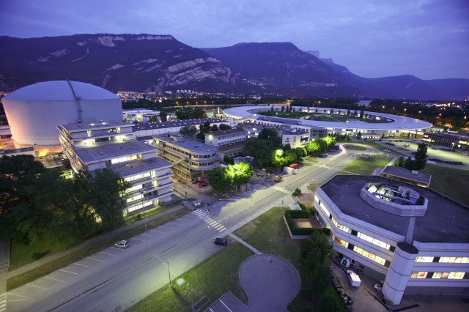
Thank You for your attention!

