Slide 1
WP02 PRR: Master Oscillator and RF Reference Distribution
Master Oscillator Redundancy
Notes:
How to edit the title slide
Upper area: Title of your talk, max. 2 rows of the defined size (55 pt)
Lower area (subtitle): Conference/meeting/workshop, location, date, your name and affiliation, max. 4 rows of the defined size (32 pt)
Change the partner logos or add others in the last row.

Slide 2
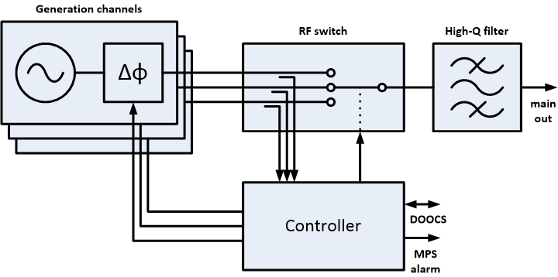
Redundant MO Overview
Maintaining continuous and correct output signal
Channel selection and synchronization
Failure detection and reaction
Notes:
Redundancy functions:
Main function: maintain continuous and correct output signal
Continuous = without intteruptions
Correct = in terms of amplitude, frequency, noise
Required capabilities:
Channel selection (obvious in redundancy)
Channel synchronization (required for seamless channel switching – no phase jumps)
Failure detection and reaction (also obvious)
Communication with rest of the system (MPS alarm on failure,

Slide 3
Channel Selection
RF switch subsystem
High reliability
High performance
Integrated with signal quality monitoring
Currently under design
Critical components ordered or available

Slide 4
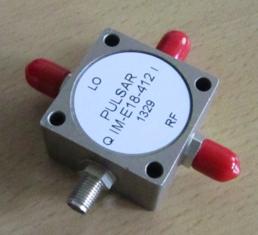
Channel Synchronization
Phase shifter for each channel
Integrated within generation channels
Vector modulator as a phase shifter
Phase of the current master channel is frozen
Other two channels are synchronized to the current master
COTS component

Slide 5
Controller
Real-time monitoring of all three reference signals
Amplitude and phase
Decision-making unit
Controls the RF switch and the vector modulators
Asserts MPS alert
Talks with DOOCS (via TMCB)
Looking for COTS solution
Requirements: high-reliability, low-latency, fast ADCs, …
Notes:
Monitors amplitude and (relative) phase of signal coming from each generation channel.
Detects failures by analysing these signals.
Makes decisions about what happened, and what actions need to be performed.
Controls state of the RF switch (ie. switches signal source when current master failed)
Controls phase shift of each channel (to keep them synchronized)
Talks with rest of the world (MPS, DOOCS)

Slide 6
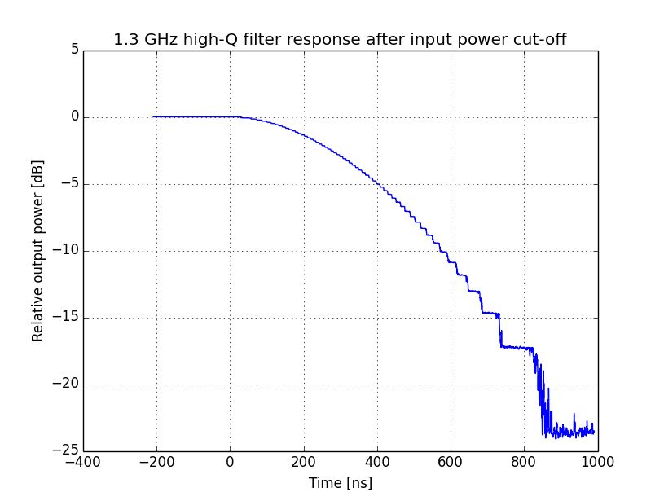
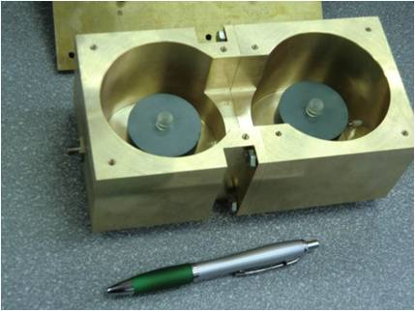
High-Q Bandpass Filter
Custom made dielectric resonator filter
Stores energy
Filters out far-from-carrier noise
Already at DESY
Notes:
High quality factor filter – dielectric resonator filter (Q > 10000)
Q = ~15000 => group delay ~300 ns
Stores energy, and releases it in case of failure:
About 3 dB drop after 300 ns at „no input power” condition
Additionally filters out far-from-carrier noise

Slide 7
Redundancy Box
Standard 4U 19” crate
Powered from external PSM

Slide 8
Performance Limits
Impossible to foresee failures
Handling failures cannot be transparent
Target: keep synchronism of the XFEL subsystems
Signal quality can degrade for a moment (usually < 1 us)
MPS is informed about failure event
Phase detection is relative
Three channels are needed for phase monitoring
If one fails phase detection is impaired
Notes:
Performance limits:
-Future is unknown
-Failure is detected when it has already occured
-Transients will be present at the output, but mostly for less than 1 us
-MPS should be informed of such event (always or only if output fails for longer than usual?)
-Phase detection is relative
-Three channels are needed for proper signal phase detection
-When one channel fails, phase-based signal monitoring has to be turned off

Slide 9
General Failure Scenario Analysis
There is huge number of possible failures
Only general analysis is practical
Most MO failures will be visible in amplitude or phase
All these will be detected
Phase noise degradation is not critical
No reason to act automatically
Phase noise monitoring is only long term
Redundancy subsystem is designed to be highly reliable
Notes:
All amplitude/phase disturbing failure will be detected, at least as long as all channels were working properly prior to the event.
Phase change means relatively large change, which are no typical „noise”.
Phase noise is intrinsic attribute of every signal with specific frequency.
Redundancy subsystem has to be much more reliable than a single MO channel, because its failures are potentially not correctable.

Slide 10
Thank you for your attention

