Slide 1

Capacitive Energy Storage for the PS Booster Accelerator
Fulvio Boattini
CERN Technology Department | Electrical Power Converters
Acknoweledgements: Charles-Mathieu Genton, Stefano Rocca, Andres Marquez

Slide 2
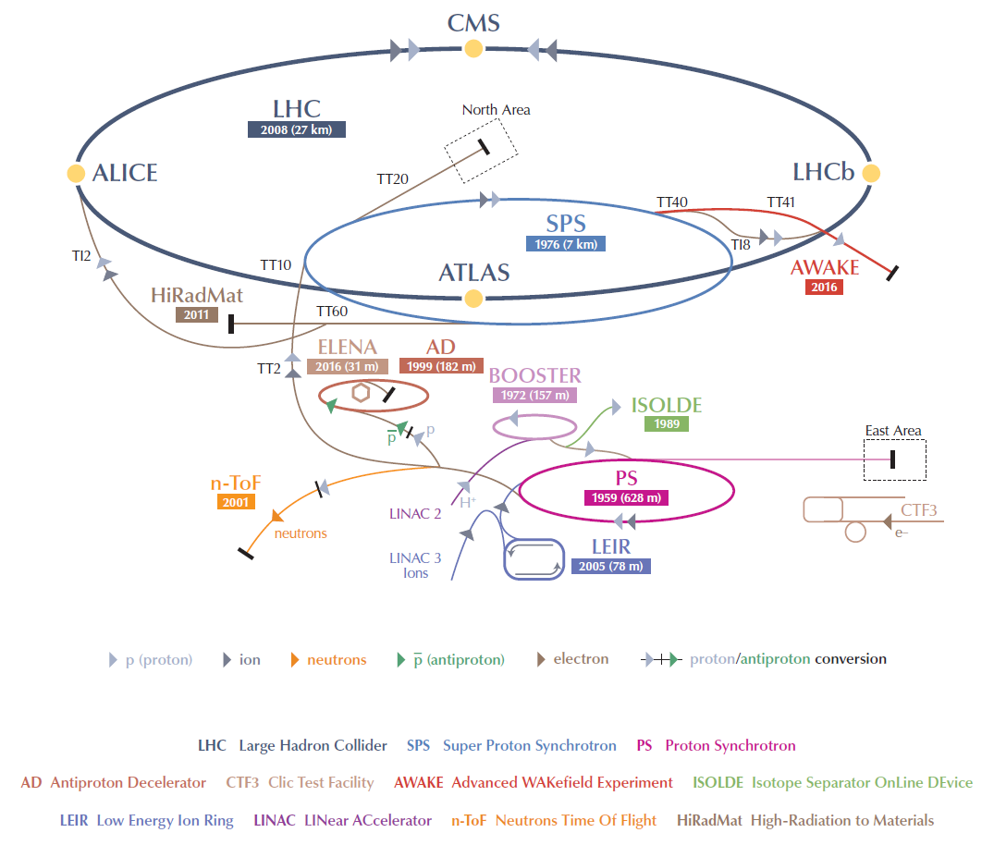
The CERN PS Booster accelerator

Slide 3
PS Booster accelerator: facts & figures

Slide 4
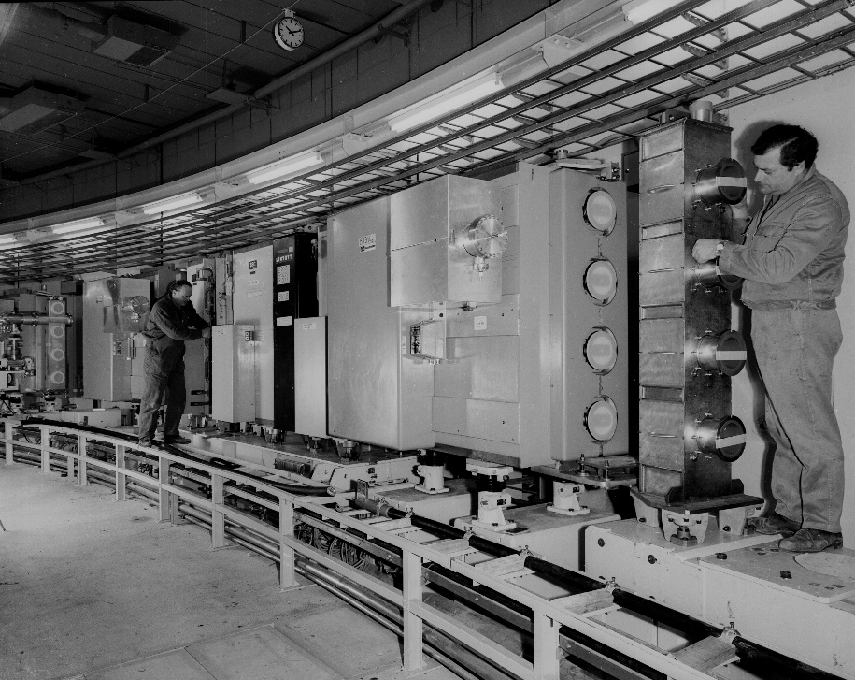
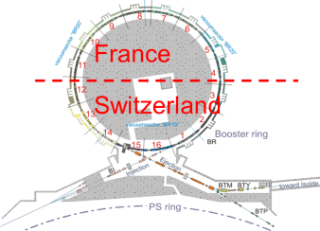
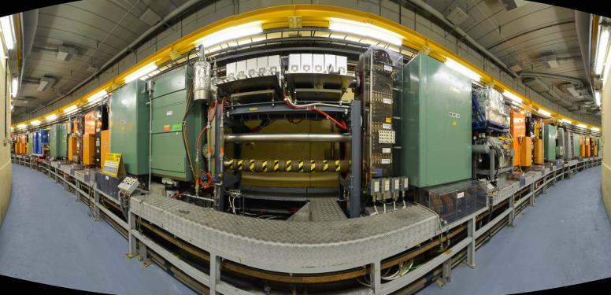
PS Booster accelerator: facts & figures
PS Booster ring was developed in the 60’s (first p+ in 72) to increase injection energy in the PS from 50 to 800 MeV as required by the ever increasing beam intensities.
Since its creation, the PS Booster extraction energy has already been increased twice:
800MeV to 1GeV (1988)
1 GeV to 1.4GeV (1999)
4
Pag 4

Slide 5
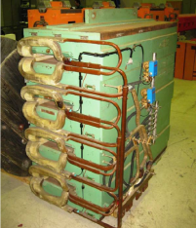
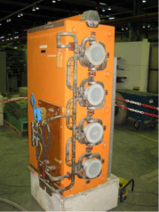
PS Booster accelerator: facts & figures
Takes particles from Linac2 at 50MeV and accelerates them up to 1.4GeV
Pulsed operation:1.2s cycles repeated continuously 300days/year 24h/day
4 rings 157m circumference accelerator. 32 dipoles and 48 quadrupole magnets connected in series.
TOTAL MAGNETS IMPEDENCE
Ltot=0.18H
Rtot=0.5ohm
4 magnets into one structure
External rings need more current
Trim converter required
dipole
quadrupole
5

Slide 6

PS Booster accelerator: facts & figures
From 1.4GeV to 2GeV
Reduces the negative effects of space charge on beam allowing higher beam intensity.
Increase of energy is limited by Magnet max and rms current.
30% more peak current
10% higher r.m.s. current for magnets cooling limitations
(*) Chamonix 2010
40% Higher voltage and 30% higher current from power converter
6

Slide 7
PS Booster accelerator: facts & figures
New circuit connection
PSB 1.4 GeV:
all magnets connected in series
PSB 2 GeV:
Rings 1&4 + QFO
Rings 2&3 + QDE

Slide 8
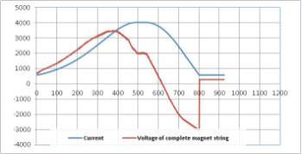
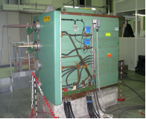
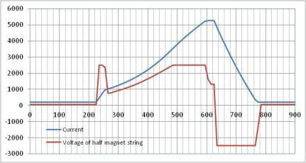
PS Booster accelerator: facts & figures
2GeV increase is compatible with the 10% maximum increase in rms current
Magnet current
1.4GeV cycle is 1.2s duration 4kApk 3.6kVpk for 1.4GeV
Irms is 2250Arms
Irms 1.2s =2250A
Magnet voltage
Magnet current
Irms0.9s=2450A
2GeV cycle will be 1.2s duration 5.25kApk 2x2.5kVpk
Irms is 2450Arms
Magnet voltage

Slide 9
POPS-B MPC (main power converter)
9

Slide 10
POPS-B MPC : main project numbers
Power for PS-Booster
The project includes the following working units:
Construction of a new building to host the new MPS
Realization of the POPS-B high power converters (2+1 units)
Realization of the quadrupole trims (+ injector and extraction trims)
The total budget is 16MCHF
Building + services: 3.4MCHF
MPS high power converters: 12 MCHF
Trims: 0.6MCHF
The total LIU PSB budget is 21.7MCHF + 3MCHF for LIU-L2B
Commissioning 2019-20 (LS2)
10

Slide 11
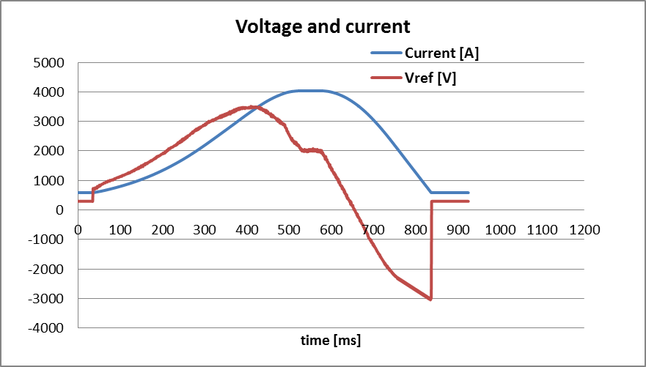
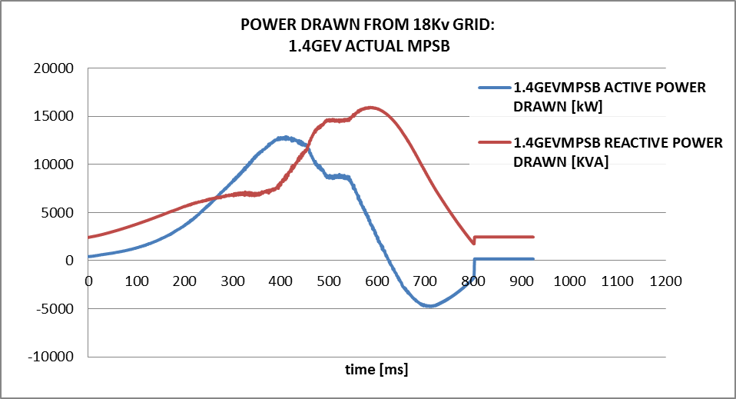
POPS-B MPC : present realization
4X12 pulse thyristor bridges directly connected to the AC network via a 3 winding 18kV/389V transformer
13 MW peak active power
15 Mvar peak reactive

Slide 12
POPS-B MPC: new topology
A storage capacitor bank connected on the DC side provide power decoupling from the network.
The storage capacitance is around 0.3F (@5kV Udc nominal)
Power transformer:
Power=2.5MW
Vac=2000Vrms
Storage Capacitors:
Cap=0.3F
Vmax=5000V
Vmin=3000V
Output:
Imag_pk=6000A
Imag_rms=3000A
Vout_pk=3000V
Load (Mag):
Lmag=100mH
Rmag=250mOhm
UDC
Vac
Additional common mode filter inductance required for DVripple
Imag
Vout
12

Slide 13
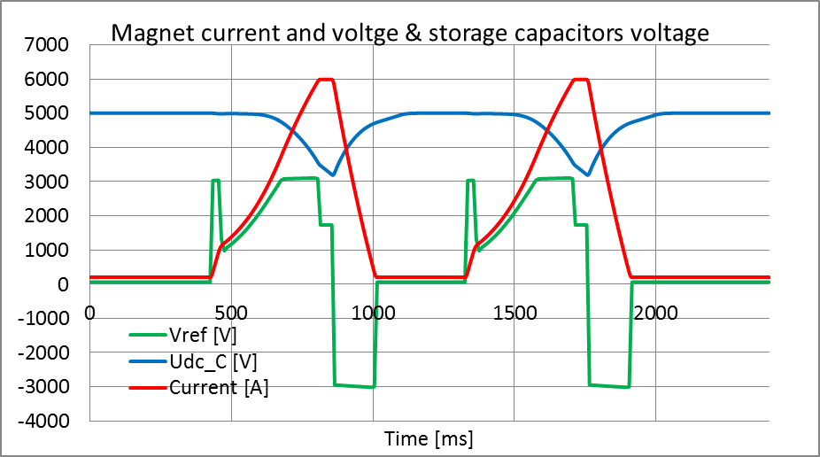
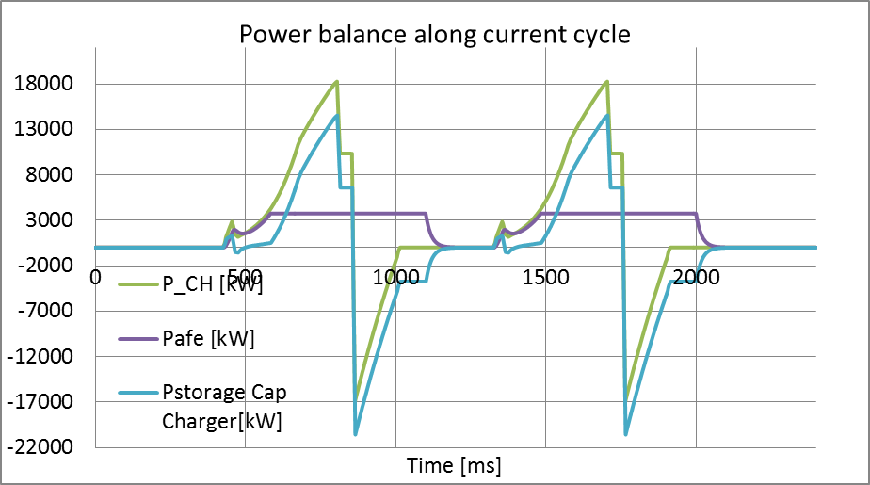
POPS-B MPC: storage capacitors
Storage capacitors operation
Storage capacitors discharge
Instantaneous power to magnets
Instantaneous power from storage capacitors
Instantaneous power from AFEs
13

Slide 14
POPS-B MPC: storage capacitors
Variable saturation limits on Udc control loop
14

Slide 15
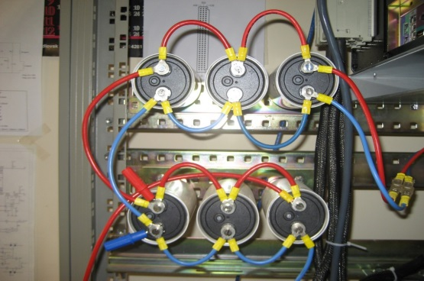
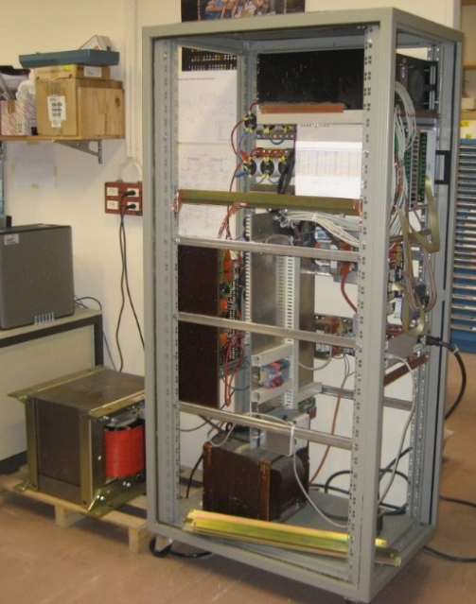
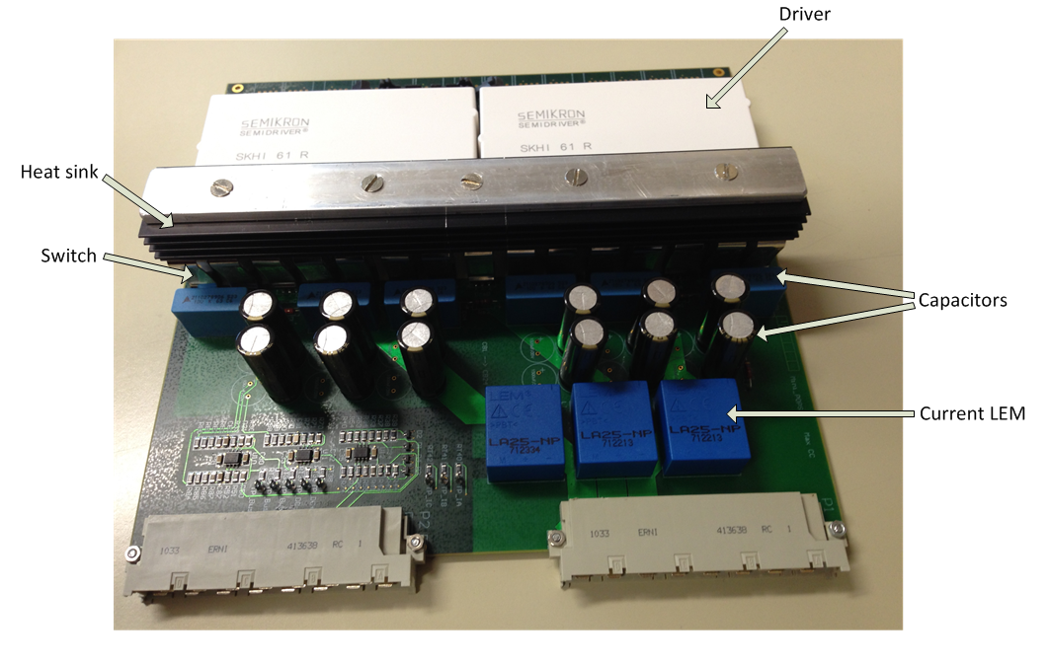
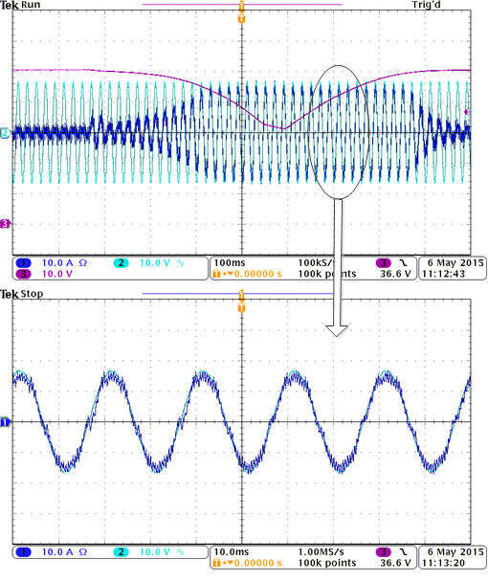
POPS-B MPC: prototype tests
Storage capacitors
Reduced scale prototype:
1/10.000 on power
1/100 on currents and voltages
Rapid control prototyping
IGBT converters
15

Slide 16
The new building B245
16

Slide 17
The new Building B245
17

Slide 18
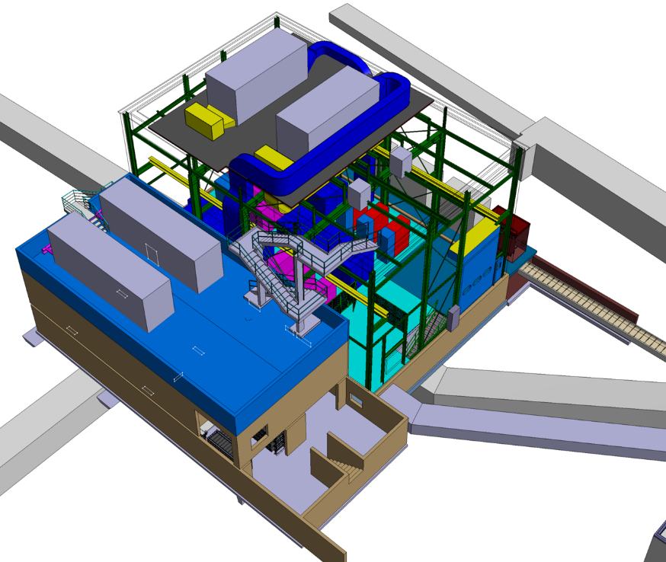
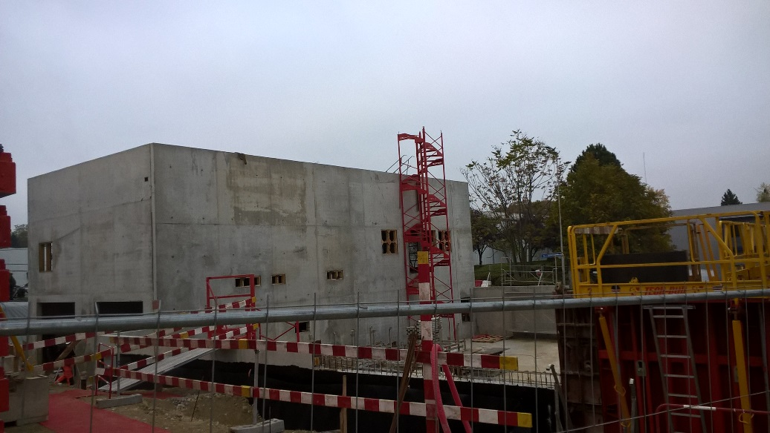
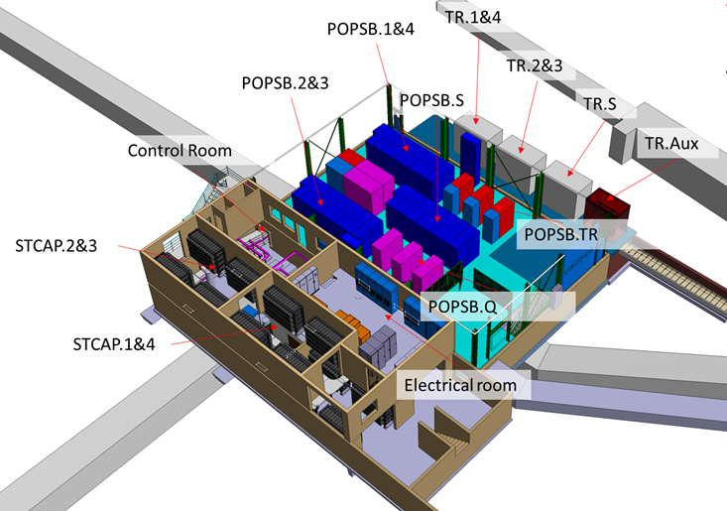
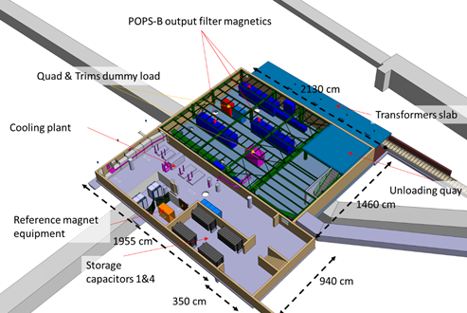
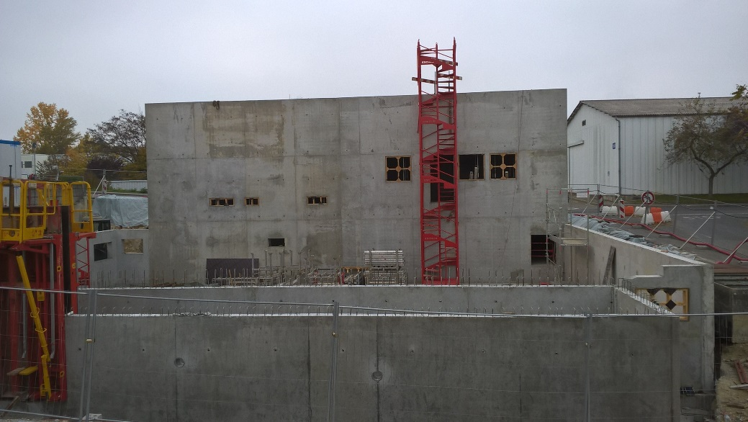
The new Building B245
18

Slide 19
Storage Capacitors
19

Slide 20
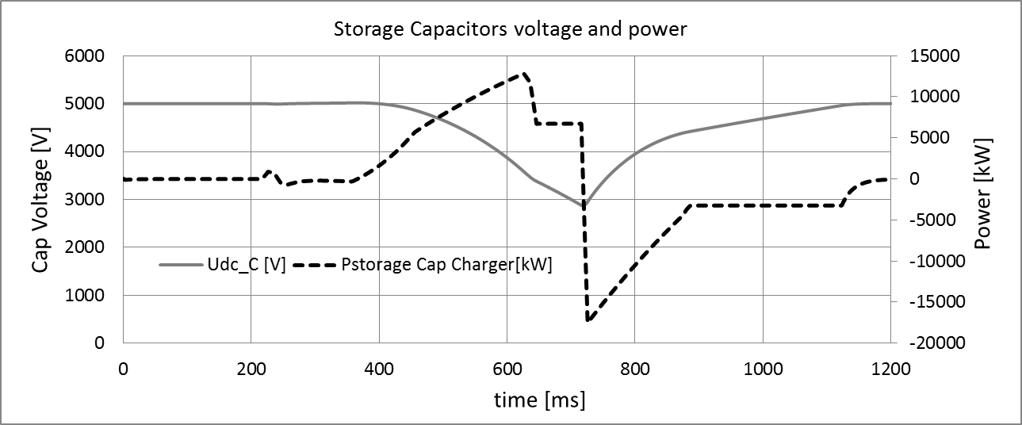
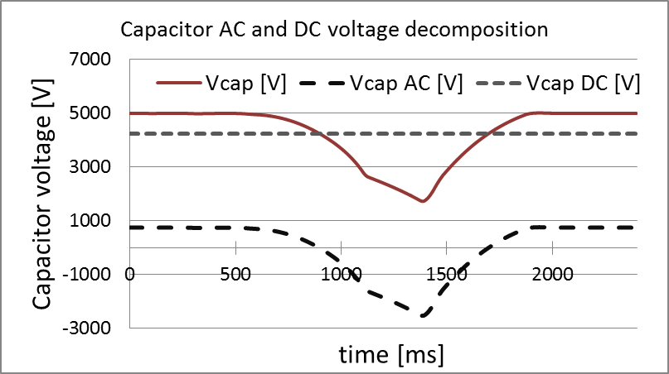
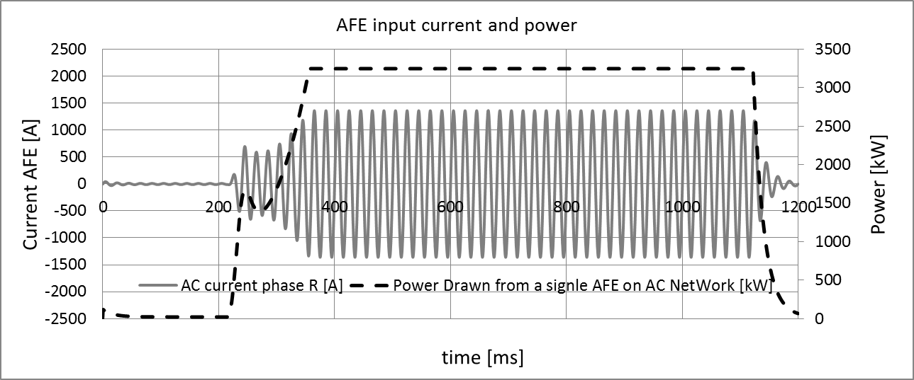
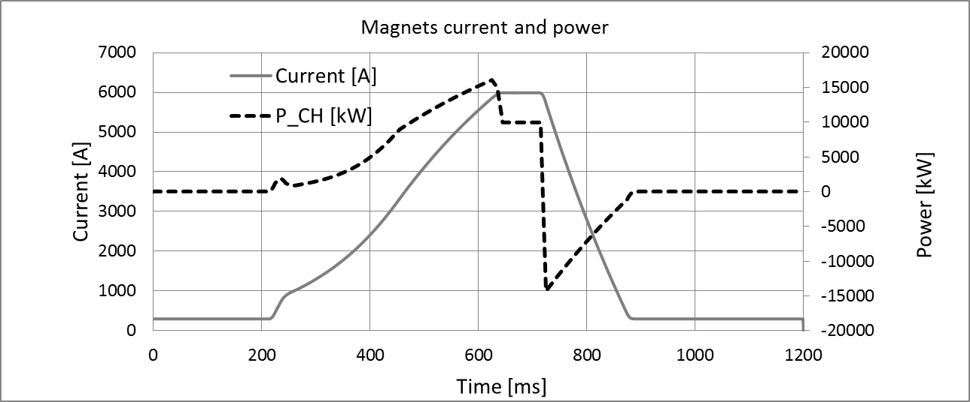
Storage capacitors: AC+DC voltage stress
20

Slide 21
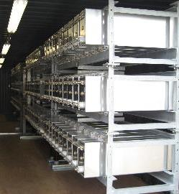
Storage capacitors: technology
The two main solutions are NON-IMPREGNATED and OIL-IMPREGNATED polypropylene metalized film capacitors
1100 mm
Series-parallel connection
POPS capacitor bank at CERN.
6 Containers 65 tons
21

Slide 22
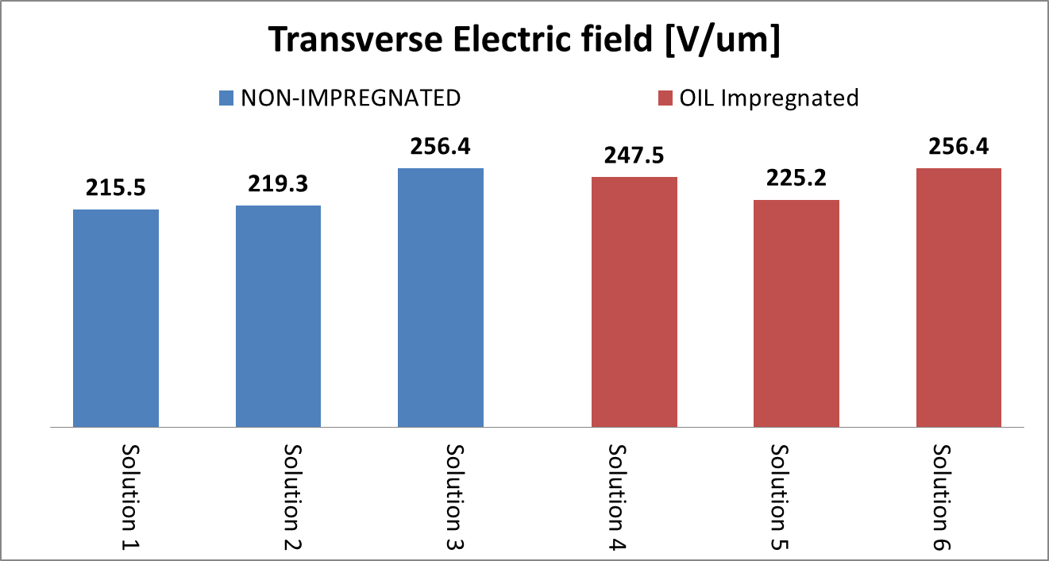
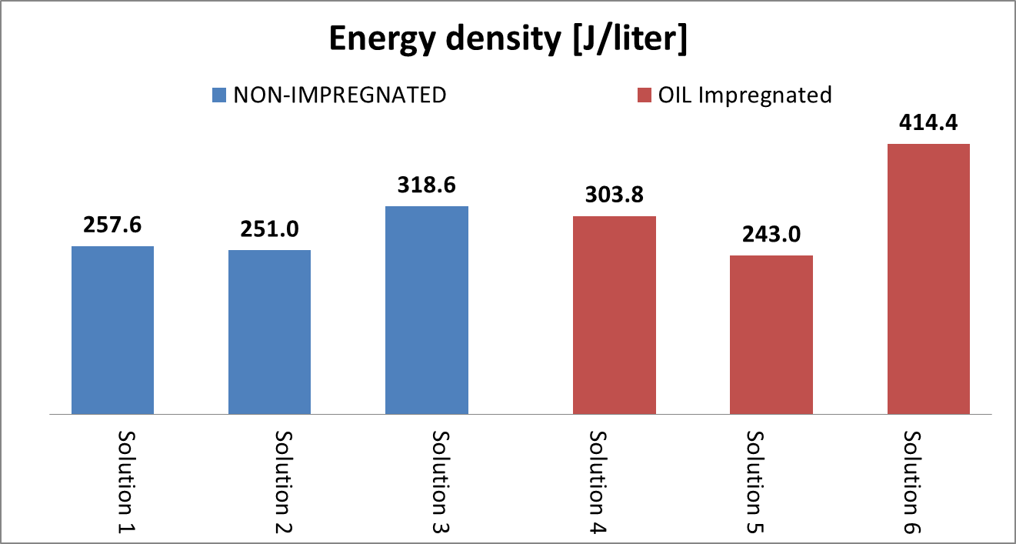
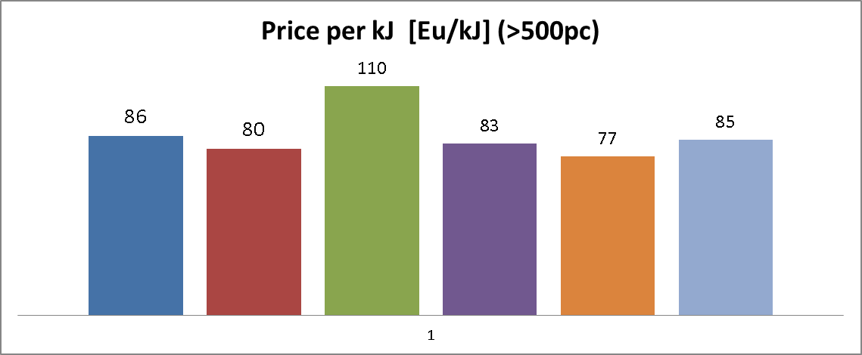
Storage capacitors: technology
Series-parallel connection
22

Slide 23
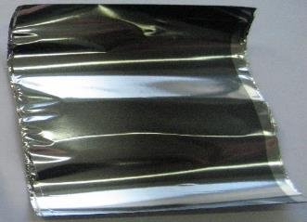
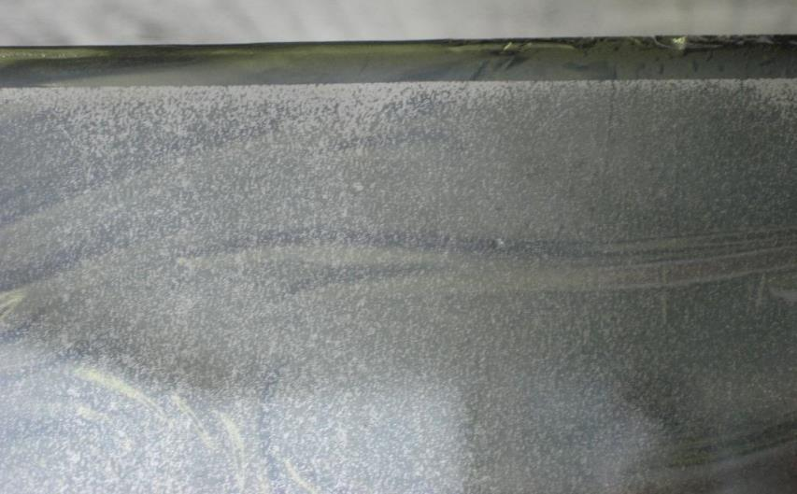
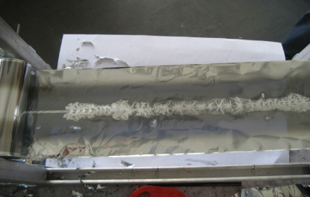
Storage capacitors: ageing
Metallized PP film as new
5mm
Excessive surface electro-erosion of the metallization
Flash Over on surface between + and –
Extended corrosion of metallization along the surface
Flashover between polarities….
175 mm
20mm
400mm
23
Notes:
This is how the double layer metallized polypropylene film looks like when it is brand new.
During the exploitation of the POPS power converter we faced several problems with capacitors.
Excessive surface electro-erosion
Huge metallization corrosion
Flash-over between polarities
The capacitors seems to age faster than foreseen on the field. The common cause seems to be the alternating voltage component.
With 65 tons of installed capacitors and another 50 tons to be purchased in the near future for a new project, we decided that an investigation of the characteristics of these capacitors was worth the effort and started the design of a testing circuit for capacitors.

Slide 24
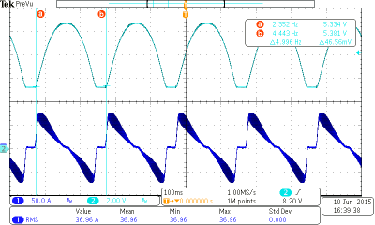
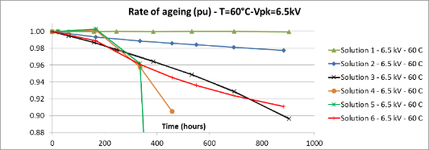
Storage capacitors: accelerated ageing tests
Preliminary results on six different solutions. Tested 900h on a single unit/solution
4850 V
3300 V pk to pk
failed
CERN capacitor accelerated test laboratory
Max Cut = 2000 uF
Max Vdc = 5500 V
Max Vac = 3000 V
Max freq = 8 Hz
Max temp = 70ºC
24

Slide 25
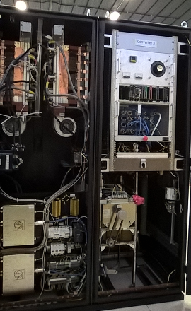
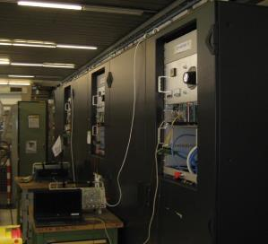
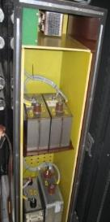
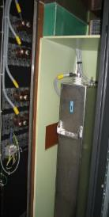
Storage capacitors: accelerated ageing tests
Capacitors accelerated ageing lab
Picture of the interior
Reduced scale samples
Full scale unit
Thermal Chamber
4
5
1
3
7
6
AC source;
DC source;
Control crate;
Power cabinets
Thermal chamber;
Reduced scale capacitors under test;
Full scale capacitor under test.
2
25

Slide 26
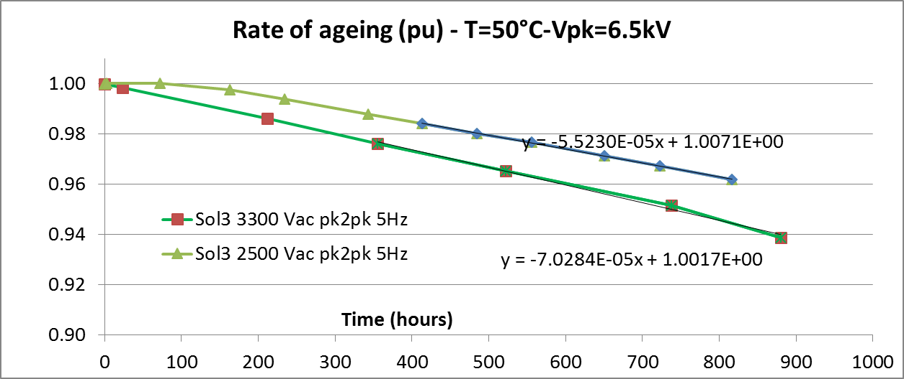
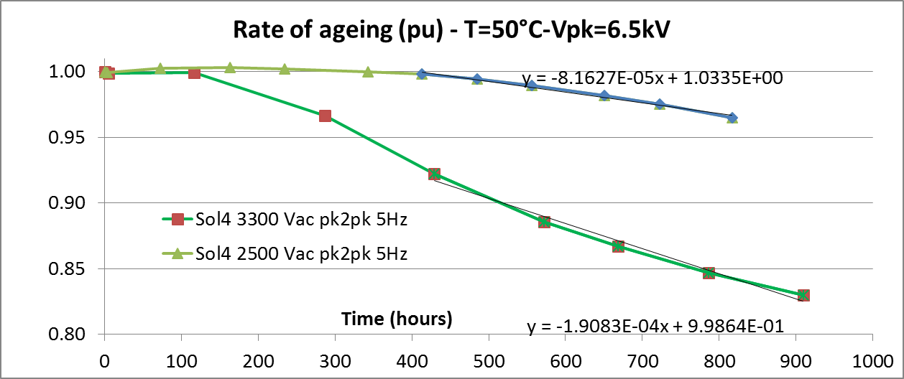
Storage capacitors: accelerated ageing tests
Inspection of the film conditions
Electro-corrosion appears on the metallization: aluminum oxide Al₂O₃
On all Solutions from three to six
600 µm
More evident on the external film layers
2500 Vs 3300 Vac pk2pk Non Impregnated
2500 Vs 3300 Vac pk2pk Impregnated
1.27
2.33
26

Slide 27
Storage capacitors: application at CERN
65 Tons of 5 kV capacitors Estimated cost ≈ 2.5 MCHF
POPS: POwer for PS
First example at CERN using capacitors for storing energy. In operation since 2011.
52 Tons of 5 kV capacitors Estimated cost ≈ 2 MCHF
POPS-B: POwer for PS Booster
New MPS for the PS-Booster, LIU project.
Installation in LS2.
Sirius power converter
46 “s” type bricks TT2 (LS2)
40 “s” type bricks PSB (LS2)
125 “s” type bricks East Area (under discussion)
16 Tons of 0.4 kV capacitors Estimated cost ≈ 1 MCHF
27

Slide 28
Conclusions
The new PSB main power converter will include an energy storage mean in form of a capacitor bank;
Energy storage for pulsed applications efficiently smooth the interface of the power converter with the electrical network;
No need of an SVC for compensating the reactive power;
Storage capacitor technology is mature for this application
  …. but carefully consider the presence of the AC component !

Slide 29
Thank you for your attention

Slide 30

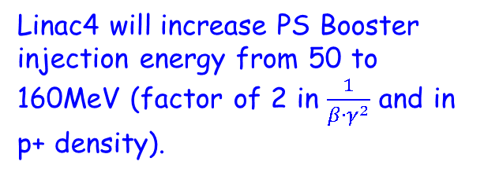
From 1.4GeV to 2GeV: the rationale
The main limitation to machine performance appears to be connected with tune shift due to space charge.
Increasing beam energy will decrease the factor: $\frac{1}{β∙γ^{2}}$ leading to higher intensity with same maximum |ΔQ| (a value around 0.3 seems to be accepted as limit).
Linac4 will increase PS Booster injection energy from 50 to 160MeV (factor of 2 in $\frac{1}{β∙γ^{2}}$ and in p+ density).
(*) Chamonix 2010
30
Pag 7

Slide 31
From 1.4GeV to 2GeV: the rationale
The improved performance related to Linac4 can only be exploited only lifting the space charge limit in the PS.
This is achieved by increasing the injection energy in the PS.
Mainly for Magnet limitations (max current), it is not possible to recover the same factor of 2 given by the Linac4.
With 30% magnetic field increase (10% Irms increase) a factor 1.6 can be achieved.
(*) Chamonix 2010
31
POPS-B 29 January 2015
Pag 8

Slide 32
PS Booster accelerator: facts & figures
The improved performance related to Linac4 (50 to 160 MeV @ PSB injection) can be fully exploited only by lifting the space charge limit in the PS.
This is achieved by increasing the injection energy in the PS.
Increase of energy is limited by Magnet max and rms current.
30% more peak current
10% higher r.m.s. current for magnets cooling limitations
(*) Chamonix 2010
Higher voltage and current from power converter
32
POPS-B 29 January 2015
Pag 8

Slide 33
Present MPS limitations
4X12 pulse thyristor bridges directly connected to the AC network via a 3 winding 18kV/389V transformer
Performance limited to 3.6kV x 4kA peak power on the magnets.
Rms current in transformers already close to the limits.
Reactive power (and Active peak power) drawn from the 18kV network already at limit.

Slide 34
Present MPS limitations
Due to Udc voltage limitation, 2GeV cycle would be too slow. To high rms for converters and for magnets
Irms1.2s=3000A
Irms0.9s=2450A
Irms1.2s=2250A
18kV network quality at risk due to further increase in power peak

Slide 35
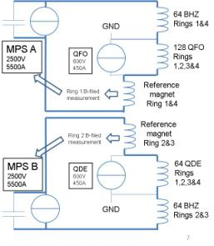
Booster 2GeV MPS: general introduction
P+ energy increased from 1.4 to 2GeV. Current increased from 4 to 5.5kA
Magnets will be split into 2 equivalent series
2 separated power converters will be used to power each half string of magnets
Only 2 trim converters required for quadrupoles
L=0.09H
R=0.25ohm
2GeV cycle developed by physicists
Magnet current
Magnet voltage
L=0.09H
R=0.25ohm
Future cycle will be 0.9s duration 5.5kApk 2x2.5kVpk for 2GeV
Irms on cycle duration is 2450Arms

